Slide 1

REACT
REACT:
Event-driven
Asynchronous
Concurrent
Turing-complete
Students: Will Noble,
Aleksandar Milicevic
Supervisor: Stelios Sidiroglou PI: Prof. Martin Rinard

Slide 2

Robotics Programming
Abstraction gap
high-level problem, low-level implementation primitives
Typically steep learning curve, especially for hobbyists
Programming in terms of low-level primitives is tedious and error-prone
Largely non-standardized

Slide 3





Distributed, Interactive, Heterogeneous
Concurrent and distributed architecture
data races
atomicity
deadlocks
shared data inconsistency
Implementation complexity
hard to analyze, test, ensure correctness
3

Slide 4
Proposed Solution
Model-based, event-driven paradigm
global model of the entire distribute system
simple sequential semantics
expressive programming language
Runtime environment
manages access to shared state
no data races by construction
Analyses
amenable to formal analyses (e.g., testing, security, …)

Slide 5
REACT: Records, Contexts, Events
Records
simple data structures
used to represent the core data model of the system
Contexts
encapsulate different processes (nodes)
Events
allow robots to dynamically react to their environments
triggered by the user, timer, whenever a condition holds, …

Slide 6
Example: BeaverSim
Implement a beaver simulator: (inspired by the ROS turtlesim example)
model: a beaver has position (x, y) and speed (vx, vy)
constraint: no more than 5 beavers allowed
every 1s positions are updated according to speed
whenever a beavers hits a wall, its speed is reversed
one simulator node displays current positions of all beavers
arbitrary number of remote controller nodes

Slide 7
Implementation challenges
concurrent access to (shared) beaver data
from multiple remote controllers
from timer events
from GUI threads
fragmented implementation of whenever actions
whenever conditions can turn true at various code points
e.g., (1) when position is auto-updated based on speed and (2) when position is explicitly set by a remote controller
fragmented implementation of constraint checks

Slide 8
BeaverSim in REACT: model
context BeaverSim [
beavers: listof(Beaver)
] {
invariant {
beavers.size() < MAX_BEAVERS
}
# ...
}
context RemoteCtrl {
# ...
}
MAX_BEAVERS = 5
MAX_X, MAX_Y = (10, 10)
record Beaver [
name: str,
x: int,
y: int,
vx: int,
vy: int
]

Slide 9
BeaverSim in REACT: events
event Spawn [
receiver: BeaverSim,
name: str
] {
guard { name.length() == 1 }
handler {
receiver.beavers << Beaver.new(name: name,
x: 0, y: 0,
vx: 1, vy: 0)
}
}

Slide 10
BeaverSim in REACT: events
event ChangeSpeed [
receiver: BeaverSim,
idx: int,
dx: int,
dy: int
] {
guard { 0 <= idx < receiver.beavers.size() }
handler {
receiver.beavers[idx].vx += dx
receiver.beavers[idx].vy += dy
}
}

Slide 11
BeaverSim in REACT: contexts
context BeaverSim [
beavers: listof(Beaver)
] {
on_start { @gui = MyGui.new; @gui.start() }
on_exit { @gui.stop() }
every(1000) {
@gui.draw_beavers(beavers)
for b in beavers { b.x += b.vx; b.y += b.vy }
}
whenever(some b in beavers | b.x < 0) {
b.x = 0; b.vx = -b.vx
}
}

Slide 12
BeaverSim in REACT: contexts
context RemoteCtrl {
on_start { @selected = -1 }
on_KEY_0 { @selected = 0 }
on_KEY_4 { @selected = 4 }
on_KEY_c { trigger Spawn.new(name: ‘B’) }
on_KEY_UP { trigger ChangeSpeed.new(idx: @selected
dx: 0, dy: -1)}
on_KEY_DOWN { trigger ChangeSpeed.new(idx: @selected
dx: 0, dy: 1) }
on_KEY_LEFT { trigger ChangeSpeed.new(idx: @selected
dx: -1, dy: 0)}
on_KEY_RIGHT { trigger ChangeSpeed.new(idx: @selected
dx: 1, dy: 0) }
}

Slide 13
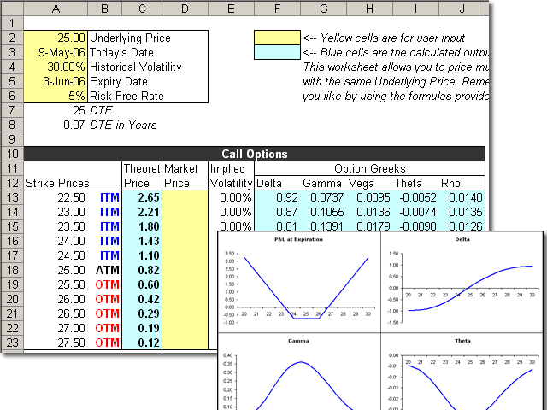

Big Idea
Generic platform for programming event-driven systems
covers a whole class of programs
interactive event-driven apps
spreadsheets
REACT
similar to
cms
End-user programming of interactive apps
examples: social web apps, robots
makes simple tasks easy and difficult ones possible

Slide 14
Demo

Slide 15




Status
Prototype for client/server + mobile apps
implemented in Java
event handling and synchronization back-end
automatic data propagation
Prototype for web applications
implemented for Ruby on Rails
Next: look for concrete robot examples
robots are event driven, often mission critical
adapt our event paradigm to programming robots
verify functional correctness

Slide 16




Benefits and Future Goals
Rich programming platform
speeds up development process
eliminates a whole class of concurrency bugs by construction
Application in the security domain
every field access is managed by the runtime system
security policies can be defined independently and automatically enforced at runtime
Robot programming for end-users
Thank You!

Slide 17
The End

Slide 18
Hello World example
context Main {
/* trigger-event */
on Main:enter {
/* action call w/ argument */
Sys.print! msg:“Hello, world!”
/* built-in action call */
Main.exit!
}
}
Outputs: Hello, world!

Slide 19
A more complex example
context Headbanger {
banging = 0
bangSpeed = 0
action bangHead! forTime:dur:5000 withEnthusiasm:enth {
banging = Clock.time + dur
bangSpeed = enth
}
whenever (banging > Clock.time) {
#spinhead(bangSpeed)
}
}
context Main {
on Main:enter {
Headbanger.enter!
Headbanger.bangHead! withEnthusiasm:10 forTime:10000
}
every (20000) {
Headbanger.bangHead! withEnthusiasm:20
}
}

Slide 20
Variables
Syntax:
(public) (active) name = value
where name is the variable identifier, value is a numerical expression
public modifier allows variable to be visible outside of its own context
active modifier creates an active variable: read-only once defined, and re-evaluate their assigned expression every time they are referenced. They are implemented as in-line function calls

Slide 21
In-depth: ‘whenever’ vs. ‘every’ events
Whenever
Every
Syntax:
whenever (condition) {
[code to execute]
...
}
condition: boolean expression to check
for direct reactions to changes in the robot’s environment
Syntax:
every(interval) {
[code to execute]
}
interval: numerical expression for time interval
requires some method of retrieving clock ticks
Implementation:
last_call = 0
whenever (last_call + interval
< clock_time) {
last_call = clock_time
[code to execute]
}

Slide 22
In-depth: ‘on’ events vs. actions
‘on’ event
Action
Syntax:
on cntxt_name:event_name {
[code to execute]
}
Called explicitly with:
trigger cntxt_name:event_name
for reactions to user-defined circumstances
only execute if context is live
Syntax:
action name! <arguments> {
code
}
Argument syntax:
ext_name:int_name(:def_val)
Use system of constraints to ensure safety
Take dynamic arguments
Calling syntax:
context_id.action_id!
<arguments to pass>

Slide 23
Embedded C
Special “C context” construct for creating libraries of C-code interfaceable with REACT, use _c_context keyword
C contexts can contain active variables or actions.
_c_context Foo {
public active c_val = “<C expression>”
action c_act! withArg:arg:50 “
[code...]
”
}
Code copied verbatim from within quotes
In order to implement APIs for particular robots in REACT, platform-specific code will surely be needed. Embedding native C-code into REACT source can facilitate this.

Slide 24


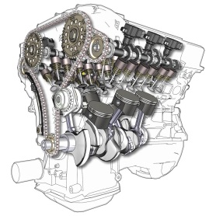
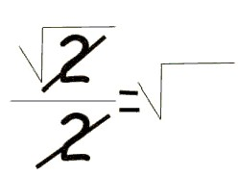
Technical contributions
Expressive power & programming efficiency
Programming language close to the problem domain
think in terms of simple data structures
don’t worry about concurrency and distributed architecture
declarative programming: say what not how
Runtime environment + code generation
no explicit synchronization, queues, message passing
no data consistency issues
synthesized clients for different platforms
Amenable to tools, testing, and formal analyses
core aspect of the system are kept succinct and formal
important for safety/security critical systems

Slide 25

Challenges and Team Strength
Number of challenges lie ahead
parallelizable runtime environment
data consistency in a distributed system
efficient engine for enforcing declarative security policies
analyses for ensuring functional system correctness (e.g., testing, verification, model-checking, etc.)
Notes:
However, there are still research challenges lying ahead, which are necessary to carry out to fully evaluate our approach and see how effective it will be in practice.
We are super smart and we published a fair amount.

Slide 26

REACT
Designed to be intuitive and easy to learn
Powerful expressiveness
Widespread applications

Slide 27
Proposed Solution
Model-based, event-driven programming paradigm
provides a simple declarative conceptual model
expressive power & programming efficiency
programming language close to the problem domain
Runtime environment
manages access to single shared global state
keeps everyone updated
programs free of concurrency bugs by construction
Rich tool set
amenable to formal analyses and automated testing
enabled by the succinct and formal event model

Slide 28

REACT summary
Pros
Highly abstract → easy to learn & portable
Flexible → can interface with native C code
Accessible → robotics programming requires extensive technical knowledge; REACT abstractions eliminate the need for hobbyists to acquire such knowledge.
Expressive → programs written faster, robots developed more easily
Cons
Centralized (not designed for distributed systems)
Sequential implementation (no concurrent events)
No explicit data model
data conflated with contexts

