Slide 1

8600-300 : Solving Problems and Making Business Decisions
Business Administration

Slide 2
Week 1
Question 1
Describe a problem, its nature scope and impact (12 marks)
Describe:
What the problem is and what may have caused it.
Its scope (e.g. how widespread, how often, how much, etc).
Who, how and what it affects in the workplace/team.
What you are trying to achieve by solving the problem.
What the result would be if no action is taken.

Slide 3
Question 2
Gather and interpret information to identify possible solutions to a problem (24 marks)
Briefly describe possible solutions to the problem. To do this you must gather and interpret information to identify possible solutions.

Slide 4
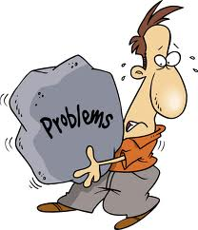
Recognising problems
It is an issue or obstacle which make it difficult to achieve a desired goal, objective or purpose. It refers to a situation, condition, or issue that is yet unresolved.
It is a question that motivates you to search for a solution. This implies first that you want or need to solve a problem and second that you have to search for a way to find a solution. Whether a question is a problem or an exercise depends on a prior knowledge of the problem solver.

Slide 5

Define problems
Defining a problem can be tricky. You need to evaluate the situation and, if necessary, get guidance as to exactly what is the problem. If you fail to correctly define the problem you may continue to get the same undesirable outcomes.
A good way to define a problem is to write down a accurate statement which summarises the problem, and write down where you want to be after the problem has been resolved. The objective is to get as much as information as possible.

Slide 6
Problems
A problem is one of those words we use loose to describe any situation which looks uncertain or difficult in any respect. It is something which is difficult to deal with or to resolve.
A problem is the difference between the actual condition and the desired condition.
Problem exist when someone or something is not performing as it expected.

Slide 7
Action needs to be taken to solve the problem thus action should follow from a clear understanding of the problem.
It’s critical to get input from other people who noticed the problem and who are affected by it.
It’s often useful to collect input from other individuals one at a time. Otherwise, people tend to be inhibited about the offering their impressions of the real causes of the problems.
To the extent possible, the entity should gather data and information through such primary research techniques as interview, observation, and survey. That gathering relevant information may lead to restating the problem.

Slide 8
Analysing problems
Question should be asked and information gathered and sifted (separating key points from irrelevant information).
Do not make the mistake of assuming you know what is causing the problem without an effort to fully investigate the problem you have defined.
Try to view the problem from a variety of viewpoints, not just how it affects you. Think about how the issue affects others. It is essential to spend some time researching the problem.

Slide 9
Questions to ask when analysing
Questions to ask when analysing a problem:
What is the history of the problem? How long has it existed?
How serious is the problem?
What are the causes of the problem?
What are the symptoms of the problem?
What methods does the group already have for dealing with the problem?
What are the limitations of those methods?

Slide 10
How much freedom does the group have in gathering information and attempting to solve the problem?
What obstacles keep the group from achieving the goal?
Can the problem be divided into sub problems for definition and analysis?

Slide 11
Describe objective setting in relation to problem
Objectives are those specific steps that enable you to accomplish a goal.
Setting objectives involves a continuous process of research, evaluation, measurement, and realignment.
Knowledge to the problem is a vital starting point in setting objectives. It allows you to understand exactly where you stand in the problem.

Slide 12
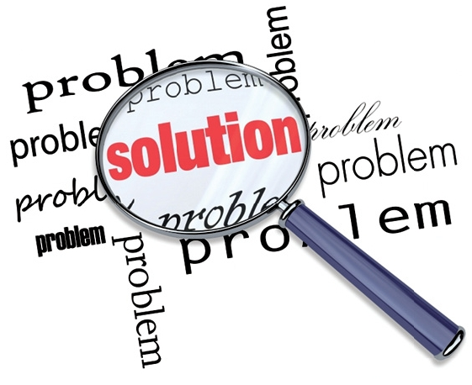
Investigating problems
The ability to problem-solve is an important skill. Investing a problem can help you decide what goal you want to achieve and what actions to take towards that goal. The investigation component of problem-solving is often overlooked, leading to rash decisions or, conversely, inaction.

Slide 13
Differences between Data and information
Data are facts while information are interpreted facts.
When we talk about the data, they are facts that people gather based on their observation and experiences. They are raw facts which people gather. Meanwhile, information is what becomes of these data. They are interpreted facts based on a data gathered.
Data is based from records and observations while information is based on research.
Most data are just simple records of facts and observation. They are often written down on a sheet of paper or stored in one’s brain. On the other hand, information is more factual in nature. They’re also more reliable since they’re backed from research. Often, they are gathered from experts.

Slide 14
Data are mere numbers and figures while information give meaning to these numbers and figures.
When we talked about data we refer to the numbers and figures we often see in math textbooks. They come in the form of graphs, timelines, fractions, decimal, ratio and proportion, and many more. But once these are interpreted and given meaning t they become information.
Data lack meaning while information are meaningful.
Indeed, numbers and figures alone lack meaning. They can never tell you something unless they are interpreted and explained. This is what data are. On the contrary, information are full of meanings. They’re data which are explained or interpreted to be understood by individuals.

Slide 15
Data are valueless while information are useful and valuable.
Data alone are meaningless. What’s the use of gathering them if you don’t know what they are about or what they stand for? Information on the other hand are something you can readily understand and use. You can benefit a lot from information since you can apply them in your daily life.

Slide 16
Case Study
Workplace dispute over an internal promotion
Type of dispute: Workplace conflict due to promotion.
Background: Both Jessica and Alan have been working alongside one another for many years at the local newspaper. As their existing manager leaves the company, Alan is promoted, but still shares an office with the team, of which he used to be a member. Tensions arise when Alan decides to introduce a new policy, which makes little sense to the rest of the team and is likely to increase their already heavy workload.

Slide 17


The challenge: Alan and Jessica have been close friends and professional work colleagues for many years. For this reason the biggest challenge was to identify the “spark” that ignited the disagreement and decipher (decode) the most appropriate way of resolving the conflict, so that they could regain their previous friendship.
Objectives:
Allow each individual to express what is troubling them in a safe manner.
Find a common ground which they can both agree on.
Make a future agreement, rather than dwelling on the past.
Get them working together as a team again.

Slide 18
Reason for conflict:
Jessica’s position: Working at the newspaper for the longest period of time, Jessica has seen what initiatives worked well and what tended to cause problems. She was convinced that the new policy would fail, as well as increasing everybody’s individual workload. It was clear that the policy was set by senior management, but Jessica felt that Alan could have demonstrated a firmer opposition to the proposal, as he also believes it would make everybody’s working day more strenuous.
Jessica believes that as a person Alan lacks in confidence and has overcompensated for this by becoming overly strict with a couple of the team members, in an attempt to demonstrate that he is the boss. Aside to this Jessica, also believes that the team meetings are a waste of time, as Alan takes a while to get started and becomes distracted easily. This just adds to the mounting frustrations of the team.

Slide 19
Alan’s position: Having not done particularly well at school, Alan has found a job that he really enjoys and suits him. Surprised by the promotion that he receives, it boosted his confidence and he was looking forward to managing the colleagues that he previously worked with.
Due to this, Alan sees a split in the team dynamic. Half of the team continue to treat him in the same as they did before the promotion, which is difficult when challenging the standard of work that is produced. The other half of the team distance themselves from Alan, and he gets the impression that they degrade his performance by saying negative things about him in secret. Jessica becomes more difficult to work with, and Alan thinks she is annoyed that she was not offered the promotion, as she is slightly more experienced and is a longer serving member of the newspaper. Jessica seems to want to sabotage Alan’s attempts to become a successful manager, as she makes small remarks during team meetings, which undermines his authority.

Slide 20

Class activity
After studying the case study, answer the following questions:
What the problem is and what may have caused it.
Its scope (e.g. how widespread, how often, how much, etc).
Who, how and what it affects in the workplace/team.
What you are trying to achieve by solving the problem.
What the result would be if no action is taken.

Slide 21
! Assignment Q.1
Attempt to answer question 1 of the assignment, the following questions may be able to help you start:
What the problem is and what may have caused it.
Its scope (e.g. how widespread, how often, how much, etc).
Who, how and what it affects in the workplace/team.
What you are trying to achieve by solving the problem.
What the result would be if no action is taken.

Slide 22
References
http://www.ukmediation.net/case-studies/case-study-1-workplace-dispute-over-an-internal-promotion

Slide 23
Problem solving techniques
Identify the problem – be sure to state or define what is hindering your process in achieving your goal. Don’t mistake contributors to the problem as the actual problem.
Assess your available resources/options – look all the things you can do to eliminate the problem and list all the resources available to you to use in resolving the problem.
Set objectives – determine what results you want to achieve or what is beneficial to you as the outcome.

Slide 24
Plan development – select, one by one, the resources you will test and get all available information about the resources so that you can eliminate the least helpful ones and make a selection.
Implement the plan – now that you made your decision on which resources serve you the best, it is time to implement your plan. Plans or strategies are of little value if you do not follow-though to work the plan you have developed. This is the test period also to see if you made the best selection of your resources.
Evaluate the Results – obviously, some results are immediate and therefore evaluation will be easy. You will be able to see that you made the right decision because you are able to begin achieving your goal. However if you are dissatisfied with the results/resources you choose after a reasonable period of time, then start over again and make another selection using the same procedure as before.

Slide 25
Possible solutions
Generating several options will normally help you to select the one that will best help you achieve your decision’s objectives.
The time and effort spent generating options depends on the importance of the decision being made.
There is not an optimum number of option for making an effective decision.
Options can be generated by:
Research
Brainstorming
Informal Discussion
Meetings

Slide 26
Gather and interpret information to identify possible solutions to a problem.
Know the facts - this may help you with the next step to identifying possible solutions.
List specific observation about the problem.
What steps or hurdles do you have to deal with.
Do Background research on the problem - you may discover that the ideal solution already exists.
This could include:
Information research – gather the relevant facts and details.
Interviews with successful individuals – talk to people who have dealt with this or a similar problem.

Slide 27
A poll of friends, teachers - talk to people who have dealt with this or a similar problem, or who have relevant facts to share.
A poll of individuals affected by the problem – this will shed light on the dimensions of the problem or provide valuable leads.

Slide 28
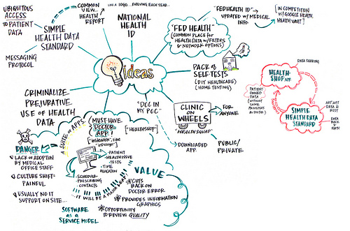
Brainstorming
Brainstorming is a group activity technique. It is designed to generate lots of ideas for solution of a problem. The underlying principle is that the greater the number of ideas generated, the possibility that a quality solution will be found.

Slide 29
Techniques for brainstorming
Free Writing
When you free write, you write whatever comes into your mind. You don’t judge the quality of writing and don’t worry about the style, spelling, grammar, or punctuation. When you have finished writing and have reach your goal, read back over the text, decide the solution.
Nominal Group Technique
Participants are asked to write their ideas anonymously. Then the moderator collects the ideas and each is voted on by the group. The best idea is chosen.

Slide 30
Group passing technique
Each person in a circular group writes down one idea, and then passes the piece of paper to the next person in a clockwise direction, who adds some thoughts. This continues until everybody gets his or her original piece of paper back. By this time, they will examined each idea in detail.
Team Idea Mapping Method
This technique may improve collaboration and increase the quantity of ideas, and is designed so that all attendees participate and no ideas are rejected.
The process begins with a well-defined topic. Each participants brainstorms individually, then all the ideas merged onto one large idea map.

Slide 31

Individual Brainstorming
It typically includes such techniques as free writing, free speaking, word association, and drawing a mind map, which people diagram their thoughts. Individual brainstorming is useful method in creative writing.
Question Brainstorming
This process involves brainstorming the questions, rather than trying to come up with immediate answers and short term solutions.
Questions are important in that technique. We need a list of questions to reach to the best solution in an orderly way.

Slide 32
Preparing a summary sheet
Problem | Facts | Evidence | Possible Solution

Slide 34
CREATIVE THINKING TECHNIQUE
Solving Problems and Making Decisions
Creative thinking technique are very much useful in generating new ideas in every organization. The new way of thinking should always be encouraged and creativity should always be welcome.

Slide 35
Types of Focus Group
Solving Problems and Making Decisions
Focus Group – is a form of qualitative research in which a group of people are asked about their attitude towards a product, service, concept, advertisement, idea, or packaging.
Two-way Focus Group – one focus group watches another focus group discusses the observed interactions and conclusions.
Dual Moderator Focus Group – one moderator ensures the session progresses smoothly, while another ensures that all the topics are covered.

Slide 36
Types of Focus Group
Solving Problems and Making Decisions
Duelling Moderator Focus Group – two moderators deliberately take opposite sides on the issue under discussion.
Respondent Moderator Focus Group – one or more are respondents are asked to act as the moderator temporarily.
Client Participant Focus Group – one or more client representatives participate in the discussion, either covertly or overtly.

Slide 37
Types of Focus Group
Solving Problems and Making Decisions
Mini Focus Group – groups are composed of four or five members rather than 6 to 12.
Teleconference Focus Groups – telephone network is used.
Online Focus Groups – computers connected via the internet.
Attribute Analysis – is a process of breaking down a problem, idea, or thing, into attributes or component or component parts and then thinking about the attributes rather than the thing itself.

Slide 38
Steps in Attributes Analysis
Solving Problems and Making Decisions
Identification of major attributes
Evaluation of alternatives
Generation of Alternatives
Synectic – is a problem solving method that stimulates thought processes of which the subject maybe unaware.
- It is also a technique of problem solving by using a variety of analogies.
Major Analogies
Direct Analogy
Fantasy Analogy
Personal Analogy
Symbolic Analogy

Slide 39
Describe how to calculate and use simple averages and basic summary statistics
Solving Problems and Making Decisions
Statistics is a problem-solving process that seeks answers to questions through data.
Tables and graphs can provide basic information about variables of interest using simple descriptive statistics.

Slide 40
Describe how to prepare and used data and tables
Solving Problems and Making Decisions
APPROACH |  |  | WHEN TO USE |  |  |  |  | WHAT
Write Action Plan |  |  | Suspected cause(s) cannot be |  |  |  |  | Brainstorm solutions to major
(for Cause Remedies) |  |  | changed or undone easily once |  |  |  |  | causes
 |  |  | they are made; dependent
 |  |  | variable (other than Measure |  |  |  |  | Solution "areas" identified for
 |  |  | of Effectiveness) not obvious; |  |  |  |  | major causes
 |  |  | lack of data to study causes
 |  |  |  |  |  |  |  | Action Plan written to describe
 |  |  |  |  |  |  |  | What, Who, how of solutions
Write Experimental test Plan |  |  | When the suspected cause(s) can "operate" |  |  |  |  | Experimental Design test Plan written to
 |  |  | at two or more levels; the levels can be |  |  |  |  | test and verify all major causes, uses other
 |  |  | deliberately and easily altered; the effects |  |  |  |  | techniques or experimental design
 |  |  | can be measured through dependent |  |  |  |  | techniques
 |  |  | variables
Shown in the data above is the distinction between these two strategies and in particular, the difference between an Action Plan and Experimental Test Plan. It will necessary to use a combination of Action Plans and Experimental Test Plans. That is, for some cause areas an Action Plan is appropriate and other causes within the same problem, carrying out an Experimental Test Plan is the best route.

Slide 41
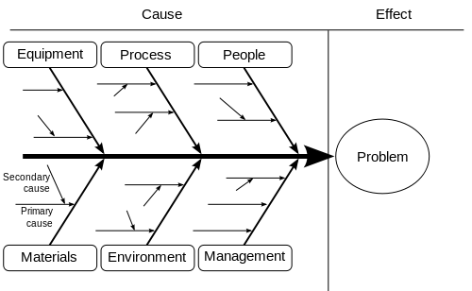
Solving Problems and Making Decisions
Describe the interpretation of charts and diagrams
Ishikawa diagram, in fishbone shape, showing factors of Equipment, Process, People, Materials, Environment and Management, all affecting the overall problem. Smaller arrows connect the sub-causes to major causes.

Slide 42
Solving Problems and Making Decisions
Describe the interpretation of charts and diagrams
Ishikawa diagrams
(also called fishbone diagrams, herringbone diagrams, cause-and-effect diagrams, or Fishikawa) are causal diagrams created by Kaoru Ishikawa (1968) that show the causes of a specific event. Common uses of the Ishikawa diagram are product design and quality defect prevention, to identify potential factors causing an overall effect. Each cause or reason for imperfection is a source of variation. Causes are usually grouped into major categories to identify these sources of variation.

Slide 43
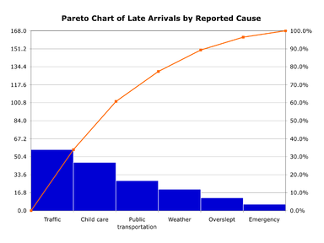
Solving Problems and Making Decisions
Describe the interpretation of charts and diagrams
Pareto Chart
A Pareto chart, named after Vilfredo Pareto, is a type of chart that contains both bars and a line graph, where individual values are represented in descending order by bars, and the cumulative total is represented by the line.

Slide 44
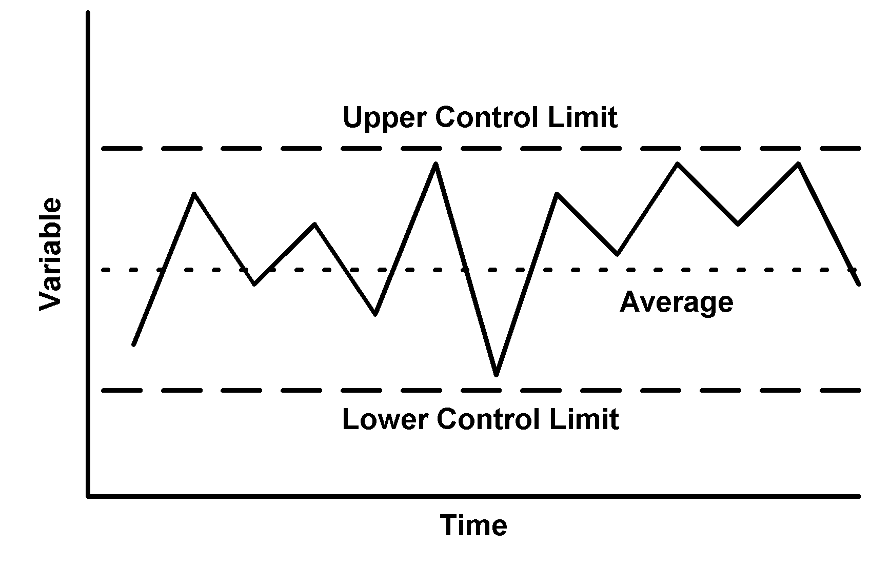
Solving Problems and Making Decisions
Describe the interpretation of charts and diagrams
Control Chart
Good way to show data over time
Collect data over time. Look for the average.
Consider the moving average for rapidly changing results.
Set control limits for upper and lower boundaries.
Look for “out of control” patterns. Points outside control limits, run up and down, points always and under or over average value.

Slide 45
Solving Problems and Making Decisions
Describe how to evaluate options.
To evaluate options you should use critical thinking skills and feel confident in your decision.
Critical thinking is the important skill set to develop for your personal and professional life. Practice critical thinking by taking the time to reflect on possible outcomes. Analyze the things you watch, read and listen to according to pros or cons. Critical thinking often takes often takes out of their comfort zone, so try to put yourself out of your mental comfort zone more often, and you will find you can think faster and smarter.

Slide 46
Solving Problems and Making Decisions
Describe how to evaluate options.
It is recommended by many that when making a decisions you should list all the option as well your criteria in order to sort out the best path to take. And there are many decision making tools and techniques designed for this purpose, decision trees, decision matrix, decision risk matrices, spreadsheet and database analysis programs and so on.
And basically the idea here is to make sure that you’re making the best choice and avoiding negative consequences. At the same time, it is often where people waste time, worrying about what will happen and trying to predict the future.

Slide 47
Solving Problems and Making Decisions
Describe the importance of adequate and relevant information for effective decision-making
An effective decision is one that optimizes some set of factors
Consider relevant information to resist the temptation to consider everything in a case as a “fact”
Create relevant information, if not available, by blending together the data given in the case
An effective decision is one which is action-oriented, goal-directed, and provides efficiency in implementation.

Slide 48
Solving Problems and Making Decisions
Describe the importance of adequate and relevant information for effective decision-making
Action oriented - decisions are action-oriented and are directed towards relevant and controllable aspects of the environment.
Decisions are totally pragmatic in nature and their value is dependent on the success of the actions that follow.
Decisions may be treated as an intervening variable which may ultimately lead to the end-result variables.
From this point of view, decisions should ultimately find their utility in implementation. Therefore, the decisions to be effective must specify the various actions which are to be taken to achieve the objective necessitating decision making.

Slide 49
Solving Problems and Making Decisions
Describe the importance of adequate and relevant information for effective decision-making
Goal Direction – organizations are goal-directed units and, therefore, any organizational process, including decision making, should be goal-directed to enable the organization to meet its objectives.
Naturally , the value of the decision and the associated action is related to the dispatch with which the goal is achieved. While the value of the decision is dependent on the attainment of a given goal or set of goals, such attainment is a function of both the accuracy of the decision and its implementation.
In evaluating the decision, then, a distinction should be made between the effects of goal attainment brought about by the better decision and those attainments arising out of execution.

Slide 50
Solving Problems and Making Decisions
Describe the importance of adequate and relevant information for effective decision-making
Efficiency in Implementation – an effective decision should provide the way in which it can be implemented. Therefore, decision making should take into account all the possible factors not only in terms of external context but also in internal context so that a question can be implemented properly. Often, the results are obtain by proper implementation of proper decision. Therefore a brilliant may fail if it is not suitable for the implementation.

Slide 51
Solving Problems and Making Decisions
Describe the importance of adequate and relevant information for effective decision-making
Effective decision-making:
It focuses on what is important.
It is logical and consistent.
It acknowledges both subjective and objective thinking and blends analytical with intuitive thinking.
It requires only as much information in analysis as is necessary to resolve a particular dilemma.
It encourages and guides the gathering of relevant information and informed opinion.
It is straightforward, reliable, easy to use, and flexible.

Slide 52
Solving Problems and Making Decisions
Identify techniques in decision-making.
Techniques in Decision-making
Cost/Benefit Analysis – a tool that allows the decision maker to simply compare the costs with the benefit of something
SWOT – the acronym stands Strengths, Weaknesses, Opportunities, and Threats. It is very useful and effective tool for various situations in businesses and organizations wherein the strengths and weaknesses are identified as well as the opportunities and threats in order to arrive at sound decisions
Pareto Analysis – this tool is useful in focusing on major causes for changes that will bring about huge benefits to the decision maker

Slide 53
Solving Problems and Making Decisions
Identify techniques in decision-making.
Techniques in Decision-making
Stepladder-Technique – the technique works by managing the entry or admission of members in a decision making group. It encourages every member to contribute ideas and alternatives to the group
Starbusting – is a process of gaining knowledge on new ideas through brainstorming but the focus is more on the questions and not the answer
PMI – is used for arriving at quick decisions that do not quite have problems. The acronym stands for Plus, Minuses and Interesting points

Slide 54
Solving Problems and Making Decisions
Describe the use of simple planning techniques
Decision making without planning is fairly common, it is often not pretty. Planning allows decisions to be made in a much more comfortable and intelligent way. Planning even makes a decisions easier by providing guidelines and goals for decision. We might even say that planning is a type of decision simplification technique.

Slide 55
Solving Problems and Making Decisions
Describe the use of simple planning techniques
Planning converts values to action. When you are faced with a decision, you can consult your plan and determine which decision will help advance your plan best. Decisions made under the guidance of planning can work together in a coherent way to advance company or individual goals.

Slide 56
Solving Problems and Making Decisions
Describe the use of simple planning techniques
Planning converts values to action. When you are faced with a decision, you can consult your plan and determine which decision will help advance your plan best. Decisions made under the guidance of planning can work together in a coherent way to advance company or individual goals.
Planning allows the establishment of independent goals. The vision which will shape the decision is set apart from surrounding events. Decisions are not made only as reactions to external stimuli. Sometimes the difference between planning and not planning is describe as “proactive” (taking control of the situation) versus “reactive” (responding to stimuli).

Slide 57
Solving Problems and Making Decisions
Describe the use of simple planning techniques
Planning allows limited resources to be committed in an orderly way. Budgets, time, effort, manpower—all are limited. Their best use can be made when a plan governs their use.
Planning is useful in emergency situations, too. When a crisis arises, a little thought about the overall plan will help you to determine which decision to make that will not only help resolve the crisis but will also help advance the overall plan. Without a plan, crises are dealt with haphazardly and decisions are made which may ultimately be in conflict with each other.

Slide 58
Solving Problems and Making Decisions
Describe the use of monitoring and review techniques to evaluate outcomes of problem solving activities
To determine if all major steps in the criteria are included. If steps are missing, determine if their absence is likely to have materially negative impact on problem-solving or decision-making.
To determine if all the steps in the process to add value. If there are steps that do not appear to add value, try to get additional information on why they are included in the process.
To review the doctor of the steps in the process to determine if it promotes productivity.

Slide 59
Solving Problems and Making Decisions
Describe the use of monitoring and review techniques to evaluate outcomes of problem solving activities
To review the level of technology used in the process to determine if it is up-to-date and appropriate to the task. Besides computer, electronic. Communications and other technology, this should include problem-solving and decision-making technology such as that listed in the appendix to this module.
To review the information about existing problem-solving process to determine if they are appropriate to the task. Compare the materiality of the issue to the thoroughness of the process, degree of documentation, and time spent.

Slide 60
Solving Problems and Making Decisions
Plan the implementation and communication of the decision.
The plan to implement the decision should anticipate the obstacles, account for details, know which actions are critical and necessary, develop contingency plans and minimize risk.
Any implementation plan should assign both responsibilities and time lines for all tasks.
Decisions are not fully implemented until they are effectively communicated. The decision must be implemented with the proper delegation of the authority to the individual(s) responsible.
The implementation of a chosen alternative involves the use of managerial, administrative, and persuasive abilities to cause the decision to be carried out.

Slide 61
Solving Problems and Making Decisions
Plan the implementation and communication of the decision.
In the first place, people must be available and willing to organize the implementation. Everyone must know well, what is going to happen, who are involved in the implementation of the selected strategy and how much time is to carry out the steps. Also, in these stage, an evaluation planning must be prepared. As well for the short term as for the long term strategy for the implementation of the selected solution must be prepared. If procedures and the strategy are not clear, there is a great chance that the implementation of the selected solution of a problem will not be effective.

Slide 62
Solving Problems and Making Decisions
Plan the implementation and communication of the decision.
In the second place attention must be paid, at implementation, to friction against the selected solution of a problem. Such possible frictions have to be taken account. It is only natural that the changes make people afraid and uncertain, is it not? This manifests itself in frictions, tensions, and irritation. That is not uncommon but nevertheless it is difficult to surmount such problems. Uncertainty can be reduced by good information and communication.

Slide 63
Solving Problems and Making Decisions
Plan the implementation and communication of the decision.
Implementation requires a series of step to:
Articulate who has to do what, with what resources, by what time, and toward what goal.
Identify who must know about the decision.

Slide 64
Solving Problems and Making Decisions
Explain which monitoring and review techniques could be used to evaluate outcomes
Among the data analysis technique useful in planning, implementing, monitoring, and evaluating outcomes are: cause-effect analysis, contingency planning, cost-benefit analysis, decision tree, Delpi technique, failure mode and effect analysis, fault free analysis, flowchart, force field analysis, gantt chart, histogram, list reduction, paired comparison, Pareto analysis, PERT/Cost, PERT/CPM, satisfaction, time chart, and weighted voting.

