Slide 1


8600-301 : Understanding Innovation and Change in Business Organisation

Slide 2
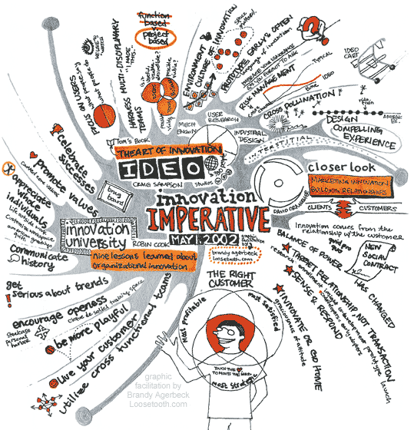
What is Innovation?
Innovation is the development of new customers value through solutions that meet new needs, inarticulate needs, or old customer and market needs in value adding new ways.
This is accomplished through more effective products, processes, services, technologies, or ideas that are readily available to markets, governments, and society.

Slide 3

What is change?
To make something different.
Company or organization going through a transformation. Organization change occurs when business strategies or major sections of an organization are altered. Also known as reorganization, restructuring and turnaround

Slide 4
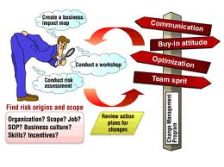
Benefits of Innovation
In order to be successful with your business you need to learn to be innovative. You need to take the road less travelled and try to find ways to make money that other businesses have not considered.
“ In order to be successful you need to do what unsuccessful people wont do”

Slide 5
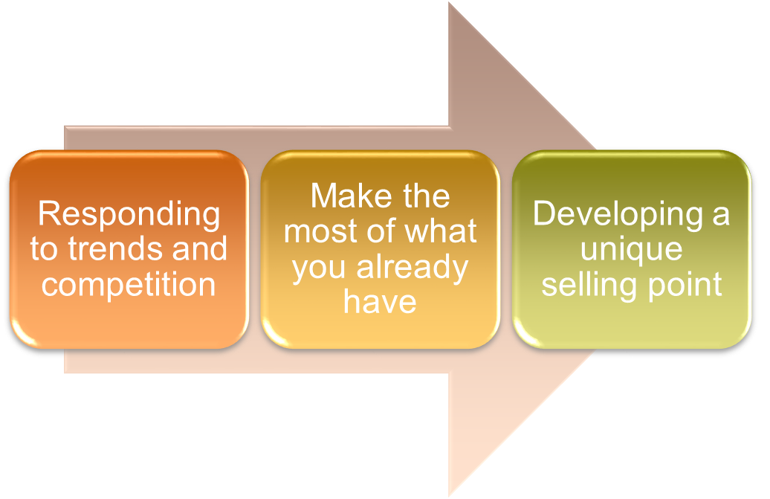
Benefits of Innovation

Slide 6
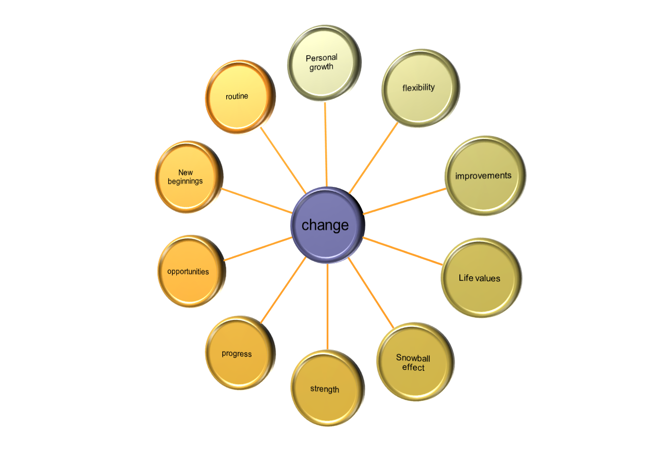
Benefits of change
Notes:
Personal Growth
You grow and learn new things every time something changes. You discover new insights about diffferent aspects of your life. You learn lessons even from changes that did not lead you to where you wanted to be.
2. Flexibility
Frequent changes make you easily adapt to new situations, new environments, and new people. As a result you do not freak out when something unexpectedly shifts.
3. Improvements
We all have things in our lives we’d like to improve—finances, job, partner, house, etc. All of us know that nothing will improve by itself. We need to do things differently to make that happen. Without change, there’d be no improvements.
4. Life values
From time to time changes make you re-evaluate your life and look at certain things from a different perspective. Depending on what the change is, it may also reinforce your life values.
5. The Snowball Effect
Often we give up because we cannot accomplish the difficult task of making a huge and immediate change. That is when small changes become extremely valuable. One shift at a time, small changes will eventually lead you to the desired big one.
6. Strength
Not all changes lead you to pleasant periods of life. Unfortunately we do not live in fairy tale and sad things happen, too. Overcoming the tough period will make you stronger.
7. Progress
Changes trigger progress. Things move forward and develop because of the them.
8. Opportunities
One never knows what each change may bring. When you turn from your usual path there will be plenty of different opportunities waiting for you. Changes will bring new choices for happiness and fulfillment.
9. New Beginnings
Each change is a turning page. It is about closing one chapter and opening another one. Changes bring new beginnings and excitement to life.
10. Routine
Remember the movie Stranger than Fiction? The main character Harold Crick does the same things in exactly same time for years. He leads a completely dull, extremely predictable, and uninteresting life. That is how your life would be without changes.
Understanding Innovation and Change in an Organisation

Slide 7
IMPLEMENTING CHANGE
Change is the only constant."
– Heraclitus, Greek philosopher
What was true more than 2,000 years ago is just as true today. We live in a world where "business as usual" is change. New initiatives, project-based working, technology improvements, staying ahead of the competition – these things come together to drive ongoing changes to the way we work.
Whether you're considering a small change to one or two processes, or a system wide change to an organization, it's common to feel uneasy and intimidated by the scale of the challenge.
You know that the change needs to happen, but you don't really know how to go about doing delivering it. Where do you start? Whom do you involve? How do you see it through to the end?
There are many theories about how to "do" change. Many originate with leadership and change management guru, John Kotter. A professor at Harvard Business School and world-renowned change expert, Kottler introduced his eight-step change process in his 1995 book, "Leading Change." We look at his eight steps for leading change below.

Slide 8
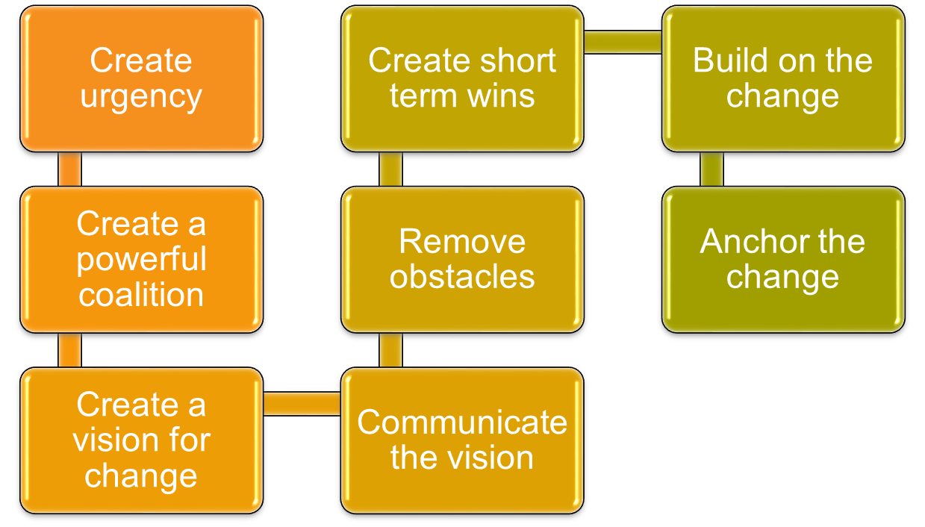
Kotler’s 8 step Model for implementing change

Slide 9
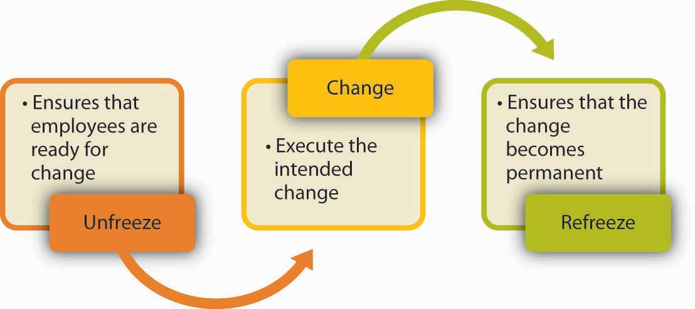
LEWIN’S CHANGE MODEL

Slide 10
Barriers to change
Cultural complacency, resistance or skepticism.
Lack of communication.
Lack of alignment and accountability.
Passive or absent leadership support.
Micromanagement.
Overloaded workforce.
Inadequate systems and structures.
Lack of control plans to measure and sustain results.

Slide 11
6. The change leadership team doesn’t include early adopters, resisters, or informal leaders.
7. The change isn’t piloted, so the organization doesn’t learn what’s needed to support the change.
8. Organizational systems and other initiatives aren’t aligned with the change.
9. Leaders lose focus or fail to prioritize, causing “death by 1,000 initiatives.”
10. People are not enabled or encouraged to build new skills.
11. Those leading the change aren’t credible—they under communicate, give mixed messages, and do not model the behaviours the change requires.

Slide 12
Barriers to innovation
1: FEELING OVERWHELMED, DIRECTIONLESS, AND WITHOUT FOCUS
This is the direct result of relying on traditional brainstorming approaches, which, by the way, have been around since the 1930s, when ad-man Alex Faickney Osborn first popularized them in his book, Applied Imagination. But the problem is that traditional brainstorming has ignored the huge difference between generating lots of ideas and capturing quality ideas
2: THINKING IN TERMS OF ISOLATED PRODUCTS, SERVICES, AND INFORMATION
It’s getting harder and harder to compete if you don’t view the world in terms of holistic product-service-information hybrids. The real advantage comes when your disruptive idea is blended in such a way that the product, service, and information components can’t be broken apart
3: GETTING STUCK AT THE WATER-COOLER
The view from inside the company, however, is different. One of the most common phrases I hear from clients is, “We don’t need any more ideas; we have too many.” But when I ask to see the documented ideas they have, they start back pedaling: “Well, we don’t have them written down or anything. But we discuss them a lot.”

Slide 13

OVERCOMING BARRIERS
1: FOCUSING YOUR EFFORTS
FORCING CONNECTIONS
2: WHAT CAN YOU BLEND TOGETHER?
REFINE THREE IDEAS
PARTNERS, BUYERS, AND USERS.
3: WHAT ARE YOUR DISRUPTIVE IDEAS?
Talking about ideas--as opposed to documenting them--keeps them general and abstract. Showing ideas, on the other hand, makes them specific and concrete, which in turn, makes them easy to share understand, and remember.
Notes:
Understanding Innovation and Change in an Organisation

Slide 14
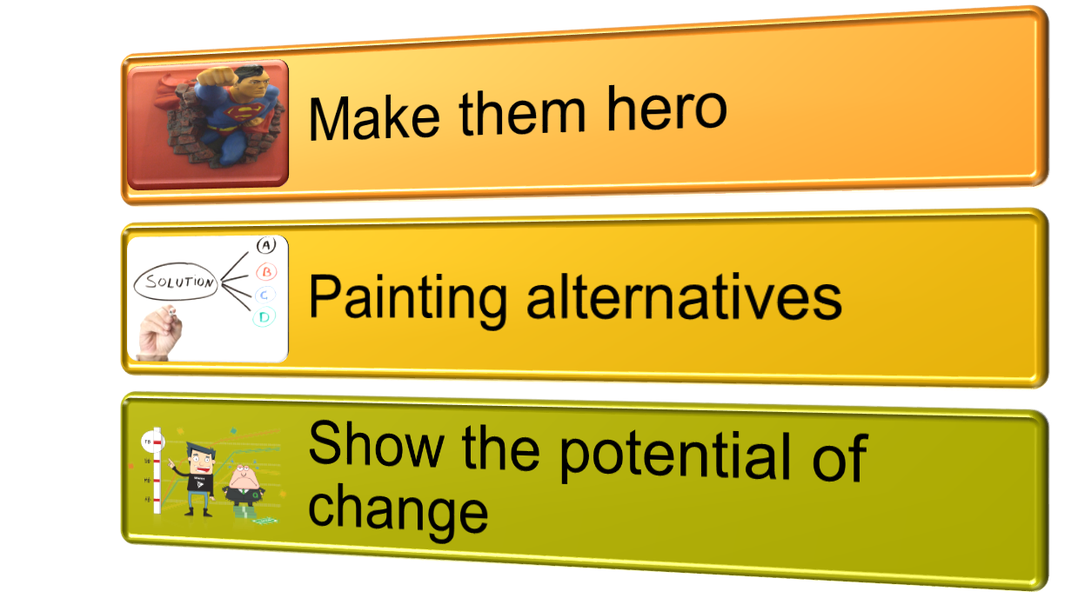
Overcoming barriers to change
Notes:
Understanding Innovation and Change in an Organisation

Slide 15
OVERCOMING BARRIERS TO CHANGE
Make Them the Hero
By making the managers the change drivers and change initiators is often the best way of securing their buy-in. The point here is that by getting the managers to be the ones who are implementing change and by giving them centre stage, it is possible to secure their participation.
By definition, senior managers are highly capable, motivated and ambitious. By making them the stars of the change process, their innate abilities can be harnessed to the benefit of the organization. It is often better to have a close association with the senior managers to achieve the desired results.

Slide 16
Painting the Alternatives
This is the stick part of the carrot and stick approach wherein senior managers are told of the urgent need for change and by indicating to them what the consequences for themselves and the organization would be if the change does not succeed. By painting harsh alternative scenarios like declining market share and repercussions of layoffs and downsizing if the change does not succeed would make the senior managers realize the flip side of resistance. In this way, they can be persuaded to accept the business realities behind the change process.

Slide 17
Show them the potential of Change
By selling change and the value of such change to the organizations and themselves the senior managers can be persuaded to accept change. The point to note is that senior managers must be told what their role in the post change scenario would be and by making them see themselves in the future vision, they can be made to play a key part in the change management. As has been mentioned earlier, if the benefits of the change are explained and by persuading that the change does not involve downsizing or other reduction in roles and responsibilities, the senior managers can be expected to be partners rather than resisters in the change management process.

Slide 18
Involving Them in the Change
By adopting a “hands on” approach that would involve “all hands” and including all the stakeholders, senior managers can be brought on board. The point is that by adopting an inclusive approach and giving a sense of ownership to the senior managers and taking their inputs and feedback would ensure that the key aspect of “engagement” is achieved. As has been pointed out throughout this paper, the key to senior manager participation in the change initiatives is through engagement and only by communicating clearly the benefits of change and by positing the alternatives would it be possible to engage with senior managers. A suitable narrative of the changes and the impact that they have on the senior managers must be communicated to all levels and there must be a process in place to bring on board as many managers as possible. Personality clashes and power politics can be addressed by consensual approaches to decision making and by adopting a carrot and stick approach as described above.

Slide 19
Planning Change
Effective planning means identifying all the relevant issues and working out how to address them. This is clearly an increase in work load – so do the minimum. Another bad practice advantage of not having a plan is that you avoid checking on progress.
Key factors that you should consider while planning are as follows:

Slide 20
Understand the people
As covered in other areas, but worth repeating here, you need to understand the people, both in terms of the legitimate needs they have regarding the change and also the personal concerns and potential responses.
Stakeholders in Change: Who are they? How might they behave?
The Psychology of Change: How will they react when they are told?
Resistance to Change: How might they push back against the change?

Slide 21
Understand the task
The basic part of change is the simple 'task' making the changes as if people would be fully committed without any problem. Getting this right has to be balanced with understanding the people. One of the key problems in change is managing this balance. Often, the people side is under-done, although it also possible to fret too much about the people and forget the nitty-gritty detail of getting things done.
Diagnosing Change: Investigation to understand the need for change.
Scope of Change: both 'what' and 'who' affect the size of the project.
Five Levels of Change: From small to huge.

Slide 22
Build the plans
When planning for change, you need to consider both the actions to make the change and the (often far more problematic) problems you might meet in gaining the required commitment to carry the actions through.
Styles of Change: the style used should match the scope.
The Change Delivery Plan: Creating an unstoppable train of events.
The Commitment Plan: Bringing the people with you.
Sponsorship of Change: You will need senior management support.
Cultural Change Planning: Understanding links between thoughts and actions.
Change Strategy: Approaches that can be used.
Four Change Strategies: Four approaches you can use.

Slide 23
Methods for Monitoring change
Performance measurement
_x0001_ Strategic planning
_x0001_ Project planning
_x0001_ Quality improvement
_x0001_ Program evaluation
_x0001_ Outcomes monitoring
_x0001_ Impact evaluation

Slide 24
Gantt Charts
Gantt Charts (also known as Gantt Diagrams) are useful tools for analyzing and planning more complex projects. They:
Help you to plan out the tasks that need to be completed.
Give you a basis for scheduling when these tasks will be carried out.
Allow you to plan the allocation of resources needed to complete the project.
Help you to work out the critical path for a project where you must complete it by a particular date.
When a project is under way, Gantt Charts help you to monitor whether the project is on schedule. If it is not, it allows you to pinpoint the remedial action necessary to put it back on schedule.

Slide 25
Drawing Gantt Chart
Drawing a Gantt Chart
To draw up a Gantt Chart, follow these steps:
Step 1 – List all Activities in the Plan
For each task, show the earliest start date, estimated length of time it will take, and whether it is parallel or sequential. Also show which other stages they depend on.
You will end up with a task list like the one in figure 1. This example shows the task list for a custom-written computer project. We will use this same example for both this section and the section on Critical Path Analysis and PERT. This will allow you to compare the results of the two approaches.

Slide 26
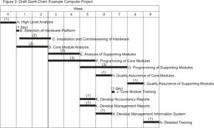
Step 2 – Set up Your Gantt Chart
Head up graph paper with the days or weeks through to task completion.
Step 3 – Plot the Tasks Onto the Graph Paper
Next draw up a rough draft of the Gantt Chart. Plot each task on the graph paper, showing it starting on the earliest possible date. Draw it as a bar, with the length of the bar being the length of the task. Above the task bars, mark the time taken to complete them.
Schedule them in such a way that sequential actions are carried out in the required sequence. Ensure that dependent activities do not start until the activities they depend on have been completed.

Slide 27
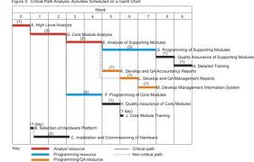
Step 4 – Presenting the Analysis
The last stage in this process is to prepare a final version of the Gantt Chart. This shows how the sets of sequential activities link together, and identifies the critical path activities. At this stage you also need to check the resourcing of the various activities. While scheduling, ensure that you make best use of the resources you have available, and do not over-commit resource.
You can also use colour to represent the different resource types that you need to use such as programmers, or analysts.

Slide 28
If all goes well, the project can be completed in 10 weeks.
If you want to complete the task as rapidly as possible, you need:One analyst for the first five weeks. (Note that we had to change the scope of activity F so that we could finish this task in two weeks, rather than three. This was because we wanted to complete the project in 10 weeks, and we couldn't commit resources to activities F and G at the same time.
  One programmer for five weeks starting week 4.
  One programmer/QA expert for three weeks starting week six. (Note that activities L and M have been moved back a week. This does not affect the critical path, but it does mean that a single programming/QA resource can carry out all three of activities K, L and M.)
Analysis, development, and testing of supporting modules are essential activities that must be completed on time.
Hardware installation and commissioning is not time-critical as long as it is completed before the Core Module Training starts.

Slide 29
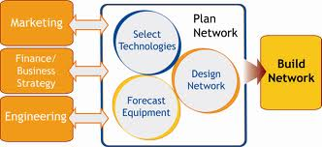
Network Planning

Slide 30
Communication
Communication is neither transmission of message nor message itself. It is the mutual exchange of understanding, originating with the receiver. Communication needs to be effective in business. Communication is essence of management. The basic functions of management (Planning,Organizing, Staffing, Directing and Controlling) cannot be performed well without effective communication. Business communication involves constant flow of information

Slide 31

Type of Communication
Oral communication:
It’s the way of communicating
Verbally expressing your views
And ideas making the next
Person understand

Slide 32

Type of Communication
Written communication:
It’s a way of expressing your views and
Ideas through written format as in e mail
Letter, SMS etc.

Slide 33
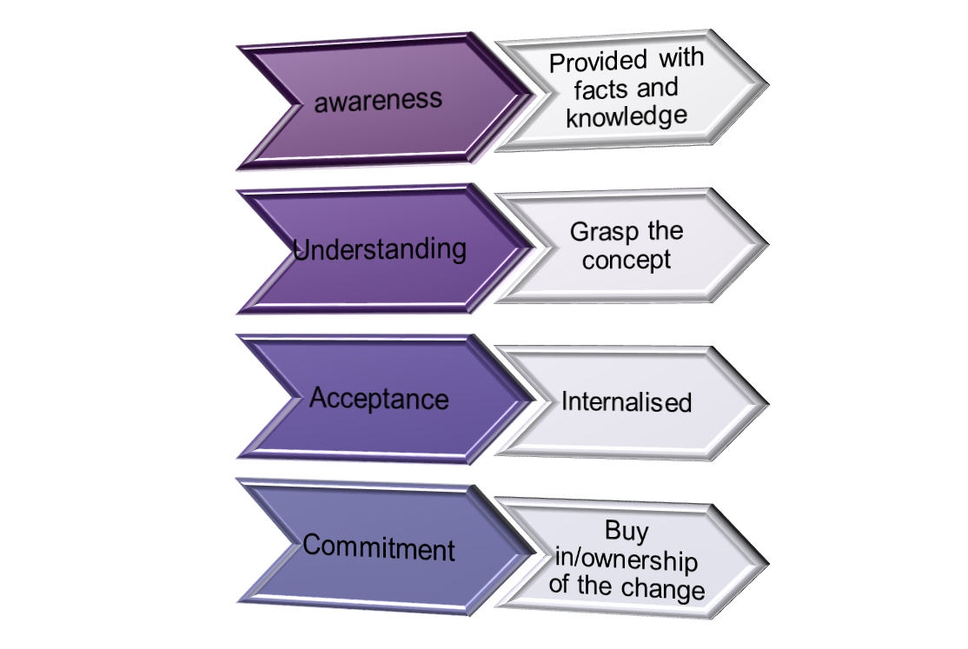
Importance of communication

Slide 34
Change Fatigue and its effects
Change Fatigue is the reaction of the employees to a change resulting into frustration, resistance etc
There’s no mystery as to why people are fatigued by change. First, your employees are smart:
They know that most change initiatives fail to achieve all their stated objectives.
They also know that change initiatives will likely require more work from them in their already-overloaded workday.
They also know that no matter how hard they work on a given initiative, on the way are more and more change initiatives that executives have already launched.

Slide 35
Adverse Effects of Change
Reacting to a Burning Platform
Most large-scale change efforts are created in reaction to a change in market conditions that threaten the organization. This can also prompt leaders to invoke a “burning platform” as a way to urge people to change – Nokia’s CEO released a now-infamous burning platform memo to his employees earlier this year. As John Kotter pointed out in a recent blog post, burning platforms usually identify a problem so significant that employees focus only on the threat and not the solution. What we have seen with this approach is that it just makes people scramble, and rarely in the same direction or at the same time. And many times, these messages simply cause talented people to jump before they get burned.

Slide 36
2. Changing Strategy Now
Many executives respond to changes in market conditions by trying to immediately shift their organization’s strategy to go in a complementary direction. However, most organizations cannot shift that quickly, especially without a clear, compelling vision that conveys the opportunity associated with the changes. It takes most organizations years to successfully change the culture that created their current situation. A strategy shift usually results in a laundry list of key initiatives that receive significant budget and executive attention – until the next crisis arises. For example, Goldman Sachs, in an effort to address criticism earlier this year, created a 63-page report and launched 39 initiatives to be completed in a 15-18 month period.

Slide 37
. Establishing Dedicated Project Teams
Once the strategy is set and initiatives are identified and funded, executives look for resources to deliver the change in strategy. Typically, they will look for “the best and the brightest” internally and externally, then assemble these people into dedicated teams and separate them from the business to design solutions in secret “war rooms.” This setup immediately creates three factors that lead to employee frustration, blame-storming and change fatigue:
Separation – When executives create a strategy, project teams create a solution, and employees live with the solution, it can disrupt team dynamics and create an “us vs. them” mentality between these parties. There is a lack of shared ownership between strategy and execution.

Slide 38
Time lag – There is a natural lag between when a strategy is designed, when the teams are established, and when teams will deliver their programs for the desired strategy.
Multiplicity – Each change in strategy usually creates multiple initiatives and project teams that all have tight timelines, operate in silos, and all ultimately affect the employees in an organization.

Slide 39
It is essential to identify the human capital impacts of a change effort on the workforce. Organisations that successfully manage change typically develop a workforce plan specifically designed to steer their organisation toward achieving its change vision. Workforce planning ensures the organisation has an adequately skilled workforce to support its post-change needs. The plan should also address the issue of redirecting resources in situations where the change creates a gap in the skills and needs of the organisation.
Organisational Needs Assessment
A first step in the workforce planning process is conducting an organisational needs assessment. Through this assessment, organisations can determine the desired workforce size, skills and competencies needed in the future to support the changed environment and it can determine the staffing required.

Slide 40
The following are examples of the types of basic assessment questions that might be required:
Future resource roles and needs:
  What new roles are needed?
  What are the responsibilities assigned to each role?
  How many people are required in each of these roles?
  Are work location changes required?
  Will a different work structure focus people on what is important?
  Is there an adequate supply of people for the new roles?
Skills and Competencies:
  What new competencies will be required for the roles?
  What skills, education, knowledge, or work experiences should the resources have for each identified competency?

Slide 41
Managing Resources
After determining the organisation’s workforce needs in the changed environment, it is then necessary to determine the competencies of the organisation’s current workforce, and identify and address the gaps between future needs and current workforce competencies. Gaps can include the number of resources required; or lack of skills. There may be a decreased need for some competencies and an increased need for others, or new specialist knowledge and learning may be required.
Based on these gaps, the organisation should then, as part of the development of a workforce transition plan, identify workforce strategies to close the gap through recruiting, hiring, deployment, retention, education and training, and other staffing and development initiatives.

Slide 42
Perhaps the most important key to mitigating the gaps between organisational needs and current workforce competencies is workforce development. This may involve:
performance management – to reinforce and sustain the change, performance management assists the organisation to develop workers with skills that align with the organisation’s change goals and to determine employee skills deficits that require development and strengthening
creating individual development plans - identifying a combination of developmental activities to assist affected employees in developing designated competencies and knowledge

Slide 43
training and education – some organisations implement on the job training, mentoring and classroom or computer based training strategies to improve competencies, and encourage professional development by setting aside part of the budget for training.
It is worth bearing in mind that while an essential component of achieving change is appropriately skilled employees; change success depends on employee performance as much as it depends on employee qualification and training. Accordingly to reinforce the change and embed a culture that motivates and sustains the change it helps to:
  Develop employee performance plans that align with the change goals
  Assign quantifiable and measurable objectives for employee performance that support the change; and
  Recognise and reward positive approaches and performance in the change process.

Slide 44
To successfully implement change, organisations need to align the performance of their workforce with the change – that is people must understand what they need to do, be enabled to do it, and be supported in doing it by appropriate incentives and rewards. Aligning individual and organisational performance management systems drives new behaviour and gradually shifts the organisational culture in support of the change vision.

