Slide 1

8600-318 : Understanding the Importance of Quality Management in Business
Business Administration

Slide 2
8600-318 : Understanding the Importance of Quality Management in Business
Week Three
Notes:
Management Communication

Slide 3
Assignment questions
Explain why quality is important to internal and external customers in the workplace (12 marks)
Explain what is meant by Total Quality Management (12marks)
Explain the difference between design quality standards and process quality standards (12 marks)
Explain the cost of quality in the workplace (12 marks)

Slide 4
Assignment questions
Describe a quality system used in the workplace (12 marks)
Identify quality standards set for the workplace (8 marks)
Describe tools used to monitor quality in the workplace (8 marks)
Describe records for maintaining quality in the workplace (8 marks)
Identify practical and positive steps to improve quality in the workplace (16 marks)

Slide 5
Content
A concept of TQM
A quality system
The ISO 9000 series
Contents of ISO 9001
The EFQM excellence model
Seven basic tools of quality
PDCA Model

Slide 6
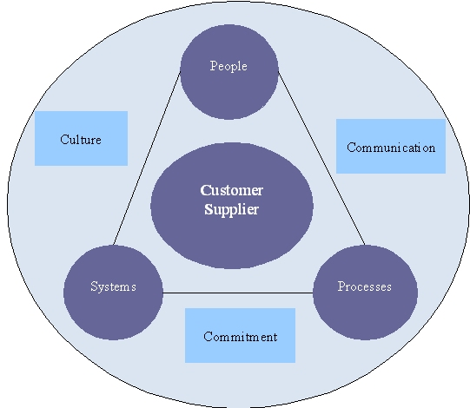
The concept of TQM (Total Quality Management)
This shows that TQM must be practiced熟练的 in all activities, by all personnel职员, in Manufacturing, Marketing, Engineering, R&D, Sales, Purchasing, HR, etc.

Slide 7
The concept of TQM (Total Quality Management)
The core of TQM is the customer-supplier interfaces接口, both externally and internally, and at each interface lie a number of processes. This core must be surrounded by commitment to quality, communication of the quality message, and recognition of the need to change the culture of the organization to create total quality. These are the foundations of TQM, and they are supported by the key management functions of people, processes and systems in the organization.

Slide 8
A Quality system
A quality system refers to activities a business uses to promote quality within the organization. It is often called a quality management system (QMS). This system includes the business's activities, plans, policies and procedures used in producing quality goods and services.
A quality system in workplace— the organizational structure, responsibilities, procedures, processes and resources for implementing quality management (International Organization Standardization, 1994)
Purpose
The purpose of a quality system is to meet customer's expectations and increase profitability. With a quality system, a company focuses on the quality of goods and services produced.

Slide 9
Details
A quality system consists组成 of planning, documenting and controlling all business processes. It requires constant不变的 review to implement changes and improvements to increase customer satisfaction and demand. A quality system focuses on continuously measuring the company's performance to make improvements to the system leading to increased profitability.
Principles
Quality systems focus on eight principles: 1.customer focus,2. leadership, 3.involvement of people, 4.process approach, 5.system approach to management, 6.continual improvement, 7.factual approach to decision making and 8.mutual beneficial supplier relationships. These eight components work together and allow companies to increase the quality in their products.

Slide 10
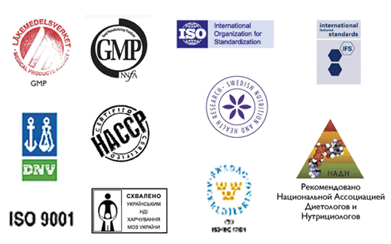
Types of quality standard

Slide 11

Systems an standards
There is a most famous of the quality system standard so call ISO 9000 series (ISO) based in Geneva. The ISO 9000 family of standards is related to quality management systems and designed to help organizations ensure that they meet the needs of customers and other stakeholders while meeting statutory and regulatory requirements related to the product. The standards are published by ISO, the International Organization for Standardization, and available through National standards bodies. ISO 9000 adopted by about 900,000 organizations in 170 countries, according to a paper published in Management Science. Specialized industry segments may call for additional requirements, such as the Food and Drug Administration safety requirements for healthcare-related products.

Slide 12
Systems an standards
ISO 9000 deals with the fundamentals of quality management systems, including the eight management principles which the family of standards is based. ISO 9001 deals with the requirements that organizations wishing to meet the standard have to fulfil.
Third party certification bodies provide independent confirmation that organizations meet the requirements of ISO 9001. Over a million organizations worldwide are independently certified, making ISO 9001 one of the most widely used management tools in the world today. Despite widespread use, however, the ISO certification process has been criticized as being wasteful and not being useful for all organizations.

Slide 13
The ISO 9000 covers:
Quality management and quality assurance standards and guidelines for selection and use– ISO 9000.
A quality systems model for quality assurance in design/development, production, installation and servicing– ISO 9001.
A quality system model for assurance in production and installation– ISO 9002
A quality system model for assurance in final inspection最终检查 and test– ISO 9003
Quality management and quality system elements: guidelines– ISO 9004

Slide 14
Contents of ISO 9001
ISO 9001:2008 Quality management systems — Requirements is a document of approximately 30 pages which is available from the national standards organization in each country. It is supplemented by two other standards: ISO 9000:2005 Quality management systems — Fundamentals and vocabulary and ISO 9004:2009 Managing for the sustained success of an organization — A quality management approach.
Only ISO 9001 is directly audited against for third party assessment purposes. The other two standards are supplementary and contain deeper information on how to sustain and improve quality management systems; they are therefore not used directly during third party assessment. Outline contents for ISO 9001 are as follows:

Slide 15
The standard specifies that the organisation shall issue and maintain the following six documented procedures:
Control of Documents (4.2.3)
Control of Records (4.2.4)
Internal Audits (8.2.2)
Control of Nonconforming Product / Service (8.3)
Corrective Action (8.5.2)
Preventive Action (8.5.3)
In addition to these procedures, ISO 9001:2008 requires the organization to document any other procedures required for its effective operation. The standard also requires the organisation to issue and communicate a documented quality policy, a Quality Manual (which may or may not include the documented procedures) and numerous records, as specified throughout the standard.

Slide 16
The EFQM excellence model
By way of comparison 比较 with ISO 9000, another set of standards of quality management is the EFQM model. It was devised by the European Foundation for Quality Management in 1988 and it’s based on quality in nice areas: leadership, customer results, people results, society result and key performance results.
EFQM Excellence Model, a comprehensive management 综合经营framework used by over 30 000 organisations in Europe. To help you implement our Model, we provide training, assessment tools and recognition for high performing organisations. But our real talent comes from gathering good practices and integrating those within our portfolio.

Slide 17
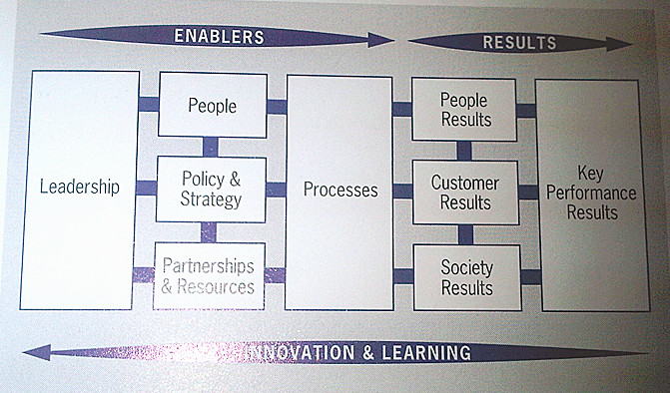
The EFQM excellence model
The EFOM excellence model
Source: European Foundation for Quality Management

Slide 18
EFQM, a not-for-profit membership Foundation, aim to share what works, through case studies, online seminars, working groups, conferences and thematic events.
Sharing our member’s enthusiasm, their motivation and the results they achieve; that is what we work for.
It is a framework to:
Assess your performance, to identify key strengths and improvement areas
Integrate existing tools, procedures and processes, to align匹配 all and remove duplicates复制
Introduce a way of thinking that encourages reflection and stimulates刺激 continuous improvement
Identify what actions are really driving your results, which areas need more attention, and which approaches should be made redundant.

Slide 19
How total quality management extends thinking on quality management?
TQM developed previous thinking on quality. It is a management philosophy concerned with improving all aspects of the operation’s performance and, in particular, with the processes for managing improvement.

Slide 20
Quality Monitoring
Monitoring is essential to ensure that the intended project objective can be achieved within the given time frame following the activities as planned to be carried out by project personnel.
Example of Pall corporation: Quality Monitoring is a critical and essential process during product manufacturing. It is performed with the aim to build quality products and ensure timely corrective action to address处理 any issues. In order to manage economics and to assure the user that high quality test data is obtained 获得on time, reliability可靠性 and reproducibility 再生性are of the utmost importance. Pall offers a comprehensive range of solutions for Quality Monitoring to assure simplicity朴素, speed and reliability of data. Please see the sections below to learn about our capabilities — from sample collection and preparation to rapid microbiological 微生物实验tests to getting rapid, reliable, results.
source: Pall corporation. com

Slide 21
Seven basic tools of quality
Quality pros have many names for these seven basic tools of quality, first emphasized by Kaoru Ishikawa, a professor of engineering at Tokyo University and the father of “quality circles.” Start your quality journey by mastering these tools, and you‘ll have a name for them too: “indispensable 不可缺少的"
Cause-and-effect diagram (also called Ishikawa or fishbone chart): Identifies many possible causes for an effect or problem and sorts ideas into useful categories.
Check sheet: A structured, prepared form for collecting and analyzing data; a generic tool that can be adapted for a wide variety of purposes.
Control charts: Graphs used to study how a process changes over time.

Slide 22
Seven basic tools of quality
Histogram柱形图: The most commonly used graph for showing frequency distributions, or how often each different value in a set of data occurs.
Pareto chart排列图: Shows on a bar graph which factors are more significant.
Scatter diagram散点图: Graphs pairs of numerical data, one variable on each axis, to look for a relationship.
Stratification分层: A technique that separates data gathered from a variety of sources so that patterns can be seen (some lists replace “stratification” with “flowchart” or “run chart”).

Slide 23
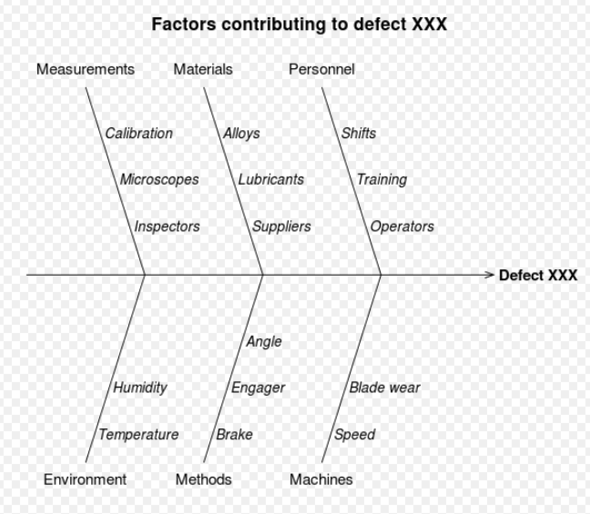
Sample of diagram
Cause-effect diagram

Slide 24
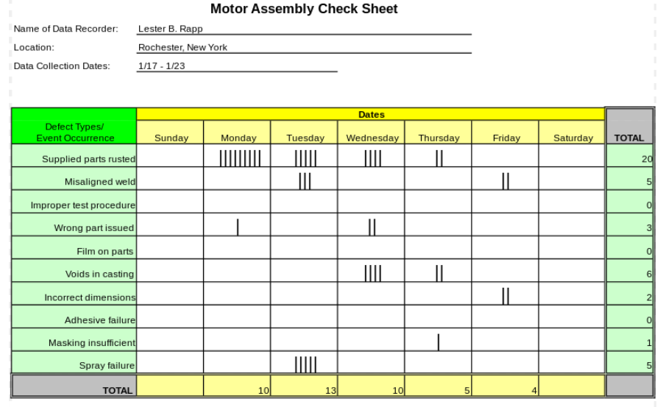
Sample of diagram

Slide 25
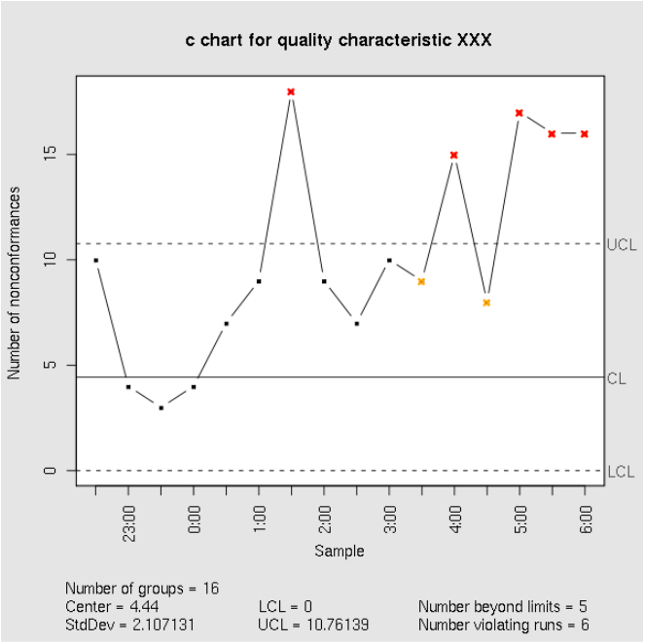
Sample of diagram
Control Chart

Slide 26

Sample of diagram
Histogram

Slide 27
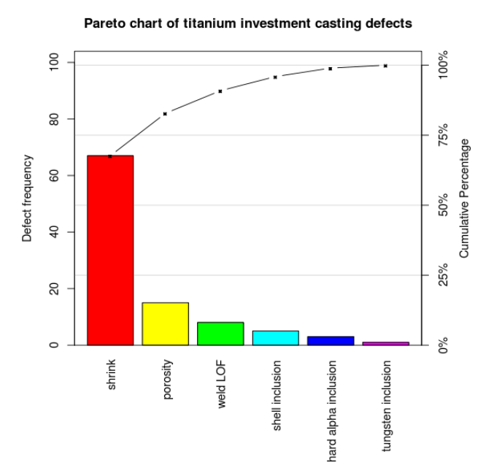
Sample of diagram
Pareto Chart

Slide 28

Sample of diagram
Scatter Chart

Slide 29
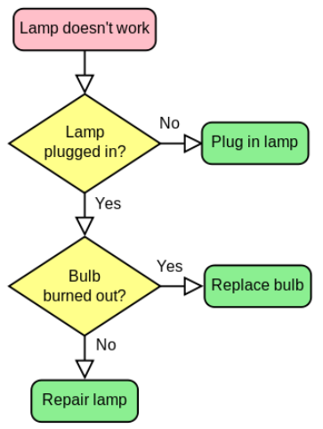
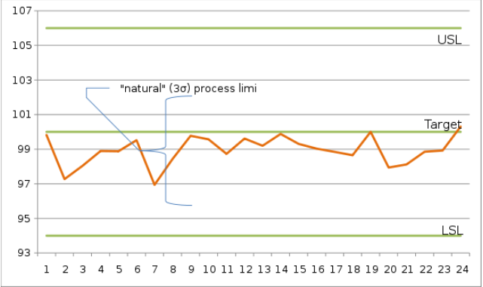
Sample of diagram (stratification)
Run Chart
Follow Chart

Slide 30
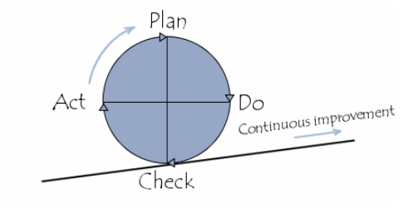
PDCA Model
One of the basic principles of quality is prevention and continual improvement. This means that quality is a never-ending project whose goal is to spot dysfunction as quickly as possible after it occurs. Thus, quality can be represented by a cycle of corrective and preventative actions called a “Deming cycle":

Slide 31
PDCA model
This cycle, represented in the Deming cycle, is called the PDCA model. PDCA refers to the four following steps:
Plan to improve your operations first by finding out what things are going wrong (that is identify the problems faced), and come up with ideas for solving these problems.
Do changes designed to solve the problems on a small or experimental scale first. This minimises disruption to routine activity while testing whether the changes will work or not.

Slide 32
PDCA model
Check whether the small scale or experimental changes are achieving the desired result or not. Also, continuously Check nominated key activities (regardless of any experimentation going on) to ensure that you know what the quality of the output is at all times to identify any new problems when they crop up.
Act to implement changes on a larger scale if the experiment is successful. This means making the changes a routine part of your activity. Also Act to involve other persons (other departments, suppliers, or customers) affected by the changes and whose cooperation you need to implement them on a larger scale, or those who may simply benefit from what you have learned (you may, of course, already have involved these people in the Do or trial stage).

Slide 33
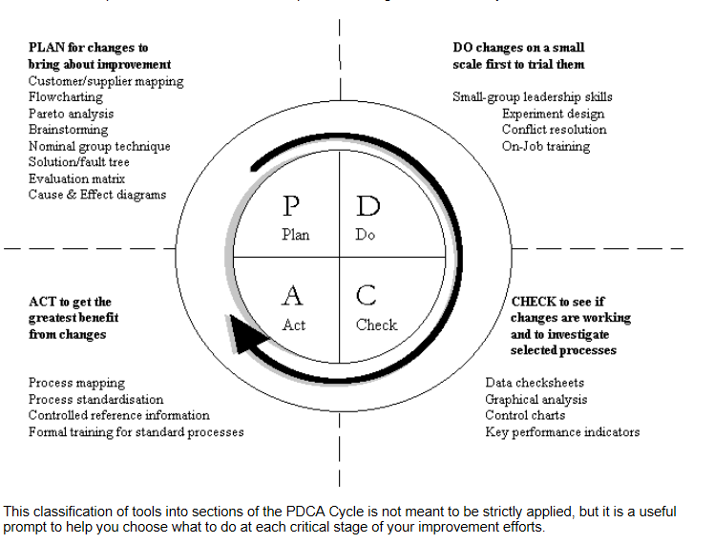

Slide 34
Class activity
Self research in QMA standard

Slide 35
Reference
http://www.ehow.com/facts_7624335_quality-system-definition.html#ixzz2YWgb8aVy
http://en.kioskea.net/contents/619-quality
http://en.wikipedia.org/wiki/ISO_9000
http://www.efqm.org/en/tabid/108/default.aspx
http://www.howto.gov/contact-centers/management/monitor-quality
Nancy R. Tague’s The Quality Toolbox, Second Edition, ASQ Quality Press, 2004, page 15.

