Slide 1

8600-332 : Understanding Sustainability and Business Environmental Issues
Business Administration

Slide 2
Definition of Sustainability
Understanding Sustainability and Business Environmental Issues
Every day we hear the term ‘sustainable’ or ‘sustainability’ being used to describe a large number of issues and news items. There is the ‘sustainable economy’, ‘sustainable agriculture’, ‘economically sustainable’, ‘the need to be sustainable’, ‘sustainable work practices 'and ‘sustainable water supply’ to name a few.

Slide 3
Definition of Corporate Social Responsibility
Understanding Sustainability and Business Environmental Issues
CSR! Is that really for me? So technical, very expensive!!
I’m overwhelmed

Slide 4
Definition of Corporate Social Responsibility
Understanding Sustainability and Business Environmental Issues
‘Corporate Social Responsibility is the continuing commitment by business to behave ethically and contribute to economic development while improving the quality of life of the workforce and their families as well as of the local community and society at large’.
– World Business Council For Sustainable Development

Slide 5
Definition of Corporate Social Responsibility
Understanding Sustainability and Business Environmental Issues
Corporate Social Responsibility
The responsibility of business towards the society

Slide 6
Definition of Corporate Social Responsibility
Understanding Sustainability and Business Environmental Issues
A voluntary initiative on the part of a business to contribute to a better society and a greener and cleaner environment.

Slide 7
The Facility Manager’s Role in Sustainability
Understanding Sustainability and Business Environmental Issues
The facility manager or maintenance manager has a critical and increasing role in defining and implementing sustainability of industrial facilities. His or her familiarity with plant, factory and building systems puts them in a unique position within the organization to identify opportunities to reduce energy consumption, recover energy, identify hazards, minimize and recycle waste, improve worker health and safety, and protect the environment.

Slide 8
The Facility Manager’s Role in Sustainability
Understanding Sustainability and Business Environmental Issues
The facility manager typically supervises a multi-talented group of employees and contract service providers. These human assets can provide a wealth of insights, ideas and resources to improve sustainability of existing systems and operations, as well as help optimize the sustainability of new facilities, equipment and procedures.

Slide 9
The Facility Manager’s Role in Sustainability
Understanding Sustainability and Business Environmental Issues
Facility and maintenance managers’ intimate familiarity with the age, condition, energy consumption and maintenance requirements of their building, power distribution, steam, HVAC, compressed air, chiller, water and other systems can help focus efforts to improve sustainability.

Slide 10
The Facility Manager’s Role in Sustainability
Understanding Sustainability and Business Environmental Issues
Their experience with selecting and managing the activities of contractors helps them identify appropriate services such as energy, steam and compressed air audits, select the most appropriate vendors, interpret results, recommend actions and manage execution.

Slide 11
The Facility Manager’s Role in Sustainability
Understanding Sustainability and Business Environmental Issues
Indirect activities typically contribute the highest injury rates, as well as the largest percentage of the number of hazardous materials a site must manage and control, so these aspects of sustainability also are strongly influenced by facilities management.

Slide 12
The Facility Manager’s Role in Sustainability
Understanding Sustainability and Business Environmental Issues
Most industrial facilities managers are fully occupied with day-to-day exigencies as well as short- and long-term planning, projects and reporting. Fortunately, the tenets of sustainability already align with their existing goals such as safety, efficiency and environmental compliance. Their ability to improve sustainability is best leveraged by making it a recognized, accepted and supported corporate priority so

Slide 13
The Facility Manager’s Role in Sustainability
Understanding Sustainability and Business Environmental Issues
they can integrate its various aspects into ongoing activities and include them in their continuous improvement programs. Then the same managerial talents that drive existing safety, reliability, efficiency, productivity and cost-reduction initiatives will align and ensure the success of industrial sustainability.

Slide 14
The Facility Manager’s Role in Customer Social Responsibility
Understanding Sustainability and Business Environmental Issues
Facility managers can expect to be asked to provide information for corporate social responsibility (CSR) reporting. More and more companies and organizations are beginning to issue annual corporate responsibility reports in addition to their annual financial reports in order to more fully report their annual performance. CSR reporting provides and organized way for companies to make public their performance information that covers all three legs of sustainability — environmental, social and financial performance.

Slide 15
The Facility Manager’s Role in Customer Social Responsibility
Understanding Sustainability and Business Environmental Issues
The bottom line is that facility managers should plan to be ready to support the preparation of CSR reports when their company or organization moves forward with them. There are two important components of being ready: 1) have the facilities actually delivering sustainable performance; and 2) have this sustainable performance tracked and documented so the data is readily available.

Slide 16
Legislative requirements in terms of minimizing Environmental Impact and Damage
Understanding Sustainability and Business Environmental Issues
Environment Protection (Impact of Proposals) Act 1974 Significant environmental matters must be fully examined and taken into consideration in relation to actions, proposals and decisions taken on or behalf of the Commonwealth Government and its agencies.

Slide 17
Legislative requirements in terms of minimizing Environmental Impact and Damage
Understanding Sustainability and Business Environmental Issues
Environment Protection (Sea Dumping) Act 1981
This Act regulates the loading and dumping of waste at sea to protect waters surrounding Australia’s coastline. The Act fulfills Australia's international obligations under the London Protocol to prevent marine pollution by dumping of wastes and other matter. Permits are required from the Department of the Environment, Water, Heritage and the Arts for all ocean disposal activities.

Slide 18
Legislative requirements in terms of minimizing Environmental Impact and Damage
Understanding Sustainability and Business Environmental Issues
National Environment Protection Council Act 1994 Establishes the National Environment Protection Council (NEPC). This is a national ministerial body which makes national environment protection measures to ensure that Australians have equivalent protection from air, water, soil and noise pollution. This Act is mirrored in all States and Territories.

Slide 19
Legislative requirements in terms of minimizing Environmental Impact and Damage
Understanding Sustainability and Business Environmental Issues
State and Territory laws implementing national environment protection measures do not apply to the activities of the Commonwealth or Commonwealth authorities. However, under this Act, the Environment Minister may (subject to considerations of national interest or administrative efficiency) apply those State or Territory laws to the activities of the Commonwealth or Commonwealth authorities in other places. If NEPMs are not implemented in relation to the activities of the Commonwealth or Commonwealth authorities they can be implemented by regulations; or if there are no regulations, through environmental audits and environment management plans.

Slide 20
Legislative requirements in terms of minimizing Environmental Impact and Damage
Understanding Sustainability and Business Environmental Issues
National Greenhouse and Energy Reporting Act 2007
The National Greenhouse and Energy Reporting Act 2007 (the Act) was passed on 29 September 2007 establishing a mandatory reporting system for corporate greenhouse gas emissions and energy production and consumption. The first reporting period under the Act commenced on 1 July 2008.

Slide 21
Legislative requirements in terms of minimizing Environmental Impact and Damage
Understanding Sustainability and Business Environmental Issues
Key features of the Act are:
Reporting of greenhouse gas emissions, energy consumption and production by large corporations.
Public disclosure of corporate level greenhouse gas emissions and energy information.
Consistent and comparable data available for decision making, in particular, the development of the Carbon Pollution Reduction Scheme

Slide 22
Types of Environmental Issues
Understanding Sustainability and Business Environmental Issues
Air Related Environmental
Green House Effect
The Greenhouse effect is a process by which planetary surface emits thermal radiations that absorbed by atmospheric greenhouse gases, and re-radiated in all directions.
Greenhouse gases are Carbon dioxide, Methane, Nitrous Oxide, Sulphur Oxides, Chlorofluro Carbons, Water vapors
Rise in global temperature.

Slide 23
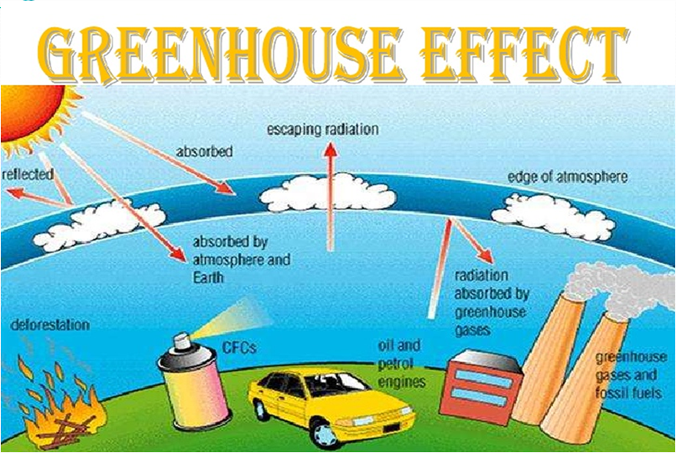
Types of Environmental Issues
GREENHOUSE EFFECT
Understanding Sustainability and Business Environmental Issues

Slide 24
Understanding Sustainability and Business Environmental Issues
Economic Impacts
Increase income inequalities between and within countries.
A small increase in global mean temperature (up to 2 degrees Celsius, measured against 1990 levels) would result in net negative market sector impacts in many developing countries and net positive market sector impacts in many developed countries
Non-market impact
Health impacts, those impacts contributed substantially to the total costs of climate change.
Market Sector

Slide 25
Understanding Sustainability and Business Environmental Issues
Economic Impacts
Agriculture
Fishery
Other Sectors
Increased energy costs
Coastal and storm damage
Reduced food production
Increased wild land Fire costs
Increased public Health costs
Lost recreation

Slide 26
Understanding Sustainability and Business Environmental Issues
Ozone Depletion
Ozone depletion is the reduction of the protective layer of ozone in the Stratosphere by chemicals released on earth.
The main chemicals that are depleting stratospheric ozone layer are chloroflourocarbons which are used in refrigerators, aerosols and as cleaners in many industries.
The damage is caused when these chemicals release highly reactive forms of chlorine and bromine
Ozone depletion cause Skin Cancer, Eye damage, Immune system damage, Reduction in phytoplankton, Damage to the DNA in various life-forms.

Slide 27
Understanding Sustainability and Business Environmental Issues
Economic Impacts
Ozone layer depletion affects agricultural products.
Disturbing the airways industries.
Tourism industry is affected.
More importantly economic impacts are not that large compared HUMAN AND ENVIRONMENTAL LOSSED INCURED TO THE WORLD.
Increase disease and cancer requires the cost of hospitalization.

Slide 28
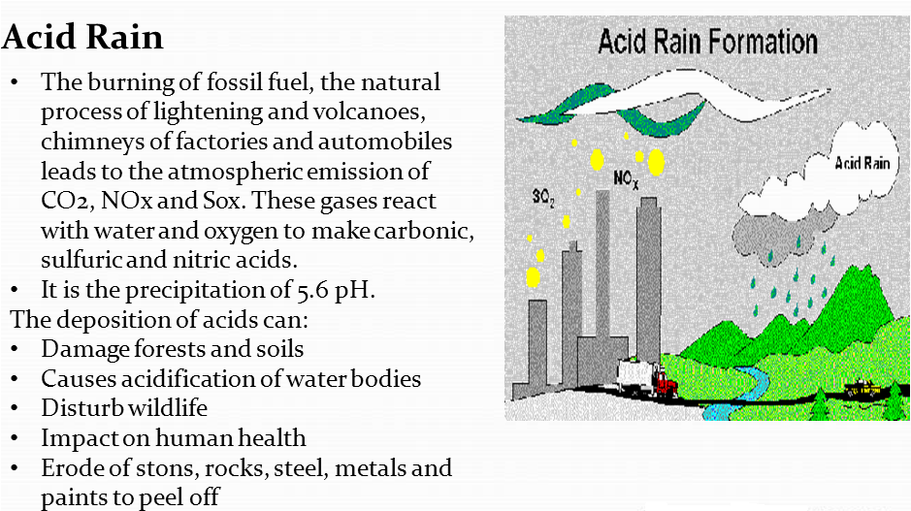
Understanding Sustainability and Business Environmental Issues
Water – Related Environmental Problems
Acid Rain
The burning of fossil fuel, the natural process of lightening and volcanoes, chimneys of factories and automobiles leads to the atmospheric emission of CO2, NOx and Sox. These gases react with water and oxygen to make carbonic sulfuric and nitric acids.
It is the precipitation of 5.6 pH.
The deposition of acids can:
Damage forests and soils
Causes acidification of water bodies
Disturb wildlife
Impact on human health
Erode of stons, rocks, steel, metals and paints to peel off

Slide 29
Understanding Sustainability and Business Environmental Issues
Economic Impacts
Acid Rain
The burning of fossil fuel, the natural process of lightening and volcanoes, chimneys of factories and automobiles leads to the atmospheric emission of CO2, NOx and Sox. These gases react with water and oxygen to make carbonic sulfuric and nitric acids.
It is the precipitation of 5.6 pH.
Acid Rain = acidic water = less fish = less money for fisherman= less money to spend and there for affecting the economy.
Acid Rain = damaged buildings = claims on insurance = less money for insurance company and there for affecting the economy.
The economic cost of property damage caused by suplhur dioxide.
While the costs of reducing automobile emissions nitrous oxides are higher.

Slide 30
Understanding Sustainability and Business Environmental Issues
Marine Pollution and Acidification
Marine Pollution is due to the different factors, which are inefficient and / or inadequate waste water treatment, urban run-off, eutrophication, solid materials, especially plastic, create a huge nuisance.
On the other hand, Marine acidification refers to the effect of anthropogenic carbon dioxide on the pH of the oceans

Slide 31
Understanding Sustainability and Business Environmental Issues
Economic Impacts
Economic loss in commercial fisheries like mollusks and potentially reduce harvests of economically important predators
The catch, net and other equipment could be contaminated by oil containers, paint tins, oil filters and other chemicals.
Large items such as wires and old nets may be collected off the seabed and may damage the nets.
If 50% of the Shetland fishing fleet was affected in the same way, which affect the income of local industries.

Slide 32
Understanding Sustainability and Business Environmental Issues
Land Related Environmental Problems
Problems arising from inefficient Land Use
I. Urban sprawl
II. Habitat Fragmentation
III. Habitat destruction
Economic Impacts
Increased community costs for maintaining roads, school bus routes, sewers, and other services needed when businesses and residences are spread out.
Ongoing increases in property taxes to meet growing need for services.
Increased cost and difficulty of providing public transportation.
Loss of agricultural and forestry jobs, and traditional land practices.
Reduction of rural character or community sense of place.

Slide 33
Understanding Sustainability and Business Environmental Issues
Problems Arising form Land Pollution and Degradation
I. Desertification
II. Land Pollution
III. Soil Pollution
Economic Impacts
Siltation of dams.
Sedimentation of waterways.
Damage to irrigation infrastructure and pumping equipment.
Contamination of drinking water reserves.
Increased frequency of flooding events.
Increased dust concentrations.
Impact on the aquatic environment.

Slide 34
Duty of Care
Understanding Sustainability and Business Environmental Issues
The Duty of Care is a code of practice to support the 1990 Environmental Protection Act section 34 . Waste can be solid, liquid or gaseous. The code of practice states, amongst other issues, that you must store waste safely and securely.

Slide 35
Duty of Care
Understanding Sustainability and Business Environmental Issues
It applies to anyone who:
produces or imports
keeps or stores
transports
treats
recycles
disposes of waste

Slide 36
Environmental Protection Act
Understanding Sustainability and Business Environmental Issues
sets out a regime for regulating and licensing the acceptable disposal of controlled waste on land. Controlled waste is any household, industrial and commercial waste (s.75(4)). Unauthorized or harmful depositing, treatment or disposal of controlled waste is prohibited with prohibition enforced by criminal sanctions. Further, there is a broad duty of care on importers, producers, carriers, keepers, treathers or disposers of controlled waste to prevent unauthorized or harmful activities. Breach of the duty of care is a crime.

Slide 37
Hazardous and Non-Hazardous Waste
Understanding Sustainability and Business Environmental Issues
A Hazardous waste is waste that poses substantial or potential threats to public health or the environment. In the United States, the treatment, storage and disposal of hazardous waste is regulated under the Resource Conservation and Recovery Act (RCRA). Hazardous wastes are defined under RCRA in 40 CFR 261 where they are divided into two major categories: characteristic wastes and listed wastes.

Slide 38
Electrical and Electronic Equipment Regulations
Understanding Sustainability and Business Environmental Issues
Waste Electrical and Electronic Equipment Regulation (WEEE) is a directive in the European Union that designates safe and responsible collection, recycling and recovery procedures for all types of electronic waste. If improperly disposed, electronic waste like old computers, mobile phones and kitchen appliances can pose environmental and health risks from exposure to lead, mercury and other heavy metals. The WEEE regulation aims to reduce these risks by providing a safe way to get rid of these materials. Eventually, WEEE will phase out dangerous materials in exchange for safer alternatives. Under these regulations, manufacturers of specified disposal equipment are directly responsible for the disposal of electronic waste. These companies must meet collection targets, collecting 65% of the average weight of electronics placed on the market in the previous two years.

Slide 39
Electrical and Electronic Equipment Regulations
Understanding Sustainability and Business Environmental Issues
Waste Electrical and Electronic Equipment Regulation (WEEE) is a directive in the European Union that designates safe and responsible collection, recycling and recovery procedures for all types of electronic waste. If improperly disposed, electronic waste like old computers, mobile phones and kitchen appliances can pose environmental and health risks from exposure to lead, mercury and other heavy metals. The WEEE regulation aims to reduce these risks by providing a safe way to get rid of these materials. Eventually, WEEE will phase out dangerous materials in exchange for safer alternatives. Under these regulations, manufacturers of specified disposal equipment are directly responsible for the disposal of electronic waste. These companies must meet collection targets, collecting 65% of the average weight of electronics placed on the market in the previous two years.

Slide 40
Packaging Waste Regulations
Understanding Sustainability and Business Environmental Issues
These Regulations are made by the Secretary of State as respects England, Scotland and Wales in exercise of the powers conferred by section 2(2) of, and paragraph 1A of Schedule 2 to, the European Communities Act 1972 and sections 93 to 95 of the Environment Act 1995(. These Regulations implement Article 6(1) of Council Directive 94/62/EC on packaging and packaging waste (“Packaging Waste Directive”) and section 93(3)(a) of the Environment Act 1995 applies. The Secretary of State is a Minister designated for the purposes of section 2(2) of the European Communities Act 1972 in relation to the environment. It appears to the Secretary of State that it is expedient for the reference to Article 6(1) of the Packaging Waste Directive to be construed as a reference to that provision as amended from time to time.

Slide 41
Packaging Waste Regulations
Understanding Sustainability and Business Environmental Issues
The Secretary of State makes these Regulations—
(a)after consultation in accordance with section 93(2) of the Environment Act 1995;
(b)having regard to the matters specified in section 93(6), as required by section 93(5) of that Act; and
(c)in accordance with the duty in section 93(7) of that Act.

Slide 42
ISO 14001
Understanding Sustainability and Business Environmental Issues
specifies the actual requirements for an environmental management system. It applies to those environmental aspects which the organization has control and over which it can be expected to have an influence.

Slide 43
Eco-Management and Audit Scheme
Understanding Sustainability and Business Environmental Issues
The Eco-Management and Audit Scheme (EMAS) is a voluntary environmental management instrument, which was developed in 1993 by the European Commission. It enables organizations to assess, manage and continuously improve their environmental performance. The scheme is globally applicable and open to all types of private and public organizations. In order to register with EMAS, organizations must meet the requirements of the EU EMAS-Regulation. Currently, more than 4,600 organizations and more than 7,900 sites are EMAS registered.

Slide 44
Energy Efficiency Scheme
Understanding Sustainability and Business Environmental Issues
The CRC Energy Efficiency Scheme (the CRC, formerly the Carbon Reduction Commitment) is a mandatory carbon emissions reduction scheme in the United Kingdom that applies to large non-energy-intensive organizations in the public and private sectors. It has been estimated that the scheme will reduce carbon emissions by 1.2 million tons of carbon per year by 2020. In an effort to avoid dangerous climate change, the British Government first committed to cutting UK carbon emissions by 60% by 2050 (compared to 1990 levels), and in October 2008 increased this commitment to 80%. The scheme has also been credited with driving up demand for energy-efficient goods and services.

Slide 45
Energy Efficiency Scheme
Understanding Sustainability and Business Environmental Issues
The CRC Energy Efficiency Scheme (the CRC, formerly the Carbon Reduction Commitment) is a mandatory carbon emissions reduction scheme in the United Kingdom that applies to large non-energy-intensive organizations in the public and private sectors. It has been estimated that the scheme will reduce carbon emissions by 1.2 million tons of carbon per year by 2020.^{[2]} In an effort to avoid dangerous climate change, the British Government first committed to cutting UK carbon emissions by 60% by 2050 (compared to 1990 levels), and in October 2008 increased this commitment to 80%. The scheme has also been credited with driving up demand for energy-efficient goods and services.

Slide 46
Ways to Prevent Damage to the Environment
Understanding Sustainability and Business Environmental Issues
Conserve Water
With 36 states in the U.S. potentially facing water shortages in 2013, water conservation is a critical environmental concern (See References 1). Conserving water not only extends our water resources for use by future generations, it protects the animals and plants that live in areas with limited water availability. Easy ways to conserve water include installing low-flow fixtures in bathrooms and kitchens, planting a native garden instead of a lawn in your yard, taking short showers and fixing leaks immediately (See References 2).

Slide 47
Ways to Prevent Damage to the Environment
Understanding Sustainability and Business Environmental Issues
Clear the Air
Despite significant improvements in air quality since 1990, approximately 124 million people in the U.S. lived in counties that exceeded one or more national ambient air quality standard (NAAQS) in 2010 (See References 4). Taking action to improve air quality runs the gamut from planting trees to filter the air to purchasing green energy for residential use and using ride-sharing, public, pedal or pedestrian transport to reduce trips and vehicle emissions (See References 4).

Slide 48
Ways to Prevent Damage to the Environment
Understanding Sustainability and Business Environmental Issues
Reduce Waste
In 2010 Americans generated garbage at a rate of 4.43 pounds per person per day and recycled garbage at a rate of only 34 percent, leaving 165 million tons of trash destined for landfills (See References 5), according to U.S. Environmental Protection Agency statistics. Reducing waste in combination with recycling can reduce methane emissions, save energy and increase forest carbon sequestration (See References 6). Waste reduction actions include reusing and buying used or recycled items, choosing items in less packaging and purchasing fewer items that could end up in a landfill (See References 7, Waste).

Slide 49
Ways to Prevent Damage to the Environment
Understanding Sustainability and Business Environmental Issues
Bonus Action: Become an Advocate for the Planet
Becoming an advocate for the environment can extend individual actions to a much larger group, creating a positive impact on protecting the planet. Talking to others about the state of the environment locally and globally raises awareness and increases the likelihood of action. Steps to consider include participating in a local environmental event, starting a recycling competition at work or sharing a commitment for the environment on social networking sites.

Slide 50
Ways to Manage Issues Affecting Organizations
Understanding Sustainability and Business Environmental Issues
We resolve issues through analysis, decisions, and actions.
Clarify the issue, including its impact on project performance and impacts on stakeholders.
Generate options. You want to be resourceful and remove barriers recognize the limitations of the established ways
Establish a preferred option

Slide 51
Ways to Manage Issues Affecting Organizations
Understanding Sustainability and Business Environmental Issues
Here are a few more tips:
Keep track of closed issues. When enthusiasm starts to flag, you can use your closed issues lists as a tangible reminder of the progress made.
Prioritize with forced choice, which involves setting up a series of 1:1 comparisons of the issues. It results in a prioritized list. This is also a good team building practice.
Make it a part of every team meeting and part of the roll up reporting to the executive council.

Slide 52
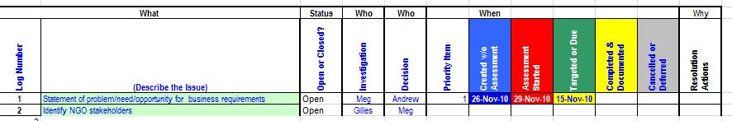
Ways to Manage Issues Affecting Organizations
Understanding Sustainability and Business Environmental Issues

Slide 53
Understanding Sustainability and Business Environmental Issues
Greenhouse gases are generally divided into two categories: (1) the three principal greenhouse gases (carbon dioxide, nitrous oxide, and methane) and (2) other gases (primarily, hydro fluorocarbons [HFCs], per fluorocarbons, and sulfur hexafluoride). Based on overall emission levels and global warming potential, CO2 is by far the most important GHG, accounting for 85 percent of total U.S. GHG emissions in 2002. Methane and nitrous oxide account for almost 14 percent. The three "other gases” account for less than 2 percent of total U.S. GHG emissions when weighted by their 100-year global warming potential.

Slide 54
Understanding Sustainability and Business Environmental Issues
Residential, commercial, and industrial buildings are responsible for 43 percent (658 MMTC) of U.S. CO2 emissions—the GHG most focused on in this report.16 Among the other two principal GHGs, buildings are responsible for an estimated 7 percent of methane (an estimated 10 MMTC-equivalent from construction and demolition debris in landfills and 2 MMTC-equivalent from the incomplete combustion of wood in fireplaces and cook stoves) and 8 percent of nitrous oxide (0.3 MMTC-equivalent, principally from fireplaces and woodstoves).

Slide 55
Understanding Sustainability and Business Environmental Issues
Among the three “other gases,” only HFCs are significantly related to buildings. HFC emissions are increasing because of their use as replacements for CFCs, halons, and other ozone-depleting chemicals that damage the earth’s stratospheric ozone layer and are being phased out under the Montreal Protocol. In particular, HFCs are used as refrigerants in refrigeration, chillers, and automobile air-conditioning, and as blowing agents in insulation. In 2002, the United States emitted an estimated 23 MMTC-equivalent of HFCs and an additional unknown amount of CFCs and hydro chlorofluorocarbons(HCFCs) that will eventually be replaced. With the exception of automobile air conditioning and a few other minor uses, the majority of these emissions are from applications in buildings.

Slide 56
Understanding Sustainability and Business Environmental Issues
New construction can more easily incorporate novel, low-GHG technologies and is therefore often a harbinger of future trends. In addition, new building technologies are often introduced in the new construction market but then spill over into the building retrofit and renovation trades. While new buildings amount to only 2 to 3 percent of the existing building stock in any given year, new construction practices will have an increasing impact over time.

Slide 57
Understanding Sustainability and Business Environmental Issues
The value of U.S. construction in 2000 is estimated to have been $1.3 trillion (2000$) including new construction, renovation, heavy construction, and public works. This represents 13.2 percent of U.S.GDP. New buildings construction represents almost half of this total ($562 billion), and building renovation was valued at $265 billion.22 Given the longevity of buildings and the amount spent annually on renovation, the existing building market represents a key, yet often harder, opportunity for GHG reduction.

Slide 58
Understanding Sustainability and Business Environmental Issues
The most impressive progress in residential green building development and construction is the result of communities and developers wanting to distinguish themselves as leaders in efficient use of resources and reducing waste in response to local issues of land-use planning, energy supply, air quality, landfill constraints, and water resources. Developers and owner/operators who have a business purpose in considering the life-cycle cost and resource aspects of their new projects are providing the green building leadership in the commercial sector.

Slide 59
Understanding Sustainability and Business Environmental Issues
One segment of the current leadership is from organizations that are committed to “walking-the-talk” on the environment and energy, such as the Chesapeake Bay Foundation, Durst Corporation (see Box 1: Greening Four Times Square), and the federal government. State and local governments are also demonstrating and requiring green building practices in their new buildings. Several whole-buildings standards have been developed to promote green buildings (see Box 2:Reducing GHG Emissions through Whole-Building Standards).

Slide 60
Understanding Sustainability and Business Environmental Issues
While there is disagreement about some of the specifics of these rating systems, they have proven to be effective in the absence of aggressive state or federal green building codes. Real market transformation, however, will require buy-in also from the supply side of the industry—due to the complex supply chain structure of the industry

Slide 61
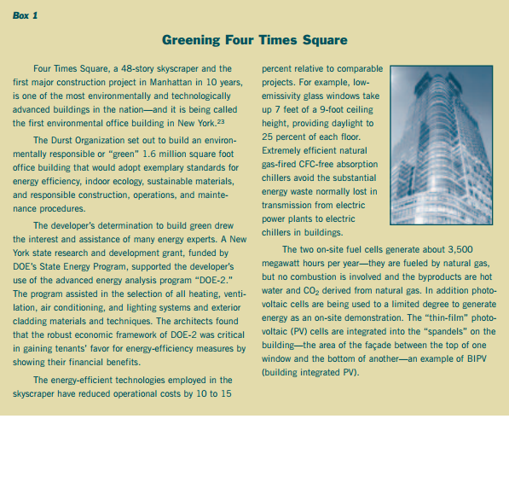
Understanding Sustainability and Business Environmental Issues

Slide 62
Understanding Sustainability and Business Environmental Issues
In the residential sector, significant opportunities for climate-friendly homes and communities are in the growth areas of the West, Southwest, and Southeast. These regions have particularly large peak electricity requirements for cooling. Improvements in the design of subdivisions for optimal building orientation, shading for passive solar heating and cooling, and efficient building shells, windows, cooling systems, and appliances are the key to reducing energy consumption. These regions also have the best solar resources and greatest opportunities for building integrated photovoltaic and solar hot water systems to meet a large fraction of the remaining energy demand.

