Slide 1

8600-332 : Understanding Sustainability and Business Environmental Issues
Business Administration

Slide 2
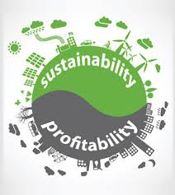
8600-332 : Understanding Sustainability and Business Environmental Issues
Week One
Notes:
Management Communication

Slide 3
Assignment questions
Explain the terms sustainability and corporate social responsibility (16 marks)
Identify the key legislation associated with sustainability and corporate social responsibility (16 marks)
List the environmental standards required in own organization (12 marks)
Explain the environmental issues affecting own organization (16 marks)
Describe environmentally friendly ways to manage issues affecting own organization (16 marks)
Explain the constraints of own organization’s buildings on environmentally friendly procedures and practices (12 marks)
Explain the opportunities to enhance own organization's buildings environmentally friendly performance (12 marks)

Slide 4
Content
Definition of sustainability
Concept of sustainability
Business sustainability
Three spheres of sustainability
Definition of corporate social responsibility
The facility manager’s role in sustainability
The facility manager’s role in customer social responsibility
Legislative requirements in terms of minimizing environmental impact and damage

Slide 5
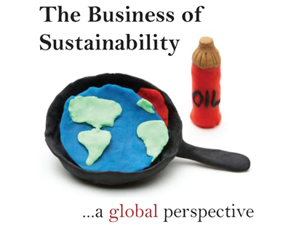
Every day we hear the term ‘sustainable可持续的’ or ‘sustainability’ being used to describe a large number of issues and news items. There is the ‘sustainable economy’, ‘sustainable agriculture’, ‘economically sustainable’, ‘the need to be sustainable’, ‘sustainable work practices 'and ‘sustainable water supply’ to name a few.

Slide 6
Definition of Sustainability
Sustainability is the capacity to endure. In ecology生态学 the word describes how biological systems remain diverse and productive over time. Long-lived and healthy wetlands and forests are examples of sustainable biological systems.
For humans, sustainability is the potential for long-term maintenance of well being, which has ecological, economic, political and cultural dimensions文化维度. Sustainability requires the reconciliation调和 of environmental, social equity and economic demands.

Slide 7
Concept of Sustainability
Sustainability interfaces with economics through the social and environmental consequences of economic activity. Sustainability economics involves ecological economics where social aspects including cultural, health-related and monetary/financial aspects are integrated.
Moving towards sustainability is also a social challenge that entails international and national law, urban planning and transport, local and individual lifestyles and ethical consumerism.

Slide 8
Concept of Sustainability
Ways of living more sustainably can take many forms from reorganising living conditions (e.g., eco-villages, eco-municipalities and sustainable cities), reappraising economic sectors (green building, sustainable agriculture可持续农业), or work practices (sustainable architecture可持续建筑), using science to develop new technologies (green technologies, renewable energy), to adjustments in individual lifestyles that conserve natural resources保护自然资源.

Slide 9
Business sustainability
Business sustainability is often defined as managing the triple bottom line - a process by which companies manage their financial, social and environmental risks, obligations债务 and opportunities. These three impacts are sometimes referred to as profits, people and planet.
However, this approach relies on an accounting based perspective and does not fully capture the time element that is inherent天生的 within business sustainability. A more robust definition is that business sustainability represents resiliency弹回 over time – businesses that can survive shocks because they are intimately亲密地 connected to healthy economic, social and environmental systems. These businesses create economic value and contribute to healthy ecosystems生态系统 and strong communities.

Slide 10
Business sustainability
Business sustainability requires firms to adhere to坚持 the principles of sustainable development. According to the World Council for Economic Development (WCED), sustainable development is development that “meets the needs of the present without compromising the ability of future generations to meet their own needs.” So, for industrial development to be sustainable, it must address important issues at the macro level, such as: economic efficiency (innovation, prosperity, productivity), social equity (poverty贫困, community, health and wellness, human rights) and environmental accountability (climate change, land use, biodiversity).
There are a number of best practices that foster business sustainability, and help organisations move along the path from laggards落伍者 to leaders. These practices include:

Slide 11
Business sustainability
Stakeholder engagement: Organisations can learn from customers, employees and their surrounding community. Engagement is not only about pushing out messages, but understanding opposition, finding common ground and involving stakeholders in joint decision-making;
Environmental management systems: These systems provide the structures and processes that help embed environmental efficiency into a firm’s culture and decline risks. The most widely recognized standard worldwide is ISO 14001, but numerous other industry-specific and country-specific standards exist;

Slide 12
Business sustainability
Life cycle analysis: Those organisations wanting to take a large leap forward跃进 should systematically analyse the environmental and social impact of the products they use and produce through life cycle analysis, which measure more accurately impacts.
Firms that are sustainable have been shown to attract and retain employees more easily and experience less financial and reputation risk. These firms are also more innovative and adaptive to their environments.

Slide 13
Three spheres of sustainability
Sustainability is broadly defined as meeting the needs of the present generation without compromising the ability of future generations to meet their own needs . The term “sustainability,” when applied institutionally within a university, is the development of a process or management system that helps to create a vibrant campus economy and high quality of life while respecting the need to sustain natural resources and protect the environment .
Sustainable programs are those that result from an institution’s commitment to environmental, social and economic health, or the “triple bottom line.” Sustainability has both individual and institutional applicability, and is usually a balancing act.

Slide 14
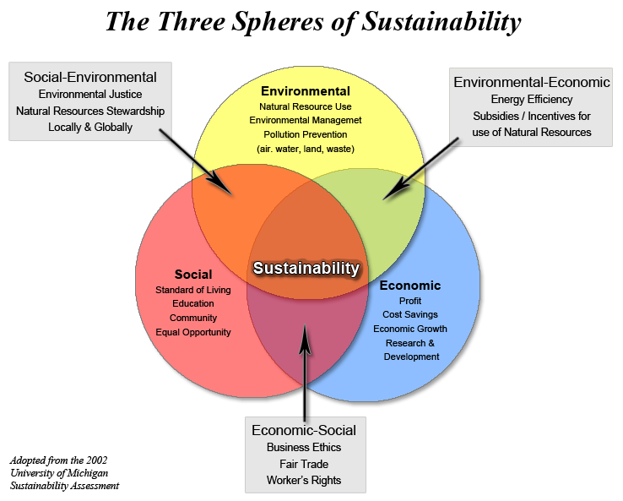

Slide 15
Definition of corporate social responsibility
‘Corporate Social Responsibility is the continuing commitment by business to behave ethically and contribute to economic development while improving the quality of life of the workforce and their families as well as of the local community and society at large’.
– World Business Council For Sustainable Development
A voluntary initiative on the part of a business to contribute to a better society and a greener and cleaner environment.

Slide 16

Definition of corporate social responsibility
Corporate Social Responsibility
The responsibility of business towards the society

Slide 17
Class activity
Understand your company social responsibilities?
from industry perspective
from social perspective
from humanity perspective etc.

Slide 18
The facility manager’s role in sustainability
The facility manager or maintenance manager has a critical and increasing role in defining and implementing sustainability of industrial facilities. His or her familiarity with plant, factory and building systems puts them in a unique position within the organization to identify opportunities to reduce energy consumption, recover energy, identify hazards危险， minimize and recycle waste, improve worker health and safety, and protect the environment.

Slide 19
The facility manager’s role in sustainability
The facility manager typically supervises a multi-talented group of employees and contract service providers. These human assets can provide a wealth of insights, ideas and resources to improve sustainability of existing systems and operations, as well as help optimize优化 the sustainability of new facilities, equipment and procedures.
Facility and maintenance managers’ intimate familiarity with the age, condition, energy consumption 能量消耗and maintenance requirements of their building, power distribution, steam,, compressed air, water and other systems can help focus efforts to improve sustainability.

Slide 20
The facility manager’s role in sustainability
Most industrial facilities managers are fully occupied with day-to-day exigencies as well as short- and long-term planning, projects and reporting. Fortunately, the tenets原则 of sustainability already align with their existing goals such as safety, efficiency and environmental compliance. Their ability to improve sustainability is best leveraged杠杆原理 by making it a recognized, accepted and supported corporate priority so they can integrate its various aspects into ongoing activities and include them in their continuous improvement programs.
Then the same managerial talents that drive existing safety, reliability, efficiency, productivity and cost-reduction initiatives will align and ensure the success of industrial sustainability.

Slide 21
The facility manager’s role in customer social responsibility
Facility managers can expect to be asked to provide information for corporate social responsibility (CSR) reporting. More and more companies and organizations are beginning to issue annual corporate responsibility reports in addition to their annual financial reports in order to more fully report their annual performance.
CSR reporting provides and organized way for companies to make public their performance information that covers all three legs of sustainability — environmental, social and financial performance.

Slide 22
The facility manager’s role in customer social responsibility
The bottom line is that facility managers should plan to be ready to support the preparation of CSR reports when their company or organization moves forward with them. There are two important components of being ready: 1) have the facilities actually delivering sustainable performance; and 2) have this sustainable performance tracked and documented so the data is readily available.

Slide 23
Environmental issues
Environmental issues are harmful aspects of human activity on the biophysical environment. Environmentalism, a social and environmental movement that started in the 1960s, addresses environmental issues through advocacy, education and activism. current problems faced by the environment-
Sustainability is the key to preventing or reducing the effect of environmental issues. There is now clear scientific evidence that humanity is living unsustainably, and that an unprecedented collective effort is needed to return human use of natural resources to within sustainable limits. For humans to live sustainably, the Earth's resources must be used at a rate at which they can be replenished.

Slide 24
Legislative requirements in terms of minimizing environmental impact and damage
Environment Protection (Impact of Proposals) Act 1974 Significant environmental matters must be fully examined and taken into consideration in relation to actions, proposals and decisions taken on or behalf of the Commonwealth Government 联邦政府and its agencies.
Environment Protection (Sea Dumping倾倒) Act 1981--This Act regulates the loading and dumping of waste at sea to protect waters surrounding Australia’s coastline. The Act fulfills Australia's international obligations under the London Protocol to prevent marine pollution by dumping of wastes and other matter. Permits are required from the Department of the Environment, Water, Heritage and the Arts for all ocean disposal activities.

Slide 25
Legislative requirements in terms of minimizing environmental impact and damage
National Environment Protection Council Act 1994 Establishes the National Environment Protection Council (NEPC). This is a national ministerial body which makes national environment protection measures to ensure that Australians have equivalent protection from air, water, soil and noise pollution. This Act is mirrored in all States and Territories.
National Greenhouse and Energy Reporting Act 2007 (the Act) was passed on 29 September 2007 establishing a mandatory reporting system for corporate greenhouse gas emissions and energy production and consumption. The first reporting period under the Act commenced on 1 July 2008.

Slide 26
Legislative requirements in terms of minimizing environmental impact and damage
State and Territory领土 laws implementing national environment protection measures do not apply to the activities of the Commonwealth or Commonwealth authorities. However, under this Act, the Environment Minister may (subject to considerations of national interest or administrative efficiency) apply those State or Territory laws to the activities of the Commonwealth or Commonwealth authorities in other places. If NEPMs are not implemented in relation to the activities of the Commonwealth or Commonwealth authorities they can be implemented by regulations; or if there are no regulations, through environmental audits and environment management plans.

Slide 27
Legislative requirements in terms of minimizing environmental impact and damage
Key features of the Act are:
Reporting of greenhouse gas emissions, energy consumption and production by large corporations.
Public disclosure of corporate level greenhouse gas emissions and energy information.
Consistent and comparable data available for decision making, in particular, the development of the Carbon Pollution Reduction Scheme

Slide 28
Class activity
Legislation that request for your organization
The main act or industry regulation that control your company operations
The international legislation that require or encourage your company action
Any social aspects such as race, religion factors that influence your company daily activites

Slide 29
Reference
http://en.wikipedia.org/wiki/Sustainability
http://en.wikipedia.org/wiki/Sustainable_business
http://lexicon.ft.com/Term?term=business-sustainability
http://www.vanderbilt.edu/sustainvu/who-we-are/what-is-sustainability/

