Slide 1

8600-332 : Understanding Sustainability and Business Environmental Issues
Business Administration

Slide 2

8600-332 : Understanding Sustainability and Business Environmental Issues
Week Two
Notes:
Management Communication

Slide 3
Assignment questions
Explain the terms sustainability and corporate social responsibility (16 marks)
Identify the key legislation associated with sustainability and corporate social responsibility (16 marks)
List the environmental standards required in own organization (12 marks)
Explain the environmental issues affecting own organization (16 marks)
Describe environmentally friendly ways to manage issues affecting own organization (16 marks)
Explain the constraints of own organization’s buildings on environmentally friendly procedures and practices (12 marks)
Explain the opportunities to enhance own organization's buildings environmentally friendly performance (12 marks)

Slide 4
Content
Environmental standard
Singapore standards
International standards
Duty of care
Types of environmental issues
Example of environmental issues and impact

Slide 5
Environmental Standard
An environmental standard is a policy guideline that regulates the effect of human activity upon the environment. Standards may specify a desired state (e.g. lake pH should be between 6.5 and 7.5) or limit alterations变动 (e.g. no more than 50% of natural forest may be damaged).
Environmental standards are a set of quality conditions that are adhered坚持 or maintained for a particular environmental component and function. The different environmental activities have different concerns and therefore different standards.

Slide 6
Environmental Management Standards in Singapore
Environmental protection and resource sustainability are becoming crucial drivers in today’s global business practices. With the growing demand on limited resources, businesses have to find better ways to minimise their impact on the environment while enhancing efficiency and reducing wastage损失.
Standards are an essential part of any environmental management plan. The need for a consistent, reliable approach to measuring, verifying and reporting data is paramount最高统冶者, especially as regulatory pressure increases and stakeholders demand transparency.

Slide 7
Environmental Management Standards in Singapore
Some benefits to your business when adopting environmental standards are:
• Cost savings and improved bottom line
• Help identify energy efficiencies and reduce costs
• Support regulatory compliance守规
• Demonstration示范 of best practices
• “Greener” product design practices
• Inspire customer confidence
• Improved company profile

Slide 8
Singapore Standards
SS ISO 50001:2011 Specification for energy management systems - Requirements with guidance for use
SS 564:2010 Green data centres- Energy and environmental management systems
SS ISO 19011:2011 Guidelines for quality and/or environment management systems auditing
SS ISO 14001:2004 Environmental management systems- Requirement with guidance for use
SS ISO 14004:2004 Environmental management systems- General guidelines on principles systems and supporting techniques
SS ISO 1400 Series (Item 4 & 5)

Slide 9
International Standards
ISO 21930:2007 Sustainability in building construction- Environmental declaration of building products
ISO 14040:2006 Environmental management- Life cycle assessment- principles and framework
ISO 14064-1:2006 Greenhouse gases- part 1, part 2 and part 3
ISO 14005;2010 Environmental management systems- Guidelines for the phased implementation of an environmental management system, including the use of environmental performance evaluation
ISO 14006:2011 Environmental management systems- Guidelines for incorporating eco-design

Slide 10
Duty of Care
The Duty of Care is a code of practice to support the 1990 Environmental Protection Act section 34 . Waste can be solid, liquid or gaseous. The code of practice states, amongst other issues, that you must store waste safely and securely. It applies to anyone who:
Produces or imports
Keeps or stores
Transports
Treats
Recycles
Disposes of waste垃圾处理

Slide 11
Class Activity
List the environmental standards required in own organization
From government perspective
From industrial requirement
Form international roles

Slide 12
Types of Environmental Issues
Air Related Environmental
Green House Effect
The Greenhouse effect is a process by which planetary surface地球表面 emits thermal radiations that absorbed by atmospheric大气的 greenhouse gases温室效应, and re-radiated in all directions.
Greenhouse gases are Carbon dioxide二氧化碳, Methane甲烷, Nitrous Oxide一氧化碳, Sulphur硫化Oxides, Carbons碳, Water vapors水蒸气
Rise in global temperature.

Slide 13
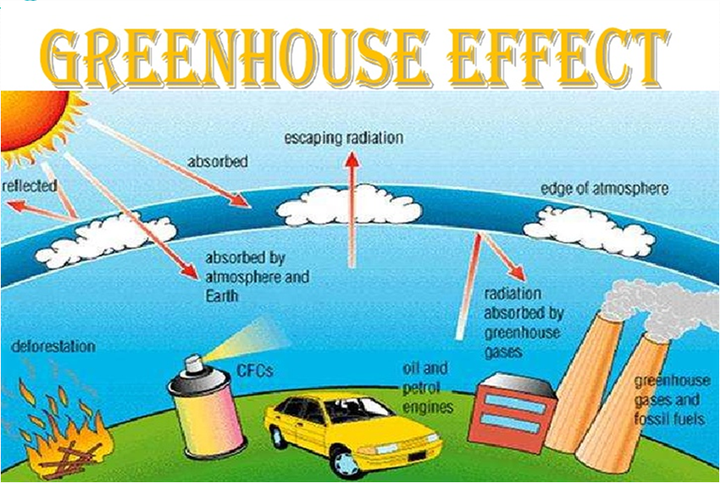
Types of Environmental Issues
GREENHOUSE EFFECT

Slide 14
Economic Impacts
Increase income inequalities 收入不平衡between and within countries.
A small increase in global mean temperature (up to 2 degrees Celsius, measured against对照 1990 levels) would result in net negative market sector impacts in many developing countries and net positive market sector impacts in many developed countries
Non-market impact
Health impacts, those impacts contributed substantially to the total costs of climate change.
Market Sector

Slide 15
Economic Impacts
Agriculture
Fishery渔业
Other Sectors
Increased energy costs
Coastal and storm damage 风灾
Reduced food production
Increased wild land荒野 Fire costs
Increased public Health costs
Lost recreation娱乐活动

Slide 16
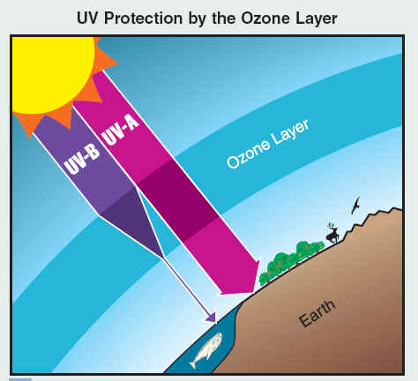
Ozone Depletion 臭氧消耗
Ozone depletion is the reduction of the protective layer 保护层of ozone in the Stratosphere最上层by chemicals released on earth.
The damage is caused when these chemicals release highly reactive forms of chlorine and bromine
Ozone depletion cause Skin Cancer, Eye damage, Immune system damage, Reduction in phytoplankton, Damage to the DNA in various life-forms.

Slide 17
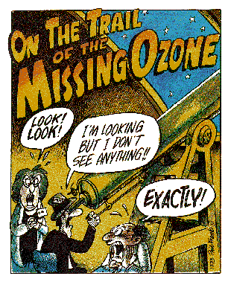
Ozone Economic Impacts
Ozone layer depletion affects agricultural products.
Disturbing the airways industries.
Tourism industry is affected.
More importantly economic impacts are not that large compared HUMAN AND ENVIRONMENTAL LOSSED INCURED TO THE WORLD.
Increase disease and cancer requires the cost of hospitalization.

Slide 18
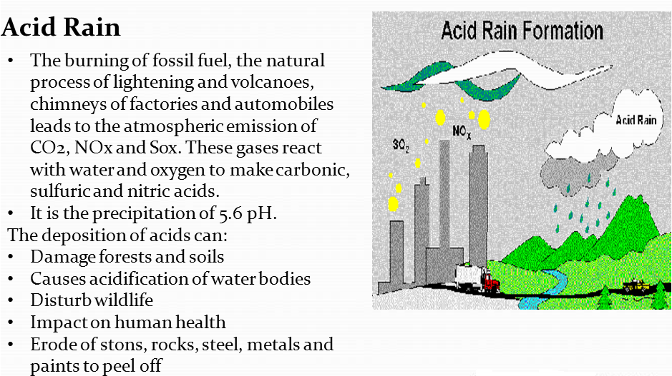
Water – Related Environmental Problems
Acid Rain酸雨
The burning of fossil fuel, the natural process of lightening and volcanoes, chimneys of factories and automobiles leads to the atmospheric emission大气排放物 of CO2, NOx and Sox. These gases react with water and oxygen to make carbonic sulfuric硫化碳 and nitric acids 硝酸.

Slide 19
Water – Related Environmental Problems
It is the precipitation沉淀 of 5.6 pH.
The deposition of acids can:
Damage forests and soils
Causes acidification酸化 of water bodies
Disturb wildlife野生动物
Impact on human health
Erode侵蚀 of stons, rocks, steel, metals and paints to peel off

Slide 20
Acid Rain Economic Impacts
The burning of fossil fuel, the natural process of lightening and volcanoes, chimneys of factories and automobiles leads to the atmospheric emission of CO2, Nox氮氧化物 and Sox硫氧化物.
Acid Rain = acidic water酸性水 = less fish = less money for fisherman= less money to spend and there for affecting the economy.
Acid Rain = damaged buildings = claims on insurance = less money for insurance company and there for affecting the economy.
The economic cost of property damage caused by dioxide. While the costs of reducing automobile emissions nitrous oxides are higher.

Slide 21
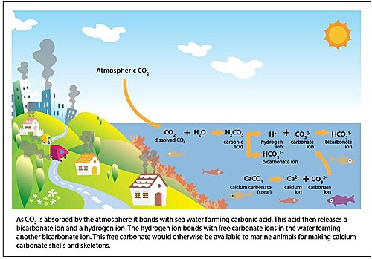
Marine Pollution and Acidification
Marine Pollution海洋污染 is due to the different factors, which are inefficient and / or inadequate waste water treatment, urban run-off, eutrophication富养化 solid materials, especially plastic, create a huge nuisance.
On the other hand, Marine acidification酸化 refers to the effect of anthropogenic carbon dioxide on the pH of the oceans

Slide 22
Marine Pollution and Acidification
Environmental issue
Economic loss in commercial fisheries商业渔业 like mollusks软体动物 and potentially reduce harvests of economically important predators食肉动物
The catch, net and other equipment could be contaminated污染 by oil containers, paint tins, oil filters and other chemicals.
Large items such as wires and old nets may be collected off the seabed and may damage the nets.
If 50% of the Shetland fishing fleet was affected in the same way, which affect the income of local industries.

Slide 23
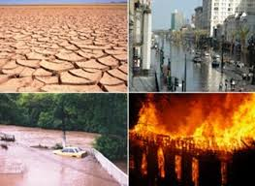
Land Related Environmental Problems
Problems arising from inefficient Land Use
I. Urban sprawl 城市扩张
II. Habitat Fragmentation 生态破碎
III. Habitat destruction 生态破坏

Slide 24
Land Related Environmental Problems
Economic Impacts
Increased community costs for maintaining roads, school bus routes, sewers排水沟, and other services needed when businesses and residences are spread out.
Ongoing increases in property taxes to meet growing need for services.
Increased cost and difficulty of providing public transportation.
Loss of agricultural and forestry jobs, and traditional land practices.
Reduction of rural character or community sense of place.

Slide 25
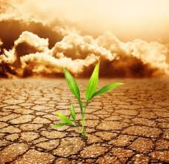

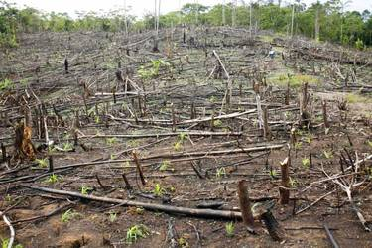
Problems Arising form Land Pollution and Degradation
I. Desertification 沙漠化
II. Land Pollution 土地污染
III. Soil Pollution 土壤污染

Slide 26
Problems Arising form Land Pollution and Degradation
Economic Impacts
Siltation of dams.
Sedimentation of waterways.
Damage to irrigation infrastructure and pumping equipment.
Contamination of drinking water reserves.
Increased frequency of flooding events.
Increased dust concentrations.
Impact on the aquatic environment.

Slide 27
Reference
http://www.singaporestandardseshop.sg/Data/Attachment/FLYER_ENVIRONMENTAL_271211%20hyperlink.pdf%203.pdf
http://en.wikipedia.org/wiki/Environmental_standard
http://en.wikipedia.org/wiki/Category:Environmental_standards

