Slide 1

8600-332 : Understanding Sustainability and Business Environmental Issues
Business Administration

Slide 2
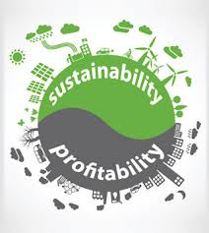
8600-332 : Understanding Sustainability and Business Environmental Issues
Week Four
Notes:
Management Communication

Slide 3
Assignment questions
Explain the terms sustainability and corporate social responsibility (16 marks)
Identify the key legislation associated with sustainability and corporate social responsibility (16 marks)
List the environmental standards required in own organization (12 marks)
Explain the environmental issues affecting own organization (16 marks)
Describe environmentally friendly ways to manage issues affecting own organization (16 marks)
Explain the constraints of own organization’s buildings on environmentally friendly procedures and practices (12 marks)
Explain the opportunities to enhance own organization's buildings environmentally friendly performance (12 marks)

Slide 4
Content
Building Management
BMS-Building Management System
Commercial Building Management
Green Building
Goals of Green Building
How to Make a Building Go Green

Slide 5
Building Management
Building management is a discipline that comes under the umbrella of facility management. A building manager supervises the hard and soft services of a built structure, ensuring that the security, health and safety, and maintenance of this built structure are in place to a satisfactory level.
There are essentially two types of building manager positions: residential and commercial. Hard services usually relate to physical, structural services such as fire alarm systems, lifts and so on whereas soft services allude to暗指 cleaning, landscaping景观美化, security and suchlike human-sourced services.

Slide 6
Building Management
Residential Building Management
In a residential environment, a building manager will typically supervise a team of porters搬运工 or security officers, cleaners, electrical and mechanical contractors and depending of the size of the development, a team of administrative staff. If the development comprises several blocks, it is common that the Building manager will report to an estate manager although both titles have become interchangeable.
A manager of a building may be responsible for a residential property. In this case, it is typically an apartment building or complex. The building manager should be responsible for identifying maintenance issues in common areas of the complex before they become issues.

Slide 7
Building Management
Commercial Building Management
This subdivision细分 of building management is quite similar to the previous one, the main difference being that the building will normally be made up of commercial units and or offices.
Commercial properties are typically managed by a building manager. In these cases, the tenants are usually businesses and organizations rather than individual tenants or families. Building manager duties in these situations are similar to that of residential — the primary difference is the type of clients the building manager is working with.

Slide 8
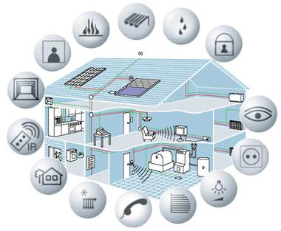
What are the equipments that you can identify on this pic?

Slide 9
BMS-Building Management System
A Building Management System (BMS) is a computer-based control system installed in buildings that controls and monitors the building’s mechanical and electrical equipment such as ventilation通风设备, lighting, power systems, fire systems, and security systems.
A BMS consists of software and hardware; the software program, usually configured in a hierarchical分层的 manner, can be proprietary一体化, using such protocols as C-bus, Profibus, and so on, recently, however, new vendors are producing BMSs that integrate using Internet protocols and open standards such as DeviceNet, SOAP, XML, BACnet, LonWorks and Modbus.

Slide 10
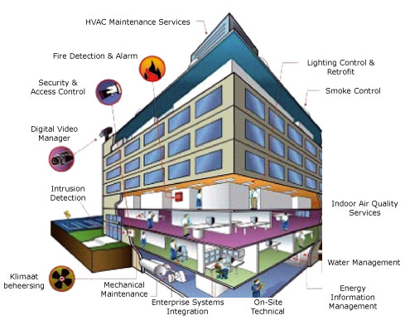
Commercial building management

Slide 11
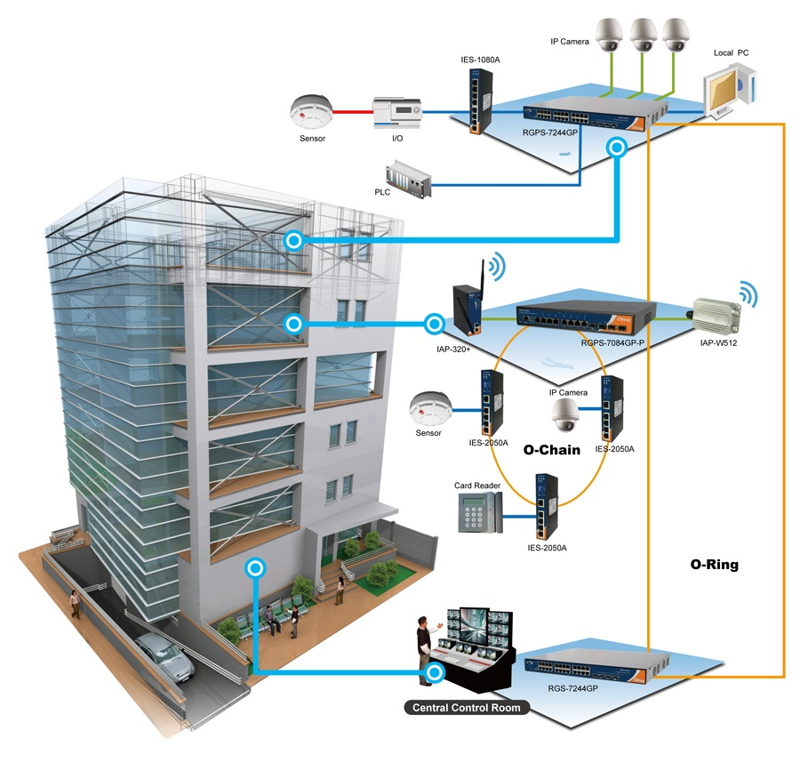
Commercial building management
CCTV Control and Monitoring System

Slide 12
Green Building
Green building (also known as green construction or sustainable building) refers to a structure and using process that is environmentally responsible and resource-efficient throughout a building‘s life-cycle: from siting选址 to design, construction, operation, maintenance, renovation, and demolition拆迁.
This requires close cooperation of the design team, the architects建筑师, the engineers, and the client at all project stages. The Green Building practice expands and complements the classical building design concerns of economy, utility, durability, and comfort.

Slide 13
Green Building
Common objective is that green buildings are designed to reduce the overall impact of the built environment on human health and the natural environment by:
Efficiently using energy, water, and other resources
Protecting occupant居住者 health and improving employee productivity
Reducing waste, pollution and environmental degradation退化

Slide 14
Goals of Green Building
Green building brings together a vast of practices, techniques, and skills to reduce and ultimately最后 eliminate the impacts of buildings on the environment and human health. It often emphasizes taking advantage of renewable resources, e.g., using sunlight through passive solar, active solar, and photovoltaic equipment, and using plants and trees through green roofs, rain gardens, and reduction of rainwater run-off.
Many other techniques are used, such as using low-impact building materials or using packed gravel碎石 or permeable concrete instead of conventional concrete or asphalt to enhance replenishment of ground water.透水混凝土代替传统的混凝土或沥青提高补给地下水

Slide 15
Goals of Green Building
While the practices or technologies employed in green building are constantly evolving进化 and may differ from region to region, fundamental principles is derived:
Siting and Structure Design Efficiency,
Energy Efficiency,
Water Efficiency,
Materials Efficiency,
Indoor Environmental Quality Enhancement,
Operations and Maintenance Optimization,
Waste and Toxics Reduction.

Slide 16
Life Cycle Assessment (LCA)
A life cycle assessment (LCA) can help avoid a narrow outlook on environmental, social and economic concerns by assessing a full range of impacts associated with all cradle-to-grave stages of a process: from extraction of raw materials through materials processing, manufacture, distribution, use, repair and maintenance, and disposal or recycling.
Impacts taken into account include (among others) embodied energy, global warming potential, resource use, air pollution, water pollution, and waste.

Slide 17
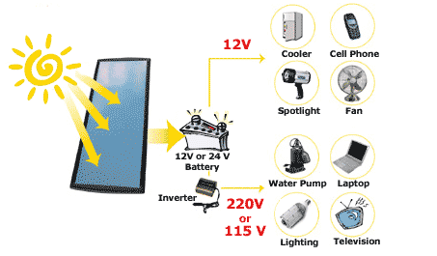
Energy Efficiency
Green buildings often include measures to reduce energy consumption – both the embodied energy物化能原required to extract, process, transport and install building materials and operating energy to provide services such as heating and power for equipment.
As high-performance buildings use less operating energy, embodied energy has assumed much greater importance – and may make up as much as 30% of the overall life cycle energy consumption.

Slide 18
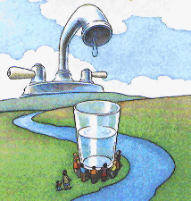
Water Efficiency
Reducing water consumption and protecting water quality are key objectives in sustainable building. One critical issue of water consumption is that in many areas, the demands on the supplying aquifer蓄水层 exceed its ability to replenish补充 itself. To the maximum extent feasible, facilities should increase their dependence on water that is collected, used, purified, and reused on-site.
The protection and conservation保护 of water throughout the life of a building may be accomplished by designing for dual plumbing that recycles water in toilet flushing or by using water for washing of the cars.

Slide 19
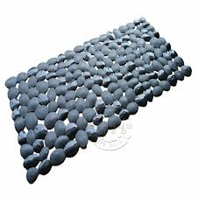

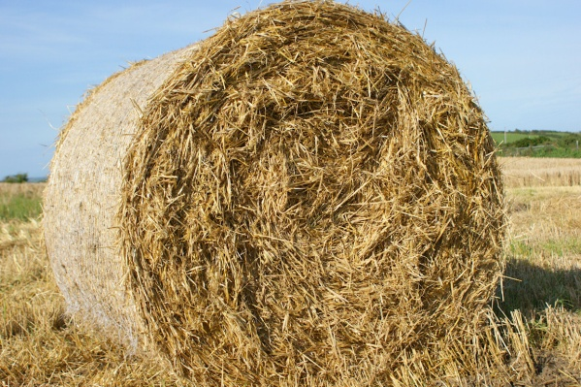
Materials Efficiency
Building materials typically considered to be ‘green’ include lumber木材 from forests that have been certified to a third-party forest standard, rapidly renewable plant materials like bamboo and straw稻草, dimension stone石材, recycled stone, recycled metal，and other products that are non-toxic无毒的, reusable, renewable, and/or recyclable

Slide 20
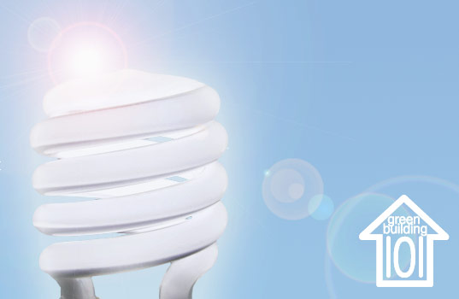
Indoor Environmental Quality Enhancement
The Indoor Environmental Quality (IEQ) category in LEED standards, one of the five environmental categories, was created to provide comfort, well-being, and productivity of occupants. The LEED IEQ category addresses design and construction guidelines especially:
Indoor air quality (IAQ)
Thermal 热量quality
Lighting quality

Slide 21
Operations and Maintenance Optimization最佳化
No matter how sustainable a building may have been in its design and construction, it can only remain so if it is operated responsibly and maintained properly.
Ensuring operations and maintenance(O&M) personnel are part of the project's planning and development process will help retain the green criteria designed at the onset of the project. Every aspect of green building is integrated into the O&M phase of a building's life.

Slide 22
Waste Reduction
Green architecture also seeks to reduce waste of energy, water and materials used during construction. For example, in California nearly 60% of the state's waste comes from commercial buildings During the construction phase, one goal should be to reduce the amount of material going to landfills.
Well-designed buildings also help reduce the amount of waste generated by the occupants as well, by providing on-site solutions such as compost bins to reduce matter going to landfills填埋.

Slide 23
How to Make a Building Go Green
When you want to go green with an existing building, you can take steps to reduce environmental impact without making major structural changes. By effectively managing the way a building uses water and energy, you can improve its carbon footprint and cut utility bills物定账单. As you plan ways to go green, start with small changes, which can add up to a big impact：
1.Update your building's lighting to make sure it uses energy efficiently. Change existing light bulbs for compact fluorescent bulbs, which use up to 75 percent less power. Put lights on a timer so they automatically shut off at night or when you are away.

Slide 24
How to Make a Building Go Green
2. Make sure your building is well insulated绝缘, so you are not wasting energy on heating or cooling. Start by checking that insulation is up to code, particularly in unheated spaces; if you have walls that border uninsulated outbuildings, make sure that they are well protected. Insulate pipes that pass through cold spaces to ensure that you don't lose heat.
3. Reduce your building's electricity use. Plug groups of appliances into a smart power strip that uses a timer mechanism to turn them all off at a certain time. Set computers to turn off after being inactive for a certain time and eliminate screen savers, which use as much energy as active screens. If you have the capital, invest in a timer system that switches off the power to nonessential systems each night.

Slide 25
How to Make a Building Go Green
4.Turn down your heating and cooling system when your building is not occupied. By dropping the heat by 10 degrees over eight hours, you can reduce energy use by 10 percent. You can also turn your water heater off when the building is empty over vacations. (See References 2) You should also make sure that your heating and cooling systems are maintained regularly so they use energy efficiently and last longer.
5. Reduce the amount of water you use for normal operations throughout the building. Fix leaks and replace your existing fixtures with low-flow options.

Slide 26
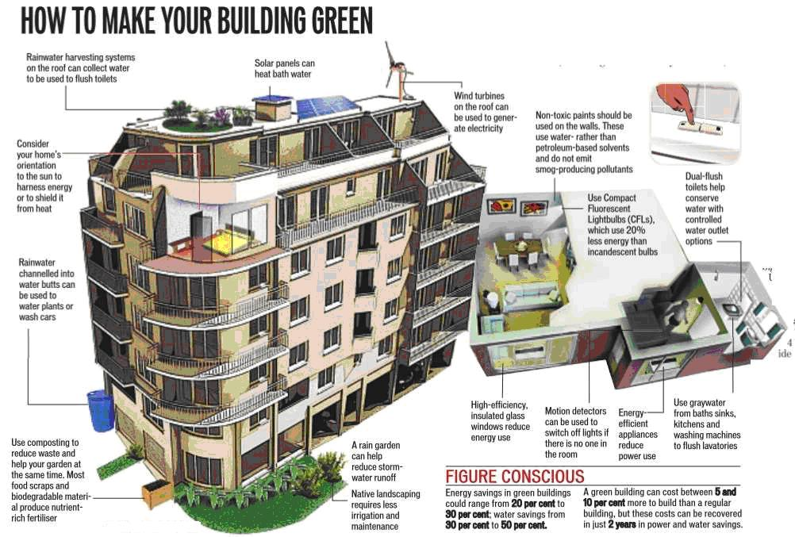

Slide 27
Reference
http://en.wikipedia.org/wiki/Facility_management
http://www.wisegeek.com/what-does-a-building-manager-do.htm
http://urvil.wordpress.com/bms-building-management-system/
http://en.wikipedia.org/wiki/Building_management_system
http://en.wikipedia.org/wiki/Green_building
http://homeguides.sfgate.com/make-building-green-78632.html
http://www.greenfudge.org/2009/10/18/build-them-green-eco-friendly-buildings-from-all-over-the-world/
http://eco-friendlyhouses.blogspot.sg/2013/08/building-eco-friendlyhouses.html

