Slide 1


8600-340 : Understanding Good Practice in Business Mentoring

Slide 2
The Origin of Mentoring
Understanding Good Practice in Business Mentoring
Mentor (the son of Alcumus) and friend of Odysseus
When Odysseus left for the Trojan War he placed Mentor in charge of his son, Telemachus.
Mentor was a trusted friend, more experience, a counselor and a teacher
Mentees are also called “Protoges”

Slide 3
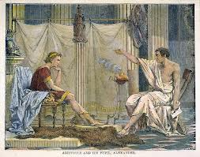
Examples
Understanding Good Practice in Business Mentoring
Aristotle and Alexander

Slide 4

Examples
Understanding Good Practice in Business Mentoring
Gandhi and Nehru

Slide 5
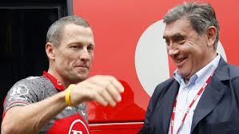
Examples
Understanding Good Practice in Business Mentoring
Eddy Merckx and Lance Armstrong

Slide 6

Examples
Understanding Good Practice in Business Mentoring
Gavaskar and Tendulkar

Slide 7
Mentoring
is about one person helping another to achieve something. More specifically, something that is important to them. It is about giving help and support in a non-threatening way, in a manner that the recipient will appreciate and value and that will empower them to move forward with confidence towards what they want to achieve. It is also concerned with creating an informal environment in which one person can feel encouraged to discuss their needs and circumstances openly and in confidence with another person who is in a position to be of positive help to them.

Slide 8
Understanding Good Practice in Business Mentoring
Workplace Mentoring
is a learning partnership between employees for purposes of sharing technical information, institutional knowledge and insight with respect to a particular occupation, profession, organization or endeavor.
Purpose of Mentoring
to provide a role model – someone who a mentee can look up to and base their own behavior on
to provide a sounding board – someone with whom the mentee can discuss ideas, problems and concerns within a safe environment
to provide a source of advice from someone who has already ‘been there’, and has real experience of the issues likely to be faced by the mentee
to enable work-related development – someone who can directly or indirectly help the mentee to develop their work-related skills and knowledge

Slide 9
Understanding Good Practice in Business Mentoring
Purpose of Mentoring . . .
to provide an advocate – someone who can help support, represent and champion the mentee when needed
to provide contacts and access to opportunities – someone who can ‘open doors’ for the mentee (sometimes called ‘sponsorship’)
to enable personal development – someone who can help the mentee to become more adept at managing themselves and their relationships and at achieving personal and career goals.

Slide 10
Understanding Good Practice in Business Mentoring
Nature of Mentoring
Formal and Informal Learning
Communities of practice
Enculturation and Cultural Dissonance
Workplace Affordances
Expansive and Restrictive Paradigms
Language and Literacy

Slide 11
Understanding Good Practice in Business Mentoring
Informal Mentoring
is a natural component of relationships that occurs throughout the society, in the workplace, as well as in social, professional, and family activities. Informal mentoring occurs in a relationship between two people where one gains insight, knowledge, wisdom, friendship, and support from the other. , in informal mentoring the protégé and mentor are selective about whom they wish to approach for a mentoring relationship; it can last for years. Informal mentoring is a strong and valuable tool for developing an employee. It occurs in a relationship that is voluntarily formed by both persons. It is friendship first, learning and career second and third.
Formal Mentoring
A formal mentoring program is beneficial if it promotes informal mentoring and involves good mentors. The goal of a formal mentoring program should be to promote the protégé’s career and to create a mentoring environment in the organization where informal mentoring is increased, because informal mentoring is the most effective.

Slide 12
Understanding Good Practice in Business Mentoring
Roles of a Workplace Mentor
TEACHER - As a teacher, you may need to teach the mentee the skills and knowledge required to perform the job successfully. This role requires you to outline the "nuts and bolts" of the position and to share your experiences as a seasoned professional. To teach the fundamentals of the position, you first need to determine what knowledge and skills are necessary to successfully meet the requirements of the position.
Counselor - The role of counselor requires you to establish a trusting and open relationship. In order to create a trusting relationship, you need to stress confidentiality and show respect for the mentee. You can promote confidentiality by not discloing personal information that the mentee whares with you. Show respect by listening carefully and attentively to the mentee and by not interrupting while your mentee is talking. To establish a trusting and open relationship, you need to make the mentee feel comfortable.

Slide 13
Understanding Good Practice in Business Mentoring
Roles of a Workplace Mentor
Motivator - As a motivator, you may at times need to generate motivation in your mentee. Motivation is an inner drive that compels a person to succeed. It's not often you will find an unmotivated mentee. In general, most mentees are enthusiastic about their jobs. After all, mentees tend to be characterized as highly motivated individuals with a thirst for success. You usually perform the role of motivator only when you need to motivate your mentee to complete a difficult assignment or to pursue an ambitious goal. Through encouragement , support, and incentives, you can motivate your mentee to succeed. One of the most effective ways to encourage your mentee is to provide frequent positive feedback during an assigned task or while the mentee strives toward a goal.
Referral Agent - Once career goals are set, you are likely to assume the role of referral agent. As a referral agent, work with your mentee to develop an action plan that outlines what knowledge, skills, and abilities a mentee needs to meet his or her career goals.

Slide 14
Understanding Good Practice in Business Mentoring
Roles of a Workplace Mentor
Sponsor - A sponsor creates opportunities for the mentee--opportunities that may not otherwise be made available. These opportunities can relate directly to the job or indirectly to the mentee's overall professional development. The goal of a mentor is to provide as much exposure for the mentee as possible, with a minimum of risks. Opportunities should challenge and instruct without slicing away the mentee's self-esteem. A mentee should not be set up for failure. New opportunities can increase the visibility of your mentee, but you must be careful in selecting these opportunities.
COACH - At times you may need to perform the role of coach to help a mentee overcome performance difficulties. Coaching is a complex and extensive process. Coaching is not an easy skill to perform. Specifically, coaching involves feedback. Mentors need to give different kinds of feedback, as the situation demands.

Slide 15
Understanding Good Practice in Business Mentoring
Roles of a Workplace Mentor
Advisor - This role requires you to help the mentee develop professional interests and set realistic career goals. As the old saying goes, "If you don't know where you are going, you won't know how to get there." This saying holds true for mentee's professional development. In the role of advisor, you need to think about where the mentee wants to go professionally. That is, you need to help the mentee set career goals.
Role Model - As a role model, you are a living example of the values, ethics, and professional practices of DOT. Most mentees, in time, imitate their mentors; as the saying goes, "Imitation is the sincerest flattery." Learning by example may be your most effective teaching tool. Your mentee will learn a lot about you while he or she observes how you handle situations or interact with others. For this reason, you should be careful how you come across to your mentee. You must strive for high standards of professionalism, solid work ethics, and a positive attitude. You should give your mentee an opportunity to learn the positive qualities of an experienced professional.

Slide 16
Understanding Good Practice in Business Mentoring
Responsibilities of a Workplace Mentor
Assists the mentee to establish realistic career goals and plan how to achieve them
Acts as a sounding board when the mentee wants to talk through decisions and ideas
You are required Challenges the mentee to face up to opportunities and problems, personal strengths and weaknesses to conduct all meetings in public locations, not a private space.
Acts as a gateway to other people and sources of knowledge

Slide 17
Understanding Good Practice in Business Mentoring
Responsibilities of a Workplace Mentor
Seeks opportunities to help the mentee practice and develop key skills for the future
Passes on know-how and essential thinking patterns and attitudes that might go with a different role or set of responsibilities
Generates workable solutions together in a mutually respectful way
Motivates, advises and supports whilst empowering the mentee to make their own decisions and take responsibility for their own actions and development

Slide 18
Understanding Good Practice in Business Mentoring
Remit of a Workplace Mentor
Expose
We must expose them to gifted people; people who are different; to environments and cultures that are different. Exposure to new people and arenas broaden them. By furnishing experiences like this, they grow.
Explain
We must help them interpret their life experiences. We must not just teach them what to think but how to think. We must help them understand who they are and where they’re strengths lie.
Exemplify
We must let them see a model of healthy leadership. I am always hopeful I can model good leadership, but it doesn’t stop there. I introduce them to other leaders who they can interview and watch.
Evaluate
We must gain permission to tell them the truth. A mentor must: Converse, model, apprentice, and debrief. This means after we experience a new person or environment, we assess what we saw and heard.

Slide 19
Understanding Good Practice in Business Mentoring
Gain Commitment from Key Stakeholders
The most important message to convey, perhaps, is that this is not just another HR initiative. As the CEO, you could draw in the support of other organizations which have adopted mentoring programs successfully – perhaps ask someone in your external network to attend a senior management team away-day and share their experiences. A sure-fire way of making your managers take this program seriously is to build mentoring objectives, standards and achievements into their performance reviews on an on-going basis. If you are an HR Director your role will be to target the CEO and top team, Board of Directors, labor union representatives and other stakeholders to set out your vision and ideas. Yes, you will need to be realistic about the investment and effort required to sustain the mentoring program – your credibility will depend on it. Either way, you can inspire people to support you by getting them to remember those managers who helped them develop their own skills, confidence and careers. They may not have had formal mentors themselves, but most successful managers can recall someone who helped them on their way and the difference this made to their performance and self-development.

Slide 20
Understanding Good Practice in Business Mentoring
Knowledge of a Workplace Mentor
Have the desire to help – you should be willing to spend time helping someone else, and remain positive throughout.
Be motivated to continue developing and growing – your own development never stops. To help others develop, you must value your own growth too. Many mentors say that mentoring helps them with their own personal development.
Have confidence and an assured manner – we don't mean overconfidence or a big ego. Rather, you should have the ability to critique and challenge mentees in a way that's non-threatening, and helps them look at a situation from a new perspective.

Slide 21
Understanding Good Practice in Business Mentoring
Knowledge of a Workplace Mentor
Ask the right questions – the best mentors ask questions that make the mentee do the thinking. However, this isn't as easy as it sounds. A simple guide is to think of what you want to tell the mentee, and to find a question that will help the mentee come to the same conclusion on their own. To do this, try asking open questions that cannot be answered with just yes or no. Or ask more direct questions that offer several answer options. Then ask the mentee why they chose that particular answer.
Listen Actively – be careful to process everything the mentee is saying. Watch body language, maintain eye contact, and understand which topics are difficult for the mentee to discuss. Showing someone that you're listening is a valuable skill in itself. It shows that you value what the person is saying and that you won't interrupt them. This requires patience, and a willingness to delay judgment.
Provide Feedback – do this in a way that accurately and objectively summarizes what you've heard, but also interprets things in a way that adds value for the mentee. In particular, use feedback to show that you understand what the mentee's thinking approach has been. This is key to helping the mentee see a situation from another perspective.

Slide 22
Understanding Good Practice in Business Mentoring
Skills of a Workplace Mentor
Have the desire to help – you should be willing to spend time helping someone else, and remain positive throughout.
Be motivated to continue developing and growing – your own development never stops. To help others develop, you must value your own growth too. Many mentors say that mentoring helps them with their own personal development.
Have confidence and an assured manner – we don't mean overconfidence or a big ego. Rather, you should have the ability to critique and challenge mentees in a way that's non-threatening, and helps them look at a situation from a new perspective.
Ask the right questions – the best mentors ask questions that make the mentee do the thinking.
Listen actively – be careful to process everything the mentee is saying. Watch body language, maintain eye contact, and understand which topics are difficult for the mentee to discuss. .
Provide feedback

Slide 23
Understanding Good Practice in Business Mentoring
Behavior Possessed/Exhibited of a Workplace Mentor
Understand themselves
Have self-control
Have empathy
Have good ‘social’ skills
Respect and value equality and diversity
Show interest in people and what they are doing
Challenge and stretch
Generate commitment to moving forward
Encourage people to develop options
Change perceptions – help people see things differently, lower fear

Slide 24
Understanding Good Practice in Business Mentoring
Role of Professional Standards in Workplace Mentoring
Adhere to the ethical rules in the coaching profession
Create a coaching agreement
Initiate a trusting relationship with the trainee or the learner
Be vigilant, mindful and spontaneous
Provide active listening
Ask effective and powerful questions
Increase the individual’s level of awareness
Design action plans to address needs and issues
Establish realistic goals with the individual
Facilitate the trainee’s progress

Slide 25
Understanding Good Practice in Business Mentoring
Ethical Standards in Workplace
Relationships at Work
Management/owner toward client/customer
Management/owner toward employees
Employee toward Employer, Co-workers, Customers
Employee toward Employer, Co-workers, Customers
Business Abuse
illegal
unethical
irresponsible Act done against an Employer
Results of Business Abuse
Higher prices
Unpleasant Working Conditions
Business Failure
Fewer Jobs

Slide 26
Understanding Good Practice in Business Mentoring
Importance of Ethical Standards in Mentoring
A code of ethics is a vital document for any business, as breaches of ethics can land companies in serious trouble with consumers, other organizations or government authorities. Creating a code of ethics makes decision-making easier at all levels of an organization by reducing ambiguity and considerations of individual perspectives in ethical standards.

Slide 27
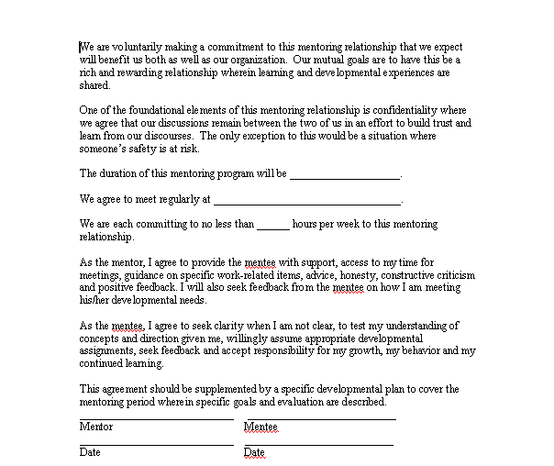
Understanding Good Practice in Business Mentoring
Contract for Workplace Mentoring

Slide 28
Understanding Good Practice in Business Mentoring
Confidentialty
is ensuring that information is accessible only to those authorized to have access, regardless of where the information is stored or how it is accessed. Each employee within an organization has the responsibility to maintain the confidentiality of the information entrusted to them for job performance and this responsibility must be reinforced through awareness.
Importance of Confidentiality in Workplace Mentoring
The mentoring process relies on the senior mentor to educate and teach the protege certain life or career skills they need to succeed. In many situations, the senior mentor uses personal and private experiences from their life to demonstrate to the protege the advice they are trying to provide. Sometimes this information is generic, other times it is highly sensitive. Confidentiality is necessary to protect the parties involved.

Slide 29
Understanding Good Practice in Business Mentoring
Mentoring Contract includes:
The roles, responsibilities, and expectations during the program duration for a mentor and protégé;
An action plan completion date
The number of times the mentor and protégé will meet;
A confidentiality clause;
Termination of agreement rules, and;
Signatures of both the mentor and protégé.

Slide 30
Understanding Good Practice in Business Mentoring
Models of Mentoring Practice
Group Mentoring - The group might discuss a variety of issues
from all mentees or concentrate on a particular issue at each meeting. This
arrangement can allow a greater number of mentees to benefit from mentoring and, where available, different mentors may be asked to attend the meetings, enabling everyone to benefit from the different specialist experience of individual mentors.
Group Peer Mentoring - This is another type of group mentoring. Here, groups come together because they have a common interest, usually a similar work role, for example new managers or owners of small businesses. Rather than have a lead mentor, the group operates in a self-directed way, in which all group members operate as both mentees and mentors.

Slide 31
Understanding Good Practice in Business Mentoring
Models of Mentoring Practice
Online mentoring - The Internet has brought a new way for mentors and mentees to find each other and work together. An increasing number of sites allow potential mentors to register and offer their services and mentees to find and communicate with selected mentors. This is a voluntary arrangement in which mentors are offered the satisfaction of passing on their wisdom to others and mentees have a safe and confidential (anonymous, if they choose) context in which to discuss concerns and uncertainties.
One-to-one mentoring - Returning to the more traditional mentoring arrangement, of one mentor and one mentee, there are further variations possible in the type of relationship between the two.
One-to-one mentoring - Returning to the more traditional mentoring arrangement, of one mentor and one mentee, there are further variations possible in the type of relationship between the two. Variations on this traditional arrangement are where the mentor is a mentee’s peer or colleague, rather than being in a senior position, or where the mentor
actually is the mentee’s line manager.

Slide 32
Understanding Good Practice in Business Mentoring
Models of Mentoring Practice
One-to-one peer mentoring - The term peer mentoring has already been used above to refer to a form of group mentoring but it can also refer to mentoring between two people, where the mentor is a peer, rather than someone of designated senior position in the organization. In this arrangement mentoring may be one-way or two-way, with each of the pair taking mentor and mentee roles, as required. This arrangement allows the two to learn from each other, share the challenges of the workplace and maybe feel less isolated. It can also open up access to mentoring for a greater number of team members.
Line manager mentoring -This is an accepted model, and no doubt happens informally all the time. However, discussing issues and uncertainties can be more sensitive within a management line relationship and could inhibit honest discussion and resolution of problems.

Slide 33
Understanding Good Practice in Business Mentoring
Principles of Mentoring
Synergy
- Mentoring should be enriching for both mentor and mentee
- Mentoring is about learning and not teaching
- Mentee is empowered to take responsibility of his/her actions
Relationship
- Mentoring is a power-free partnership between two individuals
- Focus is not to make mentee dependent but to develop mentee’s independent critical thinking
Uniqueness
- Understanding the concept of mentoring and how it is different from coaching and counseling is important
- Mentoring must provide direction in order to channelize efforts in the right direction

Slide 34
Understanding Good Practice in Business Mentoring
Concept of Mentoring
The concept of mentoring in different studies varies; however, in most cases the activity of mentor includes supervising, advising, supporting and being a person one can rely on and discuss issues related to work and find best solutions.
Concept of Mentoring
M – Manages the relationship
E - Encourages
N- Nurtures
T - Teaches
O – Offers Mutual Respect
R – Responds to the Mentee’s needs

Slide 35
Understanding Good Practice in Business Mentoring
Theories of Goal and Objective Setting
Include employees in goal setting
Set individual goals that flow directly from those of the work unit
Set specific goals
Ask supervisors to set their own goals
Have meetings with employees regularly regarding performance and progress on developmental objectives
Provide ongoing feedback and coaching=
Have employees take the lead in both setting goals and the review process
Ensure that goals are focused on areas that are important to current and future goals
Align reward systems with desirable results

Slide 36
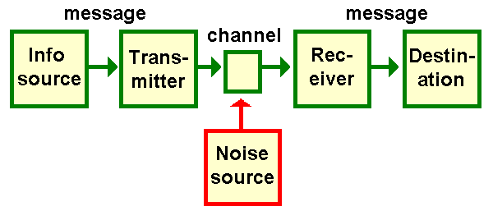
Understanding Good Practice in Business Mentoring
Theories of Communication
Human communication permeates the human condition. Human communication surrounds us and is an in-built aspect of everything human beings are and do. That makes any effort to explain, predict, or to some extent control human communication a pretty big order. How does one get a handle on the totality of human communication?
A. Arrow Theory

Slide 37
Understanding Good Practice in Business Mentoring
A. Arrow Theory
Introduction
  - “I communicate by memos because I know I’ve communicated. Then I know I did my job!!!”
Accoutrements
  - Pro-management
  - Downward comm.
  - Directive
Communication Breakdowns
  - Failure= Blame
  - Failure = Incompetence
Effectiveness
  - Clearly and precisely put my thoughts into words.
  - Speak with credibility.
  - My talk forces action.
Scorecard
  - Effective Expression = Effective Communication
  - Passive Information Processors
  - Words contain meaning
  - Focus on clear expression
  - Links words to actions
Origins
  - Past Training
  - Communication Training
  - Personality Traits

Slide 38
Understanding Good Practice in Business Mentoring
B. Circuit Theory
Introduction
  - Key terms - networking, going with the flow, making connections
  - Emphases
    * Feedback over response
    * Relationship over content
    * Process over purpose
    * Understanding over compliance
Circuit Breakers
  - Poor climate
  - Misunderstanding
  - Hidden agendas
Origins
  - Business schools
  - Communication training
  - Personality
Effectiveness
  - Actively listen to employees in order to make them happy.
  - Sensitive employee needs
  - Open to employees.
Accoutrements
  - Change initiation
  - Sources of innovation
  - Direction of communication

Slide 39
Understanding Good Practice in Business Mentoring
B. Circuit Theory
Evaluation
Understanding = Effective Comm.
Connections
  - Feedback
  - Relationship issue
Accoutrements
  - Change initiation
  - Sources of innovation
  - Direction of communication
Disconnections
  - Goals of comm.
  - Understanding = agreement

Slide 40
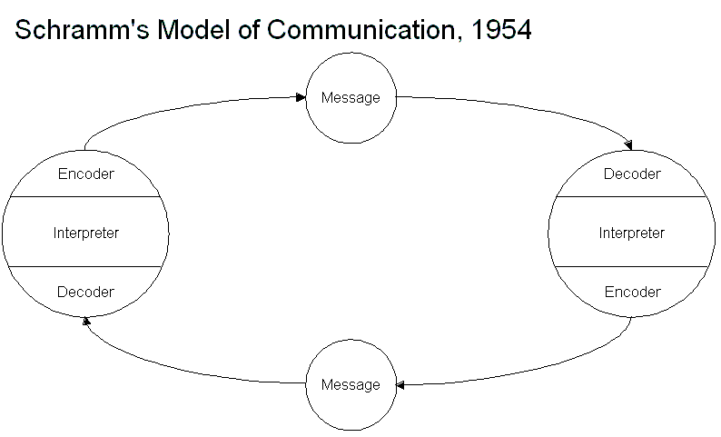
Understanding Good Practice in Business Mentoring
B. Circuit Theory

Slide 41
Understanding Good Practice in Business Mentoring
C. Dance Theory
Communication has multiple purposes
Communication involves coordinating meanings.
Communication involves co-orientation.
Communication is rule-governed.
Communication. has patterns.
Communicators develop skills that are often unconscious.
The beauty of comm. is a function of the degree of coordination.

Slide 42
Understanding Good Practice in Business Mentoring
Techniques of Goal and Objective setting
Setting goals
Clarifying situations
Communication involves co-orientation.
Understanding other people’s behavior
Dealing with road blocks
Building wide networks of support, influence, and learning

Slide 43
Understanding Good Practice in Business Mentoring
Evaluation Method for Communication
Direct consultation of the audience
- What do you want to know: content – method – setting/organization
A. Oral evaluation techniques:
- Thumb
- Card (green – red – yellow)
- Feedback: The suitcase and the bin: What will I put in my suitcase – what will I leave there?
- electronic voting system
B. Written evaluation:
- During the event (evaluation sheet)
- After the event (online evaluation)
C. Focus groups

Slide 44
Understanding Good Practice in Business Mentoring
Evaluation Method for Communication
- To what extent does the communication strategy respond to the information needs of the target audience(s)?
- How coherent are the tools and messages with the objectives of the strategy, with each other and with other existing initiatives in the field?
- How effective is the communication strategy/policy in improving
awareness and knowledge about EU policy in the field x?
- To what extent does the communication strategy/policy contribute to a better understanding/perception of the Commission’s policy in the field of x?

Slide 45
Understanding Good Practice in Business Mentoring
3-Level Classification Table
 | Compliance wih Com Objective | Efficiency of management | Efficiency of budget | Effectiveness of Distribution | Effectiveness of Targeting
Media Com | Strengthen Presentation of completed Projects |  | Increase of Budget
Online Tools | Add case study
Publications |  |  |  |  | Unified Visual Identity
Events |  |  |  |  | Create a database of contacts

Slide 46
Understanding Good Practice in Business Mentoring
Workplace Assessment
Assessment in a workplace setting enables access to operational
environments and technology that may not be available in institutional contexts. This can improve the authenticity of the assessment, particularly if simulation of a workplace context is not practical or sufficiently realistic. is also more meaningful to candidates and assessors. This ensures that candidates subsequently deemed as competent are more likely to be
job-ready to work in the industry and/or workplace concerned.
Steps in Workplace Assessment
Examine and analyze the workplace setting concerned
- Consult with key personnel in the workplace setting concerned. Dependent on the specific workplace context, this may include training staff, work teams, team leaders, supervisors, operational managers, and HR managers, etc. In these consultations, establish the role and functions of the persons to be assessed. Relate these to the units of competency involved.

Slide 47
Understanding Good Practice in Business Mentoring
Workplace Assessment
Steps in Workplace Assessment
Develop the assessment resources and prepare assessment personnel
- Design a workplace assessment strategy based on the identified assessment tasks, including the development of the assessment tools and related guidance materials. This would include, for example: performance checklists, question banks and sample responses, case study materials, assessment projects, workplace reference documents, etc.
Trial the resources and procedures for assessing in a specific workplace setting
- Plan the trial of the workplace assessment strategy, including the
production of the assessment tools and scheduling of the assessment tasks. This will need to take into account the safety and operational requirements of the workplace and the availability of candidates and the members of the assessment team.

Slide 48
Understanding Good Practice in Business Mentoring
Environmental Considerations to Ensure Quality Workplace Mentoring
Environmental issues in the workplace is a growing concern for companies, especially as it relates to employee health and safety. Bad air quality and ventilation as well as asbestos-riddled structures can lead to sick building syndrome, which can compromise the health and comfort of your employees. Employers need to take affirmative steps to ensure the health and welfare of their workers. Confronting the problem makes business sense by way of health management savings as well as low absenteeism and contained insurance premiums. If necessary, consult an environmental consultant to determine cost-effective ways to handle workplace environment issues. Training your employees about business environmental issues is vital to complete workplace compliance and helps them assess potential health issues.

Slide 49
Understanding Good Practice in Business Mentoring
Managing a Workplace Mentoring Relationship
Mentors are individuals with advanced experience and knowledge who take a personal interest in helping the careers and advancement of their protégés. Mentors may or may not be in their protégés' chain of command, be employed in the same organization as their protégés, or even be in the same field as their protégés. Mentoring relationships may range from focusing exclusively on the protégé's job functions to being a close friendship that becomes one of the most important relationships in the protégé's life.
Most mentoring relationships are informal, and develop on the basis of mutual identification and the fulfillment of career needs. The mentor may see the protégé as a "diamond in the rough" or a younger version of him or herself, while the protégé, may view the mentor as a competent role model with valued knowledge, skills and abilities. Members of mentoring relationships often report a mutual attraction or chemistry that sparks the development of the relationship.

Slide 50
Understanding Good Practice in Business Mentoring
Barriers to Workplace Mentoring
Personal and Financial Barriers: Needing the basic resources that enable individuals to survive while looking for employment and to stay employed once they are hired, as well as being effective in financial planning and money management
Emotional and Physical Barriers: Potentially debilitating emotions related to and perpetuating unemployment or physical health problems, addictions, and disabilities that may prevent an individual from looking for work.
Career Decision-Making and Planning Barriers: Needing effective skills and knowledge for making good career decisions, identifying occupations of interest, and then developing a career plan for achieving success in the world of work.

Slide 51
Understanding Good Practice in Business Mentoring
Barriers to Workplace Mentoring
Job Seeking Knowledge Barriers: Lacking knowledge about how to effectively
look for employment in today’s marketplace, how to demonstrate one’s
knowledge and skills with resumes and other documents, and how to effectively interview for jobs.
Education and Training Barriers: Needing to understand the importance of
lifelong learning and getting additional training and education to keep pace with the changes in the workplace.

Slide 52
Understanding Good Practice in Business Mentoring
Ways to Overcome Workplace Barriers
Some barriers must be overcome. With the pressure of submitting grant proposals, writing papers and teaching courses, who has time to mentor? With little pay—or prestige—offered by most schools for spending hours with a curious kid, who can justify the extra effort? And, although they often learn quickly and make important contributions to a research project, undergraduates don't always make the easiest proteges. Here this year and gone the next, they have little time to master techniques or see a project through to the end. Even when mentor and protégé are willing, everyday logistics—lack of lab space, for instance—can come between them.

