Slide 1


8600-230 : Developing Yourself as an Effective Business Team Member

Slide 2
Team Member
A person belonging to a specific group of people involved in attempting to achieve a common goal.
Module Objective
To develop yourself as an effective team member.

Slide 3
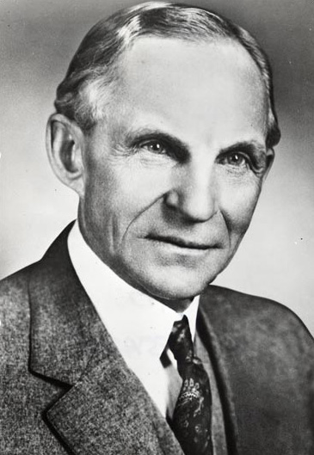
Developing Yourself as an Effective Team Member
Coming together is a beginning. Keeping together is a progress. Working together is success!
~Henry Ford~

Slide 4
Team
Consisting of three to 25 people who:
Work toward a common set of goals.
Work jointly.
Share common leadership.
Hold joint accountability for performance.
See themselves as being part of a team with common goals and shared fates.
Group
  Two or more persons who are interacting in such a way that each person influences and is influenced by each other person.
Difference . . .
A team is internally organized, with specific goals and usually with specific roles for different members of the team. A group is just a collection of people with something in common, such as being in the same place or having a shared interest.

Slide 5
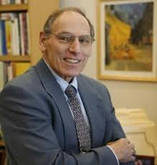
Tuckman Model of Group
Development
Bruce W. Tuckman is a respected educational psychologist who first described the (then) four stages of group development in 1965, soon after leaving Princeton. Looking at the behavior of small groups in a variety of environments, he recognized the distinct phases they go through, and suggested they need to experience all four stages before they achieve maximum effectiveness. He refined and developed the model in 1977 (in conjunction with Mary Ann Jensen) with the addition of a fifth stage. Since then, others have attempted to adapt and extend the model - although sometimes with more of an eye on rhyme than reason.
~Bruce W. Tuckman~

Slide 6
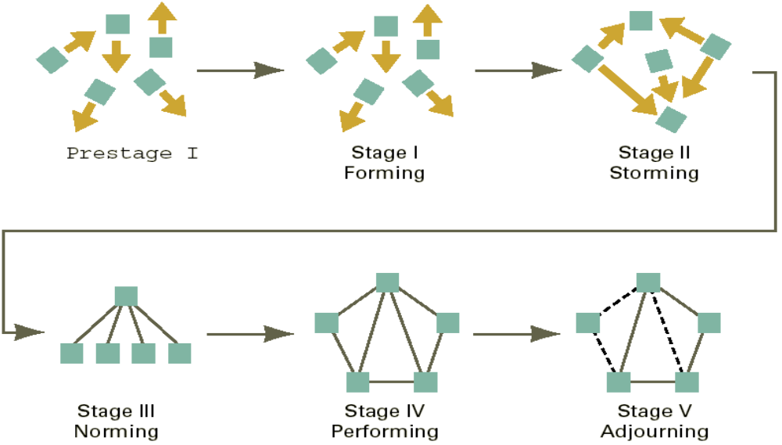
Developing Yourself as an Effective Team Member
Tuckman Model of Group Development

Slide 7
Tuckman Model of Group
Development
Stage 1. Forming
  The teams and their leaders begin working out their specific responsibilities.
  Training is the leader’s main task.
Stage 2. Storming
  Questions typically arise regarding who is leading the team and what its structure and purpose should be.
  The leader ensures that team members continue to learn and eventually exercise leadership skills.
Stage 3. Norming
  Team members agree on purpose, structure, and leadership and are prepared to start performing.
  The leader’s job is to emphasize the need for the team to temper cooperation with the responsibility to supervise its own members.

Slide 8
Tuckman Model of Group
Development
Stage 4. Performing
  A period of productivity, achievement, and pride as the team members work together to get the job done.
Stage 5. Adjourning
  After the task is completed, the team must disengage (both from the task and from fellow team-members).
  A successful adjourning happens when members are proud of what they have achieved and happy to have belonged together but at the same time they recognize that it is time to move on.

Slide 9
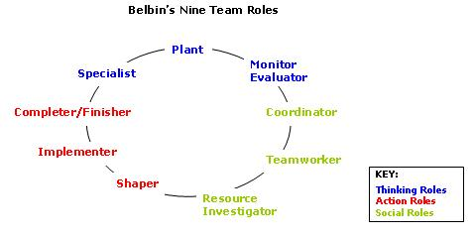
Developing Yourself as an Effective Team Member

Slide 10
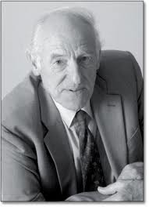
Belbin Team Roles
During a period of over nine years, Meredith Belbin and his team of researchers based at Henley Management College, England, studied the behaviour of managers from all over the world. Belbin team roles describe a pattern of behaviour that characterises one person’s behaviour in relationship to another in facilitating the progress of a team. The value of Belbin team-role theory lies in enabling an individual or team to benefit from self-knowledge and adjust according to the demands being made by the external situation.
~Meredith Belbin~

Slide 11
TEAM-ROLE CONTRIBUTION
ALLOWABLE WEAKNESSES
PLANT:
Creative, Solves difficult problems
Loses touch with everyday realities
RESOURCE INVESTIGATOR:
Enterprising, Quick to explore opportunities
Weak in follow through
CO-ORDINATOR:
Makes good use of group activities
Manipulative
SHAPER:
Driving and challenging
Provocative, Aggressive
COMPLETER FINISHER:
Painstaking, Conscientious
Anxious, Reluctant to delegate
TEAMWORKER:
Co-operative, Averts friction
Indecisive
MONITOR EVALUATOR:
Discerning and Objective
Uninspiring, Slow-moving
IMPLEMENTER:
Disciplined, Efficient, Practical
Slow to see new possibilities
SPECIALIST:
Single-minded, Professionally dedicated
Limited in Interests
Notes:
Put this slide on the screen while you ask participants to do the Belbin Phrases Exercise.
DO NOT “re-teach” the role descriptions - just leave it up for their reference while they do the exercise. Make participants use their brains - apply the Belbin theory they learned yesterday to day-to-day office behaviour, as represented by the phrases in the Phrases Exercise.
Review the answers to the phrases exercise, asking people to justify their answers - this will help to reinforce the behaviours characteristic of each role.

Slide 12
Developing Yourself as an Effective Team Member
A Group becomes a Team when :
  Every sub-task is clearly assigned.
  Final accountability is joint.
  Team member viewpoints are respected and considered.
  Regular meetings are held between team members and progress is monitored.
  All relevant information is passed around.
  A sense of ownership is inculcated in all members.

Slide 13
Developing Yourself as an Effective Team Member
Characteristic of a Good Team
Clear &
Elevated
Goal
Principled
Leadership
Results -
Driven
Structure
External
Support &
Recognition
Team
Excellence
Competent
Team
Members
Standards
Of
Excellence
Unified
Commitment
Collaborative
Climate

Slide 14
Characteristics of a Good Team
1. A clear, elevating goal:
This is a goal which has been communicated to all.
2. A results-driven structure:
  The goal has been jointly decided by all the team members. They are fully committed towards achieving it.
3. Competent members:
  Each team member has the required skill set in order to achieve the team objectives.
4. Unified commitment:
  There is nothing happening in silos. With the total commitment from team members, achieving organizational goals becomes easier.
5. A collaborative climate:
  Commitment from team members and a good leadership leads to a collaborative team with a productive work environment.

Slide 15
Characteristics of a Good Team
6. Standards of excellence:
Quality orientation is vital to the success of any organization.
7. External support and recognition:
  Appreciation as well as appraisal is required to keep the morale of the team high.
8. Principled leadership:
  Leadership defines a team. An able-bodied leadership can chart the team’s path to success. Each team member participates actively and positively in meetings as well as projects. This shows a person’s commitment as well as understanding towards a project.

Slide 16
Developing Yourself as an Effective
Team Member
The importance of appreciating other team member’s skills and abilities
In a Team, the Team Leader is responsible to encourage the development of an environment where the team members feel valued and respected. In particular the development of an environment where their skills and abilities and personal values and beliefs contribute to their role within the company. This can be achieved through the recognition of individual and team productivity and professional achievements, as well as through the interpersonal behaviors displayed by you and your team members.

Slide 17
Developing Yourself as an Effective
Team Member
Advantages of working in a Team
There are many advantages of teamwork. We’ve all heard the phrase “two heads are better than one.” Of course with more minds set on a specific goal, you have access more ideas. Looking at things from the perspective of others can increase the likelihood of quality innovation. Teams create an environment of support and propel people toward implementation. A team environment can boost the confidence of individuals, allowing them to do their best work. Good teams make the most of individual talents. Where one member may be weak, another might be strong and working together they provide the perfect resource for an organization. The more people work together, the more they learn and step away to become better workers in their own jobs. Teams can create better communication and respectful relationships among employees.

Slide 18
Developing Yourself as an Effective
Team Member
Team Building
The selection and grouping of a mix of people and the development of skills required within the group to achieve agreed objectives.‘ 'Team is a group of individuals with complementary skills who work together for accomplishing common goals. Working in teams helps build synergy between its members and, as a result, the work, at hand, gets efficiently done.
Positive Work relationship
The selection and grouping of a mix of people and the development of skills required within the group to achieve agreed objectives.‘ 'Team is a group of individuals with complementary skills who work together for accomplishing common goals. Working in teams helps build synergy between its members and, as a result, the work, at hand, gets efficiently done.

Slide 19
Developing Yourself as an Effective
Team Member
Business Development
Business Development is all about figuring out how the interactions of those forces combine together to create opportunities for growth. It’s about creating opportunities for that value to persist over the long-term, to keep the floodgates open so that value can flow indefinitely. Thinking about business development as a means to creating long-term value is the only true way to succeed in consistently growing an organization.
Conflict Management
Is the principle that all conflicts cannot necessarily be resolved, but learning how to manage conflicts can decrease the odds of nonproductive escalation. Conflict management involves acquiring skills related to conflict resolution, self-awareness about conflict modes, conflict communication skills, and establishing a structure for management of conflict in your environment.

Slide 20
Developing Yourself as an Effective
Team Member
Interrelationship
The way in which each of two or more things is related to the other or others.
Interdependence
Is a relationship in which each member is mutually dependent on the others. This concept differs from a dependence relationship, where some members are dependent and some are not. .

Slide 21
Developing Yourself as an Effective
Team Member
Importance of Trust and Respect in a Team
Trust and respect are two essential elements for building relationships in the workplace and beyond. It’s all about the relationships you have with people – which doesn’t necessarily mean friendships. Relationships are built over time, when one person has respect for another. Gradually, trust beings to build, too. You don’t have to be a close personal friend with everyone at work, but you do always need to show each person respect and professionalism.

Slide 22
Barriers to Communication
1. Physical Barriers
2. Cultural Barriers
3. Emotional Barriers
4. Perceptual Barriers

Slide 23
Barriers to Communication
1. Physical Barriers
If team members are physically far apart, such as in different departments or even different cities, then communication can be hindered. Face-to-face communication is a great way of conveying ideas and intents, and not being able to do this quickly and easily can easily form a communication barrier. This can, to some extent, be overcome with video conferencing and other technology.
….
An example of a physical barrier to communication is geographic distance between the sender and receiver(s). Communication is generally easier over shorter distances as more communication channels are available and less technology is required. Although modern technology often serves to reduce the impact of physical barriers, the advantages and disadvantages of each communication channel should be understood so that an appropriate channel can be used to overcome the physical barriers.
….

Slide 24
Barriers to Communication
2. Cultural Barriers
Language can be a large barrier to effective communication. If the team is made up of people from all over the world, the differences in language can prevent full understanding and effective communication. Cultural barriers also include factors such as not sharing your colleague's sense of humor, religion or beliefs.
For example, one of these days you’ll find yourself having a work-related conversation with a member of the opposite sex. If the conversation doesn’t go as smoothly as you’d expected, there’s a good reason: Men and women in the workplace don’t communicate the same way. According to American linguist Deborah Tannen, men tend to assert their status, to exert confidence, and to regard asking questions as a sign of weakness. Women, in contrast, tend to foster positive interrelationships, to restrain expressions of confidence, and to ask questions with no trouble.

Slide 25
Barriers to Communication
3. Emotional Barriers
Another important element to a successful team besides communication is trust, and if a team member feels that he cannot trust a co-worker, that hampers communication. Information will not be readily shared. Communication should always be open and honest, with any conflict resolved as quickly as possible.
For example, if someone has personal worries and is stressed, they may be preoccupied by personal concerns and not as receptive to the message as if they were not stressed.

Slide 26
Barriers to Communication
4. Perceptual Barriers
How you perceive others can also present a barrier to good communication, especially if you misread a request.
For example, if your boss asks you to carry out a simple task, you could perceive it as her feeling she can only give you simple tasks and does not have faith in your ability. On the other hand, someone else may perceive this as an act of trust, and in giving you this task she knows it will be completed fully.

Slide 27
Developing Yourself as an Effective
Team Member
Relationship of Organizational Goals and Team Objectives
Objectives and goals are to: Identify the team member roles and responsibilities.
Goals are defined as general results that the organization is working to accomplish, while Objective are defined as the level of achievement expected from the implementation of the goals. Generally, objectives should be expressed in terms that are measurable. The goals and objectives for organization should define the path toward ensuring the protection of employees and the company.

Slide 28
Simple steps
It would be impossible to overcome all barriers. However, we can try to reduce the risk of miscommunication by taking simple steps.
Be clear in your own mind about what you want to communicate.
Select the right medium and use it properly.
Think like the receiver and anticipate (guess) the impact of your communication.
Use feedback to encourage two-way communication and check understanding.

Slide 29
When possible, communicate directly, face-to-face so that you can use non-verbal signals.
Limit the number of links in the communication channel. For example, try not to have your message being passed down several levels of management as your message can be diffused as they move downwards and upwards. – Play “Chinese Whispers”

Slide 30
Developing Yourself as an Effective
Team Member
Importance of Communication in a Team
Team communication skills are critical for ensuring the success of the team effort, whether the team is charged with creating a new product, making a process improvement, or planning the summer picnic. Strong team communication skills can help build relationships, ensure the sharing of new ideas and best practices, and benefit team members through coaching and counseling.

Slide 31
Developing Yourself as an Effective
Team Member
Organizational Politics
Organizational politics is the management of influence to obtain ends not sanctioned by the organization or to obtain sanctioned ends through non-sanctioned means. The important point to emphasize about organizational politics is the legitimacy of both the outcomes and the methods used to achieve them.
Social Norms
Pattern of behavior in a particular group, community, or culture, accepted as normal and to which an individual is accepted to conform.

Slide 32
Developing Yourself as an Effective
Team Member
Values
Important and lasting beliefs or ideals shared by the members of a culture about what is good or bad and desirable or undesirable. Values have major influence on a person's behavior and attitude and serve as broad guidelines in all situations. Some common business values are fairness, innovation and community involvement.
Religion
The belief in and worship of a superhuman controlling power, esp. a personal God or gods.

Slide 33
Developing Yourself as an Effective
Team Member
Conflicts
a disagreement through which the parties involved perceive a threat to their needs, interests or concerns.
Examples of behavior that can cause conflict in a team
Passive/aggressive behavior
Hostility
Not completing work on-time or to quality goals
Not returning phone calls or e-mails
Not responding to requests for information
Hoarding information that should be shared
Finger pointing
Not attending required meetings
Absenteeism
Gossip

Slide 34
Developing Yourself as an Effective
Team Member
Examples of behavior that can cause conflict in a team
Gossip
Hostility
Complaining
Absenteeism
Verbal abuse
Physical violence
Finger pointing
Passive/aggressive behavior
Filing grievances or lawsuits
Not attending required meetings
Not returning phone calls or e-mails
Not responding to requests for information
Hoarding information that should be shared
Not completing work on-time or to quality goals

Slide 35
Developing Yourself as an Effective
Team Member
Ways of Preventing Conflicts
Dealing with conflict immediately – avoid the temptation to ignore it.
Being open – if people have issues, they need to be expressed immediately and not allowed to fester.
Practicing clear communication – articulate thoughts and ideas clearly.
Practicing active listening – paraphrasing, clarifying, questioning.
Practicing identifying assumptions – asking yourself "why" on a regular basis.
Not letting conflict get personal – stick to facts and issues, not personalities.

Slide 36
Developing Yourself as an Effective
Team Member
Ways of Preventing Conflicts
Demonstrating respect – if the situation escalates, take a break and wait for emotions to subside.
Keeping team issues within the team – talking outside allows conflict to build and fester, without being dealt with directly.
Not looking for blame – encourage ownership of the problem and solution.
Encouraging different points of view – insist on honest dialogue and expressing feelings.
Focusing on actionable solutions – don't belabor what can't be changed.

Slide 37
Developing Yourself as an Effective
Team Member
Ways to Reduce Team Conflicts
Get to know the individual members of your team. Becoming more knowledgeable about them will make it easier for you to spot if there is a problem.
Promote an ethos of open and honest communication between team members when the group is working on a project. No members of the group should feel left out or that they are too intimidated to make a point. Manage as many meetings as you can to ensure everyone has a chance to voice an opinion or suggestion.
Lead by example. If your staff sees you arguing with other managers, then they may become more aggressive themselves. Instead, act professionally and courteously at all times.

Slide 38
Developing Yourself as an Effective
Team Member
Ways to Reduce Team Conflicts
Deal with any conflicts by gathering the offending people in a private meeting room and hearing both sides of the story before passing any discipline. If an issue cannot be resolved by you, bring in a third-party mediator.
Use your knowledge of your team to assign individuals tasks that meet their strengths. This will reduce the number of problems found through inexperience, as well as the amount of conflict caused as a result of a person carrying out a task with which he is not familiar and doing it wrong.

Slide 39
Developing Yourself as an Effective
Team Member
Ways on Handling Conflicts
Direct Approach : It concentrates on the leader confronting the issue head-on. This approach counts on the techniques of problem-solving and normally leaves everyone with a sense of resolution, because issues are brought to the surface and dealt with.
Bargaining : This is an excellent technique when both parties have ideas on a solution yet cannot find common ground. Often a third party, such as a team leader, is needed to help find the compromise. Compromise involves give and take on both sides, however, and usually ends up with both walking away equally dissatisfied.

Slide 40
Developing Yourself as an Effective
Team Member
Ways on Handling Conflicts
Enforcement of Team Rules : Avoid using this method if possible, it can bring about hard feelings toward the leader and the team. This technique is only used when it is obvious that a member does not want to be a team player and refuses to work with the rest. If enforcement has to be used on an individual, it may be best for that person to find another team.
Retreat : Only use this method when the problem isn't real to begin with. By simply avoiding it or working around it, a leader can often delay long enough for the individual to cool off. When used in the right environment by an experienced leader this technique can help to prevent minor incidents that are the result of someone having a bad day from becoming real problems that should never have occurred.

Slide 41
Developing Yourself as an Effective
Team Member
Ways on Handling Conflicts
De-emphasis : This is a form of bargaining where the emphasis is on the areas of agreement. When parties realize that there are areas where they are in agreement, they can often begin to move in a new direction.

Slide 42
Developing Yourself as an Effective
Team Member
Conflict Resolution
Know Thyself and Take Care of Self
- Understand your "perceptual filters," biases, triggers
- Create a personally affirming environment (eat, sleep, exercise)
Clarify Personal Needs Threatened by the Dispute - Substantive, Procedural, and Psychological Needs
- Look at BATNA, WATNA, and MLATNA
- Identify "Desired Outcomes" from a Negotiated Process
Identify a safe Place for Negotiation - Appropriate Space for Discussion/ Private and Neutral
- Mutual Consent to Negotiate/ Appropriate Time
- Role of Support People (Facilitators, Mediators, Advocates), as
needed
- Agreement to Ground rules

Slide 43
Developing Yourself as an Effective
Team Member
Conflict Resolution
Take a Listening Stance into the Interaction
- Seek first to understand, then to be understood
- Use Active Listening skills
Assert your Needs Clearly and Specifically
- Seek first to understand, then to be understood
- Use Active Listening skills
Approach Problem-Solving with Flexibility
- Identify Issues Clearly and Concisely
- Generate Options (Brainstorm), While Deferring Judgment
- Be open to "tangents" and other problem definitions
- Clarify Criteria for Decision-Making

Slide 44
Developing Yourself as an Effective
Team Member
Conflict Resolution
Manage Impasse with Calm, Patience and Respect
- Clarify Feelings
- Focus on Underlying Needs, Interests, and Concerns
- Take a structured break, as needed
Build an Agreement that works
- Review "Hallmarks" of a Good Agreement
- Implement and Evaluate - Live and Learn

Slide 45
Equal Opportunity Policy
This Equal Opportunities Policy allows an employer to state their commitment to equal opportunities and to a workplace free from discrimination and harassment, and is drafted to promote good workplace relations. This policy will also help to protect employers against claims of age, sex, race or disability discrimination and bullying in the workplace. Also discrimination based on sexual orientation and religion.
The clauses in this policy include:
Workplace monitoring.
Employers right to take positive action.
What constitutes sexual and racial harassment.
What constitutes bullying.
Likely action to be taken against those that breach this policy.
Discrimination claims do not have a maximum compensation limit stated by law and so have the potential to be quite large. Plus an employer can also be ordered to pay interest on any compensation award. Without a clear and implemented policy in place any employer runs the risk of an large claim against them.

Slide 46
Developing Yourself as an Effective
Team Member
Skills and Abilities required to be an effective Team Member
Listen- By actively listening you will know what others in the group have to offer and you can often build on their ideas.
Question- Don’t just ask questions to who you perceive as the leader, ask, interact and clarify issues with all members of the team.
Persuade- Be willing to change and appreciate other points of view.
Respect- Criticize ideas, not people, and only give feedback on the task, not on an individual’s performance.
Help- Be aware of what others are doing and offer help and support if you can.
Share- be willing to share your knowledge, experience, time and talents with others in the team.
Participate- you must contribute enthusiastically to the team without dominating other members, but you must also be willing to lead and motivate when appropriate.

Slide 47
Developing Yourself as an Effective
Team Member
Areas of Improvement
Improve soft skills such as presentation or negotiation skills. Everyone needs to improve their soft skills, and highlighting this has no impact on your professionalism.
Increase proficiency in internal systems – most large companies have complex internal systems to say the least. Wanting to improve your proficiency in using internal systems does not affect your professional work (unless of course you’re in fact responsible for the system).
Improve cross group collaboration – again, most large companies struggle with cross group collaboration particularly those with complex matrix reporting structures . Your desire to improve collaboration implies you’re a team player.

Slide 48
Developing Yourself as an Effective
Team Member
Personal Development - includes activities that improve awareness and identity, develop talents and potential, build human capital and facilitate employability, enhance quality of life and contribute to the realization of dreams and aspirations. The concept is not limited to self-help but includes formal and informal activities for developing others in roles such as teacher, guide, counselor, manager, life coach or mentor. When personal development takes place in the context of institutions, it refers to the methods, programs, tools, techniques, and assessment systems that support human development at the individual level in organizations.
Training - includes activities that improve awareness and identity, develop talents and potential and build human capital.

Slide 49
Developing Yourself as an Effective
Team Member
Analyze Strengths and Weakness as a Team Member
Step 1 - Get feedback from others on the team. After all, as one person doing the assessment, what you even perceive to be strengths and weaknesses may not be accurate. Ask for feedback from other employees and managers who work with each team member under evaluation. Use the information gathered from other individuals, as well as your own assessment, to form one overall determination about the individual.
Step 2 - Pay attention to failures and successes. Determine where the team overall has succeeded or failed and which members of the team were responsible for each. When looking at each member's weaknesses and strengths, you have to consider his success with the team as a whole before looking at individual performance.

Slide 50
Developing Yourself as an Effective
Team Member
Analyze Strengths and Weakness as a Team Member
Step 3 - Gauge consistency among team member roles. For example, if one person has consistently been responsible for a certain type of task, which has been done effectively and efficiently, then the skills needed to accomplish said task are part of her core professional strengths. Alternatively, if the team member doesn't consistently perform in one area of the team or don't do a good job when she does, the skills needed to do that job may be part of her weaknesses.
Step 4 - Take a look at each team member's performance outside of the team structure to determine where they are strong and weak on their own. You may see consistency among those strengths and weakness working in the team or out of it; or you may discover that some employees have a different set of strengths and weaknesses when working independently versus working in a team structure.

Slide 51
Developing Yourself as an Effective
Team Member
Ways to Improve your Ability to Function Effectively in a Team
Manage own time and processes effectively, prioritizing competing demands to achieve personal and team goals and objectives
Earn trust and confidence of colleagues through competent and timely completion of tasks
Communicate frequently and effectively with other team members
Recognize the value diversity, develop effects interpersonal and intercultural skills, and build network relationships that value and sustain a team
Mentor others, and accept mentoring from others, in technical and team issues
Demonstrate capacity for initiative and leadership while respecting others’ agreed roles

