Slide 1


8600-400 : Understanding the Management Role to Improve Business Management Performance

Slide 2
Definition of Organization
Understanding the Management Role to Improve Business Management Performance
Organization are not static. They exist in uncertain and must continually find solution to new problem if they are to survive and prosper.
Some speculate that organization are hard to see, but the whole organization is vague and abstract and may be scattered among several locations.

Slide 3
Nature of Organization
Understanding the Management Role to Improve Business Management Performance
Most socialist would agree that as human are part of an organization structure, they too need to find a way to interate within the compound of organization. The nature of organization is to function as a whole and not as a system. Within the nature of organization, there exists workers and system that guides the organization.
Purpose of Organization
The purpose of an organization is to accomplish the goals and objectives as indicated within the organization's vision statement. The mission statement will indicate how they plan on reaching those goals and objectives.

Slide 4
Mission Statement
Understanding the Management Role to Improve Business Management Performance
The mission statement of an organization is normally short, to the point, and contains the following elements:
  Provides a concise statement of why the organization exists, and what it is to achieve;
  States the purpose and identity of the organization;
  Defines the institution's values and philosophy; and
  Describes how the organization will serve those affected by its work.
A broad declaration of an organization’s overriding purpose
Identifies what is unique or important about its products
Seeks to distinguish or differentiate the organization from its competitors

Slide 5
Value Statement
Understanding the Management Role to Improve Business Management Performance
A Value Statement is a declaration of what the company believes...its core beliefs. If the value statement does not clearly communicate where the company stands, then it is not a good one.
A value statement is an expression of a company's or individual's core beliefs. Companies write the statement to identify and connect with the consumer. Additionally, the declaration allows for the company's staff to be aware of the priorities and goals of the company.
Your VALUES define what your business stands for — they are your core rules.

Slide 6
Definition of Stakeholders
Understanding the Management Role to Improve Business Management Performance
A person, group or organization that has interest or concern in an organization.
Stakeholders can affect or be affected by the organization's actions, objectives and policies. Some examples of key stakeholdersare creditors, directors, employees, government (and its agencies), owners (shareholders), suppliers, unions, and the community from which the business draws its resources.
Not all stakeholders are equal. A company's customers are entitled to fair trading practices but they are not entitled to the same consideration as the company's employees.

Slide 7
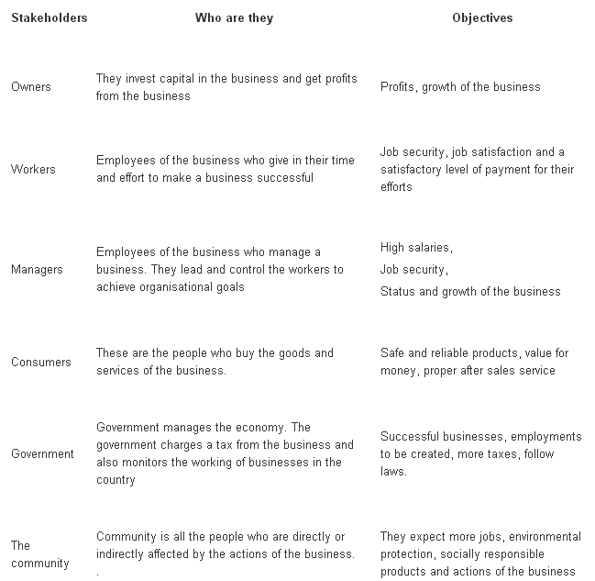
Stakeholders and their objectives
Understanding the Management Role to Improve Business Management Performance

Slide 8
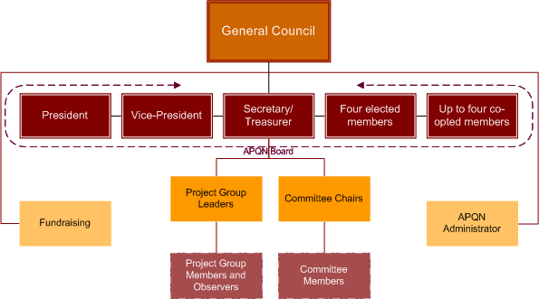
Organizational Structure
Understanding the Management Role to Improve Business Management Performance

Slide 9
Organizational Structure
Understanding the Management Role to Improve Business Management Performance
Nowadays businesses are encouraged to be more cross-functional and concentrate on the functional areas being the most central to the organisations activities.
An organisational structure is a way of illustrating how an organisation is organised as well as the control and responsibilities of different departments.
3 main Types of Organizational Structure
Flat Hierarchal
2. Tall Hierarchal
3. Matrix

Slide 10
Simple Traditional Organisational Structure
Understanding the Management Role to Improve Business Management Performance
General Manager
Finance
Marketing & Sales
Production
Human Resources
Research & Development

Slide 11
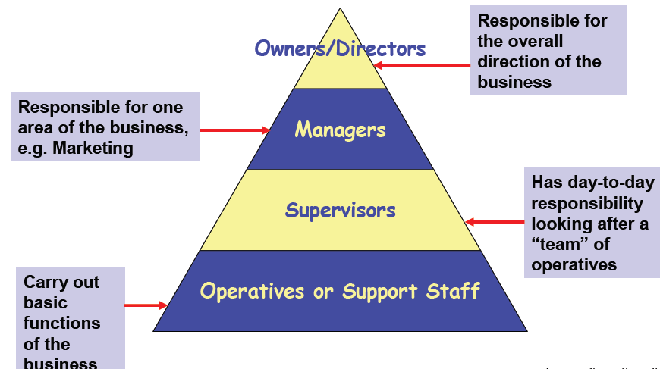
Hierarchical Organizations
Understanding the Management Role to Improve Business Management Performance
In a hierarchical organization employees are ranked at different levels, each one above another. At each level, except the bottom, one person has a team of people reporting to them. The resulting chart will be in a pyramid shape.

Slide 12
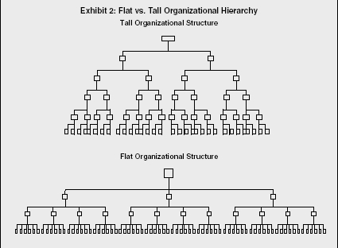
Hierarchical Organizations
Understanding the Management Role to Improve Business Management Performance
As an example, the senior managers will be responsible for the overall direction of the business whilst middle management will report to the senior managers and be accountable for their department.
Tall Hierarchy
Each middle manager will have a team of people who manage the day-to-day work of multiple staff on the bottom layer.

Slide 13
Understanding the Management Role to Improve Business Management Performance
Tall Hierarchy
A tall hierarchy will typically have narrow spans of control (the number of people working for another).
As each manager only manages a few people, the team can be closely supervised but this can restrict responsibility and make decision-making slow as approval has to be sought higher up the layers of management.
Flat Hierarchy
If there are many layers the hierarchy is said to be tall and if there are few layers it would be called flat.
In a flat hierarchy the chain of command is much shorter (fewer layers) and the span of control wider. This can lead to improved communications and strong team spirit.

Slide 14
Understanding the Management Role to Improve Business Management Performance
Flat Hierarchy
However it can limit growth or the organization as more layers would need to be added and functions can get blurred.
A hierarchy can be structured by product or customer groups as well as by function (marketing, HR, sales). In this way a large company can operate as several smaller businesses.

Slide 15
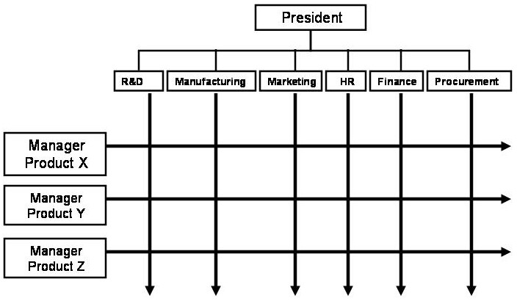
Understanding the Management Role to Improve Business Management Performance
Matrix Structure
Each project the company is involved with has a project manager. It is the function of the project managers to ensure projects they are responsible for progress satisfactorily.
Functional managers are primarily responsible for managing their staff, ensuring correct procedures and levels of quality are maintained, etc.
Project managers are responsible for managing projects, that is ensuring tasks are completed on time, budgets are met, etc.

Slide 16
Understanding the Management Role to Improve Business Management Performance
Matrix Structure
A matrix organization has teams of cross-functional people. These are often created for specific projects, such as the development and launch of new products and systems, and are led by a project manager.
The project manager’s team will be a group of specialists from around the business brought together specifically for this project.
The pros include the fact that the team is hand-selected for their skill-set and experience. Decision-making can be quick and the team is responsible to drive the project through on time and within budget.
The biggest problem is likely to be with each worker having two bosses: their line manager and the project manager. This can causes conflicts on time if the demands from both roles are heavy.
A matrix gives the individuals in the team a lot of independence to do work in the way they think best and though this encourages empowerment and is highly motivating it can be hard to monitor the work being done.
Also as the team grows it can be hard to manage increasing numbers of people so the structure has to be changed to have fewer direct reports.

Slide 17
Business Function
Understanding the Management Role to Improve Business Management Performance
first we should see what we’re actually structuring in a business
Production – responsible for making goods. This department is responsible for planning production schedules and for ensuring high quality standards
Marketing – finds out what customers want through marketing research and then plans marketing activities to attract customers
Sales – the emphasis in sales is on convincing the customer that the product meets their needs and requirements
Finance & Accounts – responsible for preparing budgets (financial plans) and for calculating the profit or loss made by various parts of the business and as a whole. Creates financial reports
Administration – responsible for creating and managing systems for keeping the business running smoothly
Human Resources – responsible for people management in the company including hiring, firing, motivating
Information Technology – create the information systems that keep the business running smoothly.

Slide 18
Understanding the Management Role to Improve Business Management Performance
Job functions of Middle Managers
There are four vital aspects of the middle management.
Focus:
Concentrate effort where it's needed. Focus the work of the organization
on what's relevant and productive. Motivate employees to do focus work.
Prevent work on things which aren't relevant or aren't productive.
Align:
Coordinate efforts of the organization with peer groups or with other
organizations.
Support:
Support the employees of the organization by eliminating barriers to
success. Provide a good working environment. Resolve any personal
disagreements among the employees in order to maintain a positive
working experience for everyone. Represent the employees upward in t
he organization, so that outstanding employees can be recognized for t
heir talents and potential. Help a few employees to realize that they are
better off working.

Slide 19
Understanding the Management Role to Improve Business Management Performance
Job functions of Middle Managers
Build:
Build the organization and its capabilities by hiring as needed and by training the employees who are there. Improve the individuals within the organization by increasing their talents and capabilities. Advance the careers of the individuals who work for you
Formal Organization
The formal organization refers to the formal relationships of authority and subordination within a company. The primary focus of the formal organization is the position the employee/manager holds. Power is delegated from the top levels of the management down the organization. Each position has rules governing what can and cannot be done. There are rewards and penalties for complying with these rules and performing duties well.

Slide 20
Understanding the Management Role to Improve Business Management Performance
Informal Organization
The informal organization refers to the network of personal and social relations that develop spontaneously between people associated with each other. The primary focus of the informal organization is the employee as an individual person. Power is derived from membership of informal groups within the organization. The conduct of individuals within these groups is governed by norms - that is, social rules of behavior. When individuals break these norms, other members of the group impose sanctions on them. Clearly, the informal structure can be either beneficial or detrimental to the functioning of the company or both.

Slide 21
Understanding the Management Role to Improve Business Management Performance
Functions of Managers
Planning: This step involves mapping out exactly how to achieve a particular goal. The manager first needs to decide which steps are necessary to accomplish that goal. These steps may include increasing advertising, inventory, and sales staff. These necessary steps are developed into a plan. When the plan is in place, the manager can follow it to accomplish the goal of improving company sales.
Organizing: After a plan is in place, a manager needs to organize her team and materials according to her plan. Assigning work and granting authority are two important elements of organizing.
Staffing: After a manager discerns his area's needs, he may decide to beef up his staffing by recruiting, selecting, training, and developing employees. A manager in a large organization often works with the company's human resources department to accomplish this goal.

Slide 22
Understanding the Management Role to Improve Business Management Performance
Functions of Managers
Leading: A manager needs to do more than just plan, organize, and staff her team to achieve a goal. She must also lead. Leading involves motivating, communicating, guiding, and encouraging. It requires the manager to coach, assist, and problem solve with employees.
Controlling: After the other elements are in place, a manager's job is not finished. He needs to continuously check results against goals and take any corrective actions necessary to make sure that his area's plans remain on track.
All managers at all levels of every organization perform these functions, but the amount of time a manager spends on each one depends on both the level of management and the specific organization.

Slide 23
Understanding the Management Role to Improve Business Management Performance
Functions of Managers
A manager wears many hats. Not only is a manager a team leader, but he or she is also a planner, organizer, cheerleader, coach, problem solver, and decision maker — all rolled into one. And these are just a few of a manager's roles.
In addition, managers' schedules are usually jam-packed. Whether they're busy with employee meetings, unexpected problems, or strategy sessions, managers often find little spare time on their calendars. (And that doesn't even include responding to e-mail!)

Slide 24
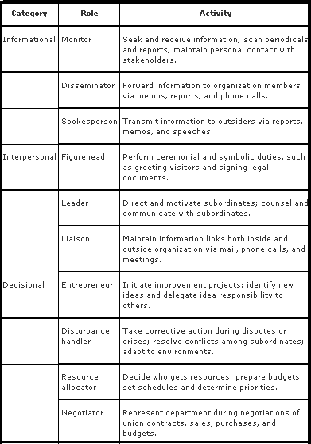
Understanding the Management Role to Improve Business Management Performance
Roles performed by Managers

Slide 25
Understanding the Management Role to Improve Business Management Performance
Styles of Management
Autocratic style
The head who subscribes to this style of management determines school policy alone and assigns duties to staff without consulting them. Directives are issued and must be carried out without question and in the prescribed manner. Autocratic style may provide a degree of certainty for those beneath the leader. They may feel safe because they do not have to be involved in solving problems. The autocratic leader usually has great self-confidence, a clear vision of what needs to be done, and the political skills to get things done. Many great figures in world history have been autocrats.
Laissez-faire style
In theory, the head who uses this style of management believes that there should be no rules and regulations since everyone has an 'inborn sense of responsibility'. Laissez-faire (literally let-do) style is opposite to the autocratic style, many of the criticisms of the latter become arguments in favour of the former. Thus individuals have to think for themselves and individual initiative and hard work may be well rewarded. A laissez-faire environment may be more creative amd fulfilling for those involved.

Slide 26
Understanding the Management Role to Improve Business Management Performance
Styles of Management
Democratic style
In this style, the head believes that the staff should be involved in decision-making processes. Decisions are arrived at after consultation with the staff, and even with the pupils. A democratic style allows freedom of thought and action within the framework of the mission and objectives of the school.
Transactional style
It has been argued that the transactional style (or Nomothetic-Idiographic in some textbooks) may be the most effective style since it seeks a compromise between stressing organizational demands or goals and individual needs.
Contingency style
One important function of the head is to communicate effectively to the staff the philosophy and objectives of the school and thus to gain their commitment to them. The head needs to realize that effectiveness in management depends on being able to diagnose and adapt to the dynamics of ever-changing situations. A contingency management style is where the head 'rides the waves', or deals with each problem as it arises.

Slide 27
Understanding the Management Role to Improve Business Management Performance
Difference of Leadership and Management
Leadership is setting a new direction or vision for a group that they follow, ie: a leader is the spearhead for that new direction.
Management controls or directs people/resources in a group according to principles or values that have already been established.
Leadership is about setting a new direction for a group; management is about directing and controlling according to established principles. However, someone can be a symbolic leader if they emerge as the spearhead of a direction the group sets for itself.

Slide 28
Understanding the Management Role to Improve Business Management Performance
Importance of Organizational Goals
All business organizations should have written goals that are part of their business plan. These goals can describe what the company plans to accomplish in terms of market share, growth and profitability. Goals may also be set for internal measurement like expanding staff or boosting employee morale. Businesses should aim to have goals that are specific, measurable, attainable, relevant and timely. There are many benefits to setting goals.
Provides Focus
Increases Motivation
Improves Group Cohesion
Increases Employee Worth
Offers Measurability

Slide 29
Understanding the Management Role to Improve Business Management Performance
Importance of Organizational Objectives
Business owners use a variety of management tools or techniques to improve their company business operations. Setting objectives is a specific management tool that creates a target for business owners to achieve. Objectives can be company-wide goals, specific to the division or department and individual employee expectations. Business owners often use performance management to follow up on objectives and measure the company overall achievement effectiveness.
Facts - Business owners often set the tone for their organization. The company mission, vision and values are usually an extension of the owner personal characteristic traits.
Features - Business owners who set objectives just to have them on a list are not usually making these objectives a priority in the company. Business objectives should be clear, measurable and realistic.

Slide 30
Understanding the Management Role to Improve Business Management Performance
Importance of Organizational Objectives
Function - Objectives held by business owners maintain a singular focus in the business environment. Rather than using generic boilerplate statements, such as a lot of money; business owners with objectives can focus on maximizing their company potential.
Considerations - Business owners should consider writing a business plan and creating a section for objectives. The business plan can act as a road map to guide the business owner throughout his operational lifetime.
Effects - Business owners can use objectives to create a competitive advantage in the business environment. A competitive advantage is when one company has the ability to produce goods or allocate economic resources better than another business.

Slide 31
Understanding the Management Role to Improve Business Management Performance
Importance of Organizational Objectives
Function - Objectives held by business owners maintain a singular focus in the business environment. Rather than using generic boilerplate statements, such as a lot of money; business owners with objectives can focus on maximizing their company potential.
Considerations - Business owners should consider writing a business plan and creating a section for objectives. The business plan can act as a road map to guide the business owner throughout his operational lifetime.
Effects - Business owners can use objectives to create a competitive advantage in the business environment. A competitive advantage is when one company has the ability to produce goods or allocate economic resources better than another business.

Slide 32
Understanding the Management Role to Improve Business Management Performance
Goals of an Organizational
How goals are set is as important as the goal itself. Thus it is important that goals meet specific criteria that can be used to easily assess them. One way of doing this is to use the acronym “SMART” as a way of evaluating the goal. SMART goals still provide a great framework to improve your goal setting and help you create more effective goals.
A further search of the first forty websites found that most used the following words to define a “SMART” goal:
• Specific
Measurable
Attainable
Relevant
Time-bound

Slide 33
Understanding the Management Role to Improve Business Management Performance
Goals of an Organizational
Specific - A goal is specific when it provides a description of what is to be accomplished.
Measurable - A goal is measurable if it is quantifiable. Measurement is accomplished by first obtaining or establishing base-line data.
Attainable - There should be a realistic chance that a goal can be accomplished. This does not mean or imply that goals should be easy. On the contrary, a goal should be challenging.
Relevant - Goals should be appropriate to and consistent with the mission and vision of the organization. Each goal adopted by the organization should be one that moves the organization toward the achievement of its vision.
Time-bound - That is, it must have a starting and ending point. It should also have some intermediate points at which progress can be assessed. Limiting the time in which a goal must be accomplished helps to focus effort toward its achievement.

Slide 34
Understanding the Management Role to Improve Business Management Performance
Objectives of an Organizational
Objectives must be realistic. This is very important for success. Achievement of established objectives provides positive reinforcement. Defining realistic objectives depends on carefully assessing the needs and capabilities of the community. The community profile, along with the strengths and weaknesses analysis should be the foundation for establishing objectives that are most suitable for your community. Short and long-term development objectives should be established for your community to keep your organization progressive and provide for ongoing community development programs. As the process proceeds, there will be a continuous generation of new long-term objectives as previous ones are achieved. Establishing objectives should involve public participation. This provides the necessary feedback to ensure that objectives are realistic and support attitudes, opinions, and judgments from your community. Setting suitable objectives requires careful thought. It involves an assessment of all the information generated so far in the process. It is through extensive discussion and debate that a set of realistic and appropriate objectives can be established for the community.

Slide 35
Understanding the Management Role to Improve Business Management Performance
Guidelines for setting Objective of an Organizational
State objectives in quantified terms and specific times set.
Set objectives in the context of the previously established goals.
One goal may have several objectives to be achieved.
Establish realistic objectives.
Set objectives for short and long-term community development.
Involve the public in setting objectives.

Slide 36
Understanding the Management Role to Improve Business Management Performance
Responsibilities of Middle Managers
Middle-level managers, or middle managers, are those in the levels below top managers. Middle managers' job titles include: General manager, Plant manager, Regional manager, and Divisional manager.
Responsible for carrying out the goals set by top management
Motivate and assist first-line managers to achieve business objectives.
Communicate upward, by offering suggestions and feedback to top managers.
Provide valuable information to top managers to help improve the organization's bottom line.
Middle managers may supervise only a small group of employees, or they may manage very large groups, such as an entire business location.

Slide 37
Understanding the Management Role to Improve Business Management Performance
Human Behavior
Human Behavior in general is the potential is the potential and expressed capacity for physical, mental, and social activity during the phases of human life.
Range of Human Behavior
1. Conscious – State of awareness of thoughts, feelings, perception and what is going on with the environment.
2. Overt – Open to public observation
3. Covert – Unseen objects such as thoughts, feelings or responses which are not easily seen.
Notes:
Introduction to Business Operations

Slide 38
Understanding the Management Role to Improve Business Management Performance
Verbal Communication
Verbal communication can be defined as communicating your thoughts through words. Such thoughts may be ideas, opinions, directions, dissatisfaction, objections, your emotions and pleasures.
The basis of communication is the interaction between people. Verbal communication is one-way for people to communicate face-to-face. Some of the key components of verbal communication are sound, words, speaking, and language.
Methods of Delivery of Verbal Communication
* Manuscript
*Memorization
*Impromptu
*Extemporaneous
Notes:
Introduction to Business Operations

Slide 39
Understanding the Management Role to Improve Business Management Performance
Non-Verbal Communication
Nonverbal communication (NVC) is usually understood as the
process of communication through sending and receiving wordless messages. Or, we may say that all messages other than the words that people exchange are non-verbal communication.
A person to have quality communication skills must possess the knowledge of non-verbal communication. As compared to words and vocal variety non verbal communication matters a lot.
The Voice
±Rate
±Dialect
±Pitch
±Vocal Variety
±Volume
±Articulation
±Pauses
±Pronunciation
Notes:
Introduction to Business Operations

Slide 40
Guide to overcome Communication Problems in Workplace
Understanding the Management Role to Improve Business Management Performance
Speak to them - If you think that there are problems with a certain co-worker, talk to that person. This way, you will be able to determine the root of the gap of communication. It is always important to hear the voices of every person. That is why, conducting regular meetings is vital in order give each one a chance to open up their ideas and thoughts.
Let them speak and you listen - If you want things to be good, then, you have to listen to that person. Do not speak while he is speaking. Aside from looking for ways to convey information, there should also be ways to let them express their own thoughts. You should pay heed to what other people will say and respond to them in a respectful manner. This can make things a lot easier for everyone knowing that each one has the chance to talk and be listened to. It is always vital for you to learn how to listen.
Have a mediator - If you think that the problem cannot be settled if you are the only ones working on it, you might consider a mediator. If the other party does not listen to your words and might even make up stories which worsen the situation, then call someone to help you both understand the situation. This could be a great help.

Slide 41
Guide to overcome Communication Problems in Workplace
Understanding the Management Role to Improve Business Management Performance
Do not make it too personal - When you are faced with a conflict in the workplace due to misunderstanding, do not treat in a manner that you will ruin not just your work relationship but yourself as well. Look at it as a problem between the persons involved and the situation, not as a problem between you and the other person. Bear in mind that both of you are just victims of misunderstanding. Settle it in a good way and do not take things personally.
Be open-minded - When you are open-minded, you have the ability to look at things in a wider perspective. This makes things a lot easier for you. You can see angles that other people are not able to see. This way, you will realize that what is happening is not really a big problem. Communication problems can be solved by good communication. When you have good communication, you need an open mind so that you will be able to listen to other people’s thoughts.
Be specific in your words - A good way to get rid of communication problems is by saying things in a clear and specific manner. When you say something, do not allow any misinterpretations by making it direct and understandable. Do not leave messages that have double meanings. Make sure that you will say exactly what you want to say. Also, do not generalize things. Just be specific with what you are trying to tell someone. This can greatly contribute to easy communication.

Slide 42
Guide to overcome Communication Problems in Workplace
Understanding the Management Role to Improve Business Management Performance
Do not generalize - When you are voicing out complaints or speaking about your thoughts, make sure that you are only pointing towards a specific conflict. Also, do not involve other people to it and do not pinpoint other aspects of a person’s character. Despite one misunderstanding, you still have to keep a good relationship with co-workers. So, deal with it in a good manner without making matters big.
Do not be involved in other’s problems - When you are voicing out complaints or speaking about your thoughts, make sure that you are only pointing towards a specific conflict. Also, do not involve other people to it and do not pinpoint other aspects of a person’s character. Despite one misunderstanding, you still have to keep a good relationship with co-workers. So, deal with it in a good manner without making matters big.
Have proper place and time for confrontation - If you want to discuss a problem with your co-worker, set a time and place to do that. Do not confront that person while he or she is still working in the office. That would be inapt and unprofessional. Do not discuss in front of many people who are not part of the problem. This will only cause gossip in the office.

Slide 43
Guide to overcome Communication Problems in Workplace
Understanding the Management Role to Improve Business Management Performance
Communicate regularly - Due to the advancement of technology, it leads to the fast processes of things. People become even busier with work because of this. But it doesn’t mean that you will stop communicating with each other in the workplace. Some design companies made it a point that they find a manner of communication for each one of them. They do this by using some applications for chatting online while in the office. This is very convenient for it is time and energy saving. One doesn’t have to go to the other’s working are just to speak with him. Regular meetings are also held so that each one is given the chance to share their ideas.

Slide 44
Communication Climate
Understanding the Management Role to Improve Business Management Performance
A business' work climate can be compared to the mood or atmosphere of the company as a whole, as well as within individual work groups according to Global Health Technical Briefs. This atmosphere results from the different forms of communications and interactions that take place between management and employees and amongst employees, according to BizTimes. Good communication climates foster worker productivity and initiative, while bad ones can foster low morale, lost productivity and untapped talent and abilities.
It is an integral part of organizational culture.

Slide 45
Communication Culture
Understanding the Management Role to Improve Business Management Performance
Cross-cultural communication, which is also frequently referred as intercultural communication, is a field of study that looks at how people from differing cultural backgrounds endeavour to communicate.
Intercultural communication is important to international businesses as it examines how people from various cultures, beliefs and religions come together to work and communicate with each other. Demands for intercultural communication skills are increasing as more and more businesses go global or international.
The application of cross-cultural communication studies began after World War II. It started originally within businesses and the government both seeking to expand globally. Now, there are many theories that set principles to help explain the basis of intercultural communication, including general business, management and marketing. There are also several successful educational projects that concentrate on the practical applications of these theories in cross-cultural situations.
In short, the main objective of cross-cultural communication studying is to earn respect from others and help to reduce the possible misunderstanding from different cultures groups.

Slide 46
Importance of Feedback Skills
Understanding the Management Role to Improve Business Management Performance
Feedback is an essential skill in interpersonal communication and the quality of an individual's interpersonal communication can be a determinant in their success or lack of it, in all kinds of relationships.
The importance of giving effective feedback comes from the concept of self-esteem, which in turn is the value we place on our own self-images. We all carry around within ourselves a picture of who we are - I have a picture of who this person called "Tony" is, and this picture is made up of all the responses I get to what I do and say in my everyday life. I say things to my wife and she responds, I say something to my child and she does something (not always what I might want her to do!), I communicate by email to a colleague and (I hope) get an answer. These responses are all clues to how the other person is experiencing me, and from these clues, these sometimes very subtle messages, I build up a picture of who I, Tony, am.

Slide 47
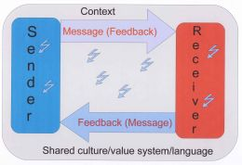
Importance of Feedback Skills
A very basic model of communication. The "lightening bolt" shapes indicate noise, either internal or external
Understanding the Management Role to Improve Business Management Performance
Another, very common example, is in the performance management situation where a manager is giving performance feedback to an employee. This frequently ends disastrously for both, and leads to employees becoming very cynical about the whole performance management process.

Slide 48
Networking Skills
Understanding the Management Role to Improve Business Management Performance
A business' work climate can be compared to the mood or atmosphere of the company as a whole, as well as within individual work groups according to Global Health Technical Briefs. This atmosphere results from the different forms of communications and interactions that take place between management and employees and amongst employees, according to BizTimes. Good communication climates foster worker productivity and initiative, while bad ones can foster low morale, lost productivity and untapped talent and abilities.
It is an integral part of organizational culture.

Slide 49
Social Skills
Understanding the Management Role to Improve Business Management Performance
is any skill facilitating interaction and communication with others. Social rules and relations are created, communicated, and changed in verbal and nonverbal ways. The process of learning such skills is called socialization. Social skills are the skills we use to communicate with each other, both verbally and non-verbally, through gestures, body language and image.
Importance of Trust and Control
Trust and control are complex and ambiguous concepts. It refers to “highly complex forms of social relationships and processes, whose definitions have been inherently elusive and often challenge by scholars” and therefore, “it is not surprising that varied, and sometimes divergent conceptualizations of trust and control found in the literature.

Slide 50
Effect of Interpersonal Skills in managerial performance
Understanding the Management Role to Improve Business Management Performance
The vast majority of managers and staff in this survey said that poor communication within or across work teams is one of the greatest causes of poor productivity in the workplace. Most executives agreed that one’s interpersonal skills could make or break a career. This in-the-trenches look at work life identifies a real need: better interpersonal effectiveness skills. Other research shows that when managers (or employees) learn to use such interpersonal skills, they are able to apply them in a wide variety of job-specific activities, including leading teams,
coaching, managing conflict and even selling. This data shows that interpersonal skills — unlike many functional job skills — are extremely beneficial to all groups of employees and throughout the career track of individual employees.

Slide 51
Effect of Communication Skills in managerial performance
Understanding the Management Role to Improve Business Management Performance
Successful business communication will have a direct effect on a manager's performance. She will have dedicated employees, satisfied customers and positive relationships with other businesses and suppliers. A manager with poor and ineffective communications will experience an outcome that will typically include employees with low moral, inconsistent and untrusting customers and broken business relationships.Effective business communication is an ongoing process that will always have areas of needed improvement.

Slide 52
Overcoming Communication Barrier
Understanding the Management Role to Improve Business Management Performance
1. Choose the best communication channel for your specific message. A communication channel is the way in which you communicate. For example, phone calls, texts, email, and face-to-face are all communication channels. If your message is long or complicated, an email or text is not suitable. If you&#039;re worried about becoming too angry during a face-to-face conversation, then maybe an email is the way to go.
2. Choose an appropriate time to have a conversation. If you want to ask your boss for a raise, you should not do so during the company&#039;s busiest week, or you risk your boss not being able to listen or absorb what you’re saying.

Slide 53
Overcoming Communication Barrier
Understanding the Management Role to Improve Business Management Performance
3. Speak clearly when talking to someone. This doesn&#039;t just refer to the volume or annunciation of your message, but also the terms you are using. Many times doctors will explain a patient&#039;s condition to them in medical terms, which most patients are not familiar with, so the patient walks away confused. Do not use slang or terminology that the listener is not familiar with.
4. Ask the listener to repeat your message to you after you have finished talking. This is a good way of being able to tell if your message was received and understood. If the listener relays a message that is not identical to your message, then you know there was a miscommunication that needs to be remedied.
5. Listen when the other person is speaking. Instead of thinking about what you will say next, actually take in what the other person is saying so you are able to receive their message, as well.

Slide 54
Knowledge Management
Understanding the Management Role to Improve Business Management Performance
Knowledge management will deliver outstanding collaboration and
partnership working. It will ensure the region maximizes the value of its
information and knowledge assets and it will help its citizens to use their
creativity and skills better, leading to improved effectiveness and greater
innovation Knowledge Management is the discipline of enabling
individuals, teams and entire organizations to collectively and
systematically create, share and apply knowledge, to better achieve their
objectives
Knowledge Management programs are typically tied to organizational
objectives such as improved performance, competitive advantage
innovation, lessons learnt transfer (for example between projects) and
the general development of collaborative practices.

Slide 55
Sharing of Information
Understanding the Management Role to Improve Business Management Performance
Information sharing describes the exchange of data between various
organizations, people and technologies. The advent of wide distributed
networks, intranets, cross-platform compatibility, application porting, and
standardization of IP protocols have all facilitated the huge growth in
global information sharing.
When it comes to personal information however, no matter how easy it is to port the actual data, there are laws in most countries prohibiting the sharing of personal data without explicit permission being granted. In the US and Europe it is a criminal offense to share any personal data about anyone without such explicit permission.
There is plenty of other information sharing that does not fall under the law and information sharing is increasing as more networks and organizations connect and information becomes easier to share across the internet.

Slide 56
Management Styles
Understanding the Management Role to Improve Business Management Performance
Management styles are concepts and theories, that influence the general work environment of an organization. Management styles can vary a bit with a change in leadership; however, the crux of management remains the same.
Through the years, economists and business gurus have fostered and
developed several management styles, each surfacing from a
different school of thought. However, they all have the same bottom
line - profit. They may follow different routes, but are headed to the
same destination - good business! Different "styles" are also
propounded with reference to the leadership style that a manager
follows. Styles of management have seen an evolution of sorts due to
the dynamism of the corporate world as an entity.

Slide 57
Management Styles
Understanding the Management Role to Improve Business Management Performance
#1 - Taylorism | Scientific Management - This is one of the earliest management styles.
Propounded and developed by Frederick Winslow Taylor in 1900, the concept of Scientific
Management is also known as "Taylorism." This method believed in the concept of "One Best
Way", to perform a certain task. In general, Taylorism believed in the following principles:
*Decision-making should be under the purview of the management. This ensures that
emotions are not the governing factor for a business. More so, decision-making is
more professional in the hands of managers because they can be unbiased and have a
scientific approach towards management.
*Developing a standard method to perform each job. This helps in having uniformity
in the production. Standard methods speed up the production process and create an
environment of expertise.
*Providing complete support to employees so that they can plan their work and
eliminate interruptions.
*Selecting workers with appropriate abilities for each job to create an environment of
excellence and complete understanding of the task.
*Workers to be trained on the standard methods that were previously developed and
fine-tuned.
*In case of increased output by a certain employee, he/she be rewarded with a wage
incentive, or bonus.

Slide 58
Management Styles
Understanding the Management Role to Improve Business Management Performance
#2 - Fayolism | Process Approach - This is the second of the early business management
styles. The process approach was propounded by Henri Fayol in the 1920s. As such, it is
popularly known as "Fayolism." Fayolism is a modification of Taylorism. However, the
modifications made this management style very different from Taylorism as it was broader in
perspective. Fayolism follows 14 principles of administration:
- Equity
- Scalar chain
- Order
- Centralization
- Authority
- Division of work
- Initiative
- Remuneration of personnel
- Discipline
- Stability of personnel tenure
- Unity of direction
- Esprit de corps (Union is strength)
- Unity of command
- Subordination of Individual Interests to the Common Interest
Cont………….

Slide 59
Understanding the Management Role to Improve Business Management Performance
Fayolism believed that each organization has 16 management duties. These are:
1. To give serious thought to the plans of the company and have them firmly executed.
2. To have the required number of employees and equipment, with which the plans of the organization can be executed.
3. To set up a 'unique direction' (top management) which is skilled and vigorous.
4. To consult others before taking actions, in order to coordinate efforts
5. To work on formulating decisions in a clear, clean, and precise way.
6. To have an efficient recruitment, with each department being led by a skilled and active
person, and selecting an employee for the position where he can perform to his potential.
7. To define clearly the job description of each and every employee so that targets and
expectations are set.
8. To encourage people so that they take up initiatives and responsibilities

Slide 60
Understanding the Management Role to Improve Business Management Performance
Fayolism believed that each organization has 16 management duties. These are:
9. To pay appropriately, fairly, and expertly, for the services provided to the organization.
10. To have a system of correcting faults and errors made by the employees
11. To ensure discipline in the organization.
12. To aim at having individual interests subordinated to the organization's interest.
13. To give special attention to the 'unity of command'.
14. To supervise the material order and social order, in order to keep the place tidy, and to avoid strikes.
15. To verify output by applying quality control on every operation.
16. To conquer the "red ribbon" attitude.
Cont………….

Slide 61
Understanding the Management Role to Improve Business Management Performance
As per Fayolism, a manager should have the following 7 qualities :
1. Health and vigor
2. Cleverness
3. Moral qualities
4. General knowledge (culture)
5. Management capacity
6. Notions about other functions (activities)
7. The strongest skills in the function managed .
The process approach really simplified several production as well as service
functions and is still widely followed. In fact, it is known as one of the most
effective management styles.

Slide 62
Management Styles
Understanding the Management Role to Improve Business Management Performance
#3 - The Hawthorne Effect - enveloped in the 1930s and 1940s, the Hawthorne experiments by Elton Mayo, were the basis of this management style. This management style believed in the concept of: "A happy worker is a good worker." According to this management style, majority of the concentration was focused on providing employees with required amenities. Adequate light, healthy diet, and conducive environment were provided to the employees to ensure optimum output. This concept was developed on the basis of two beliefs:
1. People are not the rational and economic beings assumed by classical theorists.
2. Social interaction is important and people work well if they feel valued.
The Hawthorne experiments highlighted the fact that human beings were the
main resources for any organization and had to be kept happy to ensure high
productivity.

Slide 63
Management Styles
Understanding the Management Role to Improve Business Management Performance
# 4 - Needs and Motives - Maslow's theory on the 'Hierarchy of Needs' had many implications for management style. According to Maslow, every individual's needs are divided into a certain hierarchy.
♣ Physiological needs
♣ Safety Needs
♣ Social Needs
♣ Esteem Needs:
♣ Self-actualization Need:
Cont………….

Slide 64
Management Styles
Understanding the Management Role to Improve Business Management Performance
As per safety culture, the following factors were pertinent to the safety interests of
any organization:
-Prioritization of safety over production.
-Maintaining a high profile for safety in meetings. .
-Personal attendance of managers at safety meetings and walkabouts.
-Face-to-face meetings with employees that featured safety as a topic.
-Job description that included safety contracts.
-Communication about safety issues, including pervasive channels of formal and
informal communication and regular communication between management,
supervisors and the workforce.
-Involvement of employees for delegation of responsibility to maintain safety in
the organization.
This style is used to a moderate extent with certain organization-specific
modifications.

Slide 65
Management Styles
Understanding the Management Role to Improve Business Management Performance
# 6 - Management by Objectives - This is one of the recent management styles, and in today's diverse market, it is very useful. It was popularized by Peter Drucker in 1954. The objective of Management by Objectives (MBO) is "To create empowered employees who have clarity of the roles and responsibilities expected from them, understand their objectives to be achieved and thus help in the achievement of organizational as well as personal goals." It has the following advantages:
♣ Motivation: Participative environment that includes employees in goal setting, which motivates them to come to work.
♣ Better Communication and Coordination: This method has made general communication and coordination much easier and smoother. Regular reviews, feedback, and an open-door policy help in creating an amicable environment in the organization.
♣ Clarity of Goals: With MBO, the objectives are "SMART":
Cont………….

Slide 66
Management Styles
Understanding the Management Role to Improve Business Management Performance
Despite its advantages, MBO has a few limitations. It concentrates on goals more than outcome. More so, it fails to state the context in which the goals are set. Appraisals are based on "What an employee should be", not on, "What an employee should do", and a few other organization-specific limitations. However, principles of this management style are kept in mind for general management benefit.
As management encompasses man, money, and material, there are several aspects that govern and are governed by management styles. As man is the first and foremost consideration, the leadership styles followed by different managers have led to forging different management styles as well.
Cont………….

Slide 67
Techniques of Self-Assessment
Understanding the Management Role to Improve Business Management Performance
1. Restatement of objectives - The objectives of the job should be rephrased according to the employee’s understanding of it, in order for his superior to gauge whether the employee has indeed understood these, or not.
2. Most noteworthy achievements - All major achievements should be given focus as these are key indicators of an employee’s performance.
3. Explanation of why those achievements are important - Mention the effects of the achievements you made, and how these have greatly helped the organization
4. Areas for improvement - Whilst the main focus of self-assessments are the employee’s good performance, it is also important to mention the challenges that he believes he has, and it would be helpful to include some suggestions on how his superior and the organization can help him overcome these.

Slide 68
Self-Assessment
Understanding the Management Role to Improve Business Management Performance
Investigate and improve support for people in evaluating their own
possible competences through new methods of self-evaluation of
personal competences of adult learners on a translational basis
Improving opportunities to re-enter the labour market possibly in a
different field:
more suitable to personal interests and wishes
higher success, better options to stay in the job

Slide 69
Formal Personal Development Methods
Understanding the Management Role to Improve Business Management Performance
Developing a formal personal development plan requires integrity,
perseverance, and plenty of energy. First, review your strengths and
weaknesses frankly. Then, identify which you believe you can improve.
These difficult evaluations are a significant step in personal values
development. Next, you need to be motivated to work to improve those
parts of your character least congruent with your own individual values.
Informal Personal Development Methods
The learner should have the capability and motivation to pursue their own
training. Self-directed forms of training require that the learner be highly
motivated and able to conceptualize their approach to training, particularly in
formal training. Informal personal development is rather casual and incidental.
Typically, there are no specified training goals as such, nor are their ways to
evaluate if they actually accomplished goals or not. This type of training and
development occurs so naturally that many people probably aren't aware that
they're in a training experience at all. Informal training is less effective than
formal training if one should intentionally be learning a specific area of
knowledge or skill in a timely fashion. Hardly any thought is put into what
learning is to occur and whether that learning occurred or not.

Slide 70
Understanding the Management Role to Improve Business Management Performance
Areas for Personal Development
Health & Wellbeing: Covers such areas as diet, fitness, physical appearance,
and addiction recovery.
Financial & Career: Addresses your material wealth requirements and work
goals.
Relationships: Goals related to intimate relationships, friends, immediate
family, and extended family - if applicable.
Recreation & Leisure: Everyone needs to enjoy the fruits of life and find time
to "recharge" their batteries. This area covers travel, vacationing, event, and
relaxation goals as well as any other goal whose purpose, fundamentally, is
some form of enjoyment away from the "everyday."
Community: Addresses your goals for giving back to the community in which you
live. These are goals such as charity work, assisting the elderly, donating time to
the local library, tutoring, participating in a Big Brother/Big Sister program, etc.

Slide 71
Understanding the Management Role to Improve Business Management Performance
Areas for Personal Development
Spiritual: Addresses your spiritual growth needs. Goals related to such things
as church attendance, religious text study (Bible, Koran, Dhammapada
[Buddhist], Tao Te Ching, etc.), how you will live your life to reflect your
beliefs, and so on.
Memetic: This area covers your core thoughts, ideas, and beliefs. Goals in this
area reflect a decision on your part to change or reinforce one or more of these
core components of your self.
Self Development: These include goals related to life-long learning, self-
motivation, personal growth, and entrepreneurship.
Creativity: Whether you dream of being a writer, painter, sculptor, or simply want
to take up woodworking, tying your own flies, or learning a needle craft; these
goals belong in this category.
Material: Goals related to "things" which you want to possess belong here. Some
examples include buying your first home, a new car, a new ski boat, upgrading or
replacing your computer, etc.

Slide 72
Personal Development Plan
Understanding the Management Role to Improve Business Management Performance
A personal development plan is a map of your self development journey. It is basically a goal setting practice, but specifically for the area of personal development. The objective of it is to plan for your aspirations in regards to personal development. Among other things, it involves identifying what skills you need to learn, the aspects of yourself needs to be improved, abilities that are you lacking and areas which needs to be given priority for improvement.
Personal Development Plan to Improve Managerial Performance
The first thing that you want to do is to learn more about the methods for writing a personal development plan. Things like how to discover your strengths/weaknesses, knowing what to prioritize on etc. Once you are familiar with that you can proceed to create your detailed plan.
Here is a personal development plan template that you can use as a reference to create your own. Just follow the sections in the template and you'll be on your way. Feel free to make any changes to the template to suit your personal needs if necessary. Though nothing is written in stone, however try to not to lose the essence of the template. Here is an example personal development plan as a reference. Check this out if you're having trouble with writing any part of your plan.

