Slide 1

8600-400 : Understanding the Management Role to Improve Business Management Performance
Business Administration

Slide 2

8600-400 : Understanding the Management Role to Improve Business Management Performance
Week One
Notes:
Management Communication

Slide 3
Assignment questions
Describe the goals and objectives of your organization (12 Marks)
Evaluate the specific responsibilities of middle managers in enabling your organization to achieve its goals (16 Marks)
Evaluate how interpersonal and communication skills affect managerial performance (16 Marks)
Evaluate strategies to overcome barriers to effective managerial communication and interpersonal skills (16 Marks)
Assess own knowledge, skills and behaviour, and their effect on own managerial performance (16 Marks)
Identify areas for personal development to improve own managerial performance (8 Marks)
Produce a personal development plan to improve own managerial performance (16 Marks)

Slide 4
Content
Definition of Organization
Vision and Mission Statement
Organizational Structure
Business Function
Job Functions of Middle Managers
Formal & informal Organization
Styles of Management
Importance of Organizational Goals
Goals of an Organization

Slide 5

Definition of Organization
Organization are not static. They exist in uncertain and must continually find solution to new problem if they are to survive and prosper.
Some speculate that organization are hard to see, but the whole organization is vague and abstract and may be scattered among several locations.

Slide 6
Nature of Organization
Most socialist would agree that as human are part of an organization structure, they too need to find a way to integrate within the compound of organization. The nature of organization is to function as a whole and not as a system. Within the nature of organization, there exists workers and system that guides the organization.
Purpose of Organization
The purpose of an organization is to accomplish the goals and objectives as indicated within the organization's vision statement. The mission statement will indicate how they plan on reaching those goals and objectives.

Slide 7
Mission Statement
The mission statement of an organization is normally short, to the point, and contains the following elements:
  Provides a concise statement of why the organization exists, and what it is to achieve;
  States the purpose and identity of the organization;
  Defines the institution's values and philosophy; and
  Describes how the organization will serve those affected by its work.
A broad declaration of an organization’s overriding purpose
Identifies what is unique or important about its products
Seeks to distinguish or differentiate the organization from its competitors

Slide 8
Value Statement
A Value Statement is a declaration of what the company believes...its core beliefs. If the value statement does not clearly communicate where the company stands, then it is not a good one.
A value statement is an expression of a company's or individual's core beliefs. Companies write the statement to identify and connect with the consumer. Additionally, the declaration allows for the company's staff to be aware of the priorities and goals of the company.
Your VALUES define what your business stands for — they are your core rules.

Slide 9
Definition of Stakeholders
A person, group or organization that has interest or concern in an organization.
Stakeholders can affect or be affected by the organization's actions, objectives and policies. Some examplesof key stakeholdersare creditors, directors, employees, government (and its agencies), owners (shareholders), suppliers, unions, and the community from which the business draws its resources.
Not all stakeholders are equal. A company's customers are entitled to fair trading practices but they are not entitled to the same consideration as the company's employees.

Slide 10
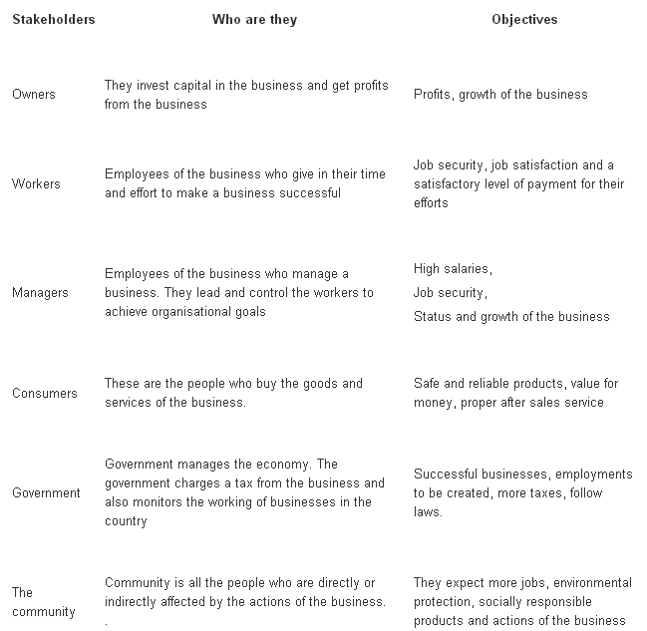
Stakeholders and their objectives

Slide 11
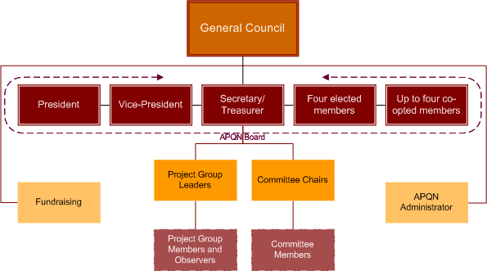
Organizational Structure

Slide 12
Organizational Structure
Nowadays businesses are encouraged to be more cross-functional and concentrate on the functional areas being the most central to the organisations activities.
An organisational structure is a way of illustrating how an organisation is organised as well as the control and responsibilities of different departments.
3 main Types of Organizational Structure
Flat Hierarchal
Tall Hierarchal
Matrix

Slide 13
Simple Traditional Organisational Structure
General Manager
Finance
Marketing & Sales
Production
Human Resources
Research & Development

Slide 14
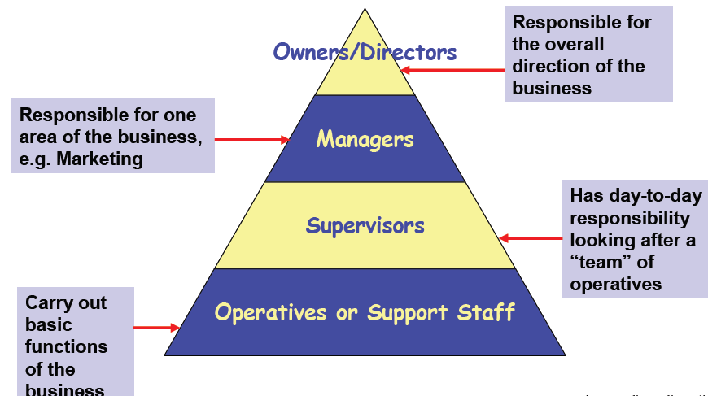
Hierarchical Organizations
In a hierarchical organization employees are ranked at different levels, each one above another. At each level, except the bottom, one person has a team of people reporting to them. The resulting chart will be in a pyramid shape.

Slide 15
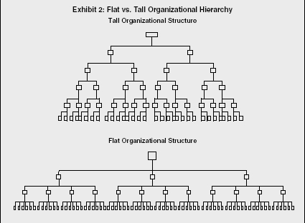
Tall Hierarchy
Each middle manager will have a team of people who manage the day-to-day work of multiple staff on the bottom layer.
A tall hierarchy will typically have narrow spans of control (the number of people working for another).
As each manager only manages a few people, the team can be closely supervised but this can restrict responsibility and make decision-making slow as approval has to be sought higher up the layers of management.

Slide 16
Matrix Structure
A matrix organization has teams of cross-functional people. These are often created for specific projects, such as the development and launch of new products and systems, and are led by a project manager.
The project manager’s team will be a group of specialists from around the business brought together specifically for this project.
The pros include the fact that the team is hand-selected for their skill-set and experience. Decision-making can be quick and the team is responsible to drive the project through on time and within budget.

Slide 17
Matrix Structure
The biggest problem is likely to be with each worker having two bosses: their line manager and the project manager. This can causes conflicts on time if the demands from both roles are heavy.
A matrix gives the individuals in the team a lot of independence to do work in the way they think best and though this encourages empowerment and is highly motivating it can be hard to monitor the work being done.
Also as the team grows it can be hard to manage increasing numbers of people so the structure has to be changed to have fewer direct reports.

Slide 18
Business Function
First we should see what we’re actually structuring in a business
Production – responsible for making goods. This department is responsible for planning production schedules and for ensuring high quality standards
Marketing – finds out what customers want through marketing research and then plans marketing activities to attract customers
Sales – the emphasis in sales is on convincing the customer that the product meets their needs and requirements

Slide 19
Business Function
Finance & Accounts – responsible for preparing budgets (financial plans) and for calculating the profit or loss made by various parts of the business and as a whole. Creates financial reports
Administration – responsible for creating and managing systems for keeping the business running smoothly
Human Resources – responsible for people management in the company including hiring, firing, motivating
Information Technology – create the information systems that keep the business running smoothly.

Slide 20
Job Functions of Middle Managers
There are four vital aspects of the middle management
Focus: Concentrate effort where it's needed. Focus the work of the organization on what's relevant and productive. Motivate employees to do focus work. Prevent work on things which aren't relevant or aren't productive.
Align: Coordinate efforts of the organization with peer groups or with other organizations.
Support: Support the employees of the organization by eliminating barriers to success. Provide a good working environment. Resolve any personal disagreements among the employees in order to maintain a positive working experience for everyone.
Build the organization and its capabilities by hiring as needed and by training the employees who are there. Improve the individuals within the organization by increasing their talents and capabilities. Advance the careers of the individuals who work for you.

Slide 21
Formal & Informal Organization
The formal organization refers to the formal relationships of authority and subordination within a company. The primary focus of the formal organization is the position the employee/manager holds. Power is delegated from the top levels of the management down the organization. Each position has rules governing what can and cannot be done. There are rewards and penalties for complying with these rules and performing duties well.
The informal organization refers to the network of personal and social relations that develop spontaneously between people associated with each other. The primary focus of the informal organization is the employee as an individual person. Power is derived from membership of informal groups within the organization.

Slide 22
Functions of Managers
Planning: This step involves mapping out exactly how to achieve a particular goal. The manager first needs to decide which steps are necessary to accomplish that goal. These steps may include increasing advertising, inventory, and sales staff. These necessary steps are developed into a plan. When the plan is in place, the manager can follow it to accomplish the goal of improving company sales.
Organizing: After a plan is in place, a manager needs to organize her team and materials according to her plan. Assigning work and granting authority are two important elements of organizing.
Staffing: After a manager discerns his area's needs, he may decide to beef up his staffing by recruiting, selecting, training, and developing employees. A manager in a large organization often works with the company's human resources department to accomplish this goal.

Slide 23
Functions of Managers
Leading: A manager needs to do more than just plan, organize, and staff her team to achieve a goal. She must also lead. Leading involves motivating, communicating, guiding, and encouraging. It requires the manager to coach, assist, and problem solve with employees.
Controlling: After the other elements are in place, a manager's job is not finished. He needs to continuously check results against goals and take any corrective actions necessary to make sure that his area's plans remain on track.
All managers at all levels of every organization perform these functions, but the amount of time a manager spends on each one depends on both the level of management and the specific organization.

Slide 24
Styles of Management
Autocratic style
The head who subscribes to this style of management determines school policy alone and assigns duties to staff without consulting them. Directives are issued and must be carried out without question and in the prescribed manner. Autocratic style may provide a degree of certainty for those beneath the leader.
Laissez-faire style
In theory, the head who uses this style of management believes that there should be no rules and regulations since everyone has an 'inborn sense of responsibility'. Laissez-faire (literally let-do) style is opposite to the autocratic style, many of the criticisms of the latter become arguments in favour of the former.

Slide 25
Styles of Management
Democratic style
In this style, the head believes that the staff should be involved in decision-making processes. Decisions are arrived at after consultation with the staff, and even with the pupils. A democratic style allows freedom of thought and action within the framework of the mission and objectives of the school.
Transactional style
It has been argued that the transactional style (or Nomothetic-Idiographic in some textbooks) may be the most effective style since it seeks a compromise between stressing organizational demands or goals and individual needs.
Contingency style
One important function of the head is to communicate effectively to the staff the philosophy and objectives of the school and thus to gain their commitment to them. The head needs to realize that effectiveness in management depends on being able to diagnose and adapt to the dynamics of ever-changing situations.

Slide 26
Difference of Leadership and Management
Leadership is setting a new direction or vision for a group that they follow, ie: a leader is the spearhead for that new direction.
Management controls or directs people/resources in a group according to principles or values that have already been established.
Leadership is about setting a new direction for a group; management is about directing and controlling according to established principles. However, someone can be a symbolic leader if they emerge as the spearhead of a direction the group sets for itself.

Slide 27
Importance of Organizational Goals
All business organizations should have written goals that are part of their business plan. These goals can describe what the company plans to accomplish in terms of market share, growth and profitability. Goals may also be set for internal measurement like expanding staff or boosting employee morale. Businesses should aim to have goals that are specific, measurable, attainable, relevant and timely. There are many benefits to setting goals.
Provides Focus
Increases Motivation
Improves Group Cohesion
Increases Employee Worth
Offers Measurability

Slide 28
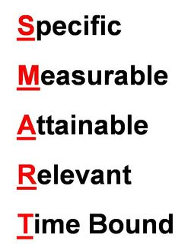
Goals of an Organization
How goals are set is as important as the goal itself. Thus it is important that goals meet specific criteria that can be used to easily assess them. One way of doing this is to use the acronym “SMART” as a way of evaluating the goal. SMART goals still provide a great framework to improve your goal setting and help you create more effective goals.
A further search of the first forty websites found that most used the following words to define a “SMART” goal:

Slide 29
Specific - A goal is specific when it provides a description of what is to be accomplished.
Measurable - A goal is measurable if it is quantifiable. Measurement is accomplished by first obtaining or establishing base-line data.
Attainable - There should be a realistic chance that a goal can be accomplished. This does not mean or imply that goals should be easy. On the contrary, a goal should be challenging.
Relevant - Goals should be appropriate to and consistent with the mission and vision of the organization. Each goal adopted by the organization should be one that moves the organization toward the achievement of its vision.
Time-bound - That is, it must have a starting and ending point. It should also have some intermediate points at which progress can be assessed. Limiting the time in which a goal must be accomplished helps to focus effort toward its achievement.

Slide 30
Guidelines for setting Objective of an Organization
State objectives in quantified terms and specific times set.
Set objectives in the context of the previously established goals.
One goal may have several objectives to be achieved.
Establish realistic objectives.
Set objectives for short and long-term community development.
Involve the public in setting objectives.

Slide 31
Responsibilities of Middle Managers
Middle-level managers, or middle managers, are those in the levels below top managers. Middle managers' job titles include: General manager, Plant manager, Regional manager, and Divisional manager.
Responsible for carrying out the goals set by top management
Motivate and assist first-line managers to achieve business objectives.
  Communicate upward, by offering suggestions and feedback to top managers.
Provide valuable information to top managers to help improve the organization's bottom line.
Middle managers may supervise only a small group of employees, or they may manage very large groups, such as an entire business location.

Slide 32
Reference

