Slide 1

8600-400 : Understanding the Management Role to Improve Business Management Performance
Business Administration

Slide 2

8600-400 : Understanding the Management Role to Improve Business Management Performance
Week Three
Notes:
Management Communication

Slide 3
Assignment questions
Describe the goals and objectives of your organization (12 Marks)
Evaluate the specific responsibilities of middle managers in enabling your organization to achieve its goals (16 Marks)
Evaluate how interpersonal and communication skills affect managerial performance (16 Marks)
Evaluate strategies to overcome barriers to effective managerial communication and interpersonal skills (16 Marks)
Assess own knowledge, skills and behaviour, and their effect on own managerial performance (16 Marks)
Identify areas for personal development to improve own managerial performance (8 Marks)
Produce a personal development plan to improve own managerial performance (16 Marks)

Slide 4
Content
Performance Management and process
Benefit of Performance Management
Performance Improvement
Personal Management style
Performance development cycle
10 Ways to Improve Performance

Slide 5
Job Performance
Job performance is a commonly used, yet poorly defined concept in industrial and organizational psychology, the branch of psychology that deals with the workplace.
It most commonly refers to whether a person performs their job well. Despite the confusion over how it should be exactly defined, performance is an extremely important criterion that relates to organizational outcomes and success.
Performance must be directed toward organizational goals that are relevant to the job or role. Therefore, performance does not include activities where effort is expended toward achieving peripheral goals

Slide 6
Performance Management
Performance management (PM) includes activities which ensure that goals are consistently being met in an effective and efficient manner.
Performance management can focus on the performance of an organization, a department, employee, or even the processes to build a product of service, as well as many other areas.
PM is also known as a process by which organizations align their resources, systems and employees to strategic objectives and priorities.

Slide 7
Employee Performance management
Employee Performance Management is a process for establishing a shared workforce understanding about what is to be achieved at an organisation level. It is about aligning the organisational objectives with the employees' agreed measures, skills, competency requirements, development plans and the delivery of results.
The emphasis is on improvement, learning and development in order to achieve the overall business strategy and to create a high performance workforce.

Slide 8
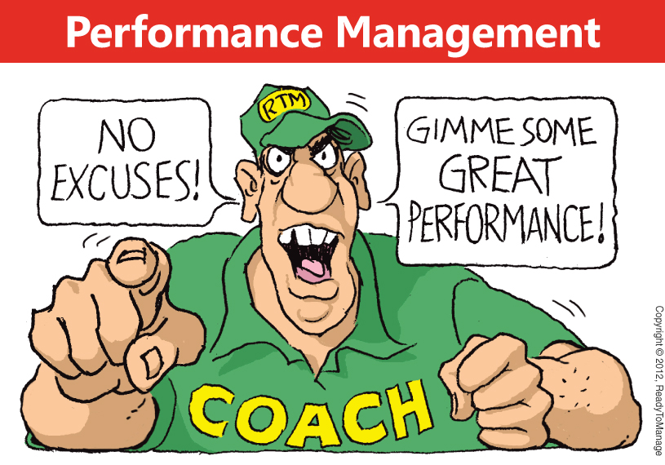

Slide 9
Benefit of Performance Management
Managing employee or system performance and aligning their objectives facilitates the effective delivery of strategic and operational goals.
Direct financial gain
Grow sales
Reduce costs in the organization
Stop project overruns
Aligns the organization directly behind the CEO's goals
Decreases the time it takes to create strategic or operational changes by communicating the changes through a new set of goals

Slide 10
Benefit of Performance Management
Motivated workforce
Optimizes incentive plans to specific goals for over achievement, not just business as usual
Improves employee engagement because everyone understands how they are directly contributing to the organizations high level goals
Create transparency in achievement of goals
High confidence in bonus payment process
Professional development programs are better aligned directly to achieving business level goals

Slide 11
Benefit of Performance Management
Improved management control
Flexible, responsive to management needs
Displays data relationships
Helps audit / comply with legislative requirement
Simplifies communication of strategic goals scenario planning
Provides well documented and communicated process documentation

Slide 12
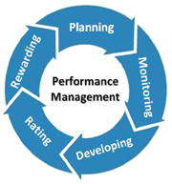
Performance Management process
Performance Management is the systematic process of:
Planning work and setting expectations
Continually monitoring performance
Developing the capacity to perform
Periodically rating performance in a summary fashion
Rewarding good performance

Slide 13
Performance Improvement
Performance improvement is the concept of measuring the output of a particular process or procedure, then modifying the process or procedure to increase the output, increase efficiency, or increase the effectiveness of the process or procedure.
The concept of performance improvement can be applied to either individual performance such as an athlete or organizational performance such as a racing team or a commercial enterprise.
Performance improvement at the operational or individual employee level usually involves processes such as statistical quality control.

Slide 14
5 Ways Great Manager Improve Employee Performance
1.Motivation - Every staff member is unique; therefore the motivation to perform better will be different for each person. Identify the motivator for each staff member and provide opportunities that encourage their interest and performance.
2.Setting Goals - Make sure you have a vision for how you want your practice to operate now and in the future. Communicate your vision to staff so that they are directing their energies toward a common goal. They will feel like they are a part of the practice and this will enhance performance.

Slide 15
5 Ways Great Manager Improve Employee Performance
3.Praise - Take advantage of big and small opportunities to praise your staff for work well done. Your recognition of their performance means a lot and it is important that you acknowledge their efforts.
4.Feedback - Be lavish with praise but selfish with criticisms - but do offer kind words of constructive feedback that makes your staff feel respected and valued.
5.Management - Be available as a resource to your staff. They should feel comfortable to approach you with questions and concerns and not feel as if they are imposing on your time. They should be able to depend upon you for guidance and as a model of what excellent performance is all about.

Slide 16
Class Activity
Skill set & Behavior Assessment
Check list

Slide 17
Personal Management Styles
Directive 指令
The directive (Coercive) style has the primary objective of immediate compliance from employees:
1. The “do it the way I tell you” manager
2. Closely controls employees
3. Motivates by threats and discipline
Effective when: There is a crisis, When deviations are risky
Not effective when: Employees are underdeveloped – little learning happens with this style. Employees are highly skilled – they become frustrated and resentful at the micromanaging.

Slide 18
Authoritative 权威性
The authoritative (Visionary) style has the primary objective of providing long-term direction and vision for employees:
1. The “firm but fair” manager
2. Gives employees clear direction
3. Motivates by persuasion and feedback on task performance
Effective when: Clear directions and standards needed, The leader is credible
Ineffective when: Employees are underdeveloped – they need guidance on what to do, The leader is not credible – people won’t follow your vision if they don’t believe in it.

Slide 19
Affiliative 亲和力
The affiliative style has the primary objective of creating harmony among employees and between manager and employees:
1. The “people first, task second” manager
2. Avoids conflict and emphasizes good personal relationships among employees
3. Motivates by trying to keep people happy
Effective when: Used with other styles, Tasks routine, performance adequate, Counselling, helping, Managing conflict (especially with disagreement)
Least effective when: Performance is inadequate – affiliation does not emphasise performance, There are crisis situations needing direction

Slide 20
Participative 参与式
The participative (Democratic) style has the primary objective of building commitment and consensus among employees:
1. The “everyone has input” manager
2. Encourages employee input in decision making
3. Motivates by rewarding team effort
Effective when: Employees working together, Staff have experience and credibility, Steady working environment
Least effective when: Employees must be coordinated, There is a crisis – no time for meetings, There is a lack of competency – close supervision required

Slide 21
Pacesetting 标杆式
The Pacesetting style has the primary objective of accomplishing tasks to a high standard of excellence:
1. The “do it myself” manager
2. Performs many tasks personally and expects employees to follow his/her example
3.Motivates by setting high standards and expects self-direction from employees
Effective when: People are highly motivated, competent, Little direction/coordination required, When managing experts
Least effective when: When workload requires assistance from others, When development, coaching & coordination required

Slide 22
Coaching 辅导
The coaching style has the primary objective of long-term professional development of employees:
1. The “developmental” manager
2. Helps and encourages employees to develop their strengths and improve their performance
3. Motivates by providing opportunities for professional development
Effective when: Skill needs to be developed, Employees are motivated and wanting development
Ineffective when: The leader lacks expertise, When performance discrepancy is too great – coaching managers may persist rather than exit a poor performer. In a crisis

Slide 23
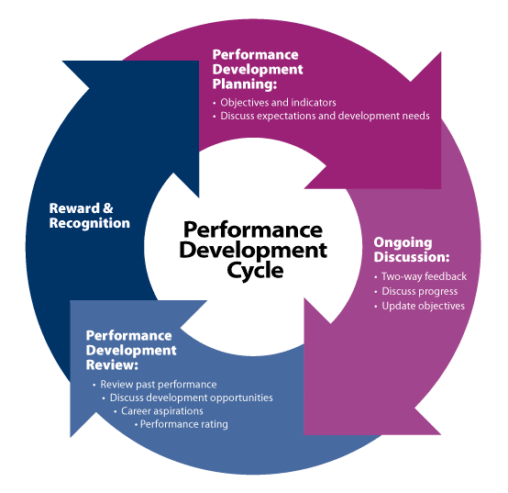
Performance Development Framework Cycle
The Performance Development Cycle consists of four components:
Performance Development Planning
Ongoing Discussions
Performance Development Review
Reward and Recognition

Slide 24
Performance Development Planning
Performance Development Planning is the first component of the cycle. During the planning stage the supervisor and staff member discuss the elements of a Performance Development Plan. At this discussion the following items are addressed:
Performance expectations;
Objectives and indicators;
Development needs and timeframes.
These aspects should be aligned with the staff member’s position description, the operational plan of the department and the company’s strategic plan and goals.

Slide 25
Ongoing Discussions
Discussions about performance should be regarded as an integral part of the continuing process of performance development. Frequent discussions will help ensure that staff receive ongoing guidance, support, coaching and encouragement.
The following items should be included in Ongoing Discussions:
Discussions on progress of the objectives;
Provision of support and coaching to staff member where needed;
Updating objectives where necessary;
Adjustments of development activities where necessary;
Provision of feedback on performance.

Slide 26
Performance Development Review
The Performance Development Review is the basis for assessing overall performance of the performance review period. The discussion should take into account all of the following:
The whole range of the performance objectives set for the review period;
Factors which influenced performance;
Performance over the whole review period;
The relevant position description;

Slide 27
Revision of the role and/or responsibilities;
Comments from significant clients or, if the staff member reported to another supervisor during the period under review, comments from the previous supervisor;
Development activities undertaken;
Career aspirations; and
The overall performance rating.
Reward & Recognition
Supervisors are required to enter the performance rating for staff members in Themis before the end of the performance development cycle. The rating will determine if eligible staff will be awarded an increment. Any rating of 'Satisfactory' or higher will automatically award increments to eligible staff from the increment date

Slide 28
10 Ways To Improve Performance
Focus —Sometimes it feels like we have a thousand “Things To Do” on the list and we rarely get any of them done. Sometimes you get so side-tracked with emails, phone calls, customer needs, etc.
Know your strengths — Focus on your strengths and know what you are good at. If you are not sure, perform a “S.W.O.T.” (Strengths, Weaknesses, Opportunities, and Threats) analysis and jot down all your strengths.
Improve your weaknesses— One of my mentors, pitching guru, Tom House says “you are as strong as your weakest link, and as efficient as your worst movement.” So it is with business and life.

Slide 29
10 Ways To Improve Performance
Surround yourself with “great” people— One of my coaches, Ali Brown, talks about surrounding yourself with a mindset of people that you want to be like. If you want to be wealthy, hang out with wealthy people.
Prioritize your “Blue-Sky” time— One of my closest mentors and friends, Wayne Cotton, has an entire system on time management to help improve productivity and organization.
Get your “Mellow Yellow” time— God knows we all need more rest. Why do you feel so guilty when you actually get down time? It is actually recommended that you take at least one day off per week and that you partake in enjoyable activities and hobbies.

Slide 30
10 Ways To Improve Performance
Improve Organization— Your organisation skills is vital. Organisation can range from simple tasks such spring cleaning to more complex tasks like arranging a group of people to attempt a difficult task.
Improve your own Health— There is nothing more important than your health. What is the best thing you have done for your health recently?
Hard-work & Enthusiasm— John Wooden talks about “hard work” and “enthusiasm” as cornerstones for success in his book, “Wooden: A Lifetime of Achievements On & Off the Court”.

Slide 31

10 Ways To Improve Performance
Persistence—Most of us are facing some adversity in our life right now. Whether it be financial burden, debt, relationships failing, family stress, business ventures gone bad, employee or employer tension, worry about a failing market, or ill-health that is bringing you down, many of us have at least one thing in our life that we need to focus on overcoming.

Slide 32
Personal Development
Personal development includes activities that improve awareness and identity, develop talents and potential, build human capital and facilitate employability, enhance quality of life and contribute to the realization of dreams and aspirations.
The concept is not limited to self-help but includes formal and informal activities for developing others in roles such as teacher, guide, counsellor, manager, life coach or mentor.
When personal development takes place in the context of institutions, it refers to the methods, programs, tools, techniques, and assessment systems that support human development at the individual level in organizations.

Slide 33
Personal Development Activities
At the level of the individual, personal development includes the following activities:
Improving self-awareness
Improving self-knowledge
Building or renewing identity/self-esteem
Developing strengths or talents
Improving wealth
Spiritual development
Identifying or improving potential

Slide 34
Personal Development Activities
Building employability or human capital
Enhancing lifestyle or the quality of life
Improving health
Fulfilling aspirations
Initiating a life enterprise or personal autonomy
Defining and executing personal development plans
Improving social abilities

Slide 35
Reference
http://en.wikipedia.org/wiki/Job_performance
http://en.wikipedia.org/wiki/Performance_management
http://en.wikipedia.org/wiki/Performance_improvement
http://www.streetdirectory.com/travel_guide/21901/corporate_matters/5_ways_great_managers_improve_employee_performance.html
http://www.kent.ac.uk/careers/sk/skillstest.html
http://www.google.com.sg/url?sa=t&rct=j&q=&esrc=s&frm=1&source=web&cd=2&ved=0CEQQFjAB&url=http%3A%2F%2Fwww.cmu.edu%2Fhr%2Fhr_services%2Fperformance%2Fself-assessment.doc&ei=UkpBUsuvFoSGrQfg_YGACw&usg=AFQjCNGrbxYrIqt6hjROV1qeTyuLOc8A3g&bvm=bv.52434380,d.bmk&cad=rjt
http://smallbusiness.chron.com/team-vs-individual-performance-appraisals-20040.html

