Slide 1

8600-400 : Understanding the Management Role to Improve Business Management Performance
Business Administration

Slide 2

8600-400 : Understanding the Management Role to Improve Business Management Performance
Week Four
Notes:
Management Communication

Slide 3
Assignment Questions
Describe the goals and objectives of your organization (12 Marks)
Evaluate the specific responsibilities of middle managers in enabling your organization to achieve its goals (16 Marks)
Evaluate how interpersonal and communication skills affect managerial performance (16 Marks)
Evaluate strategies to overcome barriers to effective managerial communication and interpersonal skills (16 Marks)
Assess own knowledge, skills and behaviour, and their effect on own managerial performance (16 Marks)
Identify areas for personal development to improve own managerial performance (8 Marks)
Produce a personal development plan to improve own managerial performance (16 Marks)

Slide 4
Content
The definition of personal development
14 core concepts of personal development
Personal development plan
Informal and formal training and development
Reactive learning cycle
E-learning and traditional learning
Advantage and disadvantage of e-learning and traditional learning

Slide 5
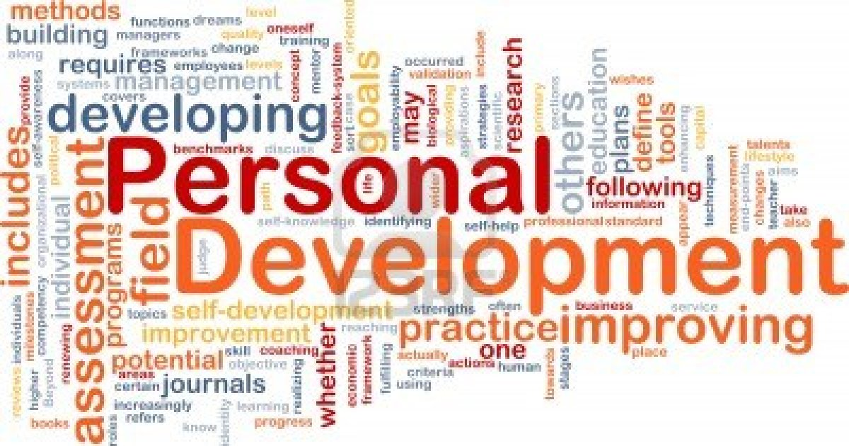
Personal Development
Personal development consists of individual self-development and the development of others. Developing others is also included with the concept of personal development as well as self development and self help.
Personal development, away from developing yourself and developing other people, is about training and investigation. Training would involve personal development procedures, learning programs, evaluation systems, tools and techniques.

Slide 6
Personal Development
Developing yourself- can be detailed to include areas such as:
Raising awareness
Defining priority
Defining moral
Defining a way of life
Defining ethics
Becoming the person you would hope to be

Slide 7
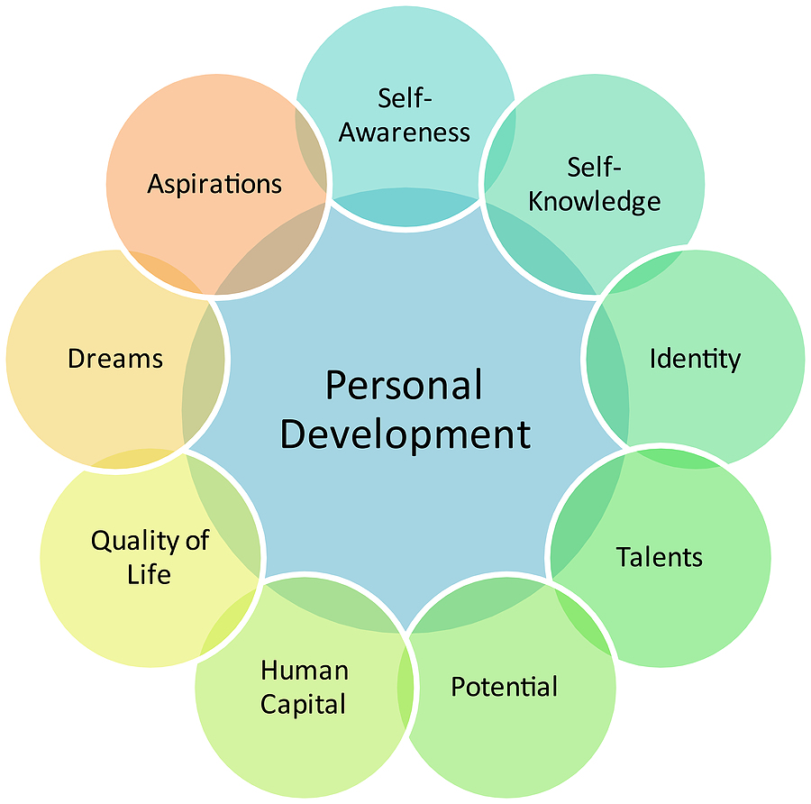
Personal Development
Personal development may include goals, plans or actions. The following statements can be represented as a start to your personal development:

Slide 8
Personal Development
Improvement of self-awareness
Building or renewing individuality
Developing your strengths or talents
Developing your self-knowledge
Identifying or improving potential
Building employability or human capital
Enhancing lifestyle or the quality of life
Realising your dreams or fulfilling your aspirations
Defining and executing personal development plans

Slide 9
14 Core Personal Development Concepts
1. Continuous learning: Take responsibility for your own lifelong personal development, knowing that it’s the secret to success in all areas of life, and your most valuable asset.
2. Positivity: Find the positive aspect in everything, accepting what cannot be changed, and acting on what can, towards a positive result.
3. Personal excellence: Strive to do your best in everything you do. If it’s worth doing, it’s worth doing well.
4. Honesty: Maintain honesty and integrity in all that you do. Trust and respect by others is hard earned, yet can be permanently lost over the smallest lie.

Slide 10
14 Core Personal Development Concepts
5. Know yourself: You are a unique individual with your own strengths and weaknesses, all others have these also.
6. Appreciate the moment: Seek happiness in the present moment, even in the simple things around you such as nature, a good conversation, or a good meal.
7. Communicate well: Learning to communicate well with others is an essential skill, which includes speaking, writing, listening well, and body language.
8. Embrace mistakes: Mistakes are a prerequisite to personal development; you must choose either courage and success, or safety and being average.

Slide 11
14 Core Personal Development Concepts
9. Embrace change: Change is a constant part of life, and integral to personal development and success.
10. Increase your Value: Know that personal development is not a selfish activity; rather it increases your value to others, ranging from relationships, business, and career.
11. Be giving: Seek to be giving, compassionate, loving, yet humble, knowing you receive what you give out.
12. Balance: Seek balance in all areas of life, considering family, relationships, career, business, health, leisure, and spirituality.

Slide 12
14 Core Personal Development Concepts
13. Gratitude: Be thankful for the gift and opportunity of life. If you have a spiritual belief, pursue the core tenets of the teachings and make them part of who you are.
14. Find your excitement: Find things in life that excite you, and act on them. Embracing things which excite and motivate you will move you more quickly into success and happiness, and attract the things you need to get there. This attitude will support and integrate with all the above tenets.

Slide 13
Personal Development Planning
Personal development planning is the process of creating an action plan based on awareness, values, reflection, goal-setting and planning for personal development within the context of a career, education, relationship or for self-improvement.
Personal development plans may also include a statement of one's career and lifestyle priorities, career positioning, analysis of opportunities and risks, and alternative plans (Plan B),and a curriculum vitae.

Slide 14
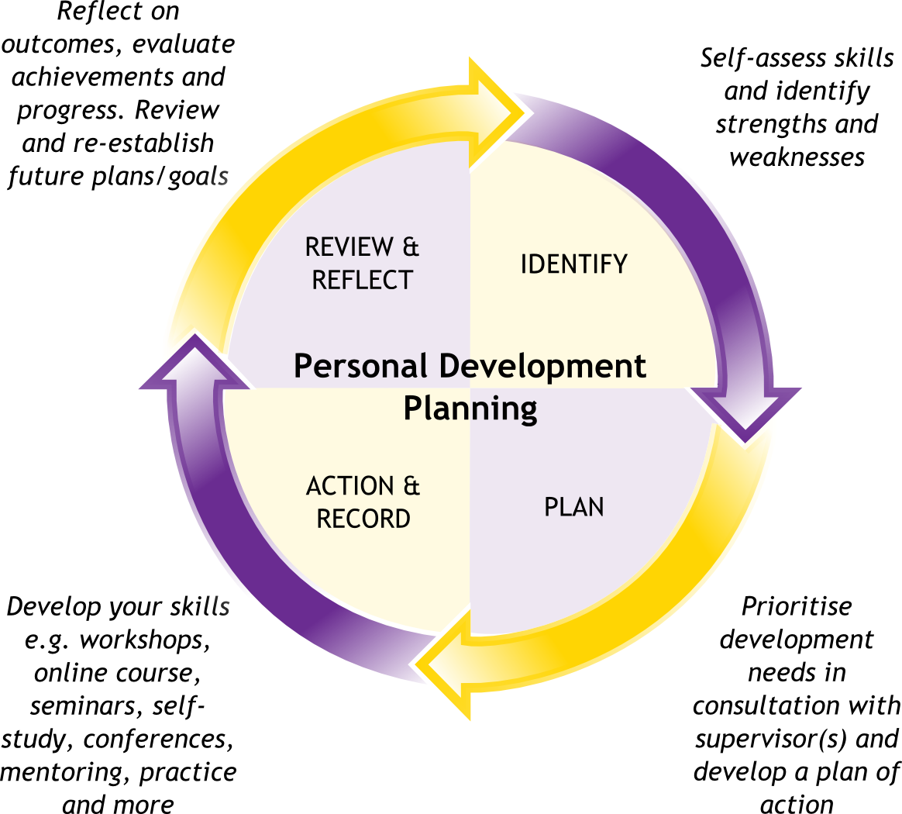
Personal Development Plan

Slide 15
Personal Development Plan
Here are ten easy steps that give you a good start: First thing to do when setting out to make change is to evaluate where you are right now. So, for at least one week (but doing it for two weeks would be better), notice how and where you spend your time.
Also, notice if things take longer than you “think” they should take you. Don’t place any judgment on how and where you spend time, just notice.
Be sure to include weekends so you have a variety between work days and non-work days. Keep this step simple. Don’t try to change anything. Just notice your time commitments.

Slide 16
Personal Development Plan
A personal development plan sample that I like has the following categories: Give yourself permission to take a few moments to dream about your perfect life. While this is only imagination, this exercise opens a portal of inner knowledge that can lead you to your perfect life.
After visualizing where you would like to take your life, compare it with your current life. Be prepared for this step to cause some pain if there is a big difference between the two. But, this step gives you a “starting point” and an “ending point,” both of which are necessary to set out plans to get from one to the other.

Slide 17

Personal Development Plan
Many times making a small change in your current circumstances has stronger ramifications as your life unfolds because it changes your focus.
For example, if you decide to take a 15 minute daily walk just to “percolate” how to take the next step for your life, this small action will move your current mindset from “I’m stuck now” to “What’s next and how do I get there?” Over time, this will gain momentum as your trajectory of life broadens because your “rocket” is now pointed to a new planet – the planet of hope!

Slide 18
Class Activity
A personal development plan

Slide 19
Informal and Formal Training and Development
Informal learning is very likely the most common form of learning. There is no formal structure or curriculum, and usually no expert trainer who teaches the participant There usually is no formal recognition of completion, for example, a certificate or diploma. Informal learning is ideal for very experienced people.
Formal learning is ideal for new learners, for example, to learn a new technology or specific procedure.

Slide 20
Informal Training and Development
Informal training and development is rather casual and incidental. Typically, there are no specified training goals as such, nor are their ways to evaluate if the training actually accomplished these goals or not.
This type of training and development occurs so naturally that many people probably aren't aware that they're in a training experience at all.
Probably the most prominent form of informal training is learning from experience on the job. A more recent approach is sending employees to hear prominent speakers, sometimes affectionately called "the parade of stars".

Slide 21
Formal Training and Development
Formal training is based on some standard "form". Formal training might include:
1. declaring certain learning objectives (or an extent of knowledge, skills or abilities that will be reached by learners at the end of the training),
2. using a variety of learning methods to reach the objectives and then
3. applying some kind(s) of evaluation activities at the end of the training.
The methods and means of evaluation might closely associate with the learning objectives, or might not. For example, courses, seminars and workshops often have a form -- but it's arguable whether or not their training methods and evaluation methods actually assess whether the objectives have been met or not.

Slide 22
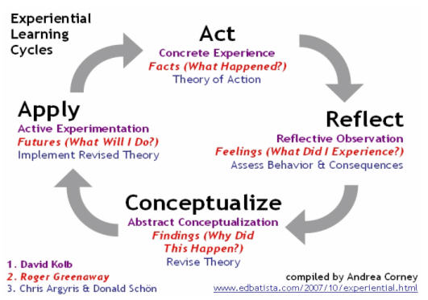
Reactive Learning Cycle

Slide 23
Reactive Learning cycle
A concrete experience compels you to gather facts concerning the incident, and theorize why it happened. It must be something that evokes your commitment to time and effort -something that will result in a significant payoff.
Reflect on how it made you feel, evaluate your behavior, and consider any consequences. Replay the event in your mind, including what others said and how you felt about that. Gather information so that you can formulate an abstract conceptualization, but don't analyze, criticize, or judge yourself harshly.

Slide 24
Reactive Learning cycle
Next in this personal development plan template comes the natural process of re-thinking and re-evaluating the string of events. This is a very analytical step. You are in a different emotional space by now, and with the new information from your previous efforts you can formulate a revised plan.
The fourth and last step is synthesis -you bring all your thoughts together into an action plan. There is where you decide what you will do differently.
You also have to put your personal development plan template into effect -otherwise, it's just an intellectual exercise- but you always have the option and capability to translate your insights into new actions, new plans, as needed.

Slide 25
E-learning and Traditional Learning
E-learning refers to the use of electronic media and information and communication technologies (ICT) in education.
E-learning includes numerous types of media that deliver text, audio, images, animation, and streaming video, and includes technology applications and processes such as audio or video tape, satellite TV, CD-ROM, and computer-based learning, as well as local intranet/extranet and web-based learning.
Information and communication systems whether free-standing or based on either local networks or the Internet in networked learning, underly many e-learning processes.[

Slide 26
Online Learning Advantages
A major reason students turn to online classes is because of the convenience. You can sit at home or go to a library to do your coursework. This eliminates the need for driving, which saves gas, and in some cases, allows you to take classes from distant schools.
Online learners also get to develop their Internet, technology and virtual team skills by participating in online discussions, tests and other virtual learning activities. The ability to do coursework on your own schedule and to manage the pace of your learning experience are also benefits to online students.

Slide 27
Online Learning Disadvantages
A key factor in assessing your potential for effective online learning is your level of self-discipline. Students sometimes misconstrue that online classes are less rigorous or time-consuming. Instead, they require more self-discipline, time management and motivation to complete work.
Limited interaction and access to instructors and no personal contact with other students are also common drawbacks. While effective online instructors are available via e-mail, phone and web conferencing, you don't have the same interpersonal relationship in most cases.
The potential for miscommunication and misunderstandings is more prevalent online as well, especially given the lack of context and nonverbal messages in e-mail and discussion forums.

Slide 28
Classroom Learning Advantages
Classroom learning typically offers multi-sensory appeal. You can listen to the instructor, receive visual cues through PowerPoint images, handouts or whiteboard lists and participate actively in hands-on activities and case studies.
You also have direct access to the instructor in class. Interaction is immediate and you normally have opportunities to ask questions and participate in live discussions.
This also allows you to benefit form the firsthand accounts of other students' experiences. If you want to build and maintain personal and professional relationships during your education, classrooms also offer greater personal contact with other students.

Slide 29
Classroom Disadvantages
In contrast to online learning, classroom learning is normally fairly structured. You meet at regularly scheduled times on the same days each week. This limits flexibility with work and other activities. You generally must be in class to get the learning experience and to keep up with requirements.
Unless your instructors record lectures, in-class instruction is not available after the class session is over. Students who struggle to focus may also find classrooms and cohorts distracting to their learning experience.

Slide 30
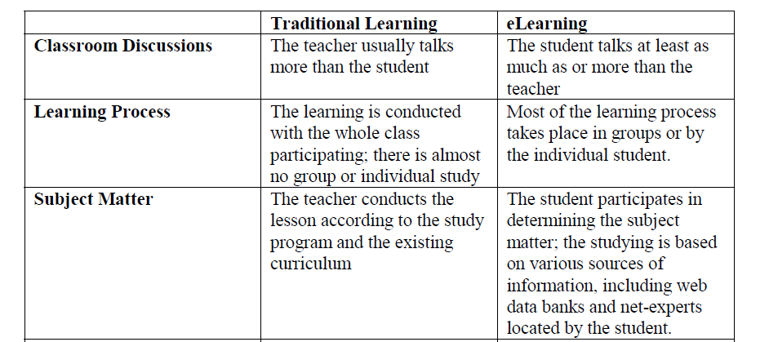
Traditional Learning V.S E-Leaning
The following table summarizes several opinions regarding the comparison between traditional learning and eLearning:

Slide 31
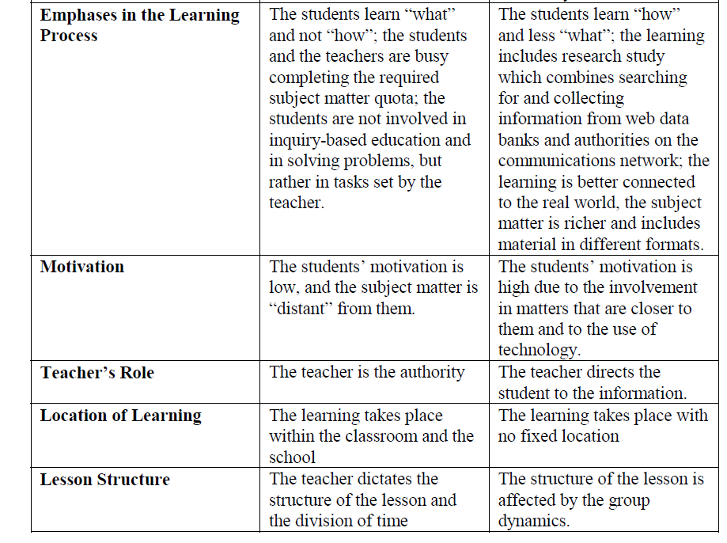

Slide 32
Performance Assessment
Once an annual ritual, performance appraisal has become a continuous process by which an employee’s understanding of a company’s goals and his or her progress toward contributing to them are measured. Performance measurement is an ongoing activity for all managers and their subordinates.
Quantity: The number of units produced, processed or sold is a good objective indicator of performance
Quality: The quality of work performed can be measured by several means.
Timeliness: How fast work is performed is another performance

Slide 33
Performance Assessment
4. Cost-Effectiveness: The cost of work performed should be used as a measure of performance only if the employee has some degree of control over costs.
5. Absenteeism/Tardiness: An employee is obviously not performing when he or she is not at work
6. Creativity: It can be difficult to quantify creativity as a performance indicator, but in many white-collar jobs, it is vitally important
7. Personal Appearance/Grooming: Most people know how to dress for work, but in many organizations, there is at least one employee who needs to be told.
10. Manager Appraisal: A manager appraises the employee’s performance and delivers the appraisal to the employee.

Slide 34
Performance Assessment
8. Self-Appraisal: The employee appraises his or her own performance, in many cases comparing the self-appraisal to management's review.
9. Team Appraisal: Similar to peer appraisal in that members of a team, who may hold different positions, are asked to appraise each other’s work and work styles
10. 360-Degree or “Full-Circle” Appraisal: The employee’s performance is appraised by everyone with whom he of she interacts, including managers, peers, customers and members of other departments.

Slide 35
Class Activity Two
The employee’s role in the performance assessment process preparing for the review

Slide 36
Reference
http://en.wikipedia.org/wiki/Personal_development_planning
http://plmds.hubpages.com/hub/A-Definition-of-Personal-Development
http://www.personal-development.com/articles/coreconcepts.htm
http://www.personal-development-coach.com/personal-development-plan-template.html
http://thebodyforyou.com/personal-development-growth-and-improvement/
http://www.miuw.info/?p=37
http://www.studymode.com/subjects/the-differences-between-traditional-learning-and-e-learning-page1.html
http://managementhelp.org/training/methods/formal-and-informal-methods.htm
http://en.wikipedia.org/wiki/E-learning
http://www.researchtrail.com/articles/Traditional_Learning_vs_eLearning.pdf
http://everydaylife.globalpost.com/online-learning-vs-classroom-learning-4190.html

