Slide 1

8600-408 : Business Management Communication
Business Administration

Slide 2
Content
What is communication?
Communication theories and the communication cycle
Feedback
Types of communication
Business language
Notes:
Management Communication

Slide 3
The communication process
Communication is a process.
Its goal is to convey information—and the understanding of that information—from one person or group to another person or group.
Notes:
Management Communication

Slide 4
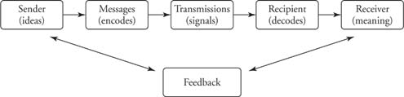
Communication model
Think: How you can relate this to management?
Figure 1: Communication model
Notes:
Management Communication
http://www.cliffsnotes.com/study_guide/The-Communication-Process.topicArticleId-8944,articleId-8918.html

Slide 5
Sender – the person who wants to communicate certain information to another party
Encoding – selecting appropriate symbols includes words, numbers, other verbal and non-verbal cues
Message – is encoded by the sender into symbols and gestures that the receiver can understand

Slide 6
Medium – is the mode of transmission; this could be written or oral, such as reports or interviews
Receiver – the receiver has to decode the message and translate it into information that is meaningful to him
Decoding – translating and attempting to understand the message

Slide 7
Noise – any factor that disturbs, confuses or interferes with communication
Feedback – the sender needs to receive feedback to ensure that the message has been received and understood

Slide 8
Feedback cycle
When two people interact, communication is rarely one-way only.
When a person receives a message, he/she responds to it by giving a reply.
The feedback cycle is the same as the sender-receiver feedback noted in Figure 1.
Notes:
Management Communication

Slide 9
Types of communication
We will go more in-depth into these next week!
Verbal communication
Non-Verbal communication
Written communication
Visual communication
Notes:
Management Communication
To do research on this and share the next week.

Slide 10
VERBAL COMMUNICATION
  This includes all forms of oral communication, usually face-to-face, or via the telephone.
NON-VERBAL COMMUNICATION
  This is also referred to as “body language and includes all gestures and expressions

Slide 11
WRITTEN COMMUNICATION
  This includes all written forms of communication such as letters, reports, memos, diagrams, charts and graphs.
  Personalized or standardized
  Stored and can be revised when needed

Slide 12
VISUAL COMMUNICATION
  Visual communication is communication through visual aid and is described as the conveyance of ideas and information in forms that can be read or looked upon.
  Visual communication in part or whole relies on vision, and is primarily presented or expressed with two dimensional images, it includes: signs, typography, drawing, graphic design, illustration, colour and electronic resources. It also explores the idea that a visual message accompanying text has a greater power to inform, educate, or persuade a person or audience.

Slide 13
Organisational Communication
VERTICAL COMMUNICATION FLOW
  This includes both downward and upward communication.
  Managers pass instructions and orders to subordinates (downward) and receive feedback on tasks, complaints, and grievances from the employees (upward)

Slide 14
LATERAL COMMUNICATION FLOW
  This type of communication takes place when employees at the same level in a company interact with each other and share information and ideas

Slide 15
INFORMAL COMMNICATION FLOW
  This is the type of communication that does not follow the official channels of communication.
  It is also commonly referred to as “the grapevine”

Slide 16
Communication in business
Without communication, organizations would not function.
If communication is diminished or hampered, the entire organization suffers.
When communication is thorough, accurate, and timely, the organization tends to be vibrant and effective.
Notes:
Management Communication

Slide 17
Communication in business
Communication is central to the entire management process for four primary reasons:
  Communication is a linking process of management.
  Communication is the primary means by which people obtain and exchange information.
  The most time-consuming activity a manager engages in is communication.
  Information and communication represent power in organizations.

Slide 18
Communication in business
Communication → A linking process
Communication is the way managers conduct the managerial functions of planning, organizing, staffing, directing, and controlling.
Notes:
Management Communication

Slide 19
Communication in business
Communication → Obtaining and exchanging information
Decisions are often dependent upon the quality and quantity of the information received. If the information on which a decision is based is poor or incomplete, the decision will often be incorrect.
Think buying shares. If you do not know correct/ enough information about the company, can you really make a good decision?
Notes:
Management Communication

Slide 20
Communication in business
Communication → The most time consuming
Managers spend between 70 to 90 percent of their time communicating with employees and other internal and external customers.
Notes:
Management Communication

Slide 21
Communication in business
Communication → Power
An employee cannot do anything constructive in a work unit unless he or she knows what is to be done, when the task is to be accomplished, and who else is involved. The staff members who have this information become centers of power.
Notes:
Management Communication

Slide 22
Reference
http://www.cliffsnotes.com
Notes:
Management Communication

Slide 23
Content
Types of communication
The need for planning when writing
Tone, Language and Formality
Notes:
Understand How To Lead Effective Meetings
01/26/13

Slide 24
Types of communication
Verbal communication
Non-Verbal communication
Written communication
Visual communication
Notes:
Understand How To Lead Effective Meetings
01/26/13

Slide 25

Types of communication
Verbal communication
Face-to-face
Telephone
Radio or Television
Other media.
Notes:
Understand How To Lead Effective Meetings
01/26/13
http://www.cliffsnotes.com/study_guide/The-Communication-Process.topicArticleId-8944,articleId-8918.html

Slide 26
Types of communication
Non-Verbal communication
Body language
Gestures
How we dress or act
Even our scent.
Notes:
Understand How To Lead Effective Meetings
01/26/13
http://www.cliffsnotes.com/study_guide/The-Communication-Process.topicArticleId-8944,articleId-8918.html

Slide 27
Types of communication
Written communication
Letters
E-mails
Books
Magazines
The Internet
Other media.
Notes:
Understand How To Lead Effective Meetings
01/26/13
http://www.cliffsnotes.com/study_guide/The-Communication-Process.topicArticleId-8944,articleId-8918.html

Slide 28
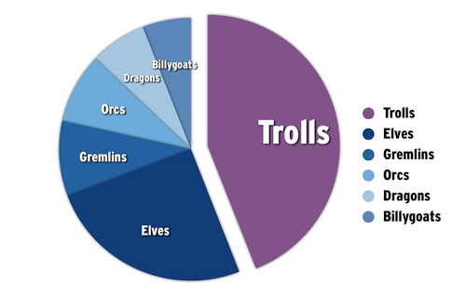
Types of communication
Visual communication
Graphs
Charts
Maps
Logos
Other visualizations.
Notes:
Understand How To Lead Effective Meetings
01/26/13
http://www.cliffsnotes.com/study_guide/The-Communication-Process.topicArticleId-8944,articleId-8918.html

Slide 29
Why plan when writing?
To first define the purpose behind their message
To construct each message with the reader in mind
To select the best medium
To make it 'feedback friendly'.
Notes:
Understand How To Lead Effective Meetings
01/26/13

Slide 30
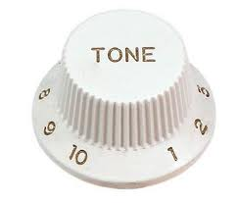
Tone, Language and Formality
Tone
Voice modulation
Pitch
Volume
Rate
Notes:
Understand How To Lead Effective Meetings
01/26/13

Slide 31
Tone, Language and Formality
Language
Vocabulary
Grammar
Slang
Precise
Notes:
Understand How To Lead Effective Meetings
01/26/13

Slide 32
Tone, Language and Formality
Formality
Degree thereof
Status of the speaker relative to the addressee
Presence VS absence of bystanders
Notes:
Understand How To Lead Effective Meetings
01/26/13

Slide 33
Reference
http://www.skillsyouneed.co.uk/IPS/What_is_Communication.html
http://www.faculty.washington.edu/ezent/el.html
Notes:
Understand How To Lead Effective Meetings
01/26/13

Slide 34
Content
Statistical/visual materials and appendices in reports
Evaluating the effectiveness of communication
Ways to acquire feedback
Notes:
Understand How To Lead Effective Meetings
01/26/13

Slide 35
Statistical/Visual materials in reports
Compare the next two presentations of a certain finding.
Notes:
Understand How To Lead Effective Meetings
01/26/13

Slide 36
Statistical/Visual materials in reports
There is a myth that says the meaning of a message is communicated by:
Your words 7%
Your tone of voice 38%
Your body language 55%.

Slide 37
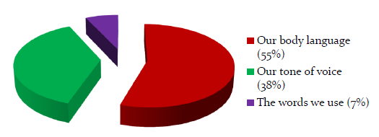
Statistical/Visual materials in reports
Notes:
Understand How To Lead Effective Meetings
01/26/13

Slide 38
Effective communication
The basic question is:
Are you providing the right communication means and products to the right people through the right channel at the right moment?
If the answer is yes to all of these questions, it is quite likely that you are having an impact in terms of communication.
Notes:
Understand How To Lead Effective Meetings
01/26/13

Slide 39
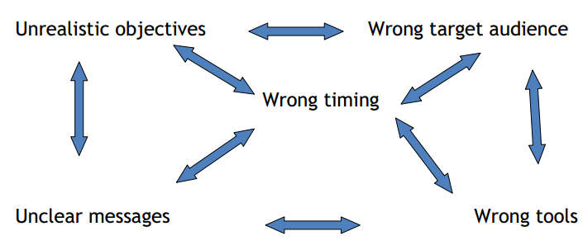
Effective communication
Typical mistakes:
Notes:
Understand How To Lead Effective Meetings
01/26/13

Slide 40
Effective Communication
Steps to effective communication:
Communication plan
Impact assessment
Monitoring communication activities
Proper evaluation
Notes:
Understand How To Lead Effective Meetings
01/26/13

Slide 41
Feedback
Definition:
Information about reactions to a product, a person's performance of a task, etc., used as a basis for improvement.
The modification or control of a process or system by its results or effects, e.g. behavioural response.

Slide 42
Why the need for Feedback?
Think: How you can relate this to management?
If not for feedback, the sender can't know whether the other parties properly interpreted the message or how they reacted to it.
Notes:
Feedback is especially significant in management because a supervisor has to know how subordinates respond to directives and plans. The manager also needs to know how work is progressing and how employees feel about the general work situation.
Understand How To Lead Effective Meetings
01/26/13

Slide 43
Acquiring Feedback
Employee surveys
Memos
Emails
Open-door policies
Company news letter
Notes:
Understand How To Lead Effective Meetings
01/26/13

Slide 44
Reference
http://www.skillsyouneed.co.uk/IPS/What_is_Communication.html
http://www.faculty.washington.edu/ezent/el.html
Notes:
Understand How To Lead Effective Meetings
01/26/13

Slide 45
Content
Techniques for evaluating own strengths and areas for improvement
Personal development planning
Notes:
Understand How To Lead Effective Meetings
01/26/13

Slide 46
Evaluating Performance
Explore the processes used to review individual performance.
There are two types of performance reviews – formal and informal review is likely to include feedback on how individuals perform. Setting clear, attainable goals and a dialogue to agree goals and tasks.
Informal reviews are likely to be more ad hoc and based on good or poor performance, change in leadership, target or objectives or for regular monitoring of performance.

Slide 47
Developing the performance review process
In developing a performance review process:
1. the organization’s goals and their link to individual needs
2. The performance the organization requires from the individual and the link to individual needs

Slide 48
A framework for considering the performance review process:
Strategy
Business plan
Department goals
Team goals
Individual goals

Slide 49
Benefits of Performance Review
Identify an individual’s strengths and weaknesses, and indicate how strengths can be built upon and weaknesses overcome
Help to reveal problems that may be restricting progress and causing inefficiencies
Develop a greater degree of consistency through regular feedback on performance and discussions about potential

Slide 50
The development cycle
Many theorists have described development as being part of a continuous cycle rather than a series of discrete events or activities– the figure indicates there are a cycle close links between the individual an organizational development processes
Identity
Evaluate
Plan
Implement
Figure: the development cycle

Slide 51
Reference
http://www.cliffsnotes.com
Notes:
Understand How To Lead Effective Meetings
01/26/13

