Slide 1

8600-408 : Business Management Communication
Business Administration

Slide 2
8600-408 :
Business Management Communication
Week 01
Notes:
Management Communication

Slide 3
Module Synopsis:
This module provides students with a broad perspective on what constitutes effective communication, and demonstrates why effective communication skills are of prime importance in carrying out a manager’s day-to-day activities. It covers the function, types, effects, primary misconception, and benefits which an effective interactive communication can bring about to a work team.
Notes:
Management Communication

Slide 4
Module Objectives:
To develop an understanding and the ability to communicate effectively, as required by a practising or potential manager.
Notes:
Management Communication

Slide 5
Explain the relevance of the communication cycle for effective communication in management (16 marks)
Explain, with examples, the importance of selecting an appropriate tone, language, and level of formality in management communications (16 marks)
Assess the effectiveness of a range of verbal and written communication methods within your area of the organisation (24 marks)
Notes:
Management Communication

Slide 6
Develop appropriate criteria to evaluate own ability to communicate effectively (12 marks)
Collect and analyse feedback on own verbal and written communication skills (16 marks)
Evaluate own communication skills as a manager, identifying strengths and areas for improvement (16 marks)
Notes:
Management Communication

Slide 7
Content
What is communication?
Communication theories and the communication cycle
Feedback
Types of communication
Business language
Notes:
Management Communication

Slide 8
What is communication?
The Definition of Communication
A gentleman orders a coffee in a crowded cafe. The young woman in line behind him shoots a withering look at the rambunctious toddler tugging on her coat. From the radio blares an advertisement for a one-day sale at the mall. At a nearby table, a deaf couple signs to each other, while a teenager in the corner busily texts a friend on his cell phone. These situations all have one thing in common. They all involve communication.
Notes:
Management Communication

Slide 9
What is communication?
The Definition of Communication
Communication is the act of conveying information for the purpose of creating a shared understanding.
It’s something that humans do every day. The word “communication” comes from the Latin “communis,” meaning “to share,” and includes verbal, non-verbal and electronic means of human interaction.
Notes:
Management Communication

Slide 10
What is communication?
The Definition of Communication
Scholars who study communication analyze the development of communication skills in humans and theorize about how communication can be made more effective.
Notes:
Management Communication

Slide 11
What is communication?
The Definition of Communication
Humans convey information through a variety of methods: speaking, telephones, email, blogs, TV, art, hand gestures, facial expressions, body language and even social contexts.
Communication can occur instantaneously in closed, intimate settings or over great periods of time in large public forums, like the Internet. However, all forms of communication require the same basic elements: a speaker or sender of information, a message, and an audience or recipient.
Notes:
Management Communication

Slide 12
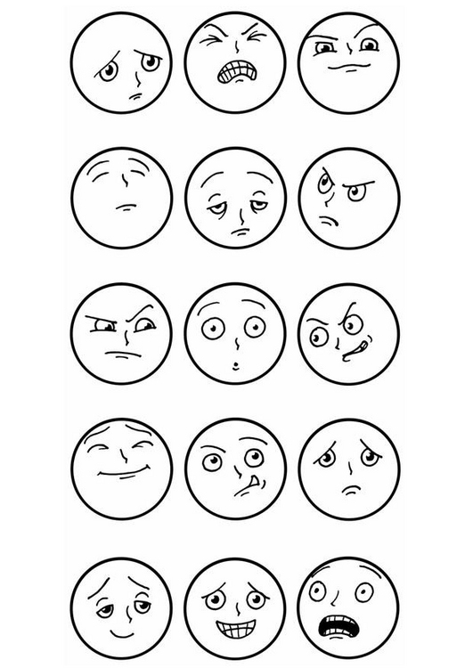


Hand gestures, Facial expressions, Body language
Notes:
Management Communication

Slide 13
What is communication?
The Definition of Communication
Humans convey information through a variety of The sender and recipient must also share a common language or means of understanding each other for communication to be successful. As such, a study of communication often examines the development and structure of language, including the mathematical languages used in computer programming.
Notes:
Management Communication

Slide 14
What is communication?
The Definition of Communication
The act of communicating draws on several interpersonal and intrapersonal skills. These include speaking, listening, observing, questioning, processing, analyzing and evaluating. Recipients of a message must be able to identify the sender’s intent, take into account the message’s context, resolve any misunderstandings, accurately decode the information and decide how to act on it. Such skills are essential to learning, forming healthy relationships, creating a sense of community and achieving success in the workplace.
Notes:
Management Communication

Slide 15
What is communication?
The Definition of Communication
As a field of study, communication spans a broad, rich array of subjects, including sociology, psychology, philosophy, political science, linguistics, history, literature, criticism and rhetoric. Although much of the field’s subject matter is theoretical in nature, communication studies have proven applicable to business, film, theatre, composition, advertising, education, foreign policy and computer science.
Notes:
Management Communication

Slide 16
What is communication?
The Definition of Communication
In today’s globalized, media-driven world, communication studies have become more relevant and exciting than ever. Web developers seek new, inventive ways to draw Internet users to their websites. Public policy writers debate society’s most pressing issues. Through linguistics, computer scientists are developing programming languages that may someday allow humans to interact directly with computers.
Notes:
Management Communication

Slide 17
What is communication?
The Definition of Communication
Students who earn degrees in communication often hold highly influential positions as journalists, editors, university professors, public relations officers, marketing consultants, speech writers, filmmakers, motivational speakers and political campaign managers. To communicate is to shape the world.
Notes:
Management Communication

Slide 18
The Communication Cycle is
THE Secret of Effective
Leadership
If you want to be a highly effective leader one of the most important secrets you need to master is the thorough use of The Communication Cycle.
In this lens I will take you through the six steps of the cycle in detail. By mastering the 6 steps your rating as a leader will improve dramatically in any situation; in any organization whether it be government, business or education
Notes:
Management Communication

Slide 19
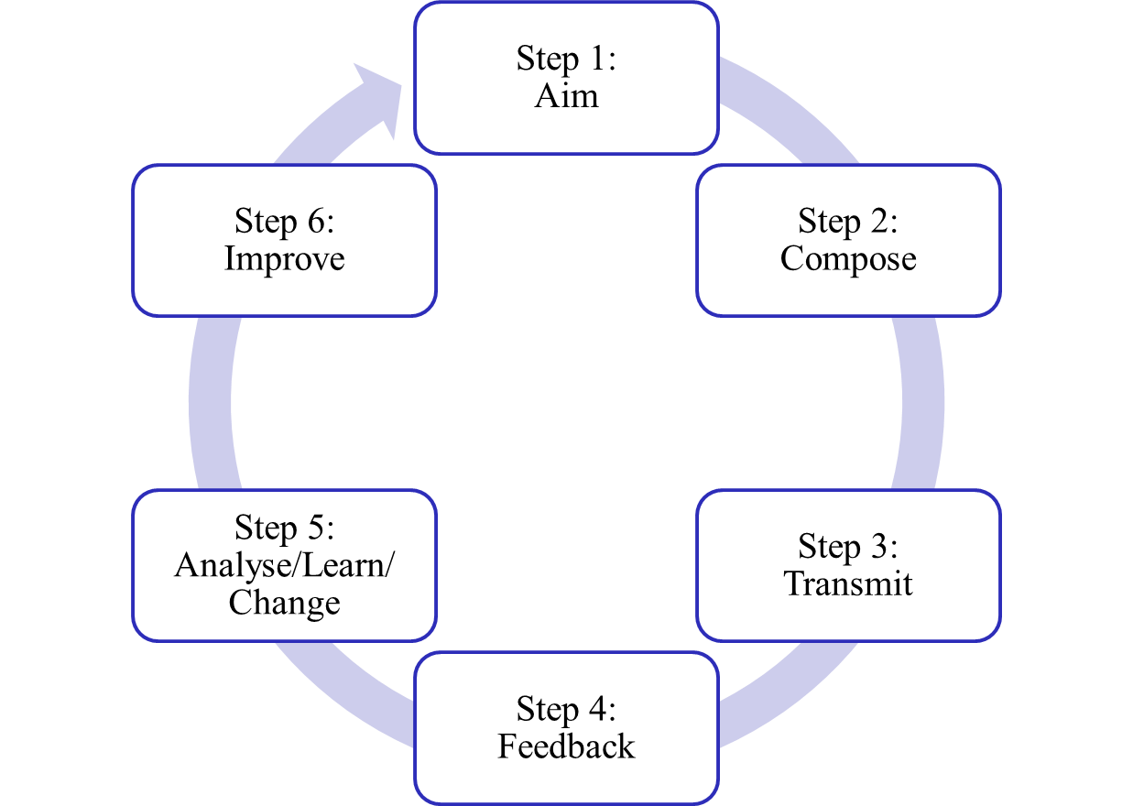
Communication Cycle
Notes:
Management Communication

Slide 20
Communication Cycle
Step 1:
Aim - Who do you want to talk to and what do you want them to do?
Step 2:
Compose - What is the best way to talk to your audience in order to get them to do what you want?
Step 3:
Transmit - Where and when should you communicate in order to optimise your results?
Notes:
Management Communication

Slide 21
Communication Cycle
Step 4:
Feedback - Find out exactly what effect your communication created.
Step 5:
Analyse/Learn/Change - Analyse and learn from the results your communication created.
Step 6:
Improve - Change your behaviour as a result of what you have learned
Notes:
Management Communication

Slide 22
The communication process
Communication is a process.
Its goal is to convey information—and the understanding of that information—from one person or group to another person or group.
Notes:
Management Communication

Slide 23
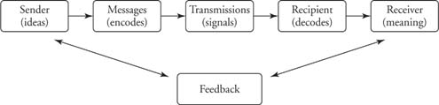
Communication model
Think: How you can relate this to management?
Figure 1: Communication model
Notes:
Management Communication
http://www.cliffsnotes.com/study_guide/The-Communication-Process.topicArticleId-8944,articleId-8918.html

Slide 24
Sender – the person who wants to communicate certain information to another party
Encoding – selecting appropriate symbols includes words, numbers, other verbal and non-verbal cues
Message – is encoded by the sender into symbols and gestures that the receiver can understand

Slide 25
Medium – is the mode of transmission; this could be written or oral, such as reports or interviews
Receiver – the receiver has to decode the message and translate it into information that is meaningful to him
Decoding – translating and attempting to understand the message

Slide 26
Noise – any factor that disturbs, confuses or interferes with communication
Feedback – the sender needs to receive feedback to ensure that the message has been received and understood

Slide 27
Feedback cycle
When two people interact, communication is rarely one-way only.
When a person receives a message, he/she responds to it by giving a reply.
The feedback cycle is the same as the sender-receiver feedback noted in Figure 1.
Notes:
Management Communication

Slide 28
Types of communication
We will go more in-depth into these next week!
Verbal communication
Non-Verbal communication
Written communication
Visual communication
Notes:
Management Communication
To do research on this and share the next week.

Slide 29
VERBAL COMMUNICATION
  This includes all forms of oral communication, usually face-to-face, or via the telephone.
NON-VERBAL COMMUNICATION
  This is also referred to as “body language and includes all gestures and expressions

Slide 30
WRITTEN COMMUNICATION
  This includes all written forms of communication such as letters, reports, memos, diagrams, charts and graphs.
  Personalized or standardized
  Stored and can be revised when needed

Slide 31
VISUAL COMMUNICATION
  Visual communication is communication through visual aid and is described as the conveyance of ideas and information in forms that can be read or looked upon.
  Visual communication in part or whole relies on vision, and is primarily presented or expressed with two dimensional images, it includes: signs, typography, drawing, graphic design, illustration, colour and electronic resources. It also explores the idea that a visual message accompanying text has a greater power to inform, educate, or persuade a person or audience.

Slide 32


VISUAL COMMUNICATION
  primarily presented or expressed with two dimensional images, it includes:
  - signs,
  - typography,
  - drawing,
  - graphic design,
  - illustration,
  - colour and
  - electronic resources.

Slide 33
Organisational Communication
VERTICAL COMMUNICATION FLOW
  This includes both downward and upward communication.
  Managers pass instructions and orders to subordinates (downward) and receive feedback on tasks, complaints, and grievances from the employees (upward)

Slide 34
LATERAL COMMUNICATION FLOW
  This type of communication takes place when employees at the same level in a company interact with each other and share information and ideas

Slide 35
INFORMAL COMMNICATION FLOW
  This is the type of communication that does not follow the official channels of communication.
  It is also commonly referred to as “the grapevine”

Slide 36
Communication in business
Without communication, organizations would not function.
If communication is diminished or hampered, the entire organization suffers.
When communication is thorough, accurate, and timely, the organization tends to be vibrant and effective.
Notes:
Management Communication

Slide 37
Communication in business
Communication is central to the entire management process for four primary reasons:
  Communication is a linking process of management.
  Communication is the primary means by which people obtain and exchange information.
  The most time-consuming activity a manager engages in is communication.
  Information and communication represent power in organizations.

Slide 38
Communication in business
Communication → A linking process
Communication is the way managers conduct the managerial functions of planning, organizing, staffing, directing, and controlling.
Notes:
Management Communication

Slide 39
Communication in business
Communication → Obtaining and exchanging information
Decisions are often dependent upon the quality and quantity of the information received. If the information on which a decision is based is poor or incomplete, the decision will often be incorrect.
Think buying shares. If you do not know correct/ enough information about the company, can you really make a good decision?
Notes:
Management Communication

Slide 40
Communication in business
Communication → The most time consuming
Managers spend between 70 to 90 percent of their time communicating with employees and other internal and external customers.
Notes:
Management Communication

Slide 41
Communication in business
Communication → Power
An employee cannot do anything constructive in a work unit unless he or she knows what is to be done, when the task is to be accomplished, and who else is involved. The staff members who have this information become centers of power.
Notes:
Management Communication

Slide 42
Reference
http://www.cliffsnotes.com
http://www.communicationstudies.com/what-is-communication
http://www.squidoo.com/thecommunicationcycle
Notes:
Management Communication

