Slide 1

8600-408 : Business Management Communication
Business Administration

Slide 2
8600-408 :
Business Management Communication
Week 03
Notes:
Management Communication

Slide 3
Explain the relevance of the communication cycle for effective communication in management (16 marks)
Explain, with examples, the importance of selecting an appropriate tone, language, and level of formality in management communications (16 marks)
Assess the effectiveness of a range of verbal and written communication methods within your area of the organisation (24 marks)
Notes:
Management Communication

Slide 4
Develop appropriate criteria to evaluate own ability to communicate effectively (12 marks)
Collect and analyse feedback on own verbal and written communication skills (16 marks)
Evaluate own communication skills as a manager, identifying strengths and areas for improvement (16 marks)
Notes:
Management Communication

Slide 5
Content
Communication skills
Types of communication skill
Formulating your own ability to enhance personal communication skill
Analyzing your verbal and written communication skill
Good and bad conversation
Notes:
Understand How To Lead Effective Meetings
01/26/13

Slide 6
Communication Skill
Every individual needs to be well equipped with 装备着the tools to communicate effectively, whether it is on the personal front, or at work. In fact, according to the management experts, being a good communicator is half the battle won 有助于成功的条件.
After all, if one speaks and listens well, then there is little or no scope for misunderstanding. Thus, keeping this fact in mind, the primary reasons for misunderstanding is due to inability to speak well, or listen effectively.
Notes:
Understand How To Lead Effective Meetings
01/26/13

Slide 7
Communication Skill
Communication skills includes lip reading, finger-spelling, sign language手语; for interpersonal skills use, interpersonal relations.
skills is the set of skills that enables a person to convey information so that it is received and understood. Communication skills refer to the repertoire 全部技能of behaviours that serve to convey information for the individual.

Slide 8
Communication Skill
Communication skills is the ability an individual displays in consistently一致地 demonstrates论证 the ability to effectively communicate with clients, colleagues, subordinates, and supervisors in professional manner and in the personal department.
Communication skills is the ability to use language (receptive) and express 传递(expressive) information.

Slide 9
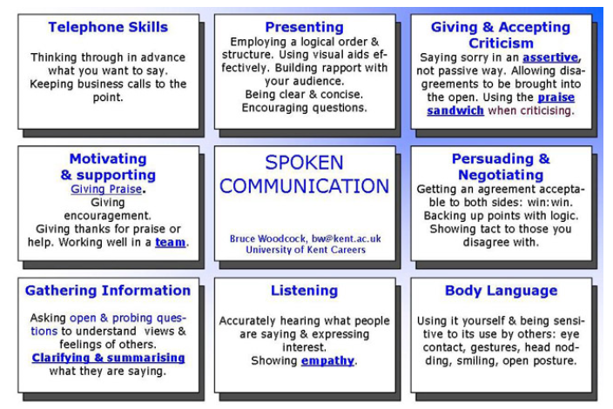
Types of communication skill

Slide 10
Spoken communication
Effective spoken communication requires being able to express your ideas and views clearly, confidently and concisely简明地 in speech, tailoring your content and style to the audience and promoting free-flowing communication.
Be clear and concise: Vary改变 your tone, pace and volume to enhance the communication and encourage questions
Persuading劝说and Negotiating谈判： Arriving at an agreement that is agreeable to both sides: a win:win situation. Back up your points with logic. Show tact to those you disagree with.

Slide 11
Spoken communication
Making a speech in front of an audience: presenting your message in an interesting way, structuring your presentation, using audio-visual aids effectively and building a rapport with your audience.
Communicating effectively in a team
Ask for help when you need it. Research suggests that asking for help with something (within reason) makes you more liked by the person you ask!

Slide 12
Listening
Make effective use of body language and speech: Be sensitive to the other person‘s body language as well as what they say: eye contact, gestures, appropriate humour幽默 and analogies比喻.
Use appropriate body language yourself: face the person with an open, attentive posture and maintain good eye contact (look at the speaker a lot, but don't stare all the time), smiling and nod your head from time to time.
Listen attentively专心地. Express interest in what people are saying and don't interrupt them.
Good listening builds a rapport and understanding with the speaker and allows them to freely express their views. It motivates them to say more
Poor listening makes assumptions, creates resistance阻力 and hostility, demotivates the speaker, inhibits抑制 their development and creates dependence on the listener.

Slide 13
Listening
Use ACTIVE LISTENING.
  These reflect back what the speaker is saying in other words to clarify understanding: you paraphrase and repeat back key points.
  They may summarise and bring new interpretations解释 to the speakers words.
  They show you're listening carefully and checks you are understanding correctly what they are saying allowing the speaker to confirm or correct your feedback.
  They encourage the speaker to elaborate精心制作 and to define their problems.
  It is often the most useful way of giving positive feedback to someone: "I hear what you're saying and take it seriously". You can't keep saying "uh-huh" or "yes" for too long without it sounding false.

Slide 14
Empathy 同感
e.g People with a musical quality to their speech (a big variation变化 in pitch and rhythm called prosody) tend to be more empathic. Lisa Aziz-Zadeh of the University of S. California found that people whose speech is most intonated, lilted or "sing-song" have more ability to empathise with others and to convey emotion. Empathy means being open to the ideas of others and sensitive to their values and feelings: trying to see things from the other person's perspective.
It is about demonstrating证明 that you understand, that you can listen from other person's point of view and reflect their meaning
Each individual has a unique perspective which should be valued. We each occupy our own private world and never completely know what's going on inside other people's minds.
Be prepared to disclose公开 your own feelings and beliefs to encourage others to do the same: be open with other people.

Slide 15
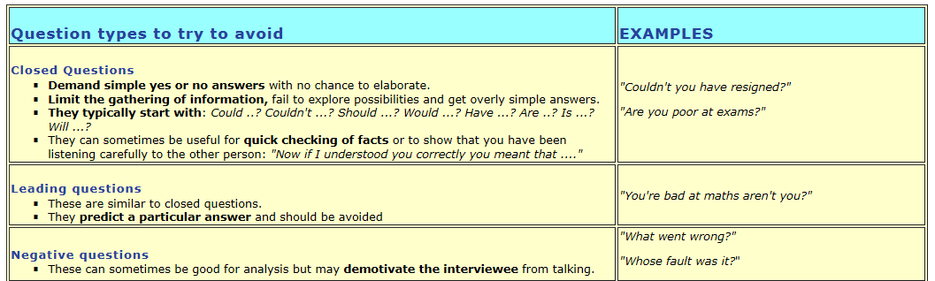

Questioning and gathering information

Slide 16
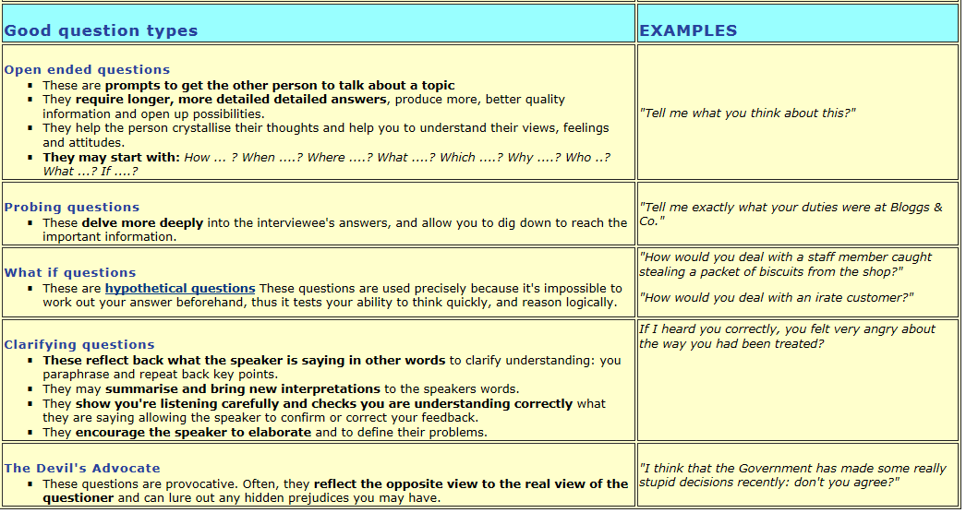
Questioning and gathering information

Slide 17
Confirm and clarify澄清
Ask yourself exactly what you want to gain from the conversation: a lack of clarity can lead to confusion and poor decisions.
Asking clarifying questions: "How?", "Why?", "When?", "Who?", "What?", "Where?", will help the other person crystallise their thoughts.
Summarise the main points in simple language.
Get the other person's agreement that your summary is accurate.
Define the problem and then move the focus to the solution: separate the points that relate to the problem and those that relate to the solution.
Agree on the action you will both take: even if this is that there will be no action. `

Slide 18
Verbal communication skills
Telephone skill
Listening
Questioning
Giving and receiving feedback
Summarizing
Responding

Slide 19
Writing communication skills
Letter
Email
SMS or intranet
Fax
Report
Proposal
Notice boards
Memo

Slide 20
Situation | Communication method
To warn a member of your team about shortfalls in performance | Letter-this is a warning and will need to be kept on record, you need to know that your team member has received it
To remind your team about the staff charity half-marathon at the end of the month | Email, text message, intranet
To remind all your team members that appraisal interviews start next week | Email, memo staff notice board, intranet
To provide a supplier with a purchase order | Letter or fax will give them a written record. You could also email, if you know that the supplier is accustomed to receiving orders, etc. in this medium
To present the month’s sales figures to senior management | Email report
To suggest a new format for product packaging | Presentation
To brainstorm some ideas for a new service with your team | Instant massaging

Slide 21
Giving feedback
Feedback has also been called constructive criticism 建设性批评.
Only give feedback if the gain利润 will exceed超过 the pain: only use it for important things.
Praise表扬 more than you criticise!批评 Identifying and developing strengths is more effective than focusing too much on negatives.
Constructive criticism which shows the person how they can improve. Not "Debbie was hopeless!", but "Debbie made some very useful contributions but her voice was a bit quiet. I couldn't hear her very well, so she needs to raise her voice a bit in future."
It's a good idea to ask permission: "Do you mind if I give you some feedback?". This gives the person time to prepare.

Slide 22
Giving feedback
Try to give feedback immediately: on the spot if possible: it's most effective when fresh in the person's mind. The more quickly it is given the more relevance and power it will have.
Be direct and honest. Get quickly to the point, don‘t have long and embarrassing令人为难的 introductions, although starting with some genuine praise based on what the person has actually done will help (see the praise sandwich below).
Give feedback in private if at all possible, it's insensitive to do this in front of others.
Focus on the most concrete具体 and recent example
Stick to坚持 a single clear issue, don't pack in too much criticism as this can be disheartening

Slide 23
Giving feedback
Only criticise behaviours that can be changed: "You need to improve your computing skills" rather than "You're stupid"!
Give feedback on a person's behaviour not about the person themselves. Give accurate descriptions of behaviour not comments about the person's qualities and worth as an individual: "You have been late for work a lot in the last month"rather than :"You're lazy"!
Don't compare the person with other people, as this can build jealousy: "Jane is always punctual"
Use "I" not "You" statements: "I feel upset" not "You made me feel upset".

Slide 24
Giving feedback
Use specific examples. Don't say "You're hopeless at this", say "We need to give you training on how to do this"!
  describe the behaviour
  describe your reaction 反应
  explain why you feel this way
  show you understand what's behind their behaviour
  suggest a different way of behaving
Stick to facts: describe behaviour but also what happened as a result.
The best decisions are those people reach for themselves. Try not to tell the other person directly what they should and shouldn't do. Let them explore their behaviour and say themselves what needs to be done. This avoids the build up of resentment.

Slide 25
Giving Praise表扬
Tell people something they have done that you like or what you like about them.
Give them thanks if they have done something for you. Even a simple thank you can make a big difference.
Give encouragement. If someone is not sure that they are able to do something, give them encouragement if you think they can do it.
Describe positive behaviour and it's effect in concrete terms "I really appreciate how you took the time to ...."
Respond to praise by thanking the person.

Slide 26
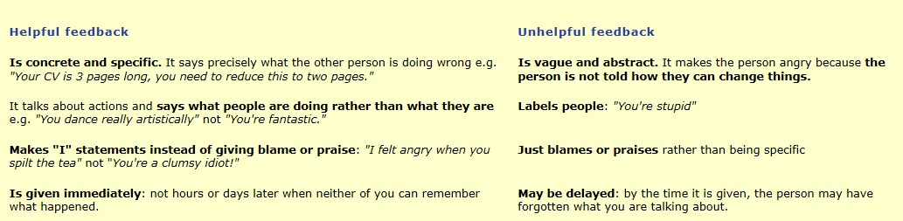
Helpful and unhelpful feedback

Slide 27
Good conversations
e.g Researchers at the University of Arizona & Washington University tracked conversations of 79 students. They assessed how many conversations were trivial不重要 and how many substantive实质性的, based on whether the information exchanged was banal平庸的: “Hot today isn't it?” or more serious: “I'm really worried about her relationship with him ...”.
The happiest subjects spent 70% longer talking than the unhappiest ones, which suggests that “the mere time a person spends in the presence of others is a good predictor of the person’s level of happiness”. The happiest participants also had twice as many substantive conversations and only a third as much small talk as those who were least content.
The authors suggest that adding five substantive conversations to your weekly social calendar could boost your spirits dramatically. “Just as self-disclosure can instill a sense of intimacy in a relationship, deep conversations may instill a sense of meaning in the interaction partners.”

Slide 28
Good conversations
Should be two way with both parties equally involved and interested. It is a shared experience. It is a partnership like a dance: you respond to each other's movements and are both winners.
Build them around respect: treat other people the way you want to be treated yourself. The atmosphere气氛 should feel comfortable: like plants, conversations need good ground to take root根 and flourish茂盛.
Talk about mainly positive things. People who talk about good news tend to cheer people up whereas people who always talk in negatives tend to depress the people they are talking to! Obviously there must be a balance, as sometimes we must talk about unhappy events, but make sure you don't do this too much. You wion't go far wrong if you use the old adage: "If you don't have anything nice to say, don't say anything at all!"

Slide 29
Good conversations
There should be a willingness乐意 to be open on both sides. Each person has the opportunity to express their point of view and feelings. Relationships develop through conversations where we open up and exchange details to create closeness.
Always address someone by their first name if you know this. It shows that you are treating them as an individual.
A good conversation makes a difference; something useful happens and it has a satisfying conclusion.
Nod 点头your head from time to time to encourage the speaker.
Leave spaces留有空间: stay silent for a few seconds. Don't talk for too long: our attention only lasts a few minutes before we need a break. Cut your story into bite sized chunks to allow breathing space.

Slide 30
Good conversations
Make descriptions specific: don‘t generalise推广 or use clichés. Be precise精确 and concrete具体.
Ask the speaker to elaborate on 详细说明major points.
Regularly summarising can improve the quality and accuracy of your conversations. Feed brief summaries back into the conversation.
When starting conversations show that you value the other person's attention: "I'd really like your opinion about ....."

Slide 31
Bad conversations
We make guesses and assumptions rather than listening properly. Assumption is the enemy of good communication; we assume that the other person is just like us. Avoid prejudice 偏见 and presumption傲慢. Similarities between people make communication possible, but differences make it worthwhile值得的.
We score points off each other and apply pressure.
Our opinions and feelings are denied拒绝deny: we feel under attack, ignored, patronised, put down and threatened.

Slide 32
Progression of conversations with people you don't know
The fundamentals基本 of conversation haven't changed much in 200 years. Even then there was a progression from small talk to more serious topics:
"The hindrance thrown in the way of a very speedy intimacy .... prevented their doing more than going through the first rudiments of an acquaintance, by informing themselves how well the other liked Bath, how much she admired its buildings and surrounding country, whether she drew, or played, or sang, and whether she was fond of riding on horseback."
Northanger Abbey by Jane Austen

Slide 33
Progression of conversations with people you don't know
Begin with light topics such as the weather and later move onto more serious topics. Light conversation/small talk
Humour幽默
Friendly gossip
Affection
Support
Problem solving
Discussing deep subjects

Slide 34
Managing turn-taking when talking to another person
First the speaker makes eye contact
The speaker then looks away whilst speaking but makes eye contact from time to time to see whether listener wants their turn to speak
If the listener doesn't want to speak they will nod or break eye contact or say something like " uh huh" or "yes"
If the listener wants to take their turn to speak they will look the speaker in the eye or lean forward or perhaps raise their finger in the air

Slide 35
Reference
http://www.kent.ac.uk/careers/sk/communicating.htm
http://en.wikipedia.org/wiki/Workplace_communication
http://www.communicationskills.co.in/definition-of-communication-skills.htm
http://www.moneycrashers.com/effective-workplace-communication-skills/
Ilmtextbook effective communication
Notes:
Understand How To Lead Effective Meetings
01/26/13

