Slide 1

8600-409 : Business Financial Management
Business Administration

Slide 2
Content
Key Financial Statements
Preparing and monitor budgets
Pricing for profitability
Reviewing financial performance
External reporting

Slide 3
Key Financial Statement
Profit - a financial gain, especially the difference between the amount earned and the amount spent in buying, operating, or producing something.
Financial Planning is an ongoing process to help you make sensible decisions about money that can help you achieve your goals in life; it's not just about buying products like a pension or an ISA.
Cash flow - the total amount of money being transferred into and out of a business, especially as affecting liquidity.
Assets keep a business afloat. They can be sold during lean times, used as collateral during expansion and help produce a healthy balance sheet. Business assets range from cash on hand, to buildings, to patents and logos.

Slide 4
Cash Flow Forecasting
Cash flow forecasting or cash flow management is a key aspect of financial management of a business, planning its future cash requirements to avoid a crisis of liquidity.
Angela is thinking of setting up on her own in business as an information systems consultant. She currently has a bank balance of $1,500. In order to meet her mortgage and other personal financial commitments, she must take $1,000 from the business each month. Angela thinks this should not be a problem. She has been promised business worth $2,000 a month from the start her business expenses will only be about $800.
At the start of each month she will invoice customers for the previous month and give them 30 days to pay. Business expenses are mainly for items like petrol and will be settled as she goes along.
Is Angela right when she says she does not have a problem ?

Slide 5
Business Assets
Asset is a resource controlled by the entity as a result of past events and from which future economic benefits are expected to flow to the entity (IASB Framework)
Classification:
Assets may be classified into Current and Non-Current. The distinction is made on the basis of time period in which the economic benefits from the asset will flow to the entity.
Current Assets are ones that an entity expects to use within one-year time from the reporting date.
Non Current Assets are those whose benefits are expected to last more than one year from the reporting date.

Slide 6
Business Assets - Example
Asset | Classification | Economic Benefit
Machine | Non-current | Used for the production of goods for sale to customer.
Office Building | Non-current | Provides space to employees for administering company affairs.
Vehicle | Non-current | Used in the transportation of company products and also for commuting.
Inventory | Current | Cash is generated from the sale of inventory.
Cash | Current | Cash !
Receivables | Current | Will eventually result in inflow of cash.

Slide 7
Preparing and monitor budgets
A sales forecast is an essential tool for managing a business of any size. It is a month-by-month forecast of the level of sales you expect to achieve. Most businesses draw up a sales forecast once a year.
Armed with this information you can rapidly identify problems and opportunities - and do something about them.
A basis for sales forecasts:
- Your sales assumptions -> Developing your forecast
-> Avoiding forecasting pitfalls -> Creating a sales plan

Slide 8
Preparing and monitor budgets
Benefits and Limitation of Financial Planning process:
Advantages:
It will help you to obtain funding if you need it.
It will set out clearly the money that you need to put together to start the business and then to run it for a period.
It will help prevent you from going into a business that will not be successful.
It will highlight periods where your business may need extra financial help.
It will help you to spot problems early so you can make plans for the necessary solution. (for example, it will highlight whether you are holding too much stock or whether your collection is less than it should be or that you will be short of cash at a particular time).

Slide 9
Preparing and monitor budgets
Benefits and Limitation of Financial Planning process:
Disadvantages of Financial Planning:
It can take a lot of time.
It can be a costly process because you will need the assistance of your accountant or financial adviser.
A financial plan merely forecasts and the acc...

Slide 10
Process of managing budgets
1. Strategic Plan
2. Business Goals
3. Revenue Projections
4. Fixed Cost Projections
5. Variable Cost Projections
6. Annual Goal Expenses
7. Target Profit Margin
8. Board Approval
9. Budget Review
10. Dealing With Budget Variances

Slide 11
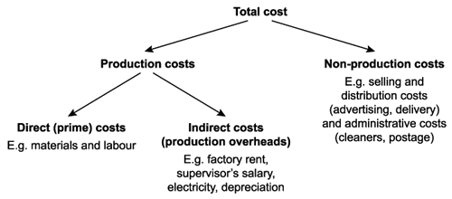
Pricing for profitability
Figure 1. Full Costing Technique

Slide 12
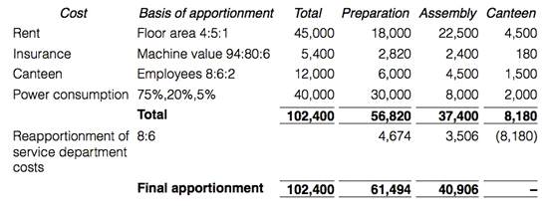
Pricing for profitability
Figure 2. Marginal Cost Technique

Slide 13
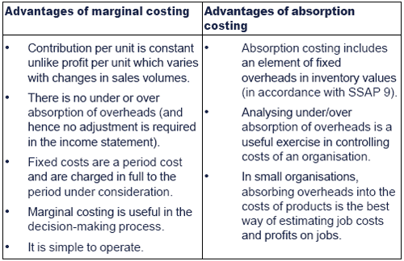
Pricing for profitability

Slide 14
Reviewing Financial Performance
Monitoring Financial Performance Using Financial Statement Data:
Trend or other report that includes the required and any supplemental financial statement measures:
The financial statement measures should be presented in a monthly trend report that ideally shows the performance of each measure each month in the fiscal year. Reports of this type are often one page and include other operating data being tracked by the health center.
Financial statement and trend report comments:
The chief financial officer should produce a brief written summary each month to accompany the interim statements and trend report highlighting and explaining any significant findings.This should include comments about the financial measures.

Slide 15
Reviewing Financial Performance
A profitability ratio is a measure of profitability, which is a way to measure a company's performance. Profitability is simply the capacity to make a profit, and a profit is what is left over from income earned after you have deducted all costs and expenses related to earning the income.

Slide 16
Reviewing Financial Performance
Key issues in preparation of financial information:
Financial statements are useless because they are incomplete; not all assets or liabilities are included
Financial statements are useless because they present assets at their historical costs rather than their fair market values.
Reviewing Financial Performance

Slide 17
Reference
http://books.elsevier.com/pergamonfl
Khan & Jain (2005) Basic Financial Management
Jeanne Bell - Financial Leadership for Nonprofit Executives: Guiding Your Organization to Long-Term Success
Jerome McKinney - Effective Financial Management in Public and Nonprofit Agencies: A Practical and Integrative Approach

