Slide 1
FitVerse
Food + Workout routine recommendation system based on AI

Slide 2
1
Problem
Statement

Slide 3
1 Problem statement
How is it possible to get most personalized diet + workout plan that is customized to your BODY ?
Problem(s)
that our app will address
Issue #1
In today’s fast-paced society, it is very challenging to eat right and exercise right. Most people know the benefits and desire to eat a balanced diet and to do the right amount of exercise, but many just do not have the time to plan what to eat and how much and what exercise to do. Some tired to count calories but there is up to now, no quick and accurate way to do so.
Issue #2
On the other hand, eating is also an activity which can bring happiness. We all feel happy when we are served our favorite food. How do we maximize this happiness and at the same time avoid putting on extra weight which makes us feel guilty the next time we ordered that chocolate ice-cream?

Slide 4
2
Proposed
Solution

Slide 5
2 Proposed solution
The proposed solution is an Intelligent Self-Learning System which recommends to the user a highly
personalized daily eating and exercise plan which keeps the calories in check and maximizes the user’s
happiness from food consumption.
The exercise plan is also being optimised such that it is just enough
to burn away the input calories by an amount based on user’s weight loss goal.

Slide 6
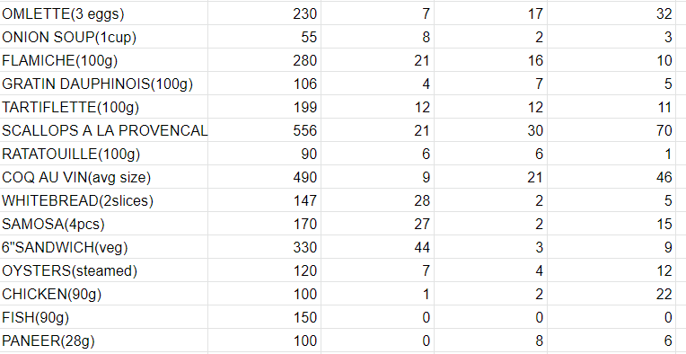
2 Proposed solution
Two datasets are used in this project. One is a listing of food items with its respective calories, utility and carbohydrate, fat and protein composite. The calories and carbohydrate, fat and protein composite information is taken from https://www.myfitnesspal.com/food/search. The utility value is arbitrarily populated for the development of the system. In a production setting, these values will be elicited from the user.

Slide 7
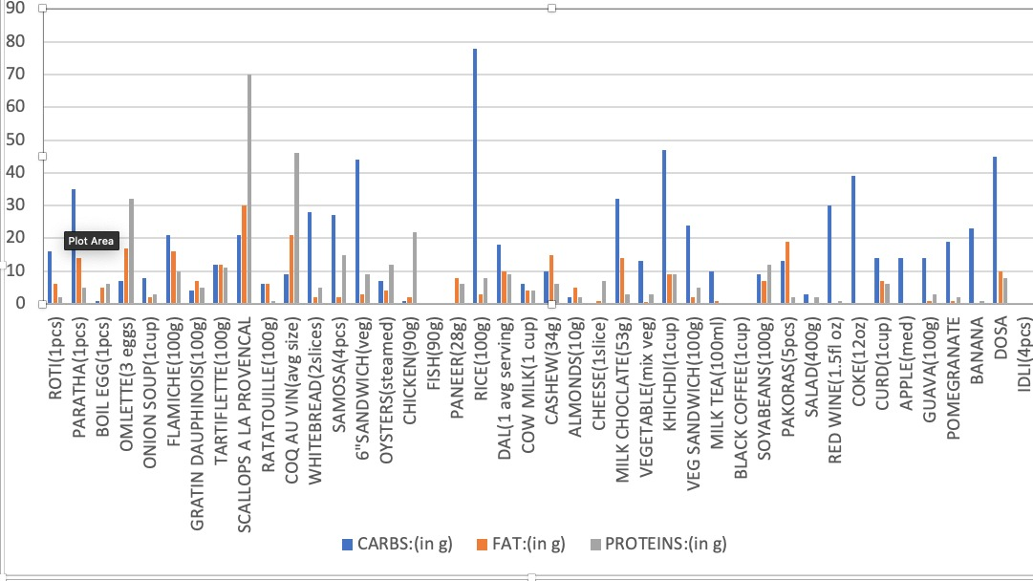
2 Proposed solution

Slide 8
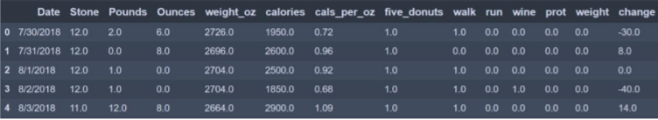
2 Proposed Solution
The second dataset is provided by ChrisBow on Kaggle. This dataset contains information like calorie intake, and whether the author went for exercises like brisk walks and runs. For this assignment, only 4 variables ‘calories’, ‘walk’ (representing if brisk walk of at least 20 minutes has been completed), ‘run’ (representing if a run of 2.5 miles has been completed) and ‘change’ (weight change in ounces,
target variable) are used. In future, rather than just indicator values for exercises, the observations
can be continuous-value data from fitness trackers like Fitbit and Garmin, providing deeper data
insights like minutes spent

Slide 9
3
Solution
Overview

Slide 10
3 Solution Overview
The solution comprises:
(1) Calories and Happiness Optimizer,
(2) Daily Meal Planner and,
(3) Daily Exercise Planner

Slide 11
3 Solution Overview
The Calories and Happiness Optimizer selects 21 food items from the food listing comprising of 44
initial food item set. Each food item has a utility score elicited from the user representing how much
the user likes that food item.
The higher the utility score, the happier the user will feel after consuming
the food item.
The goal of the optimizer is to maximise the total utility score (thus maximising
happiness) and to keep within a specific daily calorie intake. The 21 food items represent the eating
plan for a week and must not have repeated food items. Various Evolutionary Computation techniques
are used to perform the optimization for comparison. From week to week, a rule can be imposed such
that not more than 10 food items can be repeated.

Slide 12
3 Solution Overview
The Daily Meal Planner takes the weekly eating plan and uses AI and data analysis to learn the user’s preference on what food they like or do not like to eat in close succession. An example is that if the user ate chicken rice during lunch, he may enjoy some specific type of dish less for dinner as compared to if he had another type of food for lunch.
The output of the Daily Meal Planner is an optimized sequence for the 21 food items organized into 7 x 3 meals a day.

Slide 13
3 Solution Overview
The list of possible exercises for recommendation comes from a historical list of exercises which the user has engaged in the past.
This data will be collected through a smart watch which tracks user’s daily exercise activities

Slide 14
3 Solution Overview
Genetic algorithm is suitable for this task because the task is a combinatorial optimization problem with a maximum calorie constraint.
Chromosome Representation – Each chromosome has 70 genes which takes on binary ‘0’ or ‘1’ indicating if a particular food item is selected. Only 21 genes can be ‘1’.
Fitness Function – The fitness function is the summation of utility score for the 21 food items represented in each chromosome. Constraints – There are two constraints. (1) The solution must only select 21 meals (21 ones in the final solution) based on the assumption of 3 meals a day i.e. 21 meals a week. (2) The allocated calorie budget cannot be exceeded. (1) is a hard constraint and (2) is a soft constraint with penalties if violated.
Crossover Operation – The crossover operation uses 2 randomly selected crossover points.
Mutation Operation – The mutation operation random toggles the gene value based on rate of mutation. After mutation, a special handing is implemented to adjust the gene value such that there are only 21 genes with ‘1’. Replacement Strategy – The fittest half parent population is combined with the fittest half offspring population to form the next generation.

Slide 15
3 Solution Overview
Genetic algorithm is suitable for this task because the task is a combinatorial optimization problem with a maximum calorie constraint.
Chromosome Representation – Each chromosome has 70 genes which takes on binary ‘0’ or ‘1’ indicating if a particular food item is selected. Only 21 genes can be ‘1’.
Fitness Function – The fitness function is the summation of utility score for the 21 food items represented in each chromosome. Constraints – There are two constraints. (1) The solution must only select 21 meals (21 ones in the final solution) based on the assumption of 3 meals a day i.e. 21 meals a week. (2) The allocated calorie budget cannot be exceeded. (1) is a hard constraint and (2) is a soft constraint with penalties if violated.
Crossover Operation – The crossover operation uses 2 randomly selected crossover points.
Mutation Operation – The mutation operation random toggles the gene value based on rate of mutation. After mutation, a special handing is implemented to adjust the gene value such that there are only 21 genes with ‘1’. Replacement Strategy – The fittest half parent population is combined with the fittest half offspring population to form the next generation.

Slide 16
Au Revoir!

Slide 17
A presentation by
Team FitVerse
Arihant Jain
Arpit Kharbanda
Aman Bisht

