Slide 1
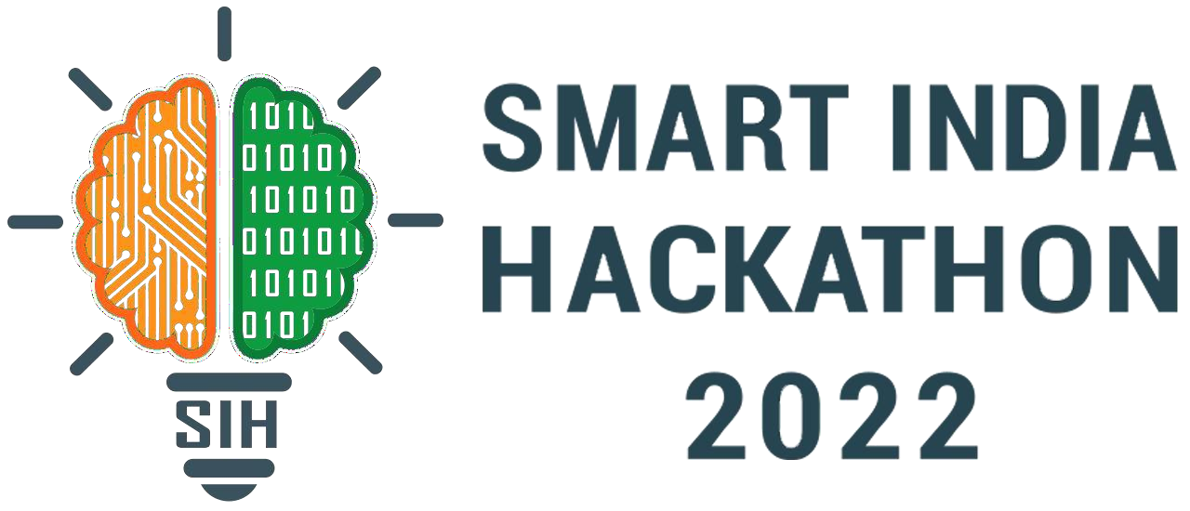
Basic Details of the Team and Problem Statement
Ministry/Organization Name/Student Innovation: Ministry of Social Justice and Empowerment
PS Code: SIH1307
Problem Statement Title:Computerized cognitive Retraining Program for Home training of Children with Disabilities.
Team Name: Team Caffiene
Team Leader Name: Yashveer Institute Code (AISHE): U-0522
Institute Name: Jaypee Institute of Information Technology , Noida
Theme Name:MEDTECH/BIOTECH/ HEALTHTECH

Slide 2
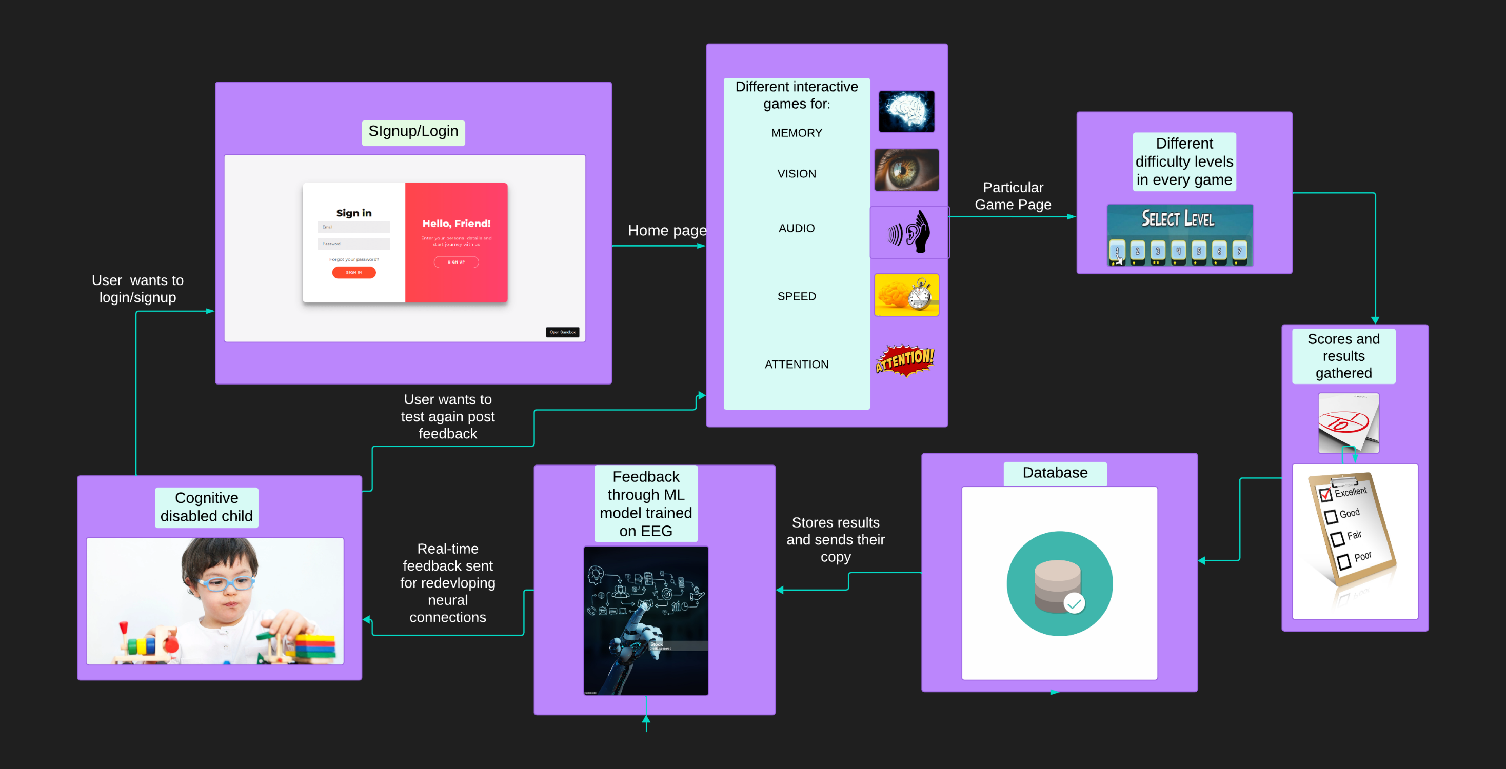
ARCHITECTURE

Slide 3
Idea Details
IDEA / SOLUTION :
Implementation of a Cognitive retraining program for home training of children with disabilities
Problem: Children with cognitive diseases have to undergo a tedious , expensive and uncomfortable therapies offline.
Our Idea: Create an online portal/website that brings in person therapies to doorstep of every disabled child at remarkably low cost.
FEATURES:
Interactive games:No bore boring therapies anymore!Every child can play and cure his coginition disabilities at same time.
Community building:An amazing community of like minded children , focused on multual growth.
Real Time feedback:Results of every game calculated and feedback sent in real time to rewire child’s neurological pattern and help him cure his coginition disabilities.
Future Implementation :
EEG Models , it have the potential to provide real-time insights into a child's brain activity, allowing for personalized and responsive training.
TECHNOLOGY STACK:
Frontend:Html,css,javascript,bootstrap
Backend:NodeJs,Express.
Database:MongoDB

Slide 4
Approach Details
The home page contains a list of various cognitive disabilities that children may face.
The list consists of memory,attention,auditory ,visual,speed and numerical cognition abilities.
The user may choose any section depending upon his/her disabilities.
Upon choosing a particular disability, the user is given different games which test, evaluate and help them improve upon their disability
The user plays the interactive game and his score is calculated and shown .
The score is also stored in our database for future references.
In future implementation, we plan to make a ML model which replaces EEG therapy in software mode by evaluating scores and sending back feedbacks in real time to trigger neuroplasticity in children.
The children will instantly act upon the feedback to make correct neurological patterns in their brain and discard the old ones

Slide 5
Team Member Details
Team Leader Name: Yashveer
Branch : BTech
Team Member 1 Name: Disha Purwar
Stream : CSE
Year : III
Branch : BTech
Team Member 2 Name: Priyanshu Branch : BTech
Team Member 3 Name:Madhav Bansal
Branch : BTech
Team Member 4 Name: Adesh Gupta
Branch : BTech
Team Member 5 Name: Shreya Purwar
Branch : BTech
Stream : CSE
Year : III
Stream : CSE
Year : III
Stream : CSE
Year : III
Stream : CSE
Year :III
Stream : CSE
Year : III

