Slide 1
Building Hybrid Oracle Forms and ADF Applications
By:
Gavin Woods, Technical Manager, PITSS America LLC

Slide 2
Agenda
Introduction
Forms-to-ADF Migration Strategies
Forms-ADF Hybrid Solutions
Case Study: DTE Energy

Slide 3
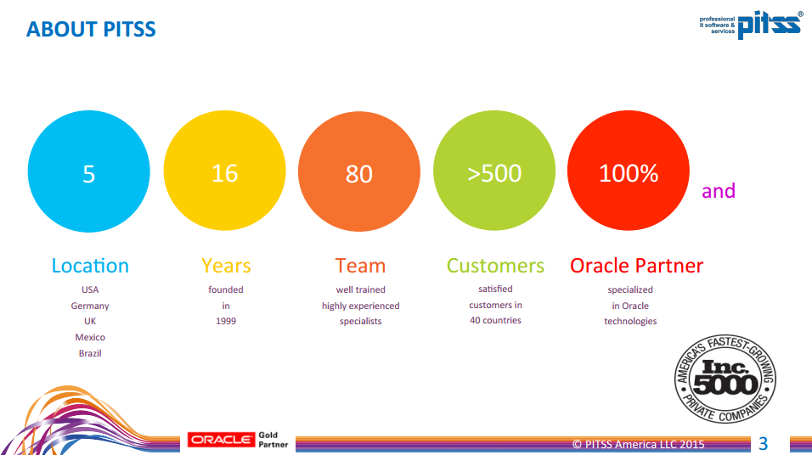

Slide 4
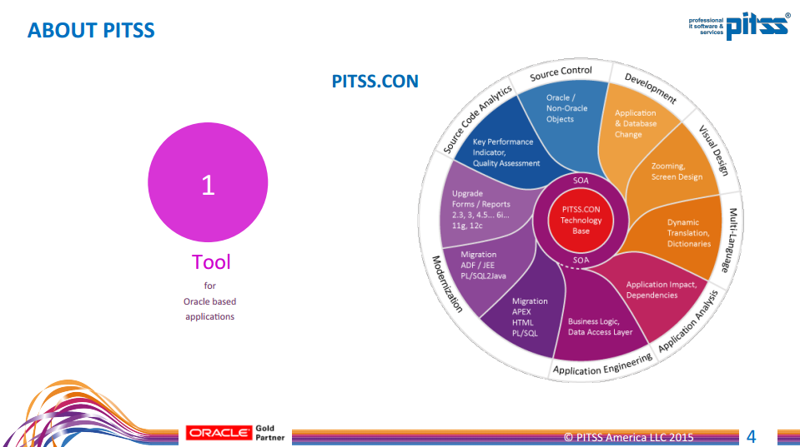

Slide 5
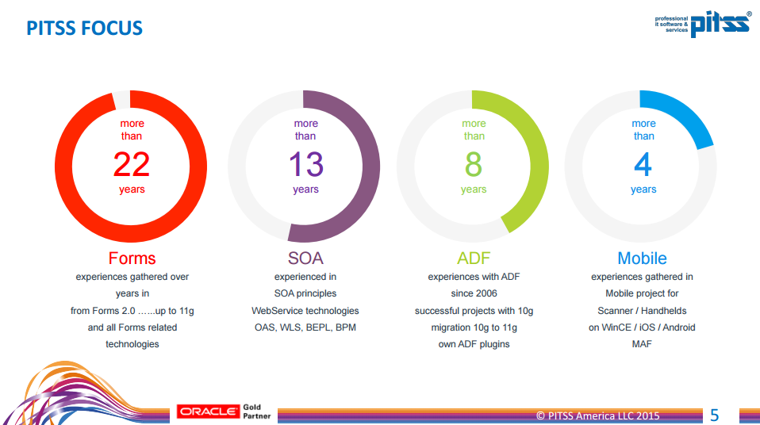

Slide 6
Gavin Woods
Technical Manager, PITSS America LLC

Slide 7
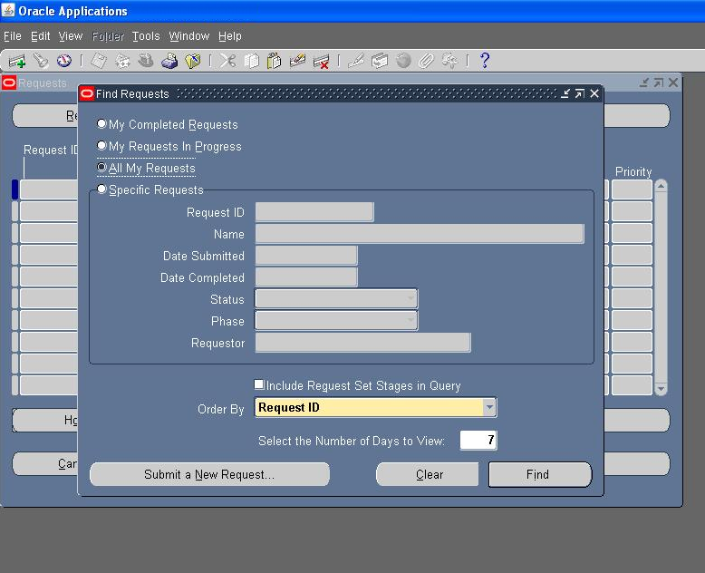
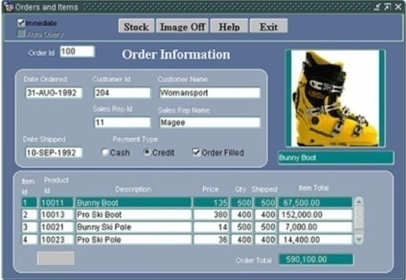

Slide 8
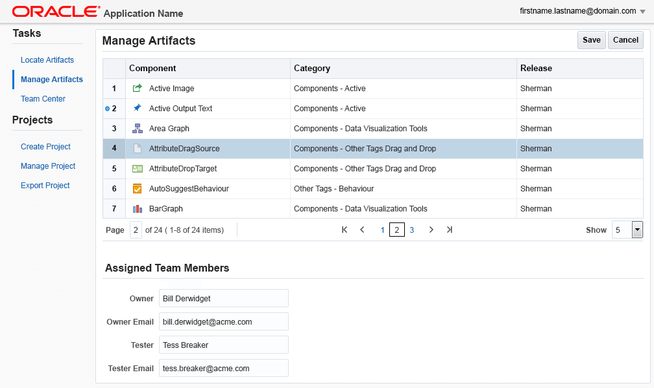
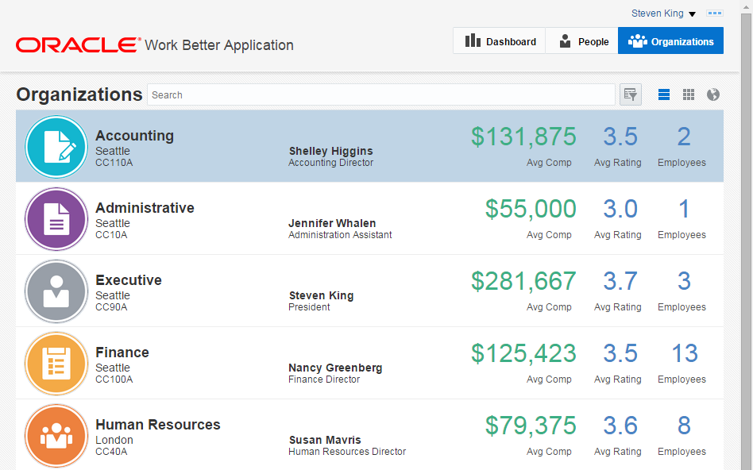

Slide 9
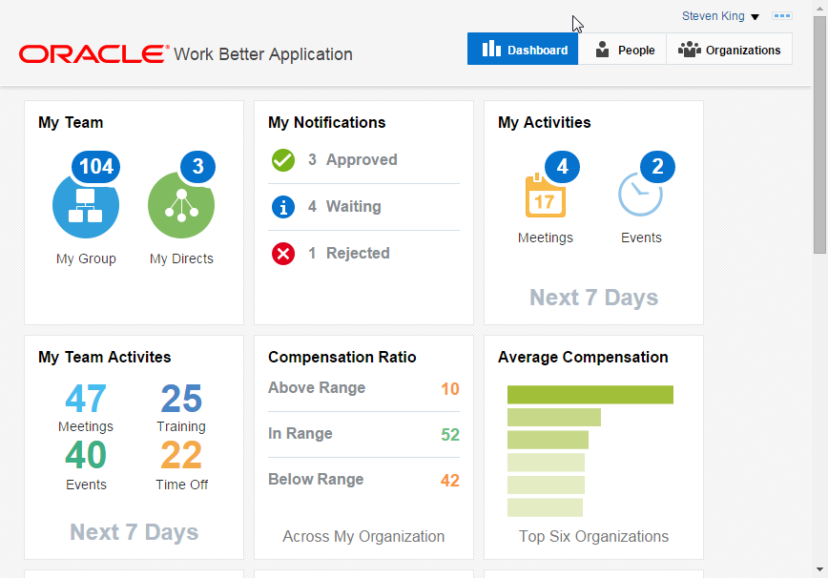

Slide 10
ADF Migration Strategies

Slide 11
What makes a successful migration?
Application Re-Engineering
Grant Ronald, Oracle Senior Group Product Manager, Oracle Application Development Tools
Writing in the ODTUG Journal
“Any attempt to [re-write] a Forms application to [ADF, Apex …] without taking into consideration the difference in architecture is in effect an effort at re-implementing the 20-year-old Forms runtime”
http://www.oracle.com/technetwork/developer-tools/forms/documentation/formsmigration-133693.pdf

Slide 12
What makes a successful migration?
Application Re-Engineering – Factors to consider
What’s your budget?
How much time can you afford to spend re-engineering your application? This can affect which path you take while re-engineering your application
What’s your development team’s technical expertise?
If your development team contains more PL/SQL than ADF knowledge, this can affect how Business Logic is extraction

Slide 13
What makes a successful migration?
Staged Migration – via Forms-ADF Hybrid Solution
“A staged (that is, phased) migration
effort enables Oracle Forms applications
to be migrated over time. This lengthens
the period during which Oracle Forms
remains an architectural element,
but reduces the overall migration risk
during that time period.”
Gartner - 2011
Forms : ADF Ratio
ADF, SOA
Forms
Time
Migrate at your own pace
*Source: http://www.oracle.com/technetwork/issue-archive/2010/toolssod-3-129969.pdf (March 2012)

Slide 14
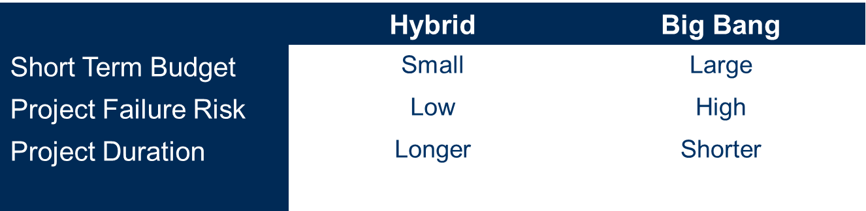

ADF Migration Strategy Comparison
Forms : ADF Ratio
ADF, SOA
VS
Forms
Time

Slide 15
Forms-ADF Hybrid Solutions

Slide 16
What is a Forms-ADF Hybrid Application?
Simple Definition: Running Oracle Forms and ADF Applications together
Examples:
Run Forms within ADF Applications
Launch Forms and ADF applications from a Portal
Enable Deep Integration by passing data between ADF and Forms sessions
Open Forms applications from ADF
Open ADF applications from Forms

Slide 17
Identify your requirements
What should my hybrid solution accomplish?
How do I want to access my applications?
Open both applications from a Portal?
Run Forms within ADF Application(s)?
Do I need to open ADF from Forms? Or visa versa?
Do I need to pass data between Forms and ADF?
Forms calling ADF?
ADF calling Forms?

Slide 18

Identify your requirements
What does this mean for application security?
Do I need Single Sign-On functionality between applications?
Make sure integration is encrypted/secure
Forms : ADF Ratio
ADF, SOA
Forms
Time
Integration needs to be secure!

Slide 19

Identify your requirements
What does this mean for my end-users?
What can I do to ensure the best user experience?
Do my users need to be trained?

Slide 20


Identify your requirements
Is my application infrastructure ready for Forms-ADF Integration?
WebLogic
ADF
Forms : ADF Ratio
ADF, SOA
Integration
Forms
Time
Forms

Slide 21
Hybrid: Opening Applications
Run Forms within ADF Applications
Tools: ADF Faces Component: Inline Frame runs Forms Applet
Use a Portal to open both ADF and Forms
Software: ADF, WebCenter Portal, Oracle Access Manager (OAM) to open applications via single sign-on
Open “child” ADF screens from Forms
Tools: Forms 11g JavaScript-Integration Built-Ins open ADF application via JavaScript

Slide 22
Hybrid: Security
Use Oracle Access Manager (OAM)!
OAM can provide Single Sign-On for Forms and ADF Applications
Most secure method for Single Sign-On functionality
It’s easy to implement OAM in ADF applications
Most 11g Forms customers have OAM licenses!
Don’t have OAM? No problem!
If you don’t have licenses or budget for OAM, develop your own solution or contact PITSS

Slide 23
Hybrid: Pass Data Between Forms-ADF
Forms invokes ADF Logic w/ JavaScript
Tools: ADF Client Listener, Forms 11g JavaScript Built-ins
ADF invokes Forms w/ JavaScript
Tools: ADF runs JavaScript to invoke Forms-Level PL/SQL Trigger to run events asynchronously
ADF invokes Forms w/ Advanced Queuing (AQ)
Tools: ADF inserts database queue record to enable asynchronous events to run in Forms

Slide 24
Case Study: DTE Energy

Slide 25


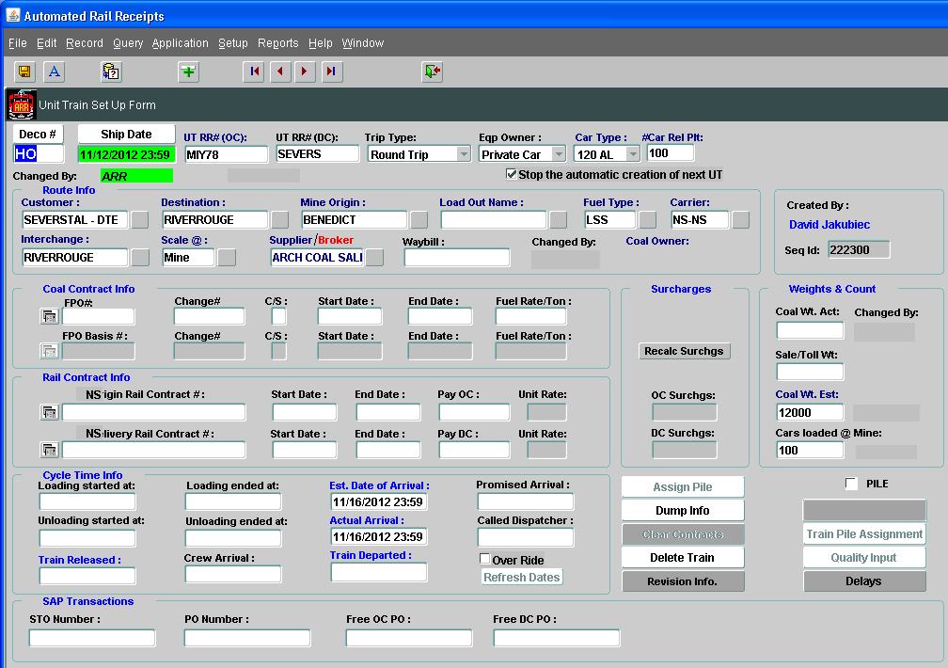
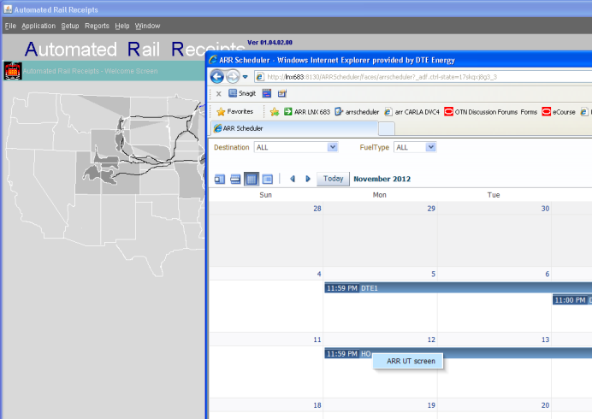
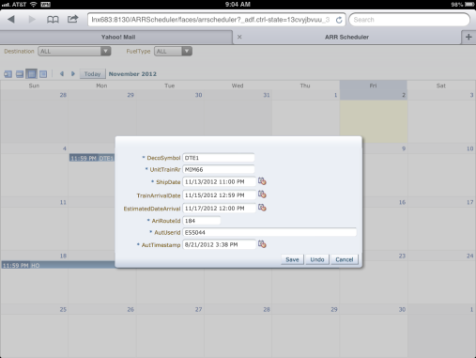
1
Train Coordinator
2
3
Train Coordinators schedule Trains with Forms 11g application
1
4
ADF Calendar can be opened direct from the Forms menu, authenticating the user into the ADF app, and displaying the Calendar Scheduling Screen
2
ADF Calendar enables drag & drop, update of key-data and allows to open any Forms-Module to display more details by automatic querying of selected record
3
ADF Calendar also accessible on Mobile Devices
4

Slide 26

DTE Case Study: Example

Slide 27
DTE Case Study: results
End-users can quickly and confidently schedule coal trains
Business-leaders love the new interactive way of scheduling trains
The ADF Calendar opened the door for more ADF Development
“Having upgraded to the latest Oracle Forms release, running on WebLogic Technology, enabled the advantage by embedding new ADF technology to significantly improve and optimized the User-Interface experience for our end-users”.
Kutumba Rao Hanumalou, MS, PMP – Principal Supervisor – ITS DTE Energy

Slide 28

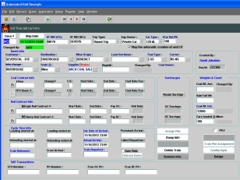
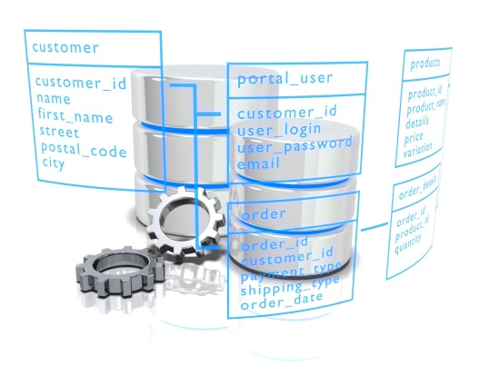

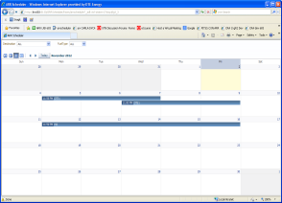

Forms-ADF Integration: Challenges
WebLogic Application Server
2
Forms Session
1
Database
Forms → ADF
1
Start new ADF Application Session in separate window
Log in to ADF Application
Interacting and sending data to ADF Application
ADF → Forms
2
Interacting and send data to existing Forms session
Updating Forms to process data received from ADF session
Update application infrastructure required for ADF-Forms Integration
ADF Session

Slide 29
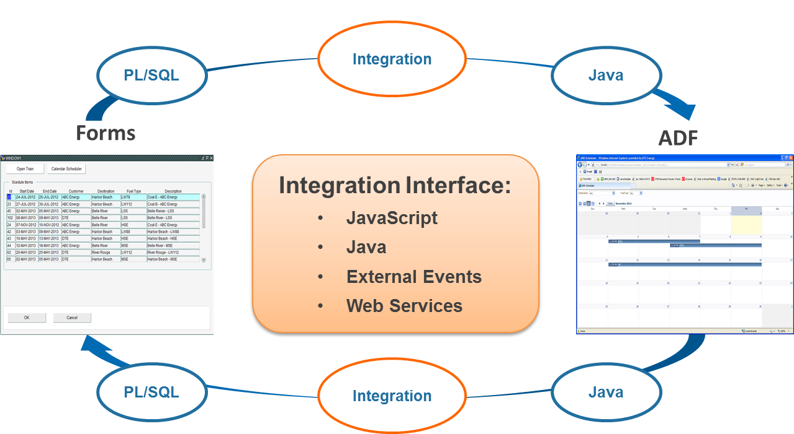
Hybrid App: Application Glue

Slide 30
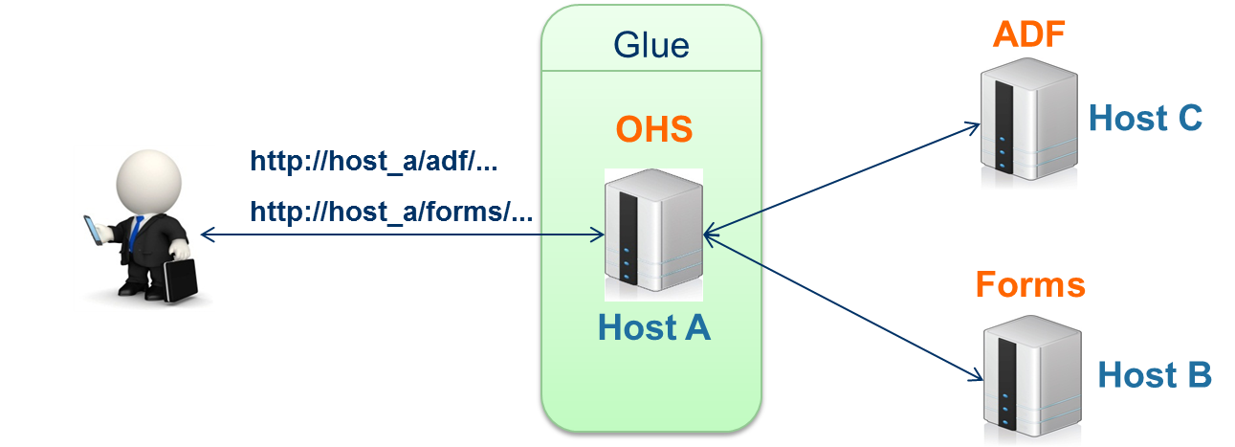
Hybrid App: Architecture Glue
JavaScript Security Rules:
Both web applications must be accessed on same port
Both web applications must be accessed on same host name
Both web applications must be accessed on same HTTP protocol

Slide 31


Forms to ADF Integration
Forms
#2 PL/SQL + JavaScript: Open Child Browser Window
ADF
#1 PL/SQL Built-in
#5 HTTP Servlet
#3 PL/SQL + JavaScript : Send ADF Login Credentials
#4 PL/SQL + JavaScript: Send any data to ADF
4

Slide 32
Forms to ADF Integration
Forms
#2 PL/SQL + JavaScript: Open Child Browser Window
ADF
#1 PL/SQL Built-in
#5 HTTP Servlet
#3 PL/SQL + JavaScript : Send ADF Login Credentials
#4 PL/SQL + JavaScript: Send any data to ADF
4
New 11g Forms PL/SQL Built-ins to run JavaScript:
web.javascript_eval_expr
web.javascript_eval_function
Allows Forms to utilize JavaScript
Allows Forms to send data and invoke any method within an ADF application

Slide 33
Forms to ADF Integration
Forms
#2 PL/SQL + JavaScript: Open Child Browser Window
ADF
#1 PL/SQL Built-in
#5 HTTP Servlet
#3 PL/SQL + JavaScript : Send ADF Login Credentials
#4 PL/SQL + JavaScript: Send any data to ADF
4
JavaScript needed for opening child browser window session from parent browser window so there is an established link between Forms and ADF Browser Windows
Established link allows JavaScript to invoke both Forms and ADF

Slide 34
Forms to ADF Integration
Forms
#2 PL/SQL + JavaScript: Open Child Browser Window
ADF
#1 PL/SQL Built-in
#5 HTTP Servlet
#3 PL/SQL + JavaScript : Send ADF Login Credentials
#4 PL/SQL + JavaScript: Send any data to ADF
4
After child browser window is opened, JavasCript can send data via encrypted cookie or HTTP POST/GET method to ADF
Crucial for sending ADF App Login credentials

Slide 35
Forms to ADF Integration
Forms
#2 PL/SQL + JavaScript: Open Child Browser Window
ADF
#1 PL/SQL Built-in
#5 HTTP Servlet
#3 PL/SQL + JavaScript : Send ADF Login Credentials
#4 PL/SQL + JavaScript: Send any data to ADF
4
ADF HTTP Servlet authenticates Login Credentials
ADF HTTP Servlet processes and stores data sent from Forms/JavaScript into ADF Application Module.

Slide 36
Forms to ADF Integration
Forms
ADF
PL/SQL
Java
Forms to ADF Integration Complete!
4
Invoke any additional ADF Client-JavaScript Listener!
Call ADF Web Services via AJAX!
Integrate with any ADF process!

Slide 37
Forms to ADF Integration
ADF
#2 JavaScript: Send PL/SQL command and data
Forms
#1 ADF Listener
#4 Java Script Trigger
#3 JavaScript: Switch Window Focus to Forms Window
ADF: Utilizes ADF Framework to lookup data and send it to Forms via JavaScript
Forms: 11g Forms JavaScript Trigger listens and processes any JavaScript event invoked within the Forms JavaScript API
4

Slide 38
Forms to ADF Integration
ADF
#2 JavaScript: Send PL/SQL command and data
Forms
#1 ADF Listener
#4 Java Script Trigger
#3 JavaScript: Switch Window Focus to Forms Window
ADF Listener constructs data to be sent to Forms
ADF Listener generates JavaScript command to invoke Oracle Forms JavaScript Trigger
4

Slide 39
Forms to ADF Integration
ADF
#2 JavaScript: Send PL/SQL command and data
Forms
#1 ADF Listener
#4 Java Script Trigger
#3 JavaScript: Switch Window Focus to Forms Window
11g Oracle Forms enables JavaScript access via Oracle Forms JavaScript API/DOM(Document Object Model)
11g Forms Applet contains a method called “raiseEvent” that invokes a Forms Trigger.
Allows ADF to send commands and invoke queries in Forms
4

Slide 40
Forms to ADF Integration
ADF
#2 JavaScript: Send PL/SQL command and data
Forms
#1 ADF Listener
#4 Java Script Trigger
#3 JavaScript: Switch Window Focus to Forms Window
When a new ADF Browser session is opened, it becomes the window of focus
JavaScript is ran to set window focus back to the Forms Applet, to provide a seamless transition from ADF to Forms
4

Slide 41
Forms to ADF Integration
ADF
#2 JavaScript: Send PL/SQL command and data
Forms
#1 ADF Listener
#4 Java Script Trigger
#3 JavaScript: Switch Window Focus to Forms Window
11g Forms provides “WHEN-CUSTOM-JAVASCRIPT-EVENT”, to serve as a listener for any Forms Applet methods invoked from JavaScript
Forms Trigger receives query or command request from ADF and runs PL/SQL logic specified by the developer
4

Slide 42
Forms-ADF Integration: Takeaways
Staged Forms to ADF Migrations are the best option
Identify your integration requirements
Forms and ADF can work together
Java, JavaScript, and PL/SQL can be the application glue
FMW is the architecture glue
Consider OAM for security (Leverage your WebLogic Suite licenses!)

Slide 43
Thank you!
-Gavin Woods

Slide 44
PITSS Professional Service Offerings
Oracle Fusion Middleware Infrastructure Consulting
WebLogic Server Installation & Configuration
Oracle Forms and Reports Installation & Configuration
Oracle WebLogic Infrastructure Planning
Single Sign-On for Enterprise applications via Oracle Access Manager (OAM) and Oracle Internet Directory (OID) Installation & Configuration
Oracle HTTP Server Load Balancer Installation & Configuration
Oracle Forms / ADF / MAF Consulting
Modernization – 11g Upgrade, Migration to ADF, etc.
Forms - ADF Integration
Mobile Application Development via Oracle Mobile Application Framework (MAF)
Forms, ADF, MAF Performance Optimization
Training
Oracle ADF Development (Beginner – Advanced)
WebLogic, Forms, Reports Server Installation and Configuration
Oracle Access Manager Installation and Configuration
Oracle Directory Services Manager (ODSM)

Slide 45


PITSS Contact Information
PITSS - Americas
Sales Contact: Joel Bell Technical Contact: Gavin Woods
Website: www.pitss.com
Email: info@pitssamerica.com
Phone: 248.740.0935 #11

