Slide 1


Evaluating
Players Fairly
A short guide for volunteer coaches
Cypress AYSO Region 154
Balanced teams start with honest observations
Notes:
Thank you for coaching in Cypress AYSO Region 154. Your observations help the Region form balanced teams so more children can learn, contribute, and enjoy the game. This short guide focuses on a few practical habits that make player ratings clearer, fairer, and more consistent.

Slide 2
COACH EVALUATION
Why player ratings matter
Ratings help division leaders form teams with a more even mix of current ability.
8U+
ALL
CONF.
Coaches evaluate players in 8U and older divisions
Compare with the whole division, not only one roster
Ratings stay confidential among coaches and division leadership
A rating describes current play. It does not define a child.
Cypress AYSO Region 154 | 2
Notes:
The goal is useful information for balanced team formation. Compare a player with others throughout the same division, not only with teammates. Keep ratings within the coach and division process. Most important, remember that a number describes what we observed this season. It never describes a child's value or future potential.
Source: 2026 Coach Eval Guide.pdf, pages 1 and 6

Slide 3
COACH EVALUATION
A fair evaluation uses several game moments
Observe patterns, not highlights
1
Several games
One great play or one mistake can mislead.
2
Different situations
Consider opponents, positions, and available opportunities.
3
The whole division
Use peers across the division as the comparison group.
4
Repeatable actions
Rate what the player does more than once.
Cypress AYSO Region 154 | 3
Notes:
Build the rating from a pattern. Think across several games and different situations. Compare the player with the division as a whole. Look for actions that appear more than once. A single goal, missed kick, unusual opponent, or short shift should not decide the final number.
Source: 2026 Coach Eval Guide.pdf, page 1

Slide 4
COACH EVALUATION
Three common rating traps
1
2
3
The “great kid” bias
Scores clustered too high
Watching only the ball
Effort and coachability matter. Keep the soccer rating tied to soccer actions.
Use the full scale. A 3 represents a solid division player.
Notice spacing, support runs, recovery, and reactions after turnovers.
Cypress AYSO Region 154 | 4
Notes:
Three habits can distort ratings. First, we may confuse a wonderful attitude with current soccer ability. Second, we may place nearly everyone near the top. Third, we may remember only the player with the ball. Respect the person, use the entire scale, and widen your view to the full play.

Slide 5
COACH EVALUATION
The 1–5 rating scale
5
Rare game changer
Repeatedly changes games within the division
4
Strong contributor
Consistently performs above the division average
3
Solid division player
Reliable core player with basic skills and understanding
2
Developing player
Shows partial skills and benefits from support
1
Building the basics
Developing comfort, coordination, and confidence
A 3 is the backbone of a balanced division
Cypress AYSO Region 154 | 5
Notes:
Use the full scale. A five is rare and repeatedly changes games. A four consistently contributes above the division average. A three is a solid, reliable player and the backbone of a balanced division. A two is developing and needs support. A one is still building basic comfort and coordination. The labels should remain respectful and behavior based.
Source: 2026 Coach Eval Guide.pdf, page 1; wording adapted for family-friendly coach training

Slide 6
COACH EVALUATION
Four observation lenses
1
TECHNICAL
2
AWARENESS
First touch and control
Spacing and support
Passing choice and accuracy
Reaction when possession changes
3
GAME PACE
4
ENGAGEMENT
Stays connected to play
Approaches routine challenges
Recovers and participates over time
Competes safely and keeps trying
Goalkeeping: evaluate only from observed goalkeeper opportunities
Cypress AYSO Region 154 | 6
Notes:
Use several lenses. Technical ability includes first touch, control, and passing. Awareness includes spacing, support, and reaction after a turnover. Game pace asks whether the player stays connected and recovers into play. Engagement means safely approaching ordinary challenges and continuing after mistakes. Evaluate goalkeeping only when you have actually observed it.
Source: 2026 Coach Eval Guide.pdf, pages 2–5

Slide 7
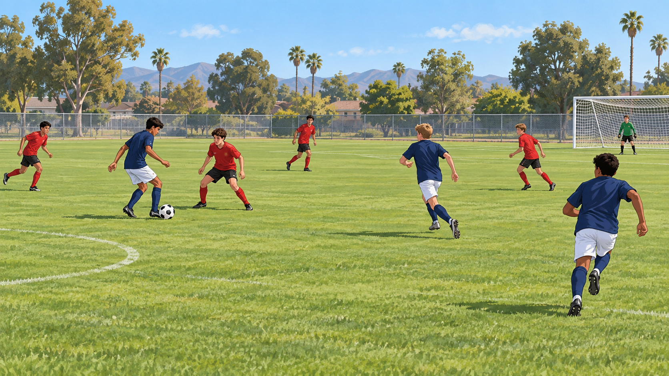
Look beyond the ball
Support run
Moves into useful space
Recovery run
Responds after a turnover
A player can affect the game without touching the ball
Notes:
Widen the view beyond the player with the ball. Notice who moves into useful space before a pass arrives. Watch the first response when possession changes. A support run, good spacing, or quick recovery may influence the play even when that player never touches the ball.

Slide 8

A practical sideline routine
1
Focus
Watch two or three players for several minutes.
2
Observe
Notice both on-ball and off-ball actions.
3
Rotate
Move your attention to the next small group.
4
Record
Write one or two examples soon after the match.
If you did not see an opportunity, mark it unobserved and look again later.
Notes:
Keep the process manageable. Focus on two or three players for several minutes, then rotate. Watch what each player does with and without the ball. After the match, write one or two concrete examples while the play is fresh. If the opportunity never appeared, leave that skill unobserved and look again later.

Slide 9
COACH EVALUATION
Observable notes create cleaner ratings
VAGUE IMPRESSION
OBSERVABLE NOTE
“Great hustle”
“Recovered quickly after several turnovers”
“Really good player”
“Controlled two passes under pressure”
“Not aggressive”
“Hesitated on two routine 50/50 balls”
Record attendance and family volunteering separately from soccer skill
Cypress AYSO Region 154 | 9
Notes:
Short, observable notes make the final rating easier to defend and compare. Replace labels such as great player or not aggressive with the action you saw. Record attendance and family volunteering where the Region requests them, but keep those facts separate from the player's soccer skill rating.
Source: 2026 Coach Eval Guide.pdf, pages 4–6

Slide 10
Thank you, coaches
Clear, consistent observations support better player experiences.
Balanced teams start with honest observations
Notes:
Thank you for giving Cypress AYSO players your time and attention. Clear, consistent observations help Region 154 form balanced teams and create better experiences for every child. Balanced teams start with honest observations.

