Slide 1
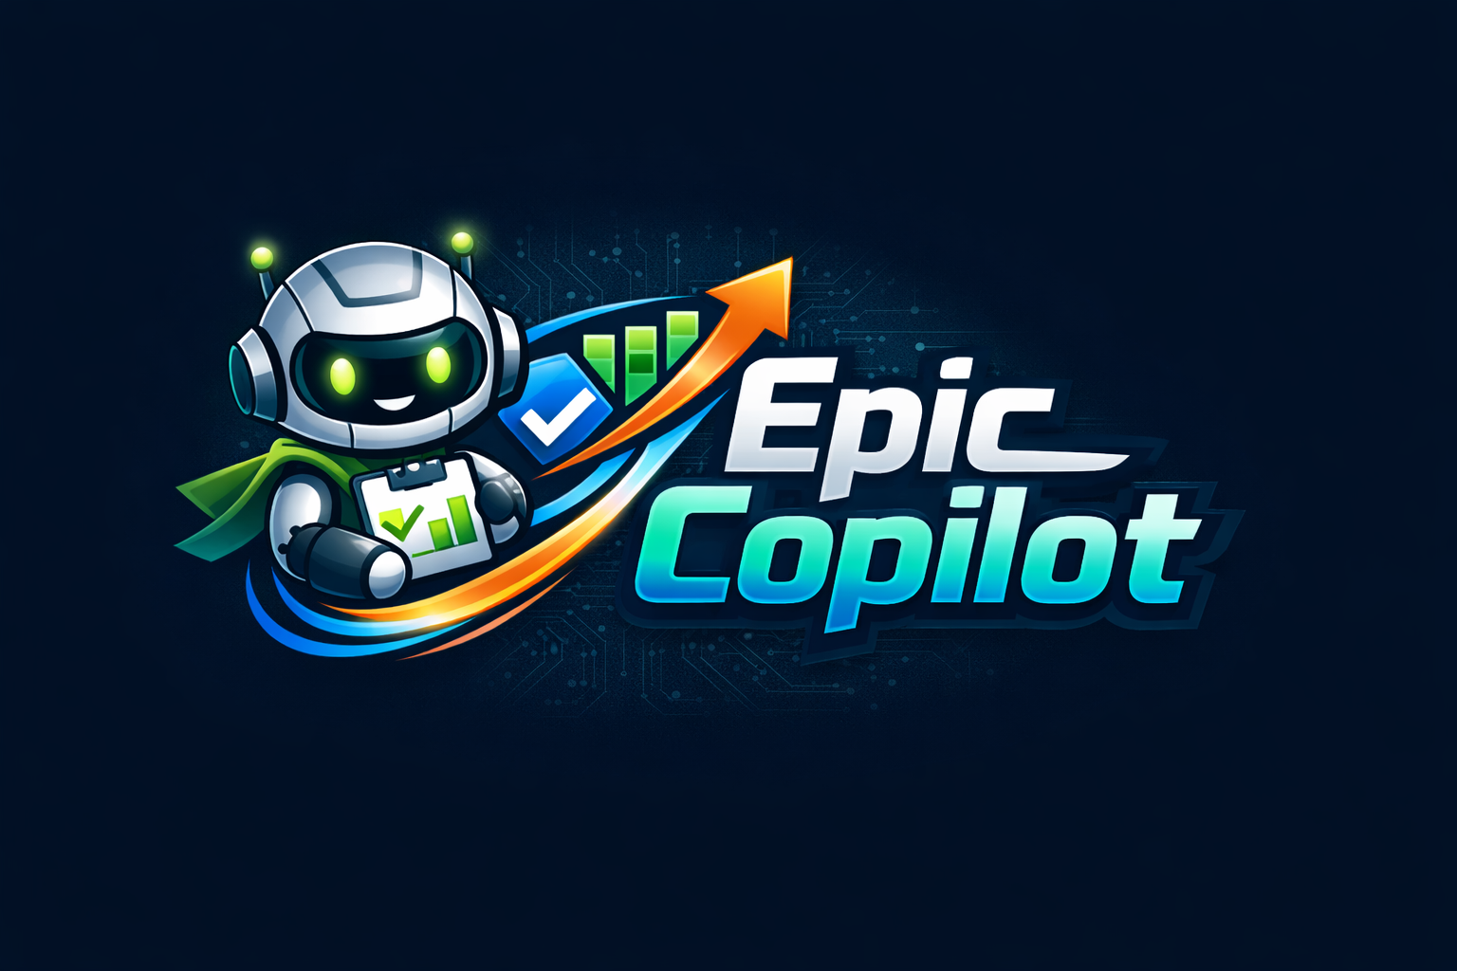
AI-Powered backlog Assistant
The enterprise problem
Critical delivery context is fragmented across backlog items, emails, docs, meeting notes, and call summaries—leading to incomplete epics, slow grooming, and constant “what’s the status?” churn.
PM/PO/DM workflows are out of sync with developers and dev tooling, creating handoffs and rework, wasting time, and struggling with stale information
Solution
Create & refine work items in Azure Boards from natural language (“create an epic from my latest meeting notes + email thread”)
Generate sprint‑ready plans (backlog breakdown + priorities) grounded in existing delivery context
Auto‑draft status updates (for stakeholders) based on latest artifacts and work item state.
Include all project managers, product owners, delivery managers in AI-native development
Business value
Reduction in context-switching for PMs between tools
Real-time project visibility without developer interruption
Reusable enterprise pattern: Copilot SDK + Work IQ MCP = customizable AI workflows
Built to solve a real enterprise customer case
Repo | Video | Questions? Maxim Salnikov
Notes:
Epic Copilot is an AI‑powered assistant that closes the collaboration gap between project managers, product owners, delivery managers, and developers by working inside the same tools, context, and workflows. Built on the GitHub Copilot SDK, it enables non‑developer roles to act with developer‑level clarity—without leaving their daily environment.
Crucially, Epic Copilot is built around a real enterprise customer need: it was inspired by a backlog‑management workshop delivered with an enterprise delivery‑manager community (“chat with your backlog”) and validated as a genuine business use case.
Centered on Azure Boards, it transforms fragmented signals from emails, files, meeting notes, and call summaries across Microsoft 365 into actionable work items, sprint plans, and up‑to‑date status reports via natural language. The current version combines the Copilot SDK with the Azure DevOps CLI; the next iteration leverages Azure DevOps MCP and Work IQ MCP for deeper traceability and automation.

Slide 2
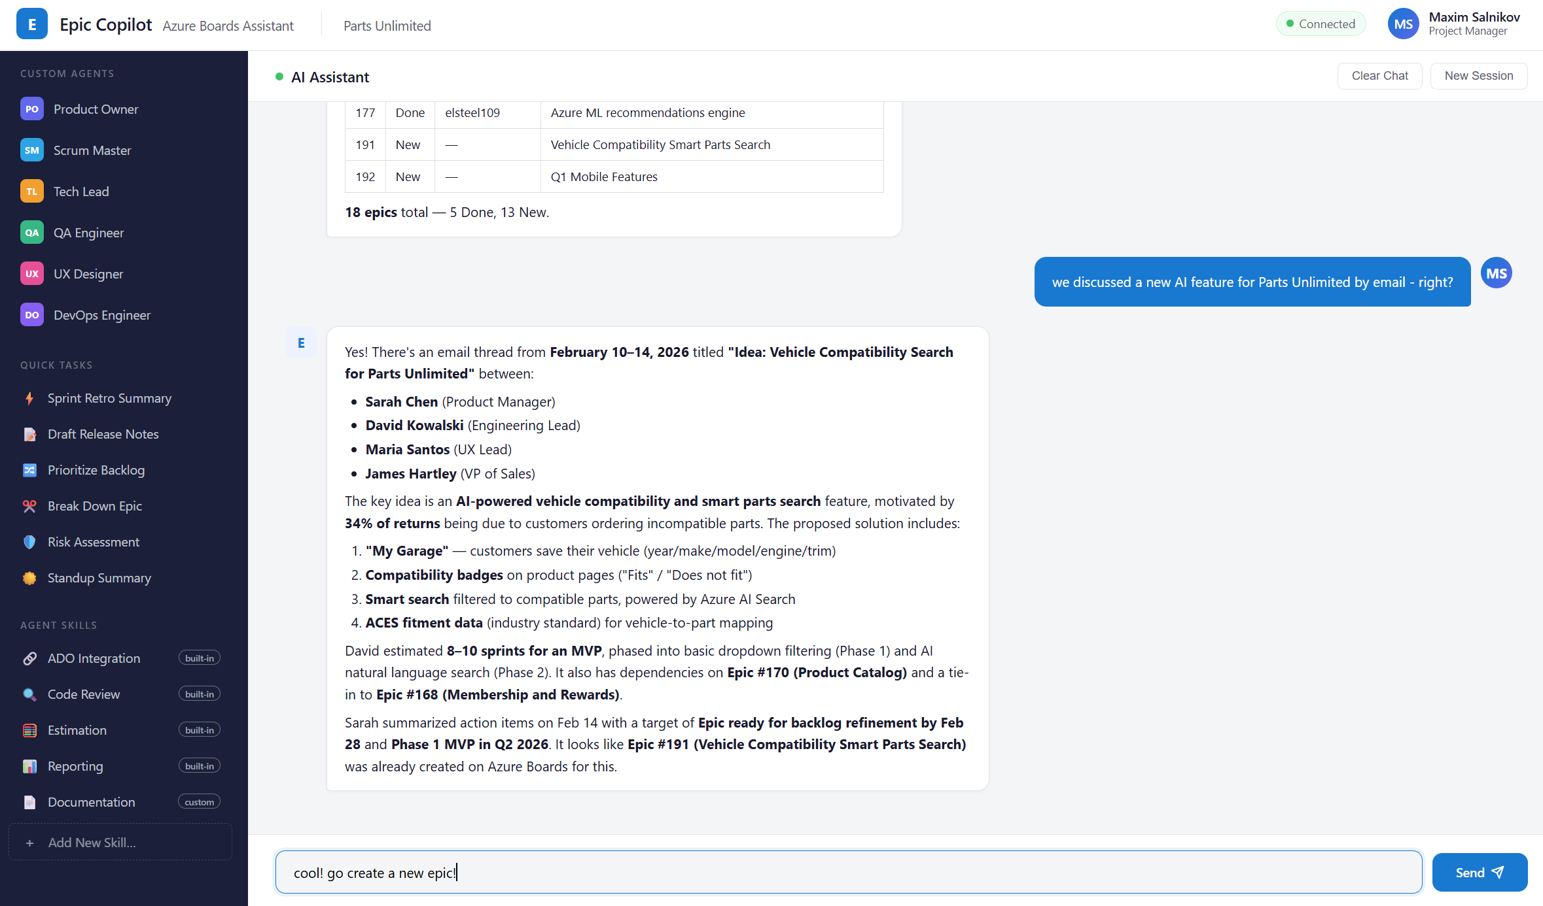
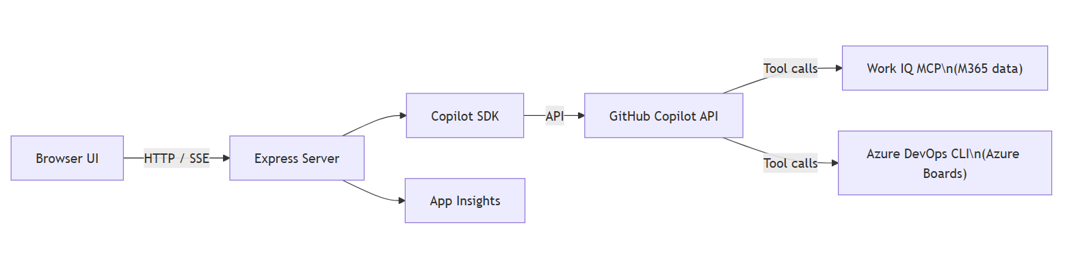
Key Differentiators
Security / RAI — signed-in user context, human-in-the-loop by design
Work IQ MCP architecture — extensible to any data source
Operational readiness: containerized, CI/CD, observability, security hardened
Architecture diagram
Technical stack
GitHub Copilot SDK (agent core)
Work IQ MCP (Microsoft 365 integration)
Azure DevOps CLI (Azure Boards ops)
Node.js / Express / TypeScript (backend)
Azure Container Apps + Bicep
Application Insights
GitHub Actions
Amplification-ready story: Repeatable enterprise workflow pattern
Notes:
Security / governance / RAI:
Operates in the signed-in user’s context (same boundary as Copilot CLI/SDK usage), helping enforce enterprise identity and permissions.
Human-in-the-loop by design: proposes changes first; user approves before creating/updating work items (prevents unintended backlog changes).
Clear data boundaries: only uses content the user can access; outputs include references back to source artifacts when available
Operational readiness:
Deployability: packaged as a repo-backed solution with setup instructions + repeatable configuration.
Supportability: logs tool calls and outcomes; structured outputs for predictable downstream use (plans, reports).
CI/CD-ready: automated checks and a minimal “demo mode” path for fast adoption by other teams.
Amplification-ready story:
A crisp “before/after” narrative: from fragmented context → consistent backlog quality → faster sprint readiness + clearer stakeholder comms.
Reusable pattern for the field catalogue: “Chat with your backlog” as a repeatable enterprise workflow pattern.

