Slide 1

A New OSI For A New Decade
Simon Phipps
webmink@opensource.org
FOSDEM, Brussels
4th February 2012

Slide 2
Software Freedom

Slide 3
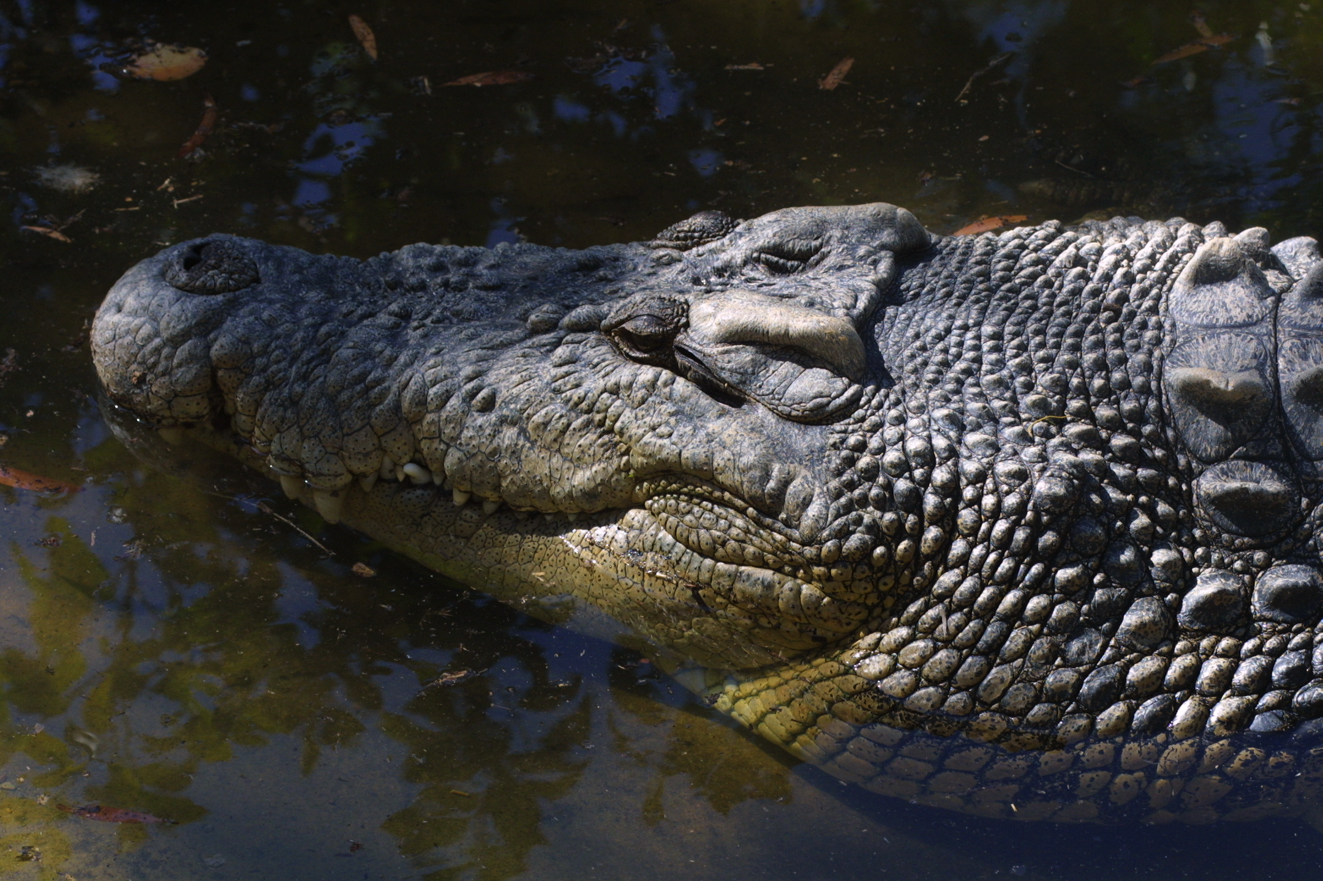

Slide 4
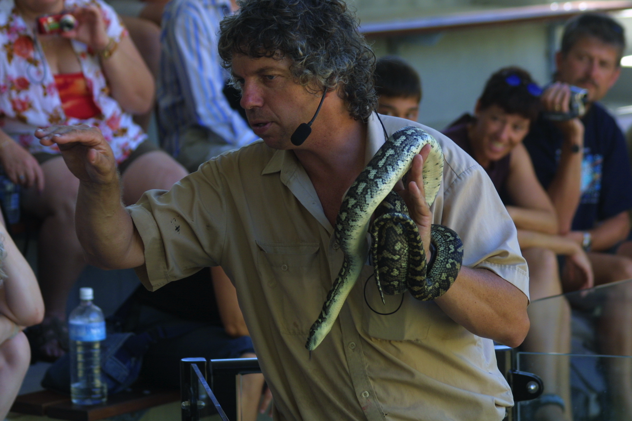

Slide 5
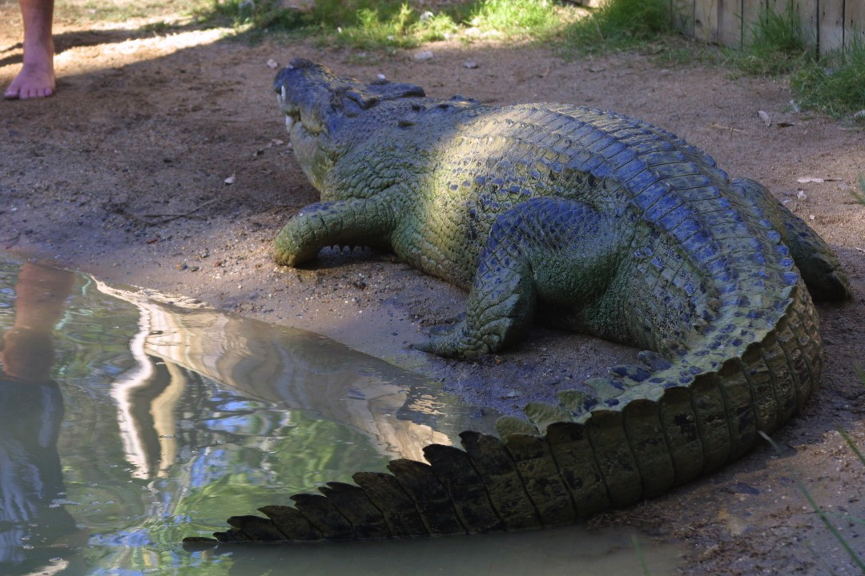

Slide 6
OSI

Slide 7
Software Freedoms
Use
Study
Modify
Distribute

Slide 8
OSI in 1998
Pragmatic software freedom to leverage corporate involvement
De-emphasise ethical imperative
  Still the bedrock
Focus on practicalities
Education
Licensing
Building understanding

Slide 9
OSI in the last decade
Licensing
OSD
Proliferation
Canonical listing
Defining open standards

Slide 10
Achievements
OSI has become the standard for open source in government
Loss of fear; uniformity; term used as a plus in other processes
Market established and open source the norm

Slide 11
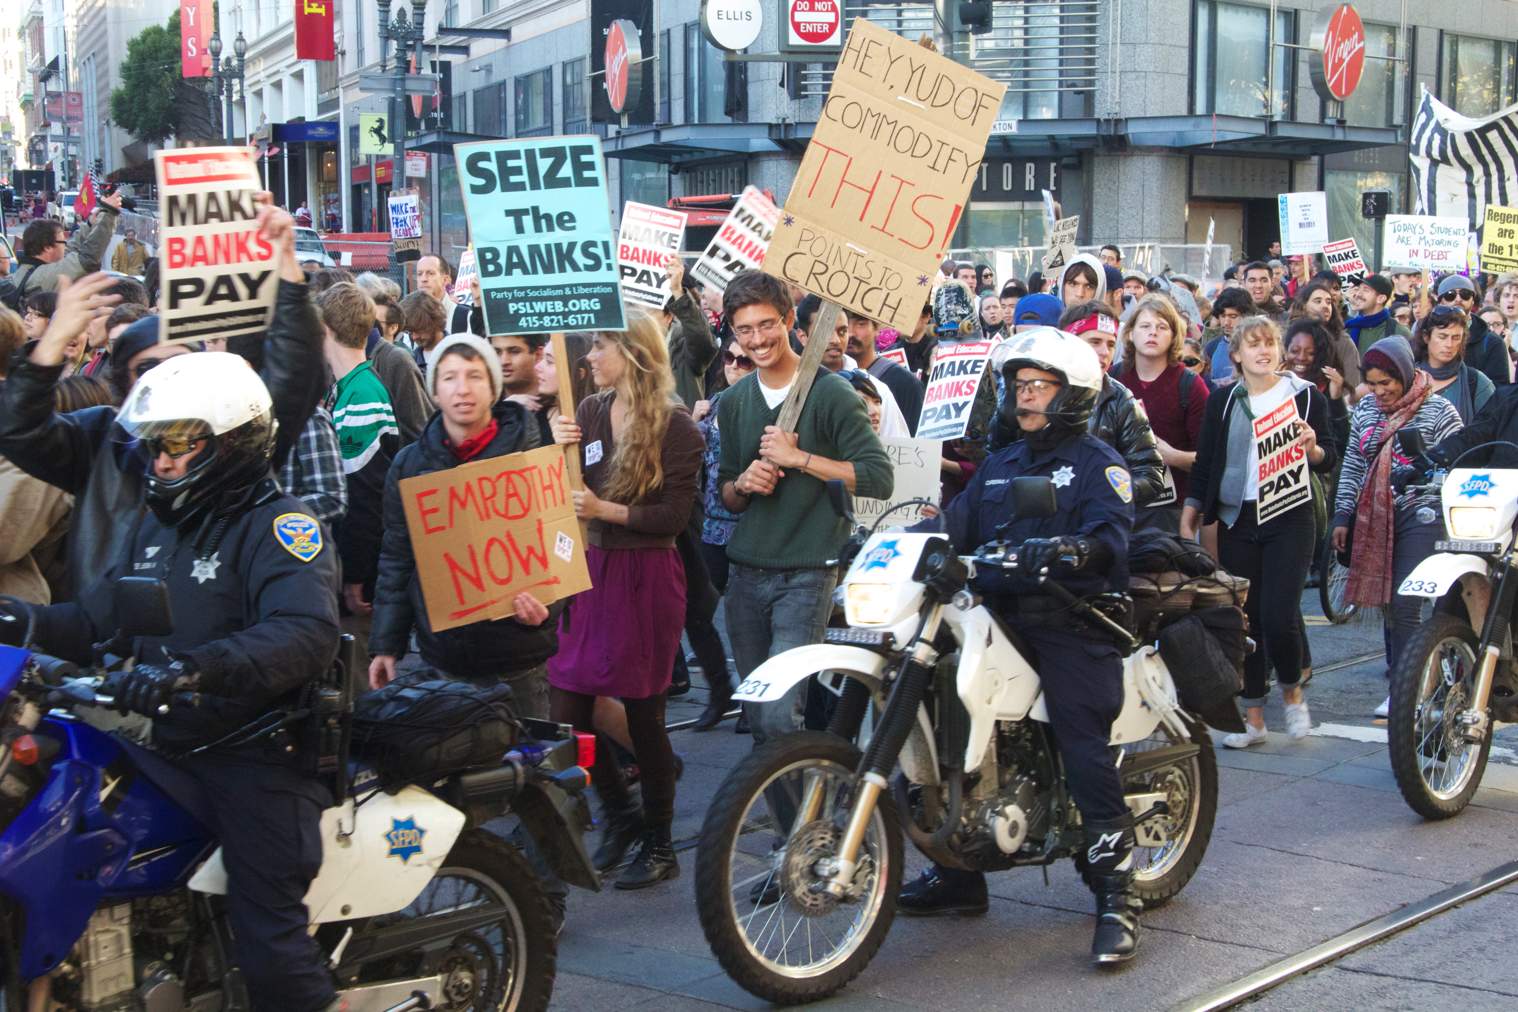

Slide 12
A New Decade
Open Source the default
Digital liberty moving to centre stage
Government by Lobbyists needs challenging

Slide 13
Responding To A New Decade
Moving beyond licensing
  deliver on education and unity
Reinvigorating with a member-based governance
Include all stakeholders

Slide 14

Affiliates
New!
Initial list of 12 announced today!
Open call to all open source non-profits to affiliate
Next stage: Invited government bodies and non-entities

Slide 15













Slide 16
Other Members
Personal Associates in 2Q2012
  Elect a single representative board member
  Gain a set of benefits
Corporate Patrons in 3Q2012
  No immediate role in governance

Slide 17
Member Survey
New!
OSI Needs Your Input
Personal Membership
Please complete our survey
  http://osi2012.limequery.com/23354/lang-en
  or
  http://bit.ly/Arf1iF

Slide 18
Bottom Up Governance
OSI to date has been a Board-only entity
Moving to a member-led governance
Members will:
  decide how OSI should operate
  build education initiatives (e.g. FLOSSBOK)
  use OSI as a policy venue
  co-ordinate locally and globally over initiatives
Board will:
  Facilitate these actions with the lightest touch
  Represent Members and be elected by them
  Prevent regulatory capture and strategy drift

Slide 19
FLOSSBOK
New!
Educators need a resource for teaching about open source
New OSI project: FLOSSBOK
Create a Body of Knowledge for Free, Libre and Open Source Software
http://flosscc.opensource.org/wiki/floss-body-knowledge

Slide 20
Next Steps
Complete membership category creation
Likely staff in 2013 to facilitate Member and Board action
  Need for funds
  Split across membership & prevent funding control
Elect replacement Board members as vacancies arise
Capture what works and set as new Bylaws in 2013 or 2014

Slide 21
Join us!
Ask your project to join OSI
Complete our survey
    http://bit.ly/Arf1iF
Join in with FLOSSBOK
Questions?
  webmink@opensource.org
  http://www.opensource.org

