Slide 1


Team Webmobix
RMSignal - Wealth Management Intelligence.
Move from portfolio monitoring to proactive, explainable advice for Relationship Managers.

Slide 2
Brief about the idea
The problem
A Relationship Manager (RM) has 20 clients and USD 596m to look after. Today's tools show numbers. They do not say who to call first or why.
What RMSignal does
It reads portfolios, mandates, market events and the RM's own notes. It gives back a ranked list of next actions: who to call, what to say and the proof behind it.
Who stays in charge
The RM. She can inspect, question and overrule everything. The AI suggests. She decides.
20
clients in one RM's book
USD 596.2m
assets under management
93
ranked next actions, 40 of them high

Slide 3
Opportunities
How is it different?
Most tools describe one portfolio. RMSignal ranks actions across the whole book.
It looks across a client's portfolios and inside structured products.
It reads the RM's own notes and flags where they disagree with the data.
How does it solve the problem?
Code finds mandate breaches, concentration, cash gaps, loan limits and overdue KYC.
Actions are ranked by importance and timing, so the RM knows who to call first.
Three scenarios show best, likely and worst cases for each client.
What is the USP?
Explainable: one click from any claim to its source data.
Safe: the AI never does the maths, and code deletes any claim whose numbers are not in the evidence.
Honest: every report lists what could not be checked.

Slide 4
List of features offered by the solution
Ranked action list
Every action for every client, sorted by importance and timing. A written summary says who to call first.
Client view
All portfolios together: allocation, currencies, biggest positions and what structured products really hold.
Notes against data
Each RM note is checked: consistent, contradicted or cannot be verified.
Mandate breaches
Code finds the breach. Notes say if it is acknowledged, client-directed or contradicted. A waiver never hides it.
Cash and credit
Liquid assets against planned spending, loan-to-value against limits, KYC review dates.
Scenarios
Gulf de-escalation, Gulf deterioration, Rates higher for longer. Best, likely and worst cases.
Bank views
Market and instrument views, each tied to dated events from the event log.
Evidence drawer
Click any claim to see the data, the figures and the note behind it.

Slide 5
Process flow diagram or Use-case diagram
Inputs
Portfolios, holdings, mandates, credit, cash needs, event log and RM notes, at one chosen date
Market and instrument views
AI agent writes the bank's view, citing dated events
Client and portfolio analysis
AI agents study each client; code does every calculation
Check RM notes
AI compares each note with the facts
1
2
3
RM reviews and decides
Opens the evidence, then calls the client
Rank across the book
Code ranks all actions; AI writes a short summary
Write actions
AI proposes; code sets importance and timing
Check mandate breaches
Code finds the breach; AI reads what notes say
7
6
5
4
Each step saves a file and the next step reads it. The same date and the same inputs give the same result.

Slide 6
Architecture diagram of the proposed solution
Data
SQLite, 12 tables seeded from the dataset. Read-only.
Tools
The only door to data. Point-in-time, per-agent allow-lists, evidence ids.
Agents
Outlook, Relationship, Portfolio, Reconcilers, Actions, Scenario, Overview.
Output guard
Code deletes claims with no evidence or with unsupported numbers.
Reports
JSON files per date: reports, evidence, actions, overview, scenarios.
The RM
Reviews and decides
RMSignal web app
TanStack Start, React
Read-only API
FastAPI, typed schema
Across every layer: policy checkpoints (mock engine) | audit log of every tool call | client names replaced before any model call | one fixed date per run, no look-ahead | KYC peer over A2A (mock)

Slide 7
Technologies to be used in the solution
AI and agents
Deep Agents
LangGraph
LangChain
Any OpenAI-compatible model
A2A (agent to agent) SDK
Pydantic
Data and analytics
Python 3.13
Polars
SQLite
FastAPI
Uvicorn
uv
Dashboard
TanStack Start
React 19
TanStack Router
TanStack Query
TanStack Table
TanStack Charts
Tailwind CSS 4
Vite
Quality
pytest
Hypothesis
Vitest
Biome
The demo run used DeepSeek v4.1 Flash through a gateway. A bank can point the same code at its own private model.
OpenAPI-generated types

Slide 8
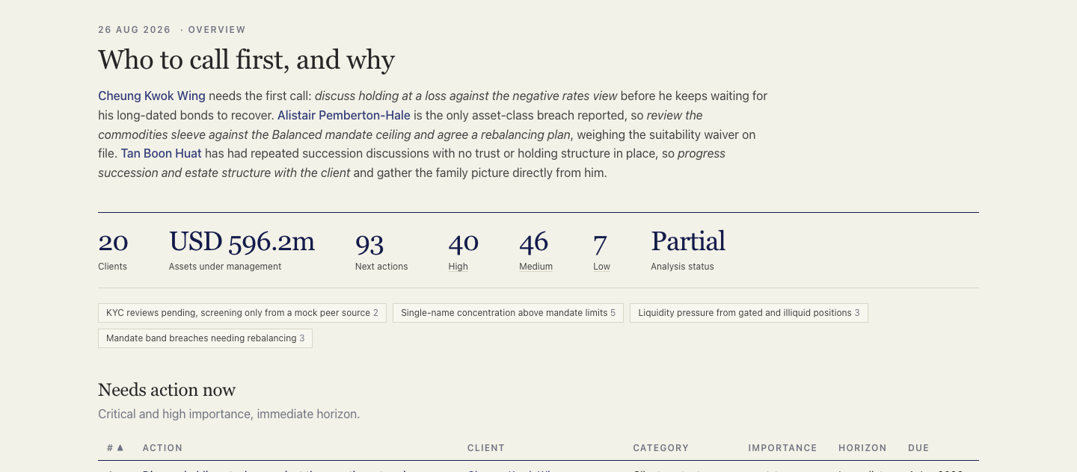
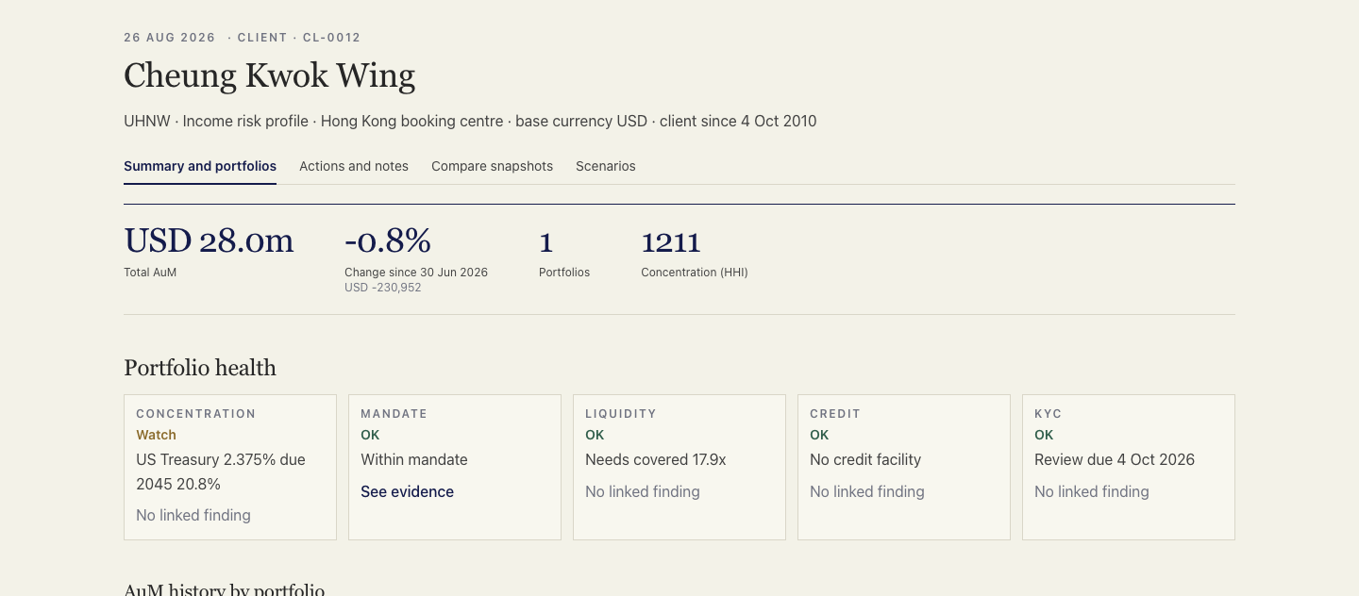
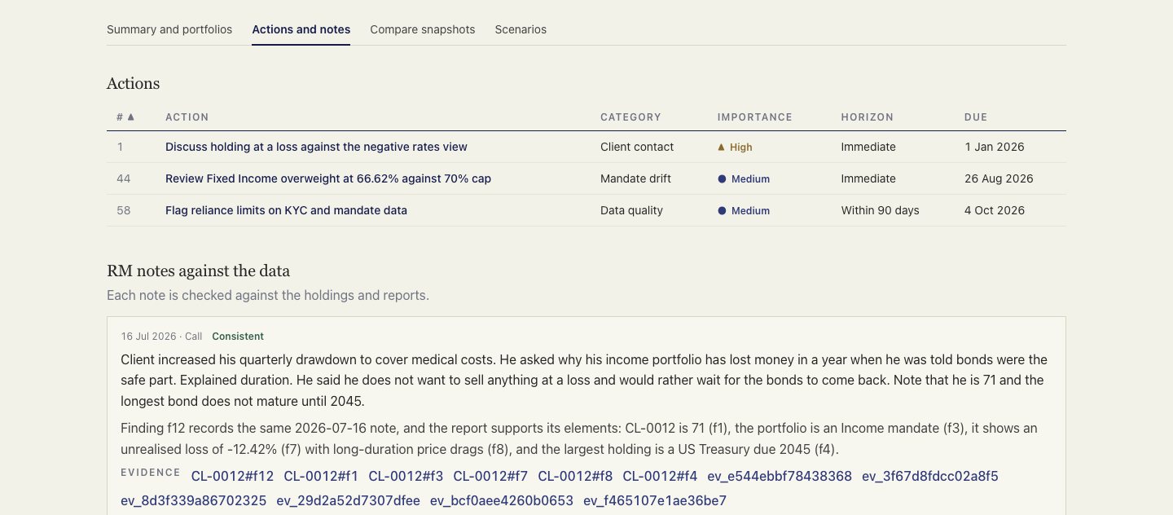
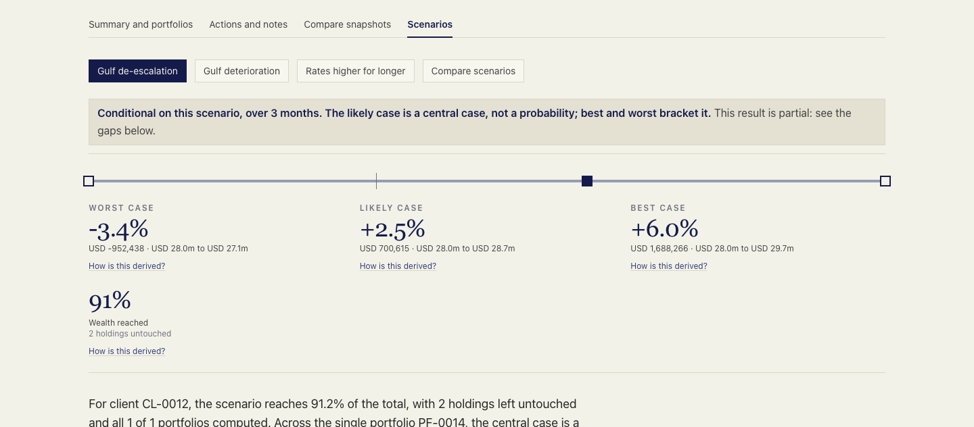
Snapshots of the prototype
Overview: who to call first, and why
Client page: portfolio health at a glance
RM notes checked against the data
Scenarios: worst, likely and best case

Slide 9
Prototype Performance report/Benchmarking
846
backend tests pass
100
dashboard tests pass (27 files)
20 of 20
clients analysed in one run
161
model calls in that run, 0 failed
10 min
to analyse the whole book, 4 clients at a time
2.2m
tokens used for the full analysis
What these numbers mean
Reports are repeatable: the same date and inputs give the same result, and unchanged outlooks cost no model call.
All 20 client reports are marked partial on purpose. The dataset has no related persons, and the report says so.
The guard works live: on the client page, a finding was removed because a figure was not in its evidence.
This is a prototype run on 20 synthetic clients, not a production load test.

Slide 10
Additional Details/Future Development (if any)
Also built
Interactive analyst sessions for follow-up questions
Agent-to-agent (A2A) cards and servers
A model-call log with counts and timing, never content
Point-in-time engine: no data after the chosen date is ever used
Call sheet per portfolio: seven questions an RM is asked in a meeting
Next steps
Connect the bank's real policy engine and KYC system
Add related persons and beneficial owners when data exists
Add an external news feed behind the same tool
Add tax-aware ideas and life-event planning
Let the RM accept, reject or edit each action
Add sign-in and per-RM access

Slide 11
Provide links to your:
GitHub Public Repository
[add link before submitting]
Demo Video Link (3 Minutes)
[add link before submitting]
Final Product Link
[add link before submitting]

Slide 12


