Slide 1
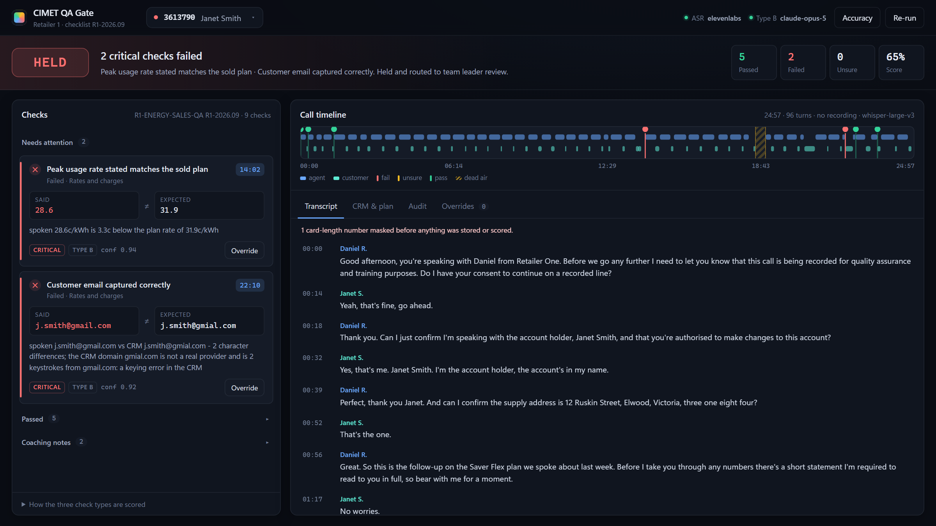
HACKATHON BUILD · QA AUTOMATION
CIMET QA Gate
Score the sale before it ships.
Every sale is checked against its retailer's checklist before it can be submitted. Every verdict points to the exact transcript line, audio timestamp and rule version behind it.
3
21
8
93
outcomes: HELD · QA · SUBMITTED
checks in 2 packs
named guardrails
self-test assertions
Notes:
Opening. CIMET QA Gate scores every sale against its retailer's checklist before it can be submitted. All green, it goes through. Any red, it is held with the exact line, timestamp and rule next to it. Everything you will see in this deck is the running product, not mock-ups.

Slide 2
01 · THE BOTTLENECK
A manual process that can't scale
Today every sale waits for a person to listen to the whole call.
Auditor pulls the recording
1,000s
~30
1
Downloaded by hand from the dialler
sales a month
retailers, each with its own checklist
2
Listens end to end
A 30-minute call is 30 minutes of listening
30 min
0
Fills an Excel form
of listening to review one call
links from the form back to the audio
3
No link back to the moment in the call
“This doesn't scale, and it won't survive a serious retailer audit.”
4
The sale waits
Customers and agents are blocked meanwhile
CIMET QA Automation brief
CIMET QA Gate
2
Notes:
The bottleneck from the brief. Today an auditor pulls the recording, listens to the whole call, fills an Excel form, and the sale waits. At thousands of sales a month across roughly 30 retailers, that does not scale and would not survive a serious retailer audit.

Slide 3
02 · THE ANSWER
Every sale gets one of three verdicts
Decided before the sale can be submitted, in seconds, with the reason attached.
HELD
QA
SUBMITTED
A critical check failed
A critical check is uncertain
Every critical check passed
Routed to a team leader queue
Card shows said vs expected
Click the time, hear 20 seconds
Fix it, or override with a reason
Unsure, or confidence below 0.60
Routed to QA review
Nothing uncertain auto-passes
Silence is never treated as a fail
Cleared to submit to the CRM
No human touch needed
5% still sampled for human audit
Measures the model, not just trusts it
CIMET QA Gate
3
Notes:
What the product decides. Every sale lands in exactly one of three states. HELD means a critical check failed with enough confidence; it goes to a team leader. QA means the machine is not sure about something critical; a human decides - nothing uncertain ever auto-passes. SUBMITTED means every critical check passed confidently; 5% of these are still sampled for a human audit so we keep measuring the model.

Slide 4
03 · HOW IT WORKS
From hang-up to verdict, with zero manual handling
Built in the order the brief asked for: recording ingestion first.
Dialler
Speech-to-text
Transcript
Checklist
Gate
Console + audit
POST recording, keyed on Lead ID
ElevenLabs Scribe or Deepgram: speakers + timestamps
Card numbers masked, agent identified, stored on the lead
Type A script · Type B facts · Type C behaviour
HELD · QA · SUBMITTED, with reasons and queue
Evidence, click-to-play, override, audit JSON
Asynchronous: the webhook answers 202 at once; the dialler never waits on transcription.
Nothing lost: the recording is saved before speech-to-text runs, so a failed transcription never loses the call.
Honest: with no speech-to-text key the webhook refuses (503) - it never passes a canned transcript off as the call.
CIMET QA Gate
4
Notes:
End to end. The dialler pushes the recording by API, keyed on Lead ID. Speech-to-text returns speaker-separated turns with timestamps. The transcript is stored against the lead after card numbers are masked and the agent is identified. Then the checklist runs, the gate decides, and the team leader sees the result with evidence. Nobody downloads or uploads anything.

Slide 5
04 · BUILD THIS FIRST
Recording ingestion: the dialler webhook
POST /api/dialler/recording — recording in, keyed on Lead ID, scored automatically.
# raw audio body - what a dialler integration sends
POST /api/dialler/recording?lead_id=3613802
Content-Type: audio/wav <binary>
# or a URL the server fetches
{"lead_id": "3613802", "recording_url": "https://..."}
# or base64 in JSON
{"lead_id": "...", "audio_base64": "...", "filename": "call.wav"}
-> 202 {job_id, poll: /api/jobs/<job_id>}
Speaker separation + timestamps from ElevenLabs Scribe or Deepgram, chosen by which key is set.
Agent found by what they say - compliance phrases only an agent uses - not by who spoke first. Method and margin are recorded.
Card numbers masked before disk - 13+ digits, whether ASR wrote “4111…” or “four one one one…”.
Recording kept + checksummed - SHA-256 on the transcript, served back with seek support for click-to-play.
Optional shared secret - set CIMET_DIALLER_TOKEN and the dialler must send X-Dialler-Token.
Proven on real audio - calls rendered with ElevenLabs and transcribed by Scribe through this exact webhook.
received
transcribing
scoring
done
error
Every transition is appended to runs/dialler_log.jsonl.
CIMET QA Gate
5
Notes:
Recording ingestion, which the brief said to build first. Three ways in: raw audio body, a URL we fetch, or base64. Every job moves through received, transcribing, scoring, done or error, and each step is appended to a log. The agent is identified by what they say - compliance phrases only an agent says - not by who spoke first, and the margin is recorded. Card numbers are masked before anything touches disk, whether ASR wrote them as digits or words.

Slide 6
05 · THE THREE CHECK TYPES
Script, facts, behaviour — each scored its own way
The part the brief said matters most.
A
Verbatim / script
B
Factual match
C
Behaviour
Transcript vs approved script
Transcript vs CRM fields vs plan
Transcript only
Token-level match over a sliding window of turns, tightened to the moment it was said. Handles ASR run-together words and alternative wordings.
The extractor reports what was SAID (quote + time). Deterministic code compares it to the CRM or plan value.
Arithmetic over turn timings and wording: longest silence, talk-over, cut-off turns, customer confusion.
LLM
No LLM. No hallucination surface.
LLM
Extraction only. Comparison is code.
LLM
No LLM.
BLOCKS SALE
Yes, if critical
BLOCKS SALE
Yes
BLOCKS SALE
Never
EXAMPLES
Recording disclaimer + consent, account holder, DMO read verbatim
EXAMPLES
Rate quoted, email, NMI, fuel type, promo & ongoing price, speed, TMC, fees, contract term
EXAMPLES
Dead air, interruptions, talk-over, customer confusion
CIMET QA Gate
6
Notes:
The brief says this part matters most. Type A compares the transcript to the approved script - deterministic, no LLM, so no hallucination surface. Type B checks facts: the LLM only reports what was said, and deterministic code compares it to the CRM and plan. Type C is behaviour - dead air, talk-over, confusion - and is removed before the gate so it can never block a sale.

Slide 7
06 · TYPE B, BUILT TO BE TRUSTED
The LLM never sees the answer
It reports what was said. Code decides whether that matches.
Transcript + check
Claude extracts
Comparator (code)
Verdict + evidence
The only inputs the prompt builder can see
Value, verbatim quote, start time, confidence
Deterministic, reproducible: rerun, same verdict
Pass / fail / unsure, quote, timestamp, prompt hash
✕ never
CRM + plan values
Joined only after extraction
Structural
Runtime leak guard
Grounded quotes (G3)
Audited
build_prompt() takes the check and the transcript. CRM and plan data are not in scope.
A prompt containing a reference value not spoken on the call is refused before sending.
A quote that isn't in the transcript is discarded. Invented evidence can't reach a verdict.
Model, effort, prompt SHA-256 and extractor are stamped on every result.
CIMET QA Gate
7
Notes:
Why a Type B match can be trusted. The prompt is built from the check definition and the transcript only - the CRM and plan are not even in scope of that function. Before sending, a leak guard refuses any prompt that contains a reference value that was not spoken on the call. The quote the model returns must exist in the transcript, and the comparison is plain code. So a match means the agent actually said it.

Slide 8
07 · GATE & ESCALATION
When a sale actually goes through
Rules evaluated in order; the first match wins.
Any critical check failed
HELD
Queued to TEAM_LEADER_REVIEW
Built in, not configured
Type C removed first: a coaching note can't change the outcome, even if someone flips it.
Real queue: HELD and QA append a routing record to runs/queue.jsonl.
Re-runs live: every override re-evaluates the gate and logs before → after.
Floor is a setting: CIMET_CONFIDENCE_FLOOR, 0.60 by default.
Any critical check unsure
QA
Queued to QA_REVIEW — never submitted
Any critical check below 0.60 confidence
QA
Low confidence routes to a human
Otherwise
SUBMITTED
Cleared, no human touch
5% of SUBMITTED
SAMPLE AUDIT
Stable hash of salt:lead_id — replays identically
The brief: “Any critical fail is held, low-confidence scores route to a human, nothing uncertain auto-passes.”
CIMET QA Gate
8
Notes:
The gate. Rules run in order, first match wins. Coaching notes are removed before anything is evaluated, so a Type C result can never influence the outcome. HELD and QA both write a routing record to a queue file, so 'queued to a team leader' is a real entry. Five percent of submitted sales are sampled with a stable hash so demos replay identically.

Slide 9
08 · GUARDRAILS & JUDGMENT
Eight guardrails that stop false criticals
Each one is named on the result it changed — in the console and the audit file.
G1
Audio-quality abstain
G2
Abstention honoured
G3
Ungrounded quote
G4
Not comparable
A script span that would fail, but sits in [inaudible]/[crosstalk] or ASR < 0.75, becomes unsure. Unheard is not unsaid.
When the extractor can't establish a value, the check is unsure — never a fail.
A quote that isn't in the transcript is discarded. Hallucinated evidence can't reach a verdict.
A value that won't parse, or no reference on the lead, is unsure rather than guessed.
G5
Low-confidence critical
G6
Timestamp corrected
G7
Possible mishear
G8
Screen vs spoken
A critical fail below the 0.60 floor becomes unsure: QA, not a hold.
If the model's time disagrees with its quote's turn, the transcript wins and it's logged.
Emails audio can't settle (rahman/raman, bigpond heard as bizpoint) go to a human. CRM typos like gmial still fail.
Agent's words vs the order screen: a FAIL at 0.7× confidence; the critical floor decides FAIL or QA.
CIMET QA Gate
9
Notes:
Eight named guardrails. Each one is attached to the result it changed, visible in the console and in the audit JSON. The theme is judgment: unheard is not unsaid, an abstention is never a fail, invented evidence cannot reach a verdict, and a machine that isn't confident routes to a human instead of holding a customer's sale. G7 and G8 came directly from testing on real audio and the official NBN artefact.

Slide 10
09 · THE CONSOLE
Built for how a team leader actually works
See the verdict → see what's wrong → hear it → fix it or override.
5
1
Verdict
1
HELD / QA / SUBMITTED, which checks and where it was routed, plus pass / fail / unsure counts.
3
2
Needs attention
2
Failed and unsure checks as cards: said vs expected, the reason, Play 20s, Override.
4
3
Call timeline
Agent and customer lanes, a pin per check, dead air hatched. Click to jump or play.
4
Tabs
Transcript, CRM & plan (read-only), Audit, Overrides.
5
Lead picker + engines
Each lead's latest verdict as a coloured dot; ASR and extractor status.
CIMET QA Gate
10
Notes:
The console, review-first. One: the verdict in plain words. Two: the checks that need a human, as cards. Three: the call as a timeline you can click. Four: tabs for transcript, CRM and plan, audit, and overrides. Five: the lead picker and engine status. Plain HTML, CSS and JavaScript served by the Python server - no build step.

Slide 11
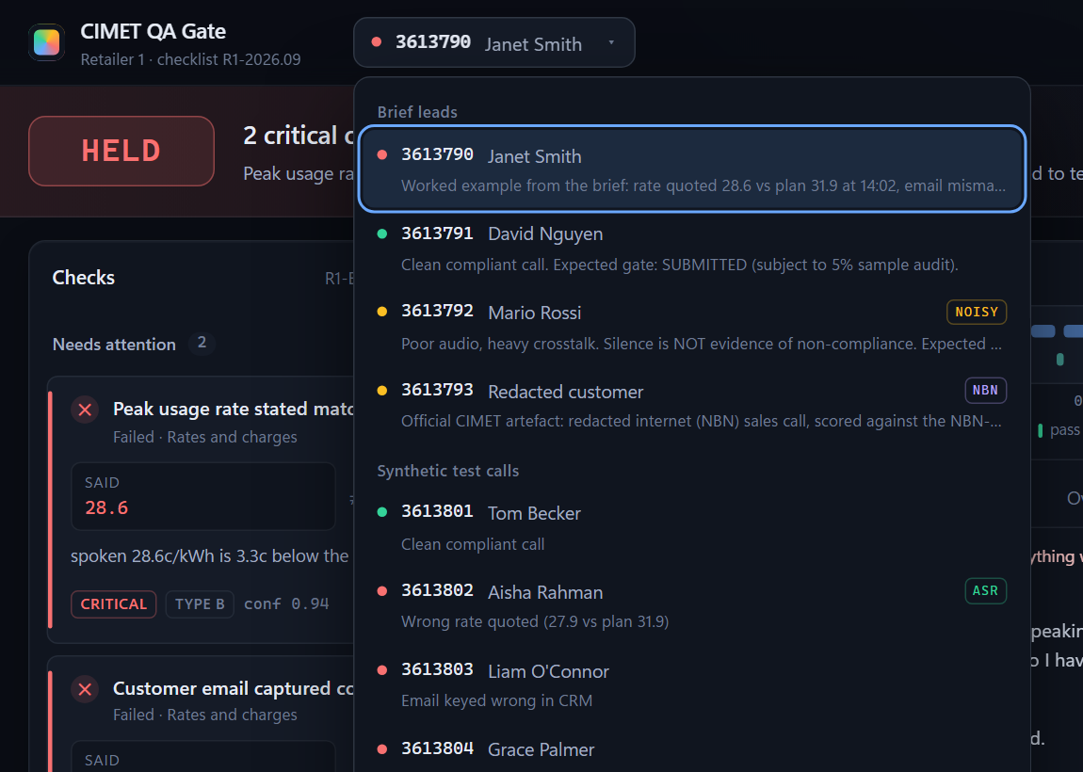
10 · LEAD PICKER
Every lead's verdict at a glance
One button, one grouped list — no hunting through tabs.
The dot is the verdict
HELD a critical check failed
QA a critical check needs a human
SUBMITTED cleared
Tags
NBN
ASR
NOISY
NBN-QA checklist · scored from a real dialler recording · poor audio
Grouped: the four brief leads, then the 12 synthetic test calls, each with a one-line note.
Always coloured: never-scored leads are scored once in the background at startup (saved, never repeated).
Keyboard: arrow keys move, Escape closes; any press outside closes it.
CIMET QA Gate
11
Notes:
The lead picker. Brief leads first, synthetic test calls below. The dot is each lead's latest verdict - red held, amber QA, green submitted - and on startup any lead never scored is scored once in the background so every dot has a colour. Tags mark the NBN pack, calls scored from a real recording, and noisy audio.

Slide 12
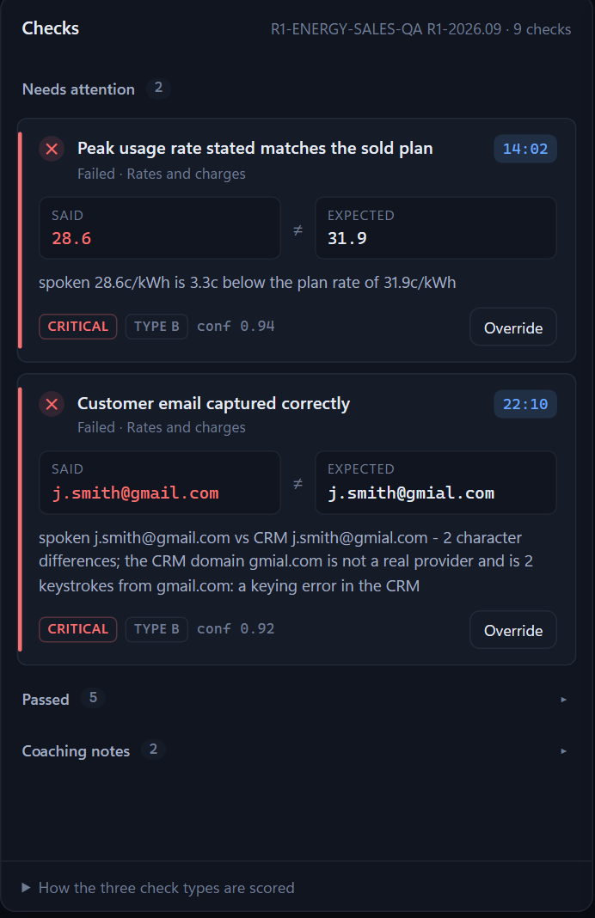
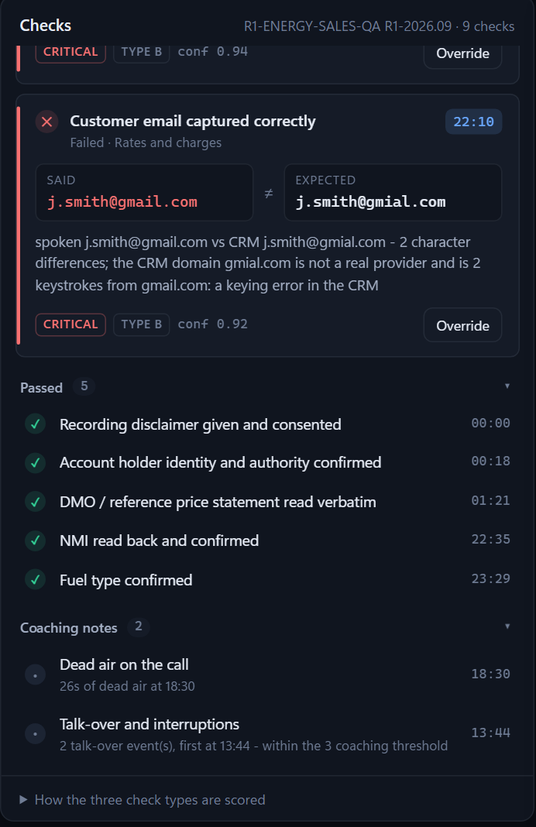
11 · NEEDS ATTENTION
Said vs expected, in one glance
The worked example from the brief, exactly as the console shows it.
SAID
EXPECTED
28.6
≠
31.9
c/kWh at 14:02 — 3.3c below the plan sold
Every card has: the check, section, time, said vs expected, one-line reason, CRITICAL / TYPE / confidence, Play 20s and Override.
Missing script wording is listed phrase by phrase with how much of it was found.
Sorted for action: critical first, fails before unsure, then call order.
Passed + coaching notes fold away (right) — one click from their own evidence.
CIMET QA Gate
12
Notes:
Problems first. Every failed or unsure check becomes a card: what was said against what it had to be, the reason in one sentence, the timestamp, Play 20 seconds, and Override. The team leader doesn't read a table - they read two cards. Passed checks and coaching notes are folded away but one click from their own evidence.

Slide 13
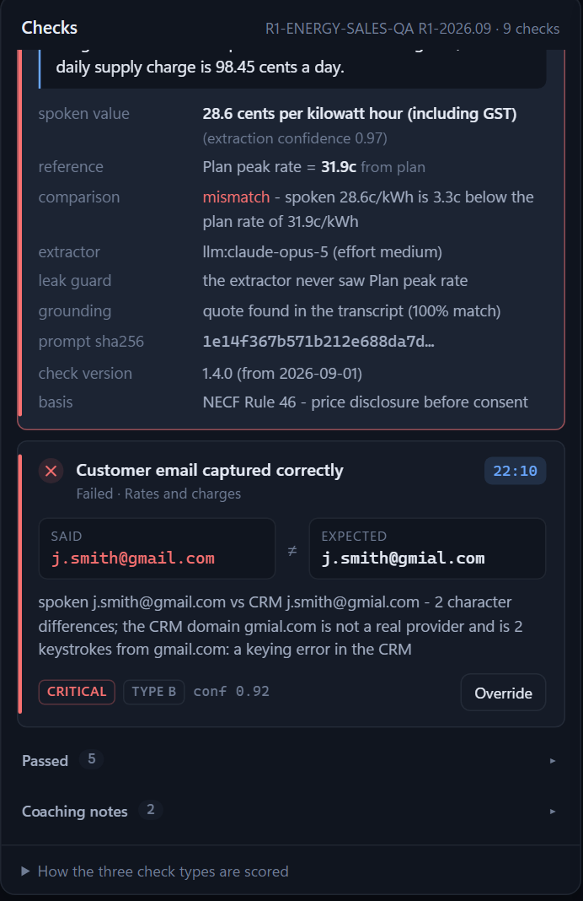
12 · EVIDENCE
Every verdict shows its working
Nothing a team leader is asked to trust is hidden.
Quote
Spoken value
verbatim line, speaker, turn and time
what the extractor heard + its confidence
Reference
Comparison
the CRM / plan value and its source
match or mismatch, and exactly why
Extractor
Leak guard
Claude model + effort, or the fallback — and why
confirms the model never saw the reference
Grounding
Prompt SHA-256
quote found in the transcript (and how closely)
the exact prompt, reproducible
Check version
Basis
e.g. 1.4.0, in force from 2026-09-01
e.g. NECF Rule 46 — price disclosure before consent
CIMET QA Gate
13
Notes:
Click a card and every claim behind the verdict is on screen: the verbatim quote with its turn and time, what the extractor heard, the reference and where it came from, the comparison, which extractor ran and with what effort, the leak guard, whether the quote was grounded, the prompt hash, the check version and its regulatory basis. A team leader never has to take the machine's word for it.

Slide 14
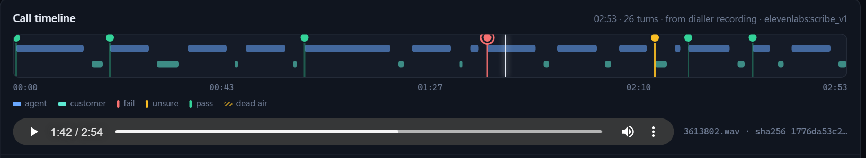
13 · CALL TIMELINE + AUDIO
Click the timestamp, hear twenty seconds
“Nobody listened to thirty minutes to find that.” — the brief's worked example
Two lanes
A pin per check
Dead air hatched
Playhead + highlight
Agent on top, customer below — who spoke when, at a glance.
Red fail, amber unsure, green pass. Click: open the check + play it.
Long silences shown where they happened; coaching only.
Follows the recording; the line being spoken lights up.
CIMET QA Gate
14
Notes:
The call as a timeline. Agent speech on the top lane, customer on the bottom, a pin for every check - red fail, amber unsure, green pass - and dead air hatched. Click a pin and the check opens and the audio plays from that moment for twenty seconds, exactly as the brief describes: the team leader clicks the timestamp, hears twenty seconds, and nobody listens to thirty minutes. With a recording, a playhead follows the audio and the line being spoken is highlighted.

Slide 15
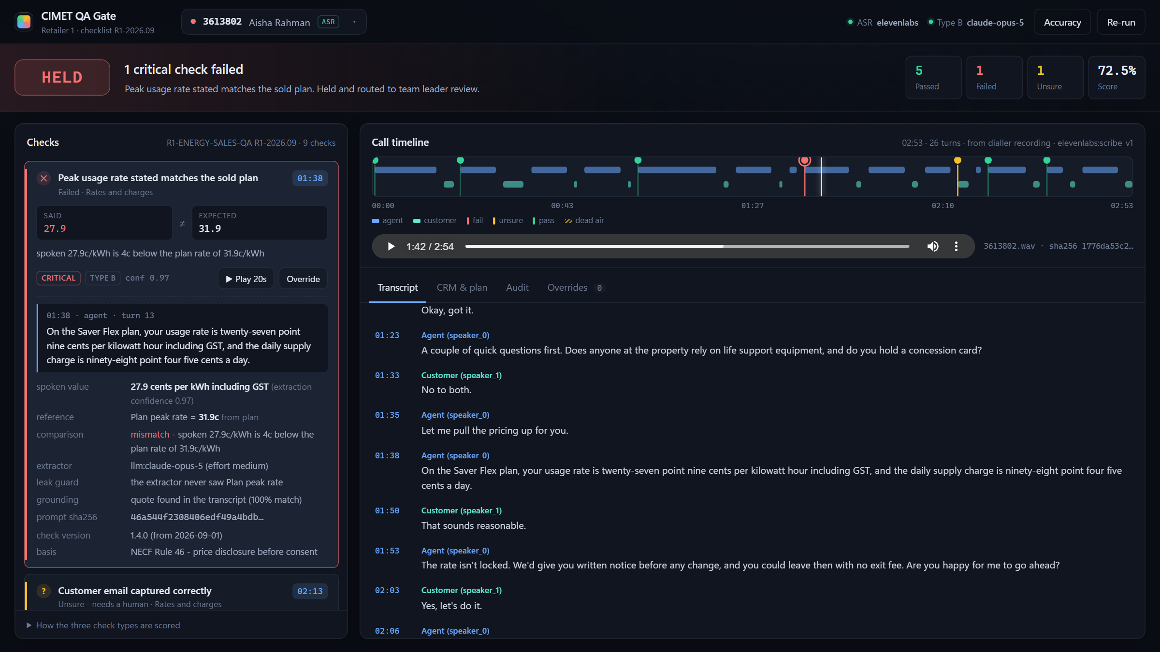
14 · ON A REAL RECORDING
Scribe transcript → Claude extraction → held in seconds
Lead 3613802: recording pushed through the webhook, transcribed by ElevenLabs Scribe.
Source: “from dialler recording · elevenlabs:scribe_v1”, with the file's SHA-256.
Rate: said 27.9, plan 31.9 — critical fail at 01:38, confidence 0.97.
Email: unsure (G7) — Scribe wrote “raman” for “rahman”, which audio can't settle.
Verdict: HELD, routed to team leader review.
CIMET QA Gate
15
Notes:
A real recording end to end. This lead's audio was pushed through the dialler webhook and transcribed by ElevenLabs Scribe. The rate card is selected, the player is at 1:42, the playhead is on the timeline, and the evidence shows Claude extracted twenty-seven point nine against the plan's thirty-one point nine. The source line reads 'from dialler recording, elevenlabs scribe v1'.

Slide 16
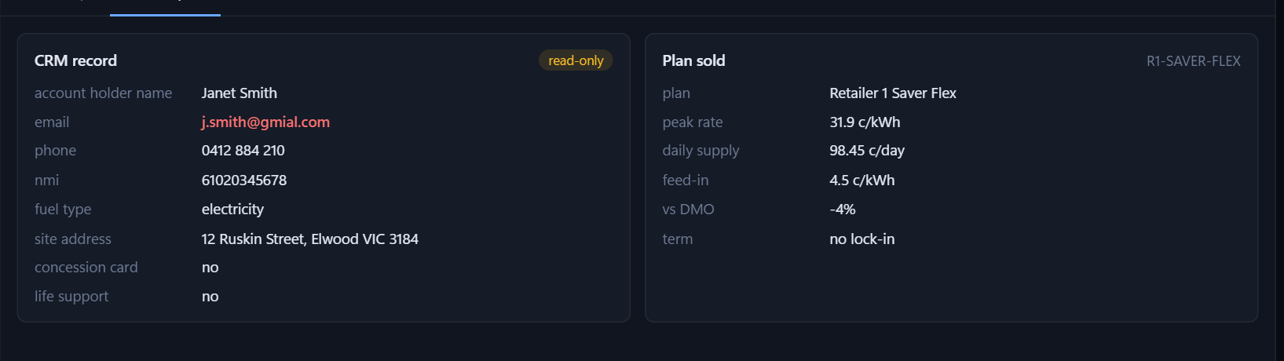
15 · TABS
The record and the audit trail, one click away
CRM & plan are read-only — the app never writes to the CRM.
Transcript
The whole call; the line being spoken is highlighted; any timestamp plays from there.
CRM & plan
Read-only. A field that failed is flagged in red. Redacted tags stay as tags.
CRM & plan: read-only; the failed field is flagged — the CRM holds j.smith@gmial.com.
Audit
Run ID, checklist version, extractor, floor, score, coverage, checksum, pipeline trace, audit JSON.
Redacted leads stay redacted
On the NBN artefact the CRM record shows the placeholder tags exactly as supplied - nothing is re-identified or filled in.
Overrides
[CUSTOMER_FULL_NAME]
[EMAIL]
[PHONE]
[DOB]
[SERVICE_ADDRESS]
The append-only log for this run: who, why, machine verdict, gate before → after.
CIMET QA Gate
16
Notes:
Details stay one click away. CRM and plan are read-only and a field that failed is flagged in red - here the mistyped email. The audit tab shows the run ID, checklist version, extractor, confidence floor, weighted score, evidence coverage, queue and transcript checksum, then the pipeline trace with timings, and the download for the full audit JSON.

Slide 17
16 · THE BRIEF'S WORKED EXAMPLE
Lead 3613790: the brief's example, reproduced
Retailer 1, 25-minute call. Every verdict matches the brief.
Check | The brief expects | CIMET QA Gate shows
Recording disclaimer + consent | PASS | PASS · 00:00
Account holder confirmed | PASS | PASS · 00:18
DMO read verbatim | PASS | PASS · 01:21
Rates and charges | FAIL · 28.6 vs 31.9 · 14:02 | FAIL · 14:02 · said 28.6 ≠ 31.9
Email captured | FAIL · gmail vs gmial · 22:10 | FAIL · 22:10 · gmial.com is a CRM keying error
Dead air (coaching) | NOTE · 47s at 18:30 | NOTE · dead air at 18:30 · never blocks
HELD
2 critical checks failed. Routed to team leader review.
The TL clicks 14:02, hears twenty seconds, corrects the email and re-confirms the rate — or the sale is cancelled.
Our transcript's opening checks fall at different times than the brief's illustration; the verdicts are identical.
CIMET QA Gate
17
Notes:
The brief's own worked example, lead 3613790, reproduced by the running system. The rate failure at 14:02 with 28.6 said against 31.9, the email failure at 22:10 with gmail said against gmial in the CRM, and the dead air coaching note at 18:30. Our transcript's opening checks land at different times than the illustration, but every verdict matches. The system adds one thing the brief didn't: it explains that gmial is not a real provider, so this is a keying error in the CRM, not a mishear.

Slide 18
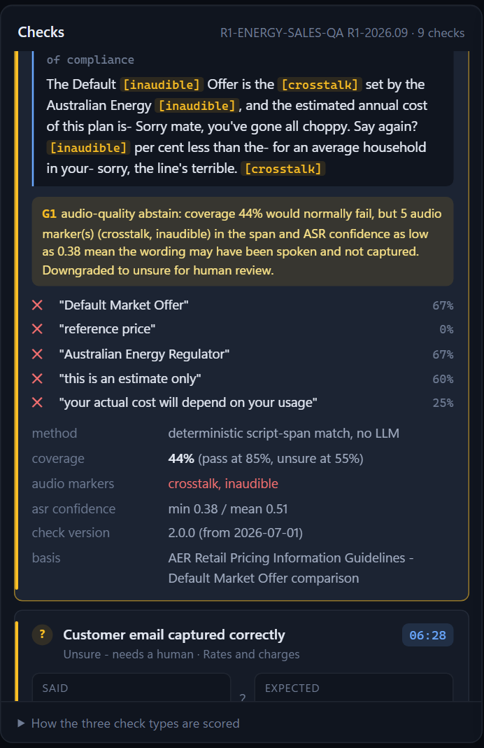
17 · MESSY REAL-WORLD AUDIO
Silence is never evidence
Lead 3613792: crosstalk, [inaudible], a dropped line → QA, not HELD.
44%
of the DMO wording found — on its own, a fail
G1
5 audio markers + ASR 0.38 in that span → unsure, not fail
G2
rate and email obstructed → extractor abstains, never guesses
QA
a human decides; audible checks still pass
The judging criterion: “Handles messy real calls — crosstalk, mishears, silence — without manufacturing false criticals.”
CIMET QA Gate
18
Notes:
Messy audio, lead 3613792. Crosstalk, inaudible markers, a dropped line. The DMO statement only matched 44% of its wording, which would normally be a fail - but G1 sees five audio markers and low ASR confidence in that span and downgrades it to unsure. The rate and email were obstructed, so the extractor abstained, G2. The checks that were audible still passed. Result: QA, not HELD. Silence is never evidence.

Slide 19
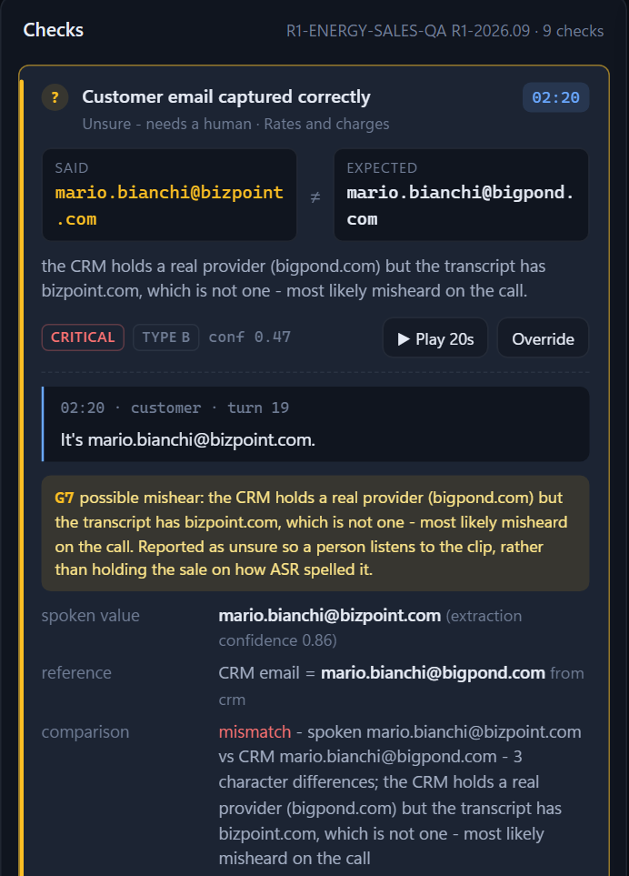
18 · FOUND BY TESTING ON REAL AUDIO
A mishear is not a keying error
ElevenLabs Scribe heard “bigpond” as “bizpoint”. Before G7, that held a clean sale.
HEARD mario.bianchi@bizpoint.com
CRM mario.bianchi@bigpond.com
UNSURE → human
Real provider in CRM, non-existent one heard
HEARD aisha.raman@gmail.com
CRM aisha.rahman@gmail.com
UNSURE → human
Spellings sound identical
HEARD j.smith@gmail.com
CRM j.smith@gmial.com
FAIL → held
CRM domain isn't a real provider: keying error
Also from real ASR: US spellings (“authorized”) now match Australian scripts (“authorised”).
CIMET QA Gate
19
Notes:
A real finding from real audio. We rendered test calls, pushed them through the webhook, and ElevenLabs Scribe heard 'bigpond' as 'bizpoint' on a noisy line. The old comparison called that a critical email failure and held a clean sale. G7 now recognises when the CRM has a real provider and the transcript has one that doesn't exist - or when two spellings sound identical - and routes it to a human with the clip. The brief's gmial case still fails, because that's a keying error in the CRM, not something anyone could mishear.

Slide 20
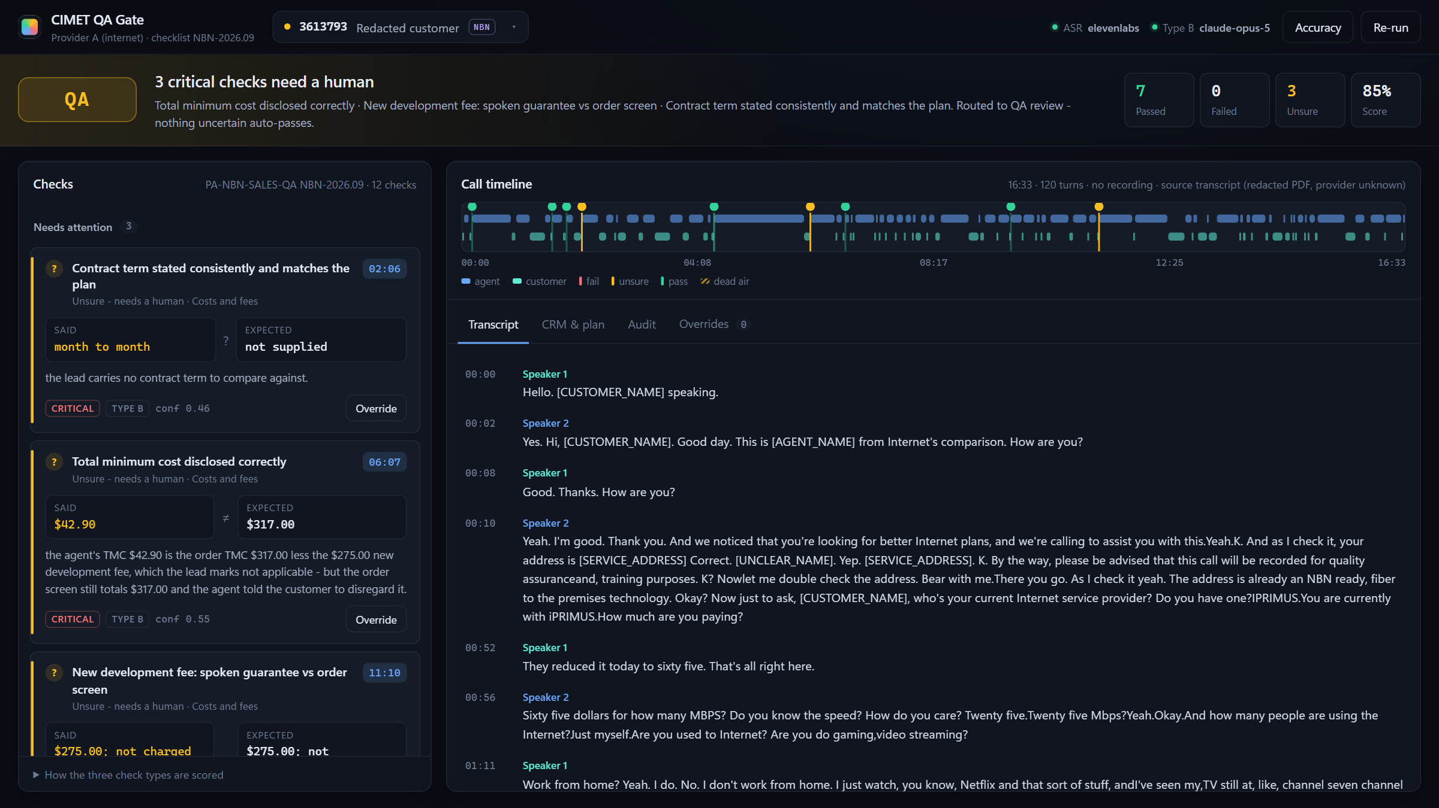
19 · MULTI-RETAILER, MULTI-VERTICAL
Checklist packs — and the official NBN artefact
Lead 3613793: the redacted internet sales call, scored against a 12-check NBN pack.
Type A · script & rules
Recording disclaimer at the open
Identity verified (name, email, DOB)
Card kept off the recording (mute, no PAN)
Type B · facts vs plan
Promo price + months
Ongoing price
Typical evening speed
Modem model + cost
Total minimum cost
Development fee vs order screen
Contract term
Packs: Retailer 1 energy (9 checks) is the default; NBN-QA (12) applies to leads that name it.
Transcript: copied row for row from the redacted PDF; all 15 placeholder tags kept verbatim.
No regressions: 0 verdict changes on 3613790–92 after adding the pack.
Honest timing: the PDF has no audio, so timestamps are estimated from turn order — and labelled as such.
Type C · coaching
Talk-over / cut-off turns
Customer confusion
CIMET QA Gate
20
Notes:
Checklist packs. The Retailer 1 energy checklist stays the default. Extra packs apply only to leads that name them. The official CIMET NBN artefact is lead 3613793: copied row for row from the redacted PDF, all fifteen placeholder tags preserved, and scored against a new twelve-check NBN pack. Adding it changed zero verdicts on the original three leads - we diffed every result before and after.

Slide 21
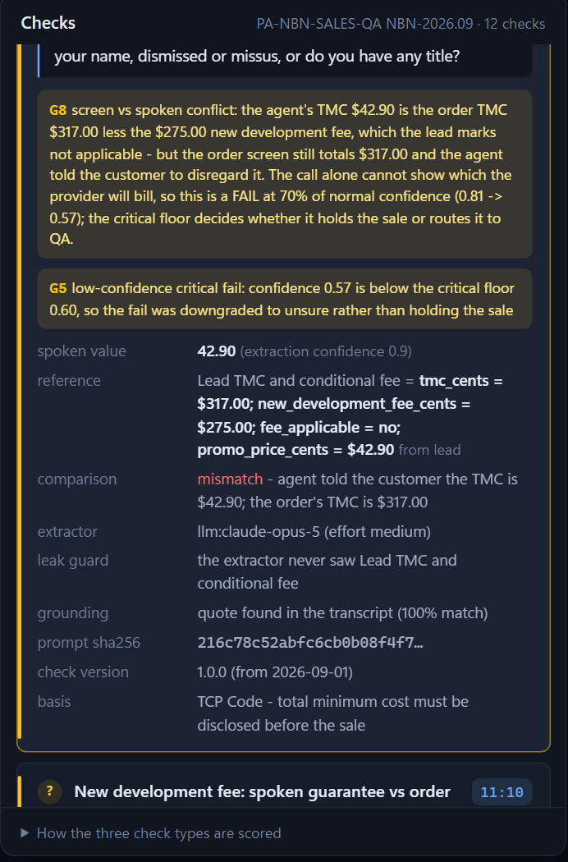
20 · NBN: WHAT THE AGENT SAID VS THE SCREEN
$42.90 said. $317 on the screen.
G8 scores the conflict; the confidence floor decides it goes to a human.
$42.90
$317
$275
the agent's TMC at 06:07 — “forty two dollars and ninety only”
read off the order screen 3× — “don't worry about that”
development fee — “I really guarantee you it will not be charged”
$317 − $275 = $42 → the agent quoted the order total without a fee the lead marks not applicable, while the submitted order still includes it.
G8
screen vs spoken: FAIL at 0.7× (0.81 → 0.57)
G5
0.57 < 0.60 floor → unsure
QA
a human confirms the fee is removed before submitting
Contract term: “month to month” and “one to one contract”, and no term on the lead → unsure (none invented).
CIMET QA Gate
21
Notes:
The hardest finding in the NBN call. At 06:07 the agent told the customer the total minimum cost would be forty-two ninety only. Later the agent read three hundred and seventeen off the customer's order screen three times and said not to worry. 317 minus the 275 development fee is 42 - the agent's figure is the order total without a fee the lead says doesn't apply, but the order still includes it and the agent guaranteed it wouldn't be charged. The call alone can't show which the provider will bill, so G8 scores it as a fail at reduced confidence, and at 0.57 it's below the floor: QA. The contract term is unsure because the agent said both 'month to month' and 'one to one contract' and the lead carries no term - we didn't invent one.

Slide 22
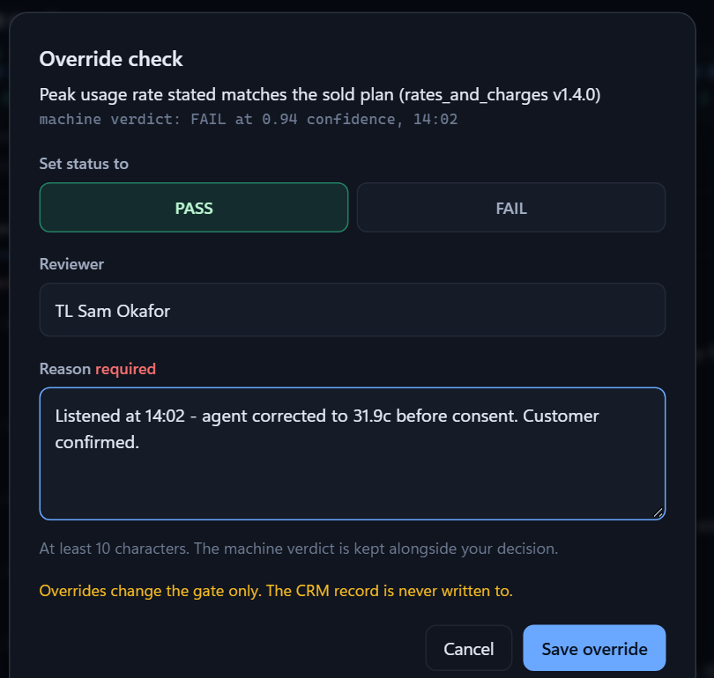
21 · RESPECT THE OVERRIDE
Humans decide — and every decision is kept
An override changes the gate, never the CRM.
A written reason
Machine verdict kept
At least 10 characters — enforced in the UI and again at the API.
Original status and confidence stay next to the human decision.
Gate re-runs live
Append-only log
HELD → SUBMITTED only when the last blocking check clears.
runs/override_log.jsonl: who, why, when, gate before → after.
CRM never written
Coaching can't block
crm_written=false on every entry. Fixing the record is the TL's job.
Type C notes can't be overridden into a blocking state.
CIMET QA Gate
22
Notes:
Respect the override. A team leader can flip any Type A or Type B verdict, but only with a written reason of at least ten characters - enforced in the console and again at the API. The machine's verdict and confidence are kept next to the human's, the gate re-runs live, and the entry is appended to a log that is never rewritten. The CRM is never touched. Coaching notes can't be overridden because they never affect the gate.

Slide 23
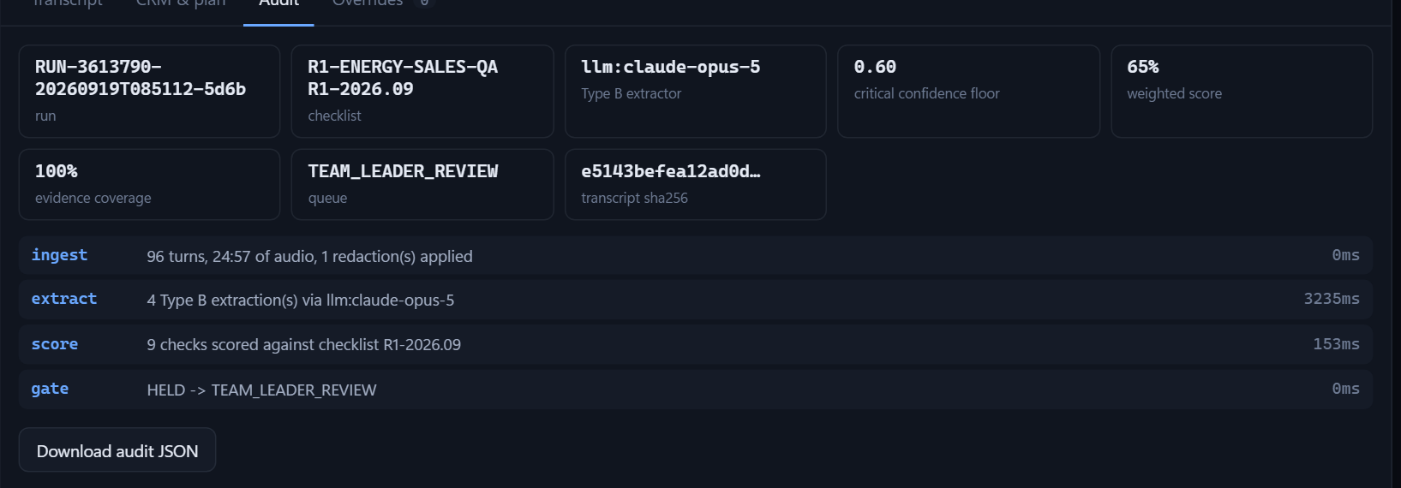
22 · TRACEABILITY
Every verdict can be rebuilt from one file
runs/<run_id>.json — the Download audit JSON button.
# every result
check_id, check_version, effective_from
status, confidence, blocks_sale
quote, start_sec, turn_idx, speaker
guardrails: [G1 ... G8 that fired]
evidence: extractor, model, prompt_sha256,
reference + source, comparison
# every run
checklist version in force
transcript_sha256 (+ recording sha256)
crm_snapshot, plan_snapshot
gate decision + reasons + history
override_log, pipeline_trace, config
Rule versions
Stamped today: every result carries its check version and the date it took effect.
Next step: resolve each check to the version that was live on the call date, not today's (the brief's requirement).
CIMET QA Gate
23
Notes:
Traceability. Every result carries the check id, version and effective date, status, confidence, the quote, the start time, the turn, the speaker, whether it blocks the sale, the guardrails that fired, and type-specific evidence. Every run writes one audit file with the checklist version in force, the transcript checksum, the CRM and plan snapshots, all results, the gate decision, its history and the override log. One honest gap: versions are stamped on every result, but choosing the version that was live on the call date is the next step.

Slide 24
23 · CONSTRAINTS & GUARDRAILS
The brief's non-negotiables, built in
Regulated Australian verticals: the scorer inherits the obligations of the calls it grades.
Test data only
In place
Consent is a check
In place
No card data surfaced
In place
Synthetic leads, the redacted CIMET artefact, and invented test calls. No real customer PII anywhere.
The recording disclaimer — including “do I have your consent” — is a critical Type A check on every call.
13+ digit runs, in digits or spoken words, are masked before scoring, the LLM or disk. NBN checks the mute.
No advice, no auto-correction
In place
Rules that were live
Partial
Respect the override
In place
The app never writes to the CRM, never contacts the customer. It says what failed and where.
Check version + effective date on every result. Resolving by call date is the next step.
Reason required, machine verdict kept, append-only log, gate before → after.
CIMET QA Gate
24
Notes:
The brief's non-negotiables and where each one lives in the product. Five are fully in place. The sixth - scoring against the rules that were live on the call date - is partly there: versions and effective dates are stamped on every result, and resolving by call date is the next step.

Slide 25
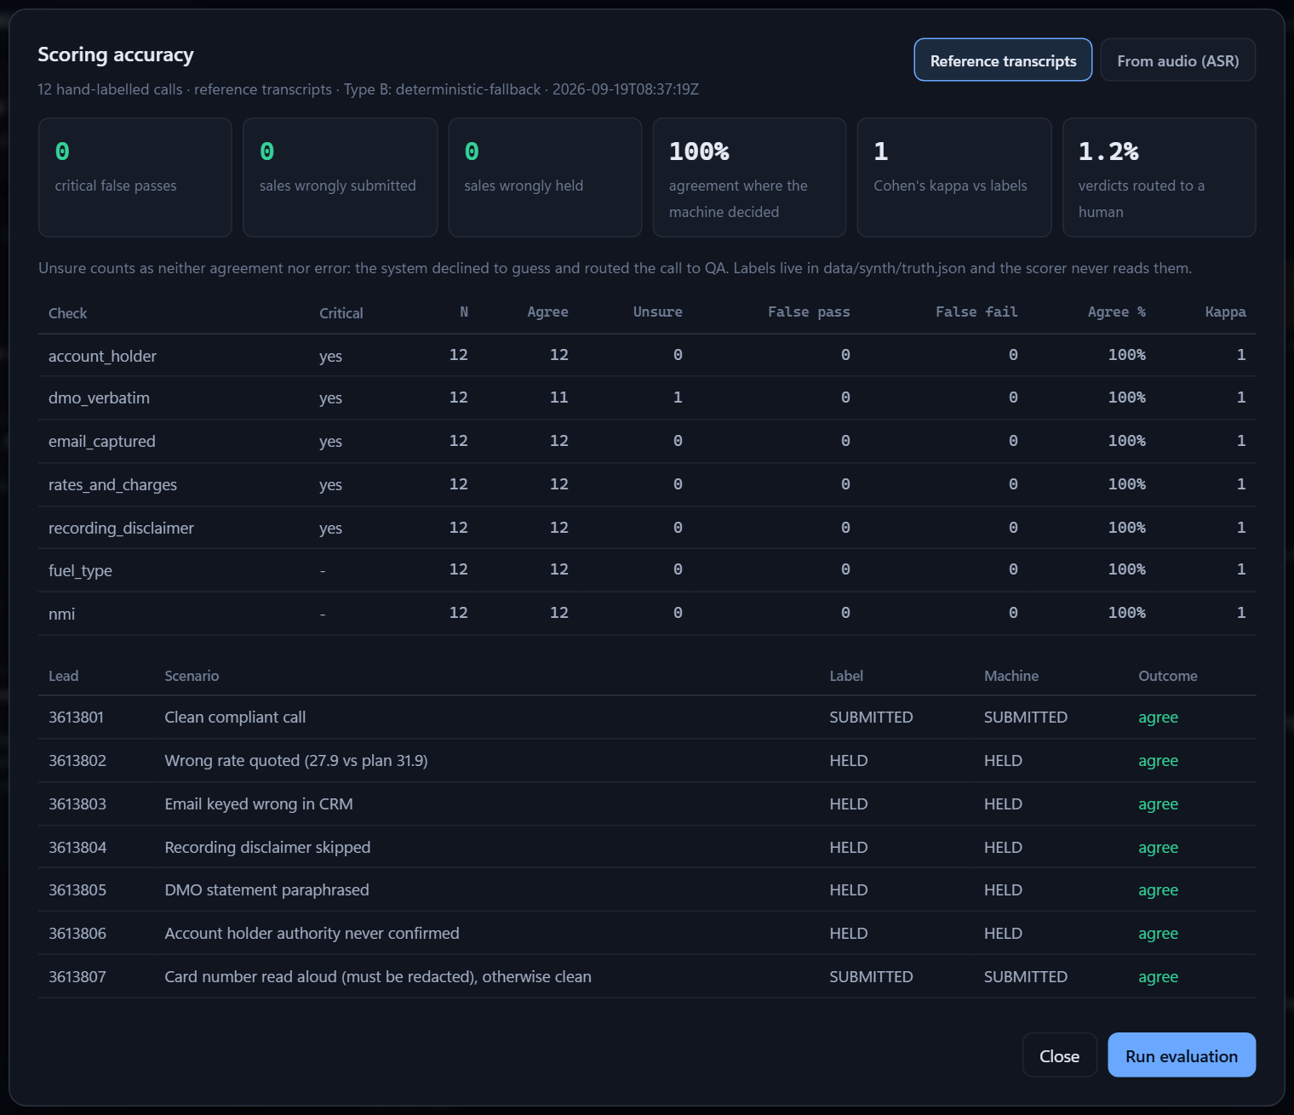
24 · SCORING ACCURACY
Zero critical false passes
Measured against 12 hand-labelled calls. The scorer never reads the labels.
0
0
critical false passes
sales wrongly submitted
0
κ 1.0
sales wrongly held
agreement with labels where the machine decided
Reference transcripts: 12 calls — 11 agree, 1 escalated to QA (crosstalk), 1.2% of verdicts routed to a human.
Real audio (ElevenLabs Scribe): 3 calls so far — 0 false passes, 0 wrong gates; 2 emails routed to a human by G7.
Caveat: reference transcripts follow the scripts, so they're a floor; the real test is the recording on the day.
CIMET QA Gate
25
Notes:
Scoring accuracy, which is thirty percent of the judging. Twelve hand-labelled synthetic calls, labels written independently of the scorer. Zero critical false passes, zero sales wrongly submitted, zero wrongly held, kappa one. One call - the crosstalk one - was routed to QA instead of passed, which is the system declining to guess. On real audio through ElevenLabs Scribe, the three calls that went through also show zero false passes and zero wrong gates, with two email verdicts routed to a human by G7. The honest caveat: reference transcripts follow the scripts, so they are a floor; the real test is the recording on the day.

Slide 26
25 · HOW WE TESTED IT
Proof, not claims
Everything below runs from the repo with one command each.
93
self-test assertions
12
labelled test calls
Offline, ~1s: worked example, messy audio, redaction, overrides, leak guard, dialler path, G7, G8, NBN pack.
Wrong rate, CRM email typo, skipped disclaimer, paraphrased DMO, no authority, card read aloud, dead air, NMI mismatch, crosstalk, two criticals…
python run.py --selftest
python tools/synth_calls.py
8 kHz
phone-quality audio
E2E
through the real webhook
ElevenLabs voices or free Windows voices; 300–3400 Hz band, line noise, real overlap, real silence.
A dialler simulator pushes each recording, Scribe transcribes, the gate scores, the eval compares to labels.
python tools/make_audio.py
python tools/dialler_sim.py --all --eval
CIMET QA Gate
26
Notes:
How we tested. Ninety-three behavioural assertions run offline in about a second, including the brief's worked example, the messy call, redaction, overrides, the leak guard, the dialler path and the NBN lead. Twelve synthetic calls each plant one or two defects with hand-written labels. Audio is generated with ElevenLabs or the free Windows voices and made to sound like a phone line. A dialler simulator pushes each recording through the real webhook, and the eval scores the ASR output against the labels.

Slide 27
26 · HOW IT MAPS TO THE JUDGING
Built against the five criteria
The proof is a real lead scored live — held or passed, with the exact reasoning shown.
Criterion | Weight | What we show
Scoring accuracy | 30% | Eval panel: 0 critical false passes, 0 wrong gates, κ 1.0 on 12 labelled calls; per-check agreement; real Scribe audio tested.
Coverage | 25% | Types A, B and C running end to end on the full Retailer 1 checklist (9 checks) and a second NBN-QA pack (12).
Traceability | 20% | Quote, timestamp and check version on every result; click-to-play; one audit JSON per run; version-by-call-date next.
Gate & escalation | 15% | Critical fail → HELD; unsure or < 0.60 → QA; nothing uncertain auto-passes; 5% of clean calls sampled.
Guardrails & judgment | 10% | G1–G8: silence, crosstalk, mishears and screen conflicts never manufacture a false critical.
CIMET QA Gate
27
Notes:
Mapped to the judging criteria. Accuracy: the eval panel, zero critical false passes. Coverage: all three check types run end to end against the full Retailer 1 checklist and a second NBN pack. Traceability: quote, timestamp and check version on every result, click-to-play, audit JSON. Gate: held, QA and submitted with a confidence floor and sampling. Guardrails: G1 to G8, tested on messy and real audio.

Slide 28
27 · TECH & SETUP
One command. No framework, no database.
Runs locally on 127.0.0.1; every external service is optional.
$ python run.py
CIMET QA Gate
http://127.0.0.1:8787/
Retailer 1 checklist R1-2026.09 | 9 checks
Type B: llm:claude-opus-5
ASR: elevenlabs
Dialler webhook: POST /api/dialler/recording
Setting | What it does
ANTHROPIC_API_KEY | LLM extraction for Type B
CIMET_MODEL | default claude-opus-5
ELEVENLABS_API_KEY / DEEPGRAM_API_KEY | dialler webhook (ASR)
CIMET_CONFIDENCE_FLOOR | critical floor, default 0.60
CIMET_SAMPLE_AUDIT_RATE | default 0.05
CIMET_DIALLER_TOKEN | require X-Dialler-Token
CIMET_PRESCORE | score new leads at startup
Python 3.10+, standard library only for the server, scoring engine and console.
Plain HTML, CSS, JavaScript — no build step, no framework.
Claude (claude-opus-5) extracts Type B values; comparisons are code.
ElevenLabs Scribe or Deepgram for speech-to-text, with speaker separation.
No keys? Still runs end to end on the deterministic extractor — and says so.
CIMET QA Gate
28
Notes:
Setup is one command. Python standard library only for the server, scoring engine and UI - no framework, no build step, no database, no Docker. Keys are optional: Anthropic for Type B extraction, ElevenLabs or Deepgram for recordings. Without keys everything still runs on the deterministic extractor and says so. Everything is configured from a .env file.

Slide 29
28 · KNOWN LIMITS & NEXT STEPS
What's next, stated plainly
Deliberate trade-offs for a solo 12-hour build.
Dashboards
Rules live on the call date
Agent-wise daily / weekly / monthly, first-pass yield, repeat offences (3+ in 7 days). Every run's audit JSON already holds the data.
Versions and effective dates are stamped; resolving each check by the call date is next.
Stereo recordings
Durable job queue
Split agent and customer by channel for certain speaker labels (mono uses diarisation today).
The dialler queue is in memory; recordings and transcripts are already on disk.
LLM availability
Wording drift
If the API fails (e.g. credit runs out), Type B falls back to the deterministic extractor and records why on every result.
Synthetic calls follow the checklist wording; the real recording on the day is the better test.
CIMET QA Gate
29
Notes:
Being honest about what's next. The brief's dashboards - agent-wise daily, weekly and monthly, first-pass yield and repeat offences - aren't built yet; the audit files already hold everything they need. Check versions are stamped but not yet resolved by call date. Stereo dialler recordings could use channels for certain speaker labels. The job queue is in memory. And if the LLM fails - for example when API credit runs out - every Type B check falls back to the deterministic extractor and records why.

Slide 30
29 · LIVE DEMO
The three-minute demo
A real lead scored live — held or passed, with the exact reasoning shown.
1
3613790 opens HELD
0:00
2
Click 14:02
0:30
The brief's worked example: two critical fails, said vs expected on each card.
Transcript jumps to the line; the evidence shows the quote, the plan value and the leak guard.
3
Override the rate
1:00
4
Switch to 3613792
1:40
Reason required. Gate stays HELD until the email clears too — then SUBMITTED.
Crosstalk and [inaudible]: QA, not HELD. G1 and G2 on the cards.
5
Open 3613793 (NBN)
2:10
6
Accuracy
2:40
The official artefact: $42.90 said vs $317 on screen, G8 → QA.
0 critical false passes, κ 1.0 — on reference and real audio.
CIMET QA Gate
30
Notes:
A three-minute live demo. Open on 3613790, the brief's example, held. Click 14:02 to show the evidence. Override the rate with a reason and show the gate stay held until the email clears too. Switch to 3613792 to show silence is never evidence. Open 3613793, the official NBN artefact, and show the forty-two ninety against three hundred and seventeen. Finish on the Accuracy panel.

Slide 31
THE ASK, ONE MORE TIME
No sale ships unscored.
Then explain exactly why, in seconds — not minutes.
HELD
QA
SUBMITTED
CIMET QA Gate
31
Notes:
Close. The ask from the brief, one more time: no sale ships unscored - and when it's held, explain exactly why, in seconds, not minutes. Thank you.

