Slide 1
How Are Genes Expressed?
From Gene to Protein

Slide 2
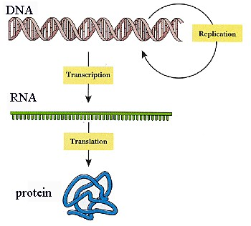

Slide 3
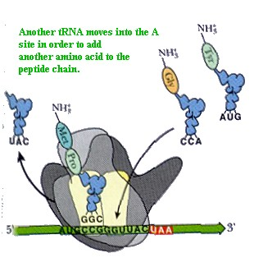
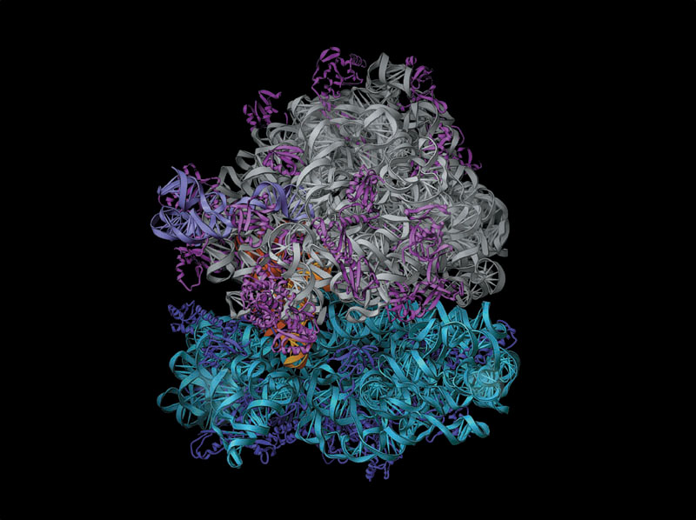
The ribosome
  Is part of the cellular machinery for translation, polypeptide synthesis

Slide 4
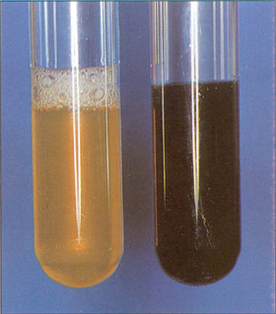
Concept 1: Genes specify proteins via transcription and translation
Evidence from the Study of Metabolic Defects
In 1909, British physician Archibald Garrod
  Was the first to suggest that genes dictate phenotypes through enzymes that catalyze specific chemical reactions in the cell
Alcaptonuria

Slide 5
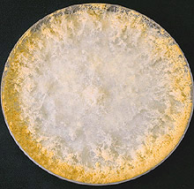
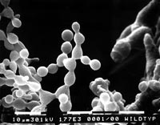
Nutritional Mutants in Neurospora: Scientific Inquiry
Beadle and Tatum causes bread mold to mutate with X-rays
  Creating mutants that could not survive on minimal medium

Slide 6
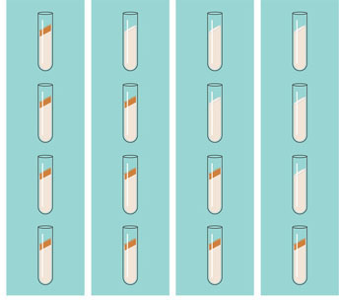
Using genetic crosses
  They determined that their mutants fell into three classes, each mutated in a different gene
EXPERIMENT
Working with the mold Neurospora crassa, George Beadle and Edward Tatum had isolated mutants requiring arginine in their growth medium and had shown genetically that these mutants fell into three classes, each defective in a different gene. From other considerations, they suspected that the metabolic pathway of arginine biosynthesis included the precursors ornithine and citrulline. Their most famous experiment, shown here, tested both their one gene–one enzyme hypothesis and their postulated arginine pathway. In this experiment, they grew their three classes of mutants under the four different conditions shown in the Results section below.
RESULTS
The wild-type strain required only the minimal medium for growth. The three classes of mutants had different growth requirements
Wild type
Class I
Mutants
Class II
Mutants
Class III
Mutants
Minimal
medium
(MM)
(control)
MM +
Ornithine
MM +
Citrulline
MM +
Arginine
(control)
Figure 17.2

Slide 7
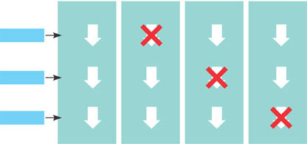
CONCLUSION
From the growth patterns of the mutants, Beadle and Tatum deduced that each mutant was unable to carry out one step in the pathway for synthesizing arginine, presumably because it lacked the necessary enzyme. Because each of their mutants was mutated in a single gene, they concluded that each mutated gene must normally dictate the production of one enzyme. Their results supported the one gene–one enzyme hypothesis and also confirmed the arginine pathway.
(Notice that a mutant can grow only if supplied with a compound made after the defective step.)
Class I
Mutants
(mutation
in gene A)
Class II
Mutants
(mutation
in gene B)
Class III
Mutants
(mutation
in gene C)
Wild type
Precursor
Precursor
Precursor
Precursor
Enzyme
A
Gene A
A
A
A
Ornithine
Ornithine
Ornithine
Ornithine
Gene B
Enzyme
B
B
B
B
Citrulline
Citrulline
Citrulline
Citrulline
Gene C
Enzyme
C
C
C
C
Arginine
Arginine
Arginine
Arginine

Slide 8
The Products of Gene Expression: A Developing Story
Beadle and Tatum developed the “one gene–one enzyme hypothesis”
  Which states that the function of a gene is to dictate the production of a specific enzyme
As researchers learned more about proteins
  The made minor revision to the one gene–one enzyme hypothesis
Genes code for polypeptide chains or for RNA molecules

Slide 9
Basic Principles of Transcription and Translation
Transcription
  Is the synthesis of RNA under the direction of DNA
  Produces messenger RNA (mRNA)
Translation
  Is the actual synthesis of a polypeptide, which occurs under the direction of mRNA
  Occurs on ribosomes
Cells are governed by a cellular chain of command
  DNA → RNA → protein

Slide 10
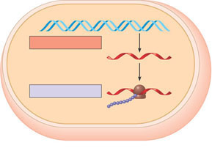
In prokaryotes
  Transcription and translation occur together
TRANSCRIPTION
DNA
mRNA
Ribosome
TRANSLATION
Polypeptide
(a)
Prokaryotic cell. In a cell lacking a nucleus, mRNA
produced by transcription is immediately translated
without additional processing.

Slide 11
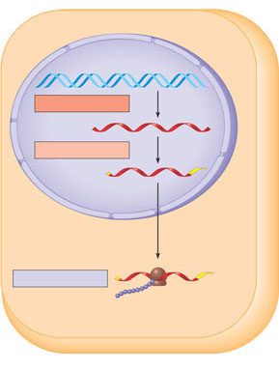
In eukaryotes
  RNA transcripts are modified before becoming true mRNA
Nuclear
envelope
TRANSCRIPTION
DNA
RNA PROCESSING
Pre-mRNA
mRNA
Ribosome
TRANSLATION
(b)
Eukaryotic cell. The nucleus provides a separate
compartment for transcription. The original RNA
transcript, called pre-mRNA, is processed in various
ways before leaving the nucleus as mRNA.
Polypeptide

Slide 12
The Genetic Code
How many bases correspond to an amino acid?
Codons: Triplets of Bases
Genetic information
  Is encoded as a sequence of nonoverlapping base triplets, or codons

Slide 13
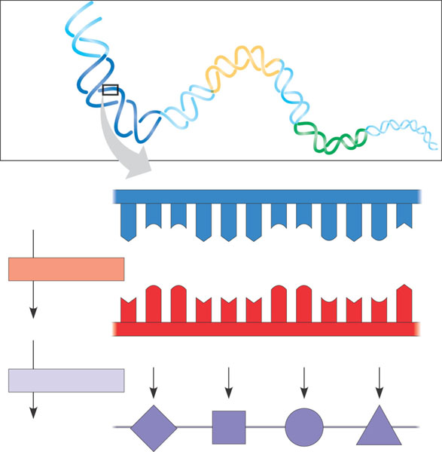
During transcription
  The gene determines the sequence of bases along the length of an mRNA molecule
Codons must be read in the correct reading frame
  For the specified polypeptide to be produced
DNA
molecule
Gene 2
Gene 1
Gene 3
DNA strand
(template)
3′
5′
A
C
C
A
A
A
C
C
G
A
G
T
TRANSCRIPTION
U
G
G
U
U
U
G
G
C
U
C
A
mRNA
5′
3′
Codon
TRANSLATION
Protein
Trp
Phe
Gly
Ser
Amino acid

Slide 14
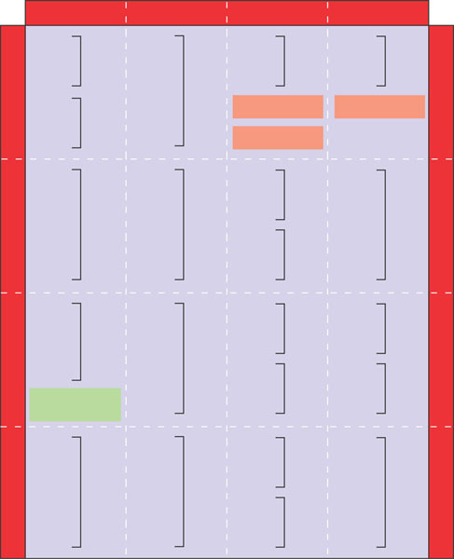
Cracking the Code
A codon in messenger RNA
  Is either translated into an amino acid or serves as a translational stop signal
Second mRNA base
U
C
A
G
UUU
UCU
UAU
UGU
U
UUC
Phe
UCC
UAC
Tyr
UGC
Cys
C
U
UUA
UCA
Ser
UAA
Stop
UGA
Stop
A
UUG
Leu
UCG
UAG
Stop
UGG
Trp
G
CUU
CCU
CAU
His
CGU
U
C
CUC
CCC
CAC
CGC
Arg
C
CUA
Leu
CCA
Pro
CAA
CGA
A
CUG
CCG
CAG
Gln
CGG
G
First mRNA base (5′ end)
Third mRNA base (3′ end)
AUU
ACU
AAU
Asn
AGU
U
AUC
lle
ACC
AAC
AGC
Ser
C
A
AUA
ACA
Thr
AAA
AGA
A
AUG
Met or
start
ACG
AAG
Lys
AGG
Arg
G
GUU
GCU
GAU
GGU
U
GUC
GCC
GAC
Asp
GGC
C
G
GUA
Val
GCA
Ala
GAA
GGA
Gly
A
GUG
GCG
GAG
Glu
GGG
G

Slide 15
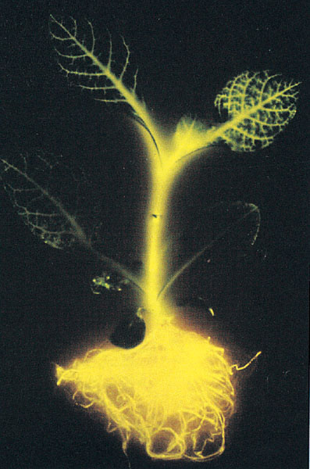
Evolution of the Genetic Code
The genetic code is nearly universal
  Shared by organisms from the simplest bacteria to the most complex animals
In laboratory experiments
  Genes can be transcribed and translated after being transplanted from one species to another

Slide 16
Concept 2: Transcription is the DNA-directed synthesis of RNA: a closer look
RNA synthesis
  Is catalyzed by RNA polymerase, which pries the DNA strands apart and hooks together the RNA nucleotides
  Follows the same base-pairing rules as DNA, except that in RNA, uracil substitutes for thymine

Slide 17
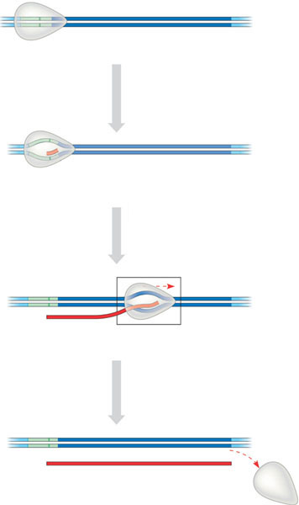
Synthesis of an RNA Transcript
The stages of transcription are
  Initiation
  Elongation
  Termination
Promoter
Transcription unit
5′
3′
DNA
3′
5′
Start point
RNA polymerase
1
Initiation. After RNA polymerase binds to
the promoter, the DNA strands unwind, and
the polymerase initiates RNA synthesis at the
start point on the template strand.
5′
3′
Template strand of DNA
3′
5′
Unwound
DNA
RNA
transcript
2
Elongation. The polymerase moves downstream, unwinding the
DNA and elongating the RNA transcript 5′ → 3 ′. In the wake of
transcription, the DNA strands re-form a double helix.
Rewound
RNA
5′
3′
3′
3′
5′
5′
RNA
transcript
3
Termination. Eventually, the RNA
transcript is released, and the
polymerase detaches from the DNA.
5′
3′
3′
5′
5′
Completed RNA transcript
3′

Slide 18
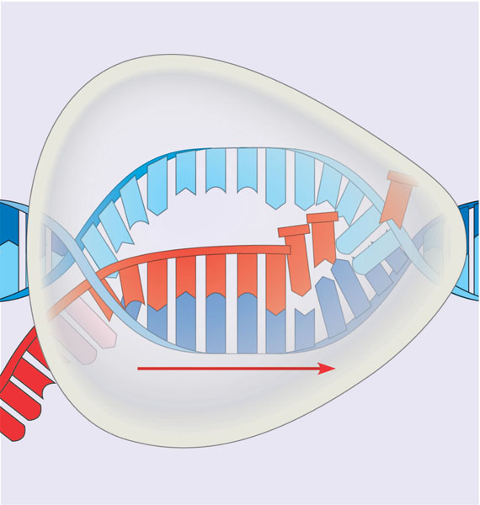
Elongation
Non-template
strand of DNA
RNA nucleotides
RNA
polymerase
A
T
C
C
A
A
T
3′
C
T
U
3′ end
T
G
A
U
G
A
G
G
A
E
5′
C
C
A
C
A
T
A
A
G
G
T
T
5′
Direction of transcription
(“downstream”)
Template
strand of DNA
Newly made
RNA

Slide 19
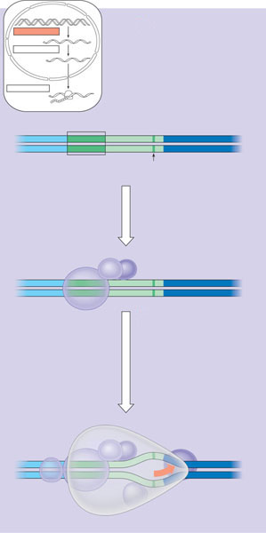
RNA Polymerase Binding and Initiation of Transcription
Promoters signal the initiation of RNA synthesis
Transcription factors
  Help eukaryotic RNA polymerase recognize promoter sequences
Eukaryotic promoters
TRANSCRIPTION
DNA
1
RNA PROCESSING
Pre-mRNA
mRNA
TRANSLATION
Ribosome
Polypeptide
Promoter
5′
T
A
3′
A
T
A
A
A
A
T
A
T
T
T
3′
T
5′
TATA box
Start point
Template
DNA strand
Several transcription
factors
2
Transcription
factors
5′
3′
3′
3
5′
Additional transcription
factors
RNA polymerase II
Transcription factors
5′
5′
3′
3′
5′
RNA transcript
Transcription initiation complex

Slide 20
Elongation of the RNA Strand
As RNA polymerase moves along the DNA
  It continues to untwist the double helix, exposing about 10 to 20 DNA bases at a time for pairing with RNA nucleotides
20

Slide 21
Termination of Transcription
The mechanisms of termination
  Are different in prokaryotes and eukaryotes

Slide 22
Concept 3: Eukaryotic cells modify RNA after transcription
Enzymes in the eukaryotic nucleus
  Modify pre-mRNA in specific ways before the genetic messages are dispatched to the cytoplasm

Slide 23
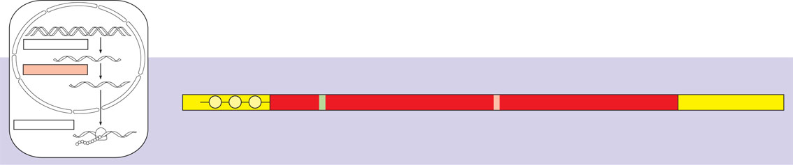
Alteration of mRNA Ends
Each end of a pre-mRNA molecule is modified in a particular way
  The 5′ end receives a modified nucleotide cap
  The 3′ end gets a poly-A tail
A modified guanine nucleotide
added to the 5′ end
50 to 250 adenine nucleotides
added to the 3′ end
TRANSCRIPTION
DNA
RNA PROCESSING
Pre-mRNA
5′
Protein-coding segment
Polyadenylation signal
3′
mRNA
G
P
P
P
AAUAAA
AAA…AAA
TRANSLATION
Ribosome
Start codon
Stop codon
5′ Cap
5′ UTR
3′ UTR
Poly-A tail
Polypeptide

Slide 24
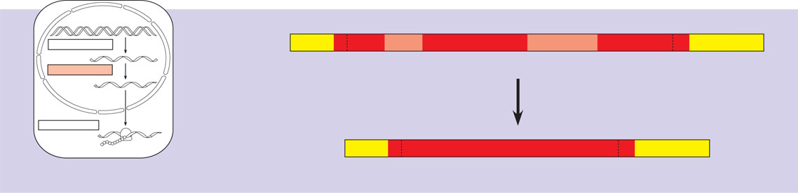
Split Genes and RNA Splicing
RNA splicing
  Removes introns and joins exons
5′
Exon
Intron
Exon
Intron
Exon
3′
TRANSCRIPTION
DNA
Pre-mRNA
5′ Cap
Poly-A tail
1
30
31
104
105
146
RNA PROCESSING
Pre-mRNA
mRNA
Coding
segment
Introns cut out and
exons spliced together
TRANSLATION
Ribosome
Polypeptide
mRNA
5′ Cap
Poly-A tail
1
146
3′ UTR
3′ UTR

Slide 25
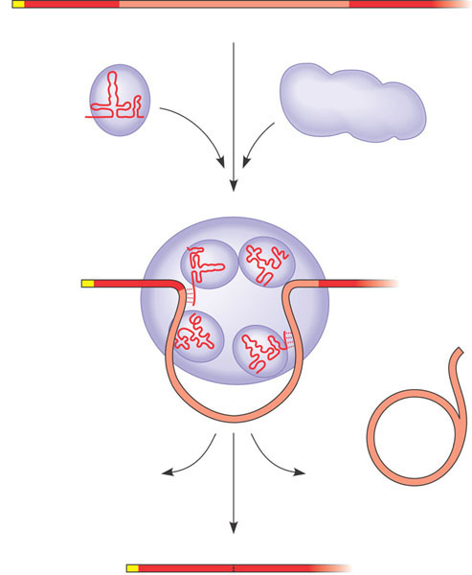
RNA Splicing
Is carried out by spliceosomes in some cases
RNA transcript (pre-mRNA)
5′
Exon 1
Intron
Exon 2
Protein
1
snRNA
Other proteins
snRNPs
Spliceosome
2
5′
Spliceosome
components
Cut-out
intron
3
mRNA
5′
Exon 1
Exon 2

Slide 26
Ribozymes
  Are catalytic RNA molecules that function as enzymes and can splice RNA
  The Functional and Evolutionary Importance of Introns
The presence of introns
  Allows for alternative RNA splicing

Slide 27
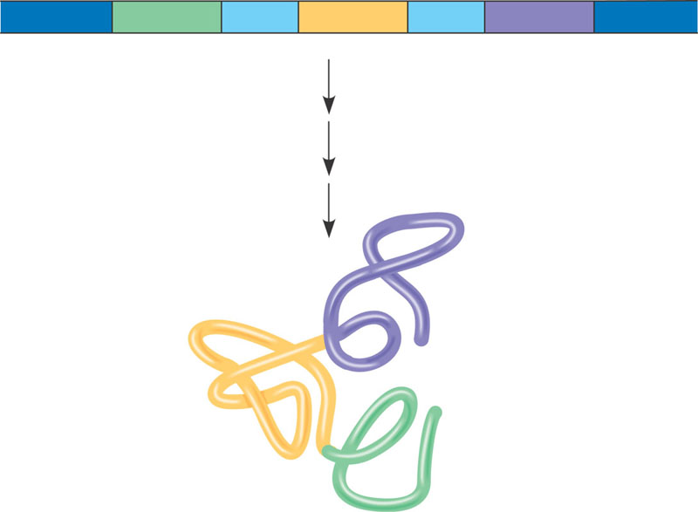
Proteins often have a modular architecture
  Consisting of discrete structural and functional regions called domains
In many cases
  Different exons code for the different domains in a protein
DNA
Gene
Exon 1
Intron
Exon 2
Intron
Exon 3
Transcription
RNA processing
Translation
Domain 3
Domain 2
Domain 1
Polypeptide

Slide 28
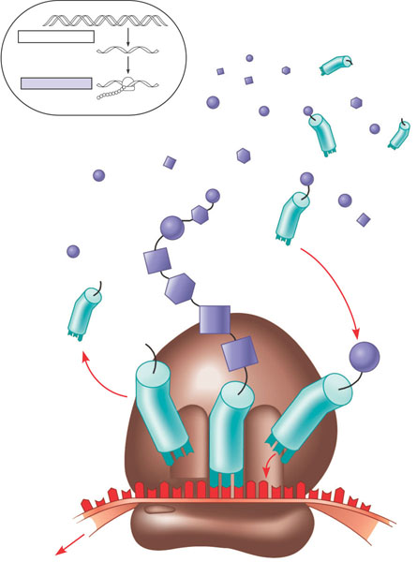
Concept 4: Translation is the RNA-directed synthesis of a polypeptide: a closer look
TRANSCRIPTION
DNA
mRNA
TRANSLATION
Ribosome
Polypeptide
Amino
acids
Polypeptide
tRNA with
amino acid
attached
Trp
Ribosome
Phe
Gly
tRNA
C
C
C
G
G
Anticodon
A
A
A
G
A
G
U
G
G
U
U
U
C
5′
Codons
3′
mRNA

Slide 29
A cell translates an mRNA message into protein
  With the help of transfer RNA (tRNA)
Molecules of tRNA are not all identical
  Each carries a specific amino acid on one end
  Each has an anticodon on the other end

Slide 30
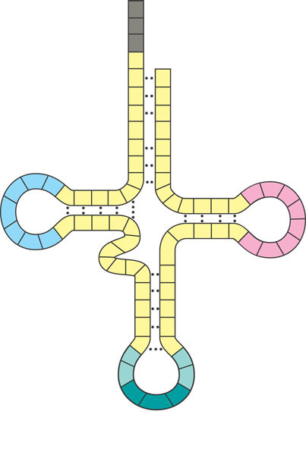
The Structure and Function of Transfer RNA
A tRNA molecule
  Consists of a single RNA strand that is only about 80 nucleotides long
  Is roughly L-shaped
A
C
C
3′
Amino acid
attachment site
A
C
C
5′
A
C
G
G
C
C
G
U
G
U
A
A
U
*
U
C
A
U
G
C
A
C
A
G
U
A
*
G
A
*
C
U
C
*
C
G
U
G
U
*
C
G
A
G
G
*
*
U
C
*
A
G
G
*
G
A
(a)
G
C
Hydrogen
bonds
Two-dimensional structure. The four base-paired regions and three loops are characteristic of all tRNAs, as is the base sequence of the amino acid attachment site at the 3′ end. The anticodon triplet is unique to each tRNA type. (The asterisks mark bases that have been chemically modified, a characteristic of tRNA.)
G
C
U
A
*
G
*
A
A
C
*
U
A
A
G
Anticodon

Slide 31
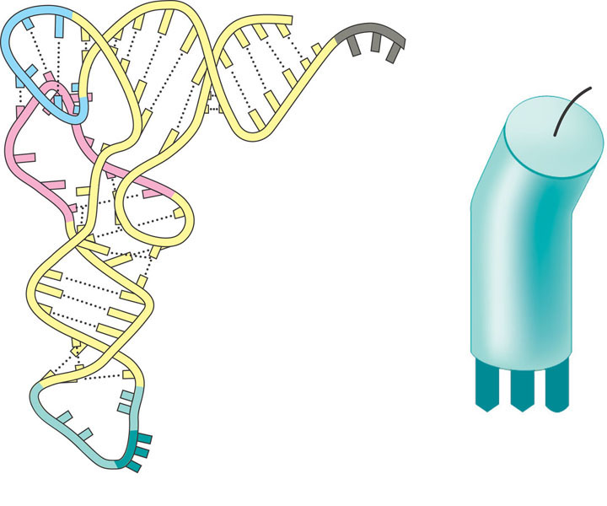
5′
Amino acid
attachment site
3′
Hydrogen
bonds
A
A
G
3′
5′
Anticodon
Anticodon
(c)
Symbol used
in this book
(b) Three-dimensional structure

Slide 32
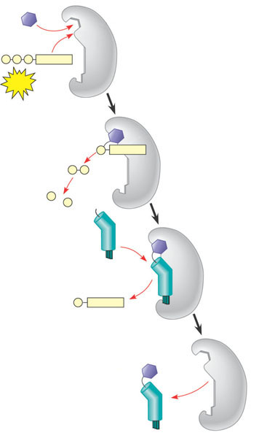
A specific enzyme called an aminoacyl-tRNA synthetase
  Joins each amino acid to the correct tRNA
Amino acid
Aminoacyl-tRNA
synthetase (enzyme)
Active site binds the
amino acid and ATP.
P
Adenosine
1
P
P
ATP
ATP loses two P groups
and joins amino acid as AMP.
2
Pyrophosphate
P
Adenosine
P
P_{i}
P_{i}
P_{i}
Phosphates
3
tRNA
Appropriate
tRNA covalently
Bonds to amino
Acid, displacing
AMP.
P
Adenosine
AMP
4
Activated amino acid
is released by the enzyme.
Aminoacyl tRNA
(an “activated
amino acid”)

Slide 33
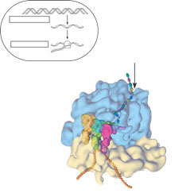
Ribosomes
Ribosomes facilitate the specific coupling of tRNA anticodons with mRNA codons during protein synthesis
The ribosomal subunits are constructed of proteins and RNA molecules named ribosomal RNA or rRNA
TRANSCRIPTION
DNA
mRNA
TRANSLATION
Ribosome
Polypeptide
Exit tunnel
Growing
polypeptide
tRNA
molecules
Large
subunit
E
P
A
Small
subunit
5′
3′
mRNA
(a)
Computer model of functioning ribosome. This is a model of a bacterial ribosome, showing its overall shape. The eukaryotic ribosome is roughly similar. A ribosomal subunit is an aggregate of ribosomal RNA molecules and proteins.

Slide 34

The ribosome has three binding sites for tRNA
  The P site
  The A site
  The E site
P site (Peptidyl-tRNA
binding site)
A site (Aminoacyl-
tRNA binding site)
E site
(Exit site)
Large
subunit
E
P
A
mRNA
binding site
Small
subunit
(b)
Schematic model showing binding sites. A ribosome has an mRNA binding site and three tRNA binding sites, known as the A, P, and E sites. This schematic ribosome will appear in later diagrams.

Slide 35
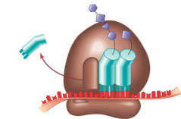
Amino end
Growing polypeptide
Next amino acid
to be added to
polypeptide chain
tRNA
mRNA
3′
5′
Codons
(c)
Schematic model with mRNA and tRNA. A tRNA fits into a binding site when its anticodon base-pairs with an mRNA codon. The P site holds the tRNA attached to the growing polypeptide. The A site holds the tRNA carrying the next amino acid to be added to the polypeptide chain. Discharged tRNA leaves via the E site.

Slide 36
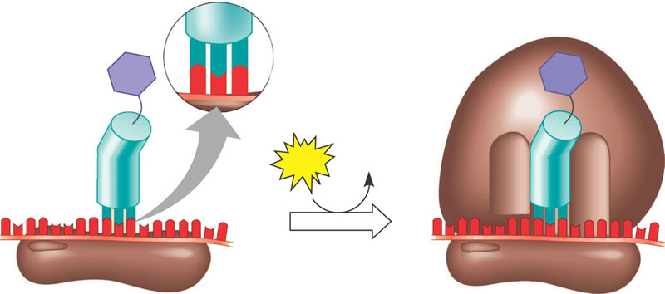
Ribosome Association and Initiation of Translation
The initiation stage of translation
  Brings together mRNA, tRNA bearing the first amino acid of the polypeptide, and two subunits of a ribosome
Large
ribosomal
subunit
3′
5′
P site
U
A
C
Met
A
3′
Met
5′
U
G
Initiator tRNA
GTP
GDP
E
A
mRNA
5′
3′
5′
3′
Start codon
mRNA binding site
Small
ribosomal
subunit
Translation initiation complex
1
A small ribosomal subunit binds to a molecule of
mRNA. In a prokaryotic cell, the mRNA binding site
on this subunit recognizes a specific nucleotide
sequence on the mRNA just upstream of the start
codon. An initiator tRNA, with the anticodon UAC,
base-pairs with the start codon, AUG. This tRNA
carries the amino acid methionine (Met).
2
The arrival of a large ribosomal subunit completes
the initiation complex. Proteins called initiation
factors (not shown) are required to bring all the
translation components together. GTP provides
the energy for the assembly. The initiator tRNA is
in the P site; the A site is available to the tRNA
bearing the next amino acid.

Slide 37
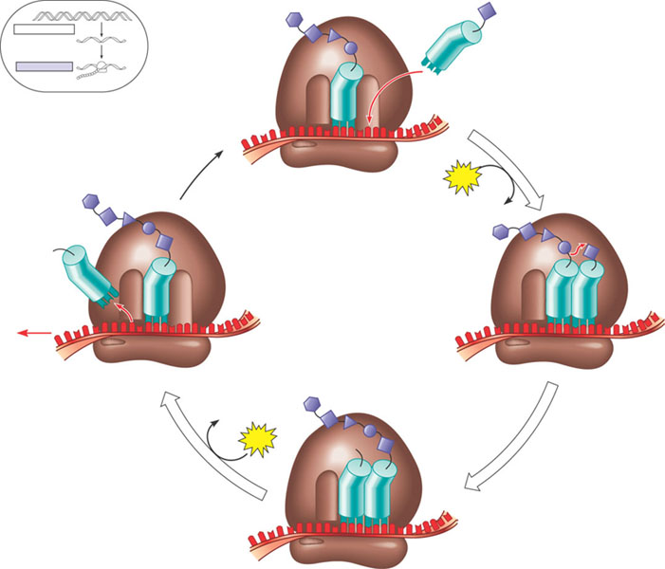
Elongation of the Polypeptide Chain
In the elongation stage of translation
  Amino acids are added one by one to the preceding amino acid
TRANSCRIPTION
DNA
Amino end
of polypeptide
mRNA
TRANSLATION
Ribosome
Polypeptide
Codon recognition. The anticodon
of an incoming aminoacyl tRNA
base-pairs with the complementary
mRNA codon in the A site. Hydrolysis
of GTP increases the accuracy and
efficiency of this step.
E
1
mRNA
3′
Ribosome ready for
next aminoacyl tRNA
P
A
5′
site
site
2
GTP
2
GDP
E
E
P
A
P
A
2
GDP
Peptide bond formation. An
rRNA molecule of the large
subunit catalyzes the formation
of a peptide bond between the
new amino acid in the A site and
the carboxyl end of the growing
polypeptide in the P site. This step
attaches the polypeptide to the
tRNA in the A site.
Translocation. The ribosome
translocates the tRNA in the A
site to the P site. The empty tRNA
in the P site is moved to the E site,
where it is released. The mRNA
moves along with its bound tRNAs,
bringing the next codon to be
translated into the A site.
3
GTP
E
P
A

Slide 38
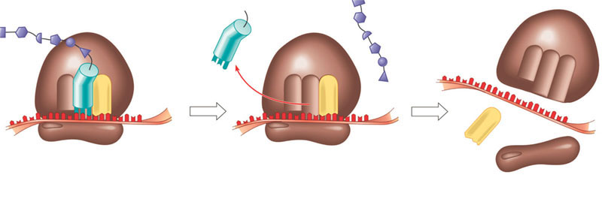
Termination of Translation
The final stage of translation is termination
  When the ribosome reaches a stop codon in the mRNA
Release
factor
Free
polypeptide
5′
3′
3′
3′
5′
5′
Stop codon
(UAG, UAA, or UGA)
1
When a ribosome reaches a stop
codon on mRNA, the A site of the
ribosome accepts a protein called
a release factor instead of tRNA.
The release factor hydrolyzes
the bond between the tRNA in
the P site and the last amino
acid of the polypeptide chain.
The polypeptide is thus freed
from the ribosome.
The two ribosomal subunits
and the other components of
the assembly dissociate.
2
3

Slide 39
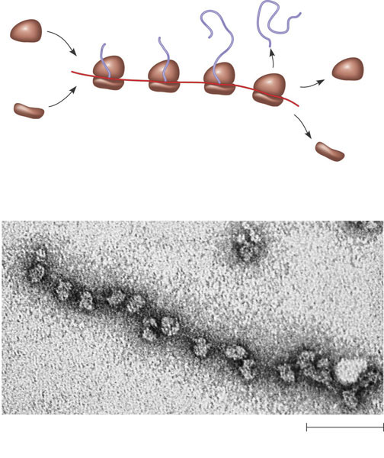
Polyribosomes
A number of ribosomes can translate a single mRNA molecule simultaneously
  Forming a polyribosome
Completed
polypeptide
Growing
polypeptides
Incoming
ribosomal
subunits
Start of
mRNA
(5′ end)
Polyribosome
End of
mRNA
(3′ end)
(a)
An mRNA molecule is generally translated simultaneously
by several ribosomes in clusters called polyribosomes.
Ribosomes
mRNA
0.1 µm
(b)
This micrograph shows a large polyribosome in a prokaryotic
cell (TEM).

Slide 40
Completing and Targeting the Functional Protein
Polypeptide chains
  Undergo modifications after the translation process
Protein Folding and Post-Translational Modifications
After translation
  Proteins may be modified in ways that affect their three-dimensional shape

Slide 41
Targeting Polypeptides to Specific Locations
Two populations of ribosomes are evident in cells
  Free and bound
Free ribosomes in the cytosol
  Initiate the synthesis of all proteins
Proteins destined for the endomembrane system or for secretion
  Must be transported into the ER
  Have signal peptides to which a signal-recognition particle (SRP) binds, enabling the translation ribosome to bind to the ER

Slide 42
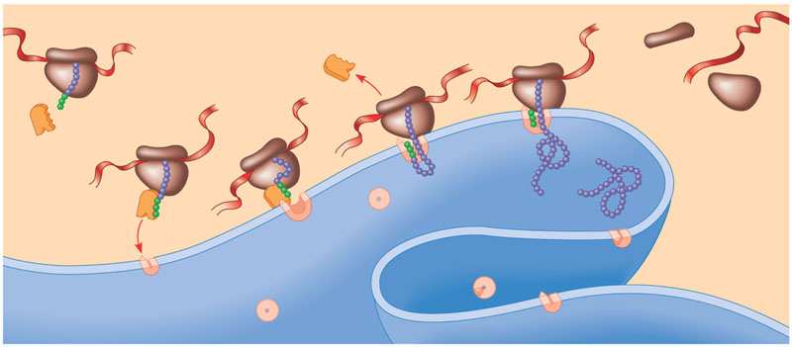
The signal mechanism for targeting proteins to the ER
Polypeptide
synthesis begins
on a free
ribosome in
the cytosol.
An SRP binds
to the signal
peptide, halting
synthesis
momentarily.
The SRP binds to a
receptor protein in the ER
membrane. This receptor
is part of a protein complex
(a translocation complex)
that has a membrane pore
and a signal-cleaving enzyme.
The SRP leaves, and
the polypeptide resumes
growing, meanwhile
translocating across the
membrane. (The signal
peptide stays attached
to the membrane.)
The signal-
cleaving
enzyme
cuts off the
signal peptide.
The rest of
the completed
polypeptide leaves
the ribosome and
folds into its final
conformation.
1
2
3
4
5
6
Ribosome
mRNA
Signal
peptide
ER
membrane
Signal-
recognition
particle
(SRP)
Signal
peptide
removed
Protein
SRP
receptor
protein
CYTOSOL
ERLUMEN
Translocation
complex

Slide 43
Concept 5: RNA plays multiple roles in the cell: a review
RNA
  Can hydrogen-bond to other nucleic acid molecules
  Can assume a specific three-dimensional shape
  Has functional groups that allow it to act as a catalyst

Slide 44
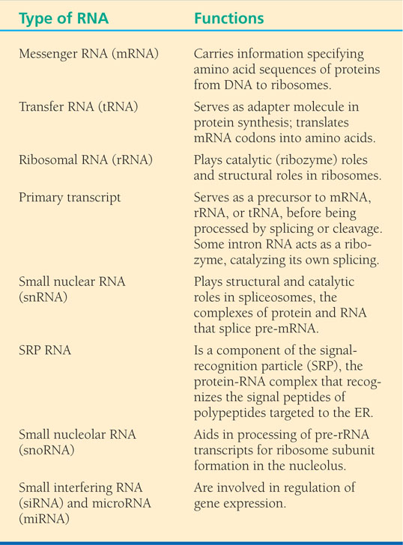
Types of RNA in a Eukaryotic Cell

Slide 45
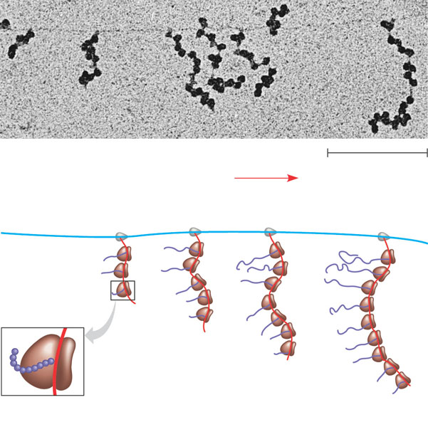
Concept 6: Comparing gene expression in prokaryotes and eukaryotes reveals key differences
Prokaryotic cells lack a nuclear envelope
  Allowing translation to begin while transcription is still in progress
RNA polymerase
DNA
mRNA
Polyribosome
RNA
polymerase
Direction of
transcription
0.25 μm
DNA
Polyribosome
Polypeptide
(amino end)
Ribosome
mRNA (5′ end)

Slide 46
In a eukaryotic cell
  The nuclear envelope separates transcription from translation
  Extensive RNA processing occurs in the nucleus

Slide 47
Concept 7: Point mutations can affect protein structure and function
Mutations
  Are changes in the genetic material of a cell
Point mutations
  Are changes in just one base pair of a gene

Slide 48
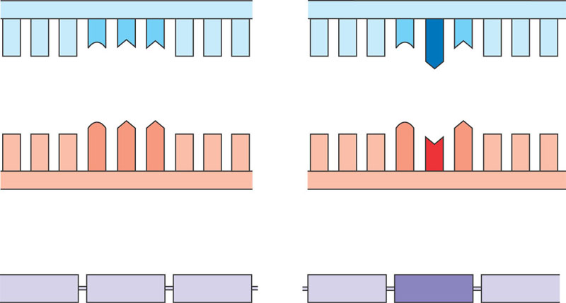
The change of a single nucleotide in the DNA’s template strand
  Leads to the production of an abnormal protein
Wild-type hemoglobin DNA
Mutant hemoglobin DNA
In the DNA, the
mutant template
strand has an A where
the wild-type template
has a T.
3′
5′
3′
5′
C
T
T
C
A
T
mRNA
mRNA
The mutant mRNA has
a U instead of an A in
one codon.
G
A
A
G
U
A
5′
3′
5′
3′
Normal hemoglobin
Sickle-cell hemoglobin
The mutant (sickle-cell)
hemoglobin has a valine
(Val) instead of a glutamic
acid (Glu).
Glu
Val

Slide 49
Types of Point Mutations
Point mutations within a gene can be divided into two general categories
  Base-pair substitutions
  Base-pair insertions or deletions

Slide 50
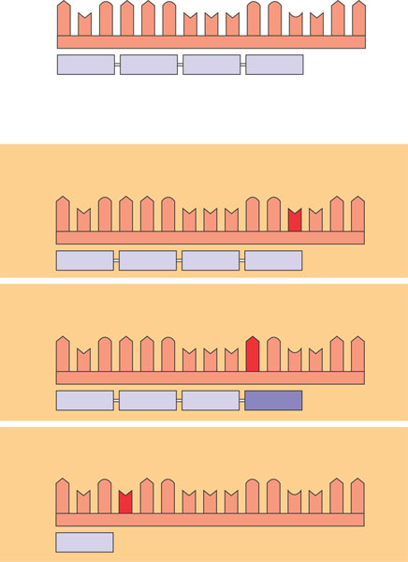
Substitutions
A base-pair substitution
  Is the replacement of one nucleotide and its partner with another pair of nucleotides
  Can cause missense or nonsense
Wild type
mRNA
A
U
G
A
A
G
U
U
U
G
G
C
U
A
A
Protein
5′
Met
Lys
Phe
Gly
3′
Stop
Amino end
Carboxyl end
Base-pair substitution
No effect on amino acid sequence
U instead of C
A
U
G
A
A
G
U
U
U
G
G
U
U
A
A
Met
Lys
Phe
Gly
Stop
Missense
A instead of G
A
U
G
A
A
G
U
U
U
A
G
U
U
A
A
Met
Lys
Phe
Ser
Stop
Nonsense
U instead of A
A
U
G
U
A
G
U
U
U
G
G
C
U
A
A
Met
Stop

Slide 51
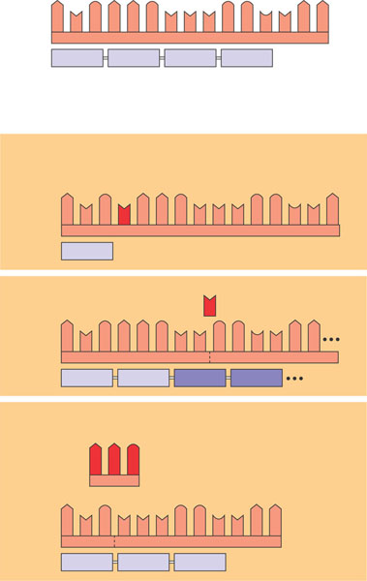
Insertions and Deletions
Insertions and deletions
  Are additions or losses of nucleotide pairs in a gene
  May produce frameshift mutations
Wild type
A
U
G
A
A
G
G
G
A
mRNA
5′
U
U
U
C
U
A
3′
Protein
Met
Lys
Phe
Gly
Stop
Amino end
Carboxyl end
Base-pair insertion or deletion
Frameshift causing immediate nonsense
Extra U
A
G
A
A
U
U
G
U
U
U
G
G
C
U
A
Met
Stop
Frameshift causing
extensive missense
U
Missing
A
U
G
A
A
G
U
A
A
U
U
G
G
C
Met
Lys
Leu
Ala
Insertion or deletion of 3 nucleotides:
no frameshift but extra or missing amino acid
A
A
Missing
G
A
U
G
U
U
U
G
G
C
U
A
A
Met
Phe
Gly
Stop

Slide 52
Mutagens
Spontaneous mutations
  Can occur during DNA replication, recombination, or repair
Mutagens
  Are physical or chemical agents that can cause mutations

Slide 53
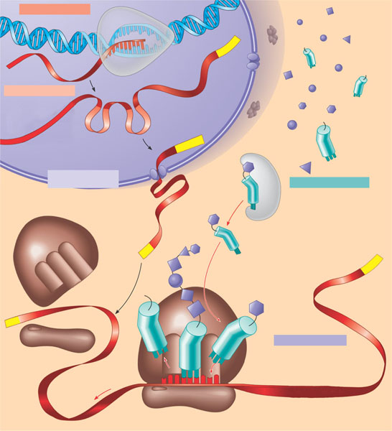
What is a gene? revisiting the question
A gene is a region of DNA whose final product is either a polypeptide or an RNA molecule
A summary of transcription and translation in a eukaryotic cell
TRANSCRIPTION
DNA
1
RNA is transcribed
from a DNA template.
3′
Poly-A
5′
RNA
transcript
RNA
polymerase
RNA PROCESSING
Exon
2
In eukaryotes, the
RNA transcript (pre-
mRNA) is spliced and
modified to produce
mRNA, which moves
from the nucleus to the
cytoplasm.
RNA transcript
(pre-mRNA)
Intron
Cap
Aminoacyl-tRNA
synthetase
NUCLEUS
FORMATION OF
INITIATION COMPLEX
Amino
acid
CYTOPLASM
tRNA
AMINO ACID ACTIVATION
3
After leaving the
nucleus, mRNA attaches
to the ribosome.
4
Each amino acid
attaches to its proper tRNA
with the help of a specific
enzyme and ATP.
mRNA
Growing
polypeptide
Poly-A
Activated
amino acid
Ribosomal
subunits
Poly-A
Cap
5′
TRANSLATION
C
5
C
A
U
A succession of tRNAs
add their amino acids to
the polypeptide chain
as the mRNA is moved
through the ribosome
one codon at a time.
(When completed, the
polypeptide is released
from the ribosome.)
E
A
A
C
A
Anticodon
A
U
A
G
G
U
G
U
U
U
A
Codon
Ribosome

