Slide 1
Basic Principles and Components of PCR
NSYSU
CHUNG-LUNG CHO

Slide 2
Published papers with ‘PCR’
1989 - 219
1990 – 496 1998,10 - >73,000
1991 – 711 1999,4 - >81,000
1992 – 906 2000,10 – 121,305
1993 –1030 2001,2 – 125,563
1994 – 857 (>4000) 2002,3 – 149,572
1995 – 823 2003,2 – 170,841
1996 – 796 2004,2,23-195,193
1997 – 732 2004,2,26-195,265
2006,3,22 - 255,788
2006/4/18 – 257,737
2007/3/9 – 283,607
2007/4/11 - 286,486

Slide 3
1985
Enzymatic amplification of beta-globin genomic sequences and restriction site analysis for diagnosis of sickle cell anemia.
Science. 1985 Dec 20;230(4732):1350-4.
  Saiki RK, Scharf S, Faloona F, Mullis KB, Horn GT, Erlich HA, Arnheim N.
  Cetus Corporation, Department of Human Genetics, Emeryville, CA 94608.

Slide 4
PCR: Polymerase Chain Reaction
A method of in vitro cloning
Allows amplification of specific DNA molecules (fragments) in vitro through cycles of enzymatic DNA synthesis
The most popular and widely used technique in all fields of biological studies probably.
Why?

Slide 5
1. simple
2. powerful
  A. sensitive – sensitivity
  B. specific – specificity
  C. reliable – reliability; fidelity
3. fast

Slide 6
DNA Replication
Purpose: To duplicate DNA molecule
Principle:
  Separation of DNA double-stranded template
  Primer formation
  Extension of new DNA strands by a DNA polymerase and deoxyribonucleoside triphosphates (dNTPs)
  Other proteins involved

Slide 7
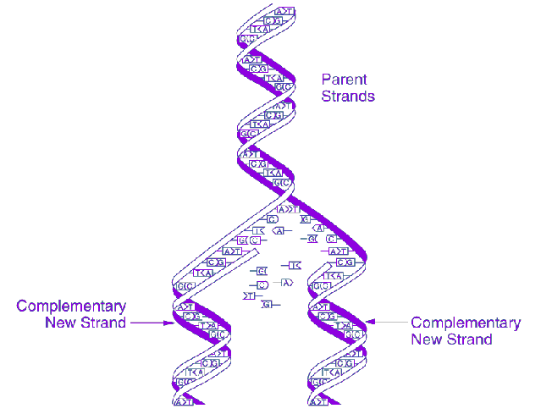

Slide 8
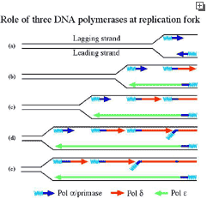

Slide 9
Principle of PCR
Purpose:
Condition:
Components:

Slide 10
Purpose
To amplify a lot of double-stranded DNA molecules (fragments) with same (identical) size and sequence by enzymatic method and cycling condition.

Slide 11
Condition
1. Denaturation of ds DNA template
2. Annealing of primers
3. Extension of ds DNA molecules

Slide 12
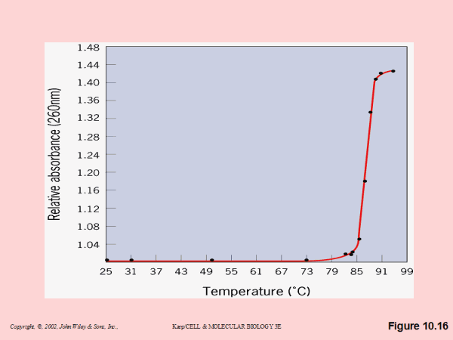
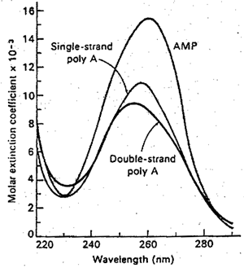
Denaturation
Melt of ds DNA
Tm: melting temperature
Consequences of DNA Strands Separation
Decrease in hydrophobic interactions between DNA bases
Increase in UV absorbance

Slide 13
Annealing
Hybridize
Primers anneal to denatured template DNA
Tm of primers
Annealing temperature

Slide 14
Extension
DNA polymerase synthesizes (polymerizes) new DNA molecule by adding deoxyribonucleoside complementary to the corresponding template base in a 5’ to 3’ direction.

Slide 15
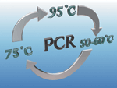
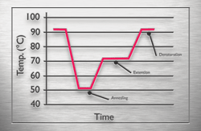
Cycling
Cycle number
Ramp time

Slide 16
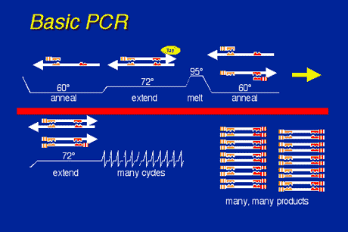

Slide 17
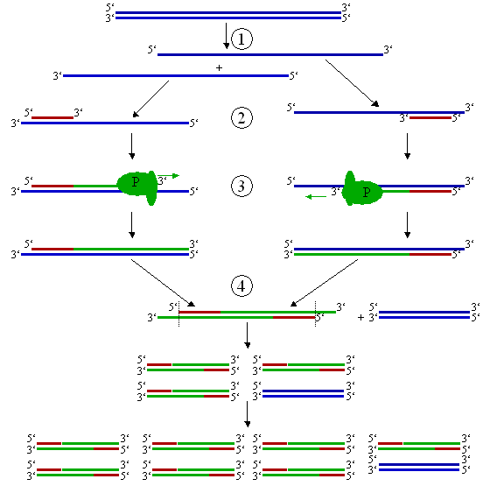

Slide 18
Chemical Components
Enzyme
Buffers and MgCl₂
  100 mM Tris-HCl, pH 8.3
  500 mM KCl
  15 mM MgCl₂
  0.1% gelatin
Deoxynucleoside triphosphates (dNTPs)
Template DNA
Primers

Slide 19
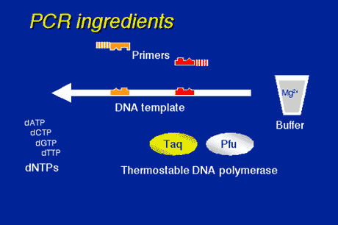

Slide 20
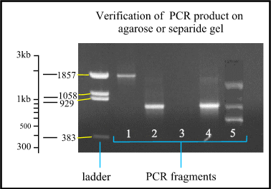

Slide 21
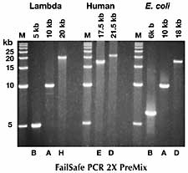

Slide 22
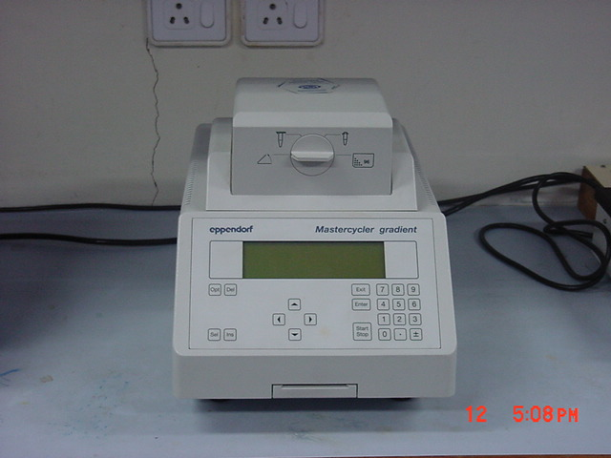
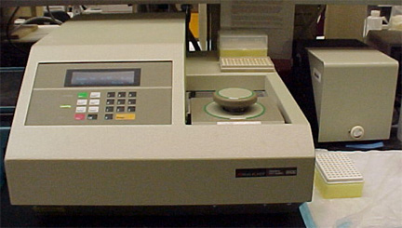
Instrumentation

Slide 23
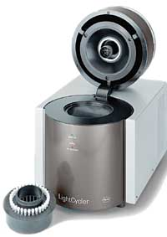
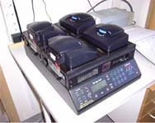

Slide 24
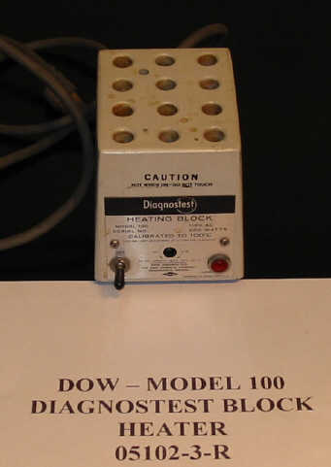
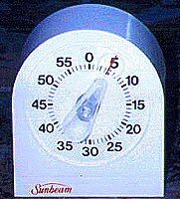

Slide 25
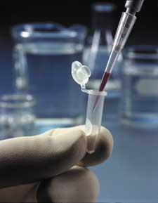
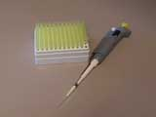
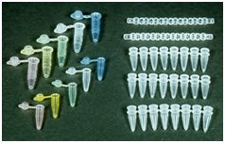
Consumables

Slide 26
Three Aspects of PCR
Specificity
Efficiency
Fidelity

Slide 27
The best way to understand PCR is to consider the reaction components and how they combine to produce the best results.
Each physical and chemical components of PCR can be modified to produce a potential increase in yield, specificity, or sensitivity.

Slide 28
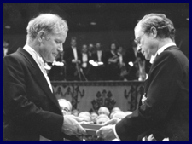
Development/Invention of PCR Technique
1993 Nobel Prize in Chemistry

Slide 29
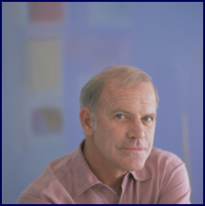

Unusual Origin of PCR, Mullis KB, Scientific American 1990,56

Slide 30


