Slide 1
Data Structures
Chapter 2: Arrays
2-<number>

Slide 2
Abstract Data Type and C++ Class
Four components in a C++ Class
  class name
  data members: the data that makes up the class
  member functions: the set of operations that may be applied to the objects of class
  levels of program access:
    private: accessible within the same class
    protected: accessible within the same class and derived classes
    public: accessible anywhere
2-<number>

Slide 3
Rectangle.h –Definition of Rectangle Class
// in the header file Rectangle.h
#ifndef RECTANGLE_H /* preprocessor
directive, “if not defined” */
#define RECTANGLE_H
class Rectangle // class name: Rectangle
{
public:
// 4 member functions
Rectangle(); // constructor
~Rectangle(); // destructor
int GetHeight();
int GetWidth();
private:
// 4 data members
int xLow, yLow, height, width;
// (xLow, yLow) is the bottom left corner
};
#endif
height
(x, y)
width
2-<number>

Slide 4
Rectangle.cpp – Operation Implementation
// in the source file Rectangle.cpp
#include <Rectangle.h>
int Rectangle::GetHeight() {return height;}
int Rectangle::GetWidth() {return width;}
ADT: Abstract Data Type
  Rectangle.h: Object representation
  (or Class Definition)
  Rectangle.cpp: Operation implementation
2-<number>

Slide 5
Constructor(1)
Constructor (建構子): the name of the function is identical to its class name, to initialize the data members
Rectangle::Rectangle(int x, int y, int h,
int w)
{
xLow = x; yLow = y;
height = h; width = w;
}
int main()
{
Rectangle r(1,3,6,6); // call constructor
Rectangle *s=new Rectangle(0,0,3,4);
return 0;
}
2-<number>

Slide 6
Constructor(2)
Another way of Constructor initialization:
Rectangl::Rectangle(int x = 0, int y = 0, int h = 0, int w = 0)
: xLow(x), yLow(y), height(h), width(w)
{ }
int main()
{
Rectangle t; // all set to 0
return 0;
}
2-<number>

Slide 7
Operator Overloading
int Rectangle::operator==(const Rectangle& s)
// overload "=="
{
if (this == &s) return 1;
else if ( (xLow == s.xLow) && (yLow == s.yLow) &&
(height == s.height) && (width == s.width) )
return 1;
return 0;
}
ostream& Rectangle:: operator<<(ostream& os,
Rectangle& r) // overload “<<"
{
os << "Position is: " << r.xLow << " ";
os << r.yLow << endl;
os << "Height is: " << r.height << endl;
os << "Width is: " << r.width << endl;
return os;
}
2-<number>

Slide 8
Complete Program for Rectangle
#include <iostream>
using namespace std;
class Rectangle
{
friend ostream& operator<< (ostream&, Rectangle&);
public:
int Rectangle::operator==(const Rectangle&)
Rectangle(); // constructor
~Rectangle(); // destructor
int GetHeight(); int GetWidth();
private:
int xLow, yLow, height, width;
};
...
int main()
{
Rectangle r(1,3,6,6),t(1,3,6,6); // call constructor
if (r == t) cout << 1 << endl; // overloaded "=="
cout << r; // overloaded "<<“
return 0;
}
2-<number>

Slide 9
Array as ADT
Array Objects:
  A set of pairs <index, value> where for each value of index (索引) there is a corresponding value.
  Index set is a finite ordered set of one or more dimensions. For example, {0,…,n−1} for one dimension, {(0,0), (0,1),(0,2),(1,0),(1,1),…,(3,2)…} for two dimensions.
class GeneralArray{
public:
GeneralArray(int j, RangeList list, float initValue = defaultValue);
// create a linear (1D) array of size j
float Retrieve(index i);
// return the value of index i
void Store(index i, float x);
// change the value of index i to x
}
2-<number>

Slide 10
1-dimentional Array in C/C++
// array declaration (陣列宣告)
int a[10]; // no intialization
float f[7];
int a[4]={10,11};
// a[0]=10, a[1]=11, a[2]=0, a[3]=0
int a[]={10,11,12}; // array size:3
// a[0]=10, a[1]=11, a[2]=12
bool b[] = {true, false, true};
char c[] = {'B', 'C', ‘\0', ‘\n'};
char d[] = “BED"; // 4 bytes
2-<number>

Slide 11
Programming skills
int a[100];
for (i = 0; i < 100; a[i++] = 0);
Better:Constants defined by identifiers
#define NUMELTS 100
int a[NUMELTS];
for (i = 0; i < NUMELTS; a[i++] = 0);
2-<number>

Slide 12
Representation of Arrays
Representation of one dimensional array
Multidimensional arrays can be implemented by one dimensional array via either row major order or column major order.
α
α+1
α+2
α+3
α+4
α+5
α+6
α+7
α+8
α+9
α+10
α+11
a[0]
a[1]
a[2]
a[3]
a[4]
a[5]
a[6]
a[7]
a[8]
a[9]
a[10]
a[11]
2-<number>

Slide 13
Two Dimensional (2D) Arrays
2-dimensional array:
int [ ][ ]a = new int[3][4]; // in C++
int a[3][4]; // in C/C++
It can be shown as a table:
a[0][0] a[0][1] a[0][2] a[0][3]
a[1][0] a[1][1] a[1][2] a[1][3]
a[2][0] a[2][1] a[2][2] a[2][3]
2-<number>

Slide 14
Row-major Order (from 2D to 1D)
int a[3][4]; // row-major order
logical structure physical structure
0
1
2
3
a[0][0]
0
a[0][1]
1
a[0][2]
2
a[0][3]
a[1][0]
A[2][1]
a[1][1]
a[1][2]
a[1][3]
Mapping function:
Address of a[i][j]= **
where one integer occupies 4 bytes.
a[2][0]
2-<number>

Slide 15
Memory Mapping of Row-major Order
α: the start address of array a
  refer to a[0], a[0][0], a[0][0][0], etc.
β: the memory size for storing each element
  char: 1 byte, β=1
  int: 4 bytes, β=4
2D to 1D
  int (char) a[u₁][u₂]
  a[i][j] = α + (i×u₂ + j) × β
3D to 1D
  int (char) a[u₁][u₂][u₃]
  a[i][j][k] = α + (i × u₂ × u₃ + j × u₃ + k) × β
2-<number>

Slide 16
Column-Major Order
  a b c d
  e f g h
  i j k l
Convert 2D into 1D by collecting elements first by columns, from left to right..
Within a column, elements are collected from top to bottom.
We get y = {a, e, i, b, f, j, c, g, k, d, h, l}
col 0
col 1
col 2
…
col i
2-<number>

Slide 17
Memory Mapping of Column-major Order
α: the start address of array a
  refer to a[0], a[0][0], a[0][0][0], etc.
β: the memory size for storing each element
  char: 1 byte, β=1
  int: 4 bytes, β=4
2D to 1D
  int (char) a[u₁][u₂]
  a[i][j] = α + (i+ j ×u₁ ) × β
3D to 1D
  int (char) a[u₁][u₂][u₃]
  a[i][j][k] = α + (i + j × u₁ + k× u₁ × u₂ ) × β
2-<number>

Slide 18
Sets in Pascal
var x, x1, x2: set of 1..10;
x = [1, 2, 3, 5, 9, 10]
A set is represented by a bit string.
e.g. 1110100011 1: in the set
0: not in the set
e.g. x1 = [2, 4, 6, 8] 0101010100
x2 = [1, 2, 5, 9] 1100100010
union 聯集:
x1 ∪ x2 = **
x1 + x2 = [1, 2, 4, 5, 6, 8, 9] **
2-<number>

Slide 19
x1 = [2, 4, 6, 8] 0101010100
x2 = [1, 2, 5, 9] 1100100010
Intersection 交集:
x1 ∩ x2 = **
x1 * x2 = [2] **
difference 差集:
x1 – x2 = **
x1 – x2 = [4, 6, 8] **
contain 包含:
x1 ⊆ x2 ⬄
x1 ⊇ x2 ⬄ **
a in x1 ⬄
The size of a set is limited.
2-<number>

Slide 20
Polynomial (多項式)
f(x) = x⁸ − 10x⁵ + 3x³ + 1.5
4 terms: x⁸, − 10x⁵, 3x³, 1.5
Coefficients(係數): 1, − 10, 3, 1.5
Nonnegative integer exponents(指數,冪):
8, 5, 3, 0
2-<number>

Slide 21
Polynomial Addition
f(x) = x⁸ − 10x⁵ + 3x³ + 1.5
g(x) = 3x³ + 2x − 4
f(x) = x⁸ − 10x⁵ + 3x³ + 1.5
g(x) = 3x³ + 2x − 4
f(x) + g(x) = x⁸ − 10x⁵ + 6x³ + 2x − 2.5
a(x) + b(x) = Σ(a_{i}+b_{i})x^{i}
2-<number>

Slide 22
Polynomial Representation (1)
#define MaxDegree 100
class Polynomial{
private:
int degree; // degree ≤ MaxDegree
float coef [MaxDegree + 1];
};
f(x) = x⁸ − 10x⁵ + 3x³ + 1.5
0 | 1 | 2 | 3 | 4 | 5 | 6 | 7 | 8 | 9 | 10 | 11 | 12 | …
1.5 | 0 | 0 | 3 | 0 | -10 | 0 | 0 | 1 | 0 | 0 | 0 | 0 | 0...
2-<number>

Slide 23
Polynomial Representation (2)
class Polynomial{
private:
int degree;
float *coef;
public:
Polynomial::Polynomial(int d) {
degree = d;
coef = new float [degree+1];
}
};
f(x) = x⁸ − 10x⁵ + 3x³ + 1.5
0 | 1 | 2 | 3 | 4 | 5 | 6 | 7 | 8 | 9 | 10 | 11 | 12 | …
1.5 | 0 | 0 | 3 | 0 | -10 | 0 | 0 | 1 | 0 | 0 | 0 | 0 | 0...
2-<number>

Slide 24
Polynomial Representation (3)
Add the following two polynomials:
  a(x) = 2x¹⁰⁰⁰ + 1
  b(x) = x⁴ + 10x³ + 3x² + 1
# of elements
0
1
2
0
1
2
3
4
a_coef
2
2
1
b_coef
4
1
10
3
1
a_exp
1000
0
b_exp
4
3
2
0
0
1
2
3
4
5
c_coef
5
2
1
10
3
2
c_exp
1000
4
3
2
0
2-<number>

Slide 25
Sparse Matrices (稀疏矩陣)
Most elements of the matrix are of zero
0 0 0 0 0 0
0 0 0 3 0 4
0 0 0 5 7 0
0 0 0 0 0 0
0 0 2 6 0 0
Row 0
5 × 6 matrix (5 by 6)
5 rows
6 columns
30 elements
6 nonzero elements
Row 1
Row 2
Row 3
Row 4
Column 4
2-<number>

Slide 26
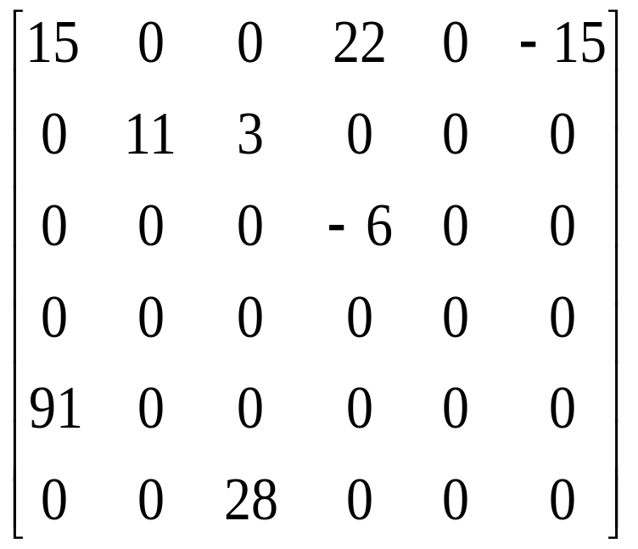
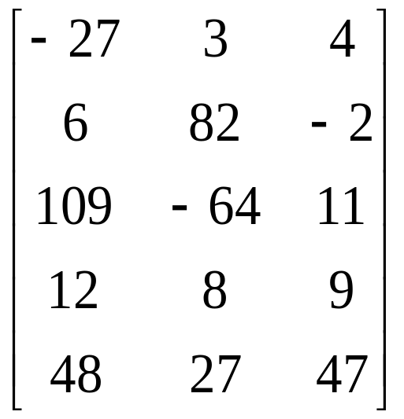
Matrices
Dense matrix 5×3
Sparse matrix
2-<number>

Slide 27
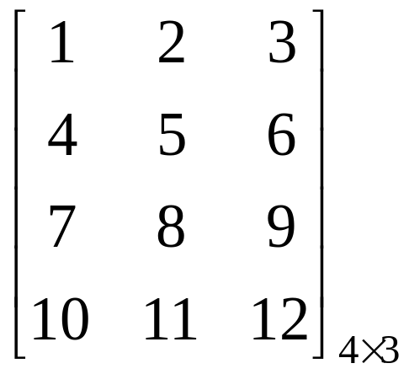
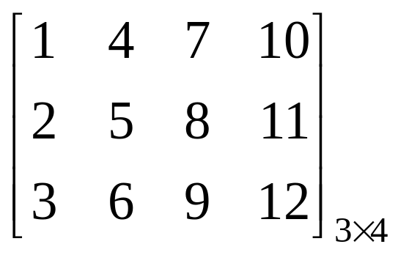
Matrix Transpose in a 2-D Array
for (i = 0; i < rows; i++ )
for (j = 0; j < columns; j++ )
    B[j][i] = A[i][j];
A =
B =
Time Complexity: O(rows × columns)
2-<number>

Slide 28
Sparse Matrix Representation
Use triples (三元組): (row, column, value)
  (1,3,3), (1, 5, 4), (2,3,5), (2,4,7),
  (4,2,2), (4,3,6)
To perform matrix operations, such as transpose, we have to know the number of rows, number of columns, and number of nonzero elements.
0 0 0 0 0 0
0 0 0 3 0 4
0 0 0 5 7 0
0 0 0 0 0 0
0 0 2 6 0 0
2-<number>

Slide 29
Linear List Representation of Matrix
0 0 0 0 0 0
0 0 0 3 0 4
0 0 0 5 7 0
0 0 0 0 0 0
0 0 2 6 0 0
row 1 1 2 2 4 4
column 3 5 3 4 2 3
value 3 4 5 7 2 6
2-<number>

Slide 30
Linear List for a Matrix
Class SparseMatrix
  Array smArray of triples of type MatrixTerm
    int row, col, value // for a triple (row, col, value)
  int rows, // number of rows in this matrix
  cols, // number of columns in this matrix
  terms, // number of nonzero elements in this matrix
  capacity; // size of smArray
Size of smArray generally not predictable at time of initialization
  Start with some default capacity/size (say 10)
  Increase capacity as needed
2-<number>

Slide 31
C++ Class for Sparse Matrix
class SparseMatrix; // forward declaration
class MatrixTerm {
friend class SparseMatrix
private:
int row, col, value;
};
class SparseMatrix {
. . .
private:
int Rows, Cols, Terms;
MatrixTerm smArray[MaxTerms];
}
2-<number>

Slide 32
Matrix Transpose
Intuitive way:
  for (each row i)
  take element (i, j, value) and store it in (j, i, value) of the transpose
More efficient way:
  for (all elements in column j)
  place element (i, j, value) in position (j, i, value)
row 1 1 2 2 4 4
column 3 5 3 4 2 3
value 3 4 5 7 2 6
3 5 3 4 2 3
1 1 2 2 4 4
3 4 5 7 2 6
2-<number>

Slide 33
Efficient Way for Matrix Transpose
0 0 0 0 0 0
0 0 0 3 0 4
0 0 0 5 7 0
0 0 0 0 0 0
0 0 2 6 0 0
0 0 0 0 0
0 0 0 0 0
0 0 0 0 2
0 3 5 0 6
0 0 7 0 0
0 4 0 0 0
M
M^{T}
row 1 1 2 2 4 4
column 3 5 3 4 2 3
value 3 4 5 7 2 6
2 3 3 3 4 5
4 1 2 4 2 1
2 3 5 6 7 4
2-<number>

Slide 34
Transposing a Matrix
SparseMatrix SparseMatrix::Transpose()
// return the transpose of a (*this)
{
SparseMatrix b;
b.Rows = Cols; // rows in b = columns in a
b.Cols = Rows; // columns in b = rows in a
b.Terms = Terms; // terms in b = terms in a
if (Terms > 0) // nonzero matrix
{
int CurrentB = 0;
for (int c = 0; c < Cols; c++) // transpose by columns
for (int i = 0; i < Terms; i++)
// find elements in column c
if (smArray[i].col == c) {
b.smArray[CurrentB].row = c;
b.smArray[CurrentB].col = smArray[i].row;
b.smArray[CurrentB].value = smArray[i].value;
CurrentB++;
}
} // end of if (Terms > 0)
return b;
} // end of transpose
2-<number>

Slide 35
Time Complexity
Time Complexity:
O(terms × columns)
=O(rows × columns × columns)
A better transpose function
  It first computes the number of nonzero elements in each columns of matrix A before transposing to matrix B. Then it determines the starting address of each row for matrix B. Finally, it moves each nonzero element from A to B.
2-<number>

Slide 36
Faster Matrix Transpose
0 0 0 0 0 0
0 0 0 3 0 4
0 0 0 5 7 0
0 0 0 0 0 0
0 0 2 6 0 0
0 0 0 0 0
0 0 0 0 0
0 0 0 0 2
0 3 5 0 6
0 0 7 0 0
0 4 0 0 0
Step 1: #nonzero in row i of transpose
= #nonzero in column i of
original matrix
= [0, 0, 1, 3, 1, 1]
Step 2: Start of row i of transpose
= size sum of rows 0,1,2, i-1 of
transpose
= [0, 0, 0, 1, 4, 5]
Step 3: Move elements, left to right, from original list to transpose list
row 1 1 2 2 4 4
column 3 5 3 4 2 3
value 3 4 5 7 2 6
2-<number>

Slide 37
Faster Matrix Transpose
0 0 0 0 0 0
0 0 0 3 0 4
0 0 0 5 7 0
0 0 0 0 0 0
0 0 2 6 0 0
0 0 0 0 0
0 0 0 0 0
0 0 0 0 2
0 3 5 0 6
0 0 7 0 0
0 4 0 0 0
row 1 1 2 2 4 4
column 3 5 3 4 2 3
value 3 4 5 7 2 6
rowStart =
[0, 0, 0, 1, 4, 5]
- 3 - - - -
- 1 - - - -
- 3 - - - -
- 3 - - - 5
- 1 - - - 1
- 3 - - - 4
- 3 3 - - 5
- 1 2 - - 1
- 3 5 - - 4
rowStart =
[0, 0, 0, 2, 4, 5]
rowStart =
[0, 0, 0, 2, 4, 6]
rowStart =
[0, 0, 0, 3, 4, 6]
2-<number>

Slide 38
Time Complexity
Step 1: #nonzero in each row
O(terms)
Step2: Start address of each row
O(columns)
Step 3: Data movement
O(terms)
Total time complexity:
O(terms + columns)= O(rows ×columns)
2-<number>

Slide 39
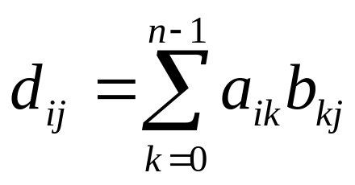
Matrix Multiplication
Given A and B, where A is m × n and B is n × p, the product matrix D = A × B has dimension m × p.
Let d_{ij} =D[i][j]
where 0 ≤ i ≤ m-1 and 0 ≤ j ≤ p -1.
2-<number>

Slide 40
Matrix Multiplication Example (1)
0 0 0 0 0 0
0 0 0 3 0 4
0 0 0 5 7 0
0 0 0 0 0 0
0 0 2 6 0 0
0 0 0
0 2 0
0 0 0
0 3 0
0 4 7
0 1 0
A_{5×6}=
B_{6×3}=
0 0 0
0 13 0
0 43 49
0 0 0
0 18 0
D_{5×3}= A × B =
2-<number>

Slide 41
Matrix Multiplication Example (2)
A_{5×6} =
row 1 1 2 2 4 4
column 3 5 3 4 2 3
value 3 4 5 7 2 6
B_{6×3}=
row 1 3 4 4 5
column 1 1 1 2 1
value 2 3 4 7 1
D_{5×3}= A × B =
row 1 2 2 4
column 1 1 2 1
value 13 43 49 18
2-<number>

Slide 42
String in C/C++
char c[] = {'B', 'C', 'D', '\0'};
char d[] = “BED"; // 4 bytes
In C/C++, a string is represented as a character array
Internal representation
0 | 1 | 2 | 3 | 4
B | E | D | \0
0 | 1 | 2 | 3 | 4
66 | 69 | 68 | 0
2-<number>

Slide 43
String in C
General string operations include comparison(比較), string concatenation(連接), copy, insertion, string matching(匹配,比對), printing
Function in C: #include <string.h>
  strcat, strncat
  strcmp, strncmp
  strcpy, strncpy, strlen
  strchr, strtok, strstr, …
#include <cstring> // in C++ for string.h
2-<number>

Slide 44
String Matching Problem
Given a text string T of length n and a pattern string P of length m, the exact string matching problem is to find all occurrences of P in T.
Example: T=“AGCTTGCTA” P=“GCT”
Applications:
  Searching keywords in a file (Text Editor)
  Searching engines (Google)
  Database searching (GenBank)
2-<number>

Slide 45
KMP Algorithm for String Matching
KMP algorithm
  Proposed by Knuth, Morris and Pratt
  Time complexity: O(m+n)
More string matching algorithms (with source codes):
http://www-igm.univ-mlv.fr/~lecroq/string/
2-<number>

