Slide 1
Data Structures
Chapter 4: Linked Lists
4-<number>

Slide 2
Singly Linked List
0 | 1 | 2 | 3 | 4 | 5 | 6 | 7 | 8
 | D | A |  |  | B | C
 | -1 | 5 |  |  | 6 | 1
data
link(pointer, address)
以-1代表結尾
(null pointer)
first = 2 header, external pointer
2 5 6 1
**
first
A
5
B
6
C
1
D
null
node
data link
4-<number>

Slide 3
Operation on the First Node
first
A
B
C | null
adding ‘F’ to the front of the list
first
F
A
B
C | null
p = getnode(); // create a new node
data(p) = ‘F’;
link(p) = first;
first = p;
(2) removing the first node of the list
first
B
C | null
p = first;
first = link(p);
x = data(p);
freenode(p); // delete node p
4-<number>
**

Slide 4
Normal Way to Draw a Linked List
c
a
e
d
b
first
first
NULL
a
b
c
d
e
link field (鏈結欄位) of a node, points to next node
data field (資料欄位) of a node
4-<number>

Slide 5
Chain/Singly Linked List
A chain (鏈), also called a singly linked list (單一鏈結串列), is a linked list in which each node (節點) represents one element.
Each node has exactly one link or pointer from one element to the next.
The last node has a NULL (or 0) pointer
first
NULL
a
b
c
d
e
4-<number>

Slide 6
Node Representation
// in C++
class ChainNode
{
char data;
ChainNode *link;
}
// in C
struct ChainNode
{
char data;
struct ChainNode *link;
}
data
link
data
link
4-<number>

Slide 7
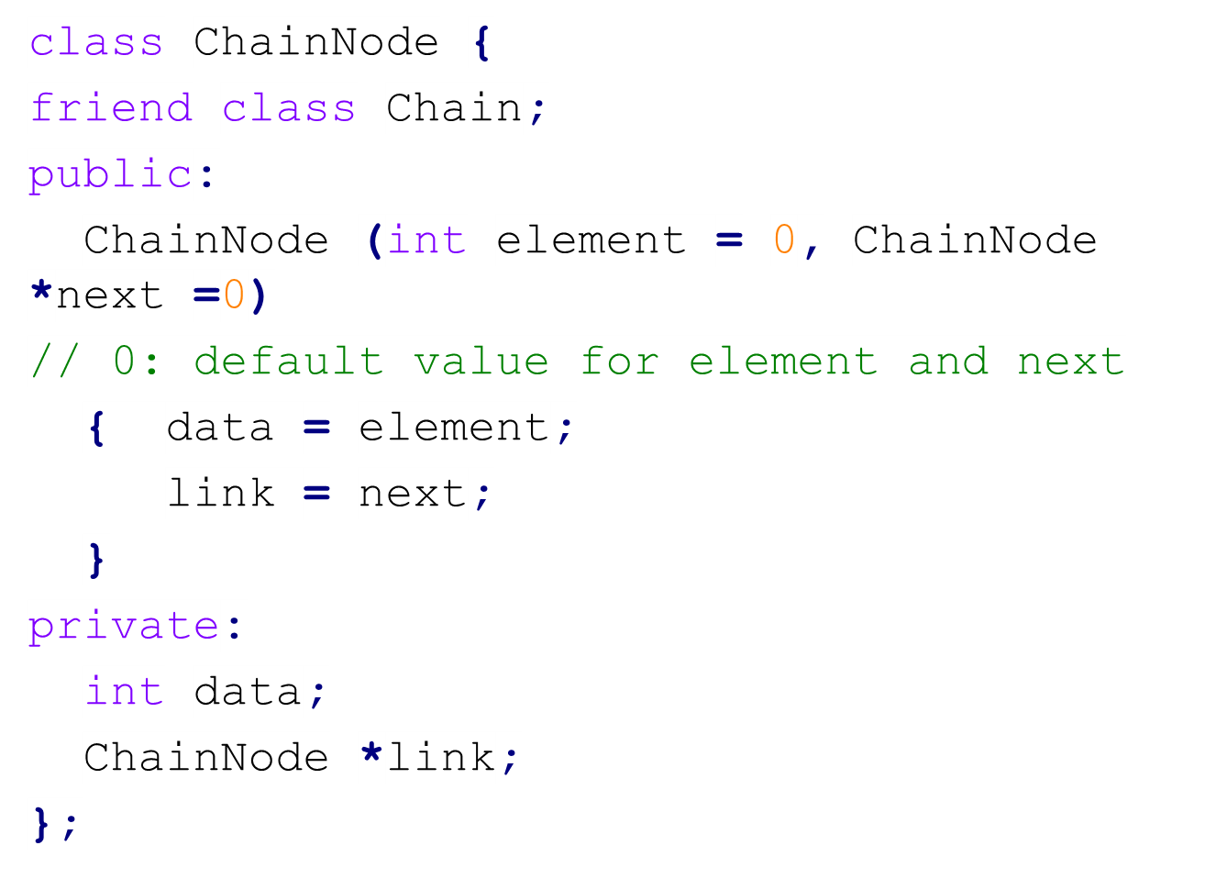
Linked List Represented by C++
4-<number>

Slide 8
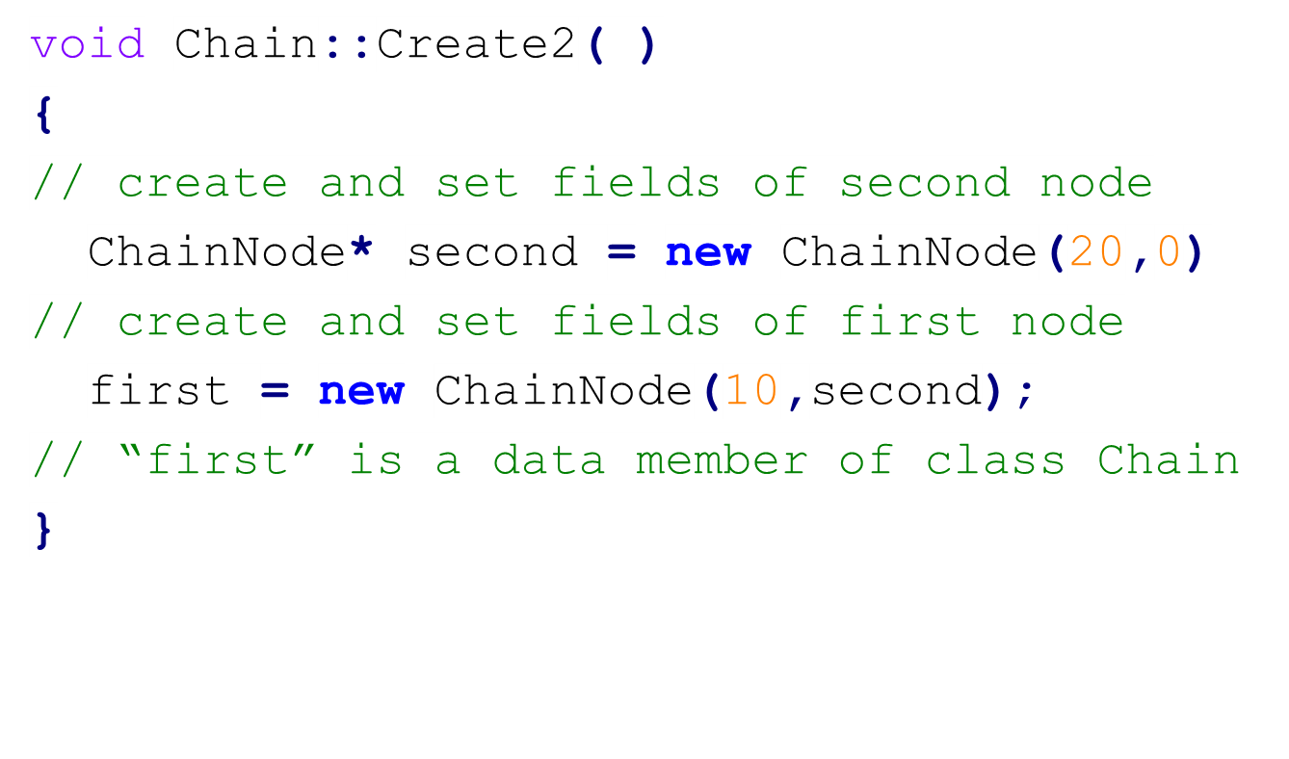

Construction of a 2-Node List
**
4-<number>

Slide 9
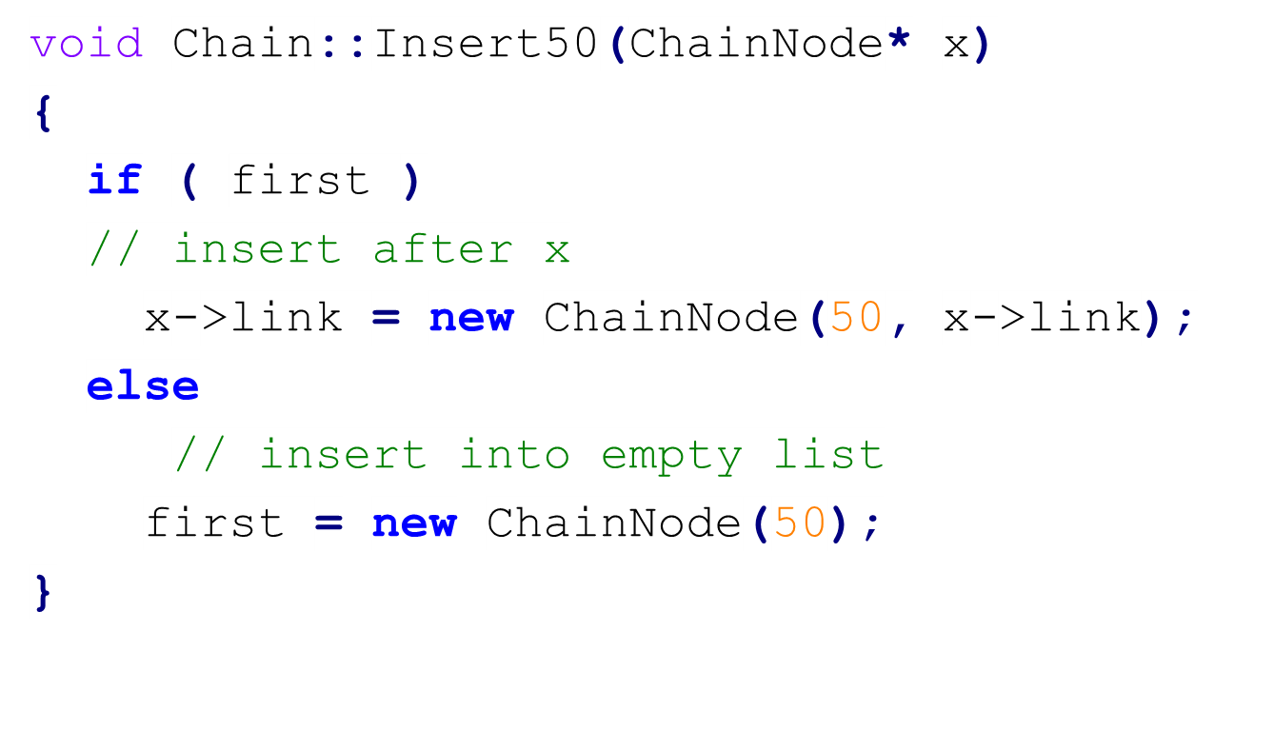
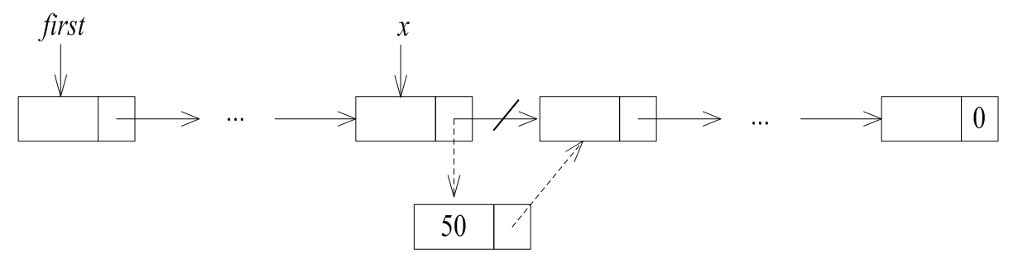
Inserting a Node after Node x
4-<number>

Slide 10
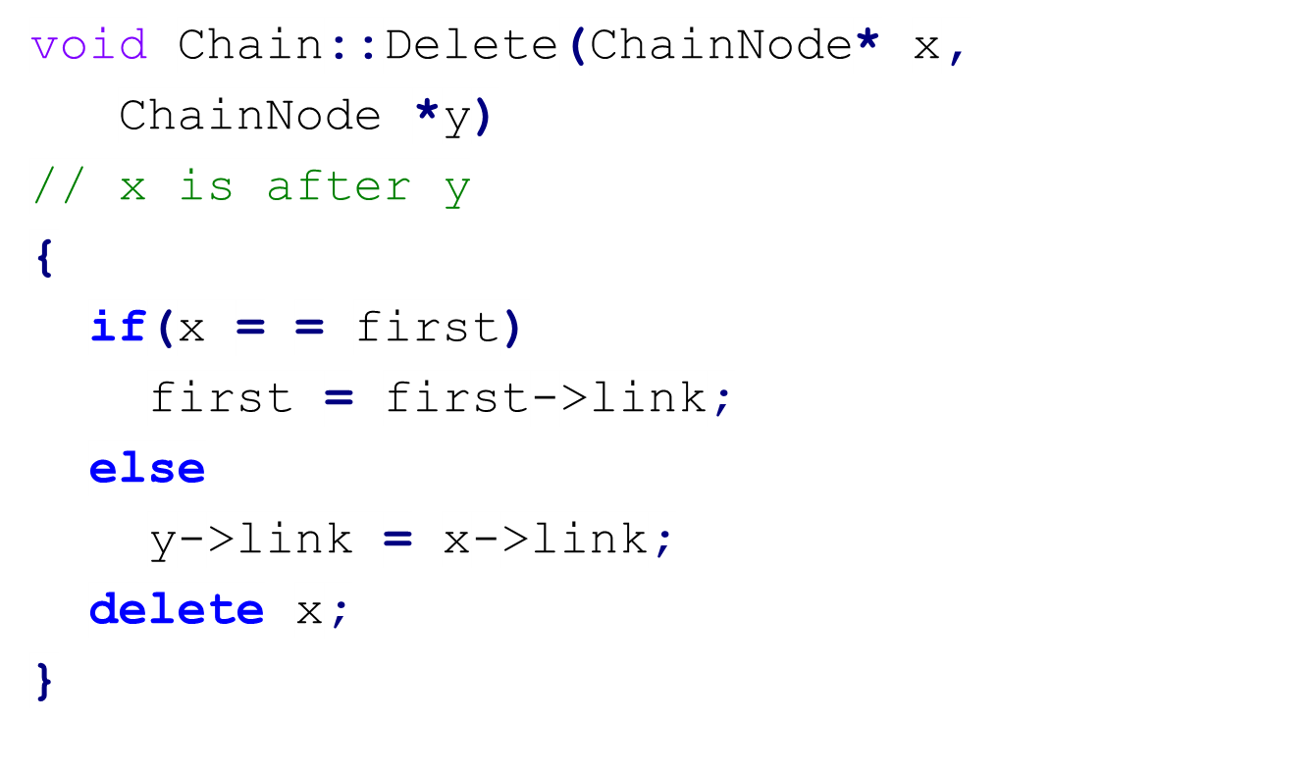
Deleting Node x
**
first
y
x
60
29
35
23
18
27
4-<number>

Slide 11
Template Class
A chain (singly linked list) is a container class (容器類別), and is therefore a good candidate for implementation with templates.
Member functions of a linked list should be general so that they can be applied to all types of objects.
The template mechanism can be used to make a container class more reusable.
4-<number>

Slide 12
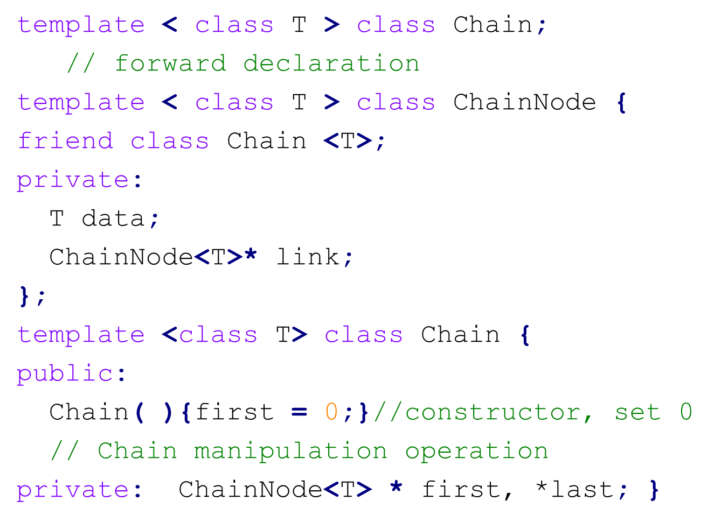
Template Definition of Class Chain
4-<number>

Slide 13
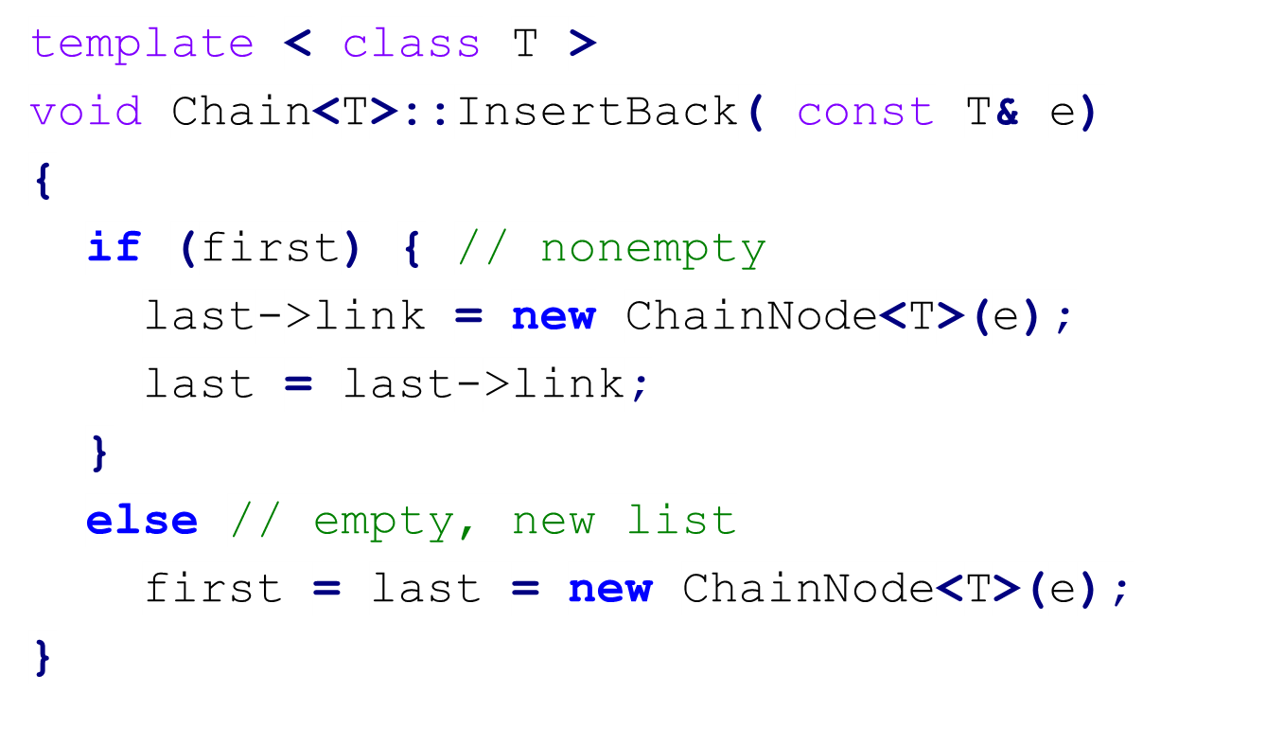
Inserting at the Tail of a List
4-<number>

Slide 14
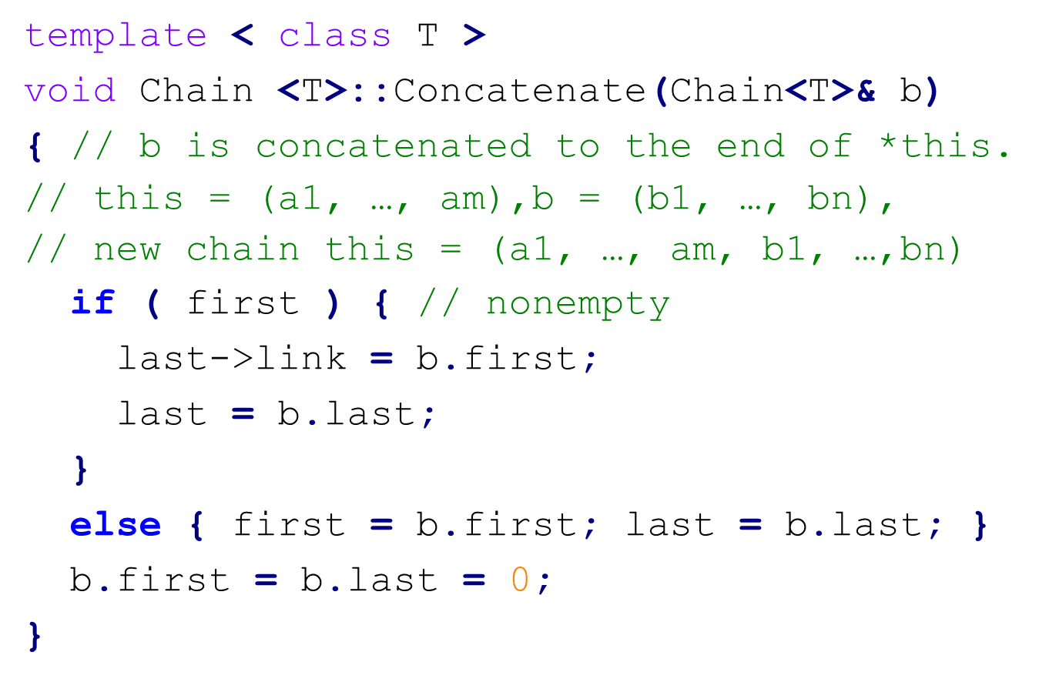
Concatenation of Two Lists
4-<number>

Slide 15
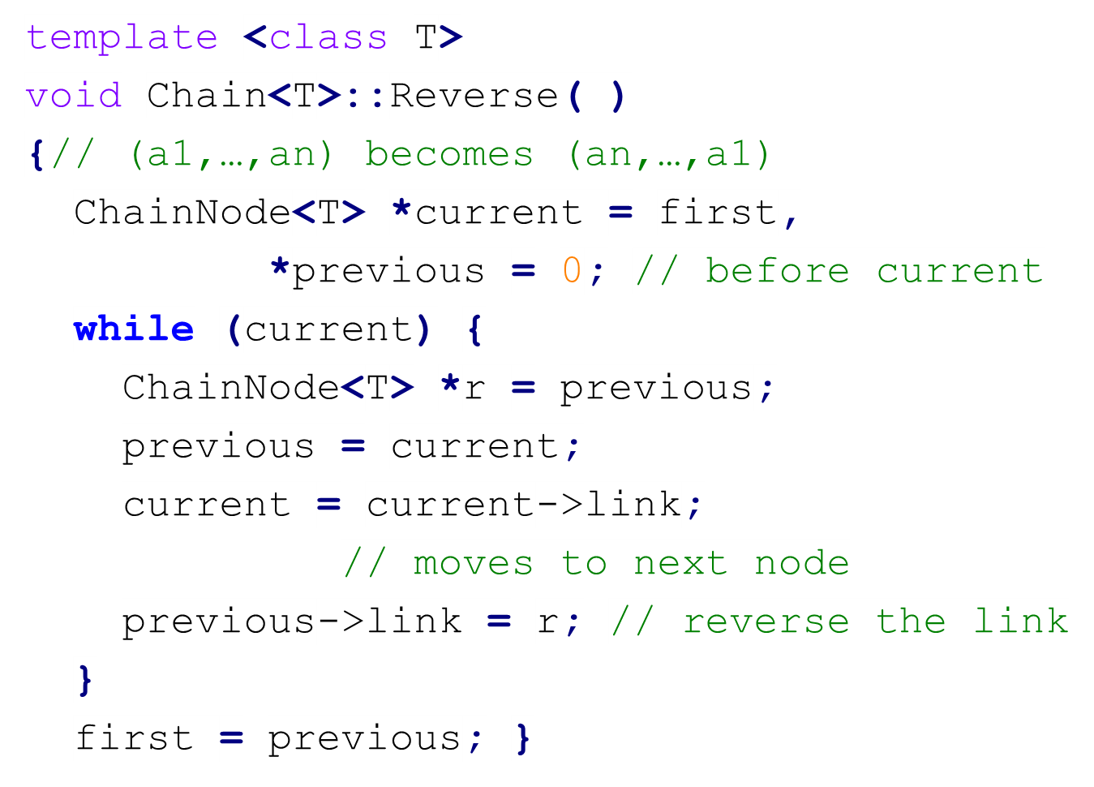
Reversing a List
4-<number>

Slide 16
When Not to Reuse a Class
Reusing a class is sometimes less efficient than direct implementation.
If the operations required by the application are complex and specialized, and therefore not offered by the class, then reusing becomes difficult.
4-<number>

Slide 17
Circular List
first
BAT
CAT
EAT
FAT
GAT
HAT
first
last
last
4-<number>

Slide 18
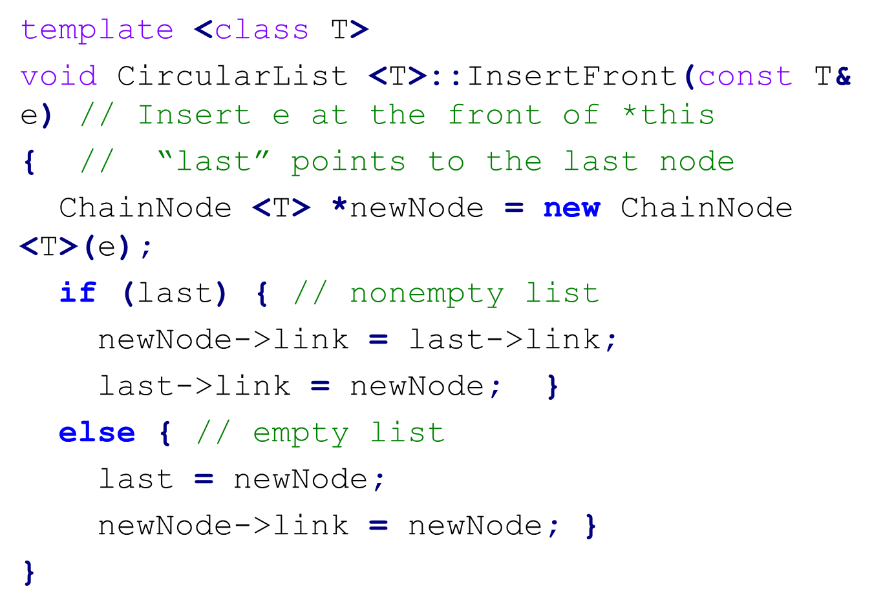
Inserting at the Front of a Circular List
4-<number>

Slide 19
Linked Stacks and Queues
top
front
rear
0
Linked Queue
0
Linked Stack
4-<number>

Slide 20
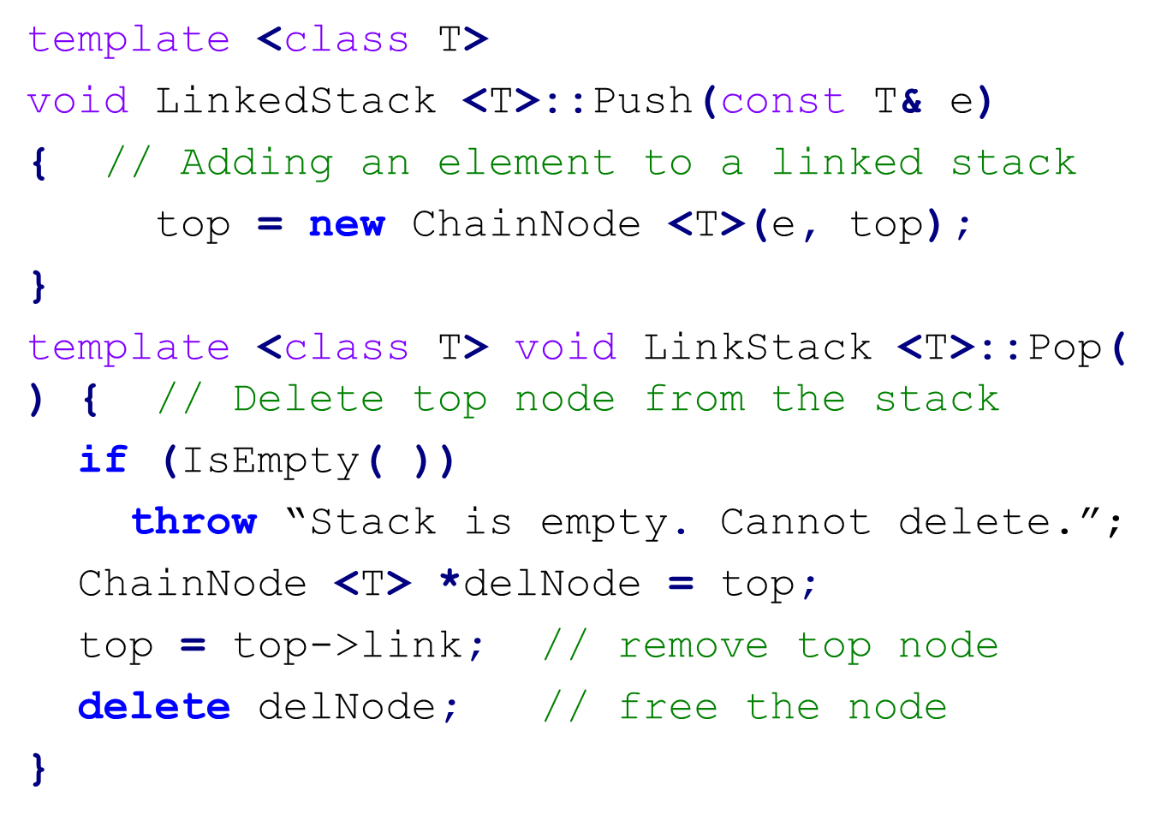
Push and Pop of a Linked Stack
4-<number>

Slide 21
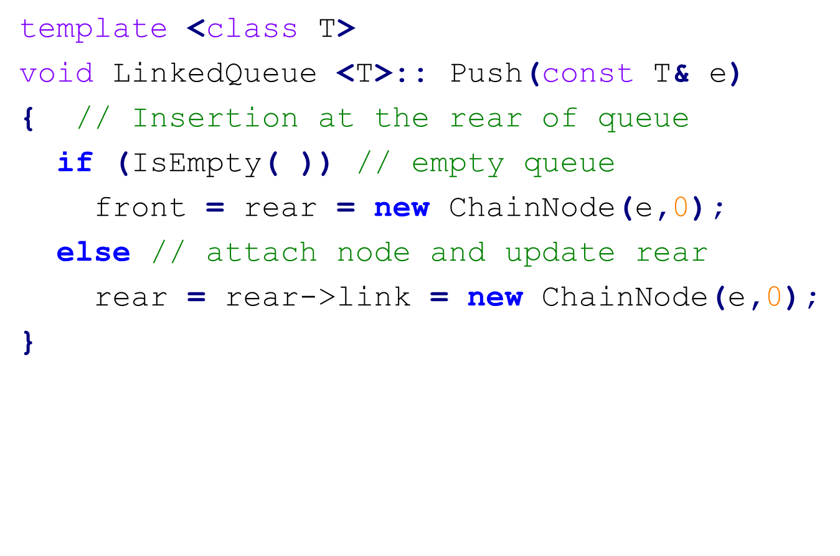
Push (Inserting Rear) of a Linked Queue
4-<number>

Slide 22
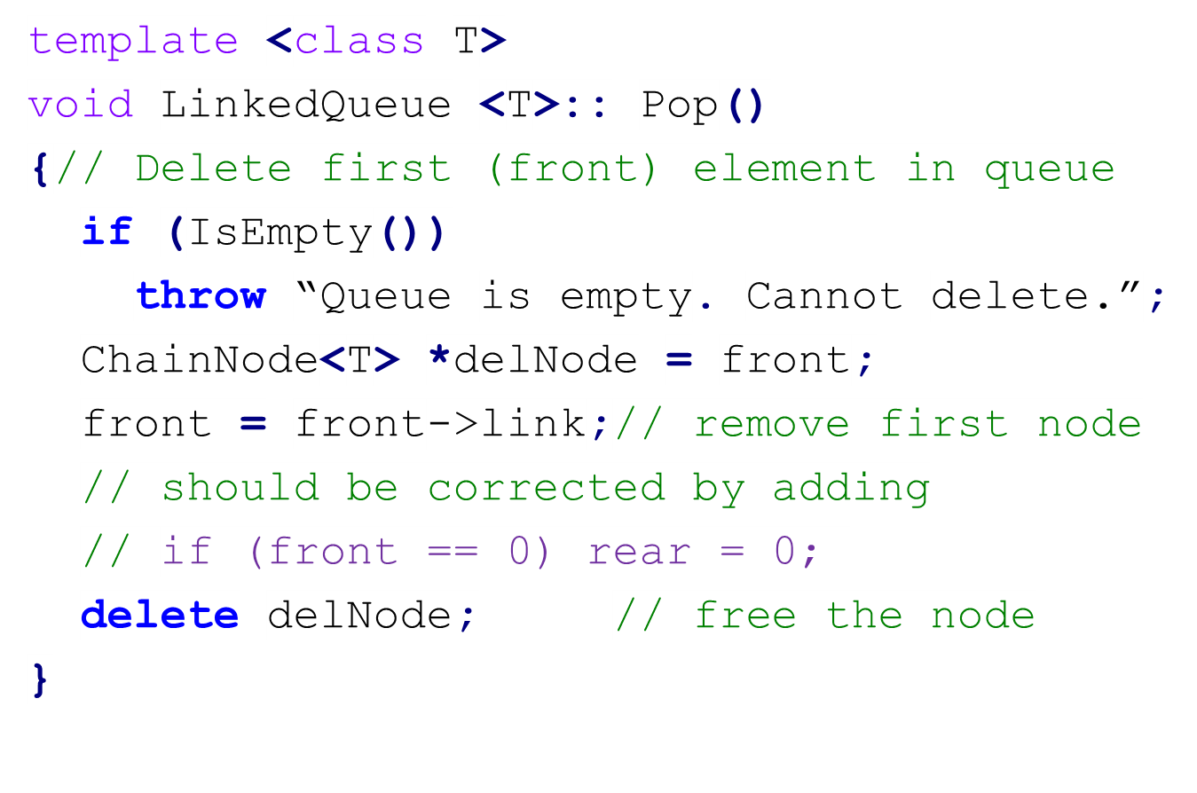
Pop (Deleting Front) of a Linked Queue
4-<number>

Slide 23
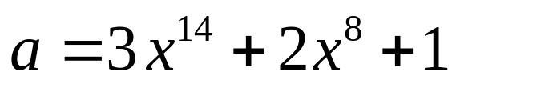
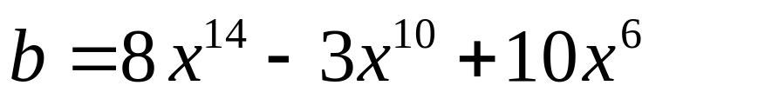
Revisit Polynomials
a.first
3
14
2
8
1
0
0
b.first
8
14
-3
10
10
6
0
**
4-<number>

Slide 24
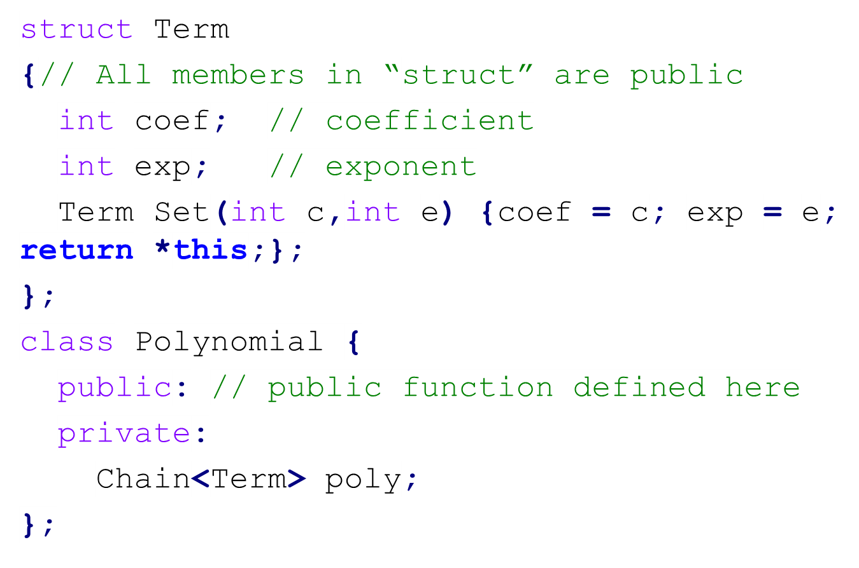
Definition of Class Polynomial
4-<number>

Slide 25
Addition of Two Polynomials (1)
It is an easy way to represent a polynomial by a linked list.
Example of adding two polynomials a and b
a.first
3
14
2
8
1
0
0
p
b.first
8
14
-3
10
10
6
0
q
c.first
(i) p->exp == q->exp
11
14
0
4-<number>

Slide 26
Addition of Two Polynomials (2)
a.first
3
14
2
8
1
0
0
p
b.first
8
14
-3
10
10
6
0
q
c.first
11
14
-3
10
0
(ii) p->exp < q->exp
4-<number>

Slide 27
Addition of Two Polynomials (3)
a.first
3
14
2
8
1
0
0
p
b.first
8
14
-3
10
10
6
0
q
c.first
11
14
-3
10
2
8
0
(iii) p->exp > q->exp
4-<number>

Slide 28
Properties of Relations
For any polygon (多邊形) x, x ≡ x. Thus, ≡ is reflexive (反身的，自反的).
For any two polygons x and y, if x ≡ y, then y ≡ x. Thus, the relation ≡ is symmetric (對稱的).
For any three polygons x, y, and z, if x ≡ y and y ≡ z, then x ≡ z. The relation ≡ is transitive (遞移的).
4-<number>

Slide 29
Equivalence Class (等價類)
Definition: A relation ≡ over a set S, is said to be an equivalence relation over S iff it is symmetric, reflexive, and transitive over S.
Example: Suppose, there are 12 polygons 0 ≡ 4, 3 ≡ 1, 6 ≡ 10, 8 ≡ 9, 7 ≡ 4, 6 ≡ 8, 3 ≡ 5, 2 ≡ 11, and 11 ≡ 0. Then they can be partitioned into three equivalence classes:
{0, 2, 4, 7, 11}; {1 , 3, 5}; {6, 8, 9 , 10}
4-<number>

Slide 30
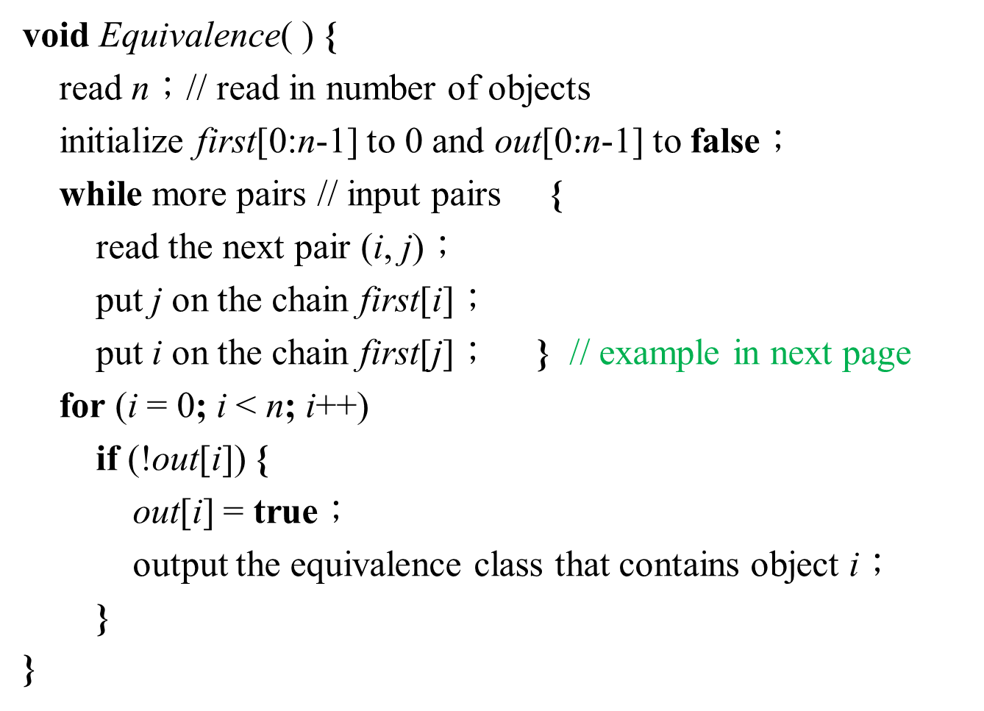
Pseudo Code for Equivalence Algorithm
4-<number>

Slide 31
Linked List Representation
Input: 0 ≡ 4, 3 ≡ 1, 6 ≡ 10, 8 ≡ 9, 7 ≡ 4,
6 ≡ 8, 3 ≡ 5, 2 ≡ 11, 11 ≡ 0
[0]
[1]
[2]
[3]
[4]
[5]
[6]
[7]
[8]
[9]
[10]
[11]
data
11
3
11
5
7
3
8
4
6
8
6
0
link
0
0
0
0
0
0
data
4
1
0
10
9
2
link
0
0
0
0
0
0
Output: {0, 2, 4, 7, 11}; {1 , 3, 5}; {6, 8, 9 , 10}
**
4-<number>

Slide 32
Summary of Equivalence Algorithm
Two phases to determine equivalence class
  Phase 1: Equivalence pairs (i, j) are read in and adjacency (linked) list of each object is built.
  Phase 2: Trace (output) the equivalence class containing object i with stack (depth-first search). Next find another object not yet output, and repeat.
Time complexity: Θ(m+n)
  n: # of objects
  m: # of pairs (relations)
4-<number>

Slide 33
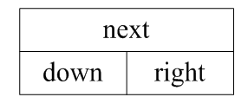
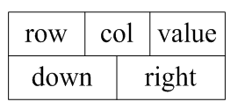
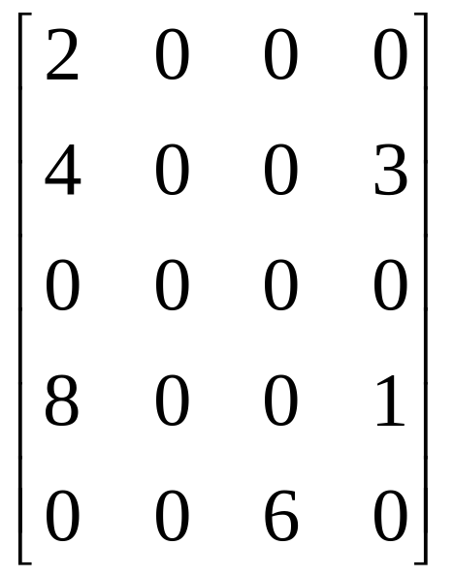
Node Structure for Sparse Matrix
Header node
Element node
A 5×4 sparse matrix
4-<number>

Slide 34
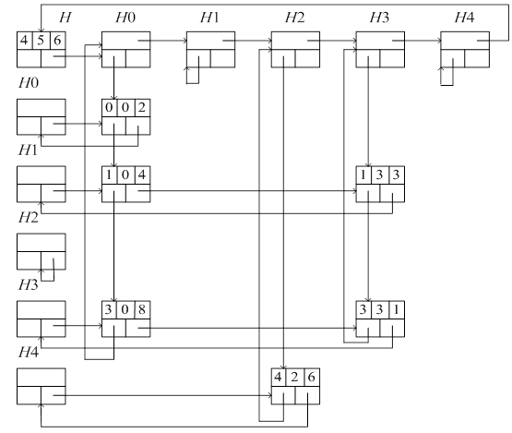
Linked List for Sparse Matrix
4-<number>

Slide 35
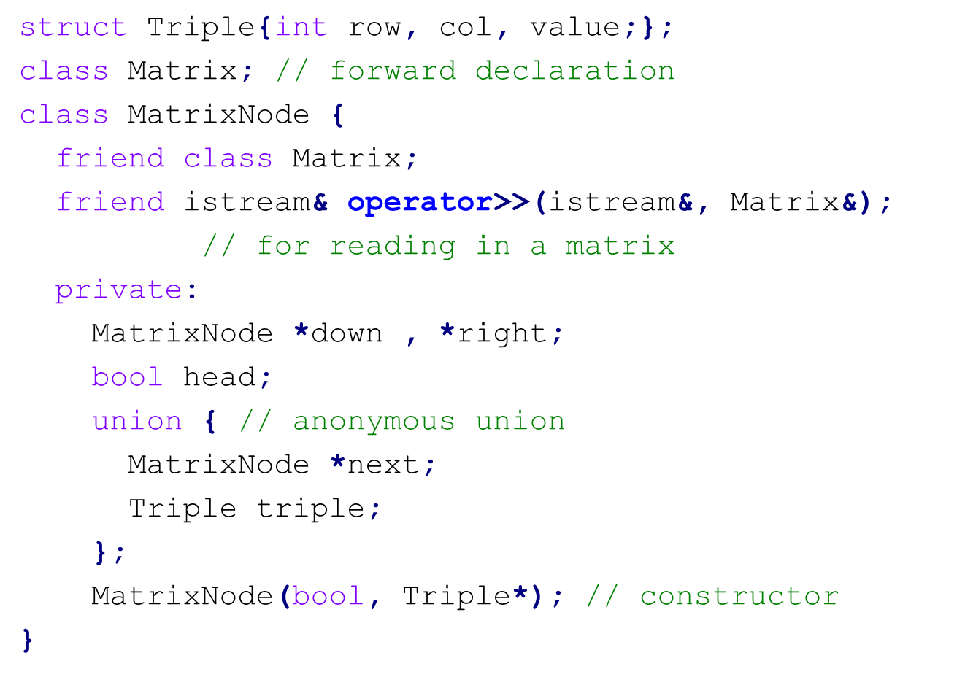
Class Definition of Sparse Matrix (1)
4-<number>

Slide 36
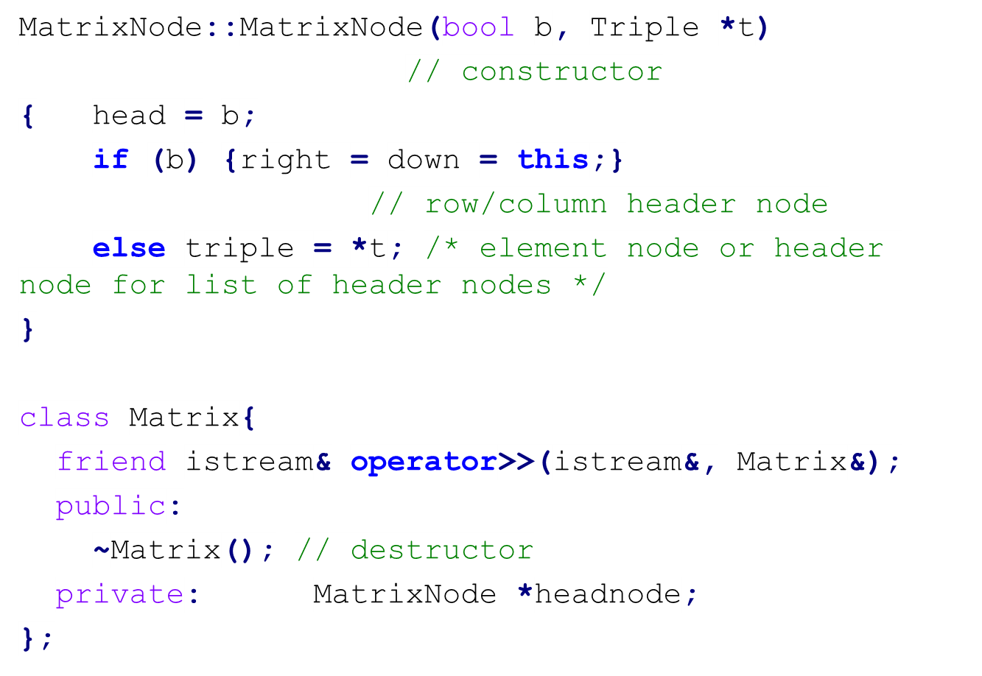
Class Definition of Sparse Matrix (2)
4-<number>

Slide 37
Doubly Linked List
In a singly linked list, if we want to delete a node ptr, we have to know the preceding (前面的) node of ptr. Then we have to start from the beginning of the list and to search until the node whose next (link) is ptr is found.
To efficiently delete a node, we need to know its preceding node. Therefore, a doubly linked list is useful.
A node in a doubly linked list has at least three fields: left, data, right.
A header node may be used in a doubly linked list.
4-<number>

Slide 38
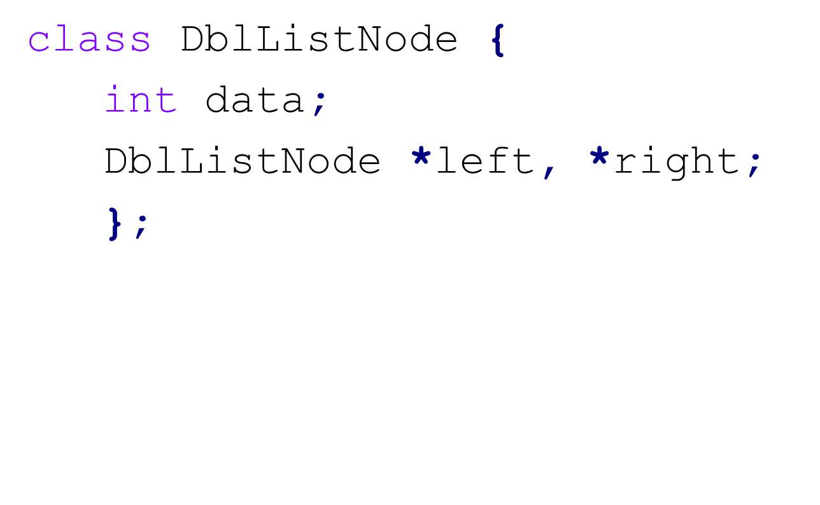
Doubly Linked List
left
data
right
Header Node
left
data
right
Empty List
Header Node
4-<number>

Slide 39
Deleting Node x in a Doubly Linked Circular List
left
data
right
Header Node
x
x -> left -> right = x -> right;
x -> right -> left = x -> left;
4-<number>

Slide 40
Inserting Node p to the Right of Node x in a Doubly Linked Circular List
left
data
right
Header Node
x
q
p
q = x -> right;
p -> left = x;
p -> right = q;
q -> left = p;
x -> right = p;
4-<number>

Slide 41
Generalized Lists
A generalized list, A, is a finite sequence of n ≥ 0 elements, a₀, a₁, a₂, …, a_{n-1}, where α_{i}, is either an atom or a list. The elements α_{i},0 ≤ i ≤ n – 1, that are not atoms are said to be the sublists of A.
A list A is written as A = (a₀, …, a_{n-1} ), and the length of the list is n.
A list name is represented by a capital letter and an atom is represented by a lowercase letter.
a₀ is the head of list A and the rest (a₁, …,
a_{n-1}) is the tail of list A.
4-<number>

Slide 42
Examples of Generalized Lists
A = ( ): the null, or empty, list; its length is zero.
B = (a, (b, c)): a list of length two; its first element is the atom a, and its second element is the linear list (b, c).
C = (B, B, ( )): A list of length three whose first two elements are the list B, and the third element is the null list.
D = (a, D): is a recursive list of length two; D corresponds to the infinite list D = (a, (a, (a, …))).
head(B) = ‘a’ and tail(B) = (b, c), head(tail(C))=B and tail(tail(C)) = ( ).
Lists may be shared by other lists.
Lists may be recursive.
4-<number>

Slide 43
General Polynomial
P(x, y, z)=
Rewritten as Cz² + Dz, where C and D are polynomials.
Again, in C, it is of the form Ey³ + Fy², where E and F are polynomials.
In general, every polynomial consists of a variable plus coefficient-exponent pairs. Each coefficient may be a constant or a polynomial.
4-<number>

Slide 44
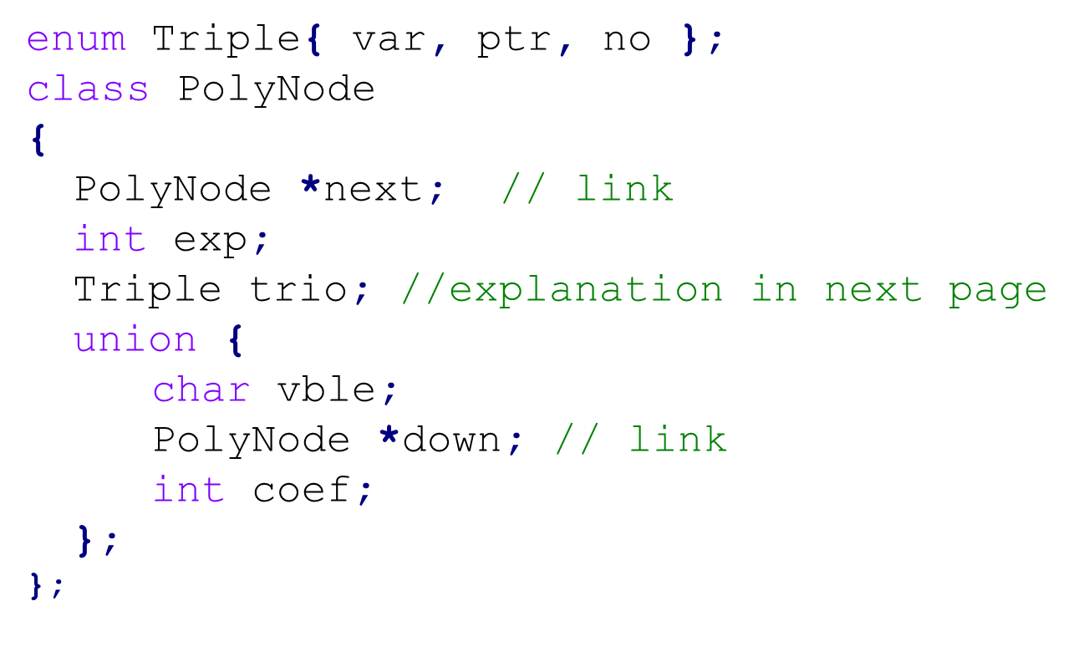
PolyNode Class in C++
4-<number>

Slide 45
3 Types of Nodes in PolyNode
trio == var
  The node is a header node.
  vble indicates the name of the variable
  exp is set to 0.
trio == ptr
  Coefficient is a list pointed by down.
  exp is the exponent of the variable on which that list is based on.
trio == no
  Coefficient is an integer, stored in coef.
  exp is the exponent of the variable on which that list is based on.
4-<number>

Slide 46
Representation of 3x²y
trio
vble
exp
next
trio
down
exp
next
var
y
0
ptr
1
0
trio
coef
exp
next
var
x
0
no
3
2
0
First
4-<number>

Slide 47
Representation of P(x, y, z)
P(x, y, z)
v
z
0
p
2
p
1
0
v
y
0
p
3
p
2
0
v
y
0
p
4
p
1
0
v
x
0
n
3
8
0
v
x
0
n
2
0
0
v
x
0
n
1
10
n
2
8
0
v
x
0
n
1
4
n
6
3
0
4-<number>

Slide 48
Representations of Generalized Lists
A = 0 Empty list
tag
tag
B=(a, (b, c))
B
f
a
t
0
f
b
f
c
0
C
t
t
t
0
0
C=(B, B, ( ))
D
f
a
t
0
D=(a, D)
tag field: t(true): a link pointing to a list
f (false): not a link
**
4-<number>

Slide 49
Reference Counts in Shared Lists
Lists may be shared by other lists for storage saving.
Add a header node to store the reference count, which is the number of pointers to it.
The reference count can be dynamically updated. The list can be deleted only when the reference count is 0.
4-<number>

Slide 50
Reference Counts in Shared Lists
header node
A
f
1
0
B
f
3
f
a
t
0
B=(a, (b, c))
f
1
f
b
f
c
0
C
f
1
t
t
t
0
C=(B, B, ( ))
D
f
2
f
a
t
0
f
1
0
D=(a, D)
reference count in header node: # of pointers to the list
4-<number>

