Slide 1
Chapter 2
Introduction to Algorithms

Slide 2
何謂演算法
Algorithm
解決問題的方法。將抽象的解法變成實際具體可行的方法或程式。
利用電腦解決問題的步驟
  Step 1: 明確定義問題（將其模式化）
  Step 2: 設計演算法，並估計所需時間
  Step 3: 撰寫程式，並加以測試

Slide 3
解決問題範例
問題：計算大學聯考英文之頂標
明確定義：計算所有考生中前25%英文成績之平均
演算法：
  Step 1: 將所有考生英文成績排序（由高至低）
  Step 2: 將排名在前面1/4的成績資料相加後，
  再除以1/4的人數
撰寫程式： …...

Slide 4
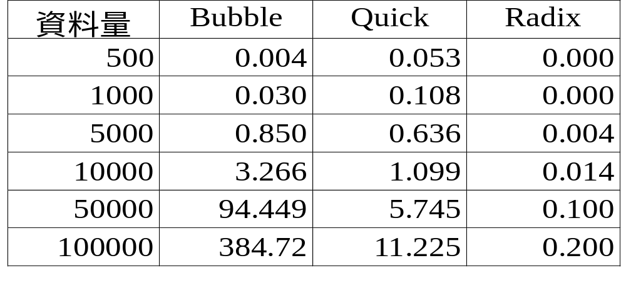
各種排序演算法所需時間比較
CPU: K6-2 350 時間單位：秒

Slide 5
演算法範例
【問題】將50元硬幣換成等值的1元、5元、10元
硬幣的方法共有多少種？
【方法-1】
採用窮舉法，每種硬幣可能的個數如下：
i (10元):0,1,2,3,4,5
j (5 元):0,1,2,…,10
k (1 元):0,1,2,…,50
假設 i, j, k 分別代表10元、5元、1元的個數，
則我們可以嘗試各種組合，並利用下面的判斷式：
i*10 + j*5 + k = 50
<執行迴圈次數> 6 * 11 * 51 = 3366

Slide 6
main()
{
int loop = 0, number = 0;
int i, j, k;
for (i = 0; i <= 5; i++)
for (j = 0; j <= 10; j++)
for (k = 0; k <= 50; k++)
{
loop++;
if (i*10 + j*5+ k == 50)
number++;
}
printf("共%d種,執行迴圈%d次\n",number,loop);
}
【執行結果】
共36種,執行迴圈3366次

Slide 7
【方法-2】
若 k 不為 5 之倍數，根本不可能轉換，所以只需
考慮 k 為 5 之倍數的情況。
i (10元):0,1,2,3,4,5
j (5 元):0,1,2,…,10
k (1 元):0,5,10,…,50
<執行迴圈次數> 6 * 11 * 11 = 726

Slide 8
main()
{
int loop = 0, number = 0;
int i, j, k;
for (i = 0; i <= 5; i++)
for (j = 0; j <= 10; j++)
for (k = 0; k <= 50; k+=5)
{
loop++;
if (i*10 + j*5+ k == 50)
number++;
}
printf("共%d種,執行迴圈%d次\n",number,loop);
}
【執行結果】
共36種,執行迴圈726次

Slide 9
【方法-3】
當 i*10 + j*5 + k = 50時，應立即跳出最內
層迴圈，因為再變化 k 之值，i*10 + j*5 + k
均已大於 50。
<執行迴圈次數> 491

Slide 10
main()
{
int loop = 0, number = 0;
int i, j, k;
for (i = 0; i <= 5; i++)
for (j = 0; j <= 10; j++)
for (k = 0; k <= 50; k+=5)
{
loop++;
if (i*10 + j*5+ k == 50)
{
number++; break;
}
}
printf("共%d種,執行迴圈%d次\n",number,loop);
}
【執行結果】
共36種,執行迴圈491次

Slide 11
【方法-4】
當 i 和 j 之值固定後，k 之值只有唯一的選擇，
因此不必考慮 k 的變化情形。
i=0,j可能為 0,1,2,…,10 (50-i*10)/5=10
i=1,j可能為 0,1,2,…,8 (50-i*10)/5=8
i=2,j可能為 0,1,2,…,6 (50-i*10)/5=6
.
.
.
i=5,j可能為 0 (50-i*10)/5=0
<執行迴圈次數> 36

Slide 12
main()
{
int loop = 0, number = 0;
int i, j;
for (i = 0; i <= 5; i++)
for (j = 0; j <= (50-i*10)/5; j++)
{
loop++;
number++;
}
printf("共%d種,執行迴圈%d次\n",number,loop);
}
【執行結果】
共36種,執行迴圈36次

Slide 13
【方法-5】
由上一個方法知，當 i 的值固定後，j 的變化情形
只有 (50-i*10)/5 種，因此只需對 i 做迴圈。
<執行迴圈次數> 6
main()
{
int loop = 0, number = 0;
int i;
for (i = 0; i <= 5; i++)
{
loop++;
number += (50-i*10)/5 + 1;
}
printf("共%d種,執行迴圈%d次\n",number,loop);
}
【執行結果】
共36種,執行迴圈6次

Slide 14
【方法-6】
我們計算的值其實是一個等差級數，即
11+9+7+…+1=6*(11+1)/2=36
將等差級數的公式寫成程式即可計算。
main()
{
int number = 0, a, b, n = 50;
a = n / 5 + 1;
if (a % 2 == 0) b = 2;
else b = 1;
number = (a+b)*((a-b)/2+1)/2;
printf("共%d種\n", number);
}
【執行結果】
共36種

Slide 15
上課教室與圖形著色
8:00
18:00
課程 A
B
C
D
E
區間圖形著色問題(interval graph coloring)：
A
C1
C1：第一個顏色
C2：第二個顏色
C3：第三的顏色
D
C3
C2
B
C
C1
E
C2

Slide 16
職棒比賽與分割問題
給予一個正整數的集合A={a₁, a₂, … , a_{n}}，是否可以將其分割成兩個子集合，而此兩個子集合的個別總和相等。
例：A = { 1, 3, 8, 4, 10}
可以分割：{1, 8, 4} 及 {3, 10}
此為 NP-complete 問題

Slide 17
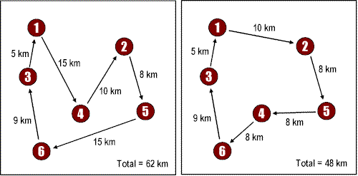
環球旅遊與推銷員問題
平面上給予 n 個點，從某一點出發，經過每個點一次，再回到出發點，而其總長度為最短
此為 NP-complete 問題

Slide 18
股票投資與0/1 knapsack問題
有n個東西，每個東西有其個別價值(value)與重量(weight)另有一個袋子，其容量為M，如何選取某些東西，使其總重要不超過M，而其總價值為最高。
例：
M = 14
最佳(optimal)解法：P₁、P₂、P₃、P₅
0/1 knapsack問題為NP-complete
 | P₁ | P₂ | P₃ | P₄ | P₅ | P₆ | P₇ | P₈
價值 | 10 | 5 | 1 | 9 | 3 | 4 | 11 | 17
重量 | 7 | 3 | 3 | 10 | 1 | 9 | 22 | 15

Slide 19
Art gallery problem
Given: an art gallery
Determine: min # of guards and their placements such that the entire art gallery can be monitored.
NP-complete

Slide 20
Minimum spanning tree
graph: greedy method
geometry(on a plane): divide-and-conquer
# of possible spanning trees for n points: n^{n-2}
n=10→10⁸, n=100→10¹⁹⁶

Slide 21
Convex hull
Given a set of planar points, find a smallest convex polygon which contains all points.
It is not obvious to find a convex hull by examining all possible solutions
divide-and-conquer

Slide 22
One-center problem
Given a set of planar points, find a smallest circle which contains all points.
Prune-and-search

Slide 23
The Goodness of an Algorithm
Time complexity (more important)
Space complexity
For a parallel algorithm :
  time-processor product
For a VLSI circuit :
  area-time (AT, AT²)

Slide 24
Asymptotic Notations
Def: f(n) = O(g(n)) "at most"
∃ c, n₀ ∋ |f(n)| ≤ c|g(n)| ∀ n ≥ n₀
e.g. f(n) = 3n² + 2
g(n) = n²
⇒ n₀=2, c=4
∴ f(n) = O(n²)
e.g. f(n) = n³ + n = O(n³)
e. g. f(n) = 3n² + 2 = O(n³) or O(n¹⁰⁰ )

Slide 25
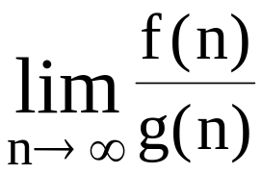
Def : f(n) = Ω(g(n)) “at least“, “lower bound"
∃ c, and n₀, ∋ |f(n)| ≥ c|g(n)| ∀ n ≥ n₀
e. g. f(n) = 3n² + 2 = Ω(n²) or Ω (n)
Def : f(n) = Θ(g(n))
  ∃ c₁, c₂, and n₀, ∋ c₁|g(n)| ≤ |f(n)| ≤ c₂|g(n)| ∀ n ≥ n₀
e. g. f(n) = 3n² + 2 = Θ (n²)
Def : f(n) ∼ o(g(n))
→ 1
e.g. f(n) = 3n²+n = o(3n²)

Slide 26
Problem Size
 | 10 | 10² | 10³ | 10⁴
log₂n | 3.3 | 6.6 | 10 | 13.3
n | 10 | 10² | 10³ | 10⁴
nlog₂n | 0.33x10² | 0.7x10³ | 10⁴ | 1.3x10⁵
n² | 10² | 10⁴ | 10⁶ | 10⁸
2^{n} | 1024 | 1.3x10³⁰ | >10¹⁰⁰ | >10¹⁰⁰
n! | 3x10⁶ | >10¹⁰⁰ | >10¹⁰⁰ | >10¹⁰⁰
Time Complexity Functions

Slide 27
Straight Insertion Sort
input: 7,5,1,4,3
7,5,1,4,3
5,7,1,4,3
1,5,7,4,3
1,4,5,7,3
1,3,4,5,7
time complexity (worst case):
1+2+3+…+(n-1)=n(n-1)/2=O(n²)

Slide 28
問題難易度
容易的問題：在多項式時間(polynomial time)可解決
的問題
如排序，找最大值
困難的問題：NP-complete，NP-hard
如：分割問題(Partition Problem)
推銷員問題(Travelling
Salesperson Problem)
不可解的問題(undecidable)：用演算法無法解決的問題
如：停止問題(Halting Problem)
lower bound：解題最少所需時間

Slide 29
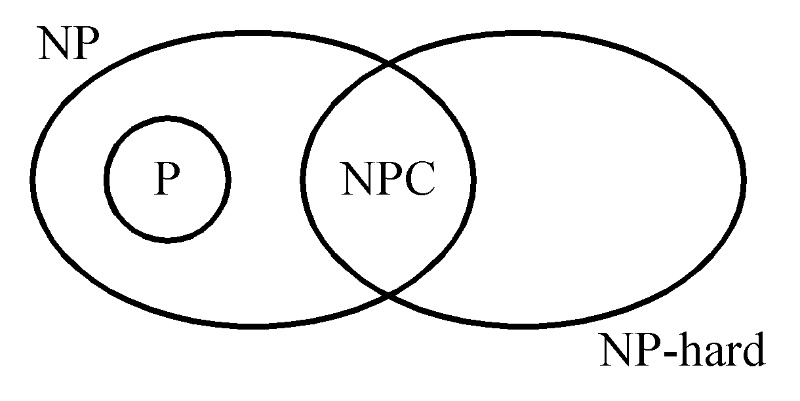
P: the class of problems which can be solved by a deterministic polynomial algorithm.
NP : the class of decision problem which can be solved by a non-deterministic polynomial algorithm.
NP-hard: the class of problems to which every NP problem reduces.
NP-complete (NPC): the class of problems which are NP-hard and belong to NP.

Slide 30
Some Concepts of NPC
Definition of reduction: Problem A reduces to problem B (A ∝ B) iff A can be solved by a deterministic polynomial time algorithm using a deterministic algorithm that solves B in polynomial time.
Up to now, none of the NPC problems can be solved by a deterministic polynomial time algorithm in the worst case.
It does not seem to have any polynomial time algorithm to solve the NPC problems.

Slide 31
The theory of NP-completeness always considers the worst case.
The lower bound of any NPC problem seems to be in the order of an exponential function.
Not all NP problems are difficult. (e.g. the MST problem is an NP problem.)
If A, B ∈ NPC, then A ∝ B and B ∝ A.
Theory of NP-completeness
If any NPC problem can be solved in polynomial time, then all NP problems can be solved in polynomial time. (NP = P)

Slide 32
NP-Complete Problems
Satisfiability
0/1 knapsack
Traveling salesperson (TSP)
Graph coloring
Sum of subsets
Multicasting
Hamiltonian cycle
Bin packing
Maximum clique
Multiple sequence alignment (MSA)
…..

Slide 33
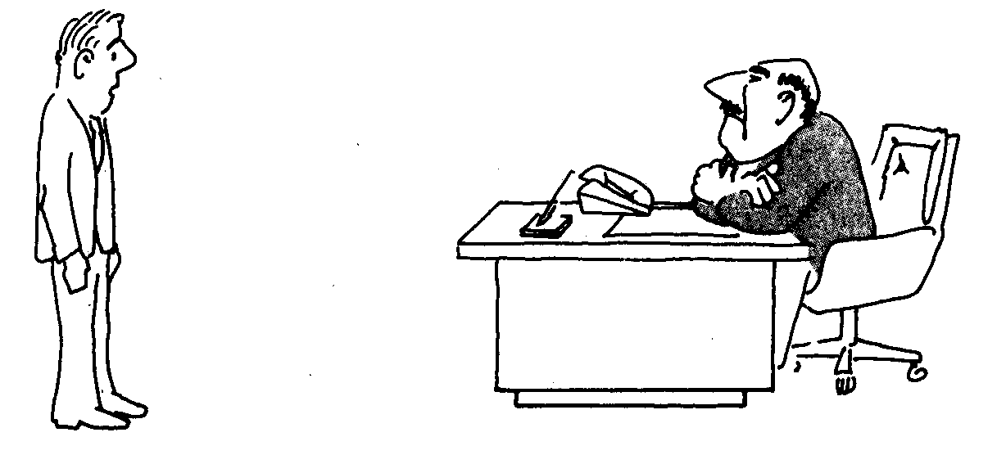
我想不出好方法，我可能太笨了！

Slide 34
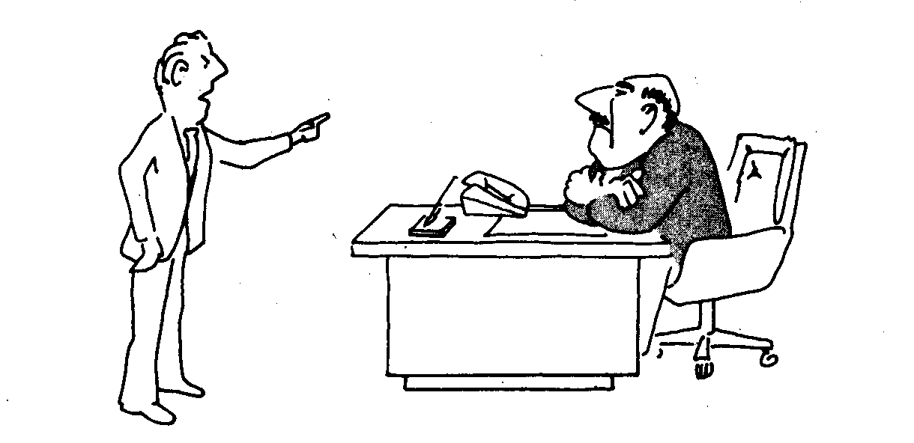
我想不出好方法，
因為不可能有這種好方法！

Slide 35
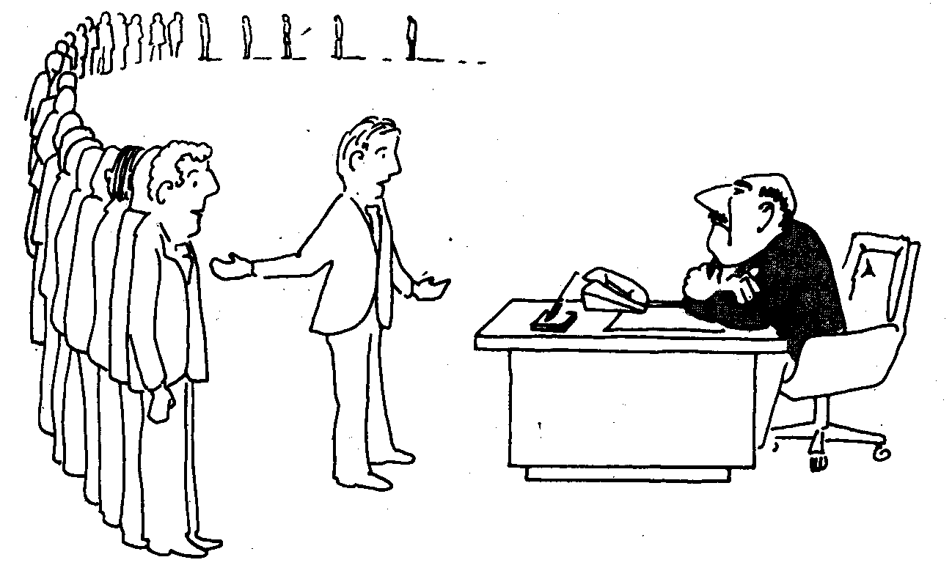
我想不出好方法，
因為這些名人專家也不會！

Slide 36
Greedy Method: Select k Maximum Numbers
Problem: Pick k numbers out of n numbers such that the sum of these k numbers is the largest.
Algorithm:
    FOR i = 1 to k
    pick out the largest number and
    delete this number from the input.
    ENDFOR
Time complexity: O(kn)

Slide 37
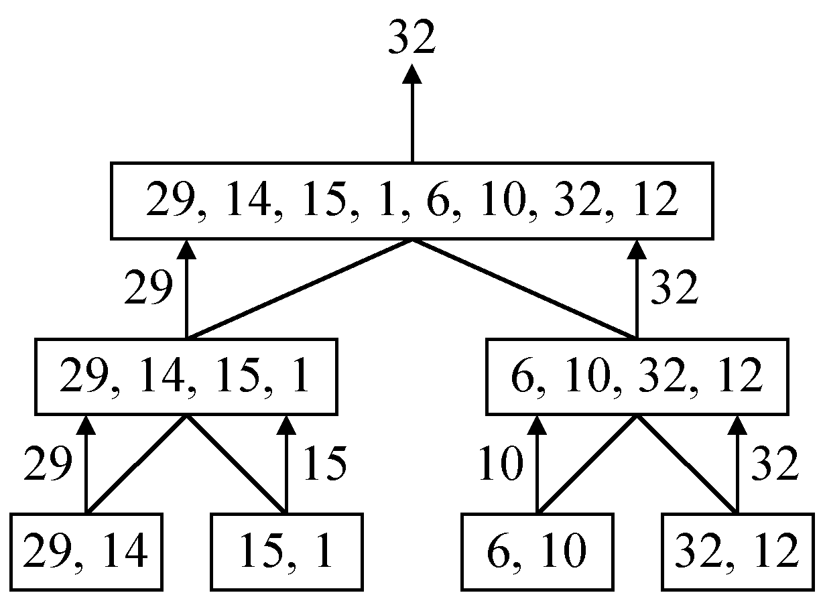
Divide-and-conquer Strategy: Maximum Finding
Finding the maximum of a set S of n numbers

Slide 38

Time Complexity
Time complexity:
Calculation of T(n):
Assume n = 2^{k},
T(n) = 2T(n/2)+1
= 2(2T(n/4)+1)+1
= 4T(n/4)+2+1
:
=2^{k-1}T(2)+2^{k-2}+…+4+2+1
=2^{k-1}+2^{k-2}+…+4+2+1
=2^{k}-1 = n-1

Slide 39
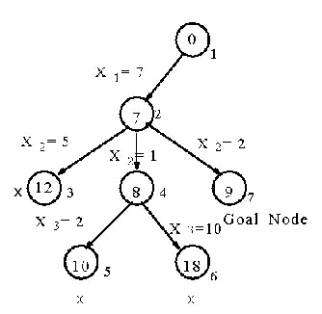
Tree Searching Strategy: Depth-First Search (DFS)
e.g. sum of subset problem
S={7, 5, 1, 2, 10}
∃ S’ ⊆ S ∋ sum of S’ = 9 ?
A stack can be used to guide the depth-first search.
A sum of subset problem solved by depth-first search.

Slide 40
Prune-and-search: Binary Search
sorted sequence : (search 9)
1 4 5 7 9 10 12 15
step 1 ↑
step 2 ↑
step 3 ↑
After each comparison, a half of the data set are pruned away.
Binary search can be viewed as a special divide-and-conquer method, since there exists no solution in another half and then no merging is done.

Slide 41
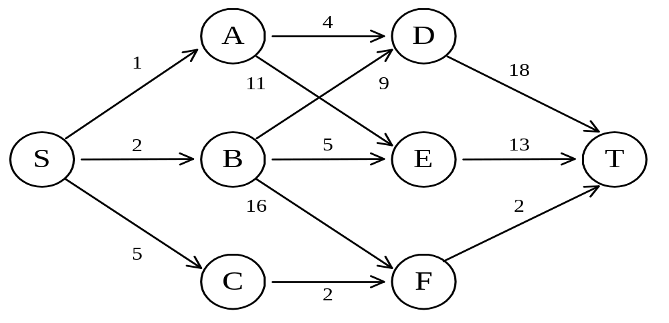
Dynamic Programming: The Shortest Path in Multistage Graphs
e.g.
The greedy method can not be applied to this case: (S, A, D, T) 1+4+18 = 23.
The real shortest path is:
(S, C, F, T) 5+2+2 = 9.

Slide 42
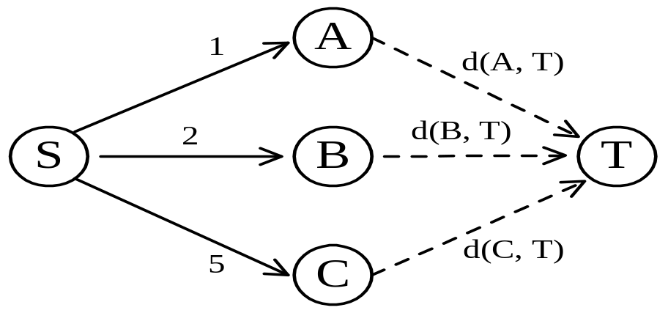
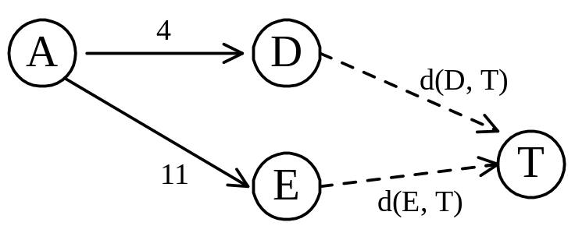
Dynamic programming approach (forward approach):
d(S, T) = min{1+d(A, T), 2+d(B, T), 5+d(C, T)}
d(A,T) = min{4+d(D,T), 11+d(E,T)}
= min{4+18, 11+13} = 22.

Slide 43
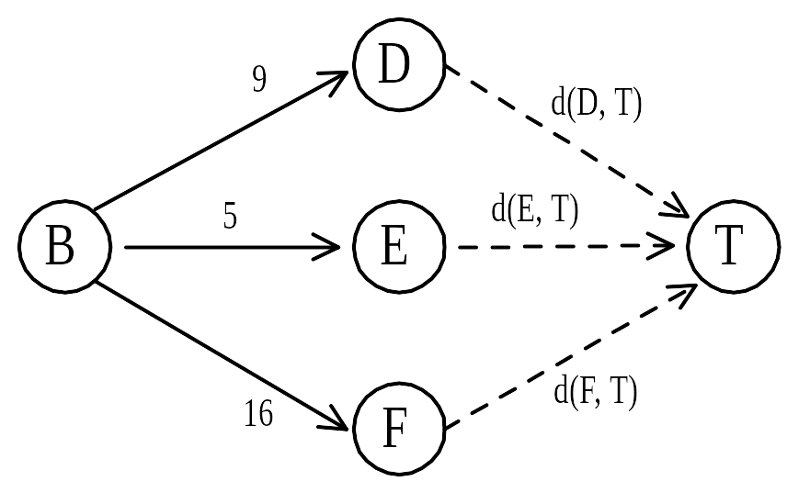
d(B, T) = min{9+d(D, T), 5+d(E, T), 16+d(F, T)}
= min{9+18, 5+13, 16+2} = 18.
d(C, T) = min{ 2+d(F, T) } = 2+2 = 4
d(S, T) = min{1+d(A, T), 2+d(B, T), 5+d(C, T)}
= min{1+22, 2+18, 5+4} = 9.
The above way of reasoning is called
backward reasoning.

