Slide 1
Chapter 3
String Matching

Slide 2
String Matching Problem
Given a text string T of length n and a pattern string P of length m, the exact string matching problem is to find all occurrences of P in T.
Example: T=“AGCTTGA” P=“GCT”
Applications:
  Searching keywords in a file
  Searching engines (like Google and Openfind)
  Database searching (GenBank)
More string matching algorithms (with source codes):
http://www-igm.univ-mlv.fr/~lecroq/string/

Slide 3
Terminologies
S=“AGCTTGA”
|S|=7, length of S
Substring: S_{i,j}=S_{i}S _{i+1}…S_{j}
  Example: S_{2,4}=“GCT”
Subsequence of S: deleting zero or more characters from S
  “ACT” and “GCTT” are subsquences.
Prefix of S: S_{1,k}
  “AGCT” is a prefix of S.
Suffix of S: S_{h,|S|}
  “CTTGA” is a suffix of S.

Slide 4
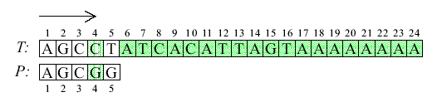

A Brute-Force Algorithm
Time: O(mn) where m=|P| and n=|T|.

Slide 5
Two-phase Algorithms
Phase 1：Generate an array to indicate the moving direction.
Phase 2：Make use of the array to move and match the string
KMP algorithm:
  Proposed by Knuth, Morris and Pratt in 1977.
Boyer-Moore Algorithm:
  Proposed by Boyer-Moore in 1977.

Slide 6
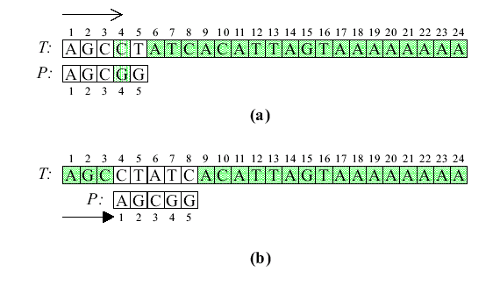
First Case for KMP Algorithm
The first symbol of P does not appear in P again.
We can slide to T₄, since T₄≠P₄ in (a).

Slide 7
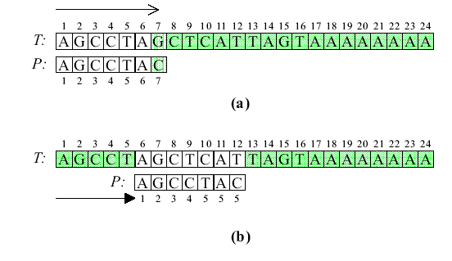
Second Case for KMP Algorithm
The first symbol of P appears in P again.
T₇≠P₇ in (a). We have to slide to T₆, since P₆=P₁=T₆.

Slide 8
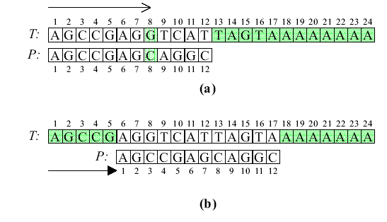
Third Case for KMP Algorithm
The prefix of P appears in P again.
T₈≠P₈ in (a). We have to slide to T₆, since P_{6,7}=P_{1,2}=T_{6,7}.

Slide 9
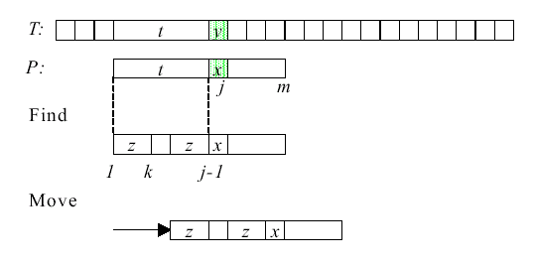
Principle of KMP Algorithm
a
a

Slide 10


Definition of the Prefix Function
f(j)=largest k < j such that P_{1,k}=P_{j–k+1,j}
f(j)=0 if no such k
f(j)=k

Slide 11
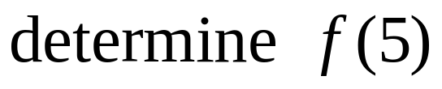
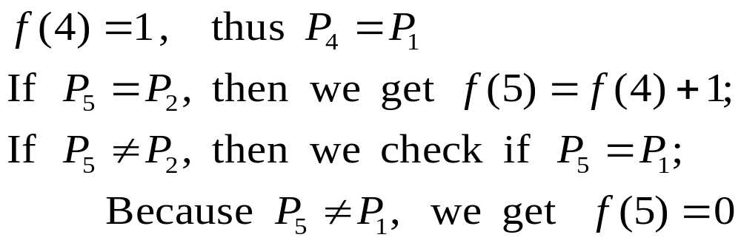
Calculation of the Prefix Function

Slide 12
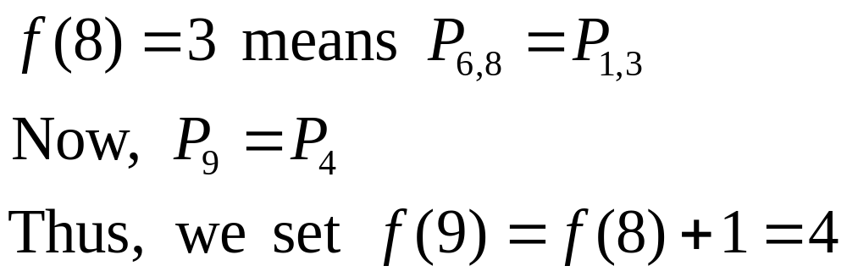
Calculation of the Prefix Function
Suppose we have found f(8)=3.
To determine f(9):

Slide 13
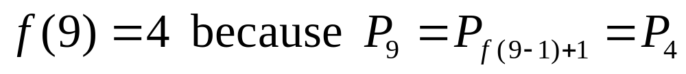

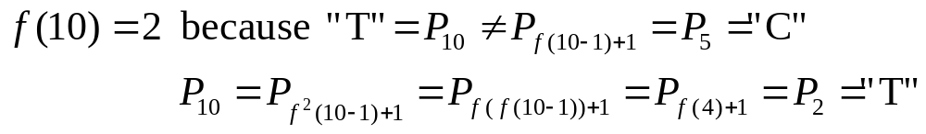
Calculation of the Prefix Function
To determine f(10):

Slide 14
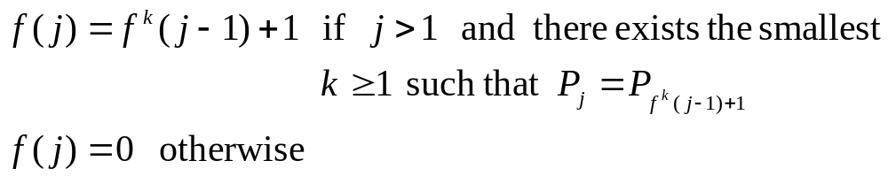
The Algorithm for Prefix Functions
j-1
j
k=1 f(j)=f(j-1)+1
f(j-1)
j-1
j
a
k=2 f(j)=f(f((j-1))+1
f(j-1)
f(f(j-1))

Slide 15
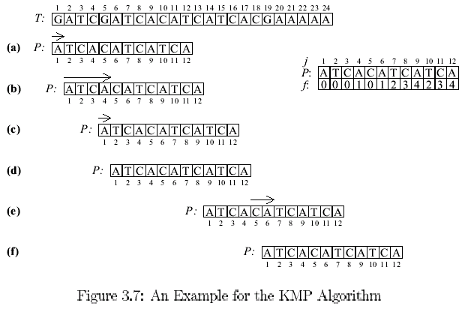
An Example for KMP Algorithm
Phase 2
f(4–1)+1= f(3)+1=0+1=1
Phase 1
matched
f(12)+1= 4+1=5

Slide 16
Time Complexity of KMP Algorithm
Time complexity: O(m+n) (analysis omitted)
  O(m) for computing function f
  O(n) for searching P

Slide 17
Suffixes
Suffixes for S=“ATCACATCATCA”
ATCACATCATCA | S₍₁₎
TCACATCATCA | S₍₂₎
CACATCATCA | S₍₃₎
ACATCATCA | S₍₄₎
CATCATCA | S₍₅₎
ATCATCA | S₍₆₎
TCATCA | S₍₇₎
CATCA | S₍₈₎
ATCA | S₍₉₎
TCA | S₍₁₀₎
CA | S₍₁₁₎
A | S₍₁₂₎

Slide 18
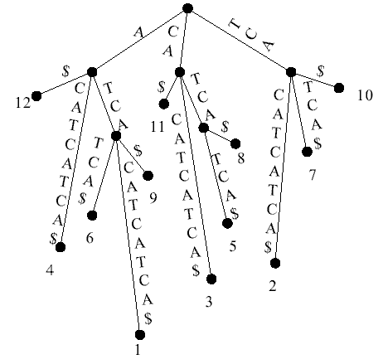
Suffix Trees
A suffix Tree for S=“ATCACATCATCA”

Slide 19
Properties of a Suffix Tree
Each tree edge is labeled by a substring of S.
Each internal node has at least 2 children.
Each S_{(i)} has its corresponding labeled path from root to a leaf, for 1≤ i ≤ n .
There are n leaves.
No edges branching out from the same internal node can start with the same character.

Slide 20
Algorithm for Creating a Suffix Tree
Step 1: Divide all suffixes into distinct groups according to their starting characters and create a node.
Step 2: For each group, if it contains only one suffix, create a leaf node and a branch with this suffix as its label; otherwise, find the longest common prefix among all suffixes of this group and create a branch out of the node with this longest common prefix as its label. Delete this prefix from all suffixes of the group.
Step 3: Repeat the above procedure for each node which is not terminated.

Slide 21
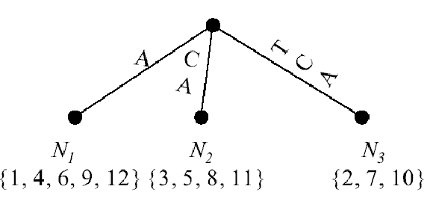
Example for Creating a Suffix Tree
S=“ATCACATCATCA”.
Starting characters: “A”, “C”, “T”
In N₃,
S(2) =“TCACATCATCA”
S(7) =“TCATCA”
S(10) =“TCA”
Longest common prefix of N₃ is “TCA”

Slide 22
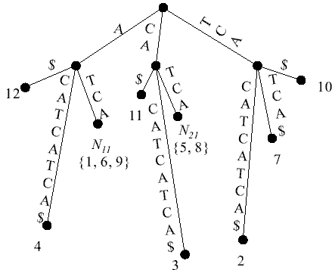
S=“ATCACATCATCA”.
Second recursion:

Slide 23
Finding a Substring with the Suffix Tree
S = “ATCACATCATCA”
P =“TCAT”
  P is at position 7 in S.
P =“TCA”
  P is at position 2, 7 and 10 in S.
P =“TCATT”
  P is not in S.

Slide 24
Time Complexity
A suffix tree for a text string T of length n can be constructed in O(n) time (with a complicated algorithm).
To search a pattern P of length m on a suffix tree needs O(m) comparisons.
Exact string matching: O(n+m) time

Slide 25
The Suffix Array
In a suffix array, all suffixes of S are in the non-decreasing lexical order.
For example, S=“ATCACATCATCA”
i | 1 | 2 | 3 | 4 | 5 | 6 | 7 | 8 | 9 | 10 | 11 | 12
A | 12 | 4 | 9 | 1 | 6 | 11 | 3 | 8 | 5 | 10 | 2 | 7
4 | ATCACATCATCA | S₍₁₎
11 | TCACATCATCA | S₍₂₎
7 | CACATCATCA | S₍₃₎
2 | ACATCATCA | S₍₄₎
9 | CATCATCA | S₍₅₎
5 | ATCATCA | S₍₆₎
12 | TCATCA | S₍₇₎
8 | CATCA | S₍₈₎
3 | ATCA | S₍₉₎
10 | TCA | S₍₁₀₎
6 | CA | S₍₁₁₎
1 | A | S₍₁₂₎
1 | A | S₍₁₂₎
2 | ACATCATCA | S₍₄₎
3 | ATCA | S₍₉₎
4 | ATCACATCATCA | S₍₁₎
5 | ATCATCA | S₍₆₎
6 | CA | S₍₁₁₎
7 | CACATCATCA | S₍₃₎
8 | CATCA | S₍₈₎
9 | CATCATCA | S₍₅₎
10 | TCA | S₍₁₀₎
11 | TCACATCATCA | S₍₂₎
12 | TCATCA | S₍₇₎

Slide 26
Searching in a Suffix Array
If T is represented by a suffix array, we can find P in T in O(mlogn) time with a binary search.
A suffix array can be determined in O(n) time by lexical depth first searching in a suffix tree.
Total time: O(n+mlogn)

Slide 27
Approximate String Matching
Text string T, |T|=n
Pattern string P, |P|=m
k errors, where errors can be substituting, deleting, or inserting a character.
Example:
T =“pttapa”, P =“patt”, k =2,
T_{1,2} ,T_{1,3} ,T_{1,4} and T_{5,6} are all up to 2 errors with P.

Slide 28
Suffix Edit Distance
Given two strings S₁ and S₂, the suffix edit distance is the minimum number of substitutions, insertion and deletions, which will transform some suffix of S₁ into S₂.
Example:
  S₁=“ptt” and S₂=“p”. The suffix edit distance between S₁ and S₂ is 1.
  S₁=“pt” and S₂=“patt”. The suffix edit distance between S₁ and S₂ is 2.

Slide 29
Suffix Edit Distance Used in Matching
Given T and P, if at least one of suffix edit distances between T_{1,1}, T_{1,2} , …, T_{1,n} and P is not greater than k, then there is an approximate matching with error not greater than k.
Example: T =“pttapa”, P =“patt”, k=2
  For T_{1,1}=“p” and P =“patt”, the suffix edit distance is 3.
  For T_{1,2} =“pt” and P =“patt”, the suffix edit distance is 2.
  For T_{1,5} =“pttap” and P =“patt”, the suffix edit distance is 3.
  For T_{1,6} =“pttapa” and P =“patt”, the suffix edit distance is 2.

Slide 30
Approximate String Matching
Solved by dynamic programming
Let E(i,j) denote the suffix edit distance between T_{1,j} and P_{1,i}.
E(i, j) = E(i–1, j–1) if P_{i}=T_{j}
E(i, j) = min{E(i, j–1), E(i–1, j), E(i–1, j–1)}+1 if P_{i} ≠T_{j}

Slide 31
Example for Appr. String Matching
Example: T =“pttapa”, P =“patt”, k=2
 |  |  | T
 |  |  | 0 | 1 | 2 | 3 | 4 | 5 | 6
 |  |  |  | p | t | t | a | p | a
P | 0 |  | 0 | 0 | 0 | 0 | 0 | 0 | 0
 | 1 | p | 1 | 0 | 1 | 1 | 1 | 0 | 1
 | 2 | a | 2 | 1 | 1 | 2 | 1 | 1 | 0
 | 3 | t | 3 | 2 | 1 | 1 | 2 | 2 | 1
 | 4 | t | 4 | 3 | 2 | 1 | 2 | 3 | 2

