Slide 1
Chapter 4
The Sequence Alignment Problem

Slide 2
The Longest Common Subsequence (LCS) Problem
A string : S₁ = “TAGTCACG”
A subsequence of S₁ : deleting 0 or more symbols from S₁ (not necessarily consecutive).
e.g. G, AGC, TATC, AGACG
Common subsequences of S₁ = “TAGTCACG” and S₂ = “AGACTGTC” :
GG, AGC, AGACG
Longest common subsequence (LCS) :
S₁: TAGTCACG
S₂: AGACTGTC
LCS: AGACG

Slide 3
Applications of LCS
The edit distance of two strings or files.
(# of deletions and insertions)
S₁: TAGTCAC G
S₂: AG ACTGTC
Operation: DMMDDMMIMII
Spoken word recognition
Similarity of two biological sequences (DNA or protein)
  Sequence alignment

Slide 4
The LCS Algorithm
S₁ = a₁ a₂ … a_{m} and S₂ = b₁ b₂ … b_{n}
A_{i,j} denotes the length of the longest common subsequence of a₁ a₂ … a_{i} and b₁ b₂ … b_{j.}
Dynamic programming:
A_{i,j} = A_{i-1,j-1} + 1 if a_{i}= b_{j}
max{ A_{i-1,j}, A_{i,j-1} } if a_{i}≠ b_{j}
A_{0,0} = A_{0,j} = A_{i,0} = 0 for 1≤ i≤ m, 1≤ j≤ n.
Time complexity: O(mn)

Slide 5
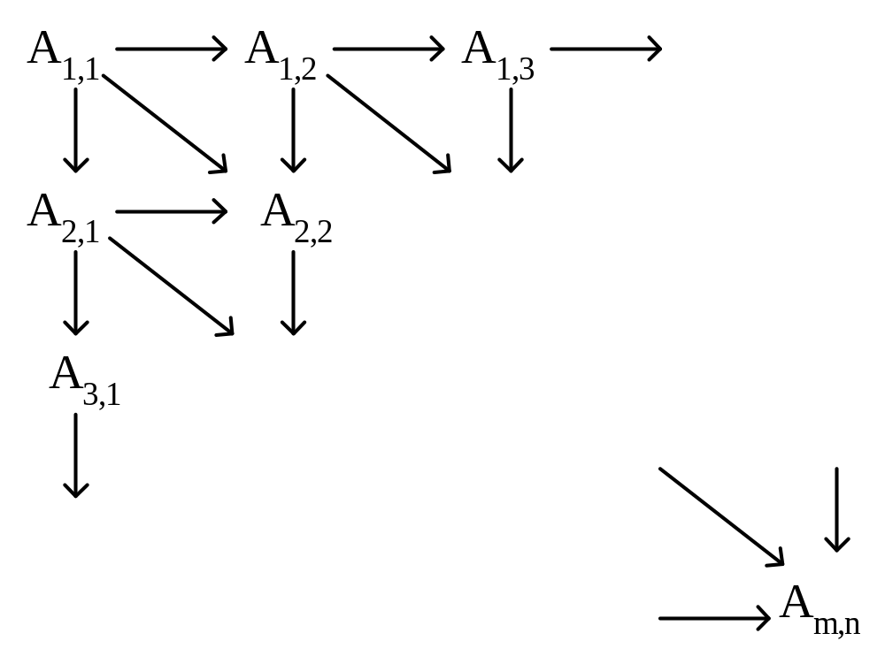
By the dynamic programming, we can calculate matrix A starting at the upper left corner and ending at the lower right corner.
Simply, we can calculate it row by row, or column by column.

Slide 6
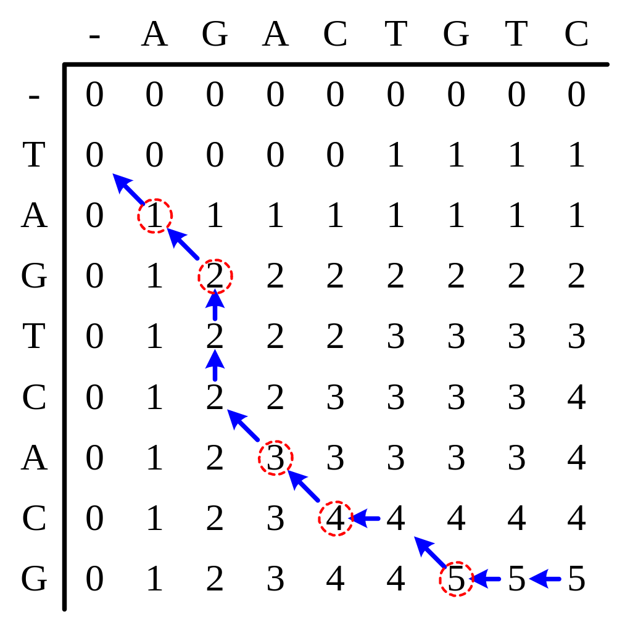
S₂
S₁
TAGTCACG
AGACTGTC
LCS:AGACG
After matrix A has been found, we can trace back to find the LCS.

Slide 7
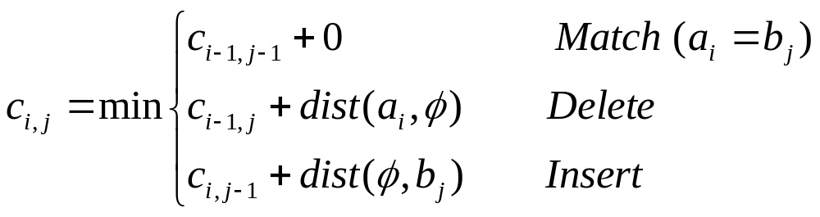
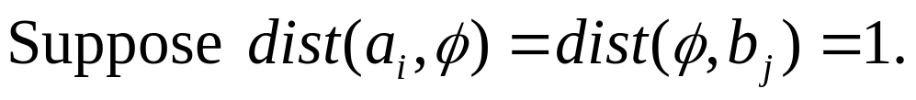
Edit Distance(1)
To find a smallest edit process between two strings.
S₁: TAGTCAC G
S₂: AG ACTGTC
Operation: DMMDDMMIMII

Slide 8
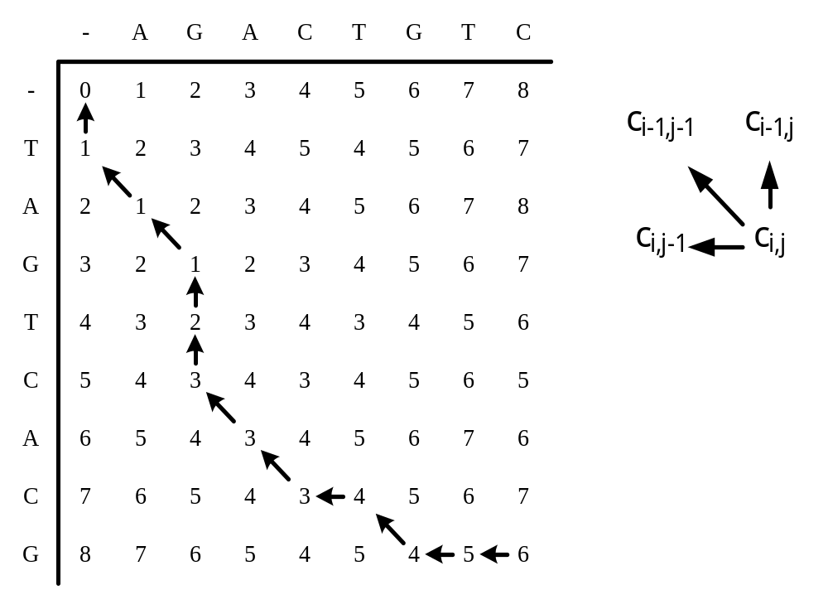
Edit Distance(2)
S₂
S₁
TAGTCAC G
AG ACTGTC
DMMDDMMIMII

Slide 9
The Longest Increasing Subsequence (LIS) Problem
Definition:
  Input: One numeric sequence S
  Output: The longest increasing subsequence in S
Example: Given S = 35274816, the LIS in S is 3578.
By applying the LCS algorithm, this problem can be solved in O(n²) time. (Why?)
Robinson-Schensted-Knuth Algorithm can solve the LIS problem in O(nlogn) time.
(See the example on the next page.)

Slide 10
Robinson-Schensted-Knuth Algorithm for LIS
Input
3
5
2
7
4
8
1
6
1
3
3
2
2
2
2
1
1
L
2
5
5
5
4
4
4
4
3
7
7
7
7
6
4
8
8
8
LIS: 3578
time complexity: O(nlogn)
  n numbers are inserted and each insertion takes O(logn) time for binary search.

Slide 11
Hunt-Szymanski LCS Algorithm
By extending the idea in RSK algorithm, the LCS problem can be solved in O(rlogn) time, where r denotes the number of matches.
This algorithm is faster than traditional dynamic programming if r is small.

Slide 12
The Pairs of Matching
Input sequences: TAGTCACG and AGACTGTC
Pairs of matching:
 | A | G | A | C | T | G | T | C
T
A
G
T
C
A
C
G
(1,5) | (1,7)
(2,1) | (2,3)
(3,2) | (3,6)
(4,5) | (4,7)
(5,4) | (5,8)
(6,1) | (6,3)
(7,4) | (7,8)
(8,2) | (8,6)

Slide 13
Example for Hunt-Szymanski Algorithm
The insertion order is row major and column backward.
 | (1,7) | (1,5) | (2,3) | (2,1) | (3,6) | (3,2) | (4,7) | (4,5) | (5,8) | (5,4)
1 | (1,7) | (1,5) | (2,3) | (2,1) | (2,1) | (2,1) | (2,1) | (2,1) | (2,1) | (2,1)
2 |  |  |  |  | (3,6) | (3,2) | (3,2) | (3,2) | (3,2) | (3,2)
3 |  |  |  |  |  |  | (4,7) | (4,5) | (4,5) | (5,4)
4 |  |  |  |  |  |  |  |  | (5,8) | (5,8)
L
Exercise: Please fill out the rest parts by yourself.
Time Complexity: O(rlogn), r: # of matches
Each match needs O(logn) time for binary search.

Slide 14
The Longest Common Increasing Subsequence (LCIS) Problem
Definition:
  Input: Two numeric sequences S₁, S₂
  Output: The longest common increasing subsequence of S₁ and S₂.
Example: Given S₁=35274816 and S₂=51724863, the LCIS of S₁ and S₂ is 246
This problem can be solved by applying the RSK algorithm on the table for finding LCS(Chao’s Algorithm).
(See the example on the next page.)

Slide 15
Chao’s Algorithm for LCIS
 | 3 | 5 | 2 | 7 | 4 | 8 | 1 | 6
5 | - | L1: 5 | L1: 5 | L1: 5 | L1: 5 | L1: 5 | L1: 5 | L1: 5
1 | - | L1: 5 | L1: 5 | L1: 5 | L1: 5 | L1: 5 | L1: 1 | L1: 1
7 | - | L1: 5 | L1: 5 | L1: 5 L2: 7 | L1: 5 L2: 7 | L1: 5 L2: 7 | L1: 1 L2: 7 | L1: 1 L2: 7
2 | - | L1: 5 | L1: 2 | L1: 2 L2: 7 | L1: 2 L2: 7 | L1: 2 L2: 7 | L1: 1 L2: 7 | L1: 1 L2: 7
4 | - | L1: 5 | L1: 2 | L1: 2 L2: 7 | L1: 2 L2: 4 | L1: 2 L2: 4 | L1: 1 L2: 4 | L1: 1 L2: 4
8 | - | L1: 5 | L1: 2 | L1: 2 L2: 7 | L1: 2 L2: 4 | L1: 2 L2: 4 L3: 8 | L1: 1 L2: 4 L3: 8 | L1: 1 L2: 4 L3: 8
6 | - | L1: 5 | L1: 2 | L1: 2 L2: 7 | L1: 2 L2: 4 | L1: 2 L2: 4 L3: 8 | L1: 1 L2: 4 L3: 8 | L1: 1 L2: 4 L3: 6
3 | L1: 3 | L1: 3 | L1: 2 | L1: 2 L2: 7 | L1: 2 L2: 4 | L1: 2 L2: 4 L3: 8 | L1: 1 L2: 4 L3: 8 | L1: 1 L2: 4 L3: 6

Slide 16
Analysis for Chao’s Algorithm
There are two types of operations to update the best tails, insert (match) and merge (mismatch).
Direct implementation will take O(n³) time, since it cost O(n) for each operation.
However, it can be shown that each merge can be done in constant time. Also, all insertions in a row will totally take O(n) time. Thus, This is an O(n²) algorithm

Slide 17
The Constrained Longest Common Subsequence (CLCS) Problem
Definition:
  Input: Two sequences S₁, S₂, and a constrained sequence C.
  Output: The longest common subsequence of S₁, S₂ that contains C.
  Example: Given S₁= TAGTCACG, S₂= AGACTGTC and C=AT, the CLCS between S₁ and S₂ would be AGTG. (LCS is AGACG)
Purpose:
  From biological perspective, we can specify the functional sites in input sequences by setting proper constraints.

Slide 18
The CLCS Algorithm
S₁ = a₁ a₂ … a_{m} , S₂ = b₁ b₂ … b_{n} and C = c₁ c₂ … c_{r}
R_{k,i,j} denotes the length of the longest common subsequence of a₁ a₂ … a_{i} , b₁ b₂ … b_{j.}and c₁ c₂ … c_{k}
Dynamic programming:
R_{k,i,j} = R_{k-1,i-1,j-1} + 1 if c_{k} = a_{i}= b_{j}
R_{k,i-1,j-1} + 1 if c_{k} ≠ a_{i}= b_{j}
max {R_{k,i-1,j}, R_{k,i,j-1}} if a_{i} ≠ b_{j}
R_{k,0,0} = R_{k,i,0} = R_{k,0,i} = -∞ for 1≤ k≤ r, 1≤ i≤ m, 1≤ j≤ n.
R_{0,i,j} = A_{i,j} (LCS without constraint, please read previous pages)
Time complexity: O(rnm)

Slide 19
Example for CLCS Algorithm
Input: S₁ = TAGTCACG, S₂ = AGACTGTC and C = AT
CLCS of S₁ and S₂ with constraint C: (X means -∞)
k = 0
k = 1 (constraint A)
k = 2 (constraint T)
 | - | A | G | A | C | T | G | T | C
- | 0 | 0 | 0 | 0 | 0 | 0 | 0 | 0 | 0
T | 0 | 0 | 0 | 0 | 0 | 1 | 1 | 1 | 1
A | 0 | 1 | 1 | 1 | 1 | 1 | 1 | 1 | 1
G | 0 | 1 | 2 | 2 | 2 | 2 | 2 | 2 | 2
T | 0 | 1 | 2 | 2 | 2 | 3 | 3 | 3 | 3
C | 0 | 1 | 2 | 2 | 3 | 3 | 3 | 3 | 4
A | 0 | 1 | 2 | 3 | 3 | 3 | 3 | 3 | 4
C | 0 | 1 | 2 | 3 | 4 | 4 | 4 | 4 | 4
G | 0 | 1 | 2 | 3 | 4 | 4 | 5 | 5 | 5
 | - | A | G | A | C | T | G | T | C
- | X | X | X | X | X | X | X | X | X
T | X | X | X | X | X | X | X | X | X
A | X | 1 | 1 | 1 | 1 | 1 | 1 | 1 | 1
G | X | 1 | 2 | 2 | 2 | 2 | 2 | 2 | 2
T | X | 1 | 2 | 2 | 2 | 3 | 3 | 3 | 3
C | X | 1 | 2 | 2 | 3 | 3 | 3 | 3 | 4
A | X | 1 | 2 | 3 | 3 | 3 | 3 | 3 | 4
C | X | 1 | 2 | 3 | 4 | 4 | 4 | 4 | 4
G | X | 1 | 2 | 3 | 4 | 4 | 5 | 5 | 5
 | - | A | G | A | C | T | G | T | C
- | X | X | X | X | X | X | X | X | X
T | X | X | X | X | X | X | X | X | X
A | X | X | X | X | X | X | X | X | X
G | X | X | X | X | X | X | X | X | X
T | X | X | X | X | X | 3 | 3 | 3 | 3
C | X | X | X | X | X | 3 | 3 | 3 | 4
A | X | X | X | X | X | 3 | 3 | 3 | 4
C | X | X | X | X | X | 3 | 3 | 3 | 4
G | X | X | X | X | X | 3 | 4 | 4 | 4
Following the link, we can obtain the CLCS AGTG

Slide 20
Sequence Alignment
S₁ = TAGTCACG
S₂ = AGACTGTC
⇒
----TAGTCACG TAGTCAC-G--
AGACT-GTC--- -AG--ACTGTC
Which one is better?
We can set different gap penalties as parameters for different purposes.

Slide 21
Sequence Alignment Problem
Definition:
  Input: Two (or more) sequences S₁, S₂, …, S_{n}, and a scoring function f.
  Output: The alignment of S₁, S₂, …, S_{n}, which has the optimal score.
Purpose:
  To determine how close two species are
  To perform data compression
  To determine the common area of some sequences
  To construct evolutionary trees

Slide 22
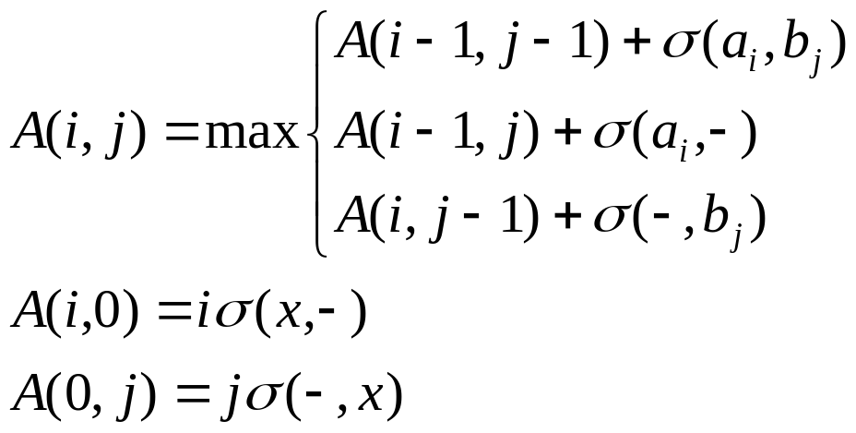

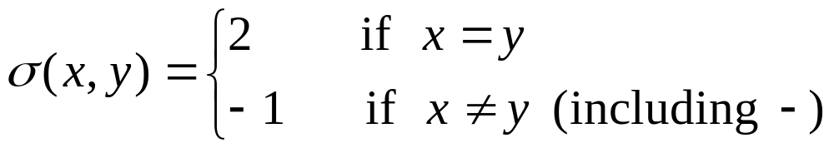
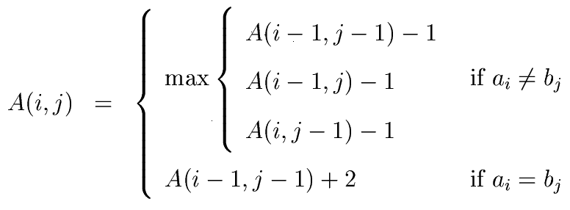
Gap Penalty
is the gap penalty.
Suppose

Slide 23
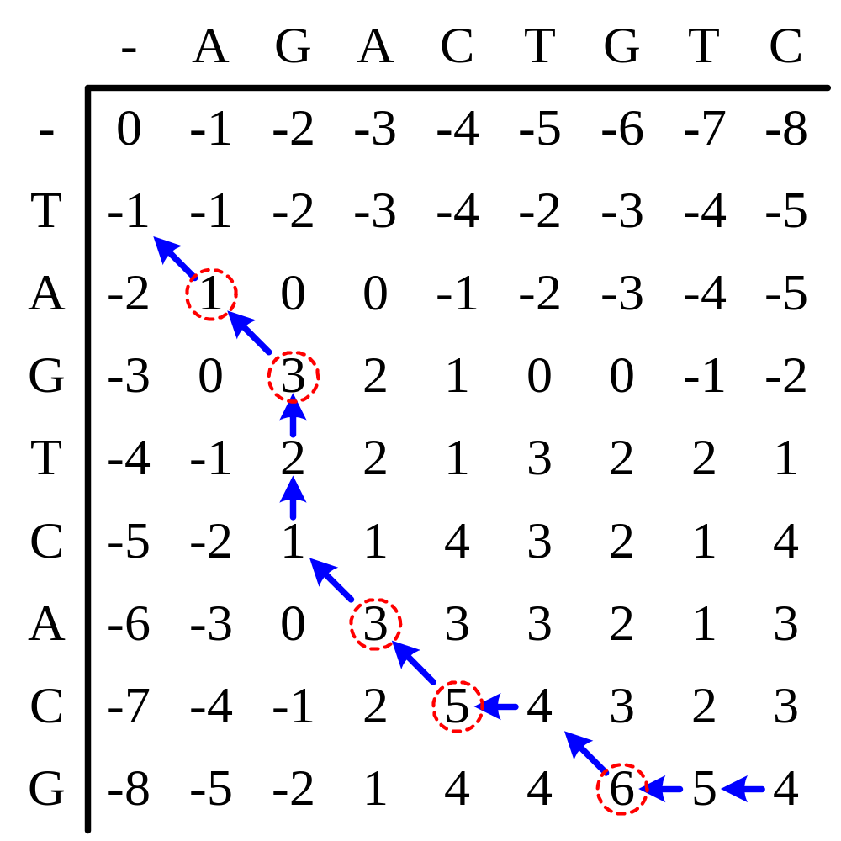
Example for Sequence Alignment
TAGTCAC-G--
-AG--ACTGTC

Slide 24
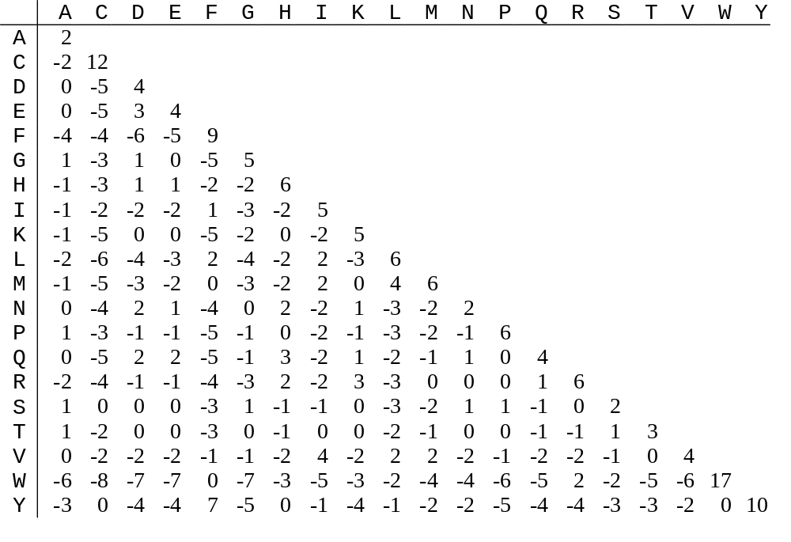
PAM250 Score Matrix

Slide 25
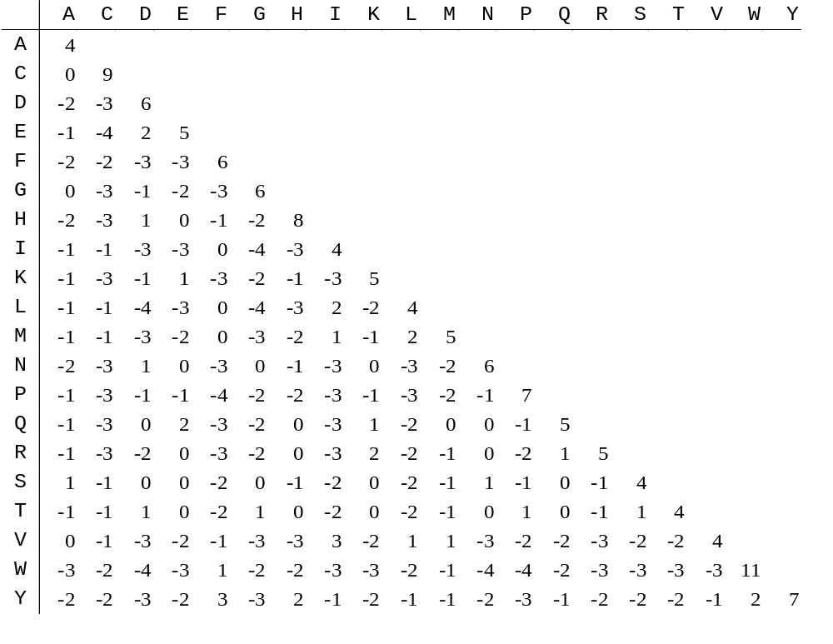
Blosum62 Score Matrix

Slide 26
The Local Alignment Problem
Input: Two (or more) sequences S₁, S₂, …, S_{n}, and a scoring function f.
Output: Substrings S_{i}’of S_{i} such that the score obtained by aligning S_{i}’ is the highest, among all possible substrings of S_{i}. (1≤ i ≤ n)
S₁= abbbcc
S₂= adddcc
Score=3×2+3×(–1)=3
S₁’= cc
S₂’= cc
Score=2×2=4

Slide 27
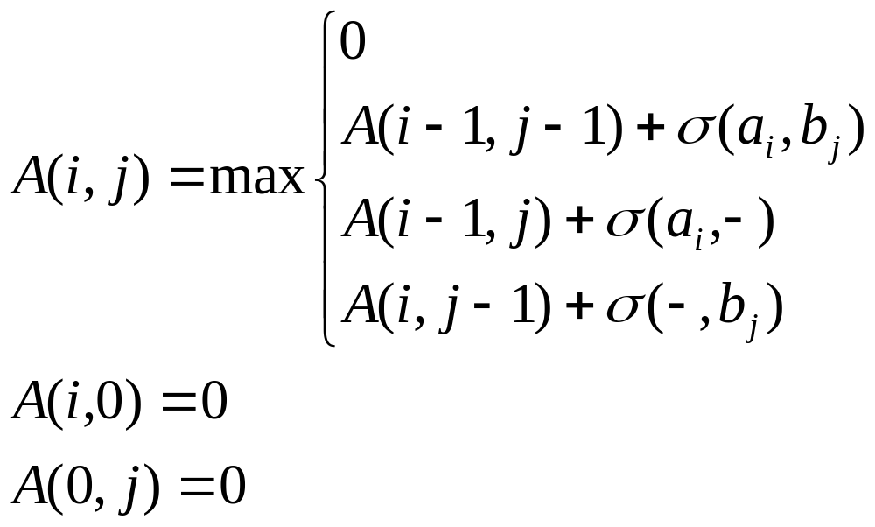
Dynamic Programming for Local Alignment
Once the score becomes negative, we reset it to 0.

Slide 28
Example for Local Alignment
-
A
G
A
C
T
G
T
C
-
0
0
0
0
0
0
0
0
0
T
0
0
0
0
0
2
1
2
1
A
0
2
1
2
1
1
1
1
1
Two solutions:
G
0
1
4
3
2
1
3
2
1
TAGTC
T-GTC
T
0
0
3
3
2
4
3
5
4
C
0
0
2
2
5
4
3
4
7
A
0
2
1
4
4
4
3
3
6
AGTCAC-G
AG--ACTG
C
0
1
1
3
6
5
4
3
5
G
0
0
3
2
5
5
7
6
5

Slide 29
The Affine Gap Penalty
S₁=ACTTGATCC
S₂=AGTTAGTAGTCC
An optimal alignment:
  S₁=ACTT-G-A-TCC
  S₂=AGTTAGTAGTCC
  Original score=12
The following alignment may be better because there is only one gap.
S₁=ACTT---GATCC
S₂=AGTTAGTAGTCC
Original score=6

Slide 30
Definition of Affine Gap Penalty
A gap is caused by a mutational event which removes a sequence of residues..
A long gap is often more preferable than several gaps.
An affine gap penalty is defined as P_{g}+kP_{e} for a gap with k, k≥1, spaces where P_{g}, P_{e} ≥ 0.
P_{g} is related to the initiation of a gap and P_{e} is related to the length of the gap.

Slide 31
Suppose that P_{g}=4 and P_{e}=1.
S₁=ACTTGATCC
S₂=AGTTAGTAGTCC
S₁=ACTT-G-A-TCC
S₂ =AGTTAGTAGTCC
Score=8×2 – 1×1 – 3×(4+1×1)=0
S₁=ACTT---GATCC
S₂=AGTTAGTAGTCC
Score=6×2 – 3×1 – (4+3×1)=2

Slide 32
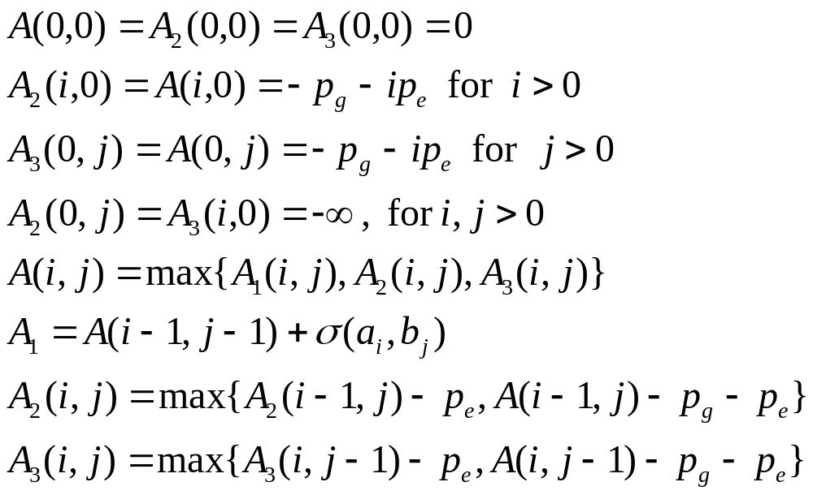
Algorithm for Affine Gap Penalty
A(i,j) is for the optimal alignment of a₁ a₂ … a_{i} and b₁ b₂ … b_{j}.
A₁(i,j) is for that a_{i} is aligned b_{j}.
A₂(i,j) is for that a_{i} is aligned -.
A₃(i,j) is for that - is aligned b_{j}.

Slide 33
Multiple Sequence Alignment (MSA)
Suppose three sequence are involved:
S₁ = ATTCGAT
S₂ = TTGAG
S₃ = ATGCT
A very good alignment:
S₁ = ATTCGAT
S₂ = -TT-GAG
S₃ = AT--GCT
In fact, the above alignment between every pair of sequences is also good.

Slide 34
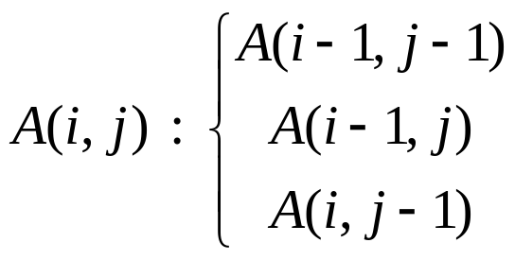
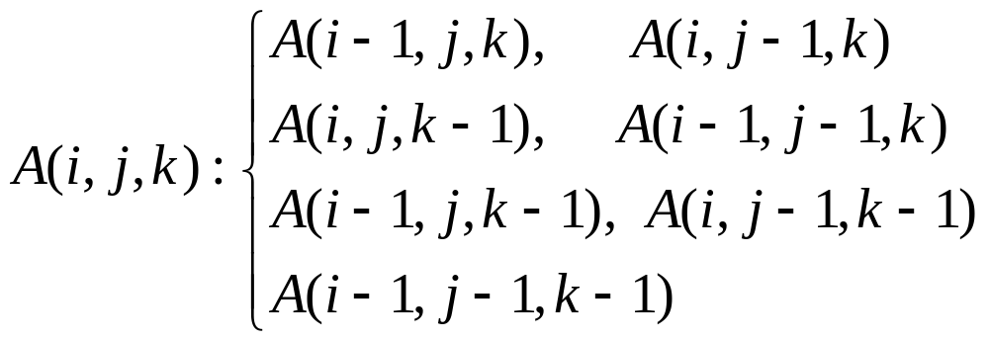
Complexity of MSA
2-sequence alignment problem:
  Time complexity: O(n²)
3-sequence alignment problem:
  σ(x,y,z) has to be defined.
  Time complexity: O(n³)
k-sequence alignment problem: O(n^{k})

Slide 35
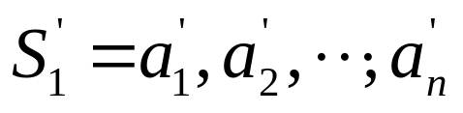
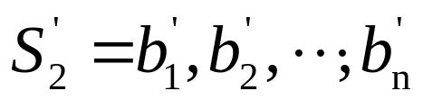
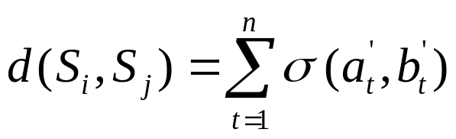
The Star Algorithm for MSA
Proposed by Gusfield
An approximation algorithm for the sum of pairs multiple sequence alignment problem
Let σ (x,y)=0 if x=y and σ (x,y)=1 if x≠y.
S₁ = GCCAT S₁ = GCCAT
S₂ = G--AT S₂ = GA--T
distance=2 distance=3
The distance induced by the alignment is define as

Slide 36
Distance
Properties of d(S_{i},S_{j}):
  d(S_{i},S_{i}) = 0
  Triangular inequality
d(S_{i},S_{j})+d(S_{i},S_{k}) ≥ d(S_{j},S_{k})
Given two sequences S_{i} and S_{j}, the minimum distance is denoted as D(S_{i},S_{j}).
D(S_{i},S_{j}) ≤ d(S_{i},S_{j})
i
k
j

Slide 37
Example for the Star Algorithm
S₁ = ATGCTC
S₂ = AGAGC
S₃ = TTCTG
S₄ = ATTGCATGC
Try to align every pair of sequences:
S₁= ATGCTC
S₂= A-GAGC
D(S₁,S₂) = 3
S₁= ATGCTC
S₃= TT-CTG
D(S₁,S₃) = 3

Slide 38
S₁= AT-GC-T-C
S₄= ATTGCATGC
D(S₁,S₄) = 3
S₂= AGAGC
S₃= TTCTG
D(S₂,S₃) = 5
S₂= A--G-A-GC
S₄= ATTGCATGC
D(S₂,S₄) = 4
S₃= -TT-C-TG-
S₄= ATTGCATGC
D(S₃,S₄) = 4

Slide 39
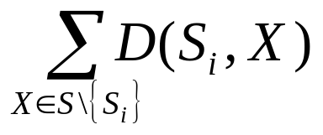
D(S₁,S₂)+D(S₁,S₃)+D(S₁,S₄) = 9
D(S₂,S₁)+D(S₂,S₃)+D(S₂,S₄) = 12
D(S₃,S₁)+D(S₃,S₂)+D(S₃,S₄) = 12
D(S₄,S₁)+D(S₄,S₂)+D(S₄,S₃) = 11
S₁ is selected as the center since S₁ is the most similar to others.
Given a set S of k sequences, the center of this set of sequences is the sequence which minimizes

Slide 40
S₁ has been selected as the center. Align S₂ with S₁:
S₁ = ATGCTC
S₂ = A-GAGC
Adding S₃ by aligning S₃ with S₁:
S₁ = ATGCTC
S₂ = A-GAGC
S₃ = -TTCTG
Adding S₄ by aligning S₄ with S₁:
S₁ = AT-GC-T-C
S₂ = A--GA-G-C
S₃ = -T-TC-T-G
S₄ = ATTGCATGC

Slide 41
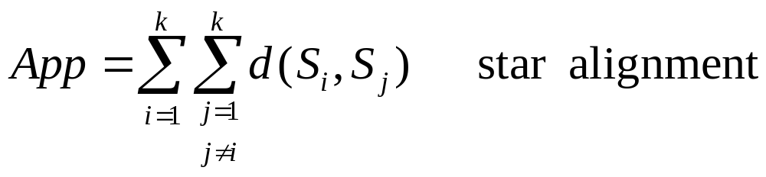
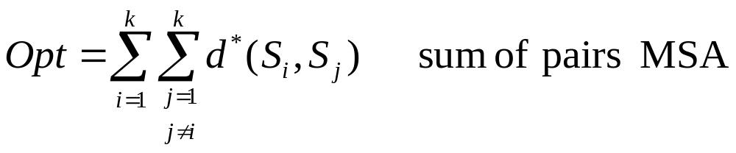
Approximation Rate
App ≤ 2Opt
(See the proof on the lecture note.)

Slide 42
The MST Preservation for MSA
In Gusfield’s star algorithm, the alignments between the center and all other sequences are optimal. Thus, (k–1) distances are preserved.
MST preservation is to preserves the distances on the edges in the minimal spanning tree.
D: distance matrix based upon optimal alignments between every pair of input sequences.
D_{m}: distance matrix based upon a multiple sequence alignment
MST(D): MST based on D
MST(D_{m}): MST based on D_{m}
Goal: MST(D)=MST(D_{m})

Slide 43
Example for MST Preservation
Input:
S₁ = ATGCTC
S₂ = ATGAGC
S₃ = TTCTG
S₄ = ATTGCATGC
Step1: Finds the pair wise distances optimally by the dynamic programming algorithm.
S₁ = ATGCTC
S₂ = ATGAGC
D(S₁,S₂) = 2
S₁= ATGCTC
S₃= TT-CTG
D(S₁,S₃) = 3

Slide 44
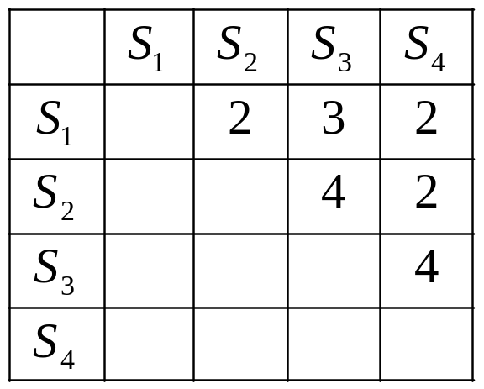
S₁= ATGC-T-C
S₄= ATGCATGC
D(S₁,S₄) = 2
S₂= ATGAGC
S₃= TTCTG-
D(S₂,S₃) = 4
S₂= ATG-A-GC
S₄= ATGCATGC
D(S₂,S₄) = 2
S₃= -TTC-TG-
S₄= ATGCATGC
D(S₃,S₄) = 4
Distance matrix D

Slide 45
Step 2: Find the minimal spanning tree based on matrix D.
S₁
2
3
S₂
S₃
2
S₄

Slide 46
Step 3: Align the pair of sequences optimally corresponding to the edges on the MST.
  For e(S_{1,} S₂) S₁ = ATGCTC
S₂ = ATGAGC
  For e(S_{2,} S₄) S₁ = ATG-C-TC
S₂ = ATG-A-GC
S₄= ATGCATGC
  For e(S_{1,} S₃) S₁ = ATG-C-TC
S₂ = ATG-A-GC
S₃ = TT--C-TG
S₄ = ATGCATGC
Step 4: Output the above as the final alignment.
S₁
2
3
S₂
S₃
2
S₄

Slide 47
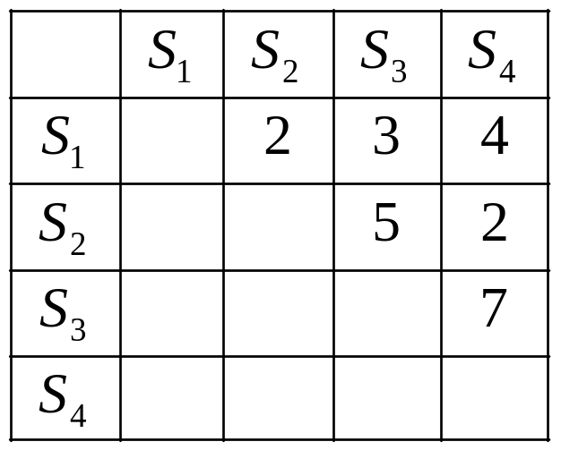
MST Preservation
Distance matrix D_{m} and the minimal spanning tree based on D_{m} :
Theorem: MST(D) is equal to MST(D_{m}).
S₁
2
3
S₂
S₃
2
S₄

