Slide 1
Chapter 5
The Evolution Trees

Slide 2
An Evolution Tree
siamang
gibbon
orangutan
gorilla
human
chimpanzee
(合趾猴)
(長臂猿)
(猩猩)
(大猩猩)
(人類)
(黑猩猩)

Slide 3
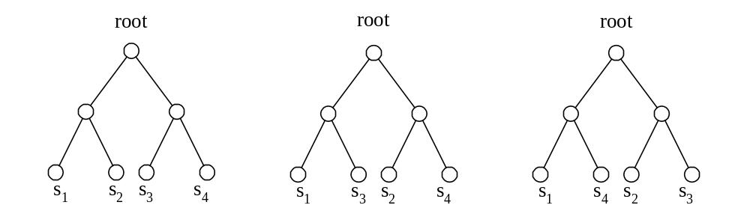
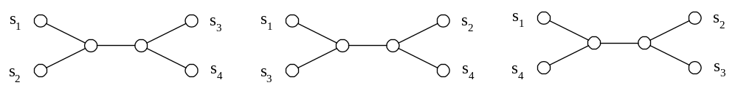
Tree Topology
Rooted trees
Unrooted trees

Slide 4
Properties of an Evolution Tree
Leaf nodes represent species.
In a rooted tree, the degree of each internal node is 3, except the root.
In an unrooted tree, the degree of each internal node is 3.
In a rooted tree, the distances from the root to all leaf nodes are the same.

Slide 5
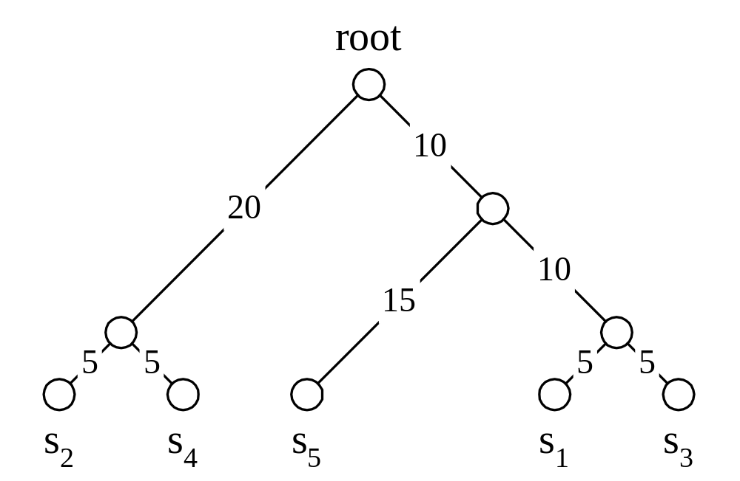
Distance Matrix and Rooted Tree
 | s₁ | s₂ | s₃ | s₄ | s₅
s₁ | 0 | 50 | 10 | 50 | 30
s₂ | 50 | 0 | 50 | 10 | 50
s₃ | 10 | 50 | 0 | 50 | 30
s₄ | 50 | 10 | 50 | 0 | 50
s₅ | 30 | 50 | 30 | 50 | 0

Slide 6
Distance
d(s_{i}, s_{j}): the distance between species s_{i} and s_{j} in the distance matrix
dt(s_{i}, s_{j}): the distance between species s_{i} and s_{j} in an evolution tree
d(s_{i}, s_{j}) ≤ dt(s_{i}, s_{j})
s₁ = agctccca s₁ = agctccca
s₂ = agccccca s'₁ = agcaccca
d(s₁, s₂) = 1 s₂ = agccccca
dt(s₁, s₂) = 2

Slide 7
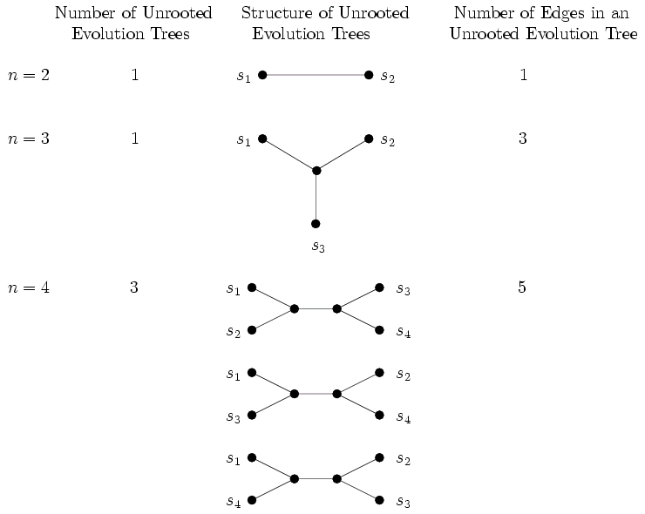

Slide 8
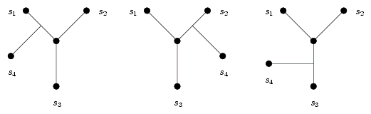
Number of Unrooted Trees
Number of edges in an unrooted evolution tree
NE(n) = 2n − 3
Number of unrooted evolution trees for n species
TU(n + 1) = (2n − 3) × TU(n)
TU(n) = (2n − 5) × (2n −7) × ⋅⋅⋅ × 1

Slide 9
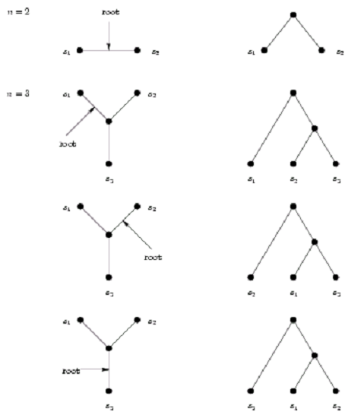
Number of Rooted Trees
TR(n) = (2n − 3) TU(n)
=(2n-3) (2n − 5) (2n −7) ⋅⋅⋅1
=TU(n+1)

Slide 10
Different Tree Specifications
Minimax evolution trees
  The maximum of (dt(s_{i}, s_{j}) − d(s_{i}, s_{j})) is minimized.
Minisum evolution trees
  The total sum of all pairs of distances among leaf nodes is minimized.
Minisize evolution trees
  The total length of the tree is minimized.

Slide 11
Complexities of Evolution Tree Problems
 | Minimax | Minisum | Minisize
Unrooted | NP-complete | NP-complete | Unknown
Rooted | O(n²) | NP-complete | NP-complete

Slide 12
The Rooted Minimax Evolution Tree Algorithm
Step 1: Find the longest distance in the distance matrix: d(s₂, s₄)
 | s₁ | s₂ | s₃ | s₄
s₁ | 0 | 2 | 3 | 3.1
s₂ |  | 0 | 3.6 | 5
s₃ |  |  | 0 | 1
s₄ |  |  |  | 0

Slide 13
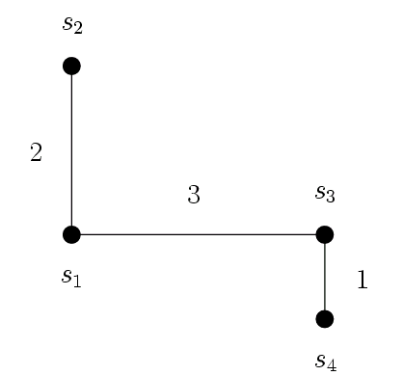
Step 2: Construct a minimal spanning tree.
 | s₁ | s₂ | s₃ | s₄
s₁ | 0 | 2 | 3 | 3.1
s₂ |  | 0 | 3.6 | 5
s₃ |  |  | 0 | 1
s₄ |  |  |  | 0

Slide 14
Step 3: Break the longest edge in the path connecting s₂ and s₄.

Slide 15
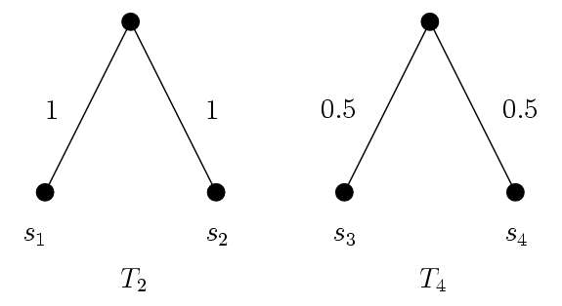
Step 4: Construct rooted subtrees recursively.
 | s₁ | s₂ | s₃ | s₄
s₁ | 0 | 2 | 3 | 3.1
s₂ |  | 0 | 3.6 | 5
s₃ |  |  | 0 | 1
s₄ |  |  |  | 0

Slide 16
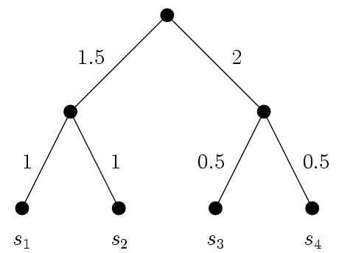
Step 5: Combine the two subtrees. The distance of each leaf to the root is d(s₂, s₄)/2. That is,
dt(s₂, s₄) = d(s₂, s₄)
 | s₁ | s₂ | s₃ | s₄
s₁ | 0 | 2 | 3 | 3.1
s₂ |  | 0 | 3.6 | 5
s₃ |  |  | 0 | 1
s₄ |  |  |  | 0

Slide 17
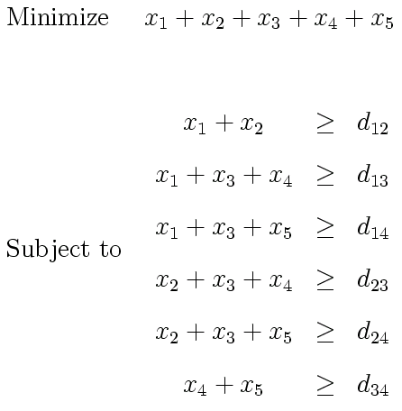
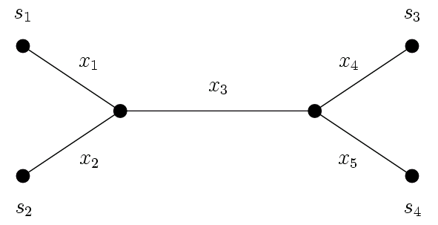
Weights Determination for a Tree with a Given Topology
Suppose we want to construct a minisize unrooted evolution tree.
Suppose the following is the best tree topology.
We can determine the weights with the linear programming approach.

Slide 18
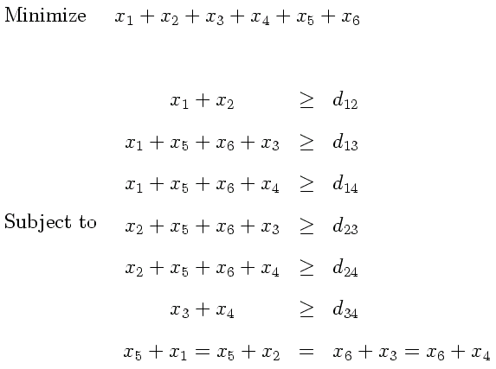
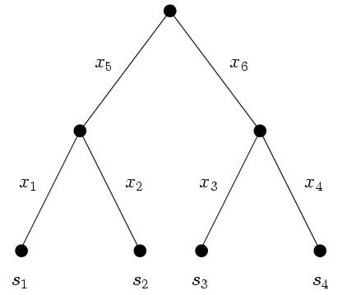
Suppose we want to construct a minisize rooted evolution tree.
Suppose the following is the best tree topology.

Slide 19
UPGMA for Rooted Evolution Trees
Unweighted pair group method with arithmetic mean
Finding a rooted evolution tree topology for a given distance matrix
Greedy and heuristic method

Slide 20
UPGMA
Step 1: Select the pair of species with the smallest distance: (s₃, s₄)
 | s₁ | s₂ | s₃ | s₄
s₁ | 0 | 4 | 4 | 3
s₂ |  | 0 | 6 | 5
s₃ |  |  | 0 | 2
s₄ |  |  |  | 0

Slide 21
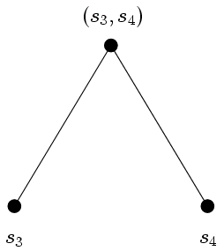
Step 2: Consider (s₃, s₄) as a new species.
d(s₁, (s₃, s₄)) = (d(s₁, s₃) + d(s₁, s₄))/2 = (4+3)/2 = 3.5
d(s₂, (s₃, s₄)) = (d(s₂, s₃) + d(s₂, s₄))/2 = (6+5)/2 = 5.5
d(s₁, s₂) = 4
 | s₁ | s₂ | (s_{3,} s₄)
s₁ | 0 | 4 | 3.5
s₂ |  | 0 | 5.5
(s₃, s₄) |  |  | 0

Slide 22
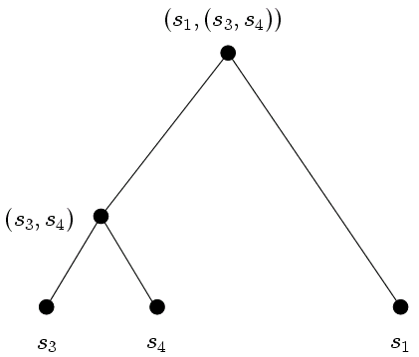
(Repeat Steps 1 and 2) Select the pair of species with the smallest distance: (s₁, (s₃, s₄))
 | s₁ | s₂ | (s_{3,} s₄)
s₁ | 0 | 4 | 3.5
s₂ |  | 0 | 5.5
(s₃, s₄) |  |  | 0

Slide 23
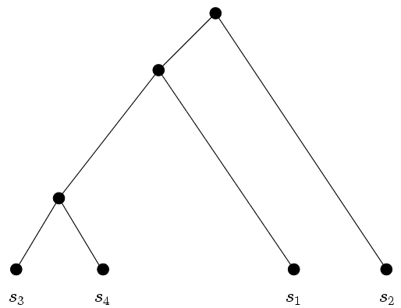
Obtain the final evolution tree.
Then use linear programming technique to produce an evolution tree for a given criteria.

Slide 24
The Neighbor Joining Method for Unrooted Evolution Trees
Finding an unrooted evolution tree topology for a given distance matrix.
Greedy and heuristic method

Slide 25
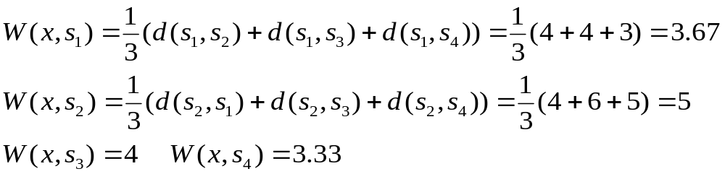
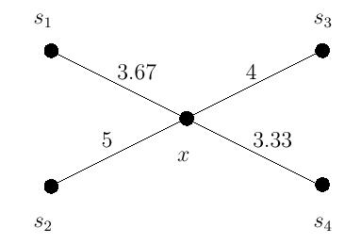
Neighbor Joining Method
Step 1: Construct a 1-star: Create an internal node x.
 | s₁ | s₂ | s₃ | s₄
s₁ | 0 | 4 | 4 | 3
s₂ | 4 | 0 | 6 | 5
s₃ | 4 | 6 | 0 | 2
s₄ | 3 | 5 | 2 | 0

Slide 26
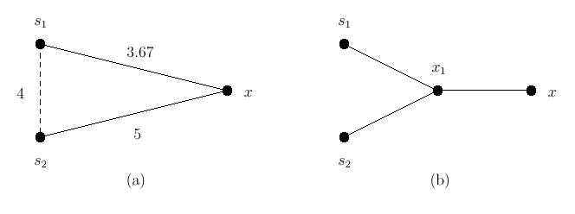
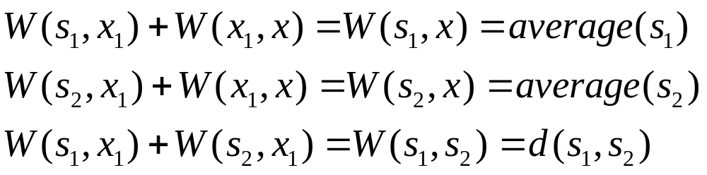
Step 2: Find a good pair for putting in the same branch.
Step 2.1: Try to select a pair of species (S₁, S₂), insert an internal node x₁.
Step 2.2: Formulate the following equations:

Slide 27
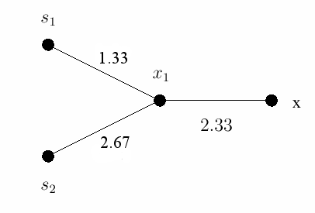
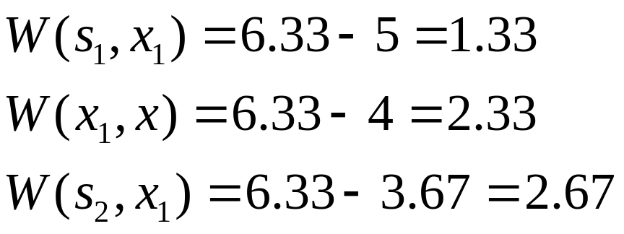
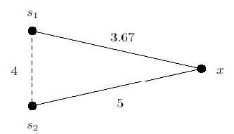
Step 2.3 Calculate the new connection cost NC.
Step 2.4: Calculate the weights of the edges.

Slide 28
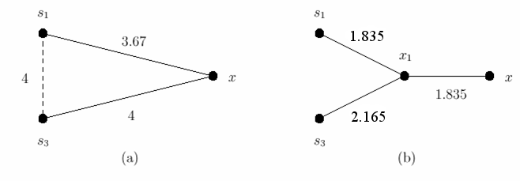
(Repeat Step 2.1) Try to select another pair of species (S₁, S₃), insert an internal node x₁.
(Repeat Steps 2.2 through 2.4) Recalculate the weights of the edges.

Slide 29
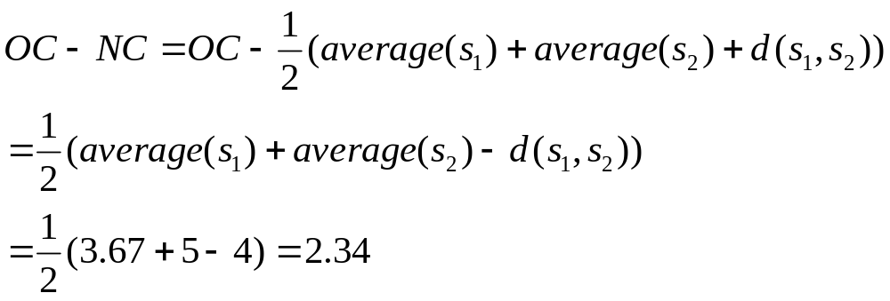
Step 2.5: Calculate the saved cost of each pair.
  The cost saved by pairing s₁ with s₂:
    Old cost OC= average(S₁)+average(S₂)=5+3.67=8.67
    Cost saved
  The cost saved by (s₁, s₃ )=1.835
  (s₁, s₄ )=2 (s₂, s₃ )=1.5 (s₂, s₄ )=1.67 (s₃, s₄ )=2.67
Step 2.6: Pair (s₃, s₄ ) has the maximum cost saving.

Slide 30
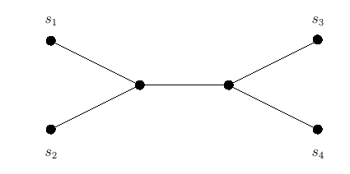
Step 3: Put S₃ and S₄ in the same branch, insert an internal node.
Repeat Steps 3 and 4 until the degree of x is 3.
The final tree structure:
After the tree topology has been found, we can apply linear programming to find the final distance of each edge.

Slide 31
An Approximation Algorithm for an Unrooted Minisize Evolution Tree
Find an unrooted evolution tree for a given distance matrix.
This algorithm is based upon the minimal spanning tree.
The approximate solution is never larger than twice of the size of an optimal solution.

Slide 32
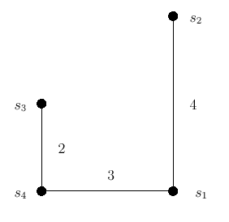
Step 1: Construct a minimal spanning tree.
Step 2: Find a BFS (breadth first search) order (with any node as the root):
s₄, s₃, s₁, s₂
(See the example for BFS on the next page.)
 | s₁ | s₂ | s₃ | s₄
s₁ | 0 | 4 | 4 | 3
s₂ |  | 0 | 6 | 5
s₃ |  |  | 0 | 2
s₄ |  |  |  | 0

Slide 33
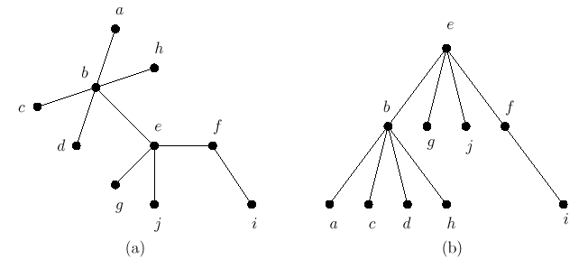
Breadth First Search
BFS order with e as the root：e, b, g, j, f, a, c, d, h, i

Slide 34
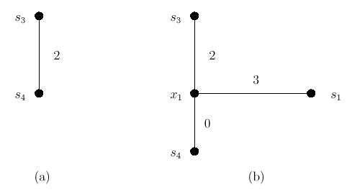
Approximation Algorithm (Cont.)
Step 3: Add nodes one by one with the BFS order.
  s₄, s₃, s₁, s₂ s₄, s₃, s₁, s₂

Slide 35
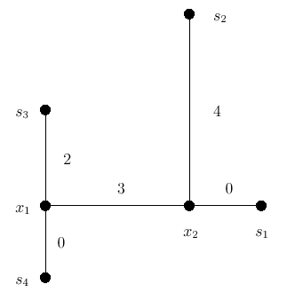
An unrooted evolution tree transformed from the minimal spanning tree.
  s₄, s₃, s₁, s₂

Slide 36
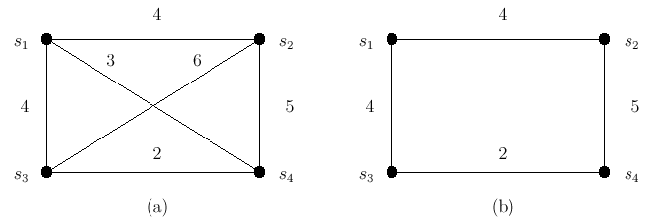
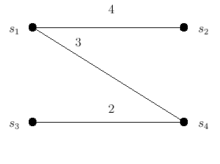
Proof of Approximate Rate
The total length of this unrooted evolution tree is less than or equal to twice of the length of an optimal unrooted minisize evolution tree. (Approximate rate=2.)
|MST|<|TSP|
APP= |MST|<|TSP|

Slide 37
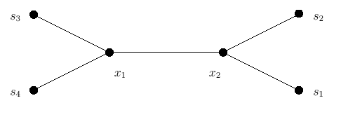
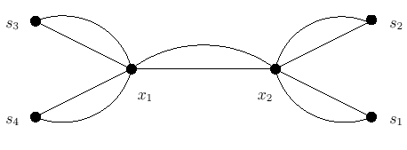
Original evolution tree
Duplicate every edge in the tree, then there exists an Euler cycle.
Euler cycle
|ET|=Total cost of Euler cycle
|ET|=2|OPT|
|TSP| ≤ |ET|=2|OPT|
APP= |MST|<|TSP|
APP<2|OPT|

