Slide 1
Chapter 6
The Secondary Structure
Prediction of RNA

Slide 2
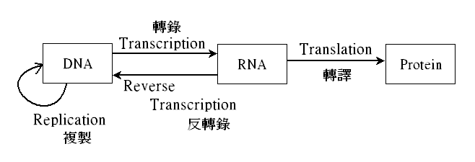
From DNA to RNA to Protein

Slide 3
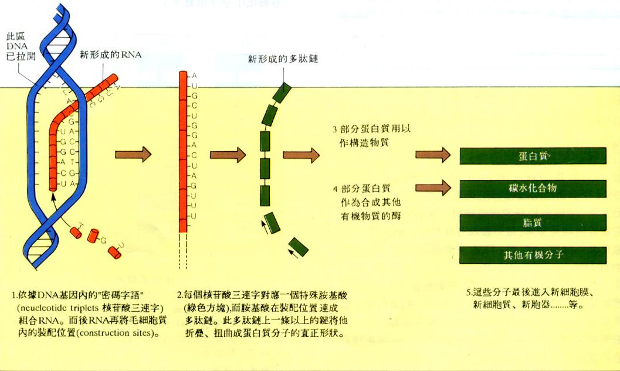
From DNA to RNA to Protein

Slide 4
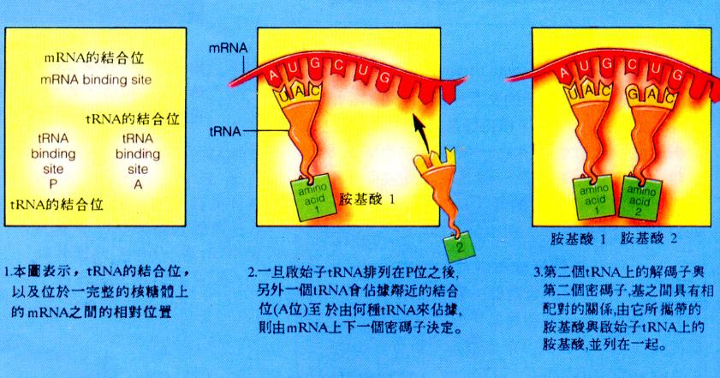
From RNA to Protein

Slide 5
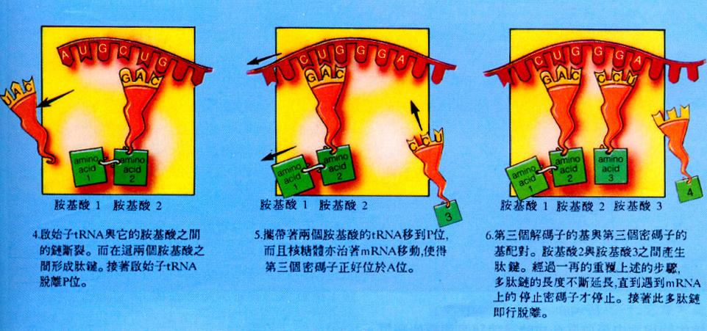
From RNA to Protein

Slide 6
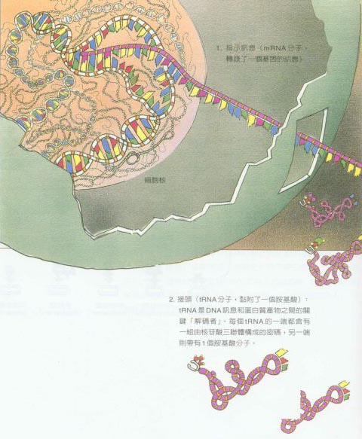
Translation From RNA to Protein

Slide 7
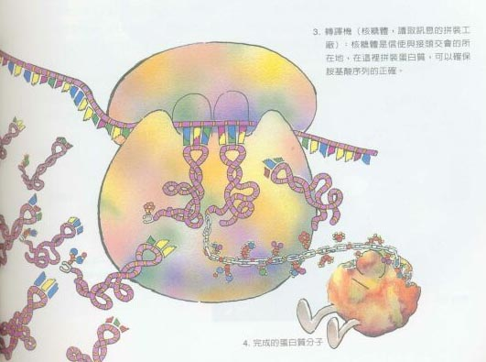

Slide 8
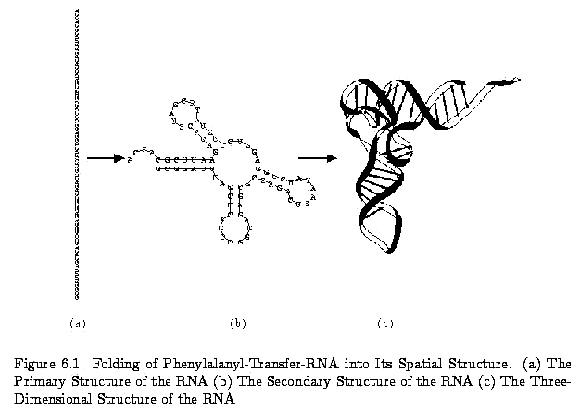
The Structure of RNA

Slide 9
Secondary Structure of RNA
Primary structure of an RNA sequence:
  Consist of {A, G, C, U}.
  Example: AGGCCUUCCU
We may predict its 3-dimensional structure according to its 2-dimensional structure.
According to the thermodynamic hypothesis, the actual secondary structure of an RNA sequence is the one with minimum free energy.

Slide 10
The Base Pairs of RNA
RNA: {A, G, C, U}
Base pairs:
  G≡C, A=U (Watson-Crick base pair)
  G−U (Wobble base pair)
The base pairs will increase the structural stability, but the unpaired bases will decrease the structural stability.
The base pairs of types G≡C and A=U is more stable than that of the type G−U.
Problem: Given an RNA sequence, determine its secondary structure with the minimum free energy.

Slide 11
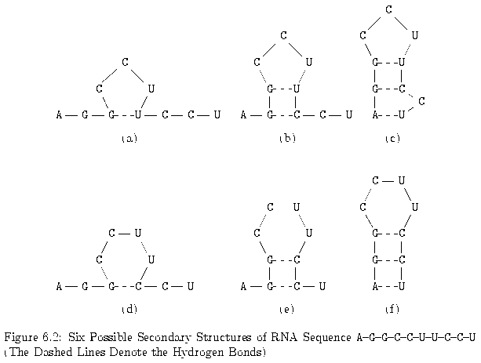
Secondary Structure of RNA

Slide 12
The Conditions of Base Pairs
An RNA sequence R=r₁r₂r₃…r_{n}
Secondary structure of R is a set S of base pairs (r_{i}, r_{j}), where 1 ≤ i < j ≤ n, :
  j– i > t, where t is a small positive constant. Typically, t = 3.
  If (r_{i}, r_{j}) and (r_{k}, r_{l}) are two base pairs in S and i ≤ k, then either
    i = k and j = l, i.e..(r_{i}, r_{j}) and (r_{k}, r_{l}) are the same base pair,
    i < j < k < l, i.e., (r_{i}, r_{j}) precedes (r_{k}, r_{l}),
    i < k < l < j, i.e., (r_{i}, r_{j}) includes (r_{k}, r_{l}).

Slide 13
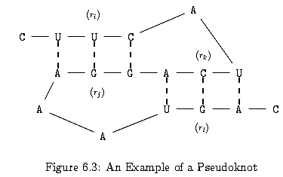
Pseudoknots
Two base pairs (r_{i},r_{j}) and (r_{k},r_{l}) are called a pseudoknot if i < k < j < l.

Slide 14
The RNA Maximum Base Pair Matching Problem
Originally, for predicting the secondary structure with minimum free energy, we may assign G≡C, A=U, G−U to –3, -2, -1.
Here, the problem becomes to find the secondary structure with maximum number of base pairs. This problem is called RNA maximum base pair matching problem.

Slide 15

Notations
M _{i,j}: Maximum # of base pairs on R _{i,j}=r_{i}r_{i+1}r_{i+2}…r_{j}
WW = {(A, U), (U, A),(G, C),(C, G),(G, U),(U, G)}.
ρ(r_{i},r_{j}): to indicate whether r_{i} and r_{j} can be a legal base pair:
1 if (r_{i},r_{j}) ∈ WW
ρ(r_{i},r_{j}) =
0 otherwise
M_{i,j} = 0 if j – i ≤ 3, since RNA sequence does not fold too sharply on itself.

Slide 16
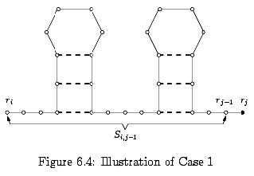
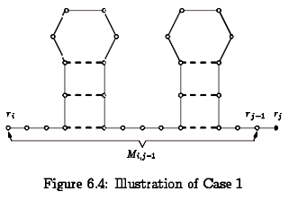
Case 1 of Matching
Case 1: r_{j} is not paired with any other base.
M_{i,j} = M_{i,j-1}.

Slide 17
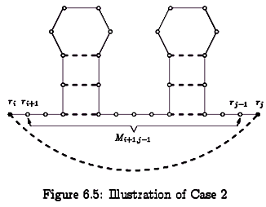
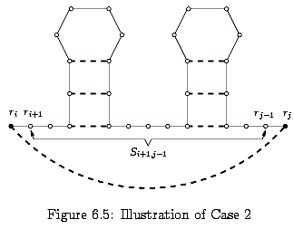
Case 2 of Matching
Case 2: r_{j} is paired with r_{i} and ρ(r_{i},r_{j}) = 1.
M_{i,j}=1+ M_{i+1,j-1}

Slide 18
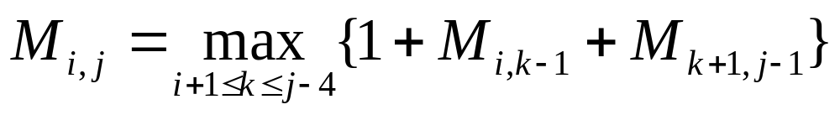
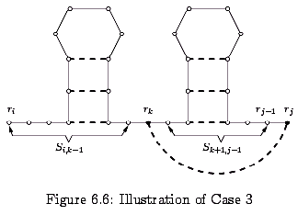
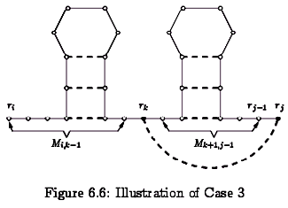
Case 3 of Matching
Case 3: r_{j} is paired with some r_{k}, where i+1 ≤ k ≤ j-4 and ρ(r_{k},r_{j}) = 1

Slide 19
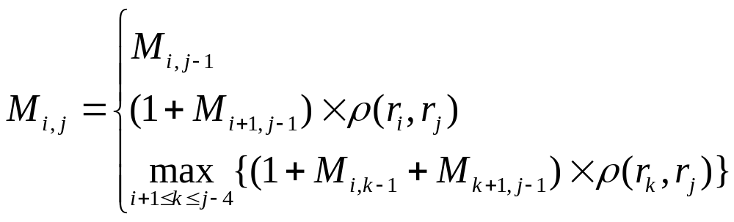
Summary of the Algorithm
If j – i ≤ 3, then M_{i,j} = 0.
If j – i > 3, then
Time complexity: O(n³)

Slide 20
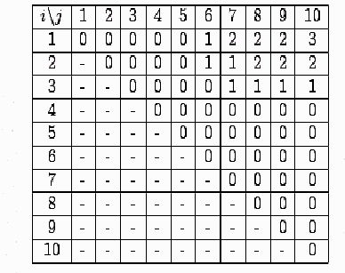
Example for the Algorithm
R _{1,10}= AGGCCUUCCU
We get M_{1,10}=3.

Slide 21
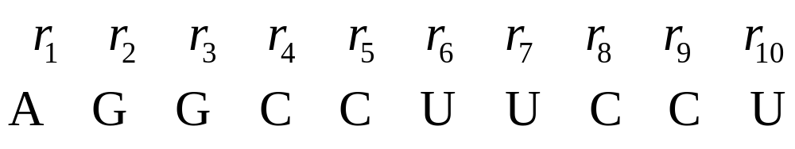
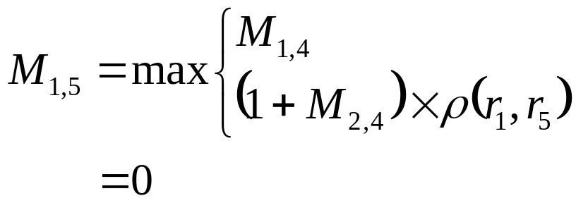
Detailed Steps in the Example
(1) i = 1, j = 5, ρ(r₁, r₅) =ρ(A, C) = 0

Slide 22
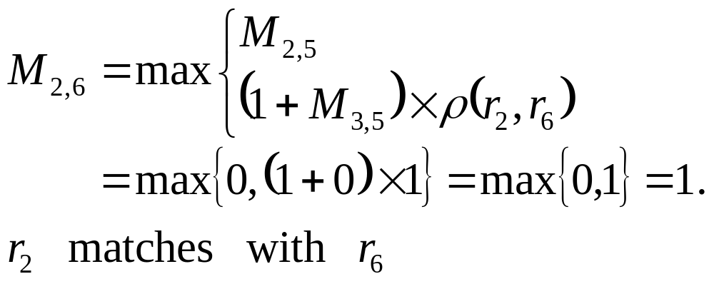
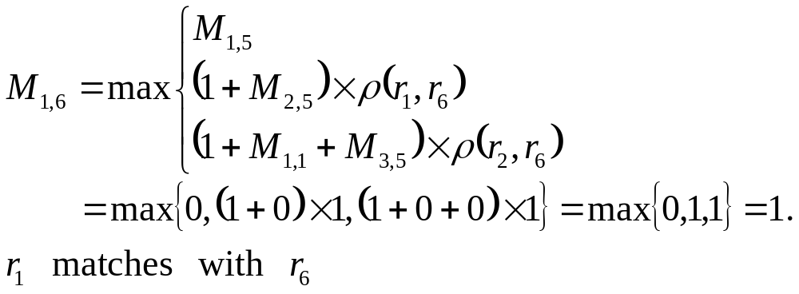
(2) i = 2, j = 6, ρ(r₂, r₆) = ρ(G, U) = 1
(3) i = 3, j = 7, …., i = 6, j = 10
(4) i = 1, j = 6, ρ(r₁, r₆) = ρ(A, U) = 1
(5) i = 2, j = 7, i = 3, j = 8, i = 4, j = 9, i = 5, j = 10

Slide 23
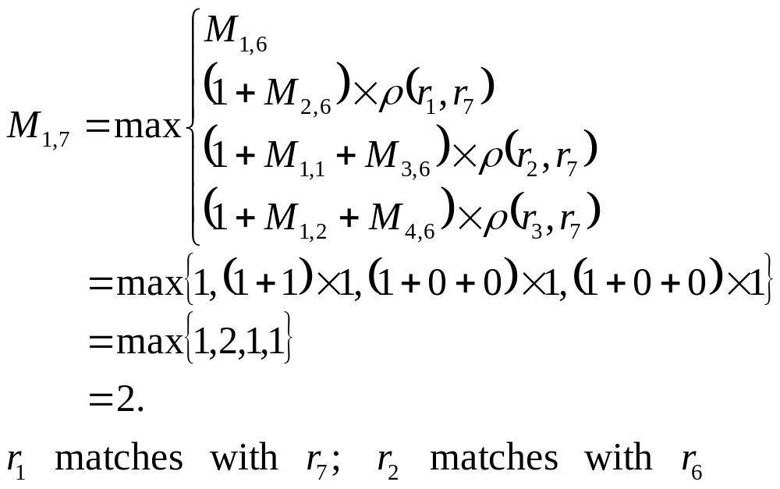
(6) i = 1, j = 7, ρ(r₁, r₇) = ρ(A, U) = 0
(7) i = 2, j = 8, i = 3, j = 9, i = 4, j = 10
(8) i = 1, j = 8, i = 2, j = 9, i = 3, j = 10
(9) i = 1, j = 9, i = 2, j = 10

Slide 24
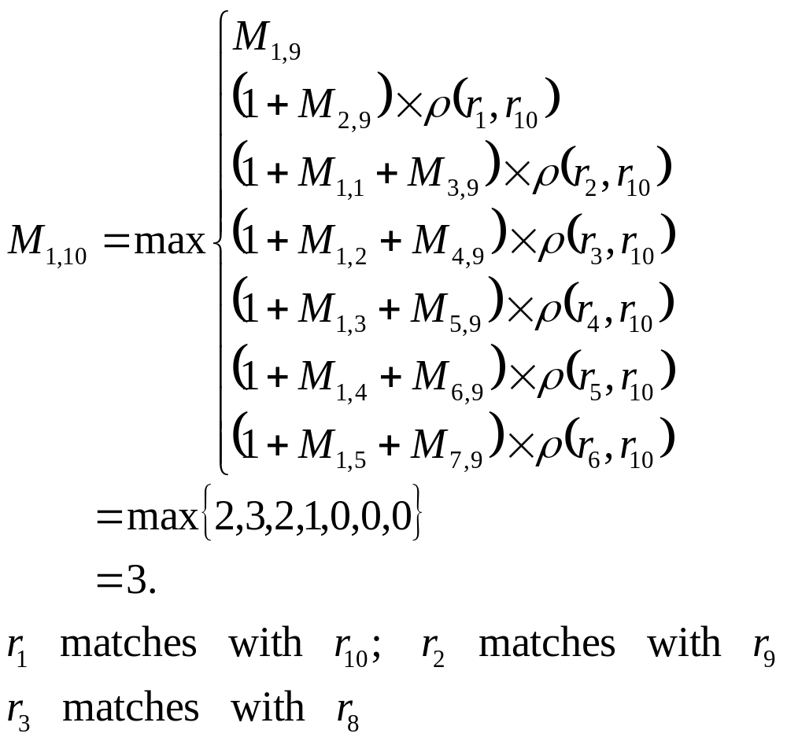
(10) i = 1, j = 10

