Slide 1
Chapter 7
Genome Rearrangement

Slide 2
Background
In the late 1980‘s Jeffrey Palmer and colleagues discovered a remarkable and novel pattern of evolutionary change in plant organelles. They mapped the mitochondrial genomes of Brassica oleracea (cabbage，高麗菜) and Brassica campestris (turnip，大頭菜), which are very closely related (many genes are 99% ~ 99.9% identical), differ dramatically in gene order.

Slide 3
Genome Rearrangement
Input: Two genomes which contains the same set of genes, but the order of genes is different.
Goal: Find the shortest sequence of rearrange operations transforming one genome to another.
Since we are interested in the order of genes, we label each gene a unique number, 1, 2, 3, …, n.
We may view the problem as a sorting problem, with some special operations (such as transposition and reversal).

Slide 4
Terminologies
G=“1 -5 4 -3 2”
-g: the reverse of gene g
  Example: gene 5=“GCTGA”, -5=“AGTCG”
Transposition: swap two adjacent substrings of any length without changing the order of the two substrings
  3 1 5 2 4 →3 2 4 1 5
Reversal: invert the order of a substring of any length
  1 -5 4 -3 2 → 1 3 -4 5 2

Slide 5
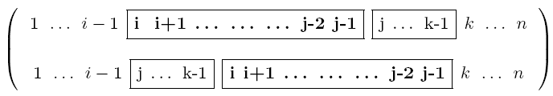
Terminologies
Transposition:ρ(i, j, k)
e.g. π ={4 5 1 6 3 2}, π · ρ(1,3,6)={1 6 3 4 5 2}
Unsigned reversal:
  3 1 5 2 4 → 3 2 5 1 4.
Signed reversal:
  3 1 5 2 4 → 3 -2 -5 -1 4.

Slide 6
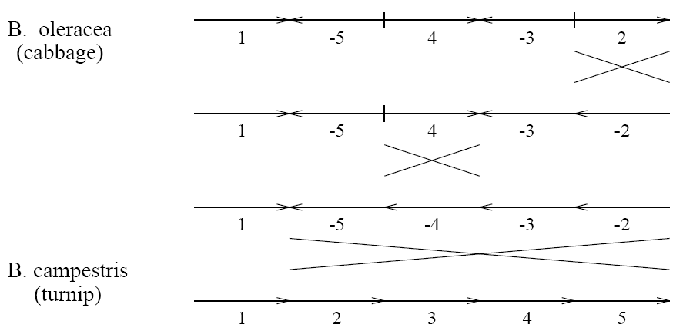
Sorting by Reversal

Slide 7
Sorting by Transposition
Input: A permutation π=π₁π₂... π_{n} of 1, 2, ..., n, with π₀= 0, π_{n+1}= n+1.
Goal: Sort π by the minimum number of transpositions.
Example:
0 1 4 5 3 2 6
0 1 3 2 4 5 6
0 1 2 3 4 5 6.

Slide 8
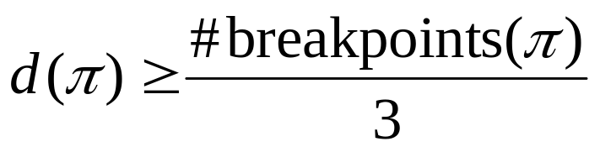
Break Points
For all 0≤ i ≤ n in a permutation, there is a breakpoint between π_{i} and π_{i+1} if
π_{i} +1≠π_{i+1} .
π= {0 3 5 6 7 2 1 4 8 9} has 6 breakpoints 0 • 3 • 5 6 7 • 2 • 1 • 4 • 8 9
We can eliminate at most three breakpoints in a single transposition.
  Example: 0 1 • 4 • 2 3 • 5 6→0 1 2 3 4 5 6
A trivial lower bound

Slide 9
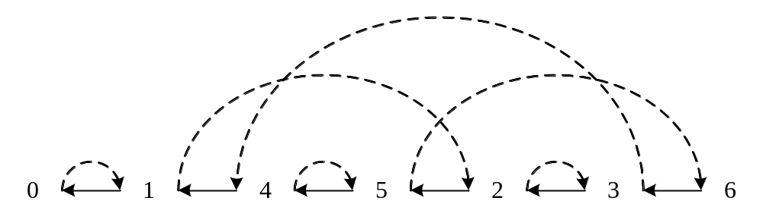
Lower Bound and Cycle Graph
gray edge: from i-1 to i
black edge:from π_{i} to π_{i-1}
There are 4 alternating cycles (each pair of adjacent edges are of different colors) .
Notation: c(G)= 4

Slide 10
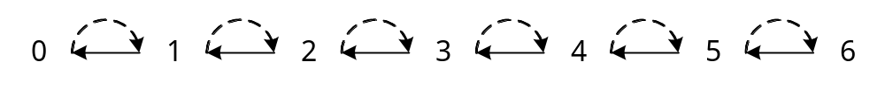
Cycle Graph of Identity Permutation
The cycle graph of identity permutation {012…(n+1)} can be decomposed into n+1 cycles.
The purpose of sorting π is increasing the number of cycles from c(π) to n+1.

Slide 11
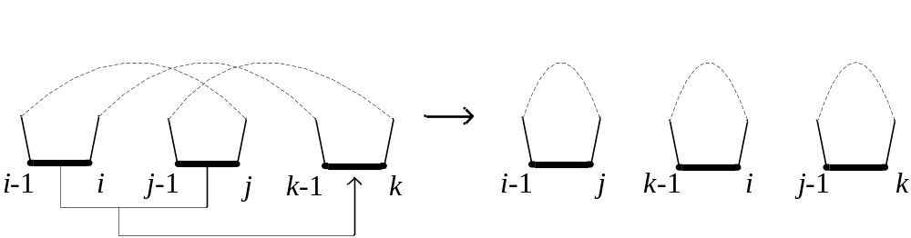
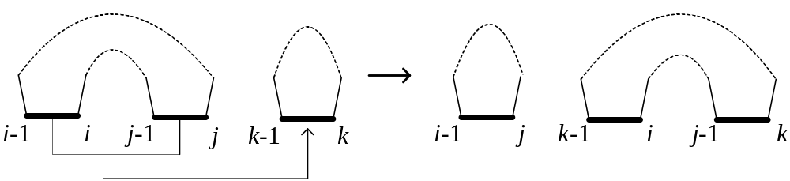
c(G) Change in Transposition (1)
Δc(G)=2
Δc(G)=0

Slide 12
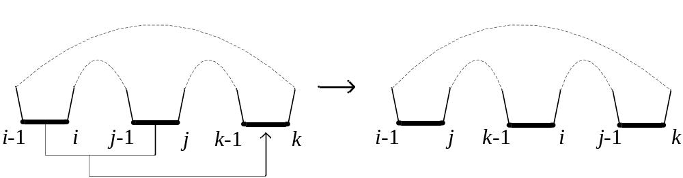
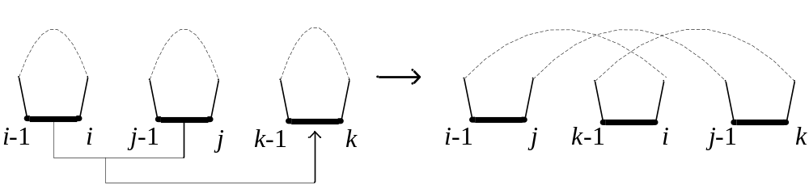
c(G) Change in Transposition (2)
Δc(G)=0
Δc(G)=-2
Δc(G)∈{-2, 0, 2}
x-move: Δc(G)= x after a transposition

Slide 13
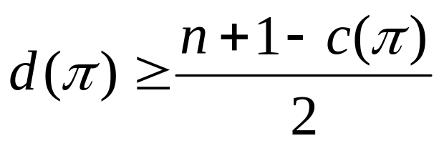
Lower Bound of Transposition Distance
Identity permutation has n+1 cycles. Each transposition increases # of cycles by at most two.
lower bound of transposition distance:

Slide 14
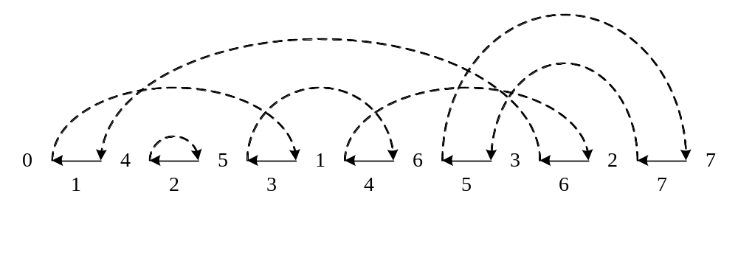
2-approximation Algorithm and Cycles
A cycle can be represented by (i₁, i₂, ..., i_{k}) according to the visiting black edges from i₁ to i_{k}, where i₁ is the rightmost black edge in the cycle.
Cycles: (6,1,3,4), (7,5) and (2)
Non-oriented cycle: (7,5): decreasing sequence
Oriented cycle: (6,1,3,4)

Slide 15
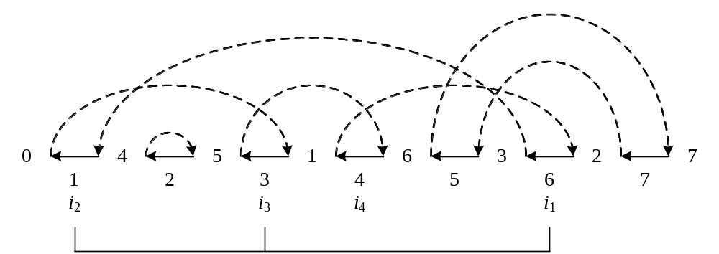
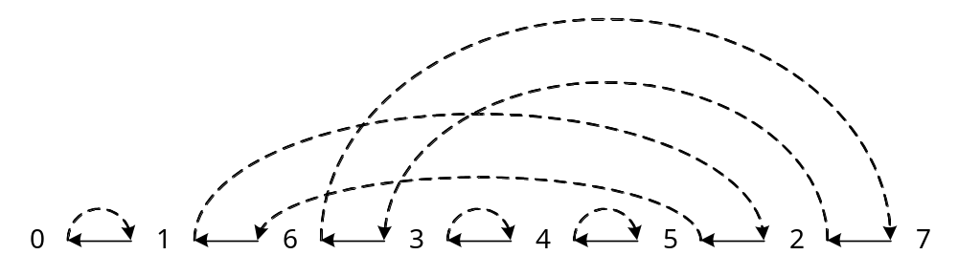
2-move on an Oriented Cycle
C = (i₁, ..., i_{k}): an oriented cycle , 3 ≤ t ≤ k, i_{t} > i_{t-1}
ρ(i_{t-1}, i_{t}, i₁) is a 2-move transposition.
After ρ(1,3,6):
Δc(G)=2

Slide 16
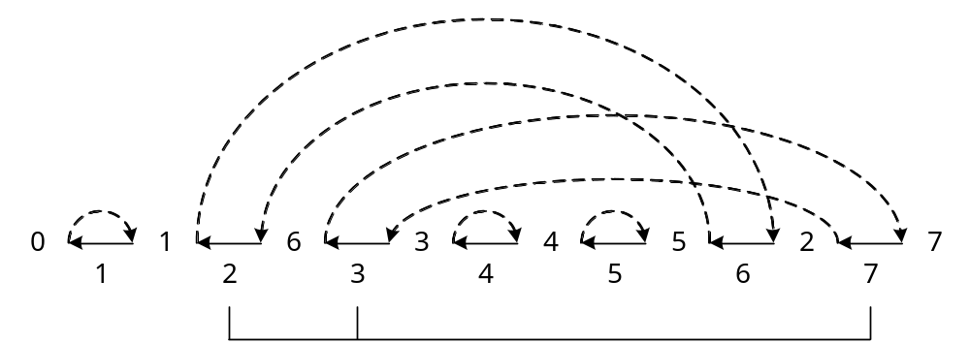
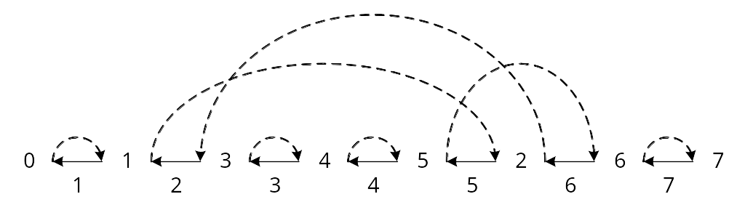
0-move in a Non-oriented Cycle
We can not perform 2-moves on a non-oriented cycle.
A non-oriented cycle can be transformed into an oriented cycle with a special 0-move transposition.
After ρ(2,3,7):
Δc(G) = 0

Slide 17
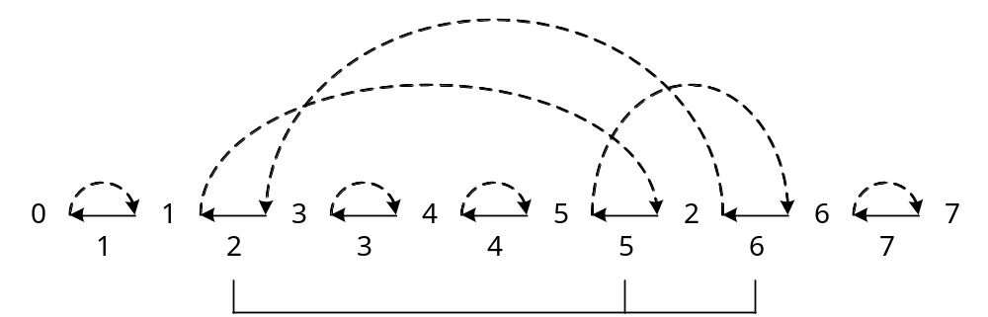
2-move on an Oriented Cycle
When there is an oriented cycle, we can perform 2-move transposition on it again.
After ρ(2,5,6):
Δc(G) = 2

Slide 18
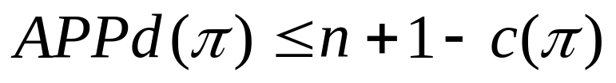
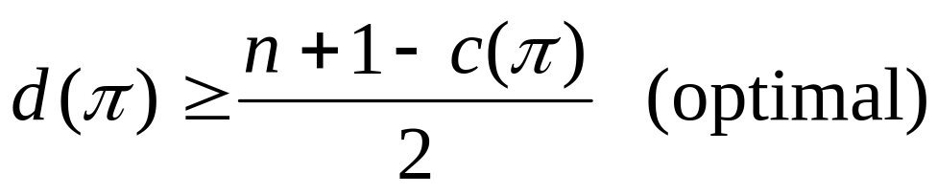
2-approximation Algorithm Summary
If there is an oriented cycle, then perform a 2-move.
If there is no oriented cycle, we can create one from a non-oriented cycle via a 0-move.
So we can increase at least two cycles in two transpositions.
It is a 2-approximation algorithm.

Slide 19
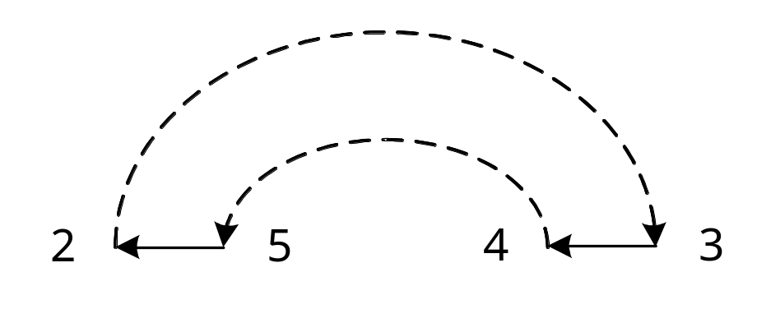
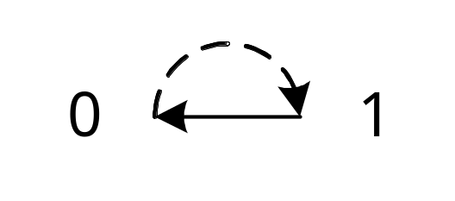
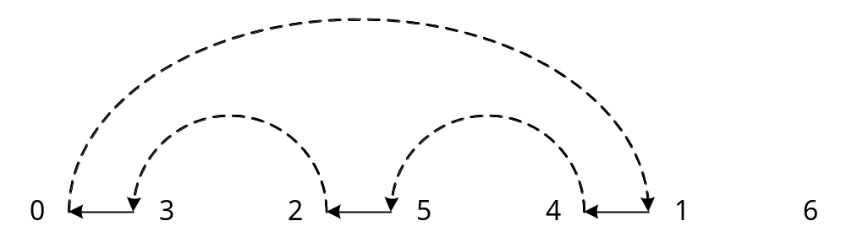
Definitions for 1.75 Approximation
Short cycle: cycle with at most two black edges.
Long cycle: cycle with three or more black edges.

Slide 20
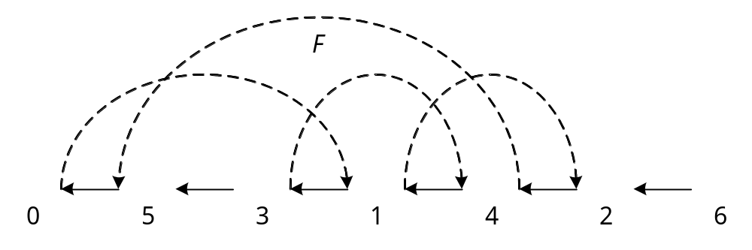
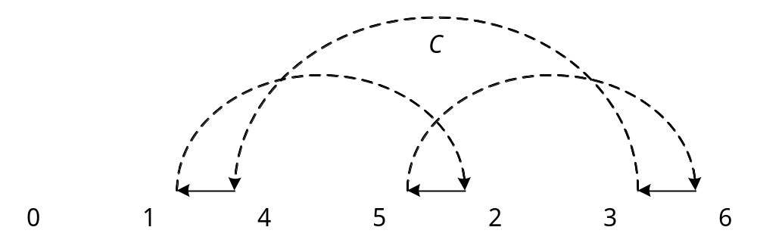
Definitions for 1.75 Approximation
Even cycle: cycle with even number of black edges.
Odd cycle: cycle with odd number of black edges.

Slide 21
Mail Approach
For a long cycle, we can increase four cycles in three consecutive transpositions.
In the worst case, average Δf₁=4/3
For a short cycle, we can increase four odd cycles and decrease two even cycles in two consecutive transpositions.
On average Δf₂=(4x-2)/2=2x-1
(See the definition of object function on the next page.)

Slide 22
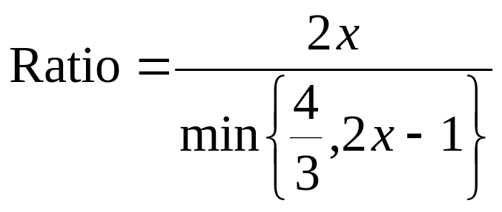
Approximation Ratio
Define an object function:
f(π)=xC_{odd}(π)+C_{even}(π), where x > 1.
For π_{I}= identity permutation, f(π_{I})=x(n+1).
Δc(G)∈{-2, 0, 2}, so f(π) increases by at most 2x after a transposition (Δf ≤ 2x)
The minimal value of Ratio: 2x-1=4/3
Ratio=1.75

Slide 23
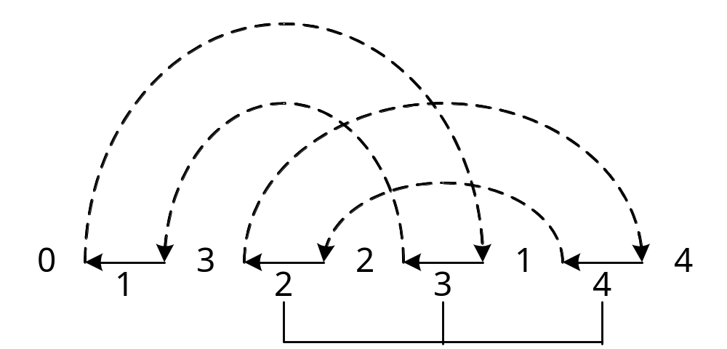
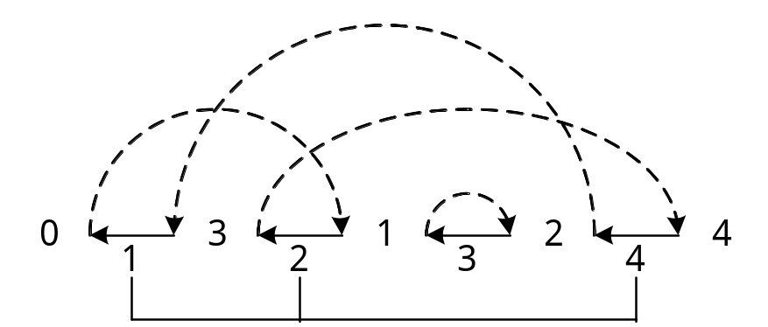
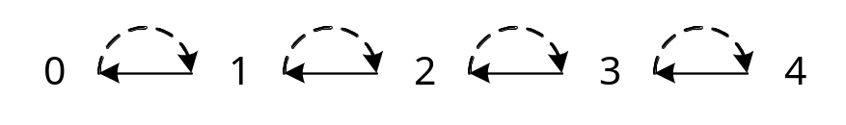
An Example for Short Cycles
C_{odd}(π)=0
C_{even}(π)=2
After ρ(2,3,4):
Δf = 2x-2
C_{odd}(π)=2
C_{even}(π)=0
Δf = 2x
After ρ(1,2,4):
C_{odd}(π)=4
C_{even}(π)=0

Slide 24
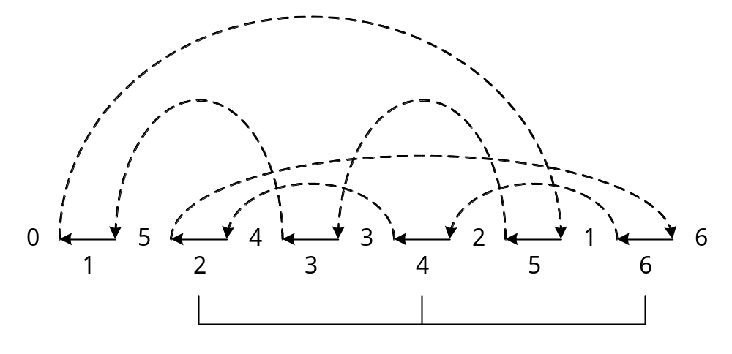
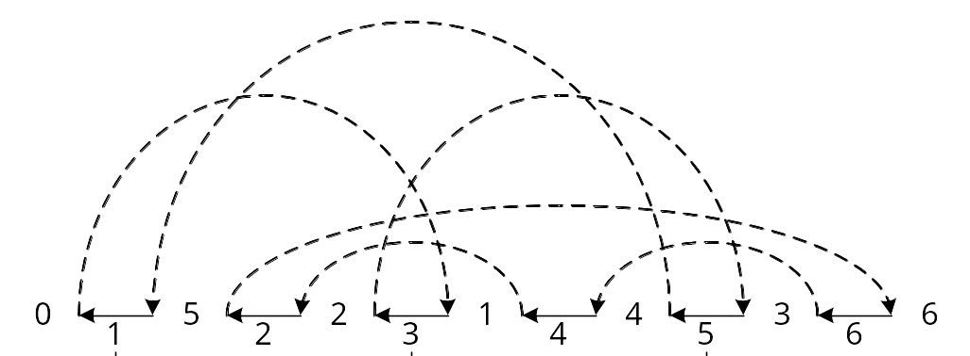
0-2-2 Move for Long Cycles (1)
Cycles:
(6,4,2), (5,3,1)
C_{odd}(π)=2
C_{even}(π)=0
0-move ρ(2,4,6):
Δf = 0
Cycles:
(6,4,2), (5,1,3)
C_{odd}(π)=2
C_{even}(π)=0

Slide 25
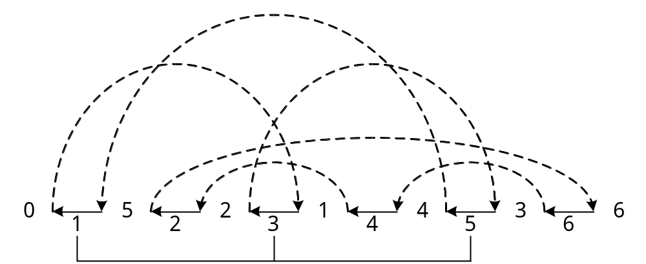
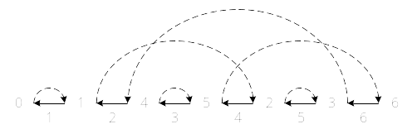
0-2-2 Move for Long Cycles (2)
Cycles:
(6,4,2), (5,1,3)
C_{odd}(π)=2
C_{even}(π)=0
Δf = 2x
2-move ρ(1,3,5):
Cycles:
(6,2,4)
C_{odd}(π)=4
C_{even}(π)=0

Slide 26
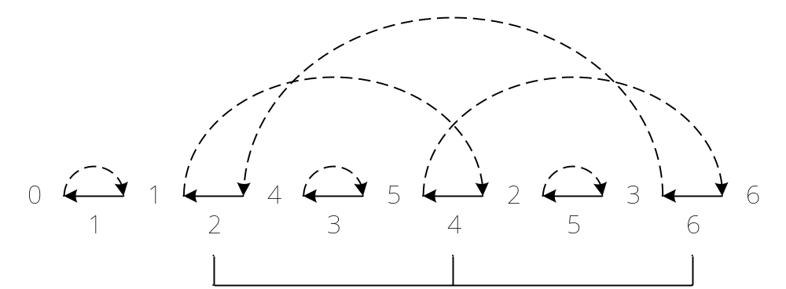
0-2-2 Move for Long Cycles (2)
Cycles:
(6,2,4)
C_{odd}(π)=4
C_{even}(π)=0
2-move ρ(2,4,6):
Δf = 2x
C_{odd}(π)=6
C_{even}(π)=0

