Slide 1
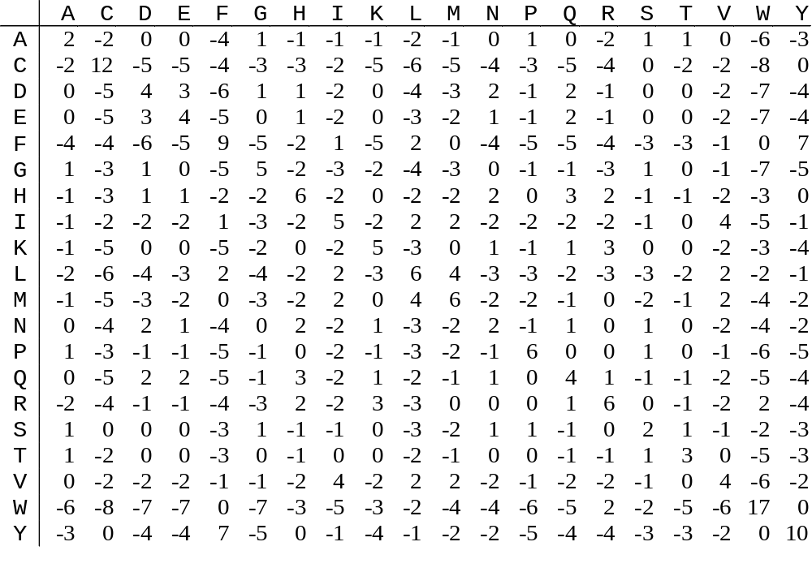
PAM250 Matrix

Slide 2
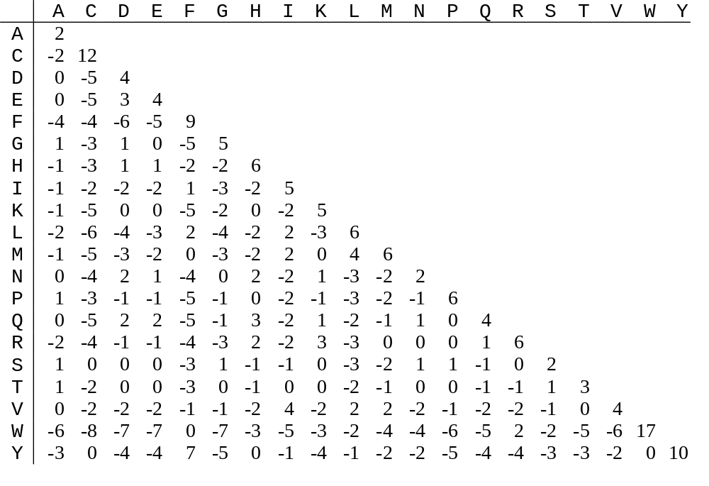
PAM250 Matrix

Slide 3
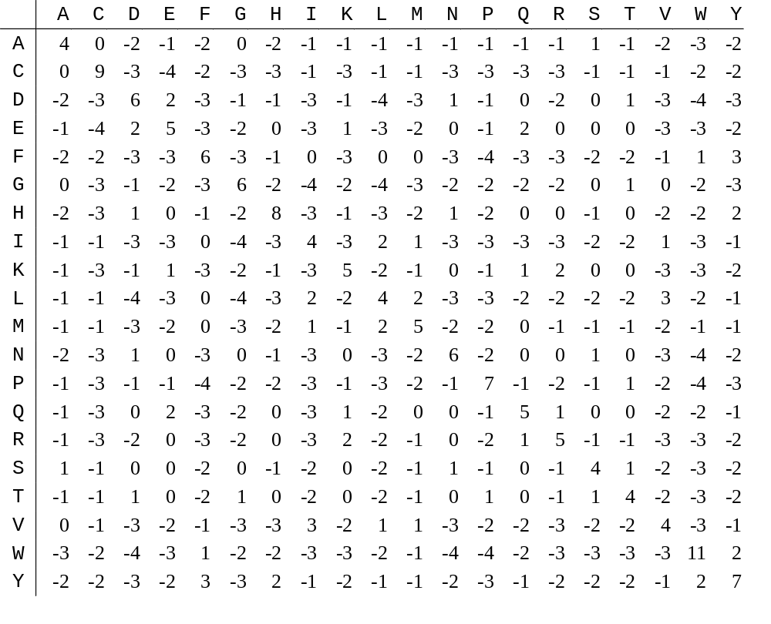
Blosum62 Matrix

Slide 4
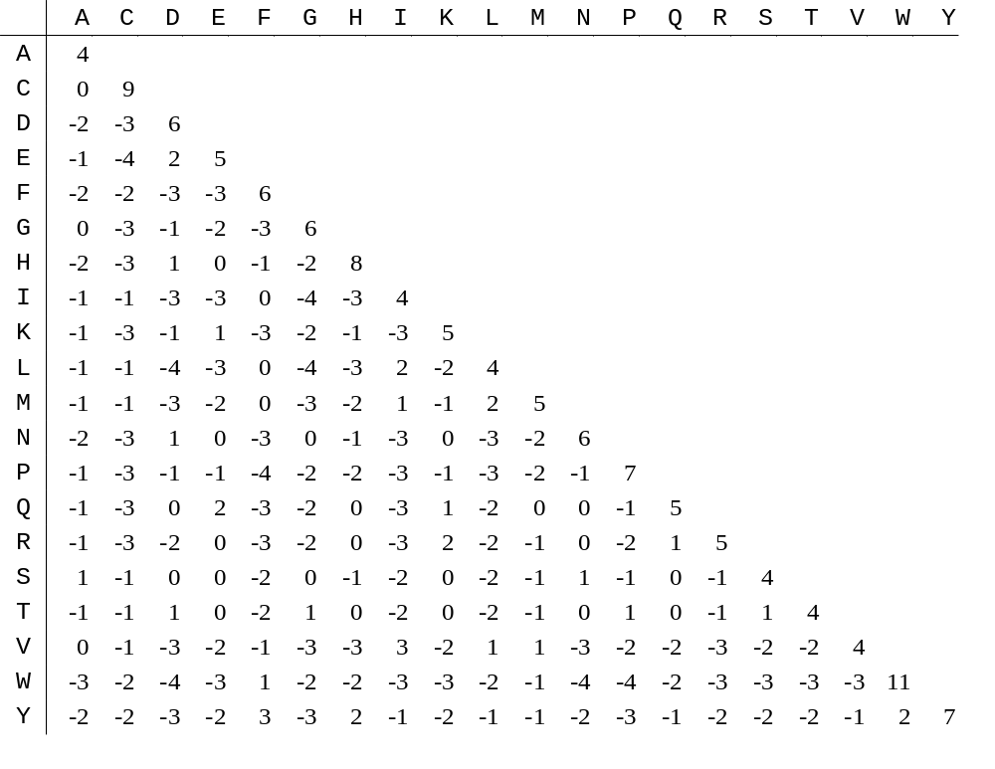
Blosum62 Matrix

