Slide 1
Chapter 2
Graph Algorithms
2 -<number>

Slide 2
Koenigsberg bridge problem
C
Is it possible to walk across all bridges exactly once from some land area and returning to the starting land area ?
c
g
d
A
river
Kneiphof
e
D
a
b
B
f
2 -<number>

Slide 3
Graph representation
vertex: land area
edge: bridge
The above problem is the Euler circuit (cycle) problem. In the circuit, each edge is visited exactly once from one source vertex and returning to the source vertex.
C
C
g
g
c
d
c
d
A
e
A
D
e
D
a
b
a
B
b
f
f
B
2 -<number>

Slide 4
Euler path
Euler path: In a graph, each edge is visited exactly once, but it needs not return to the source vertex.
Theorem: An undirected graph possesses an Euler path if and only if it is connected and has no, or exactly two, vertices that are of odd degree.
Euler circuit <=> all vertices are of even degree
An Euler cycle can be constructed in O(|E|) time, where E denotes the set of edges.
2 -<number>

Slide 5
The four-color problem
map:
Is it possible to use four colors to color any map such that no two adjacent areas have the same color?
Five colors are sufficient, which was proved by Heawood in 1890.
graph:
A
B
C
B
A
C
F
F
E
G
D
G
E
D
2 -<number>

Slide 6
Graph definition
graph G = (V, E)
V: a set of vertices (nodes)
E: a set of edges (“arcs” used in digraphs)
undirected graph:
Each edge is an
unordered pair
of vertices.
V = {A, B, C, D, E}
E = {1, 2, 3, 4, 5, 6}
or {(A,A), (A,B), (A,D), (A,C), (C,D), (C,E)}
or (B,A), (D,A), (C,A), (D,C), (E,C)
1
2
B
A
3
D
4
C
5
6
E
2 -<number>

Slide 7
degree of a node u: # of edges linked to u.
  e.g. degree of node B: 1 A: 5 C: 3
A node u is adjacent to a node v: There is an edge from u to v
  e.g. Node A is adjacent to nodes B, C and D.
Each edge is incident to the two nodes which are linked by this edge.
  e.g. Edge 2 is incident to nodes A and B.
2 -<number>

Slide 8
Directed graph
directed graph (digraph):
Each edge (arc) is an
ordered pair
of vertices.
V = {A, B, C, D, E}
E = {1, 2, 3, 4, 5, 6}
or {<A,A>, <A,B>, <A,D>, <A,C>, <C,D>, <E,C>}
1
2
B
A
3
D
4
C
5
6
E
2 -<number>

Slide 9
indegree of a node u:
# of edges which have u as the head. (entering u)
outdegree of a node u:
# of edges which have u as the tail (leaving u)
e.g. indegree of node A: 1
B: 1
C: 2
outdegree of node A: 4
B: 0
C: 1
degree = indegree + outdegree
1
2
B
A
3
4
D
C
5
6
E
2 -<number>

Slide 10
Paths in graphs
A binary relation can be represented by a graph.
path of length k from node u to node v:
a sequence k+1 nodes u₁, u₂, ..., u_{k+1}
(i) u₁ = u, u_{k+1} = v
(ii) u_{i} and u_{i+1} are adjacent, for 1≦i≦k .
e.g. (A,D,C,E) is
a path of length 3
1
2
B
A
3
D
4
C
5
6
E
2 -<number>

Slide 11
Graph representation (1)
adjacency list:
The nodes adjacent
to one node are
maintained by a
linked list.
B
E
C
A
D
A
C
D
null
B
C
null
C
D
E
null
D
E
null
E
D
null
2 -<number>

Slide 12
Graph representation (2)
adjacency matrix:
Each entry a_{ij} in the matrix has value 1 if and only if there is one edge connecting vertex v_{i} to vertex v_{j}.
 | A | B | C | D | E
A | 0 | 0 | 1 | 1 | 0
B | 0 | 0 | 1 | 0 | 0
C | 0 | 0 | 0 | 1 | 1
D | 0 | 0 | 0 | 0 | 1
E | 0 | 0 | 0 | 1 | 0
B
E
C
A
D
matrix A = (a_{ij})_{1≦i≦n, 1≦j≦n}
2 -<number>

Slide 13
Transitive closure
The reachability matrix for a graph G is the transitive closure T of the adjacency matrix of G.
matrix T = (t_{ij})_{1≦i≦n, 1≦j≦n}
1 If there is a path (not of
length 0) from v_{i} to v_{j}.
t_{ij} =
0 otherwise
 | A | B | C | D | E
A | 0 | 0 | 1 | 1 | 1
B | 0 | 0 | 1 | 1 | 1
C | 0 | 0 | 0 | 1 | 1
D | 0 | 0 | 0 | 1 | 1
E | 0 | 0 | 0 | 1 | 1
B
E
C
A
D
2 -<number>

Slide 14
Construction of transitive closure
The construction method for T:
B
E
a_{ik} = 1 and a_{kj} = 1
<=> a path of length 2 from v_{i} to v_{j} passing through v_{k}
C
A
D
 | A | B | C | D | E
A | 0 | 0 | 1 | 1 | 0
B | 0 | 0 | 1 | 0 | 0
C | 0 | 0 | 0 | 1 | 1
D | 0 | 0 | 0 | 0 | 1
E | 0 | 0 | 0 | 1 | 0
A
B
C
D
E
A
0
0
0
1
1
B
0
0
0
1
1
C
0
0
0
1
1
D
0
0
0
1
0
E
0
0
0
0
1
A²
matrix A
path matrix of length 2
2 -<number>

Slide 15
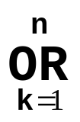
Calculation with matrix multiplication
a_{ij} of A² is computed by:
The above can be calculated by the matrix multiplication method.
meaning of (A or A²)?
(a_{ik} and a_{kj}) =
1 a path of length 2 from v_{i} to v_{j}
0 otherwise
boolean
product
matrix
multiplication
or
+
and
*
2 -<number>

Slide 16
The matrix multiplication can be applied repeatedly.
A
B
C
D
E
A
0
0
0
1
1
B
0
0
0
1
1
C
0
0
0
1
1
D
0
0
0
0
1
E
0
0
0
1
0
A³ = A² × A
A⁴ = A³ × A = (A²)²
A⁵ = A⁴ × A
2 -<number>

Slide 17
Finally, the following matrix is obtained.
Matrix T is the transitive closure of matrix A.
Required time: O(n) matrix multiplications
A
B
C
D
E
A
0
0
1
1
1
B
0
0
1
1
1
C
0
0
0
1
1
D
0
0
0
1
1
E
0
0
0
1
1
T = A or A² or A³ or A⁴ or A⁵
path of length ≦ 5
2 -<number>

Slide 18
Connectivity
Connectivity matrix C:
reflexive and transitive closure of G
matrix C = (c_{ij})_{1≦i≦n, 1≦j≦n}
1 if there is a path of length 0
or more from v_{i} to v_{j}.
0 otherwise
c_{ij} =
 | A | B | C | D | E
A | 1 | 0 | 1 | 1 | 1
B | 0 | 1 | 1 | 1 | 1
C | 0 | 0 | 1 | 1 | 1
D | 0 | 0 | 0 | 1 | 1
E | 0 | 0 | 0 | 1 | 1
B
E
C
A
D
2 -<number>

Slide 19
Construction of connectivity
Construct matrix B:
B² represents path of length 2 or less.
Then, compute B⁴, B⁸,…B^{n-1}.
Time: O(logn) matrix multiplications
(see the example on the next page)
b_{ij} = a_{ij} , for i≠j
b_{ii} = 1
that is,
1 a path of length 0 or 1
from v_{i} to v_{j}
b_{ij} =
0 otherwise
2 -<number>

Slide 20
A
B
C
D
E
B =
A
1
0
1
1
0
B
B
0
1
1
0
0
E
C
C
0
0
1
1
1
D
0
0
0
1
1
D
A
E
0
0
0
1
1
A
B
C
D
E
B² =
A
1
0
1
1
1
B
0
1
1
1
1
C
0
0
1
1
1
D
0
0
0
1
1
E
0
0
0
1
1
C = B⁴ = (B²)², same as B²
2 -<number>

Slide 21
Connected components
For every pair of nodes in a connected component, there is a path connecting them.
This undirected graph consists of 3 connected components.
Algorithms for solving the connected component problem:
  connectivity matrix
  depth-first search
  breadth-first search
3
1
2
8
5
4
6
7
2 -<number>

Slide 22
Depth-first search (DFS)
Depth-first search (traversal)
depth-first order: a b d e c g h f
It can be solved by a stack.
Time: O(|E|)
depth-first spanning tree
a
1
a
2
5
6
b
c
g
b
c
g
3
4
7
d
e
h
d
e
h
8
f
f
2 -<number>

Slide 23
Breadth-first search (BFS)
Breadth-first search (traversal)
breadth-first order: a b c g d e h f
It can be solved by a queue.
Time: O(|E|)
breadth-first spanning tree
1
a
a
2
3
4
b
c
g
b
c
g
d
e
h
5
6
7
d
e
h
f
8
f
2 -<number>

Slide 24
Minimum spanning trees (MST)
It may be defined on Euclidean space points or on a graph.
G = (V, E): weighted connected undirected graph
Spanning tree : S = (V, T), T ⊆ E, undirected tree
Minimum spanning tree(MST) : a spanning tree with the smallest total weight.
2 -<number>

Slide 25
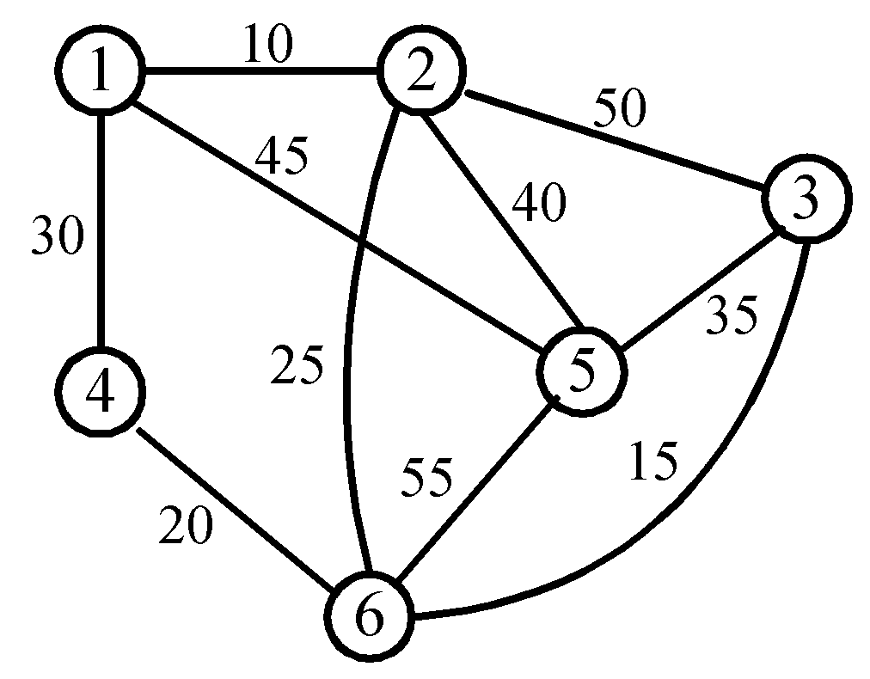
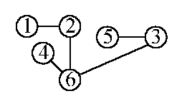
An example of MST
A graph and one of its minimum costs spanning tree
2 -<number>

Slide 26
Kruskal’s algorithm for finding MST
Step 1: Sort all edges into nondecreasing order.
Step 2: Add the next smallest weight edge to the forest if it will not cause a cycle.
Step 3: Stop if n-1 edges. Otherwise, go to Step2.
2 -<number>

Slide 27
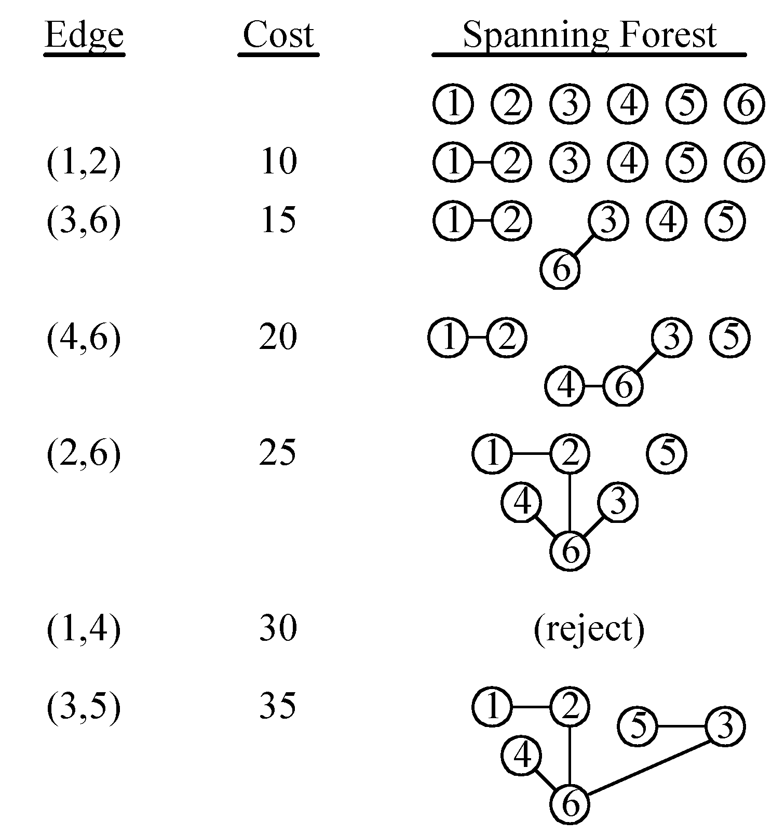
An example of Kruskal’s algorithm
2 -<number>

Slide 28
The details for constructing MST
How do we check if a cycle is formed when a new edge is added?
  By the SET and UNION method.
Each tree in the spanning forest is represented by a SET.
  If (u, v) ∈ E and u, v are in the same set, then the addition of (u, v) will form a cycle.
  If (u, v) ∈ E and u∈S₁ , v∈S₂ , then perform UNION of S₁ and S₂ .
2 -<number>

Slide 29

Time complexity
Time complexity: O(|E| log|E|)
  Step 1: O(|E| log|E|)
  Step 2 & Step 3:
  Where α is the inverse of Ackermann’s function.
2 -<number>

Slide 30
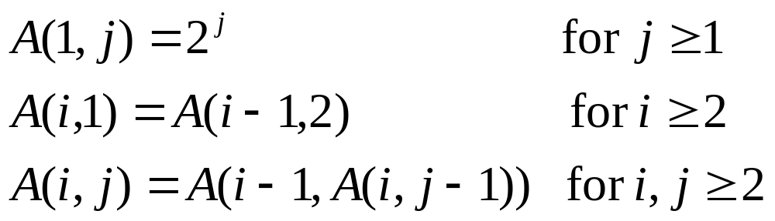
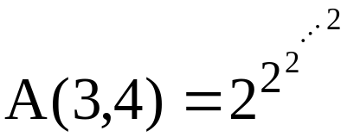

Ackermann’s function
⇒ A(p, q+1) > A(p, q), A(p+1, q) > A(p, q)
65536 two’s
2 -<number>

Slide 31
Inverse of Ackermann’s function
α(m, n) = min{i≥1|A(i, ⎣m/n⎦) > log₂n}
Practically, A(3,4) > log₂n
⇒α(m, n) ≤ 3
⇒α(m, n) is almost a constant.
2 -<number>

Slide 32
Prim’s algorithm for finding MST
Step 1: x ∈ V, Let A = {x}, B = V - {x}.
Step 2: Select (u, v) ∈ E, u ∈ A, v ∈ B such that (u, v) has the smallest weight between A and B.
Step 3: Put (u, v) in the tree. A = A ∪ {v}, B = B - {v}
Step 4: If B = ∅, stop; otherwise, go to Step 2.
Time complexity : O(n²), n = |V|.
(see the example on the next page)
2 -<number>

Slide 33
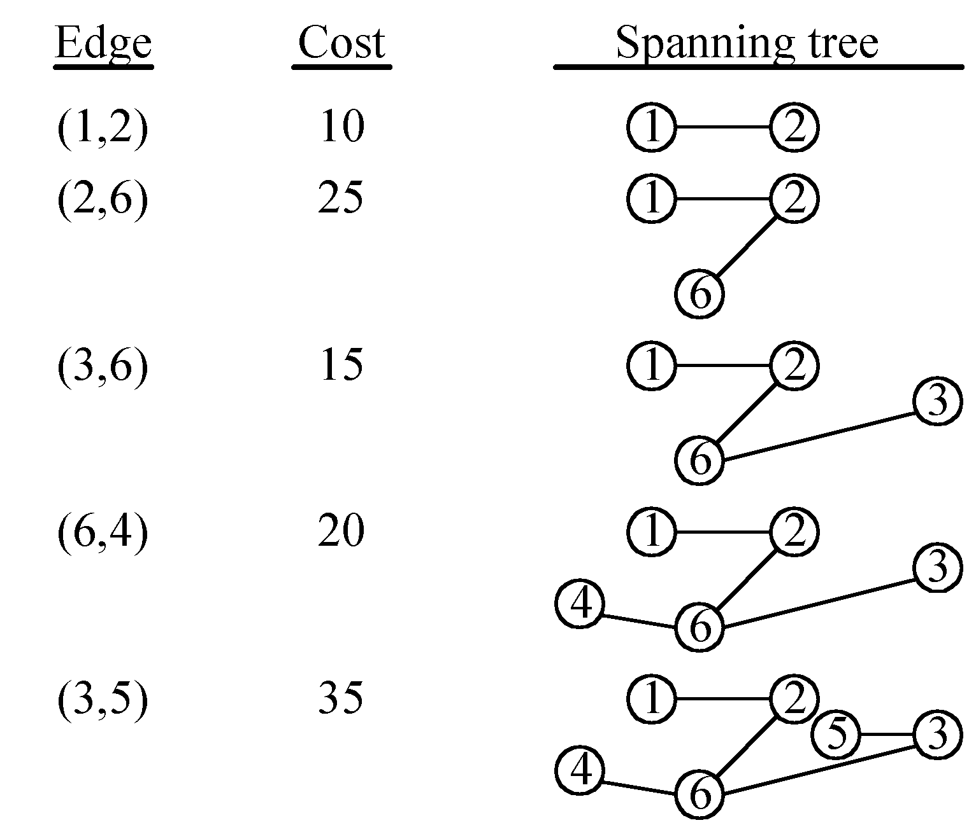
An example for Prim’s algorithm
2 -<number>

Slide 34
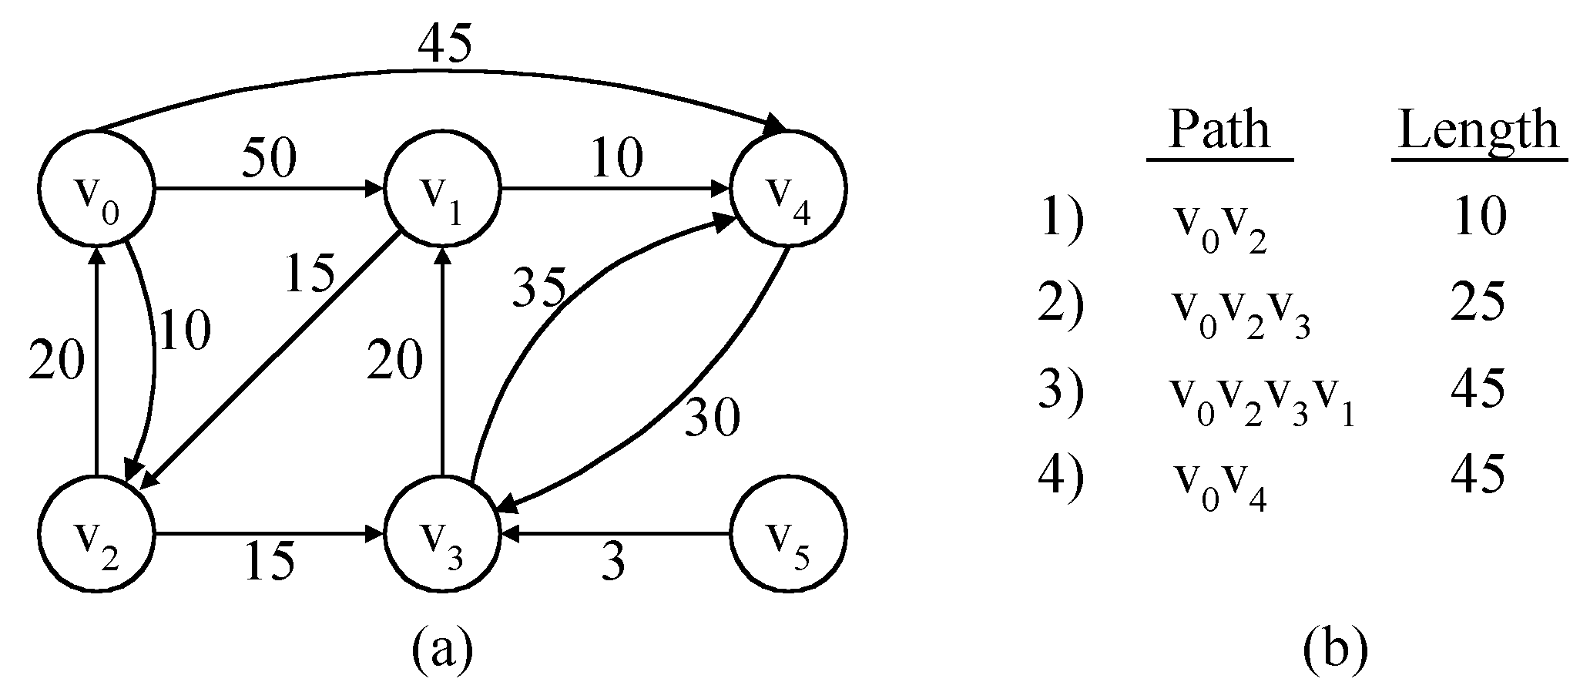
The single-source shortest path problem
shortest paths from v₀ to all destinations
2 -<number>

Slide 35
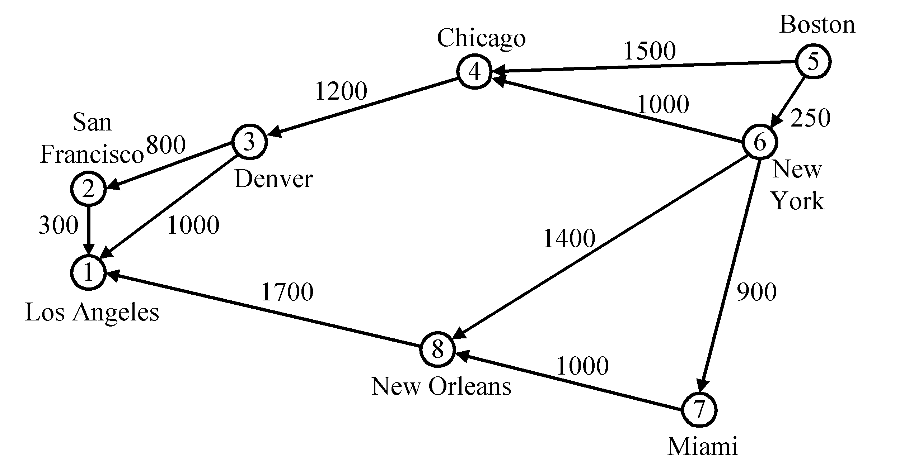
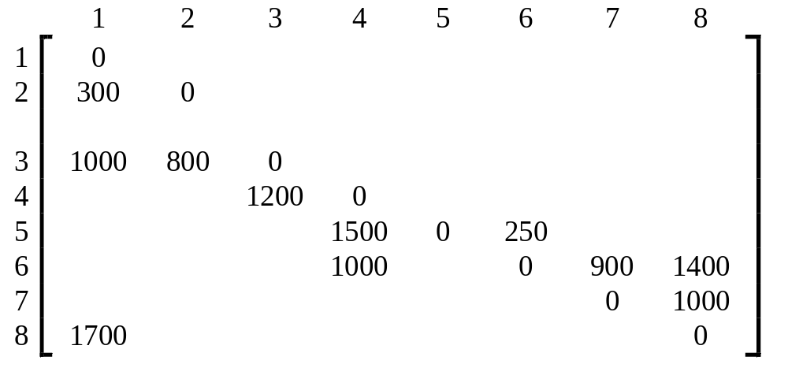
Dijkstra’s algorithm
In the cost adjacency matrix, all entries not shown are +∞.
2 -<number>

Slide 36
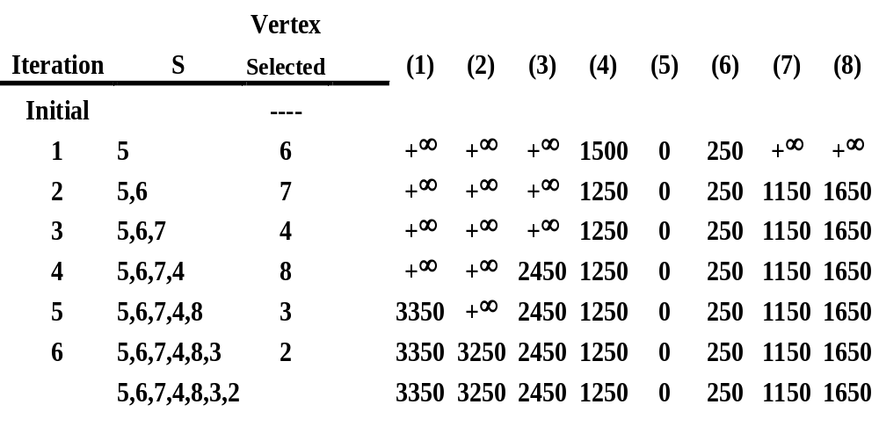
Time complexity : O(n²), n = |V|.
2 -<number>

Slide 37

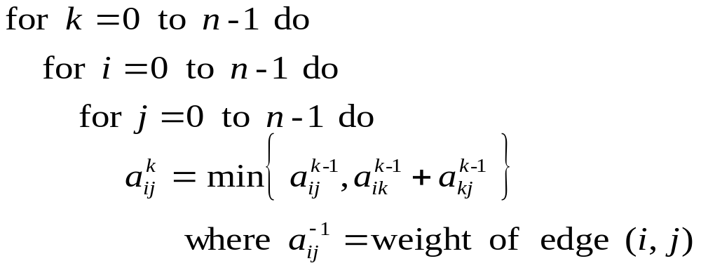
All pairs shortest paths
The all pairs shortest path problem can be solved by a dynamic programming method.
:the length of a shortest path from v_{i} to v_{j} going through no vertex of label greater than k.
Time complexity: O(n³) , n = |V|.
2 -<number>

Slide 38
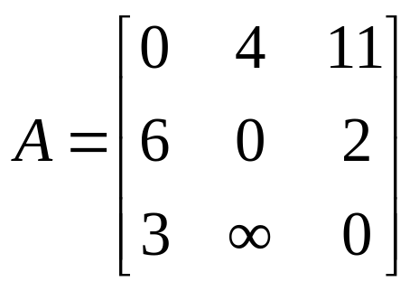
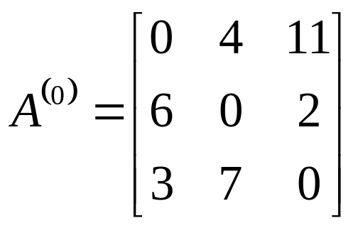
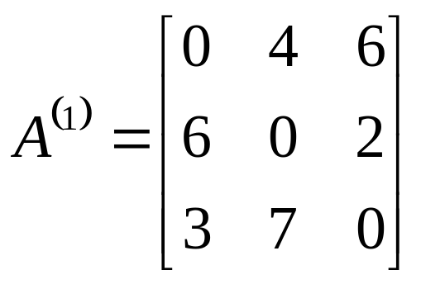
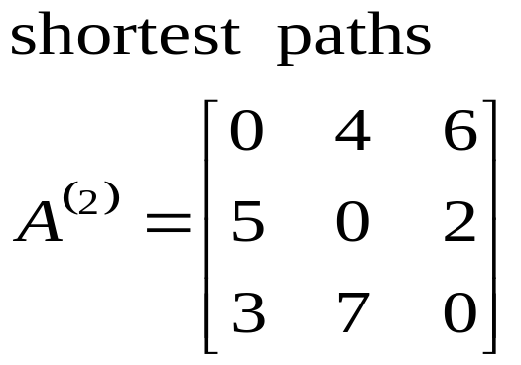
An example for all pairs shortest paths
6
v₀
4
v₁
3
11
2
v₂
2 -<number>

Slide 39
Topological order
topological order (topological sort) for acyclic digraphs
b
e
a
c
g
f
d
topological order:
a b c d e f g
a b c e d f g
a d c f b e g
...
2 -<number>

Slide 40
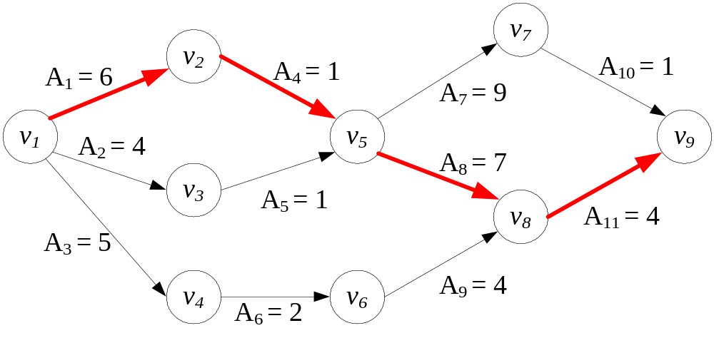
Critical path
critical path for acyclic digraphs
maximum time needed for the given activities
Activity | Time | Prior activities
A₁ | 6 | --
A₂ | 4 | --
A₃ | 5 | --
A₄ | 1 | A₁
A₅ | 1 | A₂
A₆ | 2 | A₃
A₇ | 9 | A₄, A₅
A₈ | 7 | A₄, A₅
A₉ | 4 | A₆
A₁₀ | 1 | A₇
A₁₁ | 4 | A₈, A₉
2 -<number>

Slide 41
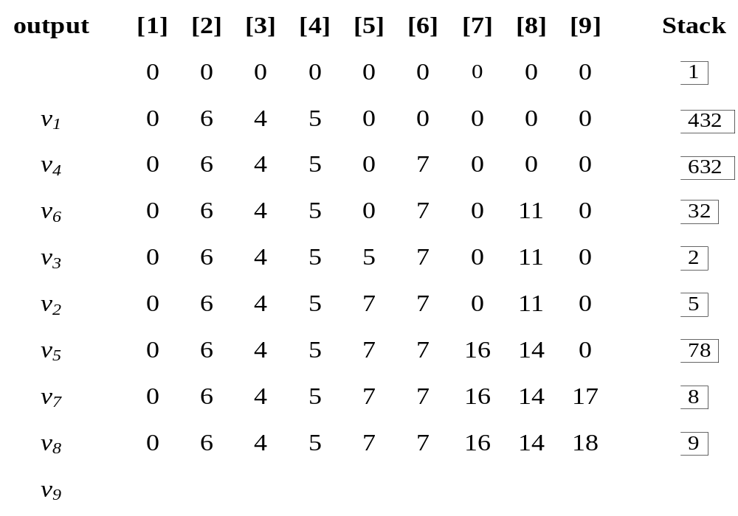

Action of modified topological order
2 -<number>

