Slide 1
Chapter 3
The Greedy Method
3 -<number>

Slide 2
A simple example
Problem: Pick k numbers out of n numbers such that the sum of these k numbers is the largest.
Algorithm:
    FOR i = 1 to k
    pick out the largest number and
    delete this number from the input.
    ENDFOR
3 -<number>

Slide 3
The greedy method
Suppose that a problem can be solved by a sequence of decisions. The greedy method has that each decision is locally optimal. These locally optimal solutions will finally add up to a globally optimal solution.
<戰國策.秦策>范睢對秦昭襄王說：「王不如遠交而近攻，得寸，王之寸；得尺，亦王之尺也。」
Only a few optimization problems can be solved by the greedy method.
3 -<number>

Slide 4
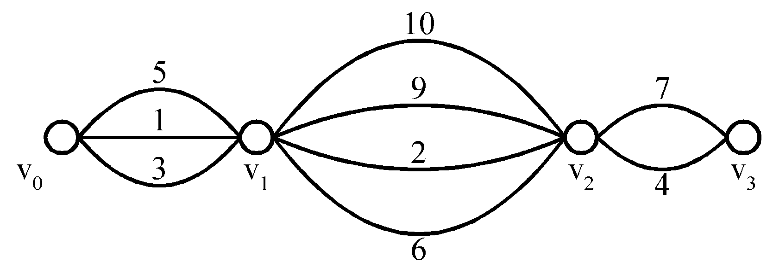
Shortest paths on a special graph
Problem: Find a shortest path from v₀ to v₃.
The greedy method can solve this problem.
The shortest path: 1 + 2 + 4 = 7.
3 -<number>

Slide 5
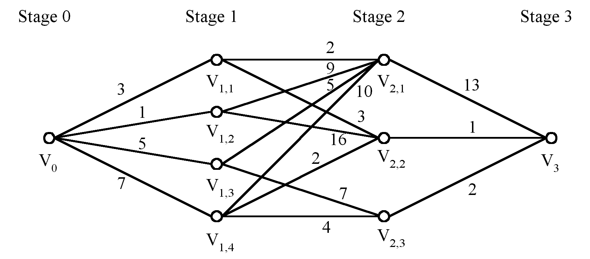
Shortest paths on a multi-stage graph
Problem: Find a shortest path from v₀ to v₃ in the multi-stage graph.
Greedy method: v₀v_{1,2}v_{2,1}v₃ = 23
Optimal: v₀v_{1,1}v_{2,2}v₃ = 7
The greedy method does not work.
3 -<number>

Slide 6
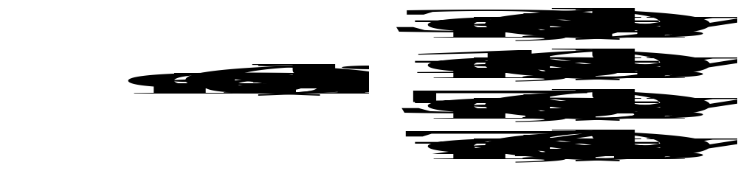
Solution of the above problem
d_{min}(i,j): minimum distance between i and j.
This problem can be solved by the dynamic programming method.
3 -<number>

Slide 7
The activity selection problem
Problem: n activities, S = {1, 2, …, n}, each activity i has a start time s_{i} and a finish time f_{i}, s_{i} ≤ f_{i}.
Activity i occupies time interval [s_{i}, f_{i}].
i and j are compatible if s_{i} ≥ f_{j} or s_{j} ≥ f_{i}.
The problem is to select a maximum-size set of mutually compatible activities
3 -<number>

Slide 8
Example:
The solution set = {1, 4, 8, 11}
Algorithm:
Step 1: Sort f_{i} into nondecreasing order. After sorting, f₁ ≤ f₂ ≤ f₃ ≤ … ≤ f_{n}.
Step 2: Add the next activity i to the solution set if i is compatible with each in the solution set.
Step 3: Stop if all activities are examined. Otherwise, go to step 2.
Time complexity: O(nlogn)
i | 1 | 2 | 3 | 4 | 5 | 6 | 7 | 8 | 9 | 10 | 11
s_{i} | 1 | 3 | 0 | 5 | 3 | 5 | 6 | 8 | 8 | 2 | 12
f_{i} | 4 | 5 | 6 | 7 | 8 | 9 | 10 | 11 | 12 | 13 | 14
3 -<number>

Slide 9
Solution of the example:
Solution = {1, 4, 8, 11}
i | s_{i} | f_{i} | accept
1 | 1 | 4 | Yes
2 | 3 | 5 | No
3 | 0 | 6 | No
4 | 5 | 7 | Yes
5 | 3 | 8 | No
7 | 6 | 10 | No
8 | 8 | 11 | Yes
9 | 8 | 12 | No
10 | 2 | 13 | No
11 | 12 | 14 | Yes
3 -<number>

Slide 10
Job sequencing with deadlines
Problem: n jobs, S={1, 2, …, n}, each job i has a deadline d_{i} ≥ 0 and a profit p_{i} ≥ 0. We need one unit of time to process each job and we can do at most one job each time. We can earn the profit p_{i} if job i is completed by its deadline.
The optimal solution = {1, 2, 4}.
The total profit = 20 + 15 + 5 = 40.
i | 1 | 2 | 3 | 4 | 5
p_{i} | 20 | 15 | 10 | 5 | 1
d_{i} | 2 | 2 | 1 | 3 | 3
3 -<number>

Slide 11
Algorithm:
Step 1: Sort p_{i} into nonincreasing order. After sorting p₁ ≥ p₂ ≥ p₃ ≥ … ≥ p_{n}.
Step 2: Add the next job i to the solution set if i can be completed by its deadline. Assign i to time slot [r-1, r], where r is the largest integer such that 1 ≤ r ≤ d_{i} and [r-1, r] is free.
Step 3: Stop if all jobs are examined. Otherwise, go to step 2.
Time complexity: O(n²)
3 -<number>

Slide 12
e.g.
solution = {1, 2, 4}
total profit = 20 + 15 + 5 = 40
i | p_{i} | d_{i}
1 | 20 | 2 | assign to [1, 2]
2 | 15 | 2 | assign to [0, 1]
3 | 10 | 1 | reject
4 | 5 | 3 | assign to [2, 3]
5 | 1 | 3 | reject
3 -<number>

Slide 13
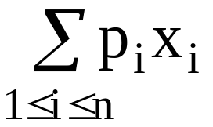
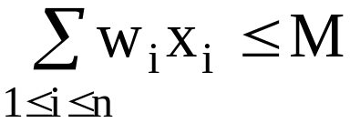
The knapsack problem
n objects, each with a weight w_{i} > 0
a profit p_{i} > 0
capacity of knapsack: M
Maximize
Subject to
0 ≤ x_{i} ≤ 1, 1 ≤ i ≤ n
3 -<number>

Slide 14
The knapsack algorithm
The greedy algorithm:
Step 1: Sort p_{i}/w_{i} into nonincreasing order.
Step 2: Put the objects into the knapsack according
to the sorted sequence as possible as we can.
e. g.
  n = 3, M = 20, (p₁, p₂, p₃) = (25, 24, 15)
  (w₁, w₂, w₃) = (18, 15, 10)
  Sol: p₁/w₁ = 25/18 = 1.39
  p₂/w₂ = 24/15 = 1.6
  p₃/w₃ = 15/10 = 1.5
  Optimal solution: x₁ = 0, x₂ = 1, x₃ = 1/2
total profit = 24 + 7.5 = 31.5
3 -<number>

Slide 15
The 2-way merging problem
# of comparisons required for the linear 2-way merge algorithm is m₁+ m₂ -1 where m₁ and m₂ are the lengths of the two sorted lists respectively.
  2-way merging example
2 3 5 6
1 4 7 8
The problem: There are n sorted lists, each of length m_{i}. What is the optimal sequence of merging process to merge these n lists into one sorted list ?
3 -<number>

Slide 16
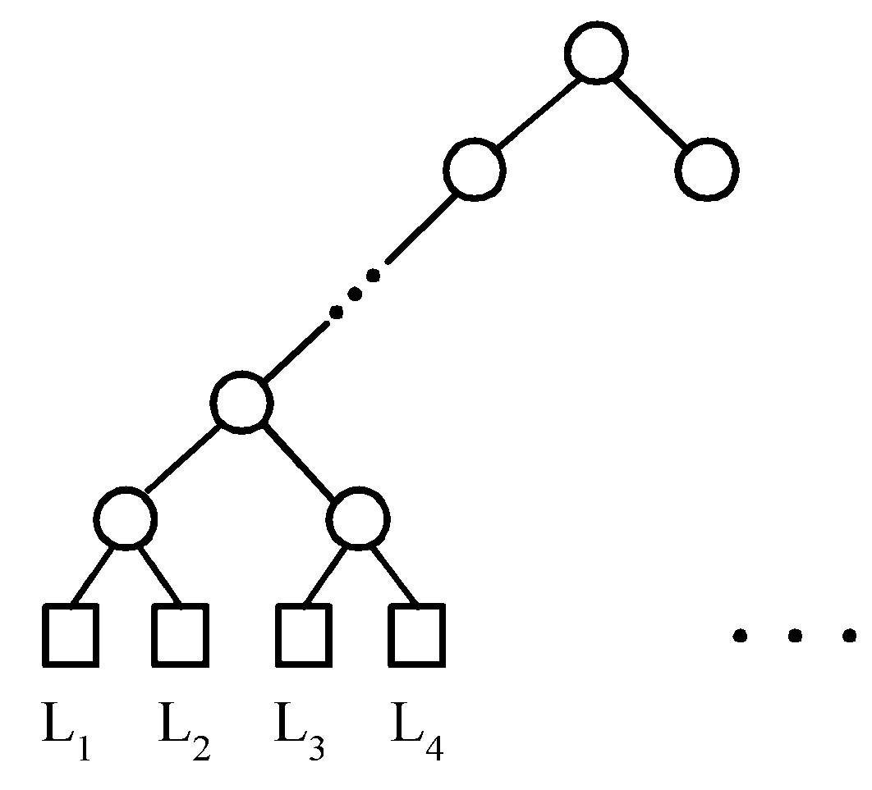
Extended binary trees
An extended binary tree representing a 2-way merge
3 -<number>

Slide 17
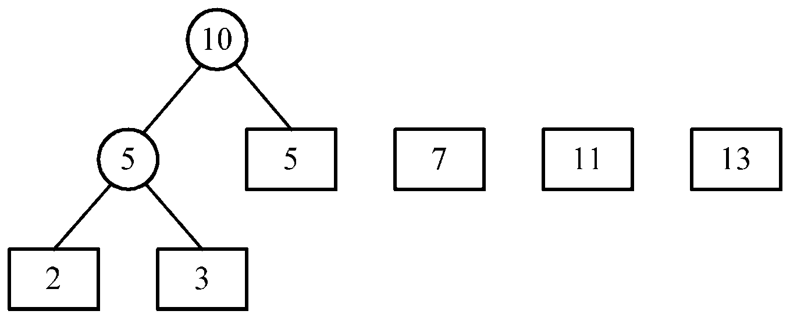
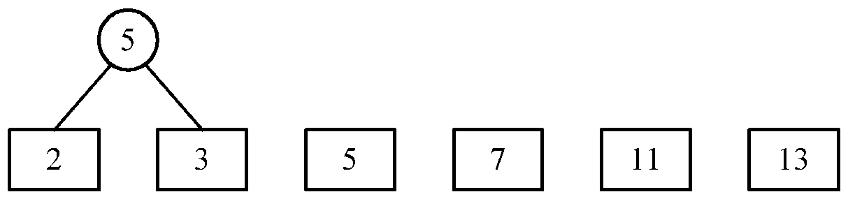
An example of 2-way merging
Example: 6 sorted lists with lengths 2, 3, 5, 7, 11 and 13.
3 -<number>

Slide 18
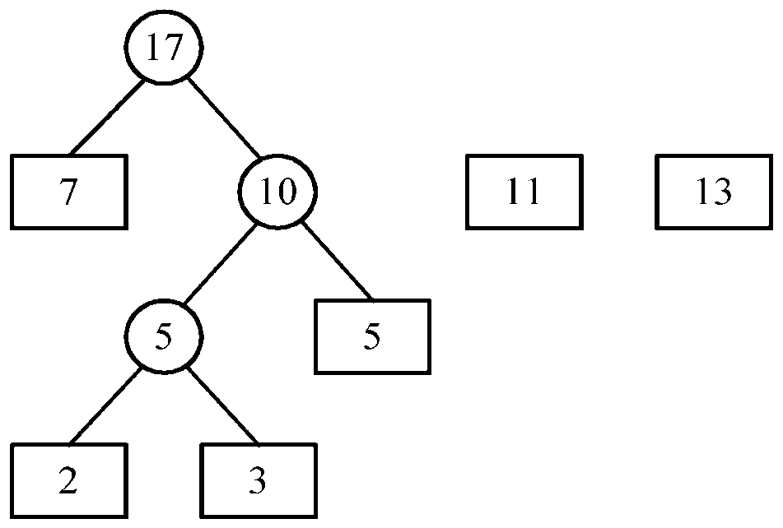
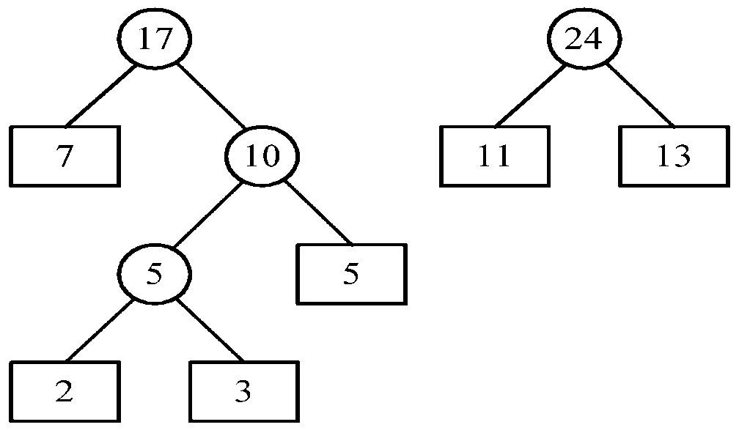
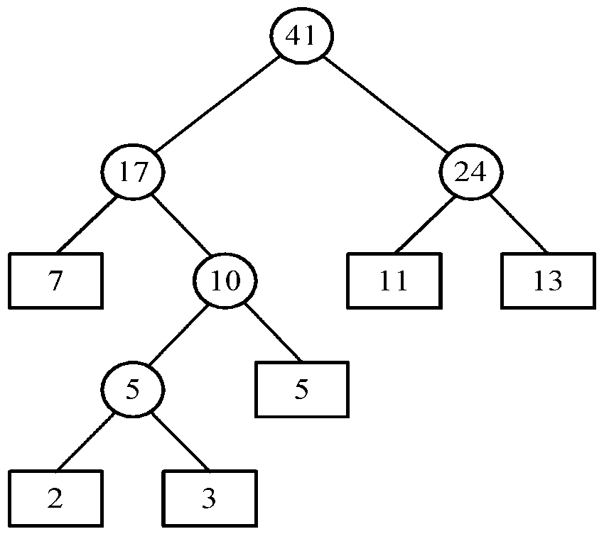
Time complexity for generating an optimal extended binary tree:O(n log n)
Using min-heap
3 -<number>

Slide 19
Huffman codes
In telecommunication, how do we represent a set of messages, each with an access frequency, by a sequence of 0’s and 1’s?
To minimize the transmission and decoding costs, we may use short strings to represent more frequently used messages.
This problem can by solved by using an extended binary tree which is used in the 2-way merging problem.
3 -<number>

Slide 20
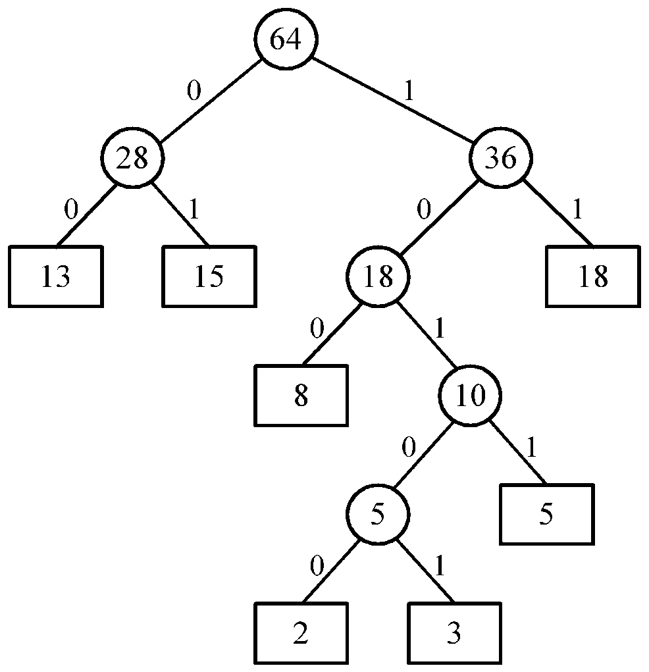
An example of Huffman algorithm
Symbols: A, B, C, D, E, F, G
freq. : 2, 3, 5, 8, 13, 15, 18
Huffman codes:
A: 10100 B: 10101 C: 1011
D: 100 E: 00 F: 01
G: 11
A Huffman code Tree
3 -<number>

