Slide 1
Chapter 5
Tree Searching Strategies

Slide 2
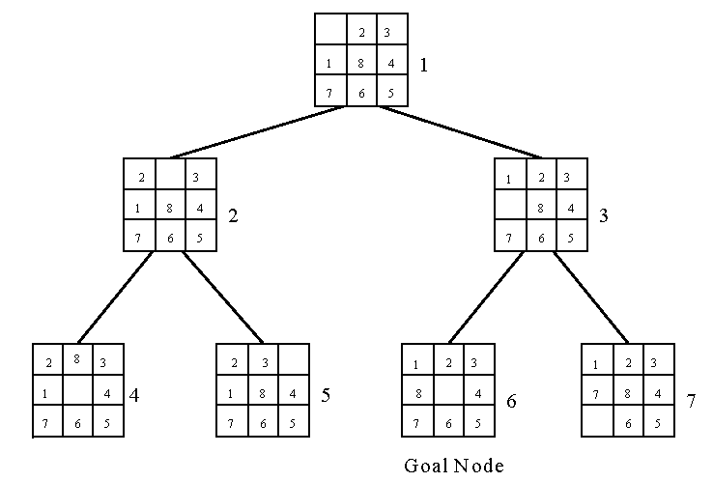
Breadth-first search (BFS)
8-puzzle problem
The breadth-first search uses a queue to hold all expanded nodes.

Slide 3
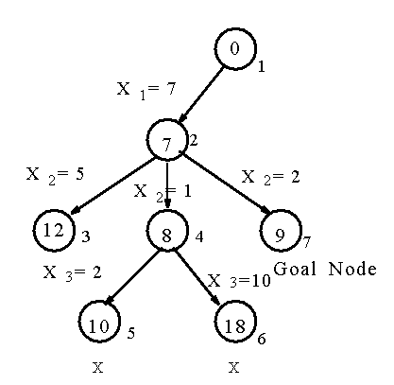
Depth-first search (DFS)
e.g. sum of subset problem
S={7, 5, 1, 2, 10}
∃ S’ ⊆ S ∋ sum of S’ = 9 ?
A stack can be used to guide the depth-first search.
A sum of subset problem solved by depth-first search.

Slide 4
Hill climbing
A variant of depth-first search
  The method selects the locally optimal node to expand.
e.g. 8-puzzle problem
evaluation function f(n) = d(n) + w(n)
where d(n) is the depth of node n
w(n) is # of misplaced tiles in node n.

Slide 5
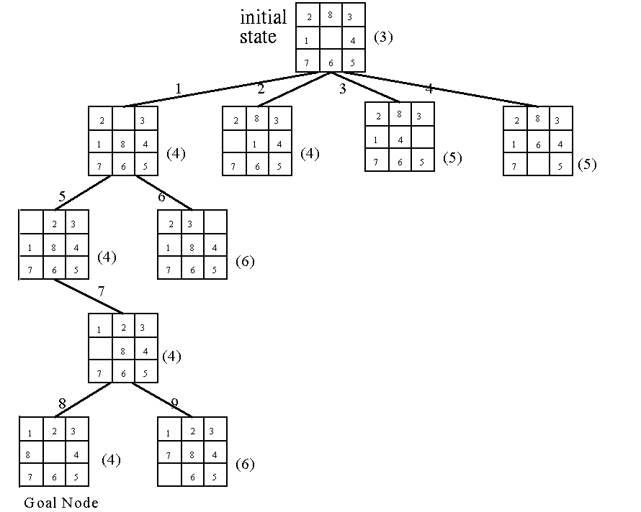
An 8-puzzle problem solved by a hill climbing method.

Slide 6
Best-first search strategy
Combine depth-first search and breadth-first search.
Selecting the node with the best estimated cost among all nodes.
This method has a global view.

Slide 7
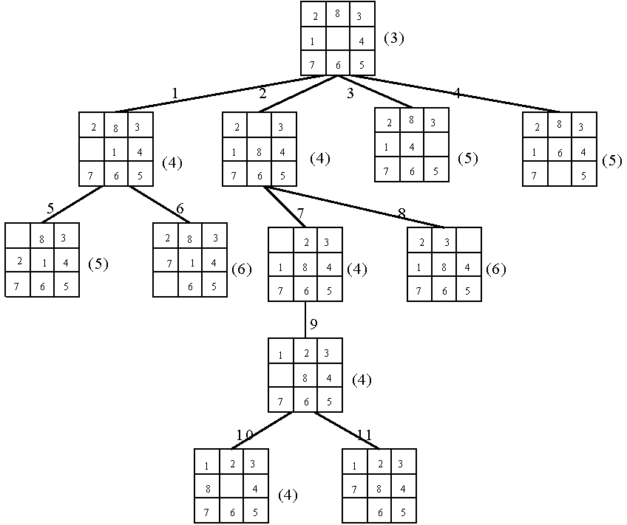
An 8-puzzle problem solved by a best-first search scheme.

Slide 8
Best-First Search Scheme
Step1: Form a one-element list consisting of the root node.
Step2: Remove the first element from the list. Expand the first element. If one of the descendants of the first element is a goal node, then stop; otherwise, add the descendants into the list.
Step3: Sort the entire list by the values of some estimation function.
Step4: If the list is empty, then failure. Otherwise, go to Step 2.

Slide 9
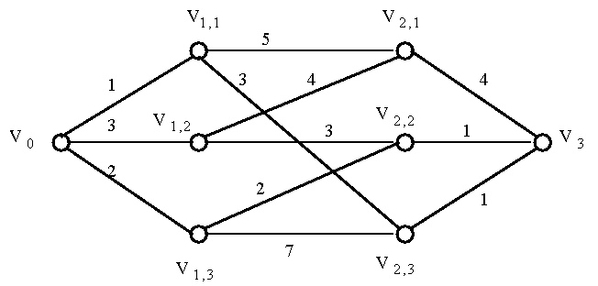
Branch-and-bound strategy
This strategy can be used to efficiently solve optimization problems.
e.g.
A multi-stage graph searching problem.

Slide 10
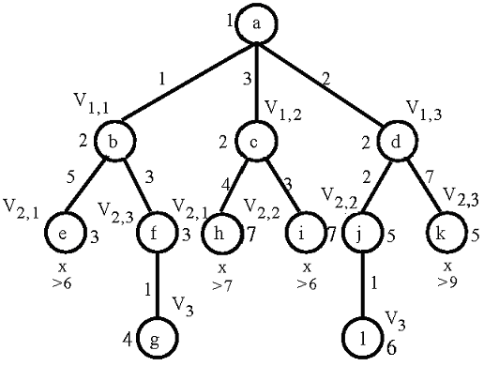
Solved by branch
-and-bound

Slide 11
Personnel assignment problem
A linearly ordered set of persons P={P₁, P₂, …, P_{n}} where P₁<P₂<…<P_{n}
A partially ordered set of jobs J={J₁, J₂, …, J_{n}}
Suppose that P_{i} and P_{j} are assigned to jobs f(P_{i}) and f(P_{j}) respectively. If f(P_{i}) ≤ f(P_{j}), then P_{i} ≤ P_{j}. Cost C_{ij} is the cost of assigning P_{i} to J_{j}. We want to find a feasible assignment with the minimum cost. i.e.
X_{ij} = 1 if P_{i} is assigned to J_{j}
X_{ij} = 0 otherwise.
Minimize ∑_{i,j} C_{ij}X_{ij}

Slide 12
e.g. A partial ordering of jobs
After topological sorting, one of the following topologically sorted sequences will be generated:
One of feasible assignments:
P₁→J₁, P₂→J₂, P₃→J₃, P₄→J₄
J₁
J₂
↓
↘
↓
J₃
J₄
J₁,
J₂,
J₃,
J₄
J₁,
J₂,
J₄,
J₃
J₁,
J₃,
J₂,
J₄
J₂,
J₁,
J₃,
J₄
J₂,
J₁,
J₄
J₃

Slide 13
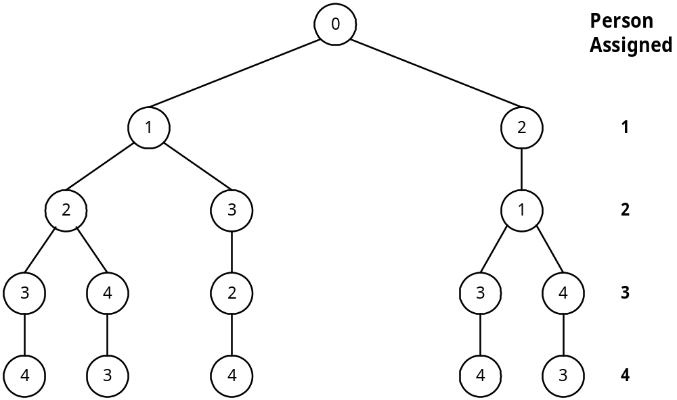
A solution tree
All possible solutions can be represented by a solution tree.
J₁
J₂
↓
↘
↓
J₃
J₄

Slide 14
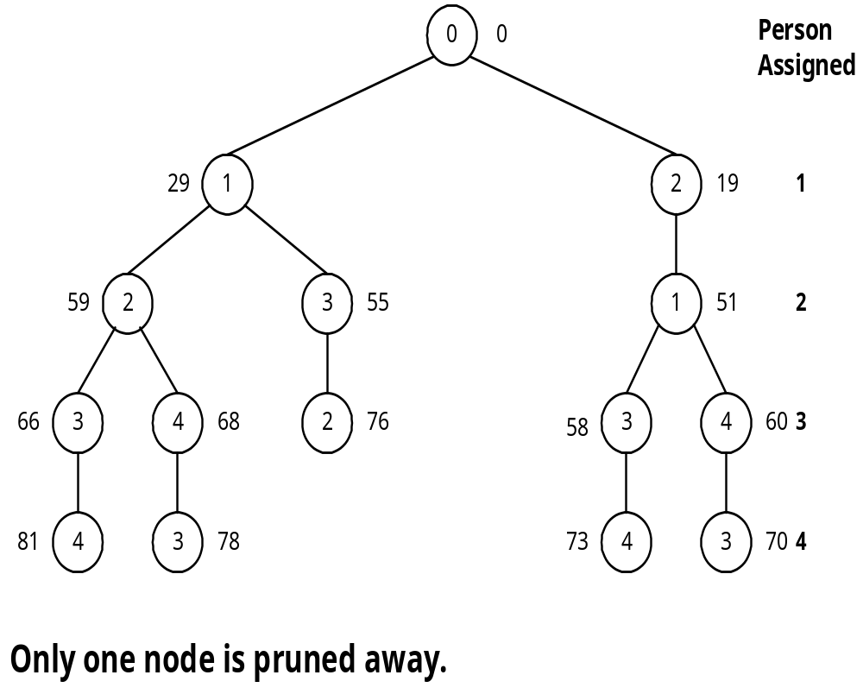
Cost matrix
Apply the best-first search scheme:
Cost matrix
Jobs
Persons
1
2
3
4
1
29
19
17
12
2
32
30
26
28
3
3
21
7
9
4
18
13
10
15

Slide 15
Reduced cost matrix
Cost matrix
Reduced cost matrix
Jobs
Persons
1
2
3
4
Jobs
Persons
1
2
3
4
1
29
19
17
12
1
17
4
5
0
(-12)
2
6
1
0
2
(-26)
2
32
30
26
28
3
0
15
4
6
(-3)
3
3
21
7
9
4
8
0
0
5
(-10)
4
18
13
10
15
(-3)

Slide 16
A reduced cost matrix can be obtained:
subtract a constant from each row and each column respectively such that each row and each column contains at least one zero.
Total cost subtracted: 12+26+3+10+3 = 54
This is a lower bound of our solution.

Slide 17
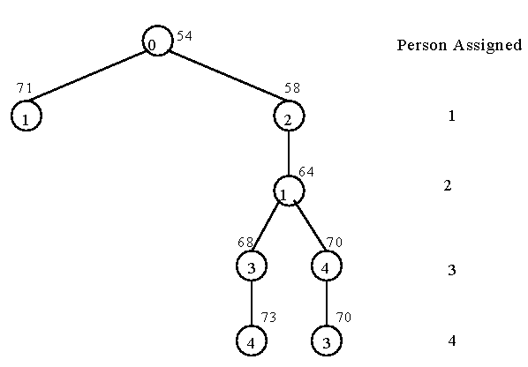
Branch-and-bound for the personnel assignment problem
Bounding of subsolutions:
Jobs
Persons
1
2
3
4
1
17
4
5
0
2
6
1
0
2
3
0
15
4
6
4
8
0
0
5

Slide 18
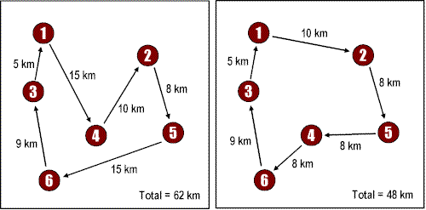
The traveling salesperson optimization problem
Given a set of points and their pairwise distances, the task is to find a shortest tour that visits each point exactly once.
It is NP-complete.

Slide 19
The traveling salesperson optimization problem
A cost matrix
j
i
1
2
3
4
5
6
7
1
∞
3
93
13
33
9
57
2
4
∞
77
42
21
16
34
3
45
17
∞
36
16
28
25
4
39
90
80
∞
56
7
91
5
28
46
88
33
∞
25
57
6
3
88
18
46
92
∞
7
7
44
26
33
27
84
39
∞

Slide 20
A reduced cost matrix
j
i
1
2
3
4
5
6
7
1
∞
0
90
10
30
6
54
(-3)
2
0
∞
73
38
17
12
30
(-4)
3
29
1
∞
20
0
12
9
(-16)
4
32
83
73
∞
49
0
84
(-7)
5
3
21
63
8
∞
0
32
(-25)
6
0
85
15
43
89
∞
4
(-3)
7
18
0
7
1
58
13
∞
(-26)
Reduced: 84

Slide 21
Another reduced matrix
j
i
1
2
3
4
5
6
7
1
∞
0
83
9
30
6
50
2
0
∞
66
37
17
12
26
3
29
1
∞
19
0
12
5
4
32
83
66
∞
49
0
80
5
3
21
56
7
∞
0
28
6
0
85
8
42
89
∞
0
7
18
0
0
0
58
13
∞
(-7)
(-1)
(-4)
Total cost reduced: 84+7+1+4 = 96 (lower bound)

Slide 22
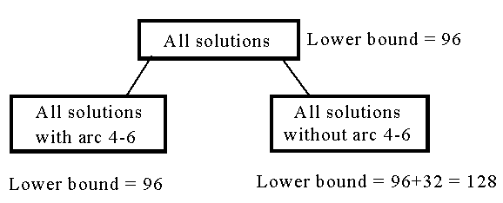
The highest level of a decision tree:
If we use arc 3-5 to split, the difference on the lower bounds is 17+1 = 18.

Slide 23
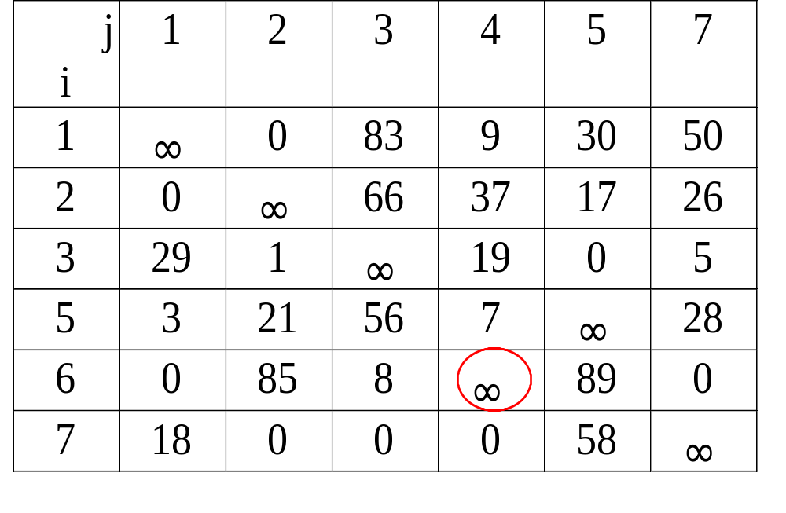
A reduced cost matrix if arc (4,6) is included in the solution.
Arc (6,4) is changed to be infinity since it can not be included in the solution.

Slide 24
The reduced cost matrix for all solutions with arc 4-6
Total cost reduced: 96+3 = 99 (new lower bound)
j
i
1
2
3
4
5
7
1
∞
0
83
9
30
50
2
0
∞
66
37
17
26
3
29
1
∞
19
0
5
5
0
18
53
4
∞
25
(-3)
6
0
85
8
∞
89
0
7
18
0
0
0
58
∞

Slide 25
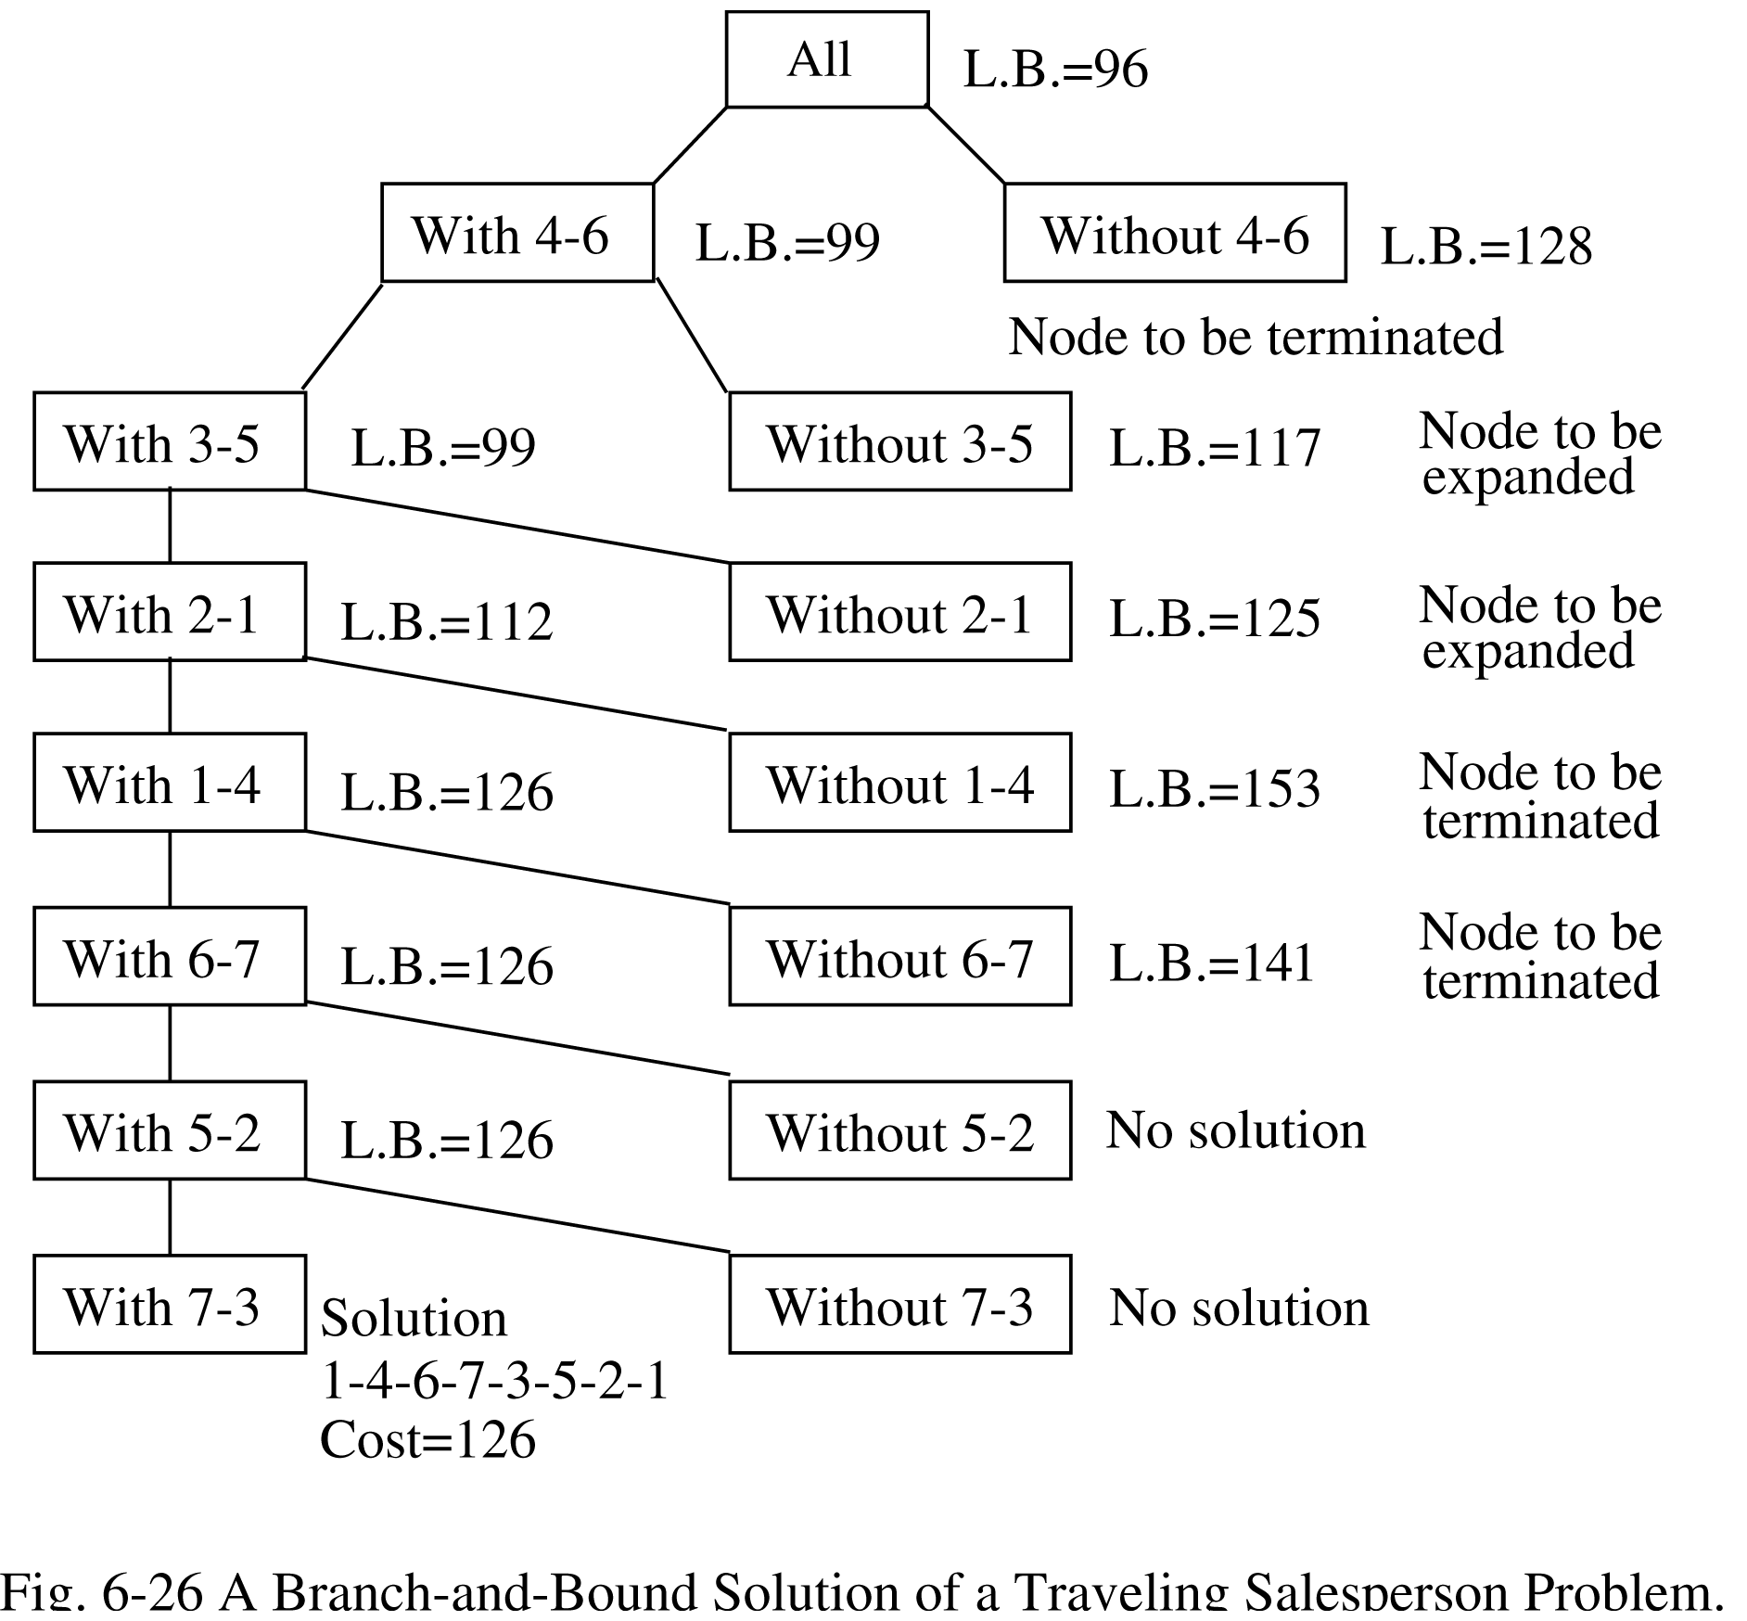
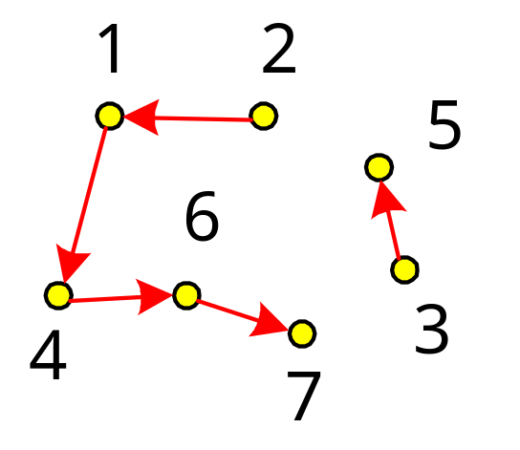
A branch-and-bound solution of a traveling salesperson problem.

Slide 26
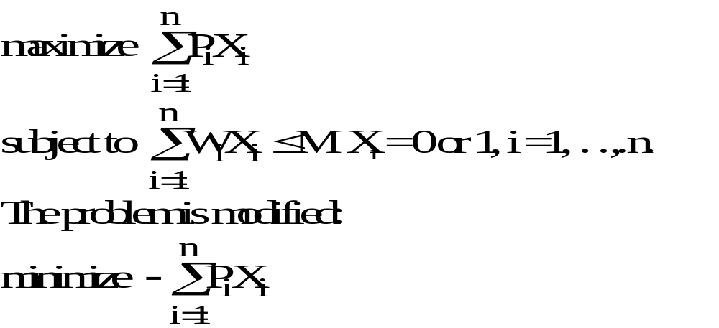
The 0/1 knapsack problem
Positive integer P₁, P₂, …, P_{n} (profit)
W₁, W₂, …, W_{n} (weight)
M (capacity)

Slide 27
e.g. n = 6, M = 34
A feasible solution: X₁ = 1, X₂ = 1, X₃ = 0, X₄ = 0, X₅ = 0, X₆ = 0
-(P₁+P₂) = -16 (upper bound)
Any solution higher than -16 can not be an optimal solution.
i
1
2
3
4
5
6
P_{i}
6
10
4
5
6
4
W_{i}
10
19
8
10
12
8
(P_{i}/W_{i} ≥ P_{i+1}/W_{i+1})

Slide 28
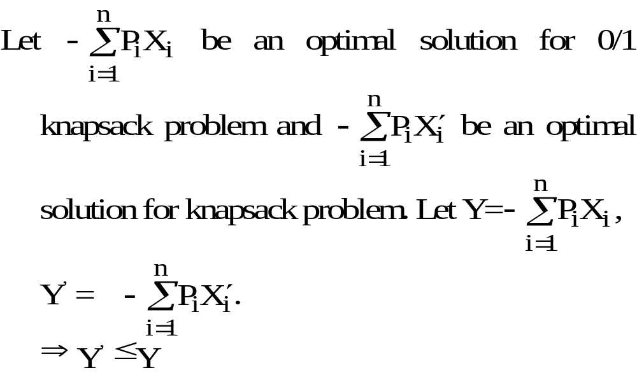
Relax the restriction
Relax our restriction from X_{i} = 0 or 1 to 0 ≤ X_{i} ≤ 1 (knapsack problem)

Slide 29
Upper bound and lower bound
We can use the greedy method to find an optimal solution for knapsack problem:
X₁ = 1, X₂ =1, X₃ = 5/8, X₄ = 0, X₅ = 0, X₆ =0
-(P₁+P₂+5/8P₃) = -18.5 (lower bound)
-18 is our lower bound. (only consider integers)
⇒ -18 ≤ optimal solution ≤ -16
optimal solution: X₁ = 1, X₂ = 0, X₃ = 0, X₄ = 1, X₅ = 1, X₆ = 0
-(P₁+P₄+P₅) = -17

Slide 30
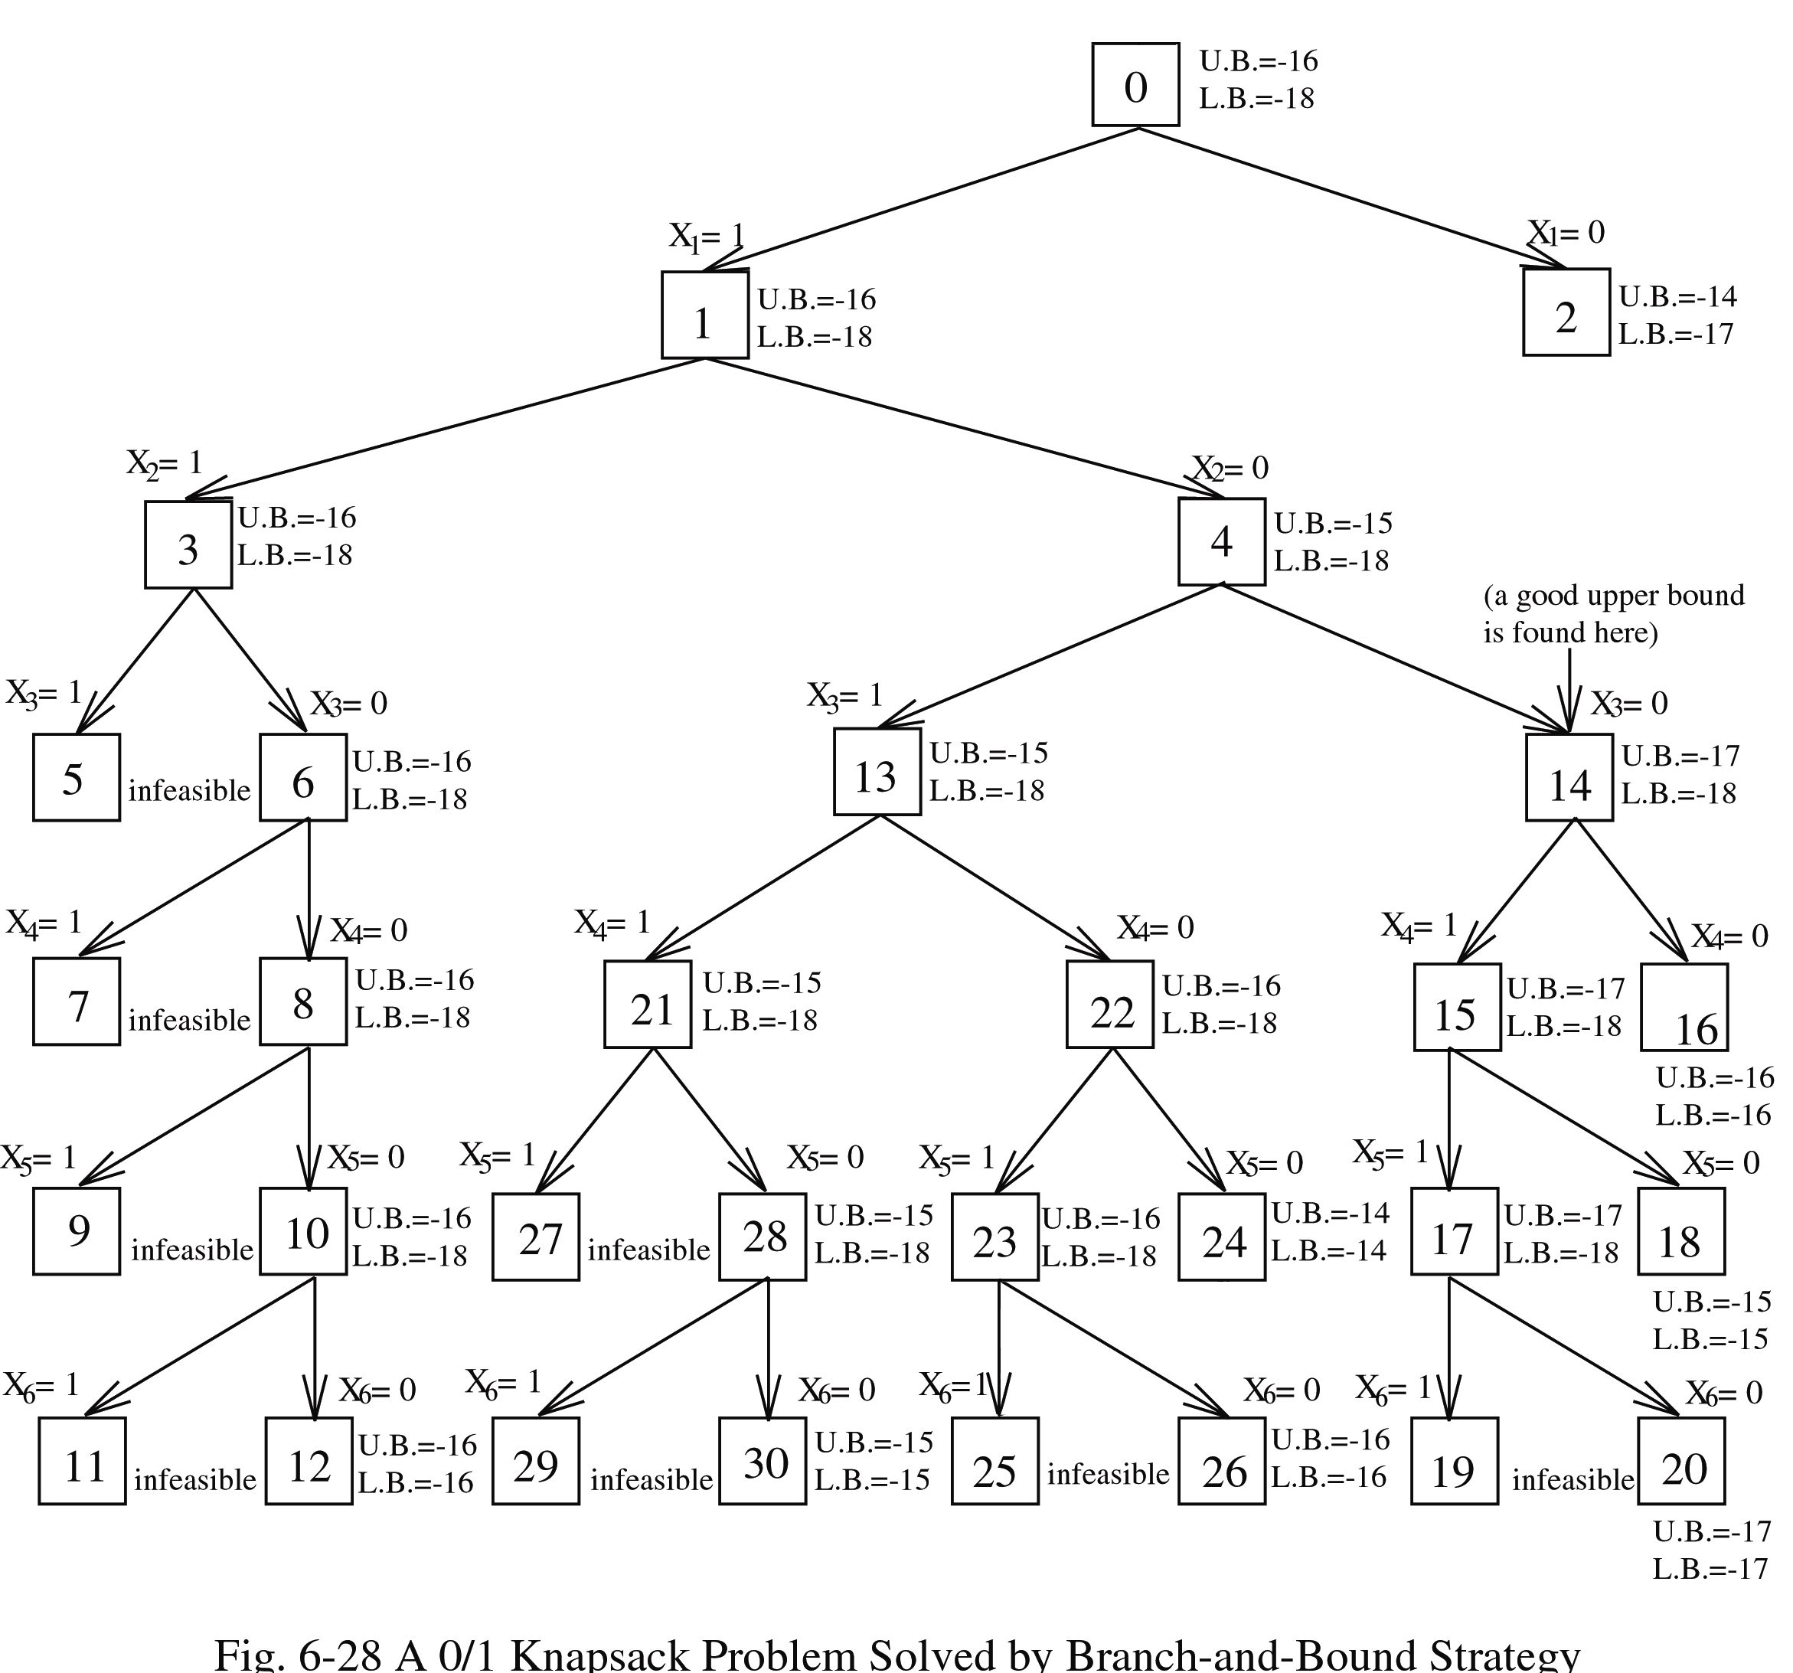
Expand the node with the best lower bound.
0/1 knapsack problem solved by branch-and-bound strategy.

