Slide 1
§ 6 The Searching Strategies
e.g. satisfiability problem
x₁ | x₂ | x₃
F | F | F
F | F | T
F | T | F
F | T | T
T | F | F
T | F | T
T | T | F
T | T | T

Slide 2
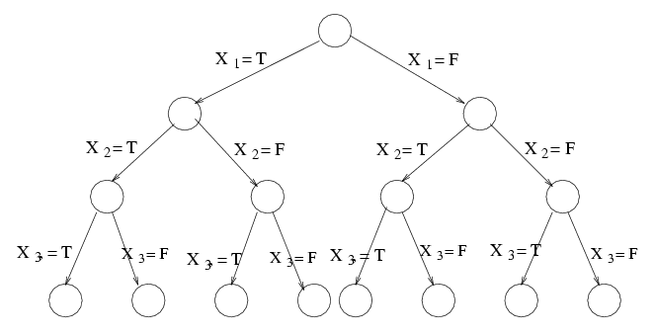
Fig. 6-1 Tree Representation of Eight Assignments.
If there are n variables x₁, x₂, …,x_{n}, then there are 2^{n} possible assignments.

Slide 3
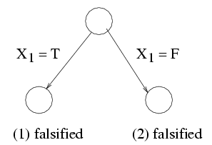
an instance:
-x1 ..................(1)
x1 ..................(2)
x2 v x5 ..........(3)
x3 ..................(4)
-x2 ..................(5)
Fig. 6-2 A Partial Tree to Determine the Satisfiability Problem.
We may not need to examine all possible assignments.

Slide 4
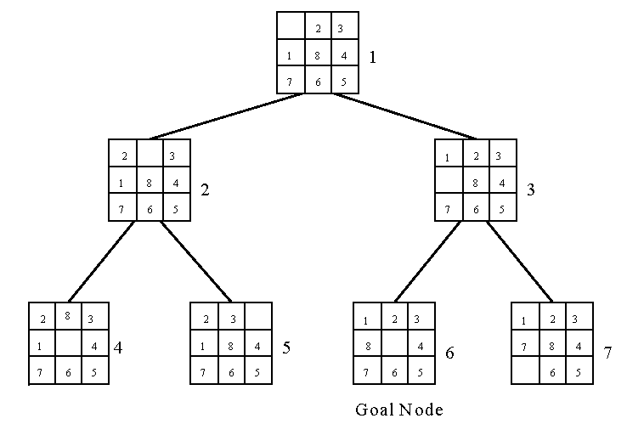
The breadth-first search
e.g. 8-puzzle problem
Fig. 6-10 A Search Tree Produced by a Breadth-First Search
The breadth-first search uses a queue to holds all expanded nodes.

Slide 5
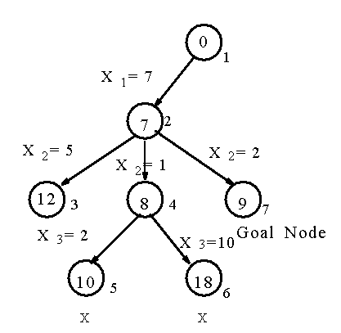
The depth-first search
e.g. sum of subset problem
S={7, 5, 1, 2, 10}
∃ S’ ⊆ S ∋ sum of S’ = 9 ?
Fig. 6-11 A Sum of Subset Problem Solved by Depth-First Search.
A stack can be used to guide the depth-first search.

Slide 6
Hill climbing
a variant of depth-first search
The method selects the locally optimal node to expand.
e.g. 8-puzzle problem
evaluation function f(n) = d(n) + w(n)
where d(n) is the depth of node n
w(n) is # of misplaced tiles in node n.

Slide 7
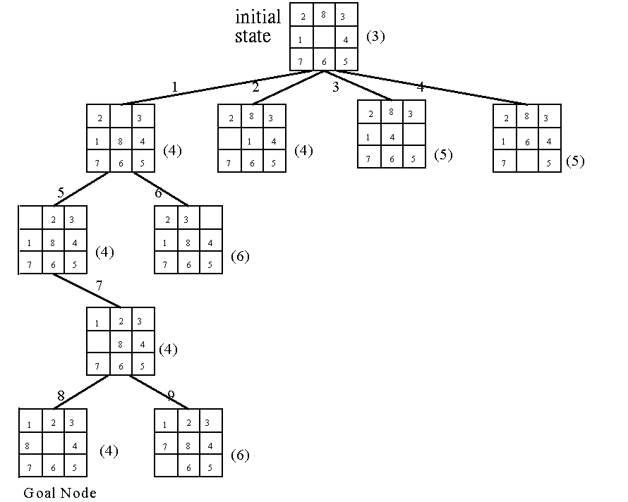
Fig. 6-15 An 8-Puzzle Problem Solved by a Hill Climbing Method.

Slide 8
Best-first search strategy
Combing depth-first search and breadth-first search.
Selecting the node with the best estimated cost among all nodes.
This method has a global view.

Slide 9
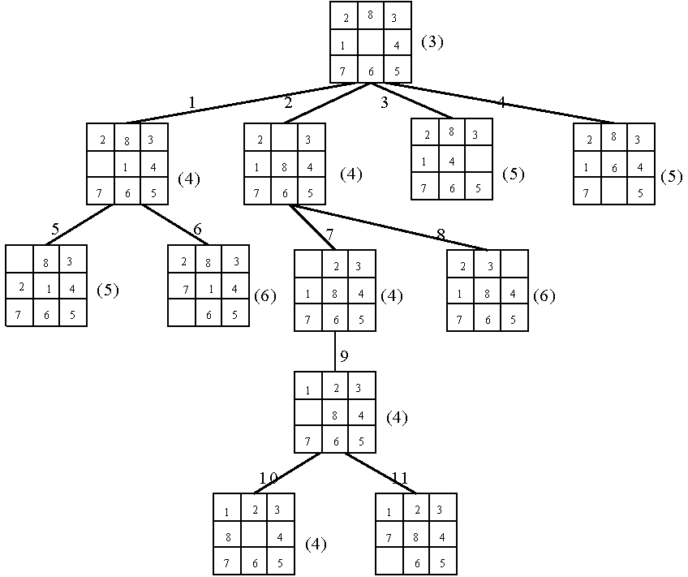
Fig. 6-16 An 8-Puzzle Problem Solved by a Best-First Search Scheme.

Slide 10
Best-First Search Scheme
Step1:Form a one-element list consisting of the root node.
Step2:Remove the first element from the list. Expand the first element. If one of the descendants of the first element is a goal node, then stop; otherwise, add the descendants into the list.
Step3:Sort the entire list by the values of some estimation function.
Step4:If the list is empty, then failure. Otherwise, go to Step 2.

Slide 11
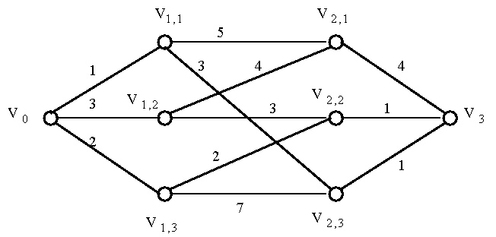
The branch-and-bound strategy
This strategy can be used to solve optimization problems. (DFS, BFS, hill climbing and best-first search can not be used to solve optimization problems.)
e.g.
Fig. 6-17 A Multi-Stage Graph Searching Problem.

Slide 12
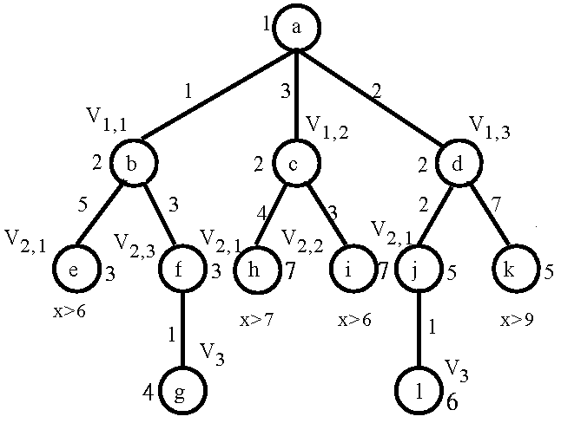
Solved by branch-and-bound:

Slide 13
The personnel assignment problem
a linearly ordered set of persons P={P₁, P₂, …, P_{n}} where P₁<P₂<…<P_{n}
a partially ordered set of jobs J={J₁, J₂, …, J_{n}}
Suppose that P_{i} and P_{j} are assigned to jobs f(P_{i}) and f(P_{j}) respectively. If f(P_{i}) ≤ f(P_{j}), then P_{i} ≤ P_{j}. Cost C_{ij} is the cost of assigning P_{i} to J_{j}. We want to find a feasible assignment with the min.
cost. i.e.
X_{ij} = 1 if P_{i} is assigned to J_{j} and X_{ij} = 0 otherwise.
Minimize ∑_{i,j} C_{ij}X_{ij}

Slide 14
e.g.
Fig. 6-21 A Partial Ordering of Jobs
After topological sorting, one of the following topologically sorted sequences will be generated:
one of feasible assignments:
P₁→J₁, P₂→J₂, P₃→J₃, P₄→J₄
J₁ |  | J₂
↓ | ↘ | ↓
J₃ |  | J₄
J₁, | J₂, | J₃, | J₄
J₁, | J₂, | J₄, | J₃
J₁, | J₃, | J₂, | J₄
J₂, | J₁, | J₃, | J₄
J₂, | J₁, | J₄ | J₃

Slide 15
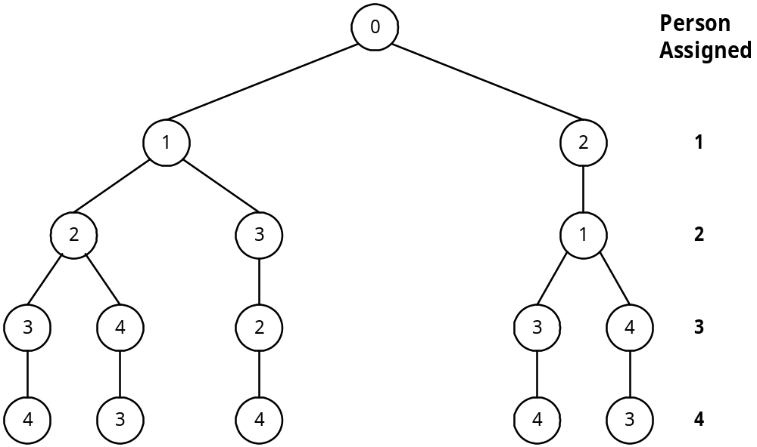
cost matrix:
Table 6-1 A Cost Matrix for a Personnel Assignment Problem.
Solution tree:
Jobs Persons | 1 | 2 | 3 | 4
1 | 29 | 19 | 17 | 12
2 | 32 | 30 | 26 | 28
3 | 3 | 21 | 7 | 9
4 | 18 | 13 | 10 | 15

Slide 16
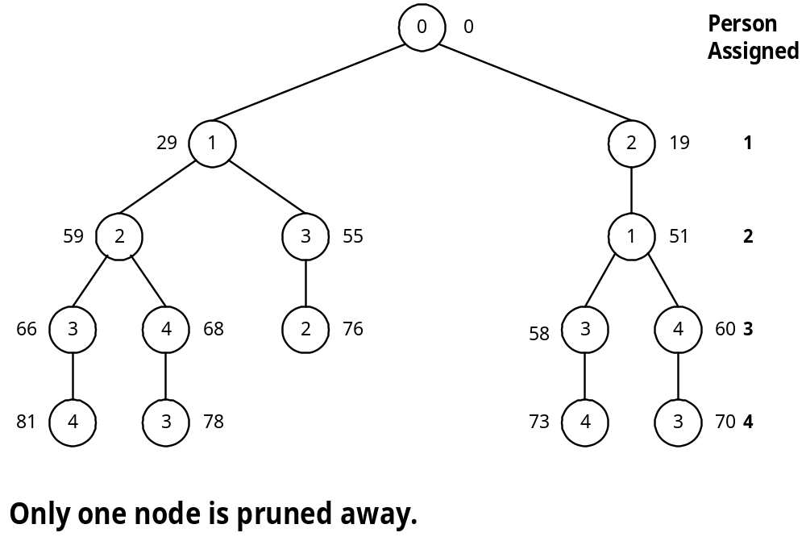
Apply the best-first search scheme:

Slide 17
reduced cost matrix:
subtract a constant from each row and each column respectively such that each row and each column contains at least one zero.
Table 6-2 A Reduced Cost Matrix
total cost subtracted: 12+26+3+10+3 = 54
This is a lower bound of our solution.
Jobs Persons | 1 | 2 | 3 | 4
1 | 17 | 4 | 5 | 0 | (-12)
2 | 6 | 1 | 0 | 2 | (-26)
3 | 0 | 15 | 4 | 6 | (-3)
4 | 8 | 0 | 0 | 5 | (-10)
 |  | (-3)

Slide 18
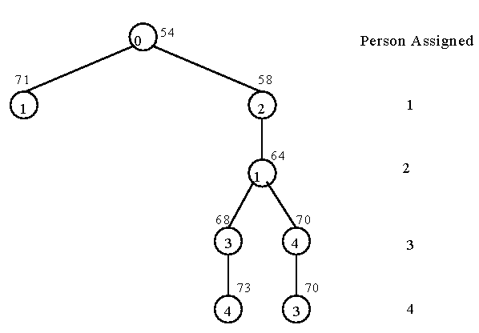
bounding of subsolutions:

Slide 19
The traveling salesperson optimization problem
It is NP-complete
e.g. cost matrix:
Table 6-3 A Cost Matrix for a Traveling Salesperson Problem.
j i | 1 | 2 | 3 | 4 | 5 | 6 | 7
1 | ∞ | 3 | 93 | 13 | 33 | 9 | 57
2 | 4 | ∞ | 77 | 42 | 21 | 16 | 34
3 | 45 | 17 | ∞ | 36 | 16 | 28 | 25
4 | 39 | 90 | 80 | ∞ | 56 | 7 | 91
5 | 28 | 46 | 88 | 33 | ∞ | 25 | 57
6 | 3 | 88 | 18 | 46 | 92 | ∞ | 7
7 | 44 | 26 | 33 | 27 | 84 | 39 | ∞

Slide 20
Reduced cost matrix:
Table 6-4 A Reduced Cost Matrix.
j i | 1 | 2 | 3 | 4 | 5 | 6 | 7
1 | ∞ | 0 | 90 | 10 | 30 | 6 | 54 | (-3)
2 | 0 | ∞ | 73 | 38 | 17 | 12 | 30 | (-4)
3 | 29 | 1 | ∞ | 20 | 0 | 12 | 9 | (-16)
4 | 32 | 83 | 73 | ∞ | 49 | 0 | 84 | (-7)
5 | 3 | 21 | 63 | 8 | ∞ | 0 | 32 | (-25)
6 | 0 | 85 | 15 | 43 | 89 | ∞ | 4 | (-3)
7 | 18 | 0 | 7 | 1 | 58 | 13 | ∞ | (-26)
 |  |  |  |  |  |  | reduced:84

Slide 21
Table 6-5 Another Reduced Cost Matrix.
total cost reduced: 84+7+1+4 = 96 (lower bound)
j i | 1 | 2 | 3 | 4 | 5 | 6 | 7
1 | ∞ | 0 | 83 | 9 | 30 | 6 | 50
2 | 0 | ∞ | 66 | 37 | 17 | 12 | 26
3 | 29 | 1 | ∞ | 19 | 0 | 12 | 5
4 | 32 | 83 | 66 | ∞ | 49 | 0 | 80
5 | 3 | 21 | 56 | 7 | ∞ | 0 | 28
6 | 0 | 85 | 8 | 42 | 89 | ∞ | 0
7 | 18 | 0 | 0 | 0 | 58 | 13 | ∞
 |  |  | (-7) | (-1) |  |  | (-4)

Slide 22
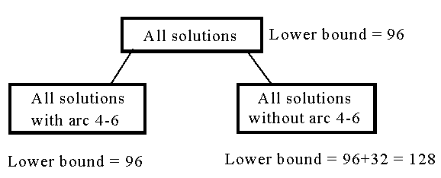
decision tree:
Fig. 6-25 The Highest Level of a Decision Tree.
If we use arc 3-5 to split, the difference on the lower bounds is 17+1 = 18.

Slide 23
j i | 1 | 2 | 3 | 4 | 5 | 7
1 | ∞ | 0 | 83 | 9 | 30 | 50
2 | 0 | ∞ | 66 | 37 | 17 | 26
3 | 29 | 1 | ∞ | 19 | 0 | 5
5 | 3 | 21 | 56 | 7 | ∞ | 28
6 | 0 | 85 | 8 | ∞ | 89 | 0
7 | 18 | 0 | 0 | 0 | 58 | ∞
Table 6-6 A Reduced Cost Matrix. If Arc 4-6 is Included.

Slide 24
The cost matrix for all solution with arc 4-6:
Table 6-7 A Reduced Cost Matrix for that in Table 6-6.
total cost reduced: 96+3 = 99 (new lower bound)
j i | 1 | 2 | 3 | 4 | 5 | 7
1 | ∞ | 0 | 83 | 9 | 30 | 50
2 | 0 | ∞ | 66 | 37 | 17 | 26
3 | 29 | 1 | ∞ | 19 | 0 | 5
5 | 0 | 18 | 53 | 4 | ∞ | 25 | (-3)
6 | 0 | 85 | 8 | ∞ | 89 | 0
7 | 18 | 0 | 0 | 0 | 58 | ∞

Slide 25
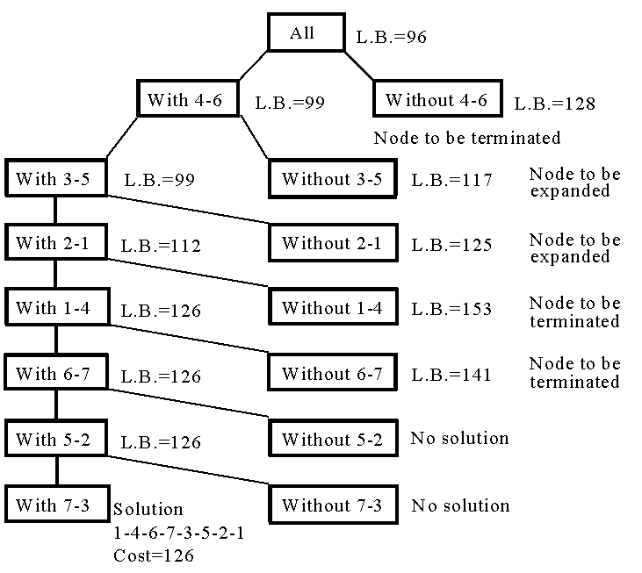
Fig 6-26 A Branch-and-Bound Solution of a Traveling Salesperson Problem.

Slide 26
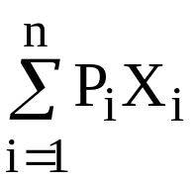
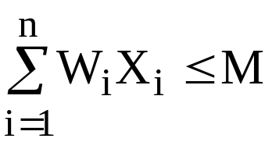
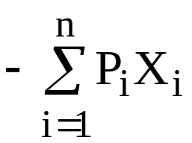
The 0/1 knapsack problem
positive integer P₁, P₂, …, P_{n} (profit)
W₁, W₂, …, W_{n} (weight)
M (capacity)
maximize
subject to X_{i} = 0 or 1, i =1, …, n.
The problem is modified:
minimize

Slide 27
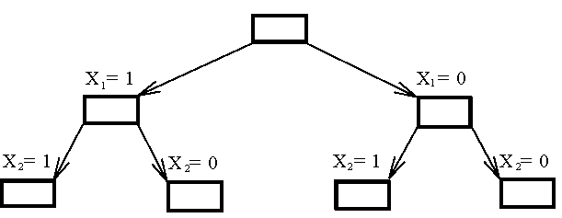
Fig. 6-27 The Branching Mechanism in the Branch-and-Bound Strategy to Solve 0/1 Knapsack Problem.
e.g. n = 6, M = 34
a feasible solution: X₁ = 1, X₂ = 1, X₃ = 0, X₄ = 0, X₅ = 0, X₆ = 0
-(P₁+P₂) = -16 (upper bound)
Any solution higher than -16 can not be an optimal solution.
i | 1 | 2 | 3 | 4 | 5 | 6
P_{i} | 6 | 10 | 4 | 5 | 6 | 4
W_{i} | 10 | 19 | 8 | 10 | 12 | 8
(P_{i}/W_{i} ≥ P_{i+1}/W_{i+1})

Slide 28
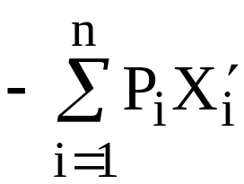
Relax our restriction from X_{i} = 0 or 1 to 0 ≤ X_{i} ≤ 1 (knapsack problem)
Let be an optimal solution for 0/1
knapsack problem and be an optimal
solution for knapsack problem. Let Y= ,
Y’ = .
⇒ Y’ ≤ Y

Slide 29
We can use the greedy method to find an optimal solution for knapsack problem:
X₁ = 1, X₂ =1, X₃ = 5/8, X₄ = 0, X₅ = 0, X₆ =0
-(P₁+P₂+5/8P₃) = -18.5 (lower bound)
-18 is our lower bound. (only consider integers)
⇒ -18 ≤ optimal solution ≤ -16
optimal solution: X₁ = 1, X₂ = 0, X₃ = 0, X₄ = 1, X₅ = 1, X₆ = 0
-(P₁+P₄+P₅) = -17

Slide 30
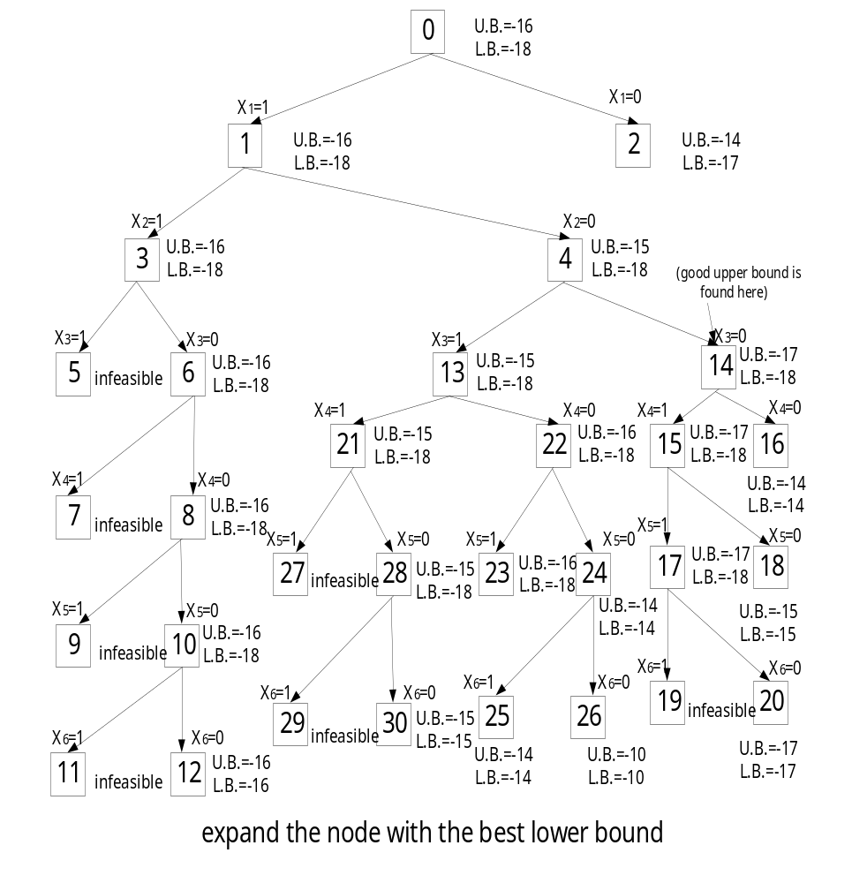
Fig. 6-28 0/1 Knapsack Problem Solved by Branch-and-Bound Strategy.

