Slide 1
Chapter 7
Dynamic Programming
7 -<number>

Slide 2
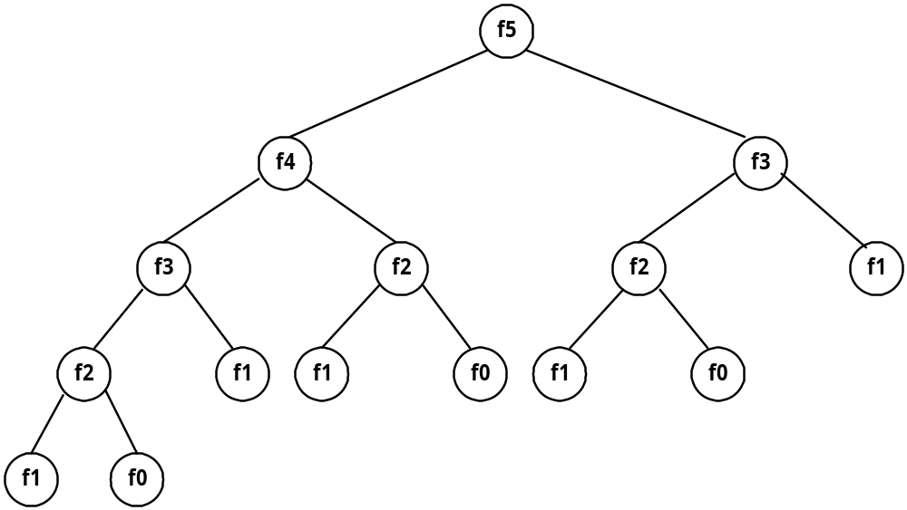
Fibonacci sequence
Fibonacci sequence: 0 , 1 , 1 , 2 , 3 , 5 , 8 , 13 , 21 , …
F_{i} = i if i ≤ 1
F_{i} = F_{i-1} + F_{i-2} if i ≥ 2
Solved by a recursive program:
Much replicated computation is done.
It should be solved by a simple loop.
7 -<number>

Slide 3
Dynamic Programming
Dynamic Programming is an algorithm design method that can be used when the solution to a problem may be viewed as the result of a sequence of decisions
7 -<number>

Slide 4
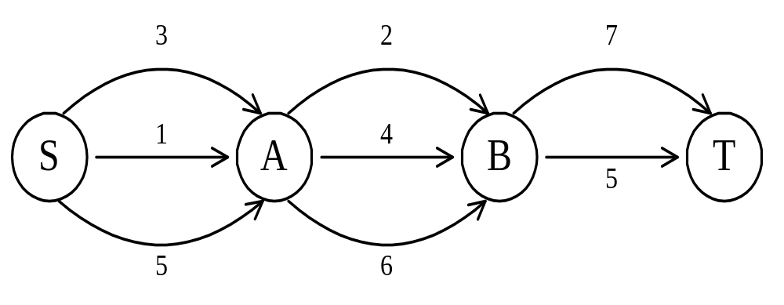
The shortest path
To find a shortest path in a multi-stage graph
Apply the greedy method :
the shortest path from S to T :
1 + 2 + 5 = 8
7 -<number>

Slide 5
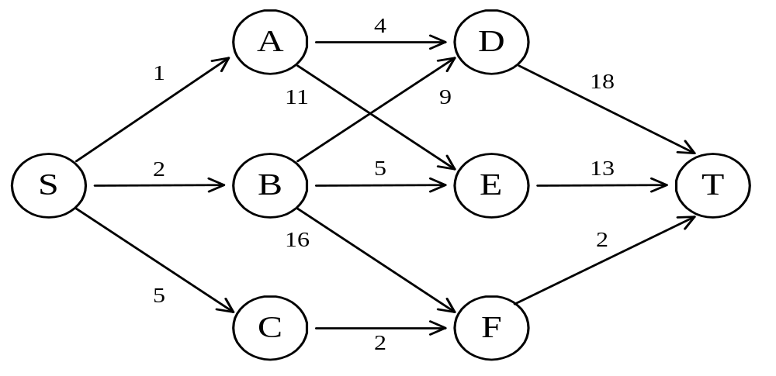
The shortest path in multistage graphs
e.g.
The greedy method can not be applied to this case: (S, A, D, T) 1+4+18 = 23.
The real shortest path is:
(S, C, F, T) 5+2+2 = 9.
7 -<number>

Slide 6
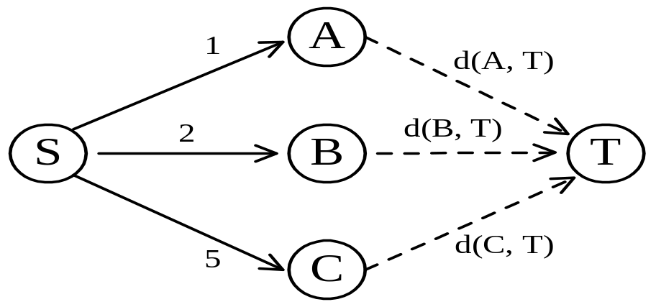
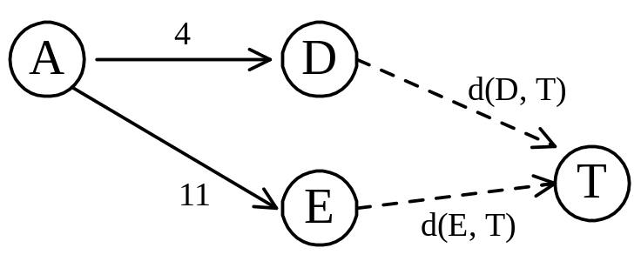
Dynamic programming approach
Dynamic programming approach (forward approach):
d(S, T) = min{1+d(A, T), 2+d(B, T), 5+d(C, T)}
d(A,T) = min{4+d(D,T), 11+d(E,T)}
= min{4+18, 11+13} = 22.
7 -<number>

Slide 7
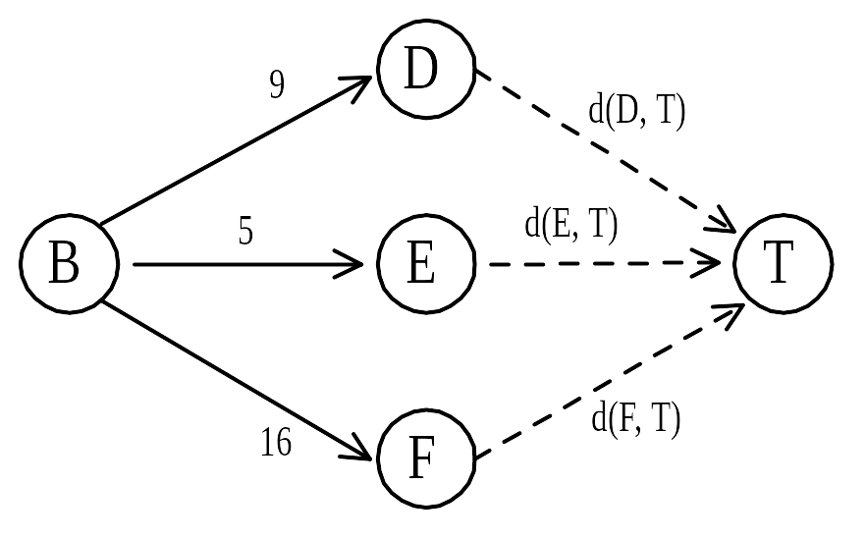
d(B, T) = min{9+d(D, T), 5+d(E, T), 16+d(F, T)}
= min{9+18, 5+13, 16+2} = 18.
d(C, T) = min{ 2+d(F, T) } = 2+2 = 4
d(S, T) = min{1+d(A, T), 2+d(B, T), 5+d(C, T)}
= min{1+22, 2+18, 5+4} = 9.
The above way of reasoning is called
backward reasoning.
7 -<number>

Slide 8
Backward approach
(forward reasoning)
d(S, A) = 1
d(S, B) = 2
d(S, C) = 5
d(S,D)=min{d(S,A)+d(A,D), d(S,B)+d(B,D)}
= min{ 1+4, 2+9 } = 5
d(S,E)=min{d(S,A)+d(A,E), d(S,B)+d(B,E)}
= min{ 1+11, 2+5 } = 7
d(S,F)=min{d(S,B)+d(B,F), d(S,C)+d(C,F)}
= min{ 2+16, 5+2 } = 7
7 -<number>

Slide 9
d(S,T) = min{d(S, D)+d(D, T), d(S,E)+
d(E,T), d(S, F)+d(F, T)}
= min{ 5+18, 7+13, 7+2 }
= 9
7 -<number>

Slide 10
Principle of optimality
Principle of optimality: Suppose that in solving a problem, we have to make a sequence of decisions D₁, D₂, …, D_{n}. If this sequence is optimal, then the last k decisions, 1 < k < n must be optimal.
e.g. the shortest path problem
If i, i₁, i₂, …, j is a shortest path from i to j, then i₁, i₂, …, j must be a shortest path from i₁ to j
In summary, if a problem can be described by a multistage graph, then it can be solved by dynamic programming.
7 -<number>

Slide 11
Dynamic programming
Forward approach and backward approach:
  Note that if the recurrence relations are formulated using the forward approach then the relations are solved backwards . i.e., beginning with the last decision
  On the other hand if the relations are formulated using the backward approach, they are solved forwards.
To solve a problem by using dynamic programming:
  Find out the recurrence relations.
  Represent the problem by a multistage graph.
7 -<number>

Slide 12
The longest common subsequence (LCS) problem
A string : A = b a c a d
A subsequence of A: deleting 0 or more symbols from A (not necessarily consecutive).
e.g. ad, ac, bac, acad, bacad, bcd.
Common subsequences of A = b a c a d and
B = a c c b a d c b : ad, ac, bac, acad.
The longest common subsequence (LCS) of A and B:
a c a d.
7 -<number>

Slide 13
The LCS algorithm
Let A = a₁ a₂ … a_{m} and B = b₁ b₂ … b_{n}
Let L_{i,j} denote the length of the longest common subsequence of a₁ a₂ … a_{i} and b₁ b₂ … b_{j.}
L_{i,j} = L_{i-1,j-1} + 1 if a_{i}=b_{j}
max{ L_{i-1,j}, L_{i,j-1} } if a_{i}≠b_{j}
L_{0,0} = L_{0,j} = L_{i,0} = 0 for 1≤i≤m, 1≤j≤n.
7 -<number>

Slide 14
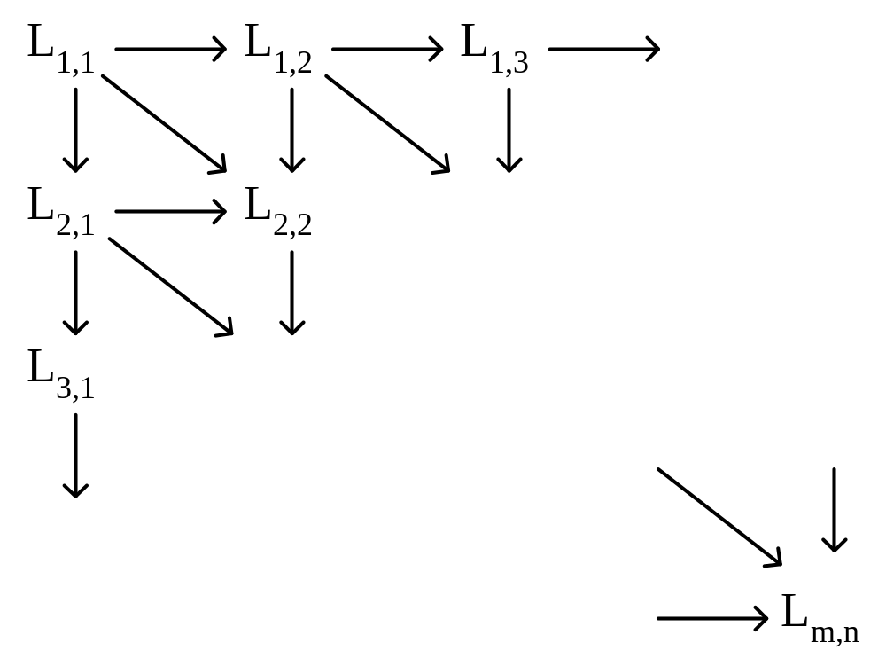
The dynamic programming approach for solving the LCS problem:
Time complexity: O(mn)
7 -<number>

Slide 15
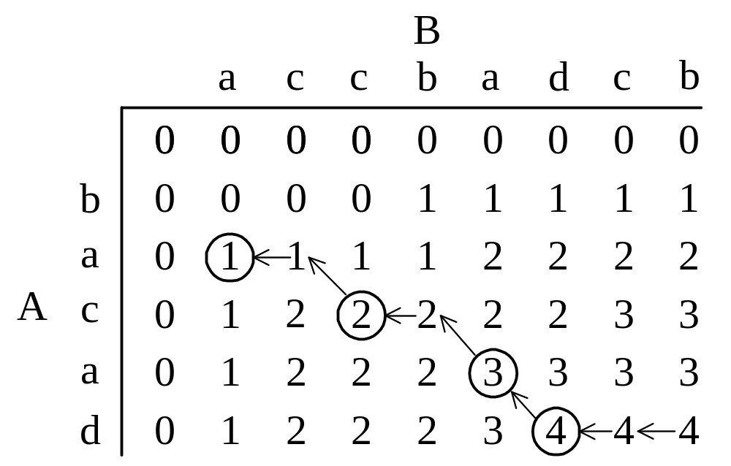
Tracing back in the LCS algorithm
e.g. A = b a c a d, B = a c c b a d c b
After all L_{i,j}’s have been found, we can trace back to find the longest common subsequence of A and B.
7 -<number>

Slide 16
The edit distance problem
3 edit operations: insertion, deletion, replacement
e.g string A=‘vintner’, string B=‘writers’
v intner
wri t ers
RIMDMDMMI
M: match, I: insert, D:delete, R: replace
The edit cost of each I, D, or R is 1.
The edit distance between A and B: 5.
7 -<number>

Slide 17
The edit distance algorithm
Let A = a₁ a₂ … a_{m} and B = b₁ b₂ … b_{n}
Let D_{i,j} denote the edit distance of a₁ a₂ … a_{i} and b₁ b₂ … b_{j.}
D_{i,0} = i, 0 ≤ i ≤ m
D_{0,j} = j, 0 ≤ j ≤ n
D_{i,j} = min{D_{i-1, j} + 1, D_{i, j-1} + 1, D_{i-1, j-1} + t_{i, j}}, 1 ≤ i ≤ m, 1 ≤ j ≤ n
where t_{i, j} = 0 if a_{i} = b_{j} and t_{i, j} = 1 if a_{i} ≠ b_{j}.
7 -<number>

Slide 18
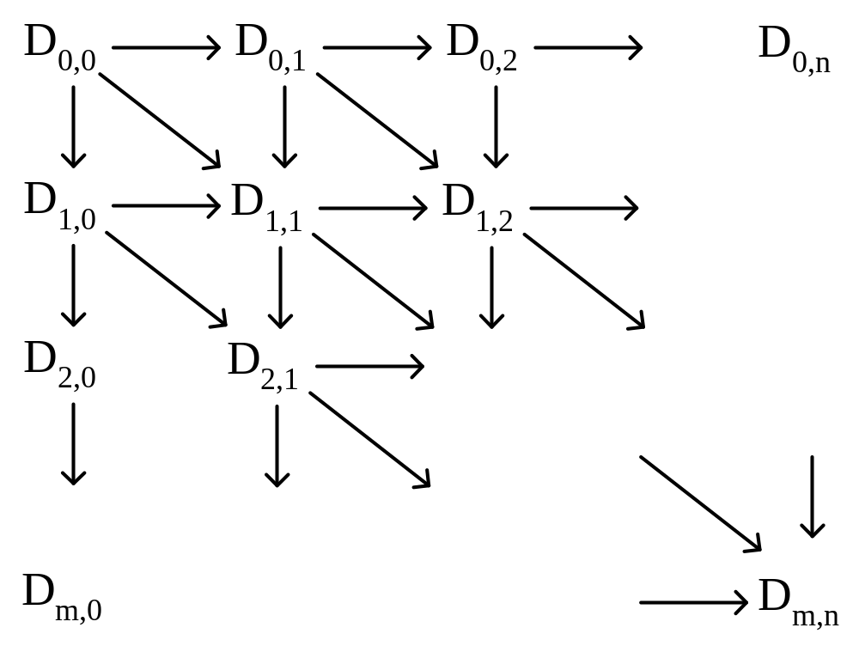
The dynamic programming approach for calculating the distance matrix:
Time complexity: O(mn)
7 -<number>

Slide 19
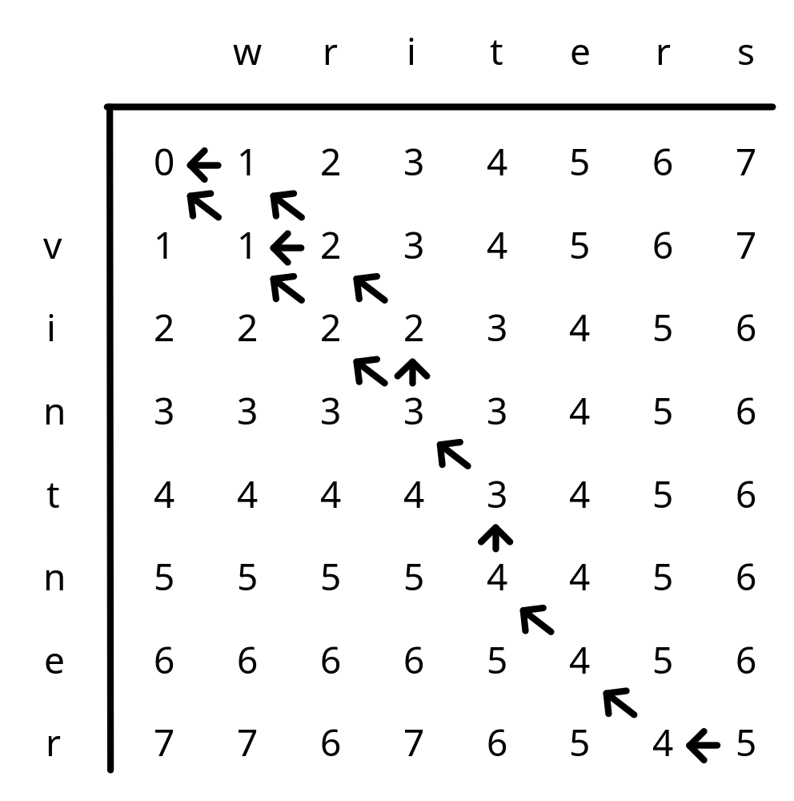
e.g. A=‘vintner’, B=‘writers’
The 3 optimal alignments :
v-intner- -:gap
wri-t-ers
-vintner-
wri-t-ers
vintner-
writ-ers
7 -<number>

Slide 20
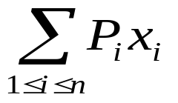
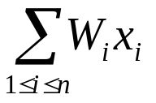
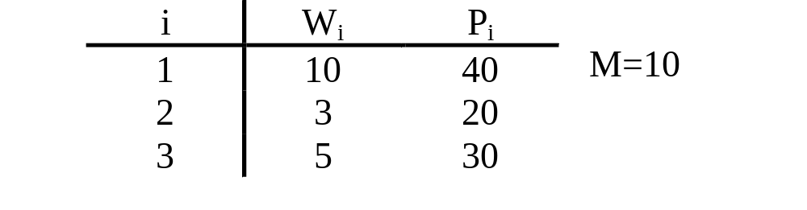
0/1 knapsack problem
n objects , weight W₁, W₂, …,W_{n}
profit P₁, P₂, …,P_{n}
capacity M
maximize
subject to ≤ M
x_{i} = 0 or 1, 1≤i≤n
e. g.
7 -<number>

Slide 21
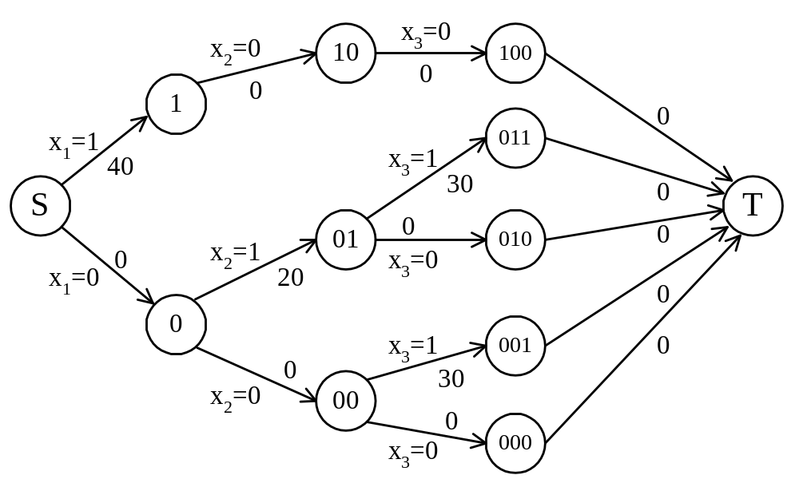
The multistage graph solution
The 0/1 knapsack problem can be described by a multistage graph.
7 -<number>

Slide 22
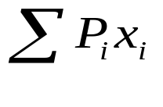
The dynamic programming approach
The longest path represents the optimal solution:
x₁=0, x₂=1, x₃=1
= 20+30 = 50
Let f_{i}(Q) be the value of an optimal solution to objects 1,2,3,…,i with capacity Q.
f_{i}(Q) = max{ f_{i-1}(Q), f_{i-1}(Q-W_{i})+P_{i} }
The optimal solution is f_{n}(M).
7 -<number>

Slide 23
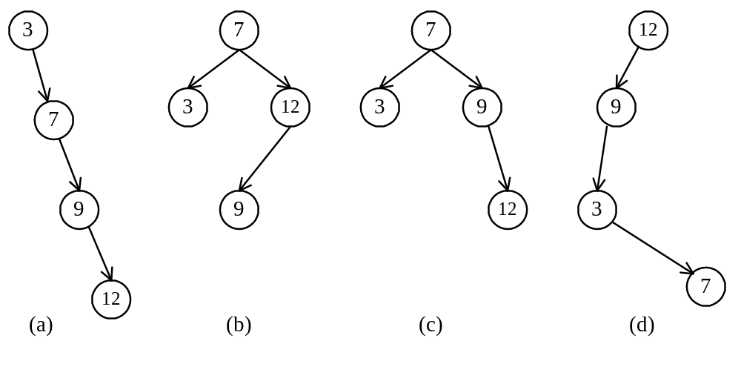
Optimal binary search trees
e.g. binary search trees for 3, 7, 9, 12;
7 -<number>

Slide 24
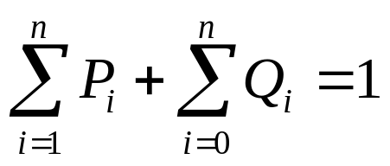
Optimal binary search trees
n identifiers : a₁ <a₂ <a₃ <…< a_{n}
P_{i}, 1≤i≤n : the probability that a_{i} is searched.
Q_{i}, 0≤i≤n : the probability that x is searched
where a_{i} < x < a_{i+1} (a₀=-∞, a_{n+1}=∞).
7 -<number>

Slide 25
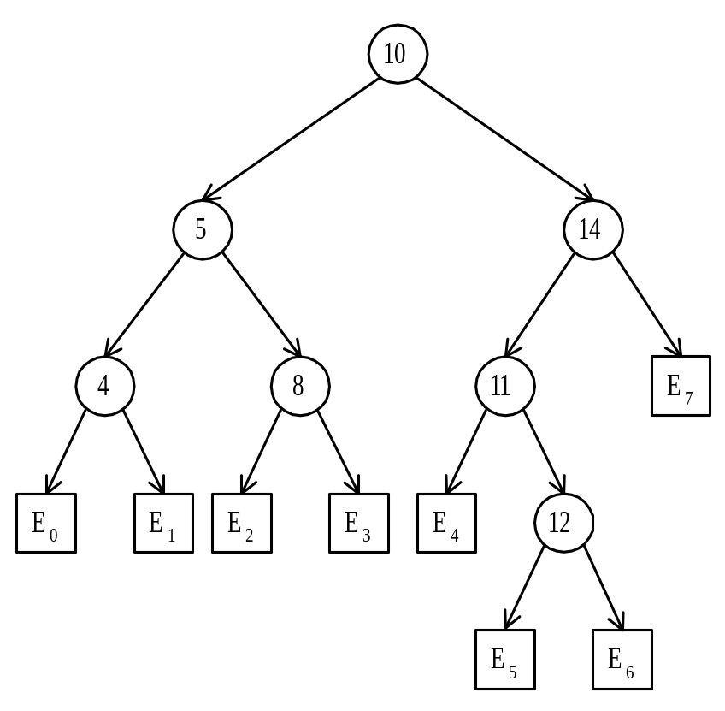
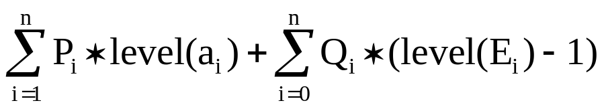
Identifiers : 4, 5, 8, 10, 11, 12, 14
Internal node : successful search, P_{i}
External node : unsuccessful search, Q_{i}
The expected cost of a binary tree:
The level of the root : 1
7 -<number>

Slide 26
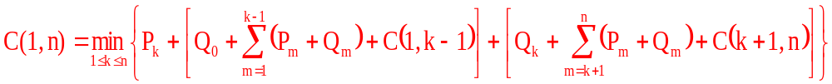
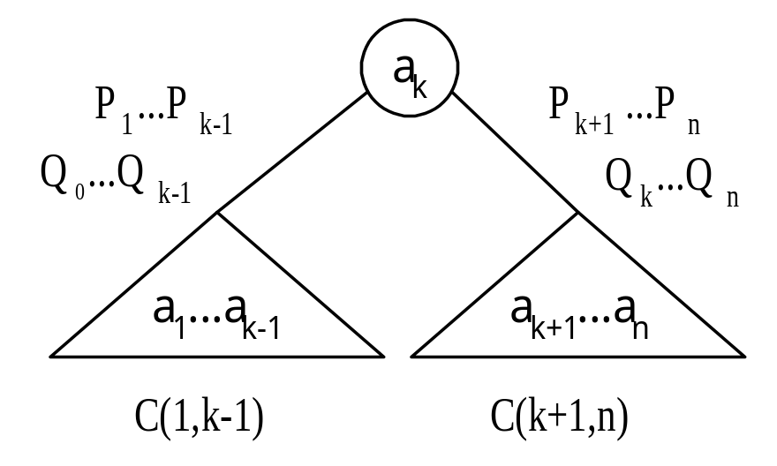
The dynamic programming approach
Let C(i, j) denote the cost of an optimal binary search tree containing a_{i},…,a_{j} .
The cost of the optimal binary search tree with a_{k} as its root :
7 -<number>

Slide 27
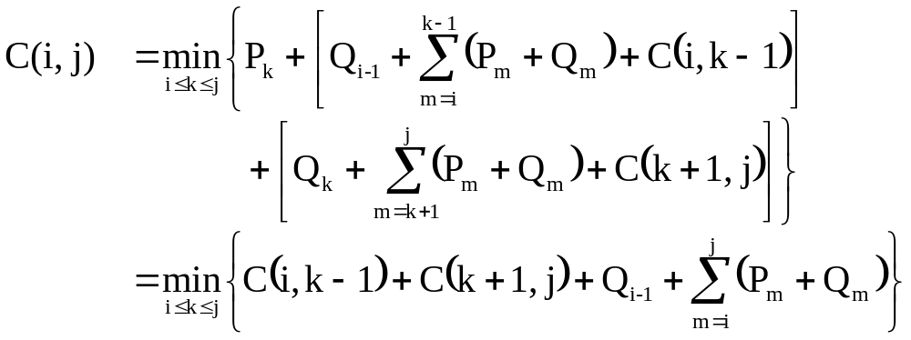
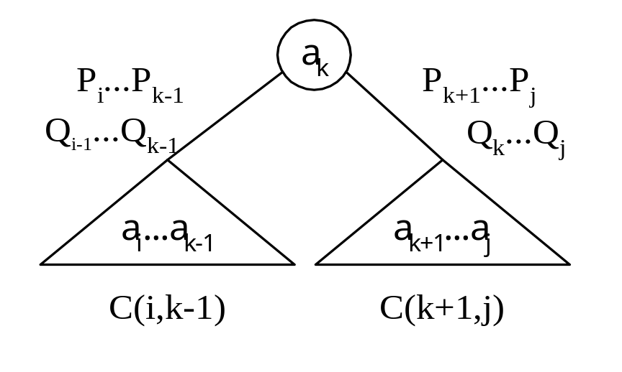
General formula
7 -<number>

Slide 28
Computation for n=4
1
2
2
3
3
4
2
1
3
2
4
3
C(1,2)
C(2,3)
C(3,4)
1
2
3
2
3
4
2,3
1
3
1,2
3,4
2
4
2,3
C(1,3)
C(2,4)
1
2
3
4
2,4
1
3,4
1,2
4
1,3
C(1,4)

Slide 29
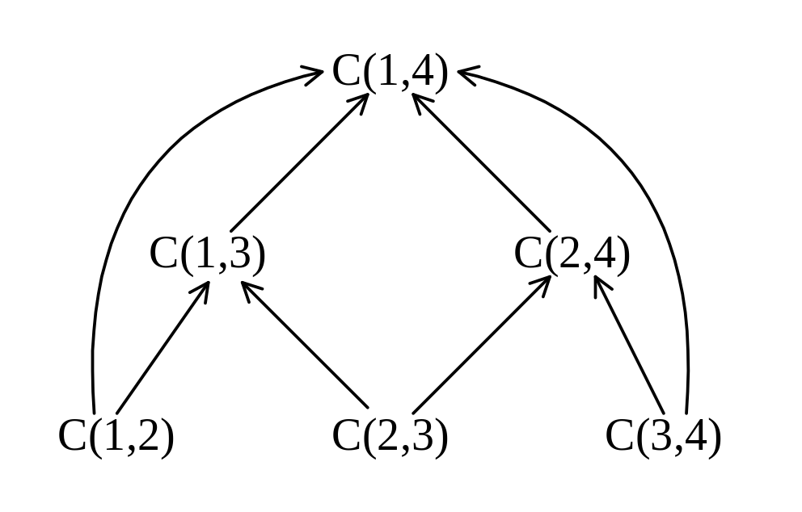
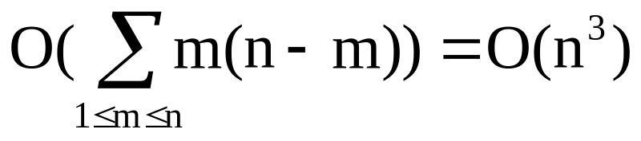
Computation relationships of subtrees
e.g. n=4
Time complexity : O(n³)
(n-m) C(i, j)’s are computed when j-i=m.
Each C(i, j) with j-i=m can be computed in O(m) time.
7 -<number>

Slide 30
Matrix-chain multiplication
n matrices A₁, A₂, …, A_{n} with size
p₀ × p₁, p₁ × p₂, p₂ × p₃, …, p_{n-1} × p_{n}
To determine the multiplication order such that # of scalar multiplications is minimized.
To compute A_{i} × A_{i+1}, we need p_{i-1}p_{i}p_{i+1} scalar multiplications.
e.g. n=4, A₁: 3 × 5, A₂: 5 × 4, A₃: 4 × 2, A₄: 2 × 5
((A₁ × A₂) × A₃) × A₄, # of scalar multiplications:
3 * 5 * 4 + 3 * 4 * 2 + 3 * 2 * 5 = 114
(A₁ × (A₂ × A₃)) × A₄, # of scalar multiplications:
3 * 5 * 2 + 5 * 4 * 2 + 3 * 2 * 5 = 100
(A₁ × A₂) × (A₃ × A₄), # of scalar multiplications:
3 * 5 * 4 + 3 * 4 * 5 + 4 * 2 * 5 = 160
7 -<number>

Slide 31
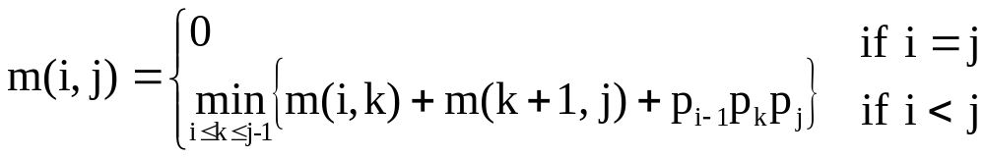
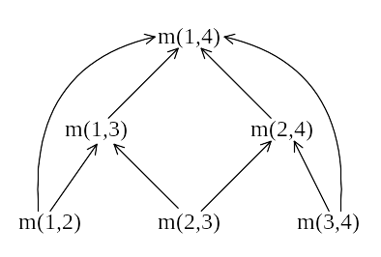
Let m(i, j) denote the minimum cost for computing
A_{i} × A_{i+1} × … × A_{j}
Computation sequence :
Time complexity : O(n³)
7 -<number>

