Slide 1
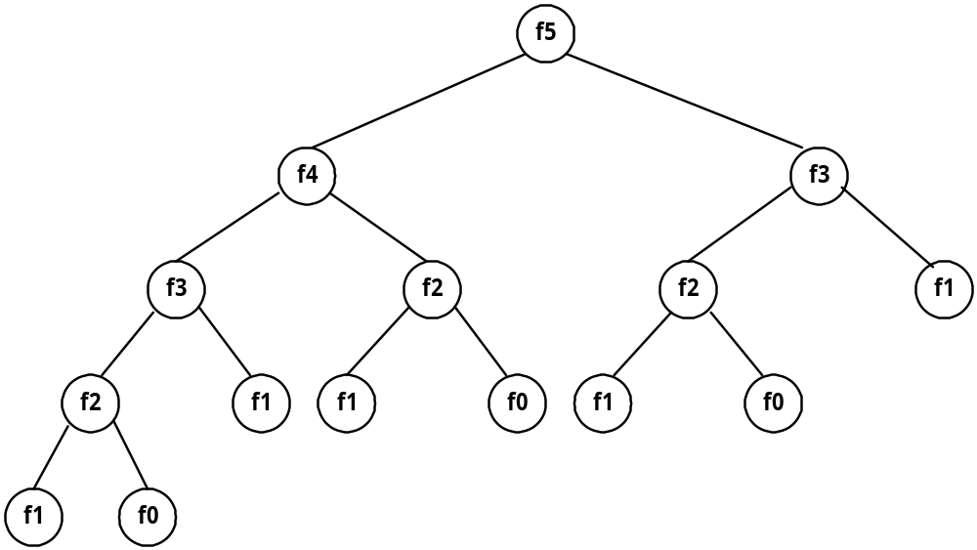
§ 8 Dynamic Programming
Fibonacci sequence
e.g. 0 , 1 , 1 , 2 , 3 , 5 , 8 , 13 , 21 ,…….
F_{i} = i if i ≤ 1
F_{i} = F_{i-1} + F_{i-2} if i ≥ 2
Solved by a recursive program:
Much replicated computation is done.
It should be solved by a simple loop.

Slide 2
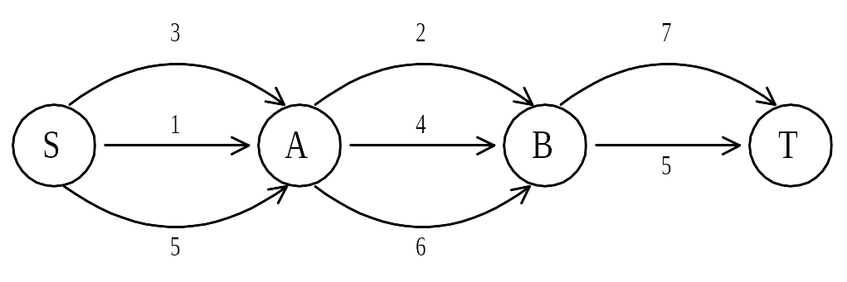
Shortest path
e.g. to find a shortest path in a multi-stage graph.
Apply the greedy method :
the shortest path from S to T :
1 + 2 + 5 = 8

Slide 3
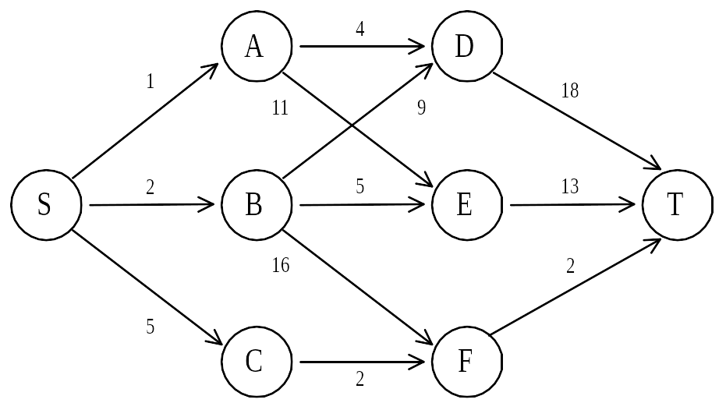
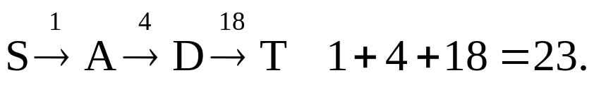
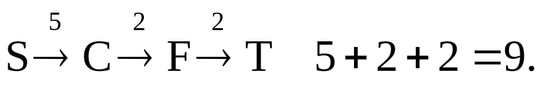
e.g.
The greedy method can not be applied to this case:
The shortest path is:

Slide 4
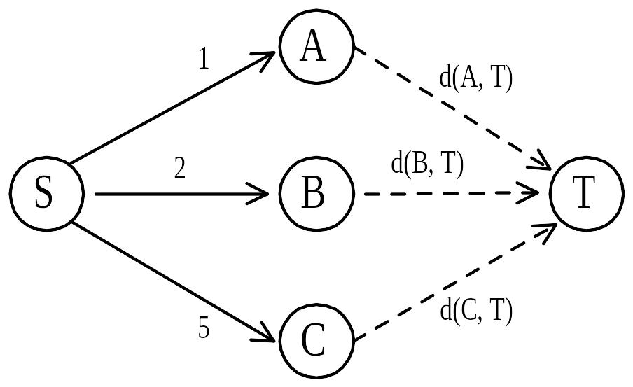
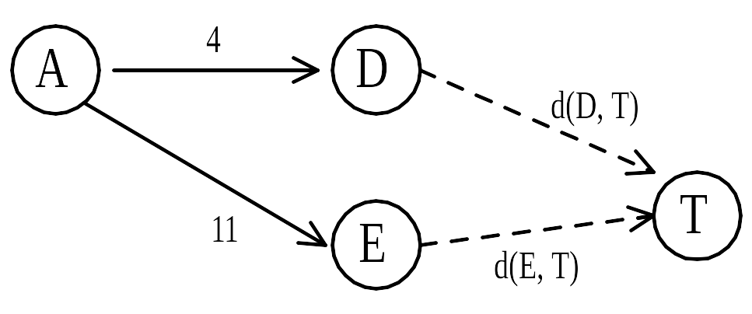
Dynamic programming approach:
d(S, T) = min{1+d(A, T), 2+d(B, T), 5+d(C, T)}.
d(A, T) = min{4+d(D, T), 11+d(E, T)}
= min{4+18, 11+13} = 22.

Slide 5
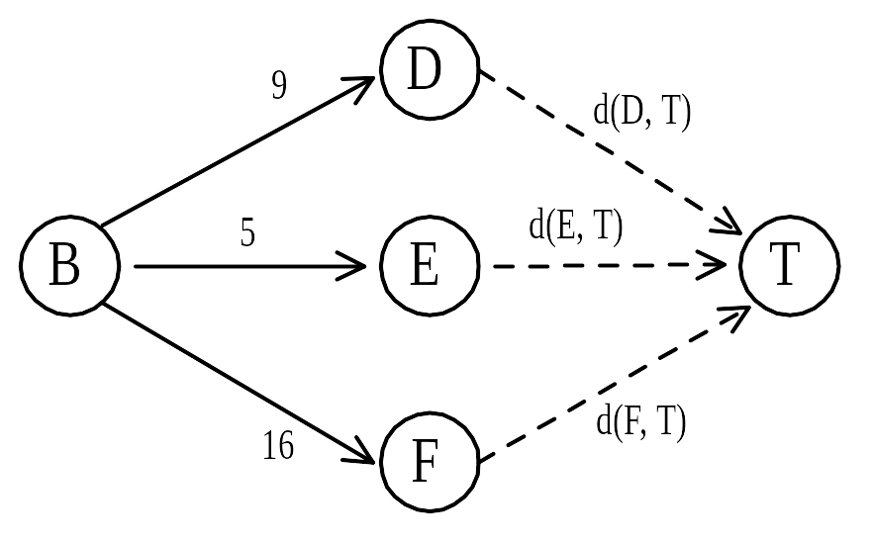
d(B, T) = min{9+d(D, T), 5+d(E, T), 16+d(F, T)}
= min{9+18, 5+13, 16+2} = 18.
d(C, T) = min{ 2+d(F, T) }
= 2+2 = 4
d(S, T) = min{1+d(A, T), 2+d(B, T), 5+d(C, T)}
= min{1+22, 2+18, 5+4} = 9.
The above way of reasoning is a backward reasoning.

Slide 6
forward reasoning :
d(S, A) = 1
  d(S, B) = 2
  d(S, C) = 5
d(S, D) = min{ d(S, A) + d(A, D), d(S, B) + d(B, D) }
  = min{ 1 + 4, 2 + 9 }
  = 5
  d(S, E) = min{ d(S, A) + d(A, E), d(S, B) + d(B, E) }
  = min{ 1 + 11, 2 + 5 }
  = 7
  d(S, F) = min{ d(S, A) + d(A, F), d(S, B) + d(B, F) }
  = min{ 2 + 16, 5 + 2 }
  = 7
d(S, T) = min{ d(S, D) + d(D, T), d(S, E) + d(E, T), d(S, F) + d(F, T)}
  = min{ 5 + 18, 7 + 13, 7 + 2 }
  = 9

Slide 7
Principle of optimality:
Suppose that in solving a problem, we have to make a sequence of decisions D₁, D₂, …, D_{n}.
If this sequence is optimal, then the last k decisions, 1 < k < n must be optimal.
e.g. the shortest path problem
If i, i₁, i₂, …, j is a shortest path from i to j, then i₁, i₂, …, j must be a shortest path from i₁ to j.

Slide 8
The longest common subsequence (LCS) problem
a string : A = b a c a d
a subsequence of A: deleting 0 or more symbols from A (not necessarily consecutive).
e.g. ad, ac, bac, acad, bacad, bcd.
common subsequences of A = b a c a d and B = a c c b a d c b :
ad, ac, bac, acad.
the longest common subsequence of A and B:
a c a d.

Slide 9
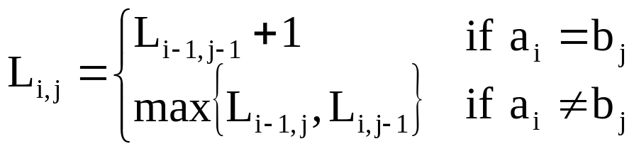
Let A = a₁ a₂ … a_{m} and B = b₁ b₂ … b_{n}
Let L_{i,j} denote the length of the longest common subsequence of a₁ a₂ … a_{i} and b₁ b₂ … b_{j.}
L_{0,0} = L_{0,j} = L_{i,0} = 0 for 1≤i≤m, 1≤j≤n.

Slide 10
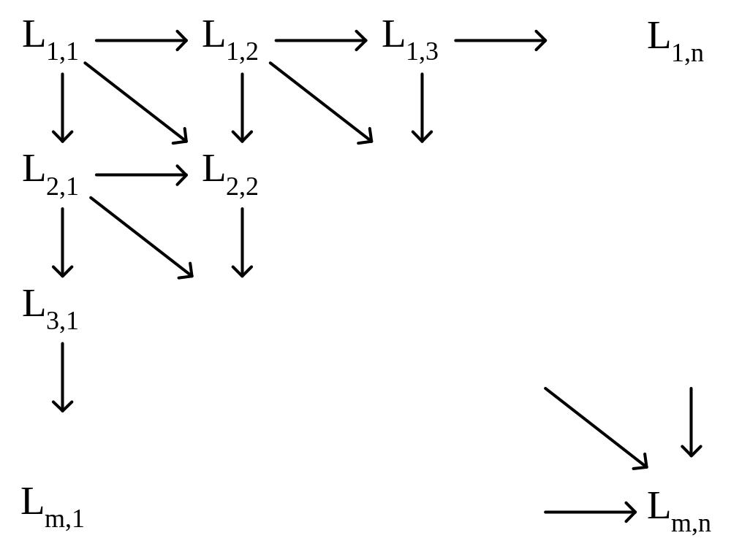
The dynamic programming approach to calculate matrix L :
Time complexity : O(mn)

Slide 11
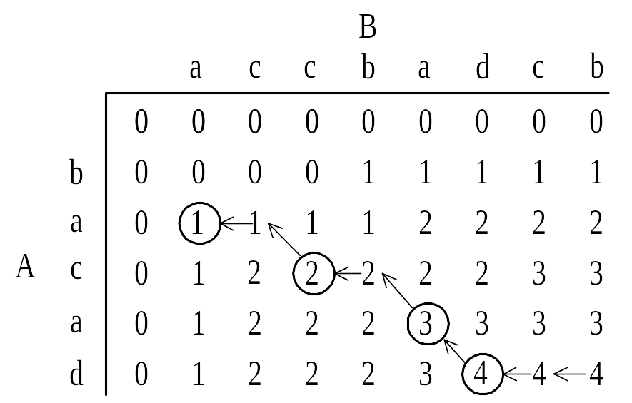
e.g. A = b a c a d, B = a c c b a d c b
After all L_{i,j}’s have been found, we can trace back to find the longest common subsequence of A and B.

Slide 12
The edit distance problem
3 edit operations: insertion, deletion, replacement
e.g string A=‘vintner’, string B=‘writers’
v intner
wri t ers
RIMDMDMMI
M: match, I: insert, D:delete, R: replace
The edit cost of each I, D, or R is 1.
The edit distance between A and B: 5.

Slide 13
Let A = a₁a₂…a_{m} and B = b₁b₂…b_{n}.
Let D_{i,j} denote the edit distance between a₁a₂…a_{i} and b₁b₂…b_{j}
D_{i,0} = i, 0 ≤ i ≤ m
D_{0,j} = j, 0 ≤ j ≤ n
D_{i,j} = min{D_{i-1, j} + 1, D_{i, j-1} + 1, D_{i-1, j-1} + t_{i, j}}, 1 ≤ i ≤ m, 1 ≤ j ≤ n
where t_{i, j} = 0 if a_{i} = b_{j} and t_{i, j} = 1 if a_{i} ≠ b_{j}.

Slide 14
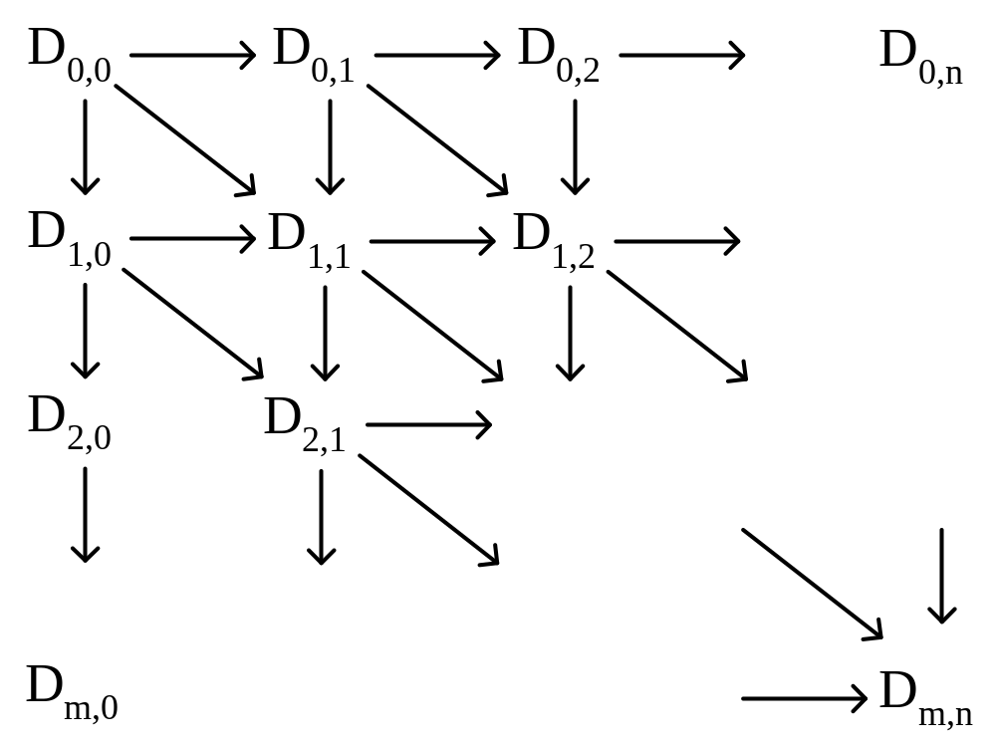
The dynamic programming approach to calculate matrix D:
time complexity: O(mn)

Slide 15
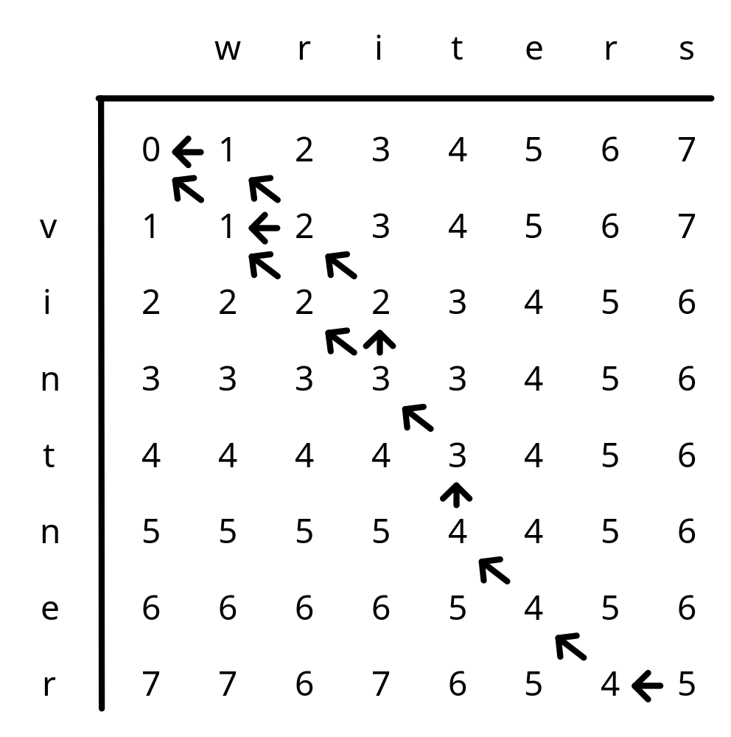
e.g. A=‘vintner’, B=‘writers’
The 3 optimal alignments :
v-intner- -:gap
wri-t-ers
-vintner-
wri-t-ers
vintner-
writ-ers

Slide 16
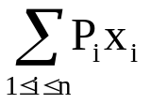
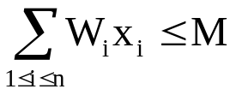
0/1 knapsack problem
n objects , weight W₁, W₂, …,W_{n}
profit P₁, P₂, …,P_{n}
capacity M
maximize
subject to
x_{i} = 0 or 1, 1 ≤ i ≤ n
e.g.
i | W_{i} | P_{i}
1 | 10 | 40
2 | 3 | 20
3 | 5 | 30
M=10

Slide 17
multi-stage graph:

Slide 18
The longest path represents the optimal solution:
x₁ = 0, x₂ = 1, x₃ = 1
ΣP_{i}x_{i} = 20 + 30 = 50
Let f_{i}(Q) be the value of an optimal solution to objects 1,2,3,…,i with capacity Q.
f_{i}(Q) = max{ f_{i-1}(Q), f_{i-1}(Q-W_{i})+P_{i} }
The optimal solution is f_{n}(M).

Slide 19
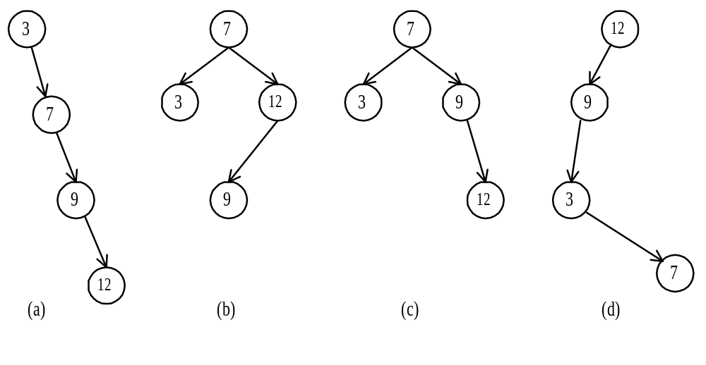
Optimal binary search trees
e.g. binary search trees for 3, 7, 9, 12;

Slide 20
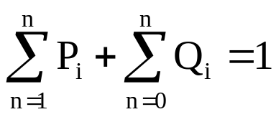
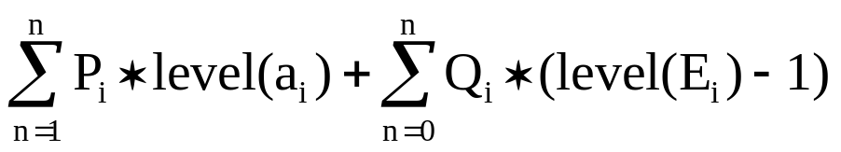
n identifiers : a₁ <a₂ <a₃ <…< a_{n}
P_{i}, 1≤i≤n : the probability that a_{i} is searched.
Q_{i}, 1≤i≤n : the probability that x is searched
where a_{i} < x < a_{i+1} (a₀=-∞, a_{n+1}=∞).
internal node: successful search , P_{i}
external node: unsuccessful search , Q_{i}
the expected cost of a binary tree:
the level of the root : 1

Slide 21
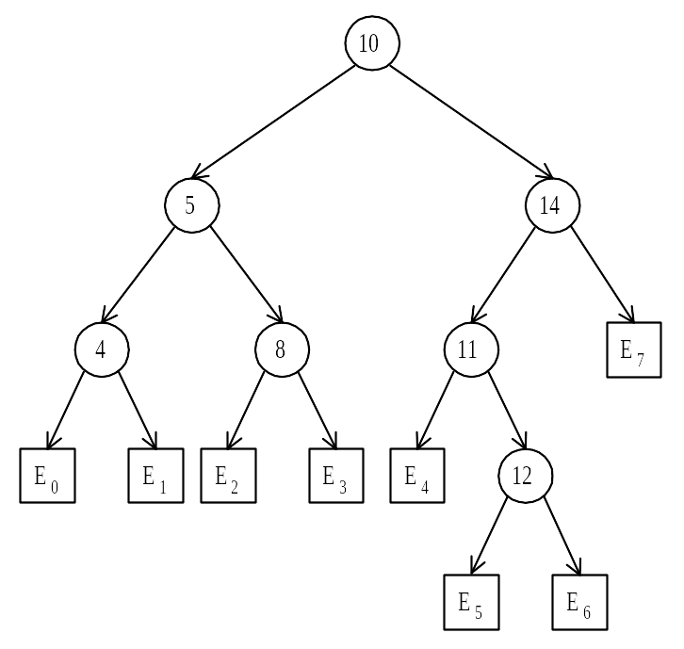
e.g. identifiers : 4, 5, 8, 10, 11, 12, 14
Fig. A Binary Tree with Added External Nodes.

Slide 22
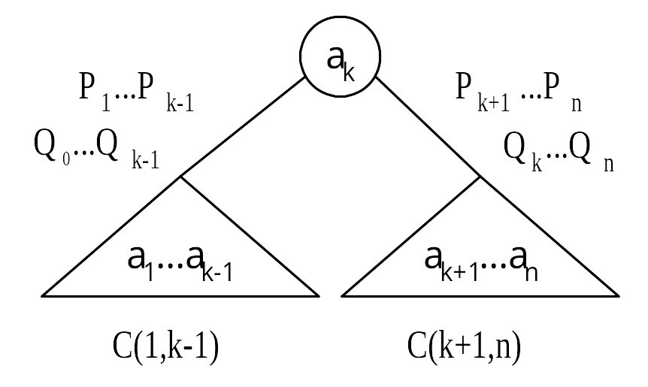
Let C(i, j) denote the cost of an optimal binary search tree containing a_{i},…,a_{j} .
The cost of the optimal binary search tree with a_{k} as its root :

Slide 23
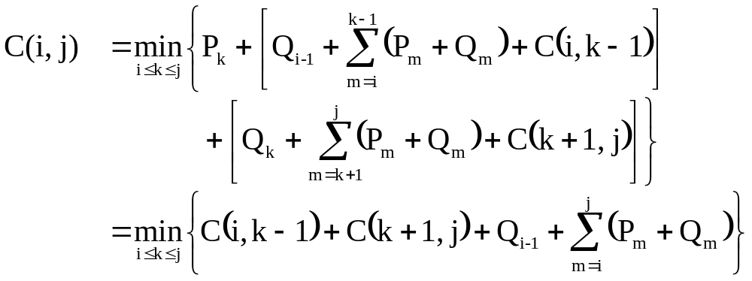
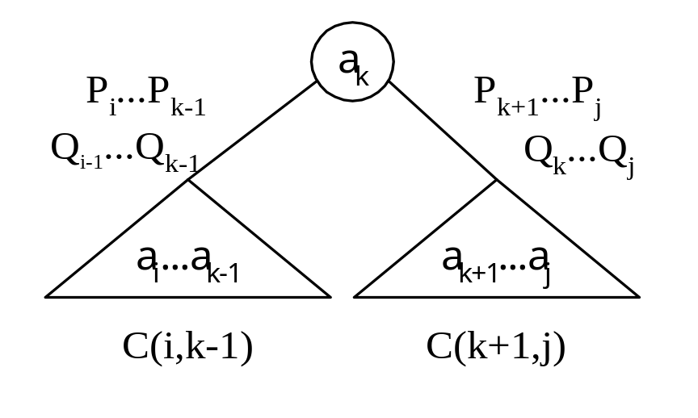
General formula

Slide 24
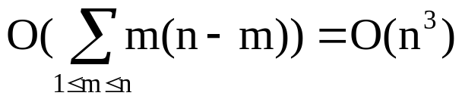
e.g. n = 4
Fig. Computation Relationships of Subtrees.
time complexity : O(n³)
when j-i=m, there are (n-m) C(i, j)’s to compute.
Each C(i, j) with j-i=m can be computed in O(m) time.
total time :

Slide 25
Matrix-chain multiplication
n matrices A₁, A₂, …, A_{n} with size
p₀ × p₁, p₁ × p₂, p₂ × p₃, …, p_{n-1} × p_{n}
Determine the multiplication order such that # of scalar multiplications is minimized.
To compute A_{i} × A_{i+1}, we need p_{i-1}p_{i}p_{i+1} scalar multiplications.
e.g. n=4, A₁: 3 × 5, A₂: 5 × 4, A₃: 4 × 2, A₄: 2 × 5
((A₁ × A₂) × A₃) × A₄, # of scalar multiplications:
3 * 5 * 4 + 3 * 4 * 2 + 3 * 2 * 5 = 114
(A₁ × (A₂ × A₃)) × A₄, # of scalar multiplications:
3 * 5 * 2 + 5 * 4 * 2 + 3 * 2 * 5 = 100
(A₁ × A₂) × (A₃ × A₄), # of scalar multiplications:
3 * 5 * 4 + 3 * 4 * 5 + 4 * 2 * 5 = 160

Slide 26
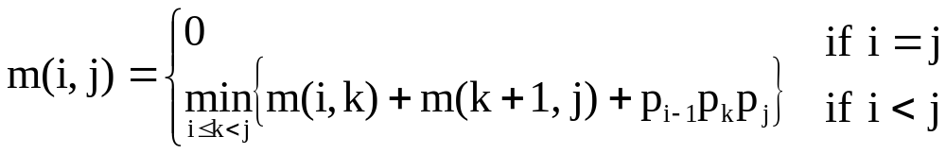
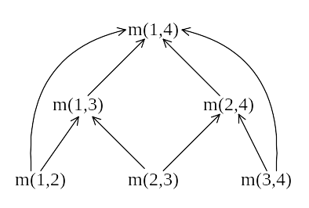
Let m(i, j) denote the minimum cost for computing
A_{i} × A_{i+1} × … × A_{j}
Computation sequence :
Time complexity : O(n³)

