Slide 1
Appendix
Permutations and Combinations
PC -<number>

Slide 2
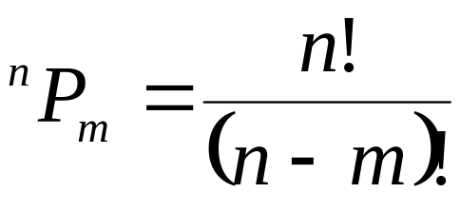
Permutations
# of m-permutations of n items:
3-permutations of {1,2,3,4} in lexicographic order:
  1 2 3, 1 2 4, 1 3 2, 1 3 4, 1 4 2, 1 4 3,
  2 1 3, 2 1 4, 2 3 1, 2 3 4, 2 4 1, 2 4 3,
  3 1 2, 3 1 4, 3 2 1, 3 2 4, 3 4 1, 3 4 2,
  4 1 2, 4 1 3,4 2 1, 4 2 3, 4 3 1, 4 3 2.
PC -<number>

Slide 3
Generating permutations lexicographically
m-permutations of {1,2,...,n}:
  first permutation: 1 2 ... m
  last permutation: n n-1 ... n-m+1
All permutations except the last permutation are updatable ( can be used to generate the next permutation).
The updatable condition for a permutation (P₁P₂ ... P_{m}):
∃ j, ∋P_{i} < j ≤ n and j is not used at the left of P_{i.}
PC -<number>

Slide 4
The updating algorithm
Let P_{i} be the rightmost element and j be the smallest index satisfying the updatable condition.
    P_{i} ← j
    P_{i+1} ← the first position which is not used.
      :
      :
    P_{i+k} ← the kth position which is not used.
      :
      :
    P_{m} ← the (m-i)th position which is not used.
PC -<number>

Slide 5
Example of updating
5-permutations of {1,2,3,4,5,6,7,8,9}:
  :
  :
  8 1 3 6 2 P_{i}=2, j=4
  8 1 3 6 4 P_{i}=4, j=5
  8 1 3 6 5 P_{i}=5, j=7
  8 1 3 6 7 P_{i}=7, j=9
  8 1 3 6 9 P_{i}=6, j=7
  8 1 3 7 2
  :
  8 1 3 7 9 P_{i}=7, j=9
  8 1 3 9 2
  :
  8 1 3 9 7 P_{i}=3, j=4
  8 1 4 2 3
  :
PC -<number>

Slide 6
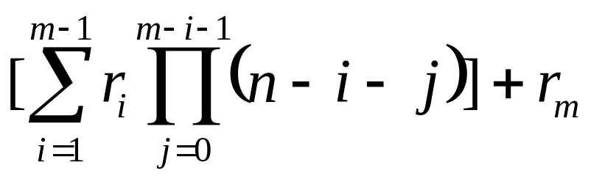
Ranking permutations
Let N={1,2,3,…,n}
The rank sequence {r₁, r₂, ..., r_{m}} of permutation (P₁P₂...P_{m}):
r_{i} is rank of P_{i} in N-{P₁ , P₂ ,... , P_{i-1}},
where the smallest rank is 0.
r₁r₂...r_{m} can be seen as a mixed radix integer:
    0 ≤ r_{m} ≤ n-m (n-m+1 digits)
    0 ≤ r_{m-1} ≤ n-m+1 (n-m+2 digits)
    :
    0 ≤ r₂ ≤ n-2 (n-1 digits)
    0 ≤ r₁ ≤ n-1
rankp(P₁P₂...P_{m}) =
PC -<number>

Slide 7
Example of ranking
3-permutations of {1,2,3,4}
  P₁P₂P₃ r₁r₂r₃ rankp
  --------- ------- ------------------------
  1 2 3 0 0 0 0
  1 2 4 0 0 1 1
  1 3 2 0 1 0 2
  1 3 4 0 1 1 3
  1 4 2 0 2 0 4
  1 4 3 0 2 1 5
  2 1 3 1 0 0 6
  2 1 4 1 0 1 7
  2 3 1 1 1 0 8
  2 3 4 1 1 1 9
  2 4 1 1 2 0 10
  2 4 3 1 2 1 11=1×3×2+2×2+1
    :
100
…
149
150
151
…
199
200
201
456=4*10²+5*10+6
PC -<number>

Slide 8
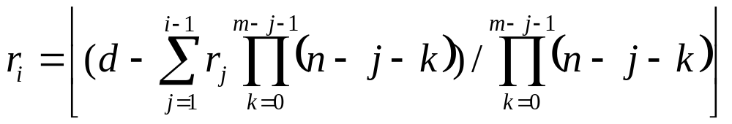
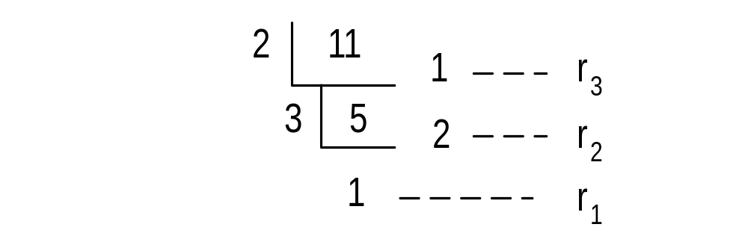
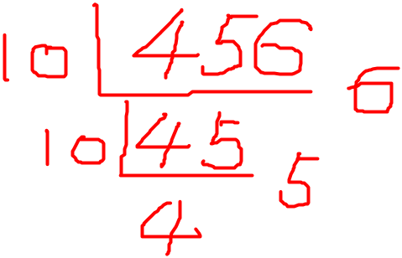
Unranking permutations
Given d = rankp( P₁P₂...P_{m} ), how to obtain ( P₁ P₂ ... P_{m}) from d?
  for i =1, 2, ..., m
d=11 in 3-permutations of {1,2,3,4}
PC -<number>

Slide 9
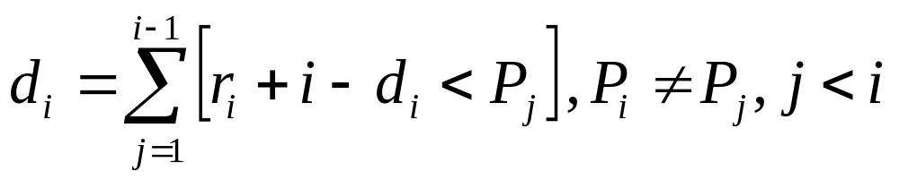
Unranking permutations
P_{i} = r_{i} + i - d_{i} where d_{i} is the smallest nonnegative integer such that
d=11
  P₁= r₁ + 1 - d₁ = 1+1-0 =2
  P₂= r₂ + 2 - d₂ = 2+2-d₂ = 4
  P₃= r₃ + 3 - d₃ = 1+3-d₃ = 1+3-1=3
PC -<number>

Slide 10
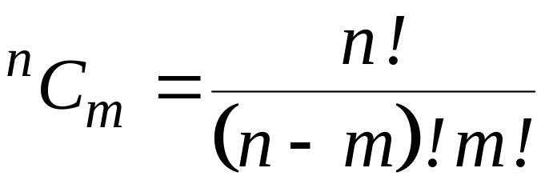
Combinations
# of m-combinations of n items:
3-combinations of {1,2,3,4} in lexicographic order:
  1 2 3, 1 2 4, 1 3 4, 2 3 4
PC -<number>

Slide 11
Generating combinations lexicographically
m-combinations of {1, 2, ..., n}:
  first combination:12...m
  last combination:(n-m+1)(n-m+2)...n
  The updatable condition for a combination (c₁c₂...c_{m}):
  ∃ j, ∋1≤ j ≤ m, c_{j} < n - m + j
PC -<number>

Slide 12
The updating algorithm
step1: Find the largest j satisfying the updatable condition.
step2: c_{j} ← c_{j} + 1
step3: c_{j+1} ← c_{j} + 1, c_{j+2} ← c_{j+1} + 1, ...,
c_{m} ← c_{m-1} + 1
Example: 3-combinations of {1, 2, 3, 4, 5, 6}
  
  1 3 4
  1 3 5
  1 3 6
  1 4 5
PC -<number>

Slide 13
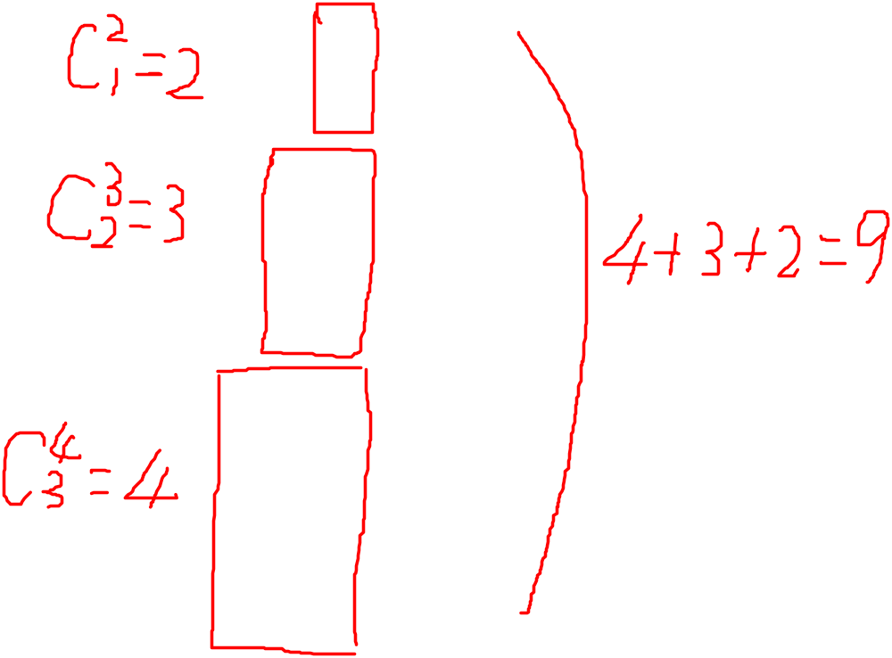
Ranking combinations
3-combinations of {1, 2, 3, 4, 5, 6}
  c₁ c₂ c₃ rankc
  -------- ---------
  1 2 3 0
  1 2 4 1
  1 2 5 2
  1 2 6 3
  1 3 4 4
  1 3 5 5
  1 3 6 6
  1 4 5 7
  1 4 6 8
  1 5 6 9
  c₁ c₂ c₃ rankc
  -------- ---------
  2 3 4 10
  2 3 5 11
  2 3 6 12
  2 4 5 13
  2 4 6 14
  2 5 6 15
  3 4 5 16
  3 4 6 17
  3 5 6 18
  4 5 6 19
PC -<number>

Slide 14
Ranking rules
3-combinations of {1, 2, 3, 4, 5, 6}
# of combinations greater than (2 3 4):
  Fix nothing, 3-combinations of {3,4,5,6}=4
  Fix (2), 2-combinations of {4,5,6}=3
  Fix (2 3), 1-combinations of {5,6}=2
Rankc(2 3 4)=19-(4+3+2)=10
PC -<number>

Slide 15
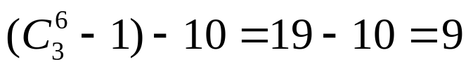
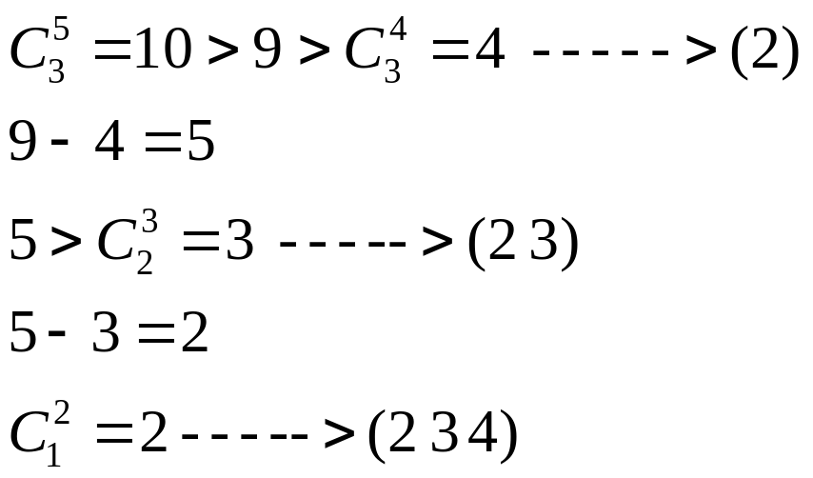
Unranking combinations
Given g = rankc( c₁, c₂, ..., c_{m} ), how to obtain ( c₁ c₂ ... c_{m}) from g?
g=10 in 3-combinations of {1, 2, 3, 4, 5, 6}
PC -<number>

