Slide 1

Axiomé: a Tool for the Elicitation and Management of SWRL Rules
Saeed Hassanpour, Martin J. O’Connor and Amar K. Das
Stanford Center for Biomedical Informatics Research,
Stanford University

Slide 2
Why Do We Need Rule Management?
Increase in the usage of rules
Increase in the size of rule bases

Slide 3
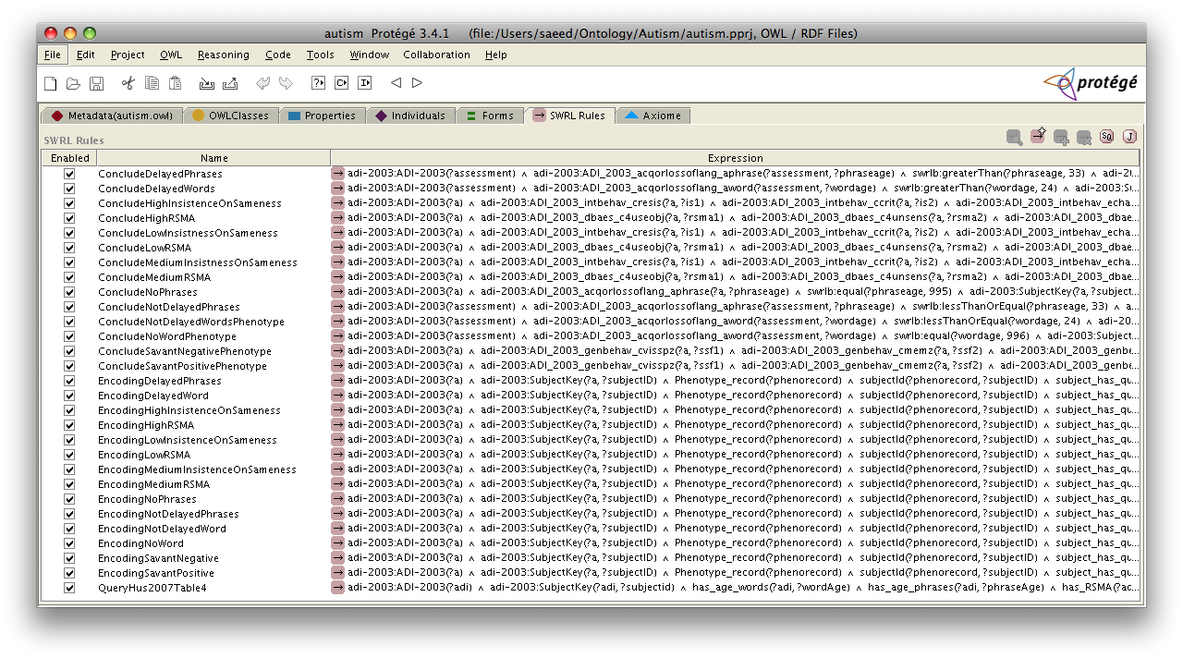
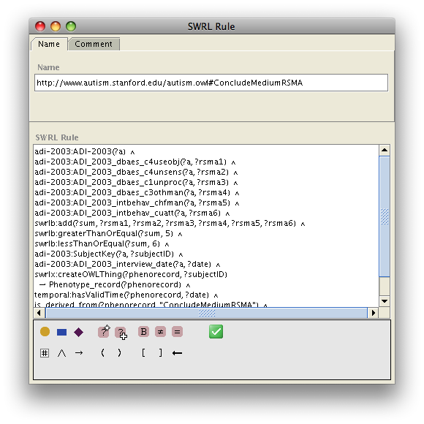

Rule Base Complexity

Slide 4
Rule Management Methodology
Rule Syntactic Analysis
Abstract Rule Structure
  Rule Visualization
  Rule Paraphrasing
  Rule Categorization
  Rule Elicitation
  Rule Browsing

Slide 5
A Sample SWRL Rule
Individuals under the age of 18 are a potential driver of a vehicle with a weight of less than 26,000 lbs in California if they possess an out-of-state driver’s license and are visiting the state for less than 10 days.
Person(?p) ^ has_Driver_License(?p,?d) ^ issued_in_state_of(?d,?s) ^
swrlb:notEqual(?s,"CA") ^ hasAge(?p,?g) ^
swrlb:lessThan(?g,18) ^ Number_of_Visiting_Days_in_CA(?p,?x) ^
swrlb:lessThan(?x,10) ^ Car(?c) ^
has_weight_in_lbs(?c,?w) ^ swrlb:lessThan(?w,26000)
→ Can_Drive(?p,?c)

Slide 6
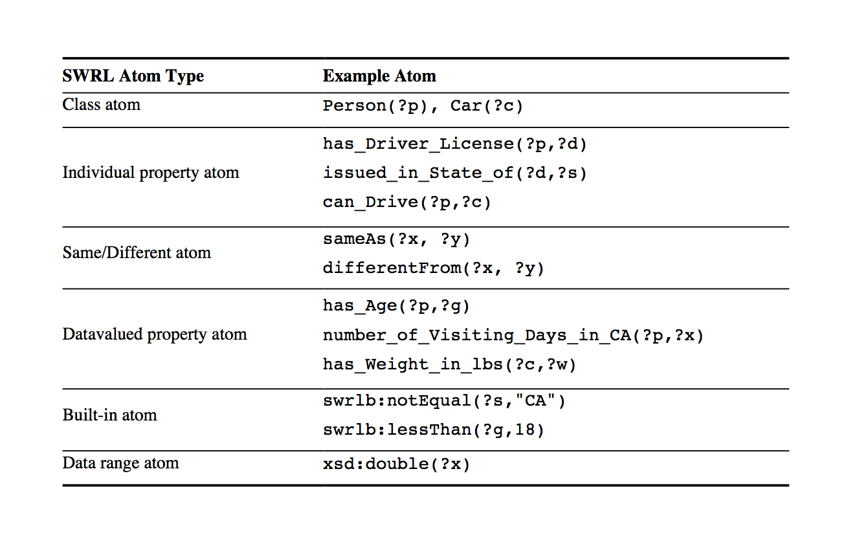
SWRL Atom Types

Slide 7
Rule Analysis
Syntactic analysis:
  Atom prioritization
  Rule atom chaining
Tree Data Structure
  Exploration of SWRL Rule Bases through Visualization, Paraphrasing, and Categorization of Rules. S. Hassanpour, M. J. O'Connor, A. K. Das, The International RuleML Symposium on Rule Interchange and Applications, Las Vegas, NV, Springer Verlag, in press.

Slide 8
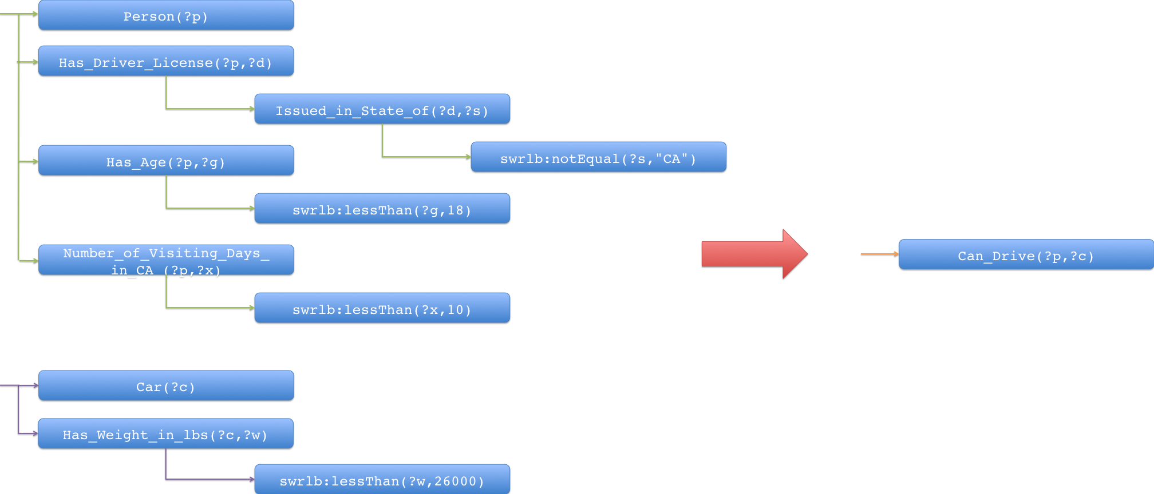
Rule Base Visualization
Person(?p) ^ has_Driver_License(?p,?d) ^ issued_in_state_of(?d,?s) ^ swrlb:notEqual(?s,"CA") ^ hasAge(?p,?g) ^ swrlb:lessThan(?g,18) ^ Number_of_Visiting_Days_in_CA(?p,?x) ^ swrlb:lessThan(?x,10) ^ Car(?c) ^ has_weight_in_lbs(?c,?w) ^ swrlb:lessThan(?w,26000) → Can_Drive(?p,?c)

Slide 9
Rule Paraphrasing
Use the rule’s tree data structure
Use several heuristics, such as:
  Annotations for built-ins atoms
  Atoms’ name analysis
  Appropriate articles and conjunctions
  Indentation

Slide 10
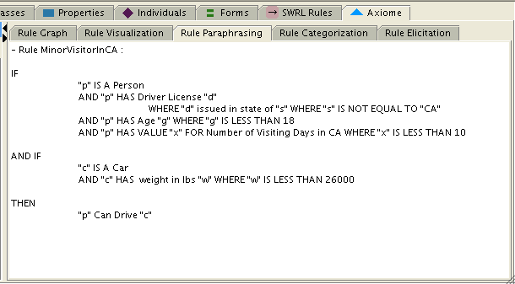
Rule Paraphrasing
Person(?p) ^ has_Driver_License(?p,?d) ^ issued_in_state_of(?d,?s) ^ swrlb:notEqual(?s,"CA") ^ hasAge(?p,?g) ^ swrlb:lessThan(?g,18) ^ Number_of_Visiting_Days_in_CA(?p,?x) ^ swrlb:lessThan(?x,10) ^ Car(?c) ^ has_weight_in_lbs(?c,?w) ^ swrlb:lessThan(?w,26000) → Can_Drive(?p,?c)

Slide 11
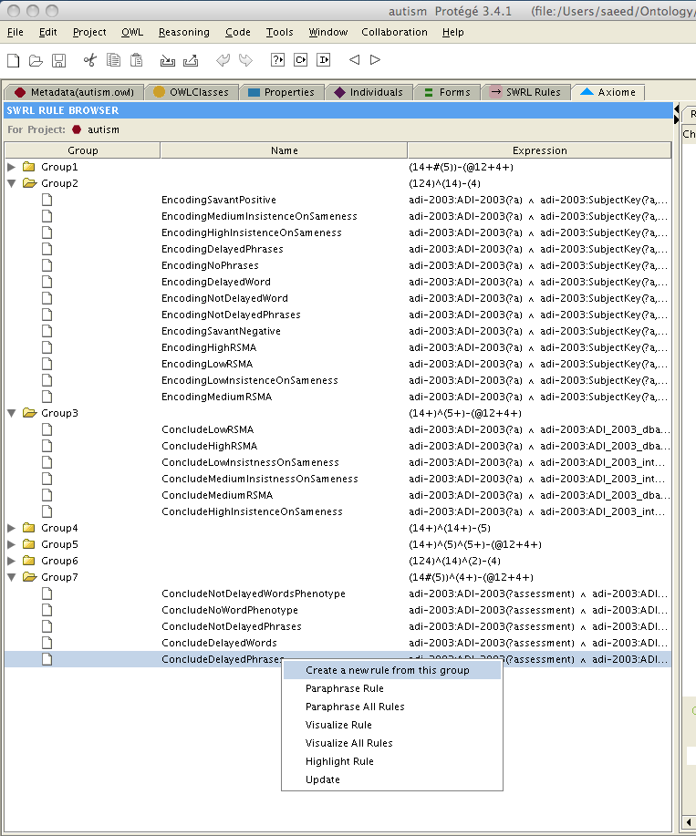
Rule Base Categorization

Slide 12
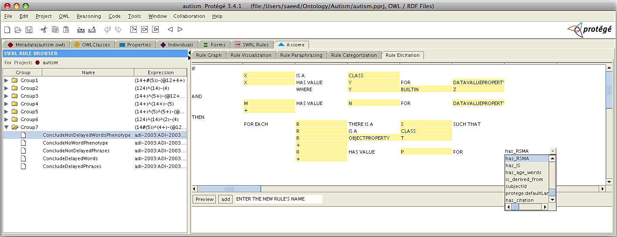
Rule Elicitation

Slide 13
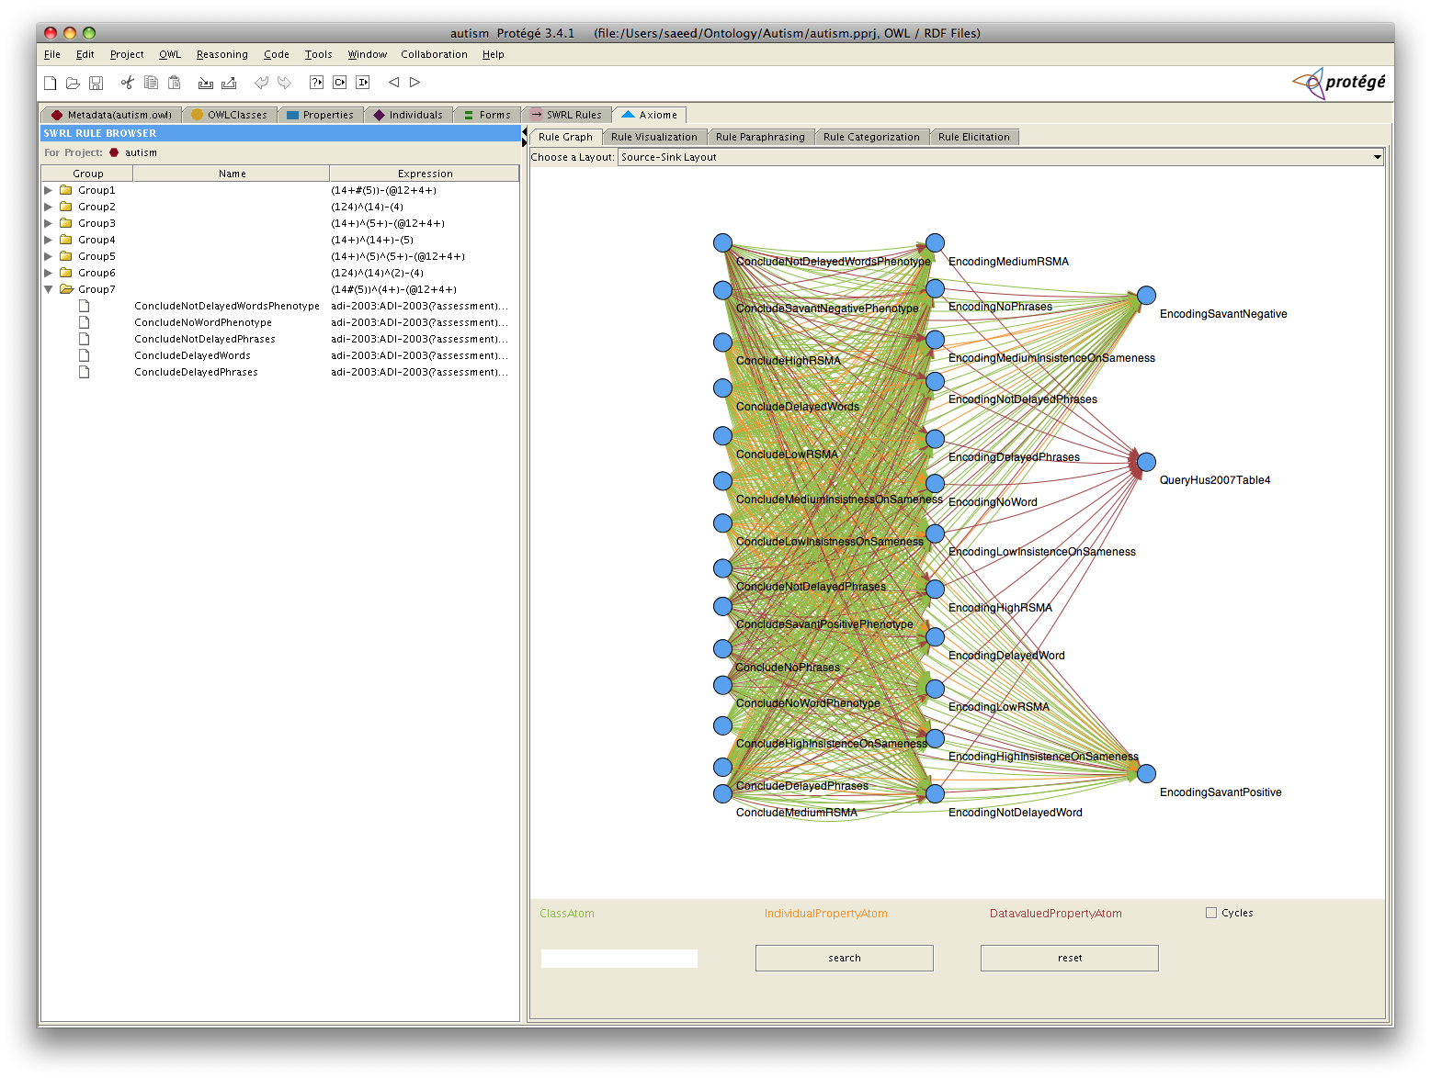
Rule Base Browsing

Slide 14
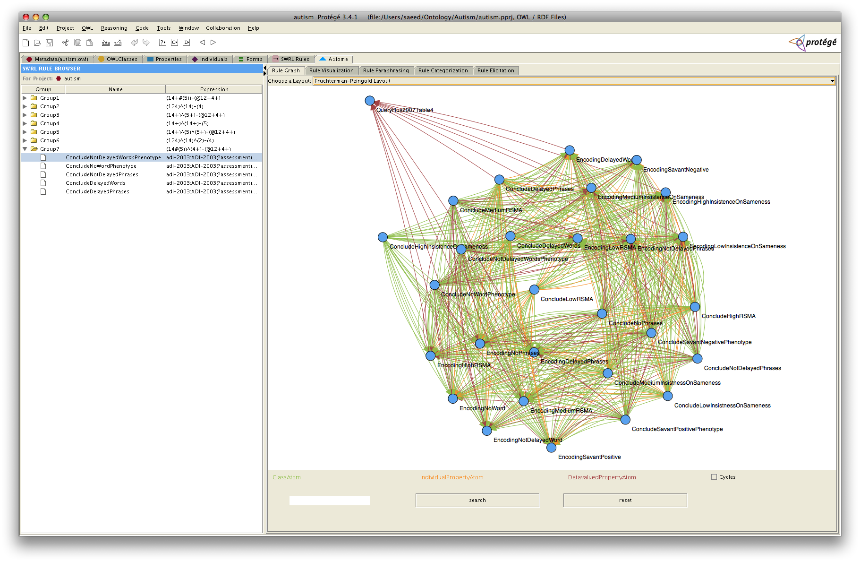
Rule Base Browsing

Slide 15
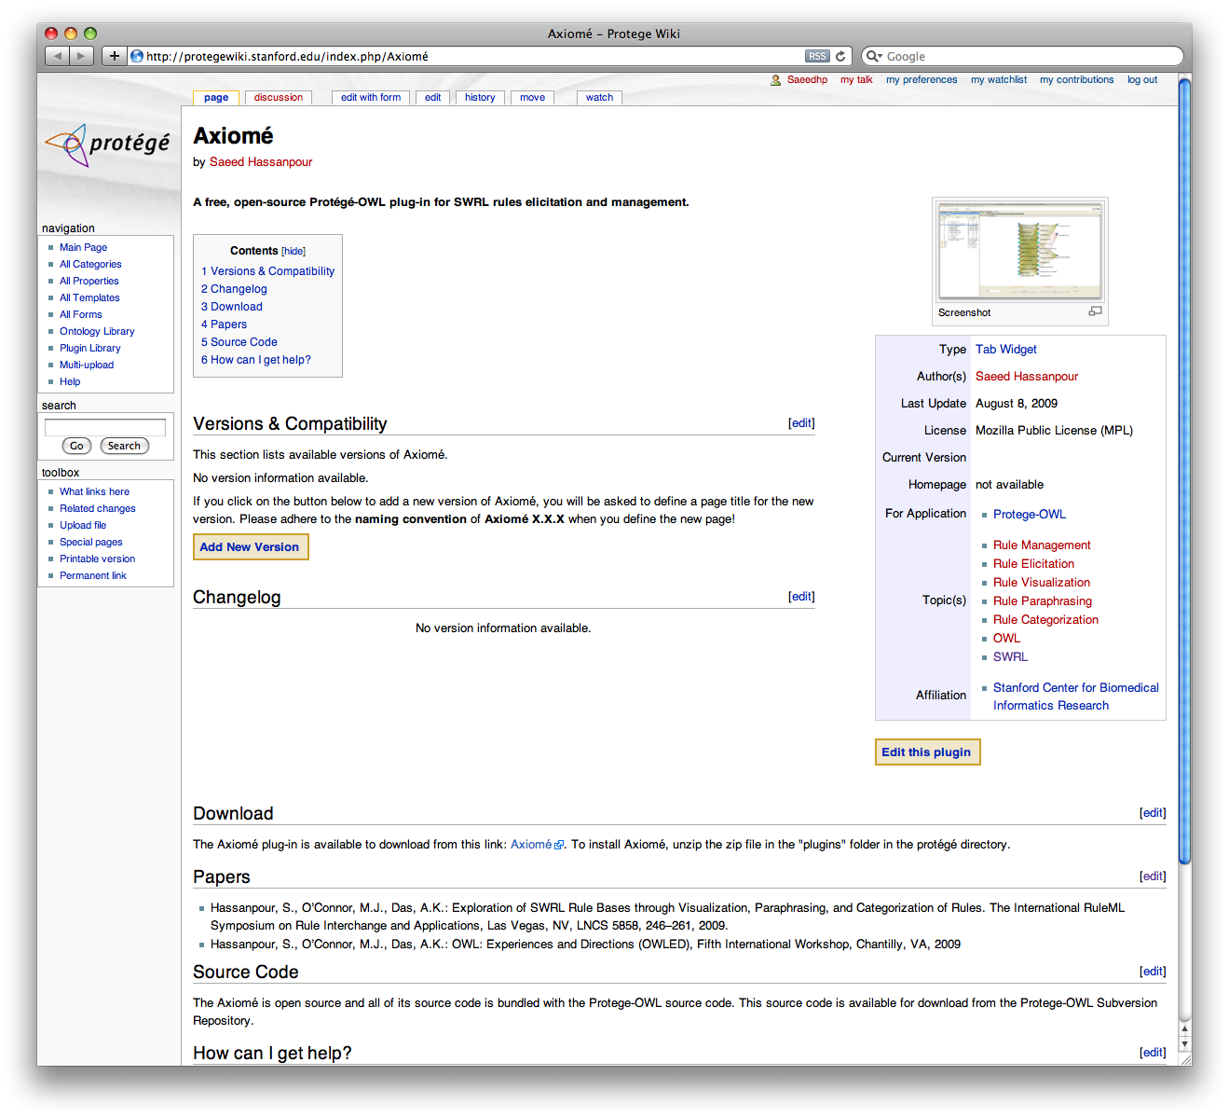
Summary
Axiomé is a free, open-source Protégé 3.4 plug-in for SWRL rule management and elicitation.
http://protegewiki.stanford.edu/index.php/Axiome

Slide 16
Future Work
Combine semantic analysis with syntactic analysis:
  Use ontology hierarchy to define a measure of semantic similarity
  Apply vector space modeling to represent each rule as a vector
  Use information retrieval methods for rule management
Make it available in Web-Protégé

Slide 17
Thank You!
Questions?

