Slide 1
Integrating SysML and OWL2
(only the static part of SysML Block Diagrams)
Henson Graves
Lockheed Martin Aeronautics
October 2009
Notes:
Abstract
To use OWL2 for modeling a system design one must be able to construct a Knowledge Base (KB) that can represent detailed information such as the number of occurrences of a part and interconnections between parts. SysML Block Diagrams (BD) have sufficient expressiveness to represent detailed designs. Suitably restricted SysML block diagrams can be translated into OWL2 to achieve the same result. A SysML graphical syntax can be used for the KBs which are characterized as designs. Block Diagrams have a natural model-theoretic semantic and this semantics is preserved by the translation into OWL2 for a restricted class of Block Diagrams. An implementation of a design is a parts description of the system being modeled. For a design, a KB-model will contain an implementation of the system, but may contain other entities. When additional constraints satisfied by a KB that represents a design then the KB serves as a template for the design implementations. Design KBs can be developed in engineering design tools and exported to OWL tools for analysis. This work yields a partial unification of SysML and OWL that is sufficient for modeling the structure of complex systems.

Slide 2
Starting Point (2007)
Can OWL2 be used to integrate formal methods into systems engineering?
Can requirements and designs be defined with OWL class constructions and can automated reasoning be used to establish
  requirements consistency &
  Verification that a design instance satisfies requirements?
Answer: able to establish consistency of some requirements, but a lot of issues

Slide 3
The Initial Question Led To
Question:
  Can OWL2 Represent Detailed Design Structures? e.g., vehicle has exactly 2 fuel tanks
Answer:
  Techniques Used in SysML can be used in OWL2

Slide 4
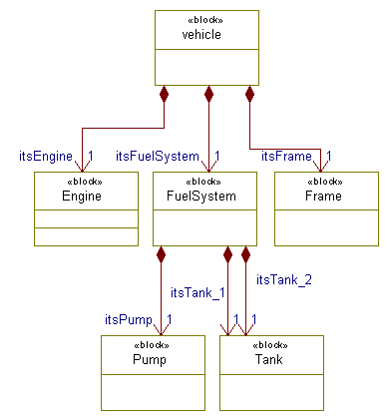
Block Diagram For Vehicle Design
Use distinct properties for each “partOF” association
For example, “itsTank_2” each has a specific domain and codomain class
The Block Diagram can be embedded in OWL2 by
  Using same signature
  Add axioms such as:
    Domain itsTank_2 = FuelSystem
    Vehicle = itsEngine and itsFuelSystem and itsFrame

Slide 5
What Does a Model of the Vehicle System KB Model Look Like?
There are no finitary constraints, there may be an infinite number of parts (instances of various classes)
Each model will contain a parts decomposition tree (i.e., implementation of Vehicle Class)
An implementation tree may contain other “after market” parts
Under suitable conditions all implementations have the same structure (characteristic of a Detailed Design)

Slide 6
Consequences:
Static Block Diagrams can be embedded in OWL2
Embedding provides formal semantics for some Block Diagrams
Provides graphical syntax for some OWL KBs

Slide 7
Conclusions
Gives a way ahead to develop a formal system for full expressiveness of Block Diagrams which will extend OWL2 considerably

