Slide 1
Developing an Ontology from the Application Up
James Malone, Tomasz Adamusiak, Ele Holloway, Misha Kapushesky , Helen Parkinson
Email: malone@ebi.ac.uk

Slide 2
Summary
Who we are
5 Ways We Use OWL
OWL/SemWeb experiences
Developing an Ontology from the Application Up
malone@ebi.ac.uk

Slide 3
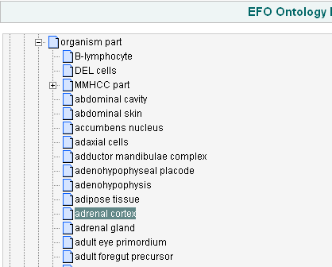

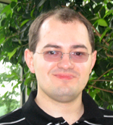
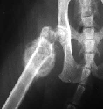
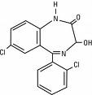
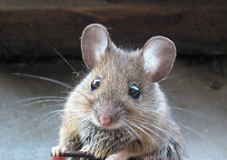
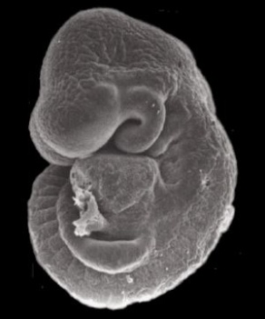
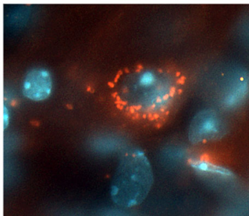

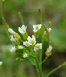


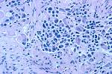

Who we are and what we do
ArrayExpress: Europe’s largest public gene expression repository
Experiment
Archive
Gene Expression Atlas
ATLAS
246,000
assays
AE/GEO acquire
Re-annotate & summarize
Literature
Developing an Ontology from the Application Up
malone@ebi.ac.uk

Slide 4

Usage 1. Experimental Factor Ontology
@ www.ebi.ac.uk/efo
Position of EFO: reuse of existing resources, shared frameworks and mapping of equivalencies where they exist
Chemical Entities of Biological Interest (ChEBI)
Relation
Ontology
Cell Type Ontology
Text mining
Disease Ontology
Anatomy Reference Ontology
Various Species Anatomy Ontologies
EFO
Developing an Ontology from the Application Up
malone@ebi.ac.uk

Slide 5
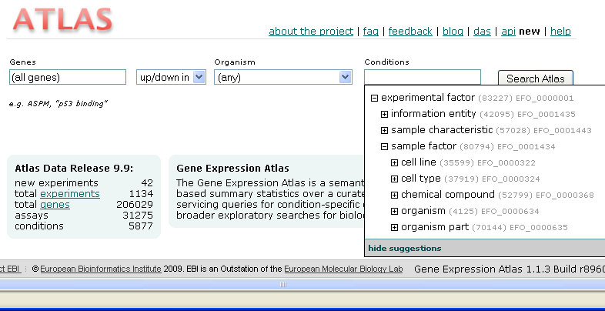
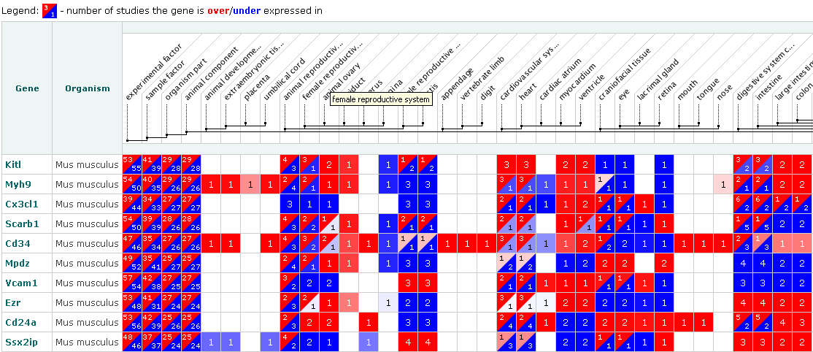
Usage 2. Gene Expression Atlas
@ www.ebi.ac.uk/gxa
Query for Cell adhesion genes in all ‘organism parts’
‘View on EFO’
Developing an Ontology from the Application Up
malone@ebi.ac.uk

Slide 6
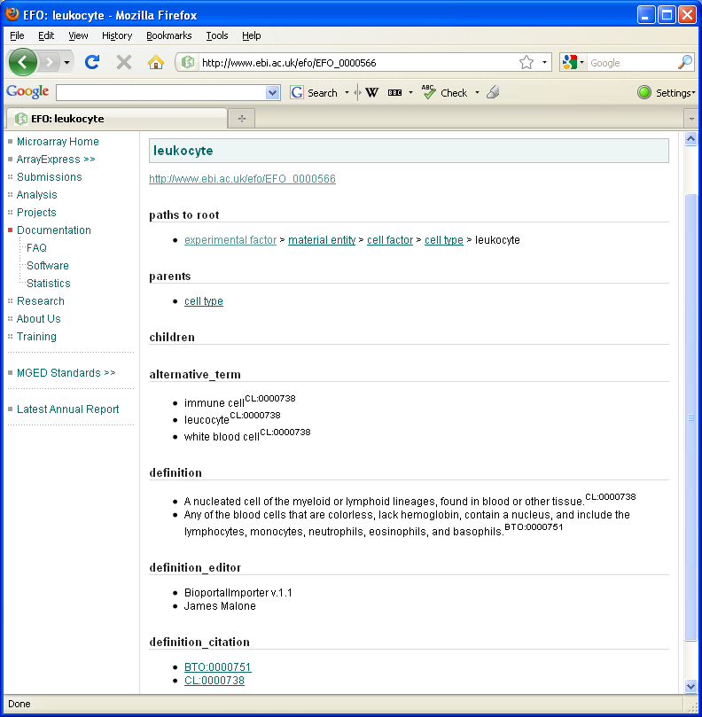
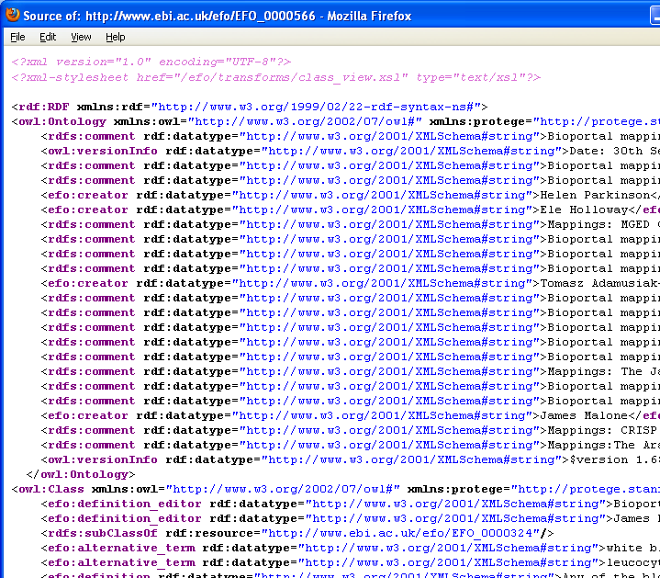
Usage 3. Linked Data
@ www.ebi.ac.uk/efo/EFO_0000001
Developing an Ontology from the Application Up
malone@ebi.ac.uk

Slide 7



Usage 4. RDF Triple Store
@ www.ebi.ac.uk/efo/semanticweb/atlas
Q: Is an RDF Triple store SPARQL query quicker than a SPARQL translated into SQL?
RDF Triple Store
SPARQL
Atlas Triple API
OWL Ontology
SQL Translation Layer
Atlas Data
Developing an Ontology from the Application Up
malone@ebi.ac.uk

Slide 8




Usage 5. Multi-Agent System Prototype
Relevant Biological
Databases (including biological data, MEDLINE abstracts, etc.)
Agents
Bio-ontologies
EFO
Application Ontology
Querying Mechanism
Aa
Metathesauri
Knowledge Base
Our ontology..
Update mechanism
Things we map to..
Developing an Ontology from the Application Up
malone@ebi.ac.uk

Slide 9


OWL and SemWeb Experience
Measuring time in OWL
Triple store technology+ federated querying
Understanding reasoning problems & optimisng performance over complex ontologies
Getting buy-in to OWL ontologies (“show me the money” effect)
Connection of bio-ontologies to rest of science
Ontology building tools (Protégé, OWL-API)
Technical support and burgeoning user community
Community built ontologies
Manchester OWL Syntax
Developing an Ontology from the Application Up
malone@ebi.ac.uk

Slide 10
Acknowledgements
Ontology creation:
  James Malone, Tomasz Adamusiak, Ele Holloway, Helen Parkinson, Jie Zheng (U Penn)
Ontology Mapping tools and text mining evaluation:
  Tim Rayner, Holly Zheng, Margus Lukk
Triple store:
  Taalai Djumabaev
GUI Development
  Misha Kapushesky, Pasha Kurnosov, Anna Zhukova. Nikolay Kolesinkov
External Review and anatomy:
  Jonathan Bard, Jie Zheng
ArrayExpress Production Staff
EBI Rebholz Group (Whatizit text mining tool)
Many source ontologies for terms and definitions esp. Disease Ontology, Cell Type Ontology, FMA, NCIT, OBI
Funders: EC (Gen2Phen,FELICS, MUGEN, EMERALD, ENGAGE, SLING), EMBL, NIH
Eric Neumann, Joanne Luciano and Alan Ruttenberg
HCLS Group - Eric Prud'hommeaux and Scott Marshall
OBI developers
Developing an Ontology from the Application Up
malone@ebi.ac.uk

