Slide 1

Use of OWL and SWRL for Semantic Relational Database Translation
Matthew Fisher, Mike Dean, Greg Joiner
{mdean, gjoiner}@bbn.com
http://asio.bbn.com
April 1st, 2008

Slide 2
Agenda
Problem Definition
Our Solution: Asio Tools Suite
Inside Automapper
  The Basics
  Use of OWL
  Use of SWRL
Related Work
Future Work
OWL 1.1 Enhancements
Questions

Slide 3
Problem Definition
Access to the vast amount of data that resides in RDMS is crucial for the increased utility of the Semantic Web
Unfortunately, this data is often inaccessible to Semantic Web applications and even when accessed, it is in a form that is incomprehensible

Slide 4
Our Solution: Asio Tools Suite
Asio Scout
  Developed in Java
  Incorporates standards-based languages
    OWL, SWRL, SPARQL
  Integration of four Asio tools
    Semantic Query Decomposition (SQD)
    Semantic Bridge for Relational Databases (SBRD)
      Automapper for Relational Databases
    Semantic Bridge for Web Services (SBWS)
      Automapper for Web Services
    Semantic Bridge for SPARQL Endpoints (SBSE)

Slide 5
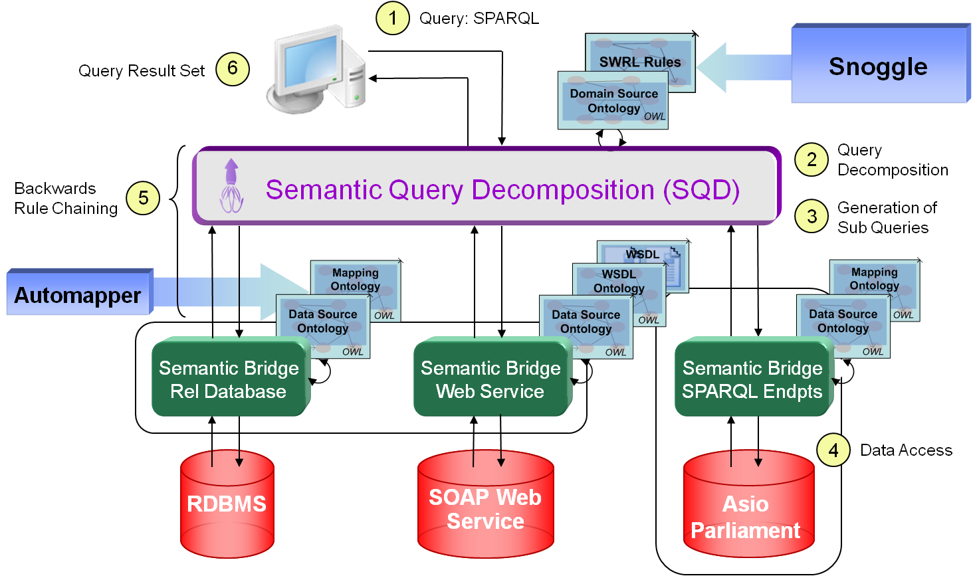
Our Solution: Asio Tools Suite

Slide 6
Inside Automapper: The Basics
Creates an OWL representation of a RDB using JDBC to query the schema metadata
Based on the D2RQ “generate-mapping” script but enhanced to more precisely model foreign-key relationships and to allow for more configurability
Manual table, primary & foreign key, and datatype mappings defined via property file

Slide 7
Inside Automapper: Use of OWL
The following table illustrates how Automapper represents RDBMS concepts in OWL.
RDBMS Concept | OWL Concept
Database Table | OWL Class
Database Column | Functional Property
Database Column Metadata | OWL Property Restrictions
- datatypes | allValuesFrom Restriction
- not nullable | cardinality(1) Restriction
- nullable | maxCardinality(1) Restriction
Database Row | OWL Individual

Slide 8
Inside Automapper: Use of SWRL
Automapper uses SWRL to identify individuals based on Primary Keys
  Uses swrl:SameIndividualAtom statements to express class-specific and multiple-property inverse functional relationships
Reduces the number of SPARQL variables resulting in more concise SQL.

Slide 9
Related Work
D2RQ, Gnowsis, ISENS, Relational.OWL, and OntoGrate
Automapper’s simplicity, expressivity, and configurability make it stand out.
Successfully built Automapper for web services based on the same constructs as the RDMS Automapper

Slide 10
Future Work
Resolvable URIs per the best practices outlined in the Linking Open Data Initiative
Continue monitoring the DL Safe SWRL Rules Task Force to keep Automapper’s rules in line with their design goals
Actively participate in the W3C RDB2RDF Incubator Group to help develop standards in the RDBMS → RDF mapping space

Slide 11
OWL 1.1 Enhancements
There are several exciting new features in OWL 1.1 that will further enhance Automapper’s capabilities
New Description Logic Constructs
  IrreflexiveObjectProperty can be used to state that an OWL individual can not be related to itself
  Other new constructs could be used as well but not in an automated fashion

Slide 12
OWL 1.1 Enhancements
Expanded Datatype Expressiveness
  Allows Automapper to represent RDBMS concepts that commonly exist in custom datatypes, triggers, and functions
    dataOneOf & datatypeRestriction
New OWL-DL Sub-Species (DL-Lite)
  Designed for modeling relational data
  Reduces “data complexity” from NP-Hard to LOGSPACE problem
Easy Key proposal

Slide 13

Questions

