Slide 1
Modeling Life Science Knowledge with OWL 1.1
Michel Dumontier & Natalia Villanueva-Rosales
Department of Biology, Institute of Biochemistry,
School of Computer Science
Carleton University
OWLED-DC 2008
April 1, 2008

Slide 2
Subscribing to Dogma - a sign of (community) maturity?
Upper level ontologies (BFO) add consistency to the representation
  Not trivial. Many issues still under philosophical development
  Semantic coherence across ontologies, possibly easier for mapping
Use a minimum set of basic relations (BRO)
  Easier to remember
  Can be used to map all other relations
Put the two together (NULO). Force constraints on use.
Process
only
hasPart
hasQuality
Quality
Process
hasParticipant
Object

Slide 3
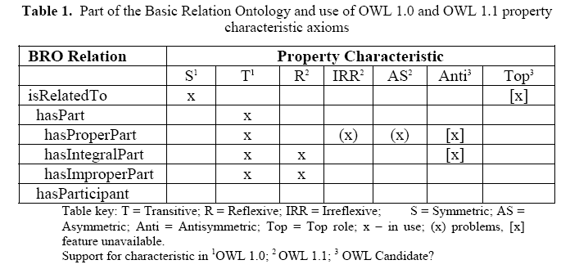


Slide 4
Evil.
“Nonstructural Restrictions on Axioms”
Protégé 4 (build 60) and the FaCT++ (Version 1.1.10).

Slide 5
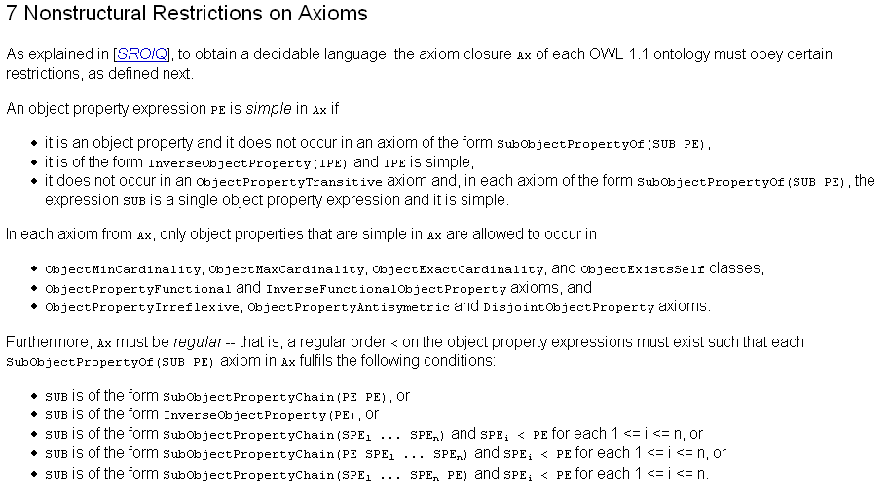
Pure Evil.

Slide 6
Stop The Evil.
I’m lazy.
Explain it to me in English or something closer to it.
I don’t want to learn yet another language to understand the one I’m working with ;-)

Slide 7
Chain Inclusion Axiom
Sweet!
  hasPart o hasParticipant -> hasParticipant
P4 interface has current limit of 2
Problems with reasoning over properties with additional owl 1.1 characteristics…
Process
hasParticipant (inferred)
Transitive
(reflexive)
hasPart
Process
hasParticipant
Object

Slide 8
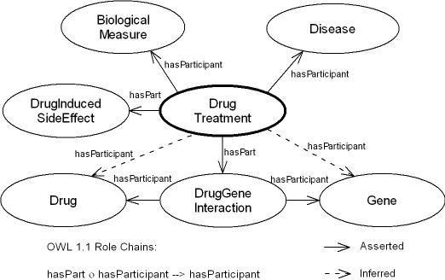
Role chains: Immediate benefit for n-ary modeling

Slide 9
Qualified Cardinality Restrictions
Yai!
Atom Ontology
  CarbonAtom := Atom hasPart 6 Proton
  CarbonAtom := Atom hasQuality 1 (AtomicNumber hasValue value 6)
Widely used and absolutely required.

Slide 10
Disjoint Union
Atom Ontology
  118 disjoint atom types
  Syntactic sugar vastly reduces xml/rdf rendering
NCBI Taxonomy
  285,000 nodes
  At least 100,000 disjoint unions
  (some ontological problems due to multiple inheritance)

Slide 11
New requirements

Slide 12
Ontology Versioning
Not currently possible to indicate a newer compatible or incompatible version
OWL 1.0
  owl:priorVersion;
  owl:backwardCompatibleWith
  owl:incompatibleWith
OWL 1.x
  owl:nextVersion
  owl:nextCompatibleVersion

Slide 13
N-ary predicates
N-ary data predicates
  Many use cases on the website, clear utility
Need to investigate N-ary object predicates
  DLR
  Tertiary predicates initiate path to Temporal Description Logics

Slide 14
Description Graphs
DL tends to underspecify
Scenerio 1:
  There exists a graph around the concept
Scenerio 2:
  We can realize instances as members of that concept
Immediate use for representing molecules and cyclic functional groups

Slide 15
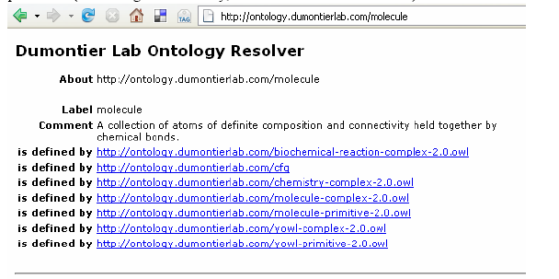
Ontologies as Bags of Concepts

Slide 16
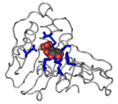

dumontierlab.com
michel_dumontier@carleton.ca

