Slide 1

Annotation Classes: A Structuring Mechanism for OWL Ontologies
Mike Dean
mdean@bbn.com
OWL Experiences and Directions 2008 DC
Gaithersburg, MD
2 April 2008

Slide 2
Annotation Classes
Extra-logical classes used to add structure to an OWL ontology
  Analogous to OWL 1.0 annotation properties
  Also referred to as invisible or abstract classes in yesterday’s extensions breakout session
  Ontology-specific root classes are a common example

Slide 3
RadLex
Radiology vocabulary under development by the Radiological Society of North America
Not developed in OWL, but influenced by it
  OWL version from NCBO BioPortal
11,962 terms (classes, properties, and individuals)
11,373 links (axioms)
Seems to be quite well done

Slide 4
RadLex Term Browser
Custom viewer for the RadLex ontology
Organizes classes hierarchically by partOf, containedIn, and other relationships as well as subClassOf
  Doesn’t visually distinguish these relationships
Driven by an RDBMS representation of the ontology
Seems to be pretty effective

Slide 5
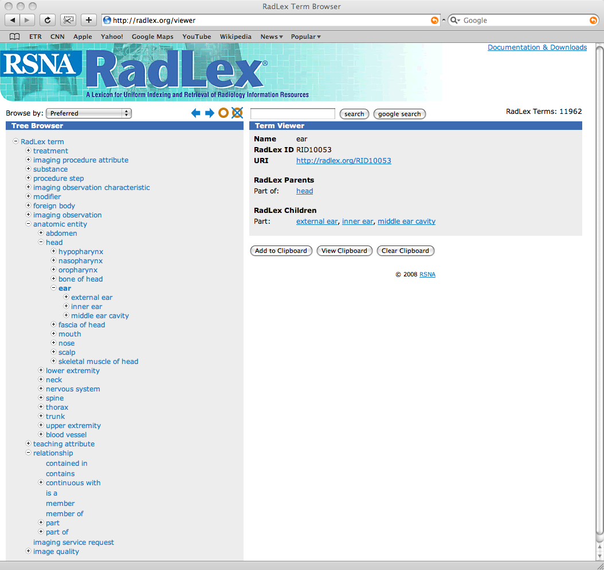
RadLex

Slide 6
radlinks
relation_type | preferred | count(*) | OWL
 | 1 | 60
isa | 1 | 5,853 | rdfs:subClassOf rdfs:subPropertyOf
synonymof | 0 | 1,860 | owl:equivalentClass owl:equivalentProperty owl:sameAs
partof | 1 | 2,464 | owl:someValuesFrom owl:Restriction on owl:ObjectProperty corresponding to term in relationship hierarchy
branchof | 1 | 732
containedin | 0 | 73
continuouswith | 0 | 1
continuouswith | 1 | 69
segmentof | 1 | 67
tributaryof | 1 | 194

Slide 7
Unnamed Relations
60 “unnamed relations” initially motivated our thoughts about annotation classes
62 terms are referenced in these relations
9 terms are referenced only in these relations
  Candidates for annotation classes
4 of these and the root probably should be annotation classes
  Radlex, Radlex term, RadLex attribute, RadLex synonym, Relationship
Also motivates use of annotation properties

Slide 8
Implementation
Add owl:AnnotationClass
Usage
  rdfs:subClassOf
  Some new normative property
(Non-)semantics TBD

Slide 9
Root Properties
OWL 1.0 includes a root class owl:Thing
It would also be helpful to include root properties
  SROIQ calls this the universal role U
  Carsten Lutz suggested owl11:universal
  Might want owl11:universalObjectProperty, owl11:universalDatatypeProperty, owl11:universalAnnotationProperty
These standard terms could be used and understood by ontology editors

Slide 10
Understanding OWL Ontologies
UML is a competitor to OWL in some respects
UML’s graphically-based representation can easily convey important extra-logical information
  Feature the most important class(es) in the center of the first diagram
It would be nice to have “standard” annotation properties to convey some of this information in OWL ontologies

Slide 11
Annotation Spaces
OWL WG Proposal from Bijan Parsia
  Discussed in a breakout session yesterday
Good modular extension mechanism
  Could support standardized annotation properties and presentation hints
  We’re generally supportive if all the details can be worked out
Doesn’t really address AnnotationClasses

